Slide 1
Super Goal 1

Slide 2
Unit 1

Slide 3
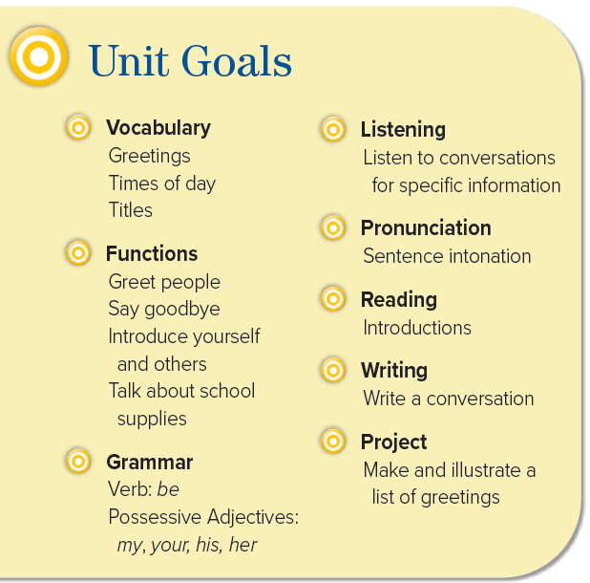


Slide 4

The objectives of the lesson :
At the end of this session, the students will be able to :
Apply greeting in a simple conversation
How to introduce a friend to others

Slide 5
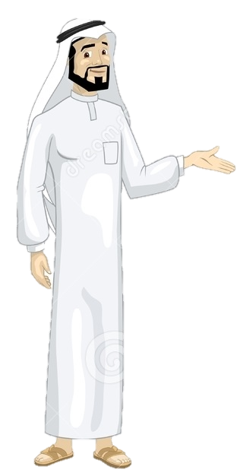
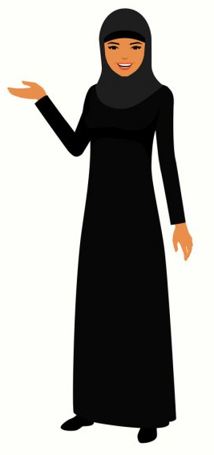
Good morning
My name is Mr. ____
My name is Mis. ______
What’s your name ?
______________
How are you ?
______________

Slide 6
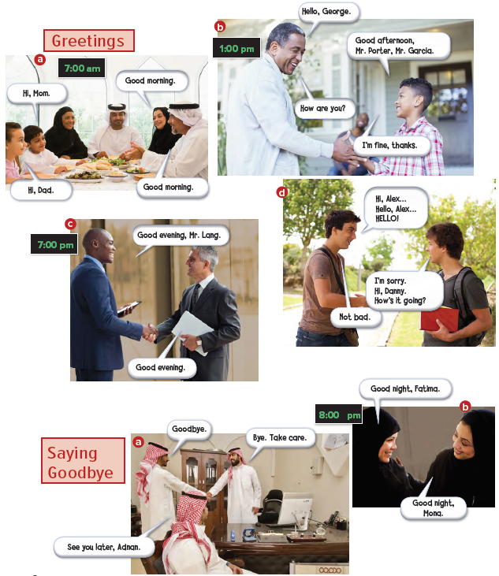


Slide 7
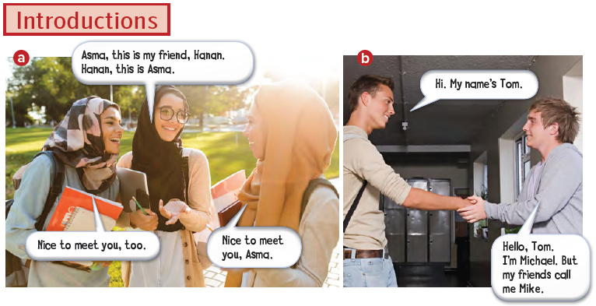

Slide 8
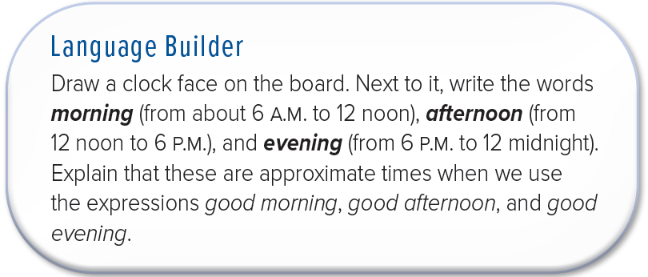

Slide 9
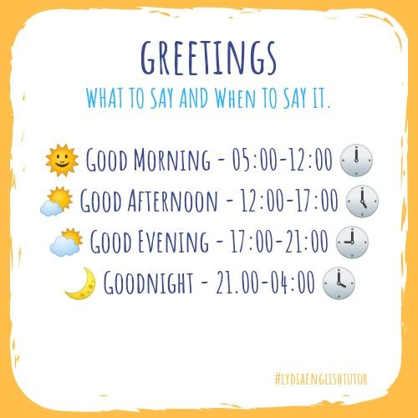


Slide 10
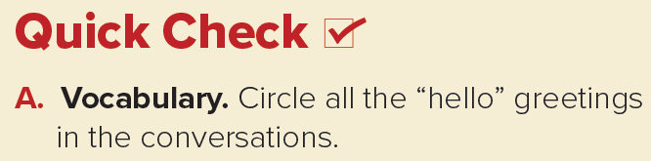
Hi, Good morning, Good afternoon, Hello, Good evening

Slide 11
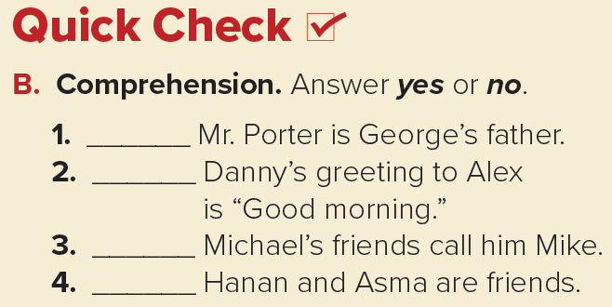
no
no
yes
no

Slide 12
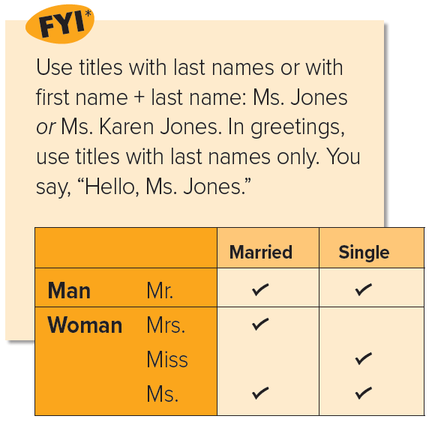

Slide 13
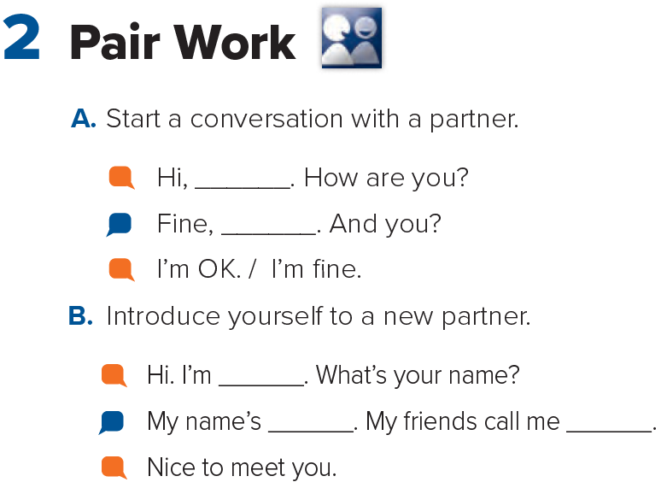
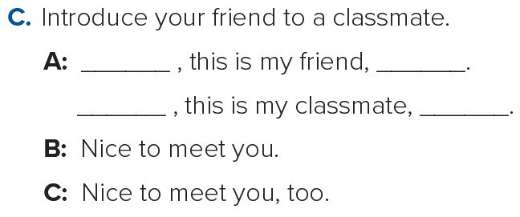

Slide 14

Page 89

