Slide 1
Back 2 School
First day
Done by: Entisar Al-Obaidallah

Slide 2

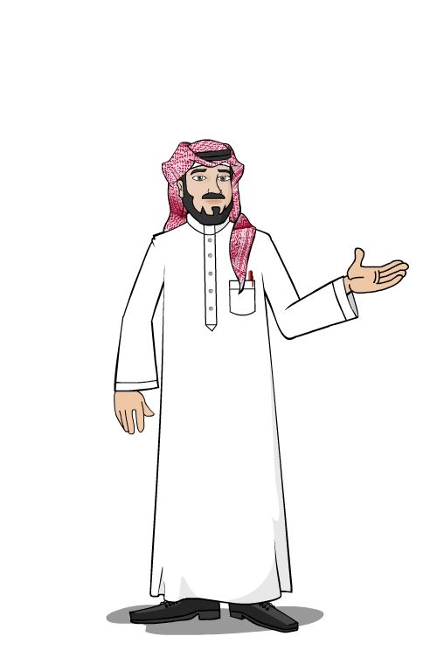

Hello
My name is …………………
I’m your English teacher .We will study the book of Mega Goal 1
We will have an amazing year ..

Slide 3

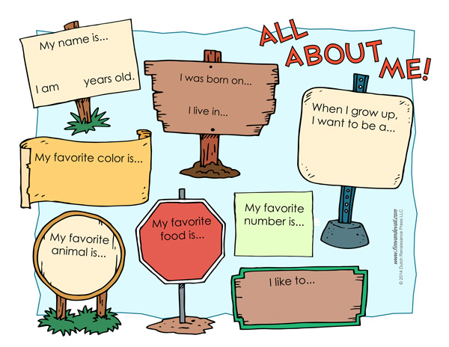
Now , talk about yourself

Slide 4




Slide 5


Slide 6
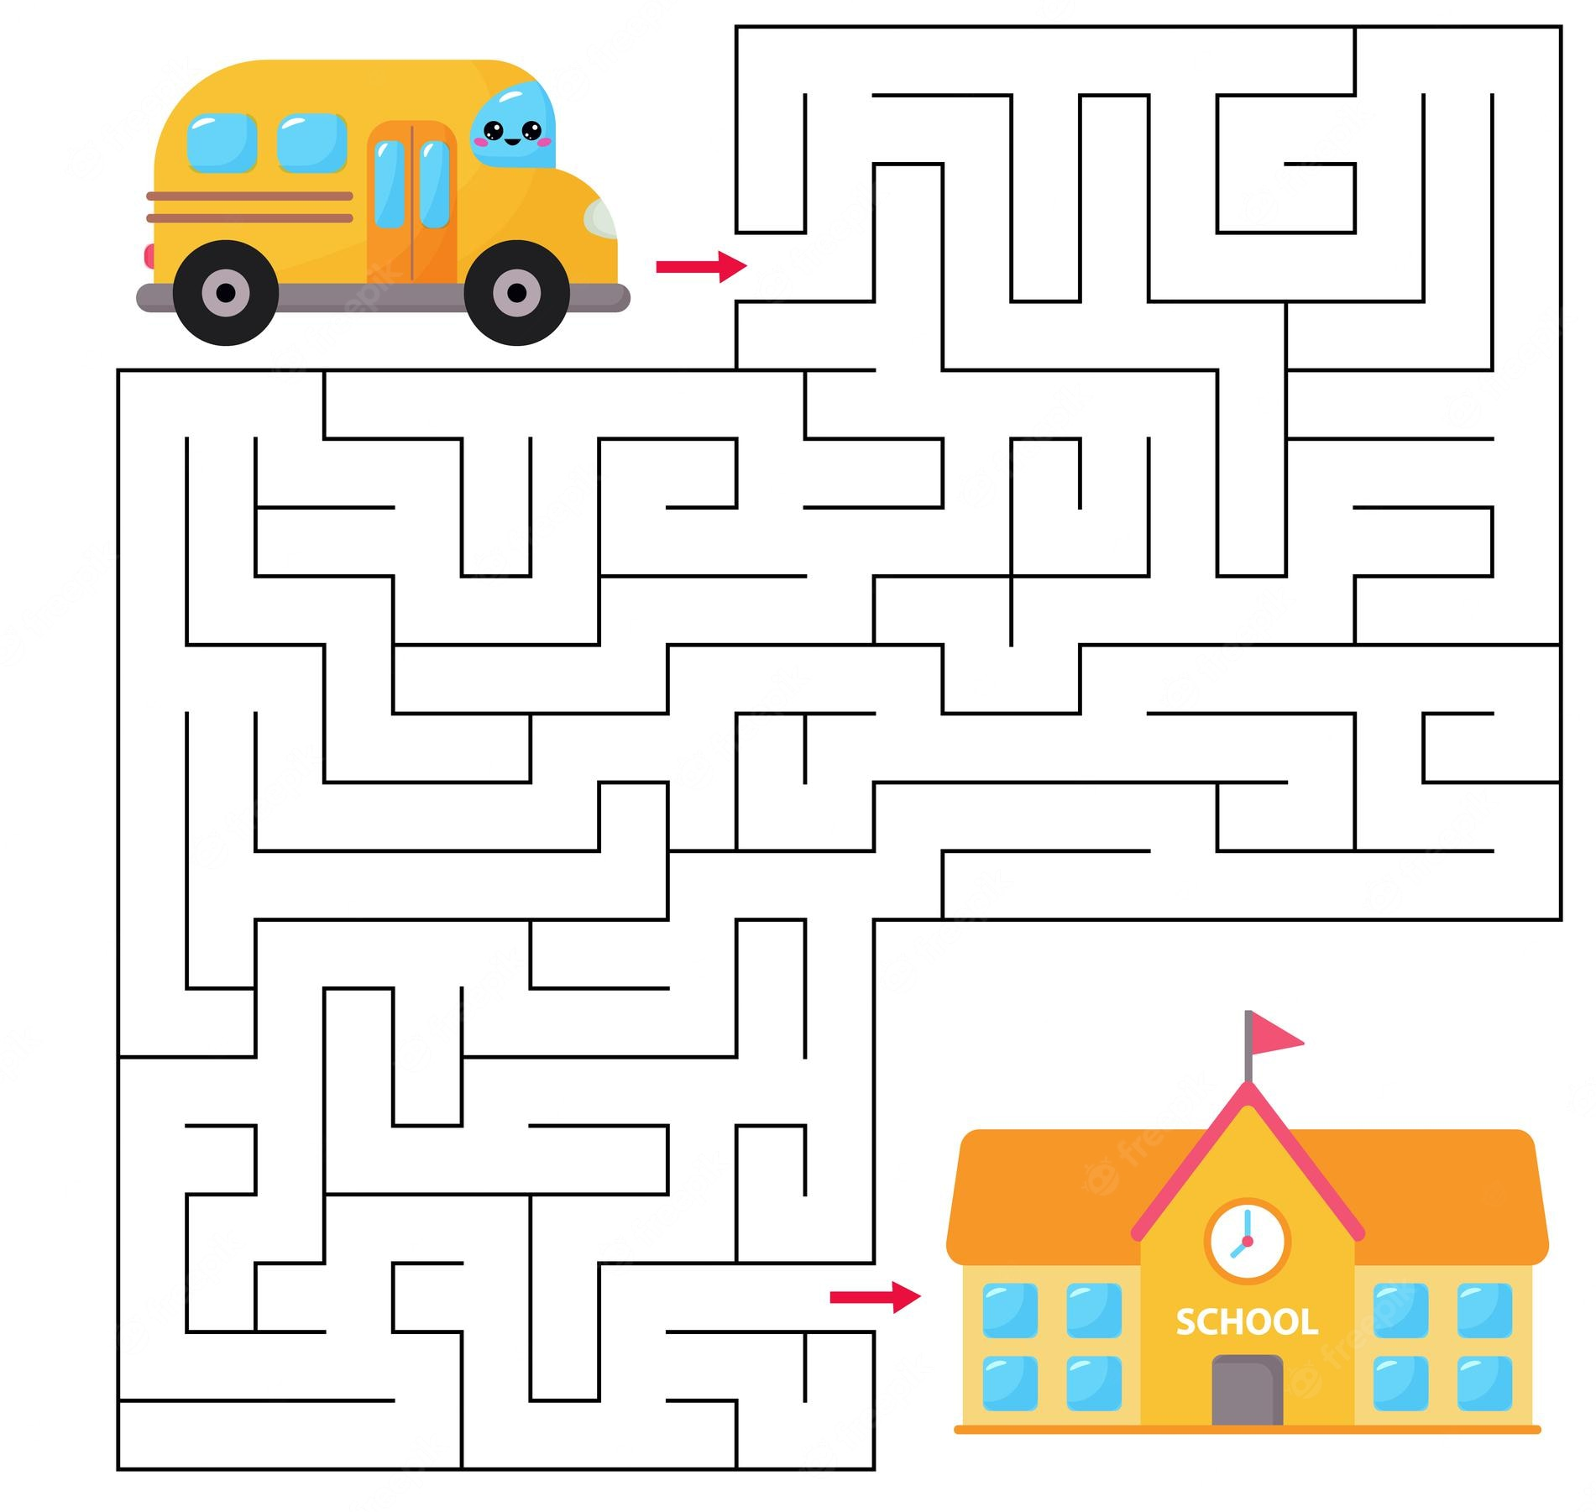
Can you help the school bus driver to find his way to school?

Slide 7
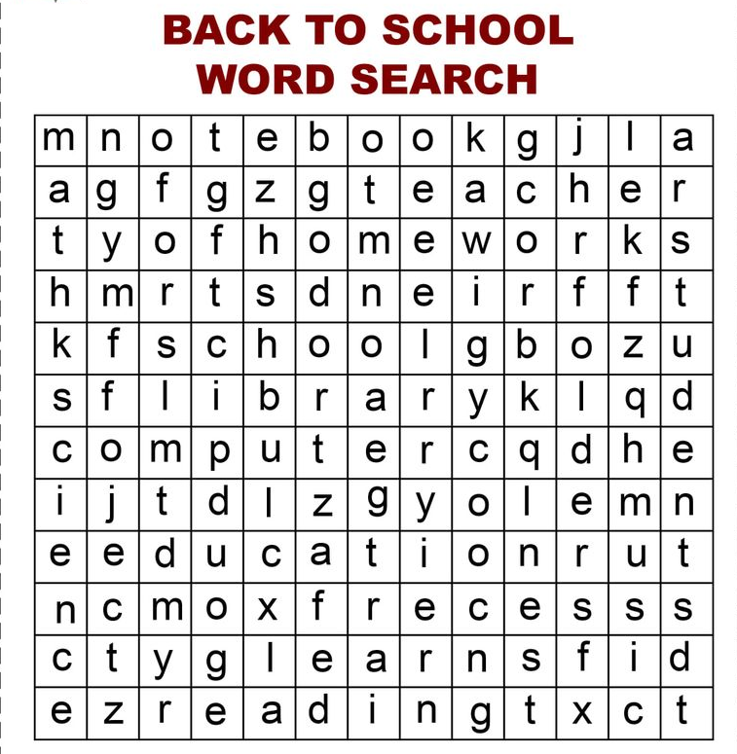
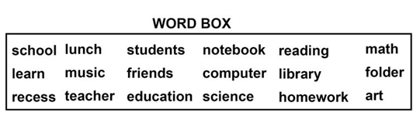
Circle each word from the list below in the puzzle . The words can go in any direction

Slide 8
Give me five
Challenge
You have to mention 5 things in each challenge

Slide 9

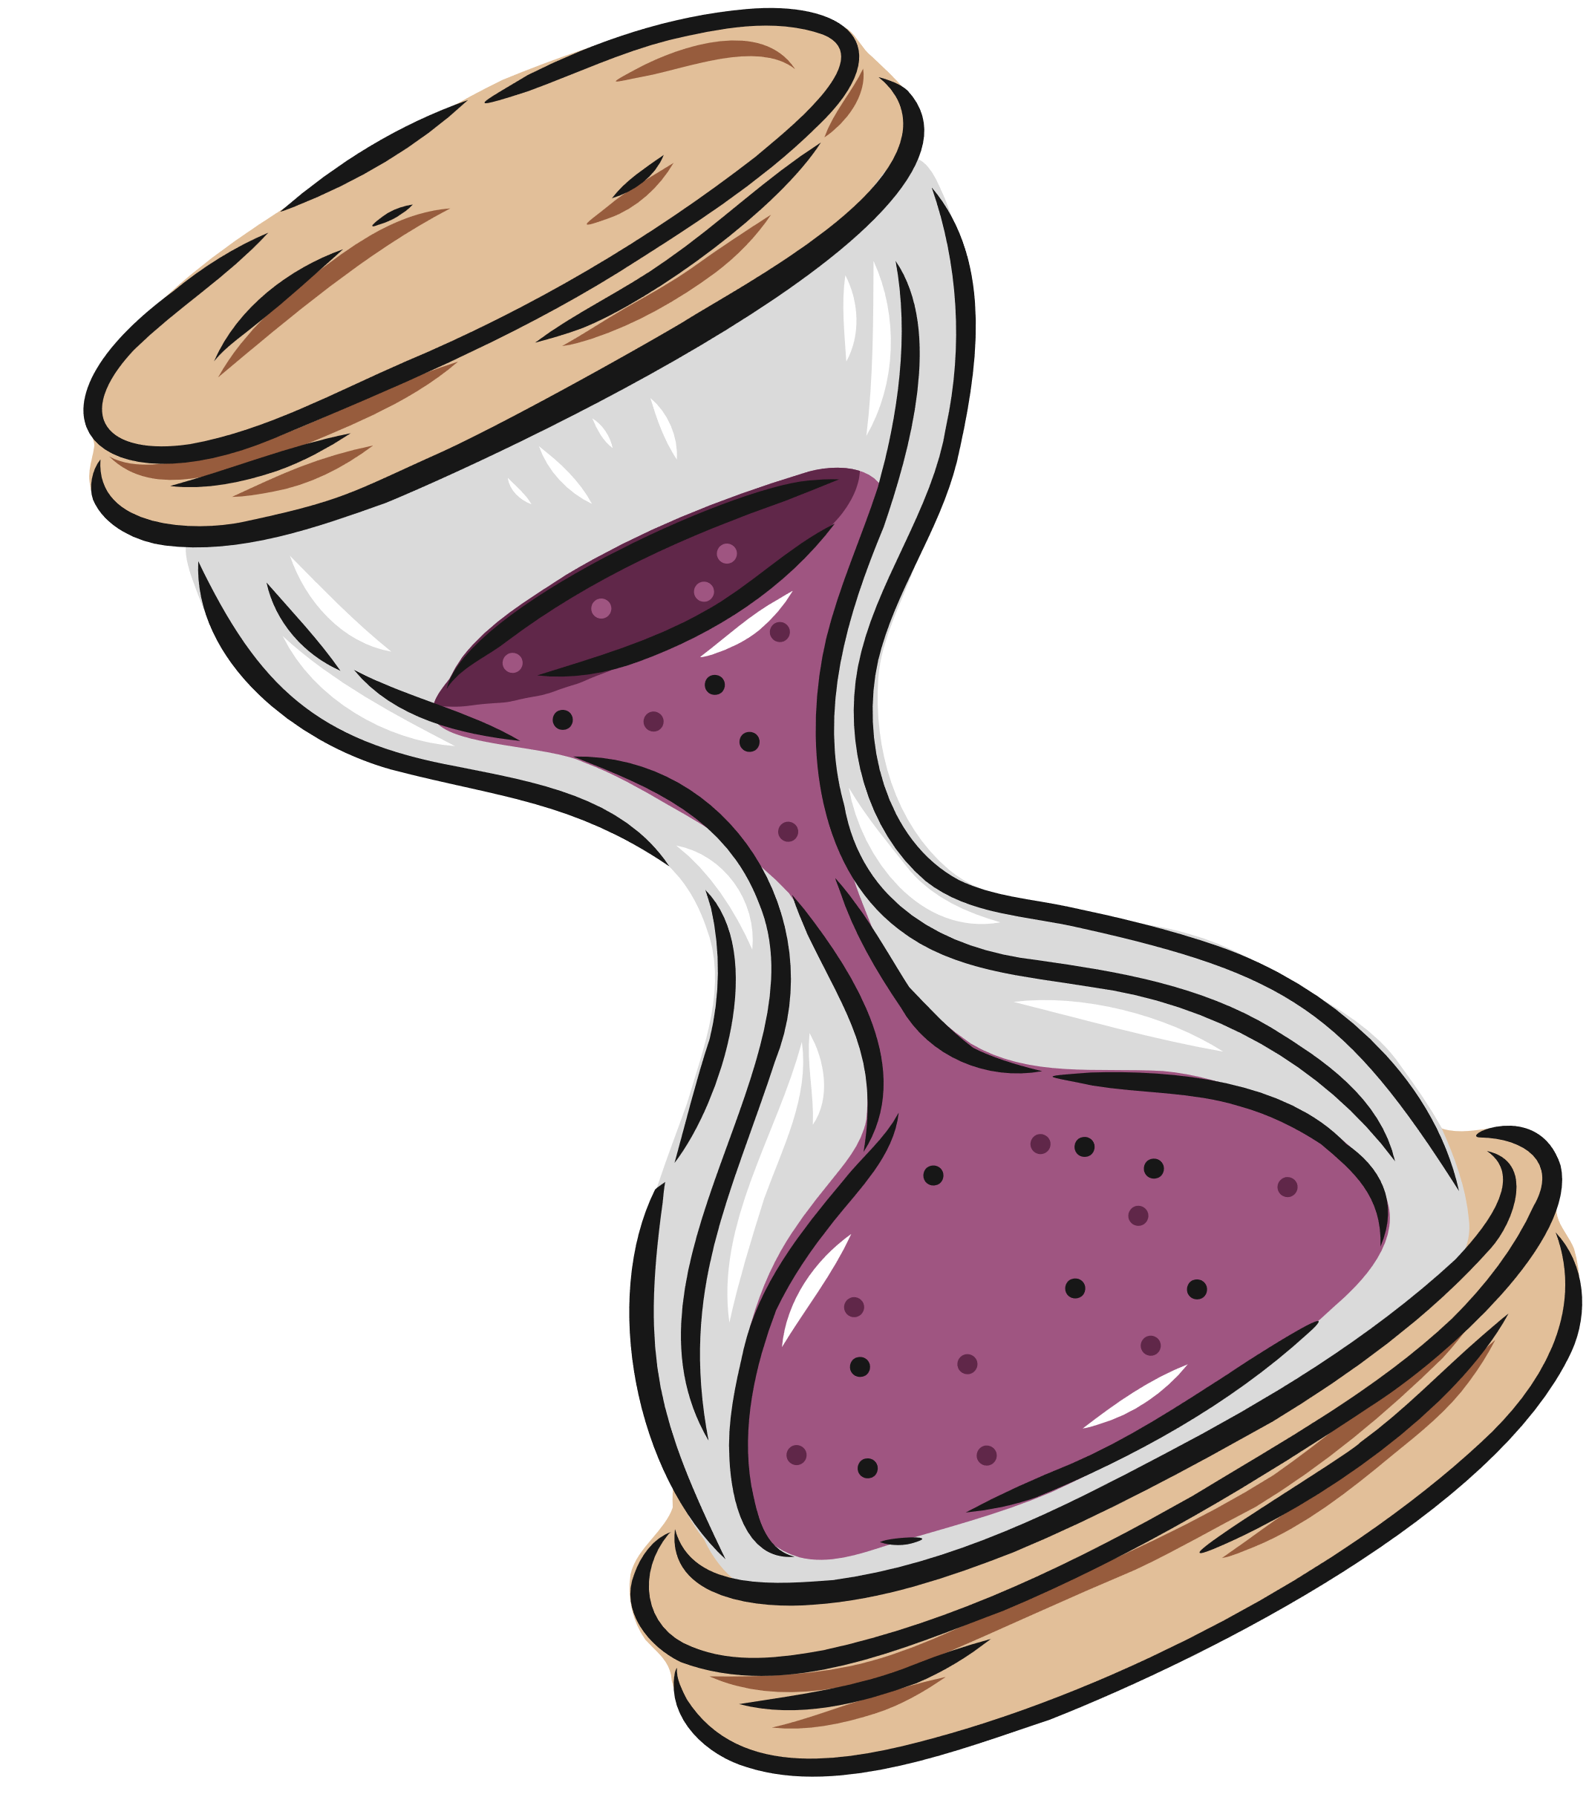

Mention 5 colors in English

Slide 10
Mention 5 things used in the classroom

Slide 11
Mention 5 names of girls started with letter N

Slide 12
Mention 5 Gulf countries

Slide 13
Mention 5 parts of your body

Slide 14

What Am I
Strategy

Slide 15

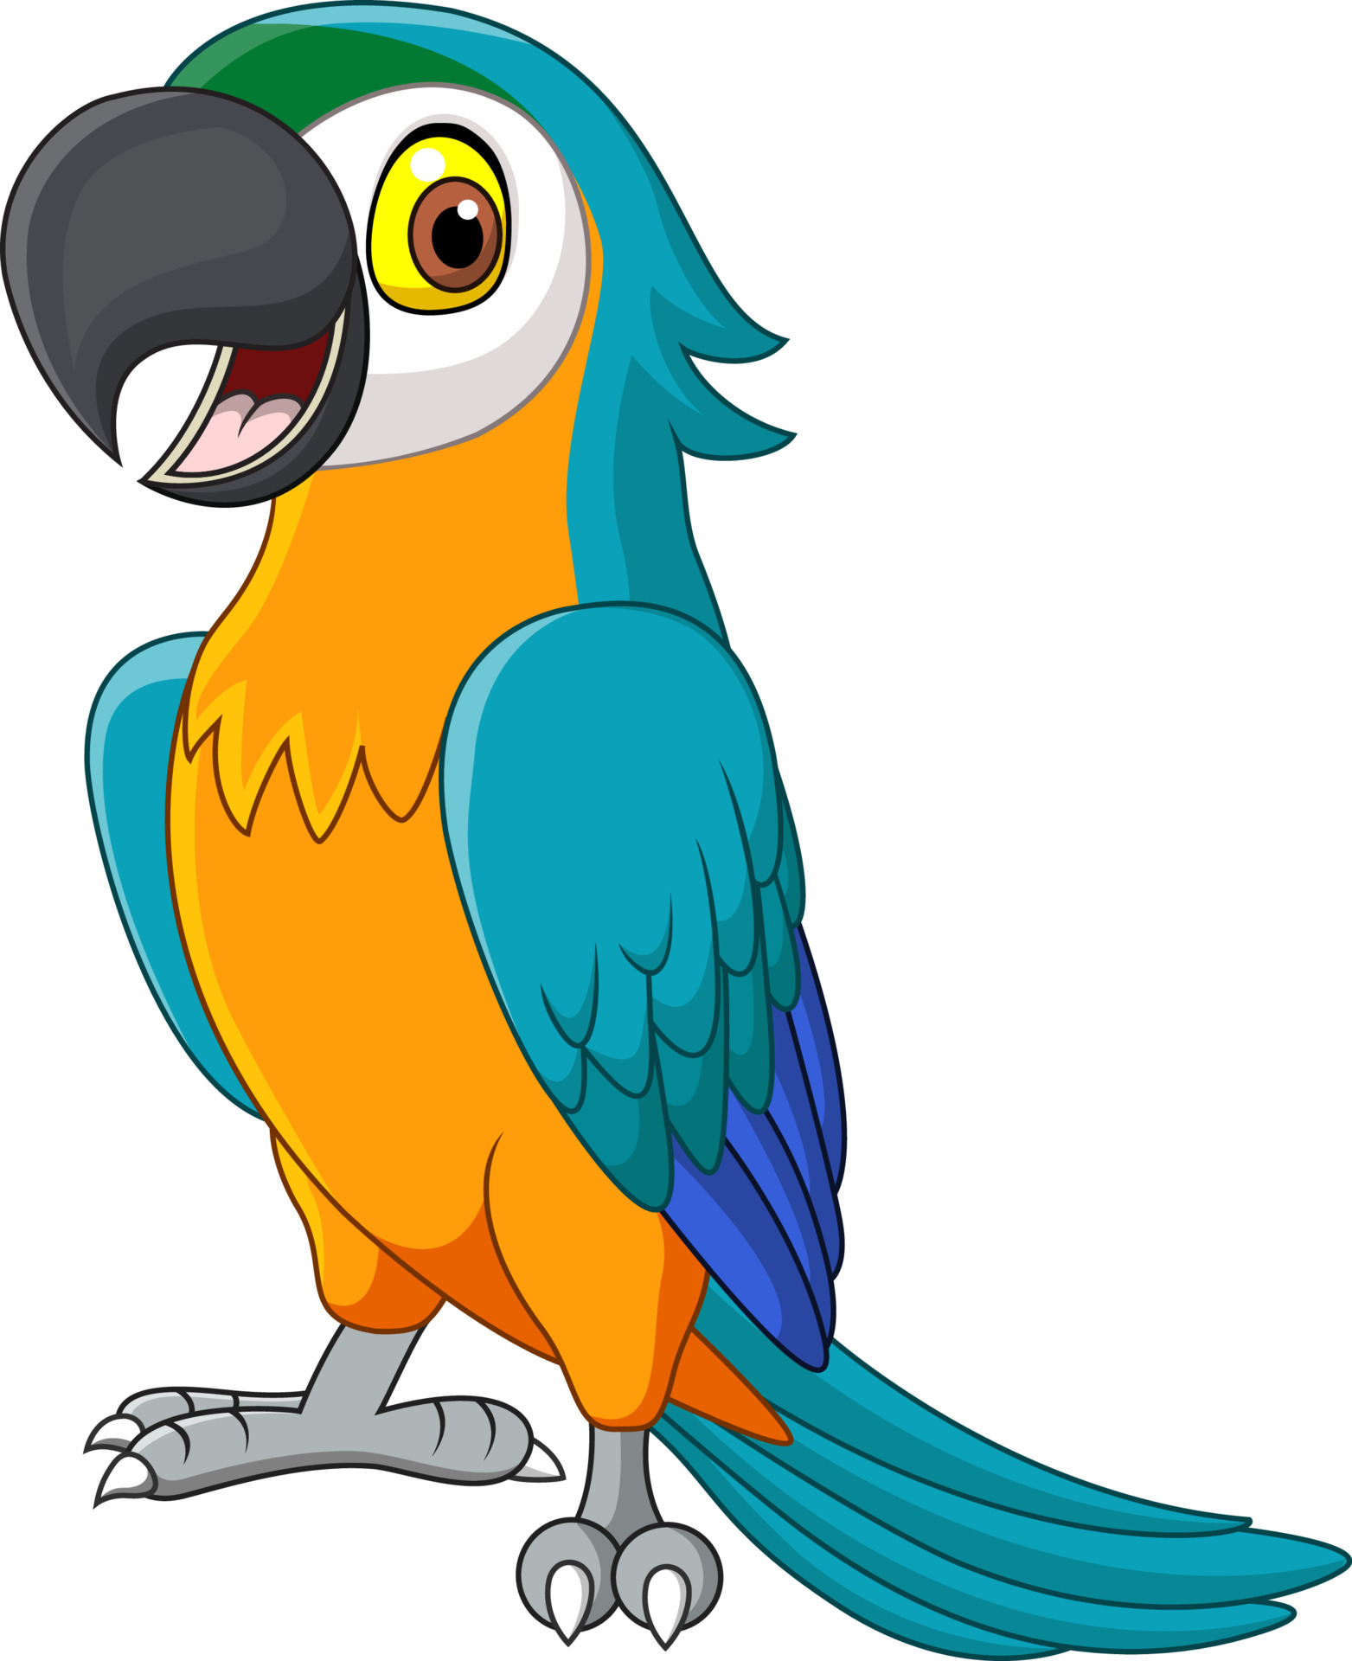

Guess then turn the card
I’m intelligent bird known for my ability to mimic human speech and sounds . Who am I ??

Slide 16

Guess then turn the card
I live on the trees and like to climb . I like to eat bananas .I have brown fur .
Who am I ?

Slide 17

Guess then turn the card
I live on land. I ‘ve long neck. I have orange and yellow skin.
Who am I ?

Slide 18
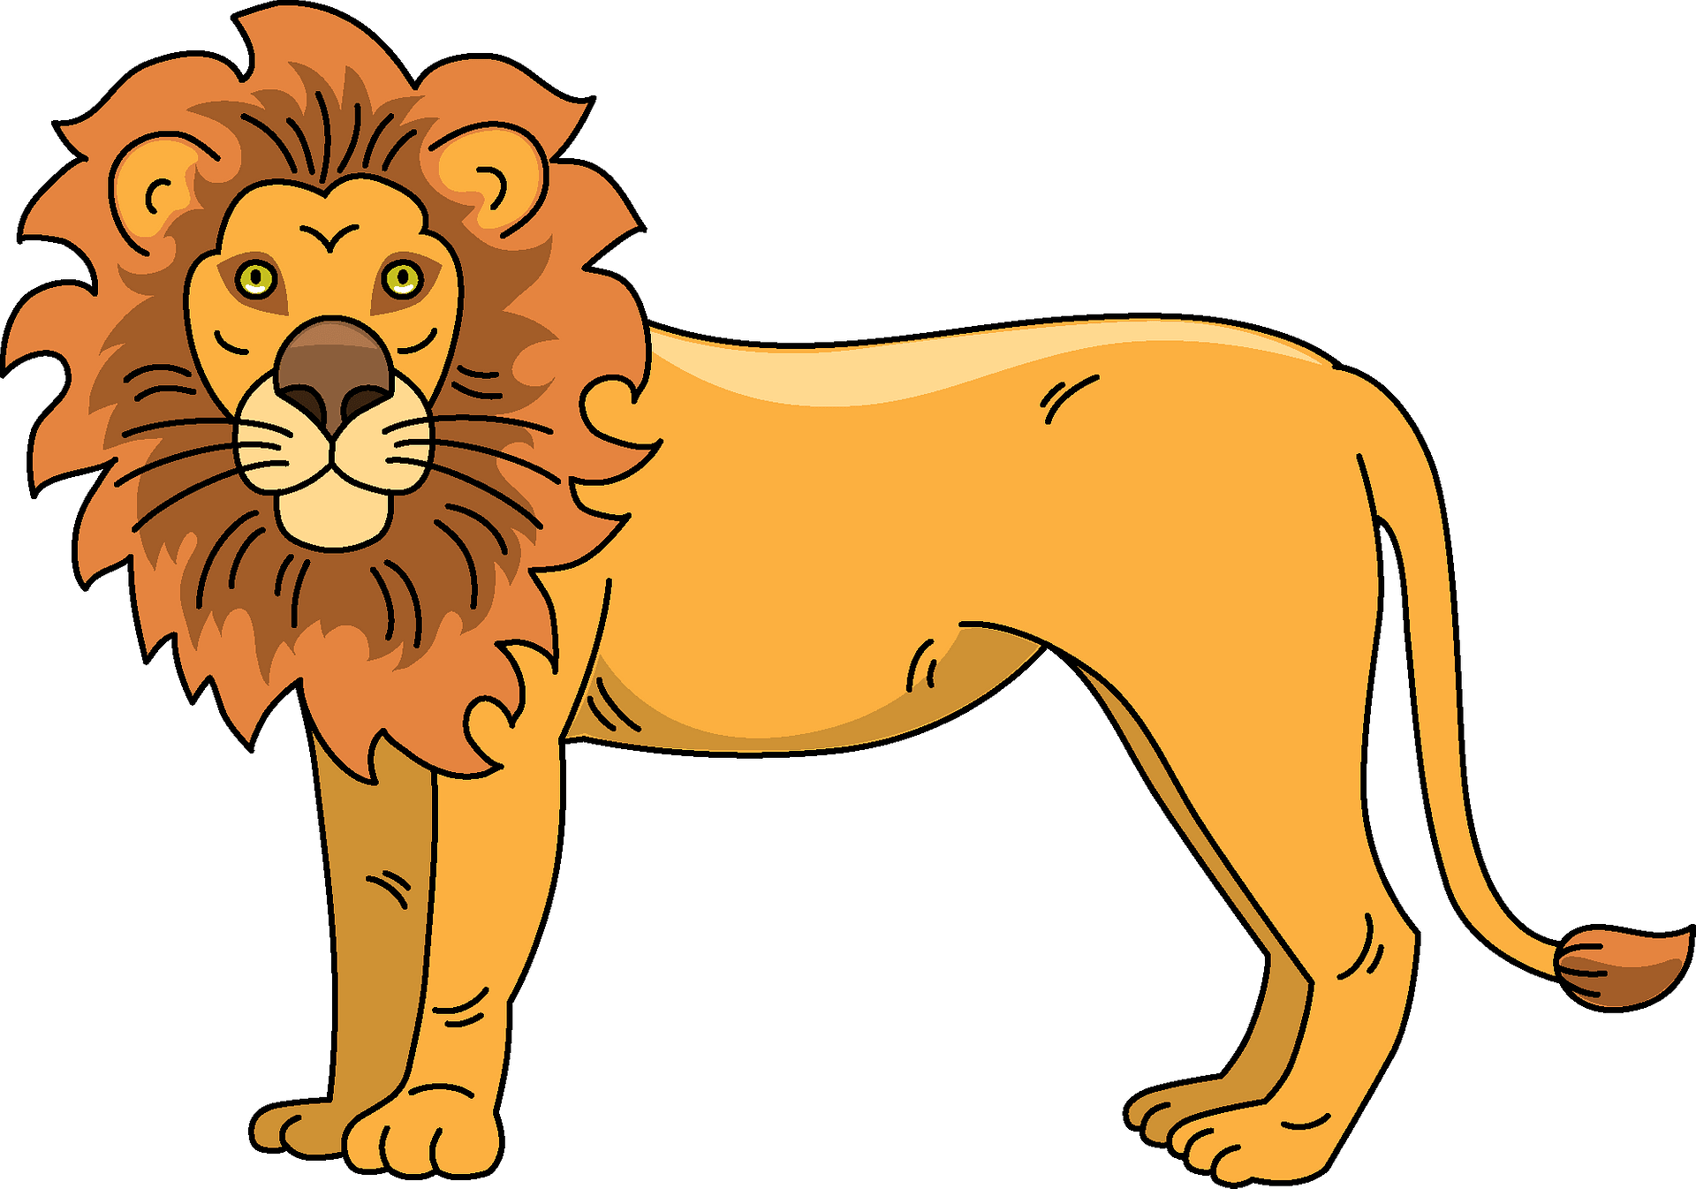
Guess then turn the card
I live on land. I ‘ve long neck. I have orange and yellow skin.
Who am I ?

Slide 19
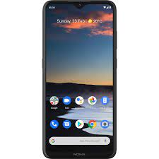
Guess then turn the card
I have touchscreen and cameras for capturing photos & videos. I can connect to Wi-Fi network to access the internet
What am I ?

Slide 20

Dice Strategy

Slide 21

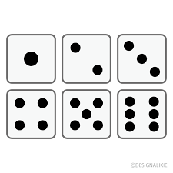
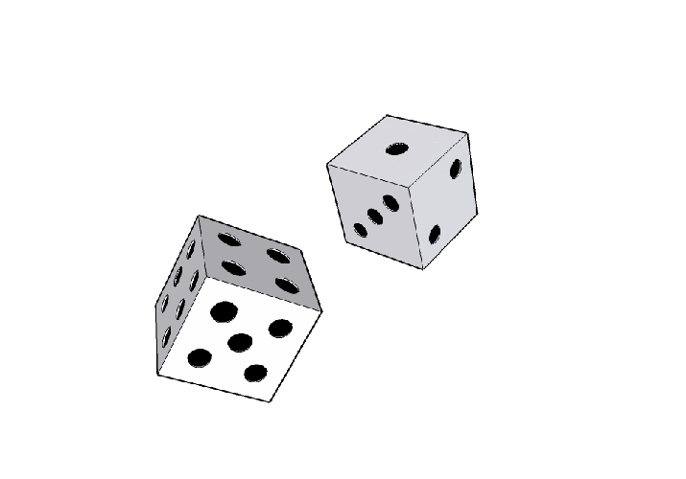
Roll & Tell
Tell 3 facts about yourself

Slide 22

Roll & Tell
Describe yourself using 3 adjectives

Slide 23
Roll & Tell
Describe your best friend in 3 adjectives

Slide 24
Roll & Tell
What is your biggest dream ?

Slide 25
Roll & Tell
What is your favorite food?

Slide 26
Roll & Tell
What is the country that you would like to visit?

Slide 27

Roll & Tell
What is your favorite book?

Slide 28
Find someone who challenge

Slide 29


Find someone who ……………
has blue bag

Slide 30
Find someone who ……………
wears glasses

Slide 31
Find someone who ……………
wears white shoes

Slide 32

Back to School Memory
https://wordwall.net/resource/34859930

Slide 33





Find the hidden picture ..

Slide 34

Remember

Slide 35

From the Holy Qura’an

Slide 36

Thanks!

