Slide 1
Unit 1
Connected by Technology
Reading
Mega Goal 2.1
Done by: Entisar Al-Obaidallah

Slide 2

Lesson Objectives
List some advantages & disadvantages of using the internet.
List ways to connect with people using the internet
Answer questions from the texts
Explain how the internet helps to meet people.
Read for specific information

Slide 3
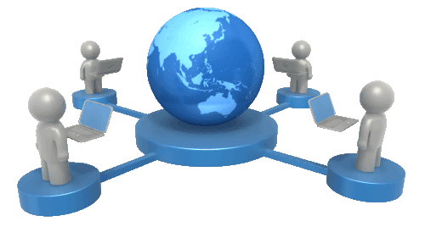





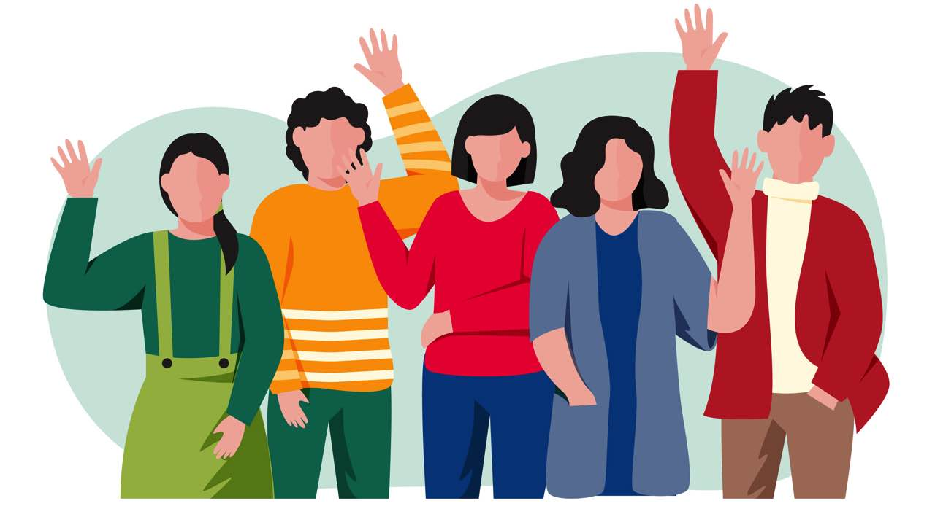
Warm up
Give examples of ways people use the internet?
electronic newspaper
Research
Downloading files
shopping
education & self learning
friendship

Slide 4

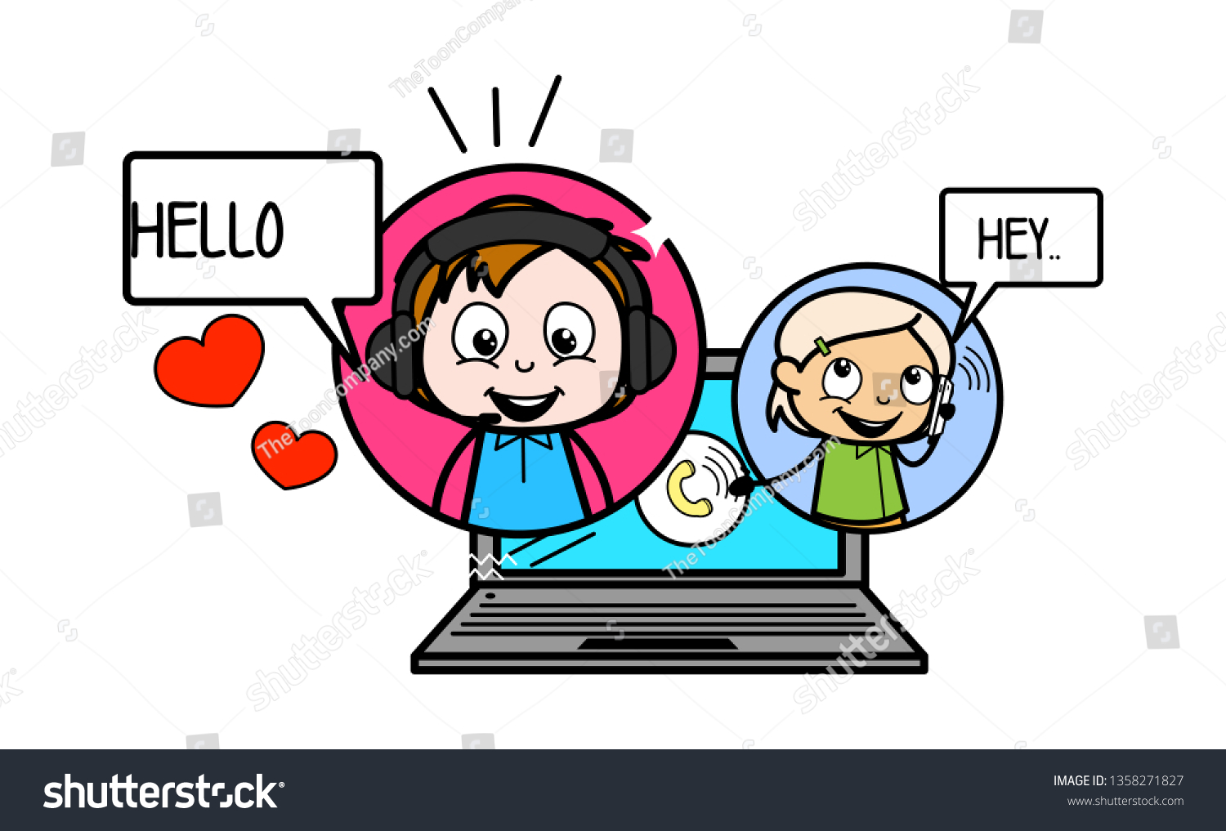

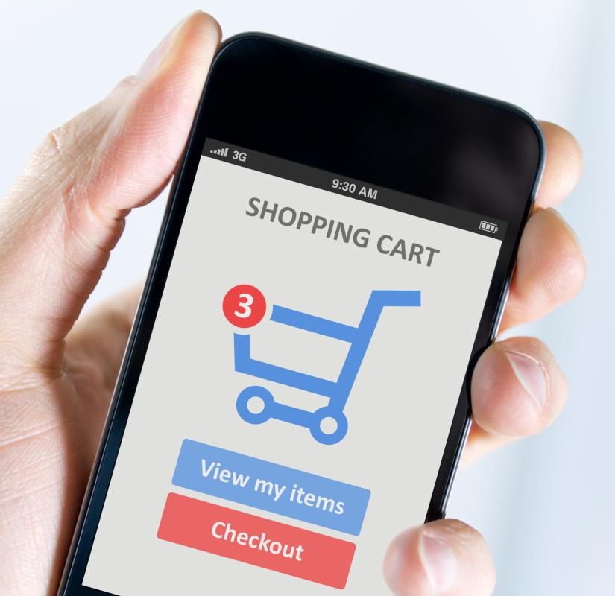


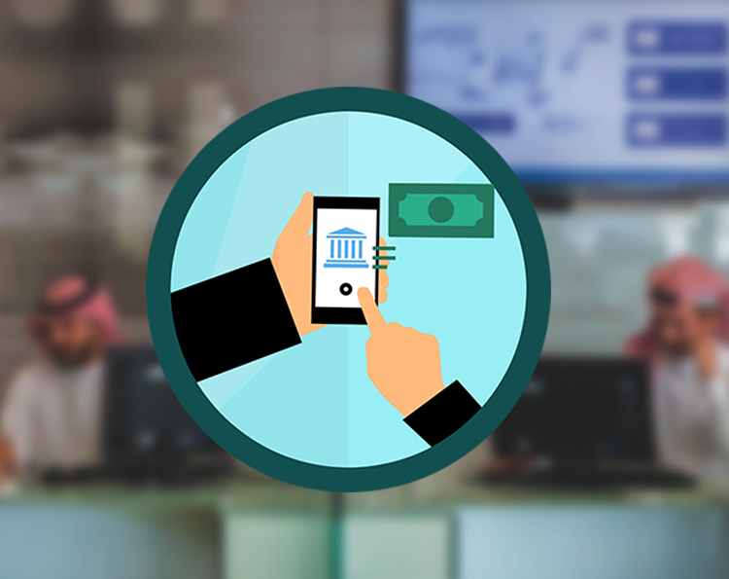
Warm up
What do you use the internet for?
Video calls
Health information
Send & receive e-mails
Online news
Shopping online
Participating in social network
Banking facilities

Slide 5
Warm up
Has the Internet ever
helped you meet or reconnect with a friend?

Slide 6
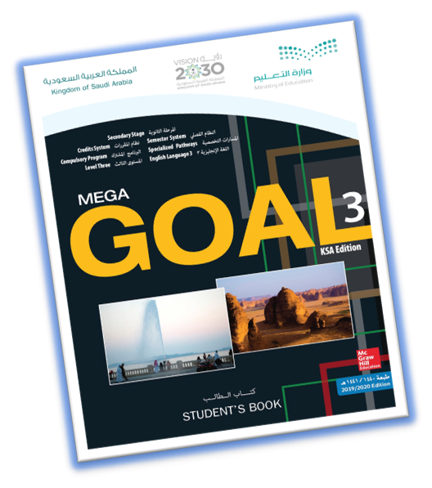
Open
Your students book Page(12 - 13)

Slide 7
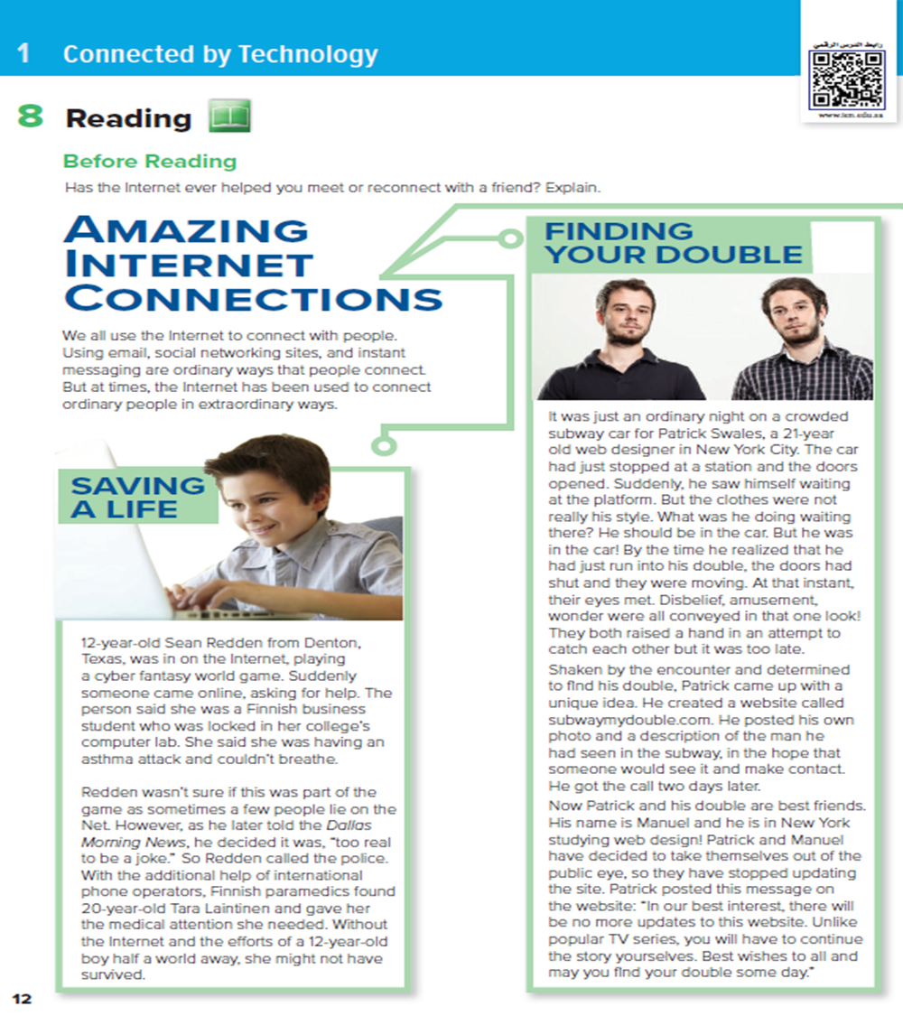
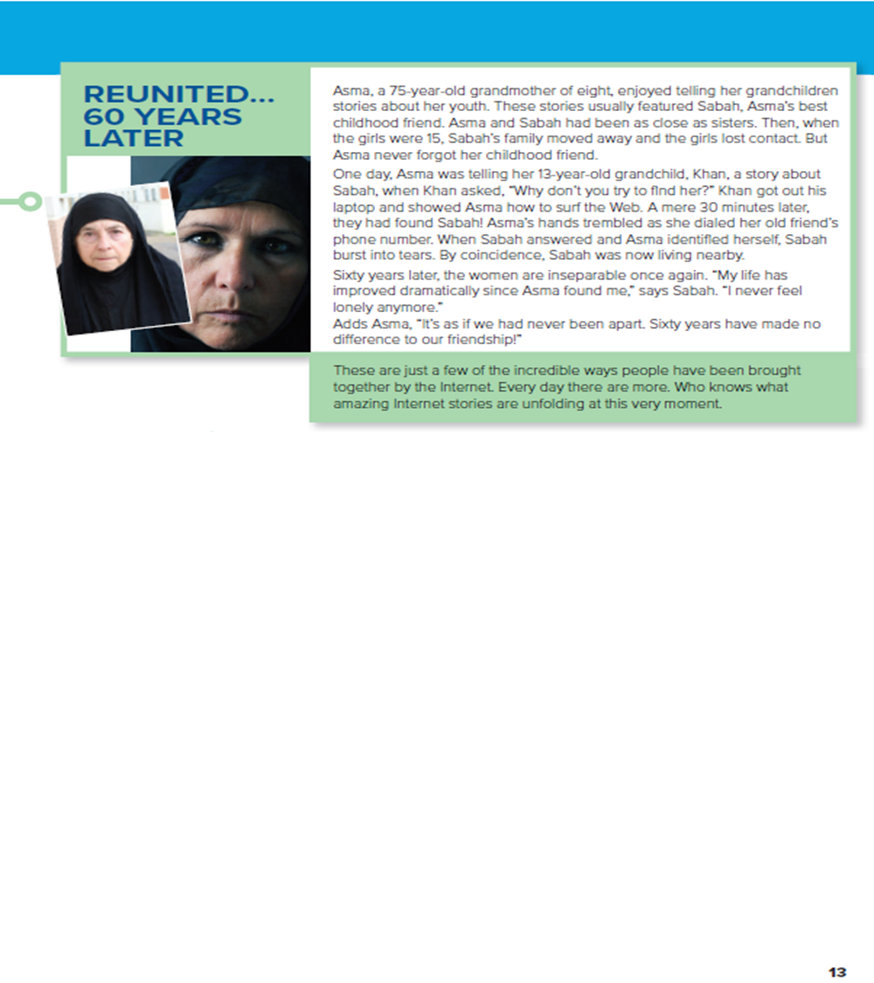
3
2
1
An old women
Tow similar young men
What is the title of the article ?
How many paragraphs are there?
A boy playing on computer
What is the title of each paragraph?
What can you see in each picture?

Slide 8

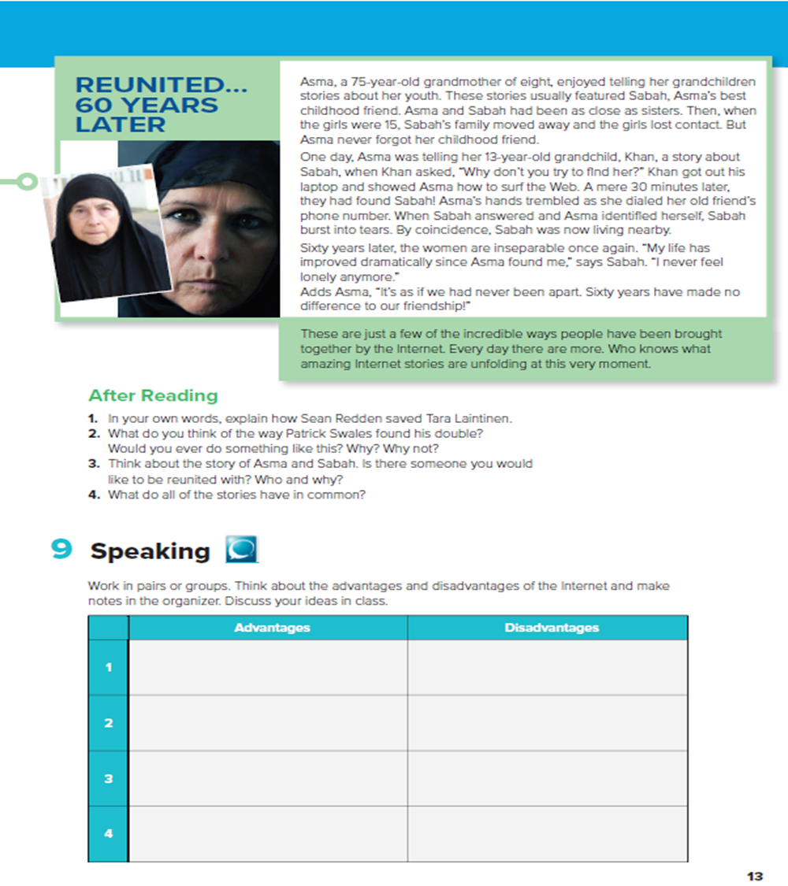

Listen & Discuss

Slide 9

Read & Answer
What is his name ?
Sean Redden
How old is he ?
12 ears old
Where is he from ? ?
From Denton , Texas

Slide 10
Read & Answer
What is his name ?
Patrick Swales
How old is he ?
21 years old
Where is he from ?
New York City

Slide 11


Read & Answer
What is her name ?
Asma
How old is she?
75 years old
What is sh doing?
Telling her grandchildren stories about her youth

Slide 12
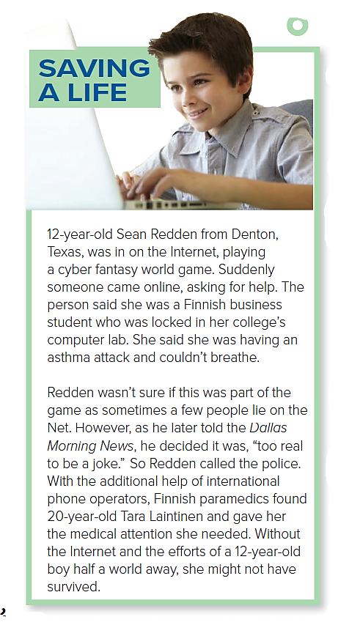
Read along as you Listen
What was Sean Redden doing ?
He was playing a cyber fantasy world game.
What problem was the Finnish woman having?
She was having an asthma attack.
Why couldn’t she get help ?
She was locked in the computer lab
What did Sean do ?
He called the police.

Slide 13
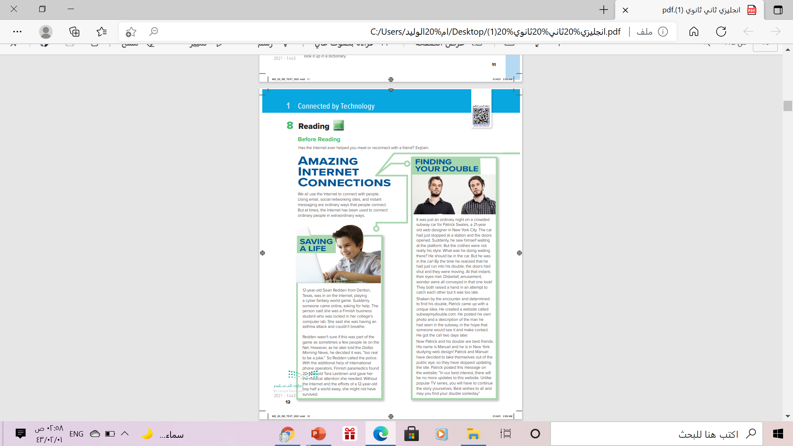
Read along as you Listen
Who is Patrick Swales?
a 21-year-old web designer.
Who did he see on the subway?
He saw his double
Why didn’t he speak to him?
The train doors shut and it started moving
How did he find him?
He created a website & posted a description of the man he had seen

Slide 14
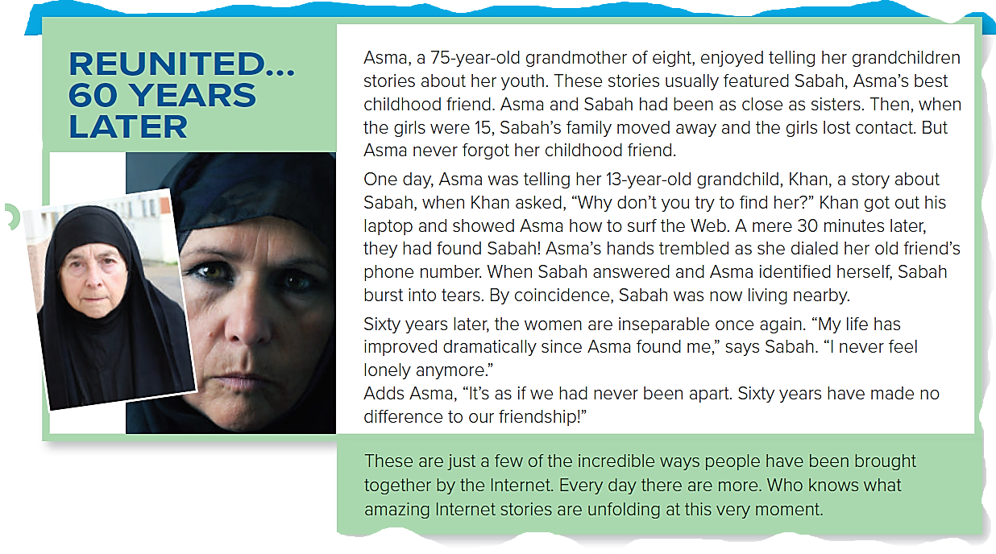
Read along as you Listen
What was the relationship between Asma and Sabah in the past?
They were best friends
Why did they lose contact?
Sabah’s family moved away
Who helped Asma find Sabah? How?
Her grandson Khan showed her how to surf the Web, and they found Sabah’s phone number.
They are inseparable
What is the relationship between Sabah and Asma now ?

Slide 15
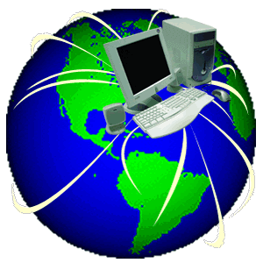
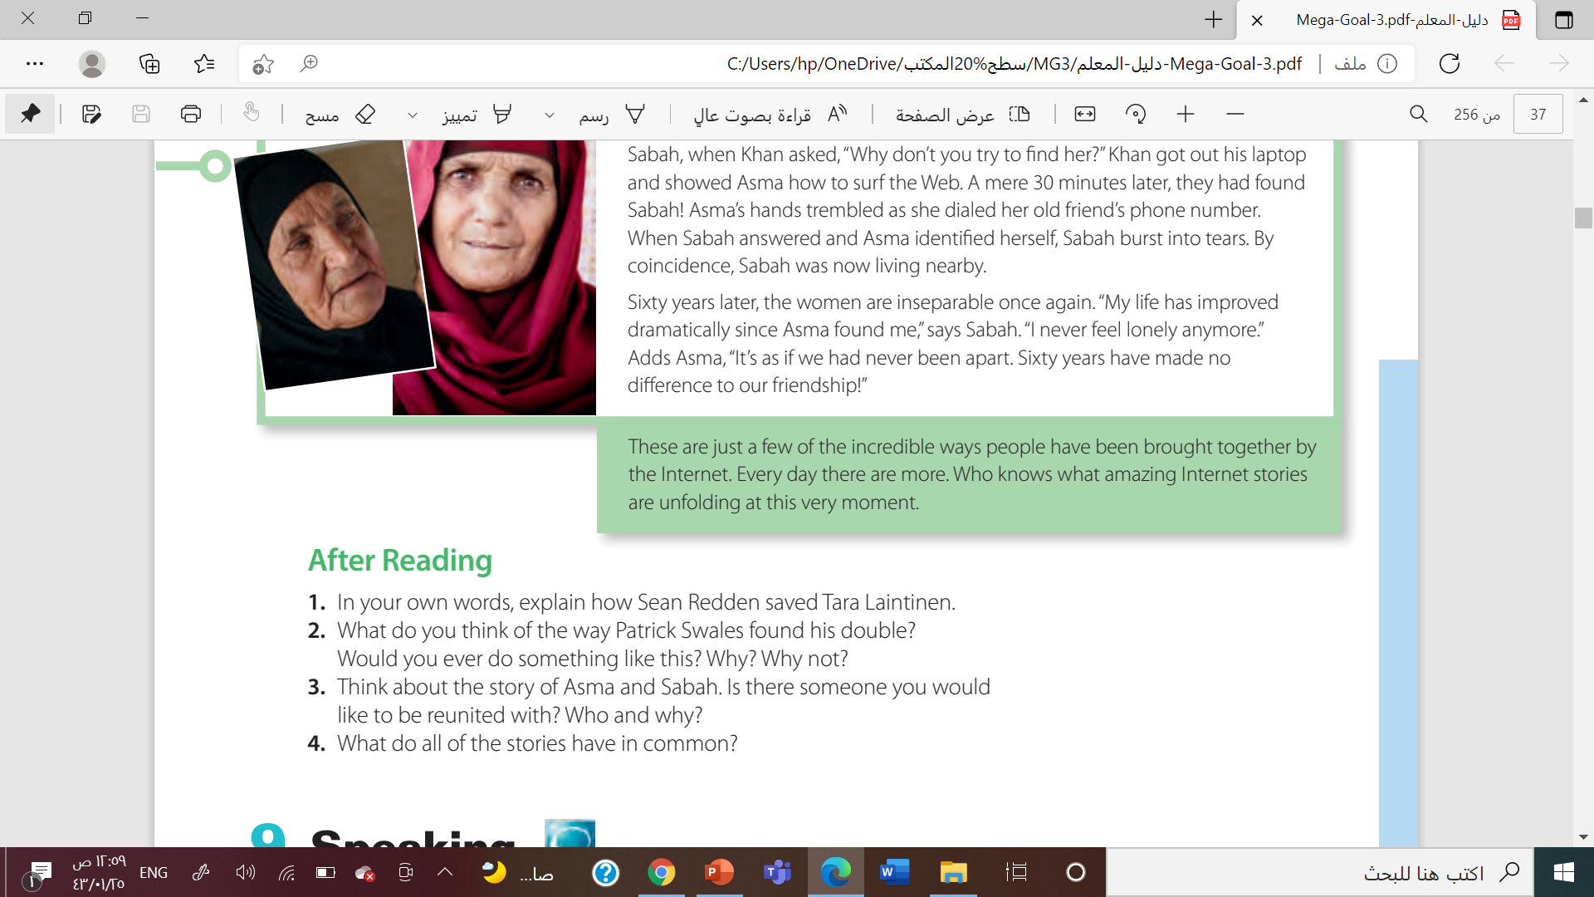
Answers will vary

Slide 16

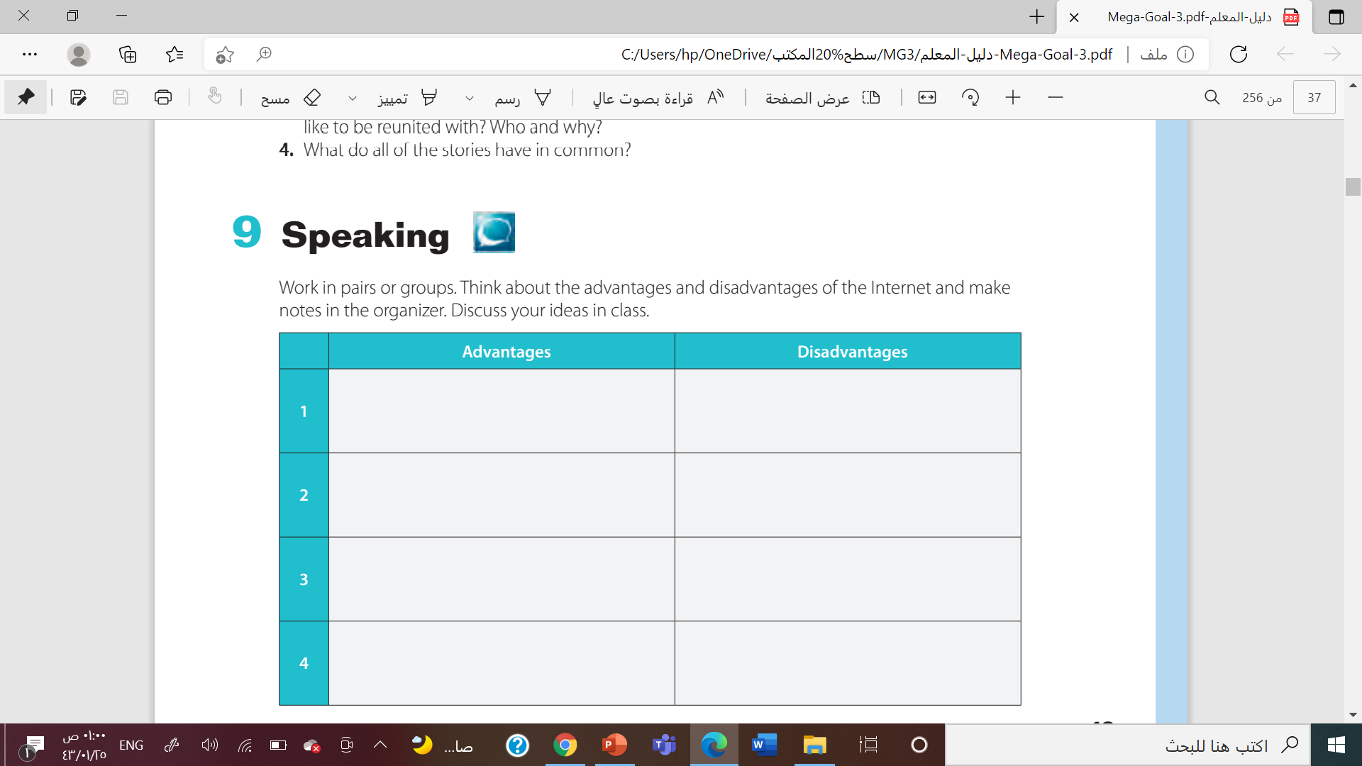


Source Of Information
A Waste Of Time
Not Safe Place For Children
Privacy Exposure
Source Of Entertainment
Money Cheats
Keep Informed
Viruses/Malwares
Online Shopping
Online Threatening Or annoyance

Slide 17



Homework

Slide 18
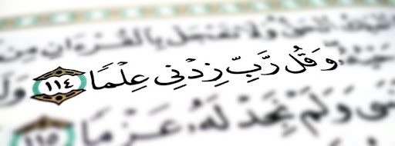


From The Holy Quraan

Slide 19

Thanks

