Slide 1
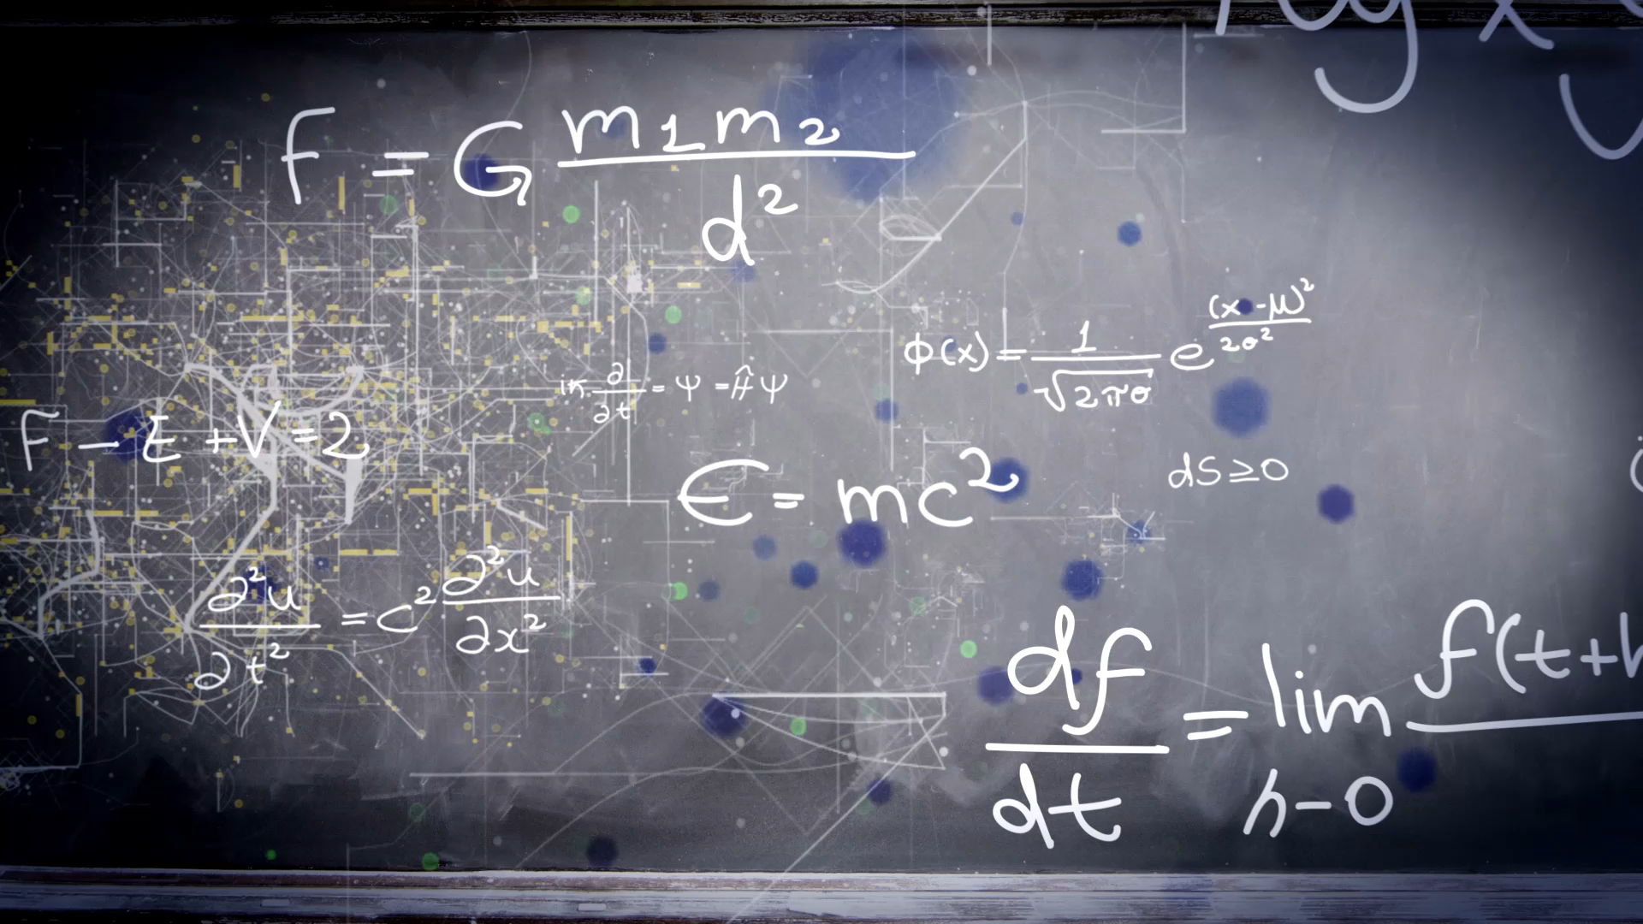
Unit 1
Good morning
Workbook pages (187 – 190)

Slide 2


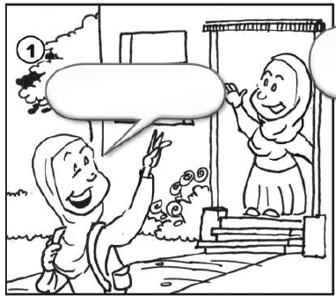
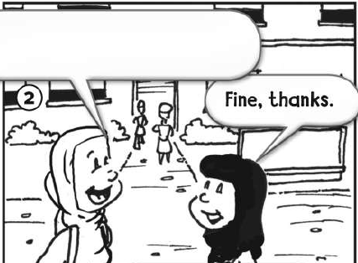
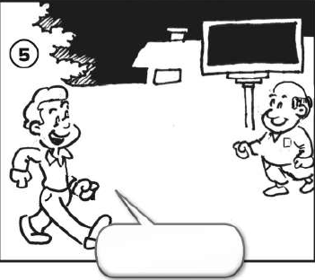
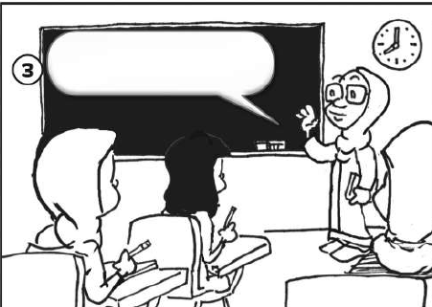
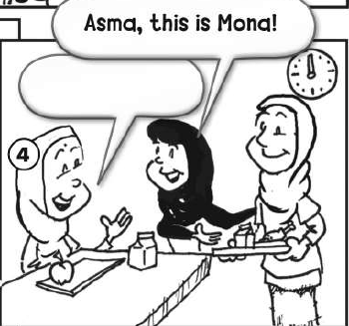
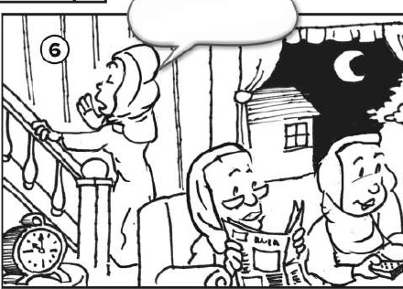

p.187
Hi. How are you?
Goodbye.
Good evening.
Good morning.
Nice to meet you.
Good night.

Slide 3
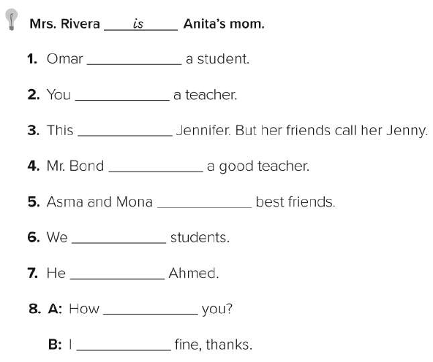

p.188
is
are
is
’s
are
’re
is
are
’m

Slide 4

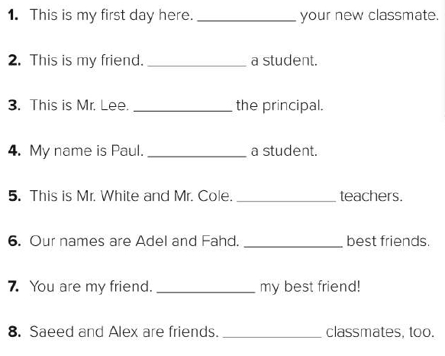

p.188
I’m
she’s
He’s
I’m
They’re
We’re
You’re
They’re

Slide 5
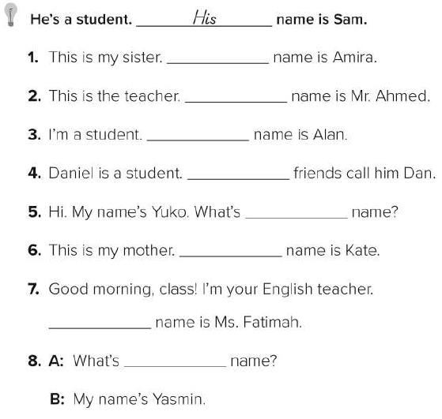
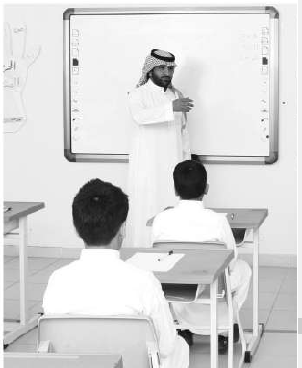

p.189
Her
His
My
His
your
Her
My
Your

Slide 6
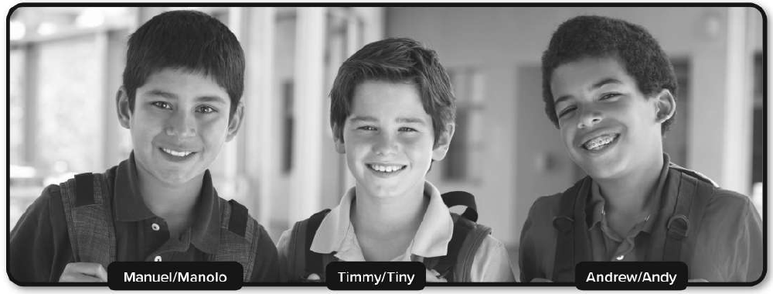
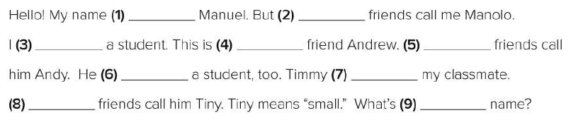

p.189
is
my
’m
my
His
is
’s
His
your

Slide 7

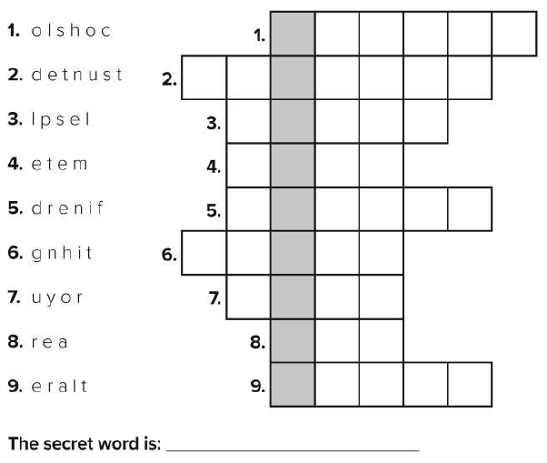
p.190
s
c
h
o
o
l
s
t
u
d
e
n
t
s
p
e
l
l
m
e
e
t
f
r
i
e
n
d
n
i
g
h
t
y
o
u
r
a
r
e
l
a
t
e
r
Super Goal

Slide 8

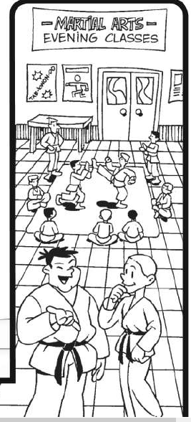
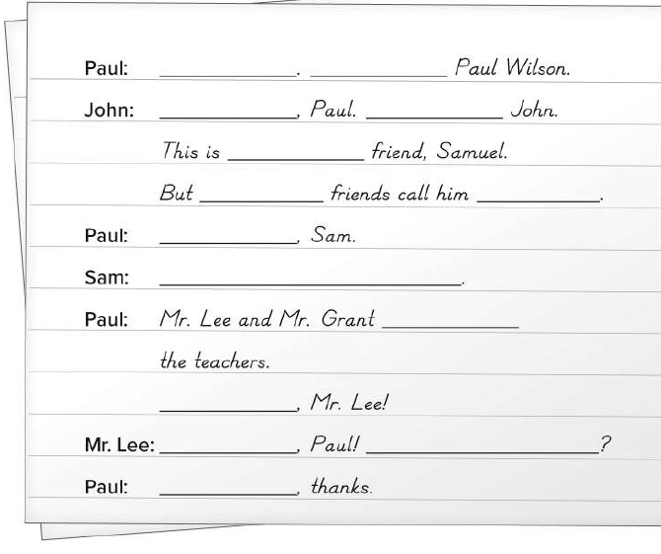

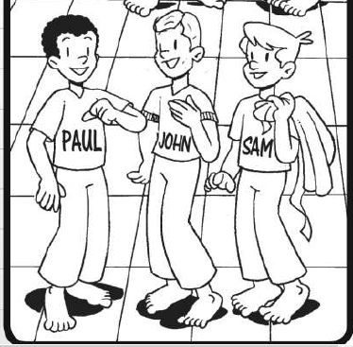
p.190
Hi
I’m
Hello
I’m
my
his
Sam
Nice to meet you
Nice to meet you, too
are
Hello
Good evening
How are you
fine

