Slide 1


5
Unit 2

Slide 2
Sea Animals

Slide 3

Review the previous lesson

Slide 4
What is your name?

Slide 5
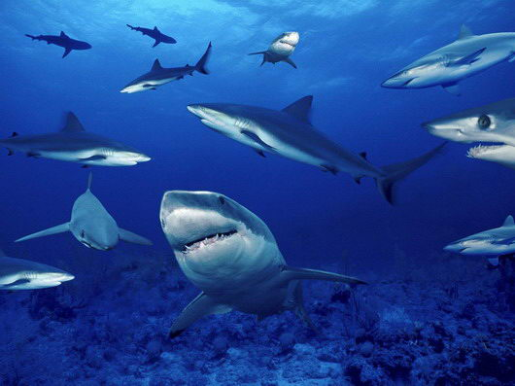
BY-SA

Slide 6
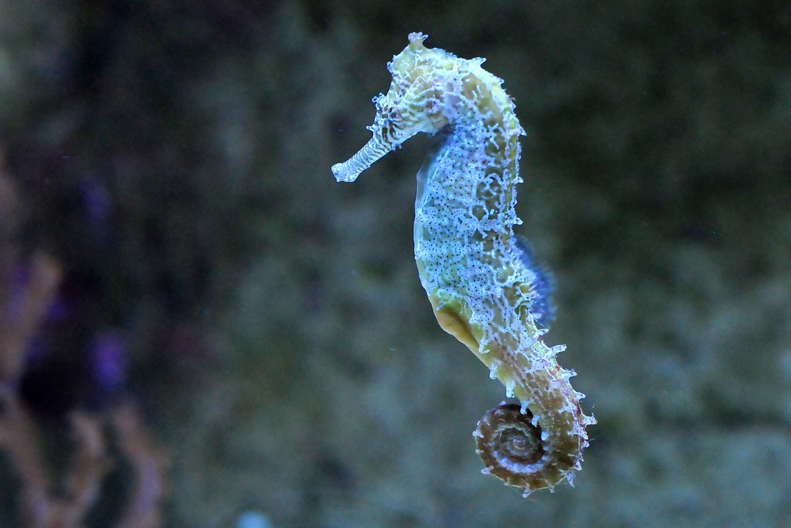
This Photo by Unknown Author is licensed under CC BY-SA-NC

Slide 7
Grammar in Action
القواعد اللغوية

Slide 8
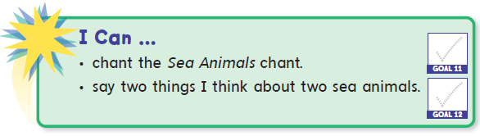

Slide 9
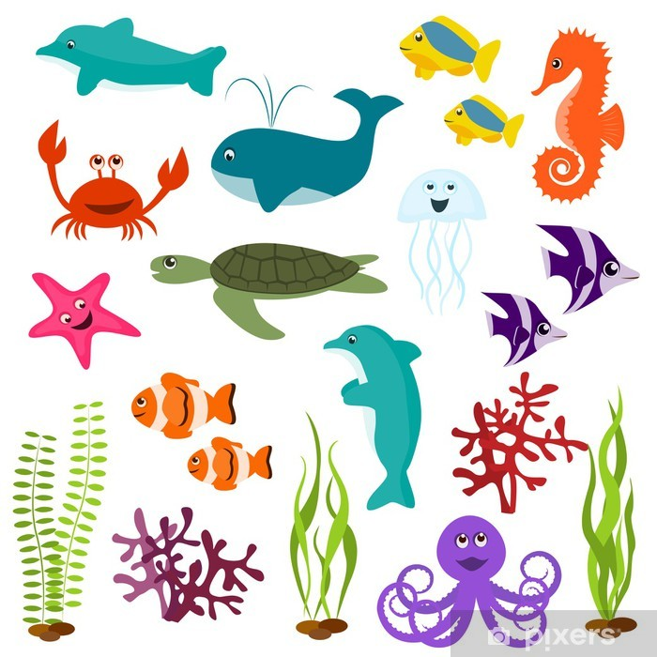
Materials :
Sea animals poster

Slide 10
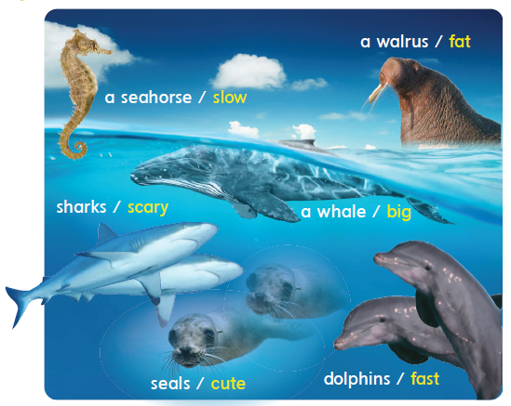
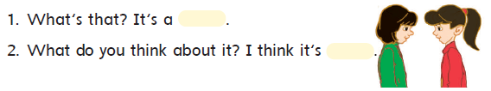

Slide 11
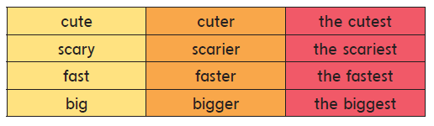

1
Listen, point, and say .استمع ، تبع ، وأعد القراءة

Slide 12
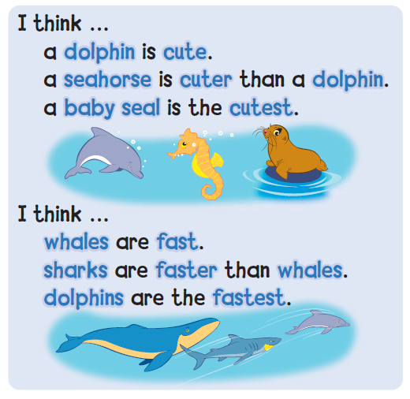

2
Listen, point, and chant Sea Animals

Slide 13
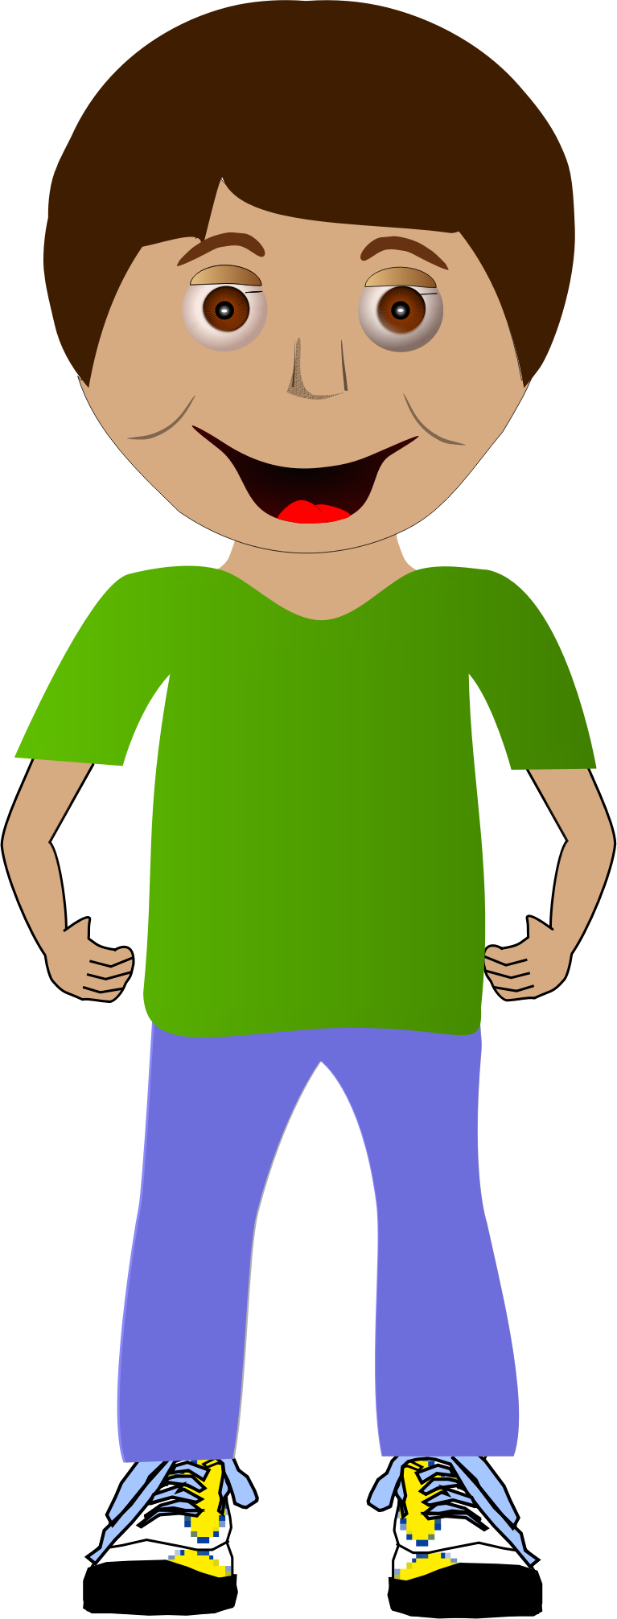
tall
Ali is tall.

Slide 14
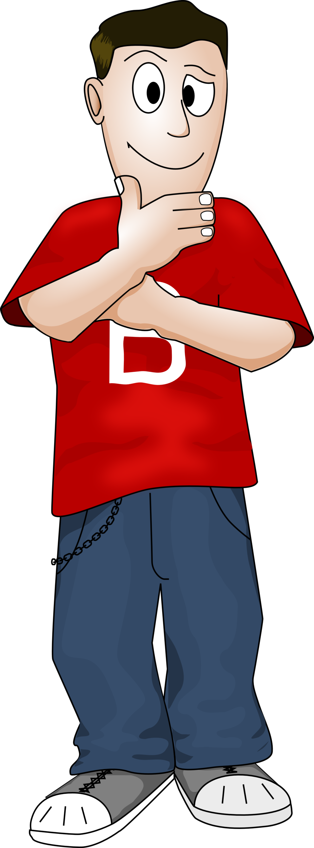

tall
Ahmad is taller than ali.

Slide 15
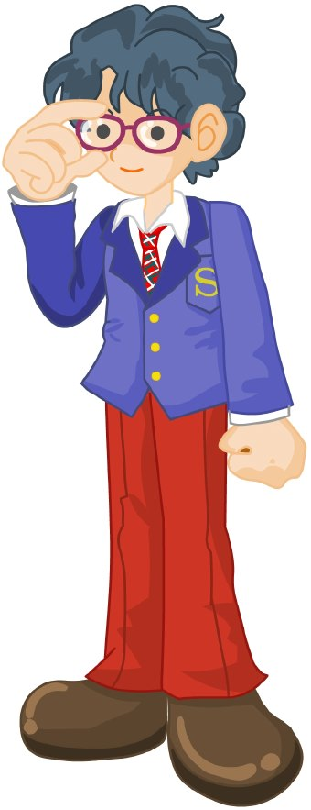


tall
Omar is the tallest .

Slide 16
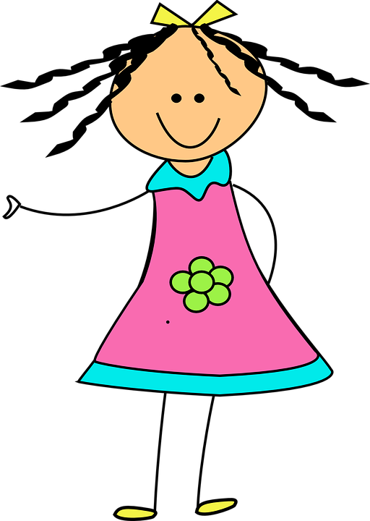
cute
Nada is cute.

Slide 17
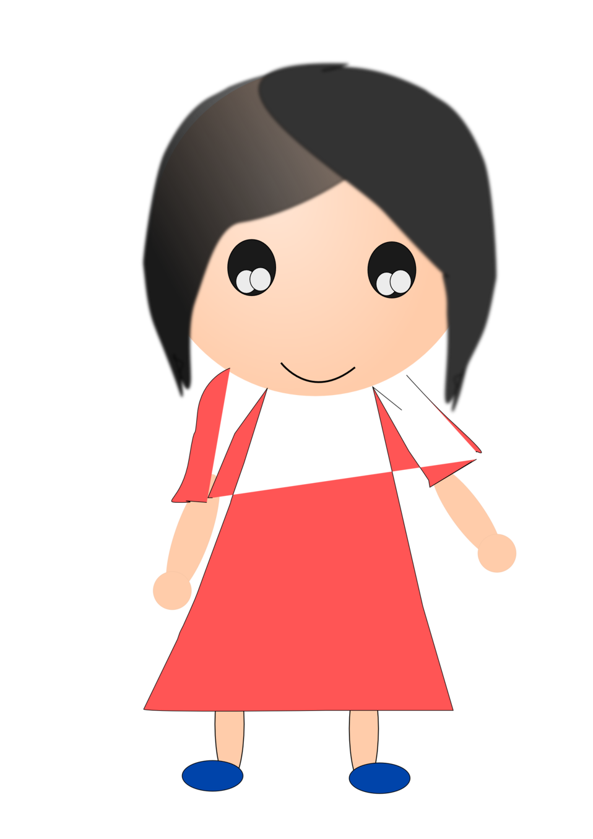
cute
Amal is cuter than nada.

Slide 18
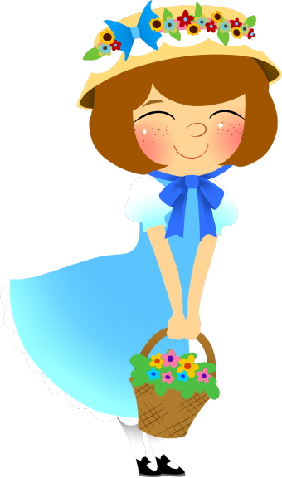
cute
Hind is the cutest .

Slide 19
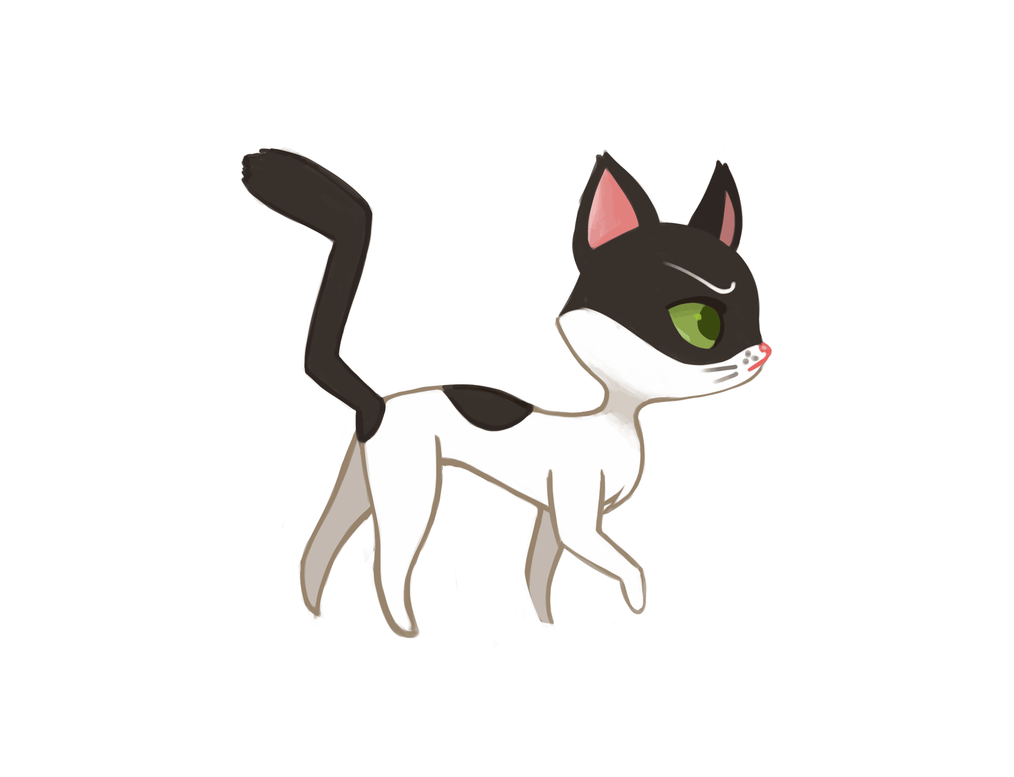
fast
Cat is fast.
This Photo by Unknown Author is licensed under CC BY-NC-ND

Slide 20
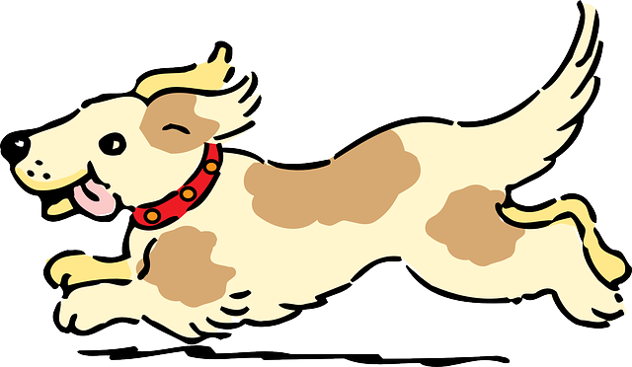
fast
Dog is faster than cat.
This Photo by Unknown Author is licensed under CC BY-NC-ND

Slide 21

fast
Cheetah is the fastest .
This Photo by Unknown Author is licensed under CC BY-NC-ND

Slide 22

وقت التحدي

Slide 23
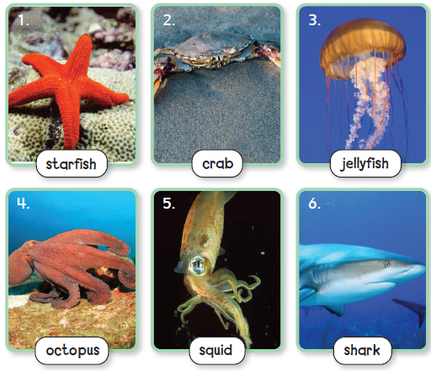

3
Three hints gameلعبة الثلاثة تخمينات
Can you listen to three hints and guess which sea animal it is ?
هل يمكنك الاستماع إلى ثلاث تلميحات وتخمين أي حيوان بحري هو؟

Slide 24
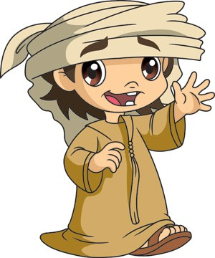
Have a nice day
Homework
81+82

Slide 25
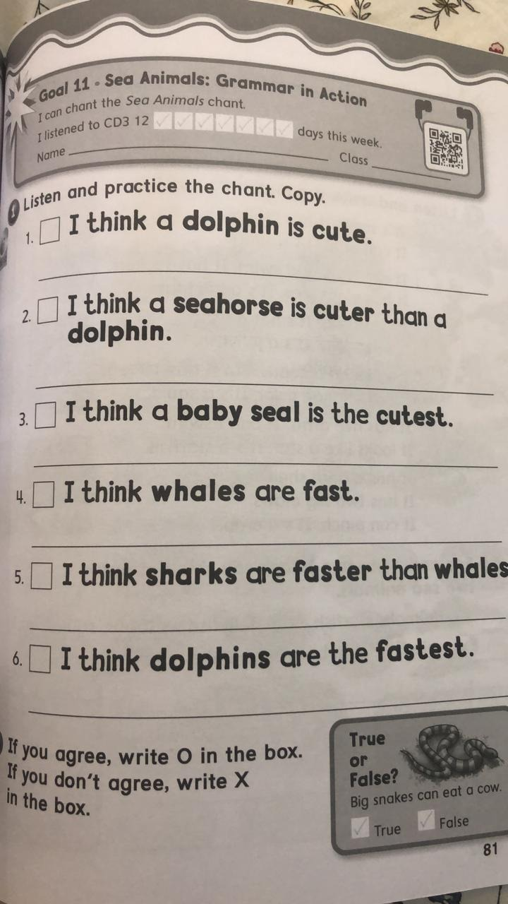

Slide 26
