Slide 1

6th grade
Unit 2
Lesson 1

Slide 2
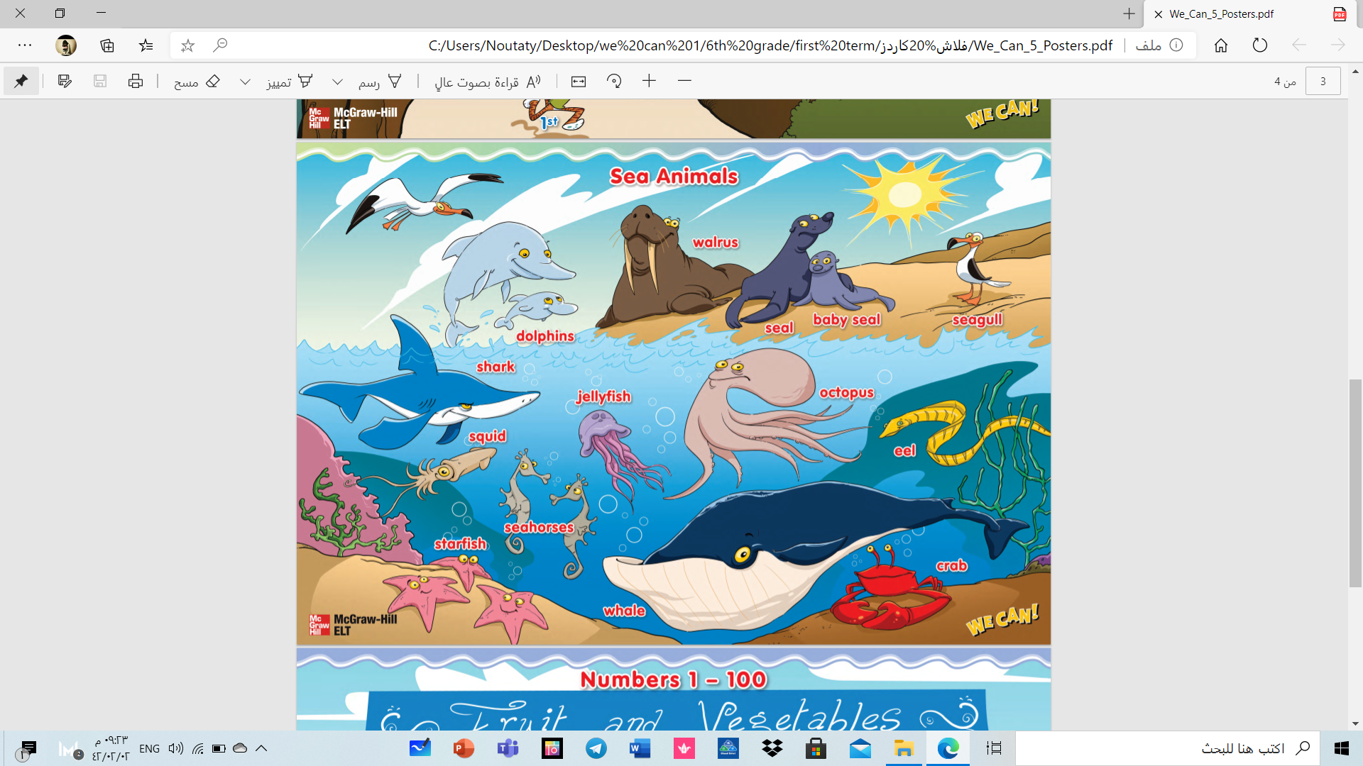
Sea animals
Finding out time

Slide 3
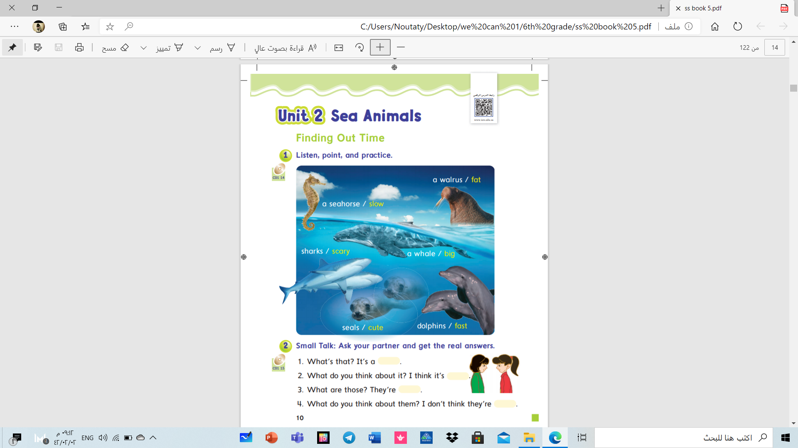


Slide 4
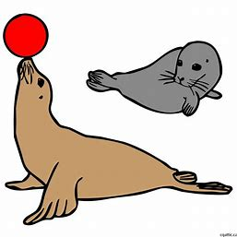
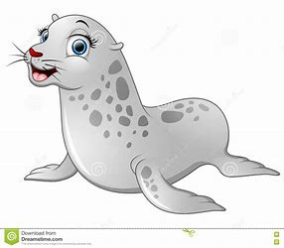
What are these?
It is a baby seal
These are seals
What do you think about it ?
I think it’s Cute.جميل

Slide 5
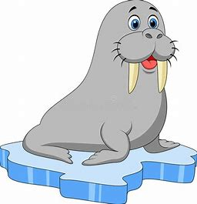
What is this?
It is a walrus.
What do you think about it ?
I think it’s fat.سمين

Slide 6
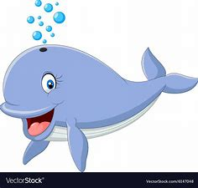
What is this?
It is a whale.
What do you think about it ?
I think it’s big .كبير

Slide 7
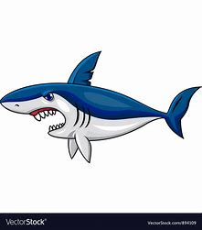
What is this?
It is a shark.
What do you think about it ?
I think it’s scary.مخيف

Slide 8
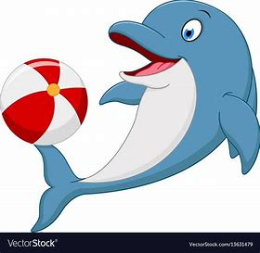
What is this?
It is a dolphin.
What do you think about it ?
I think it’s fast .

Slide 9
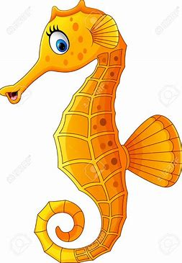
What is this? .
It is a seahorse .
What do you think about it?
I think it’s slow.

Slide 10
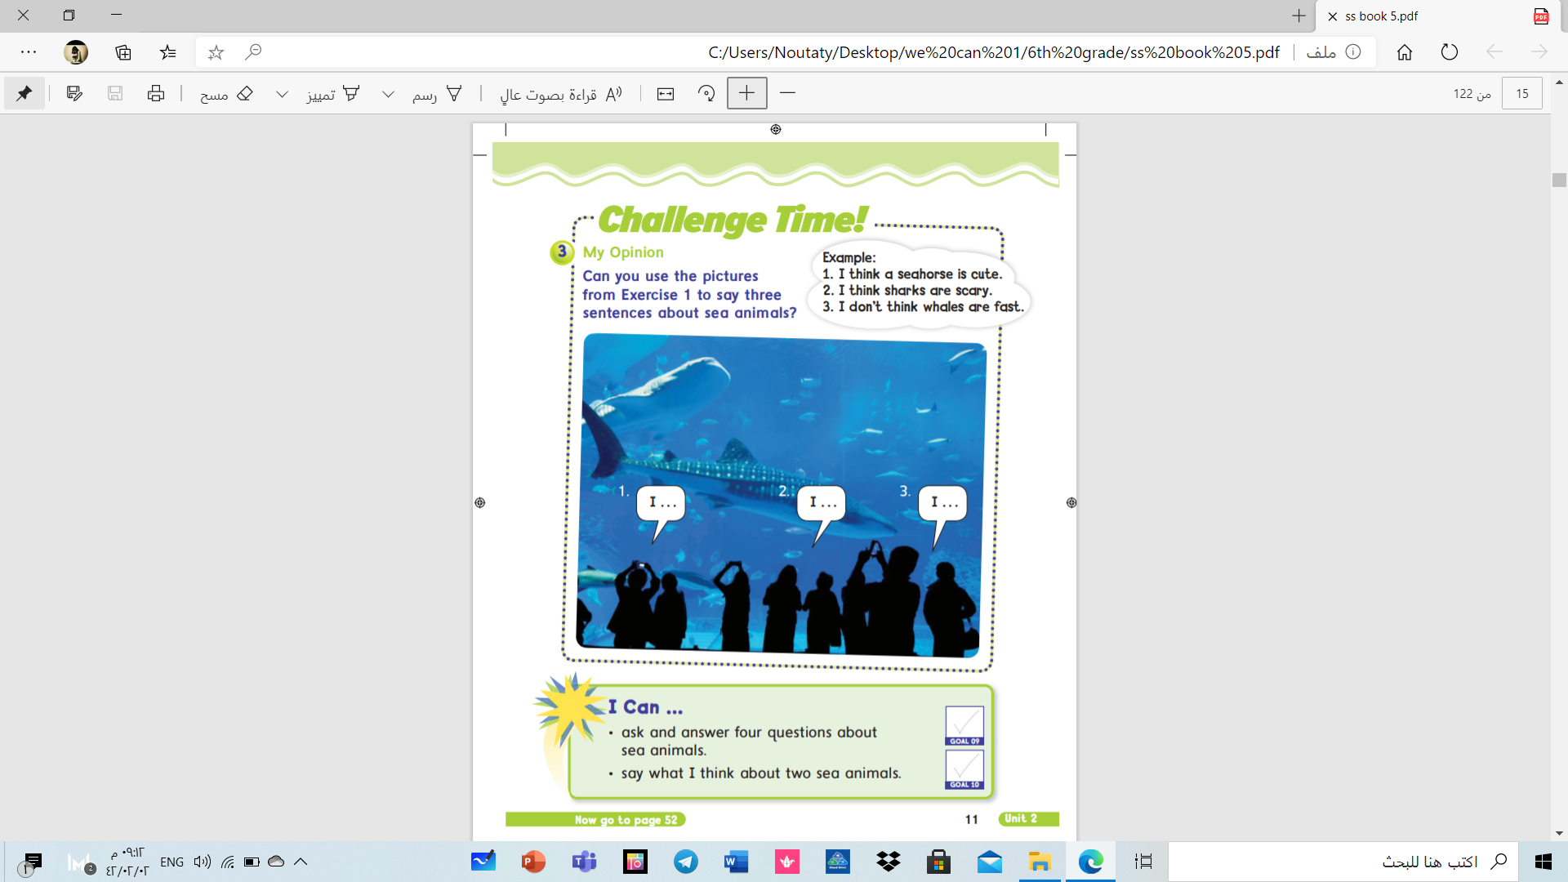

Slide 11
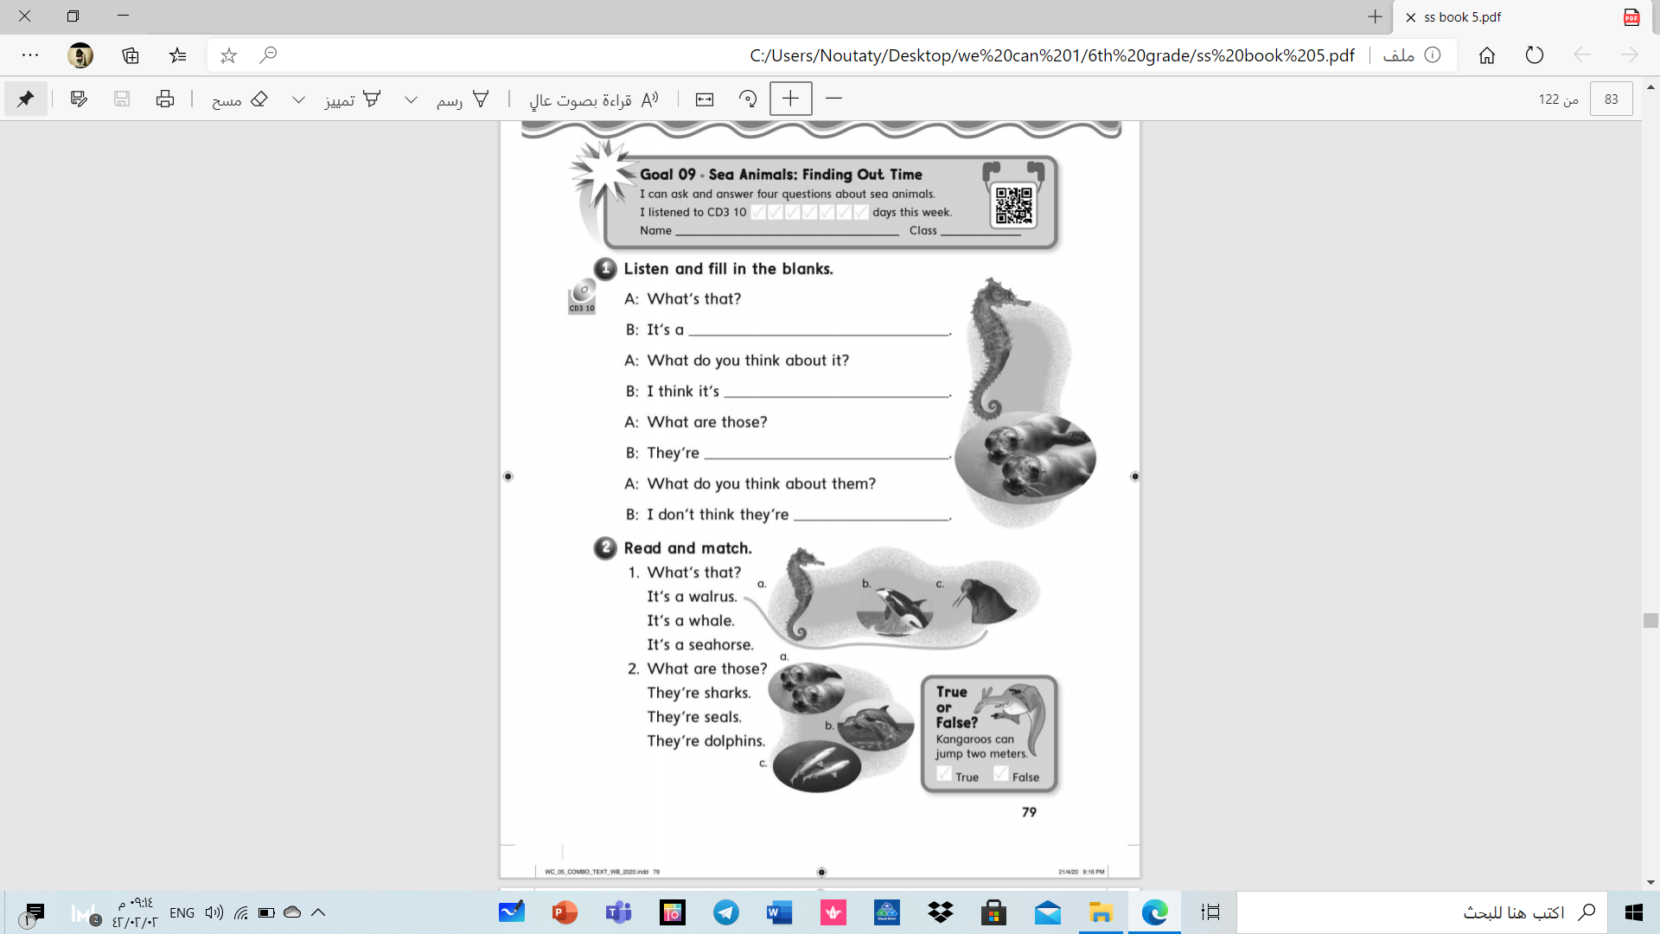

Slide 12
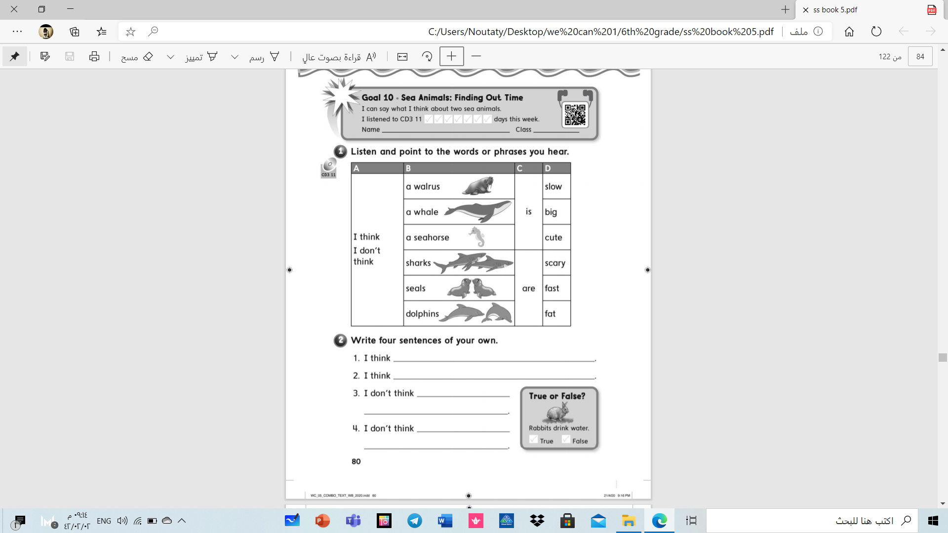

Slide 13

Have a nice day .
Teacher : Nouf .

