Slide 1

Unit-1-
Two Is Better Than One
Listen & Discuss

Slide 2
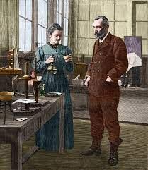
Goals:
1-
Match words with their meanings
2-
Find the why Marie Curie left Poland
3-
Name the discovery that made them famous
4-
Explain the difficult conditions
5-
Find the elements of a successful couple.
6-
Recall an Islamic couple who made a deference

Slide 3
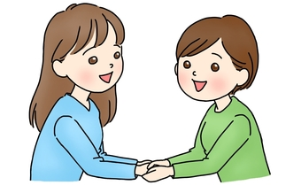
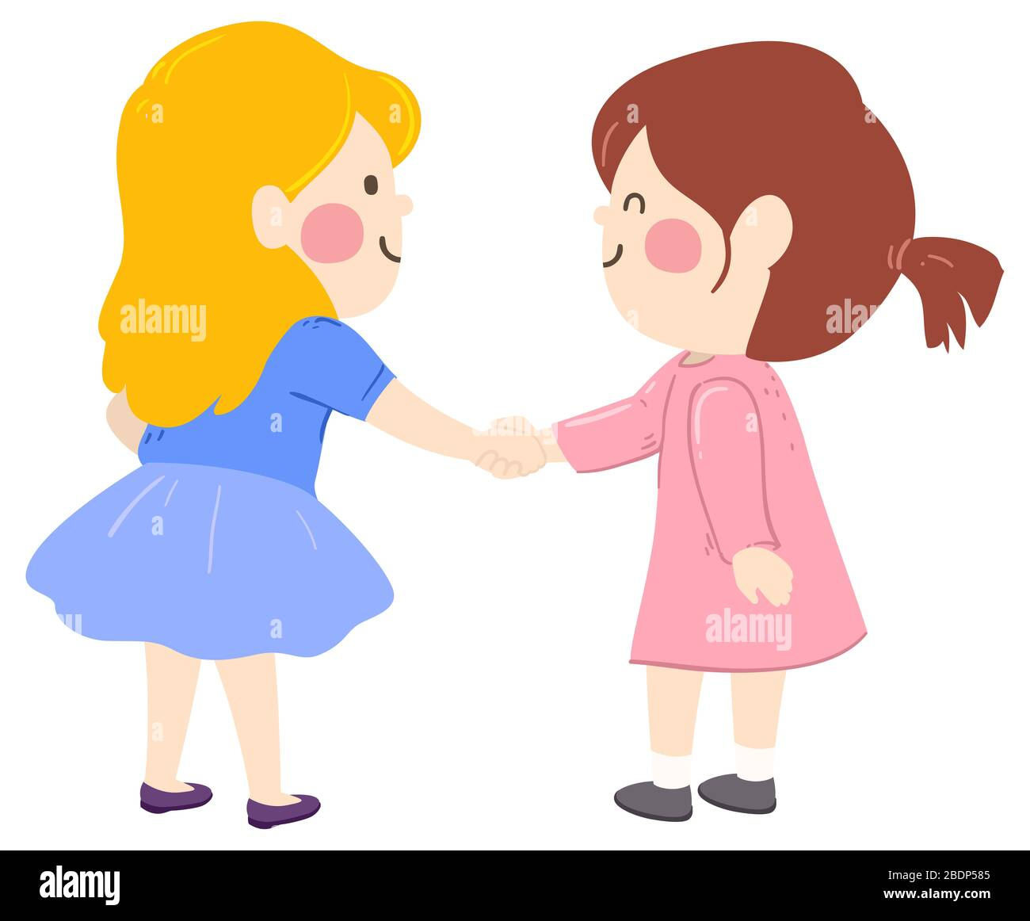
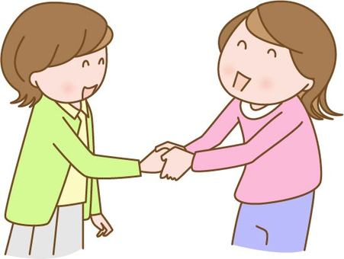
Hand shake
"Divide the group into pairs of two.
Have them make the most creative handshake they can in a couple of minutes.

Slide 4
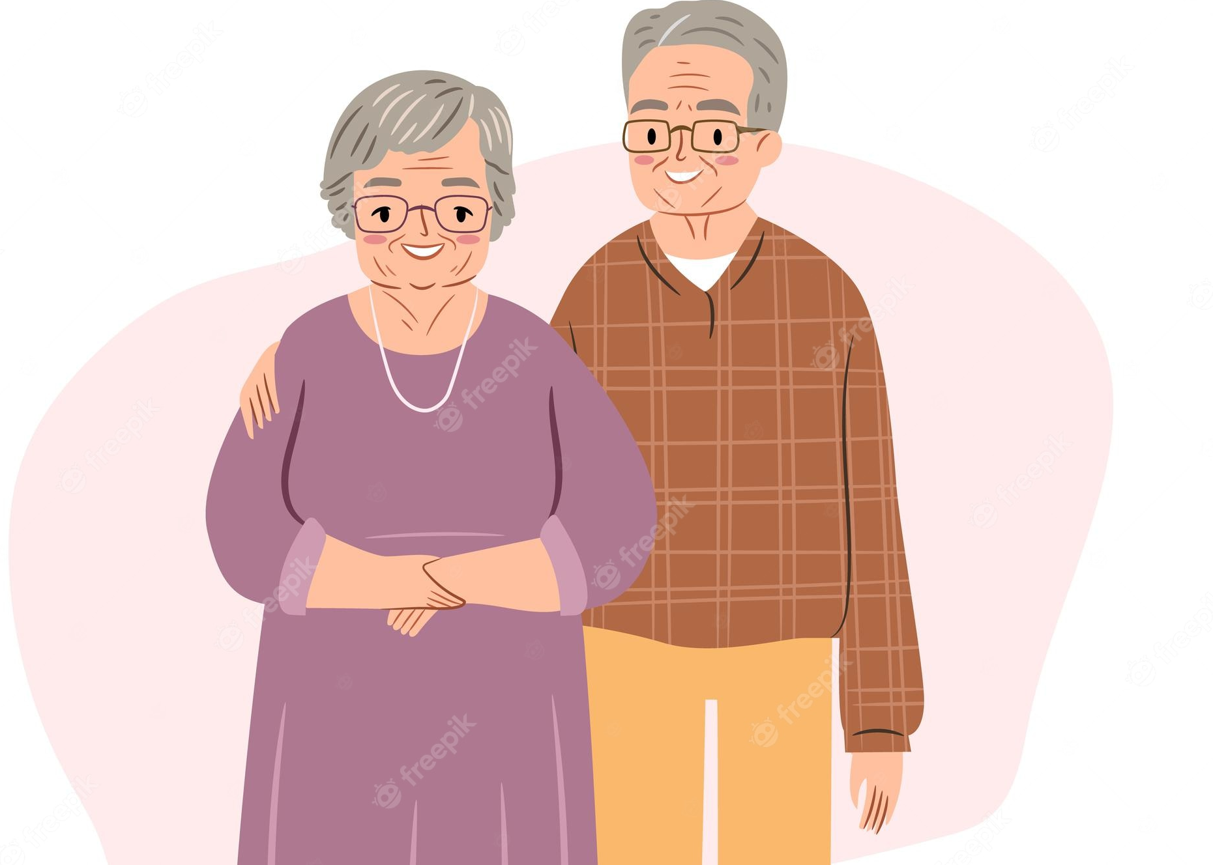
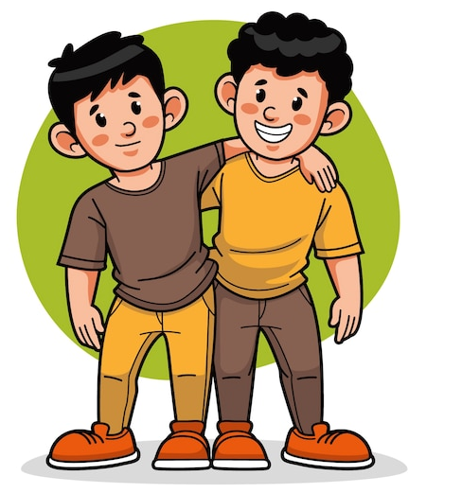
Who are some famous husbands and wives from history?
What is each of these partners famous for?
Who are some famous brothers or sisters?
Notes:
What is each of these partners famous for? What is each of these partners famous for? What is each of these partners famous for? What is each of these partners famous for? What is each of these partners famous for? What is each of these partners famous for? What is each of these partners famous for? What is each of these partners famous for?

Slide 5
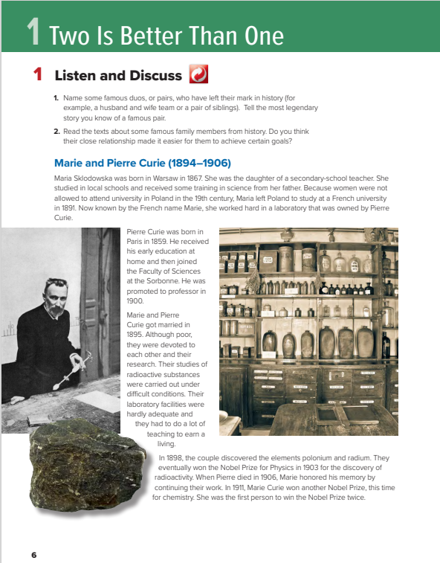
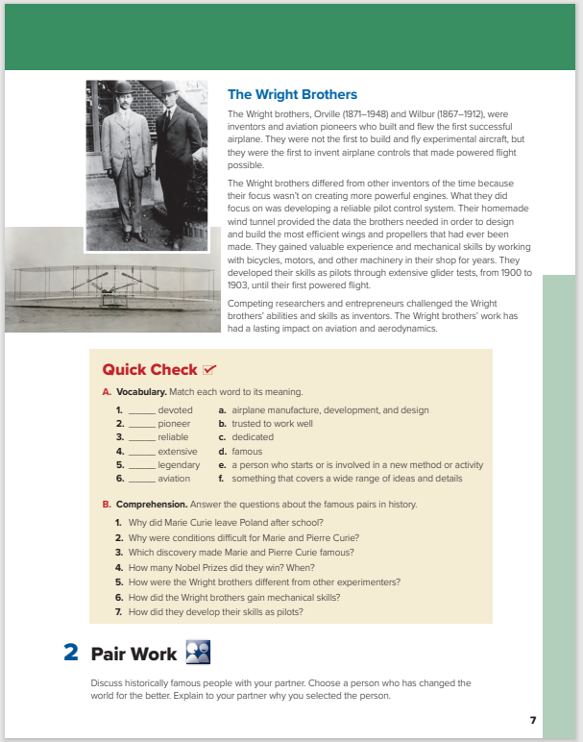
Students Book P.6-7

Slide 6
What famous marriage is discussed on these pages?
What famous siblings are discussed?
(Marie and Pierre Curie).
(Orville and Wilbur Wright).

Slide 7



Listen

Slide 8
Listen & Read along
Where did Marie and Pierre meet?
What did they discover together?
(in a laboratory in France)
Do you think their close relationship made it easier for them to achieve certain goals?
(the elements polonium and radium)

Slide 9
Listen & Read along
Who were the Wright brothers?
Why were they famous?
What did their homemade wind tunnel help them do?
Do you think their close relationship made it easier for them to achieve certain goals?
(inventors and aviation pioneers)
(They built and flew the first successful airplane.)
(design and build the most efficient wings and propellers that had ever been made)

Slide 10
What do these dates refer to?
(the date of their marriage)
their years of birth and death)

Slide 11
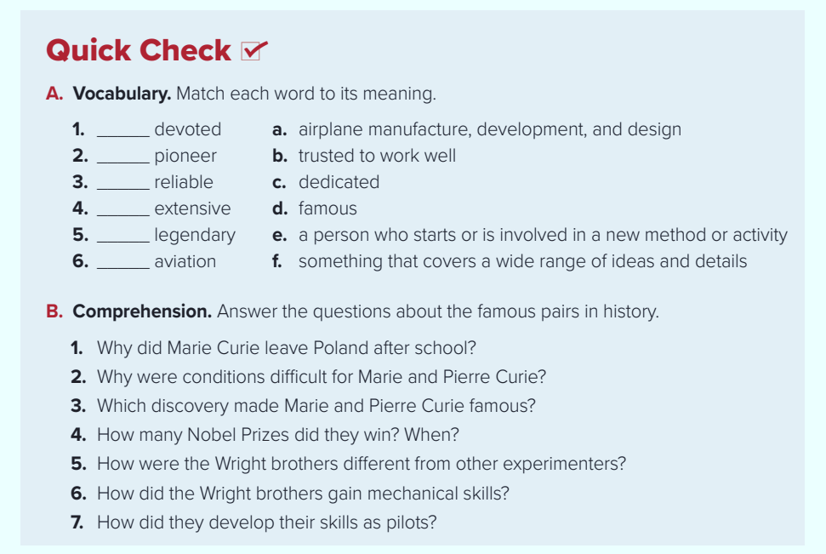
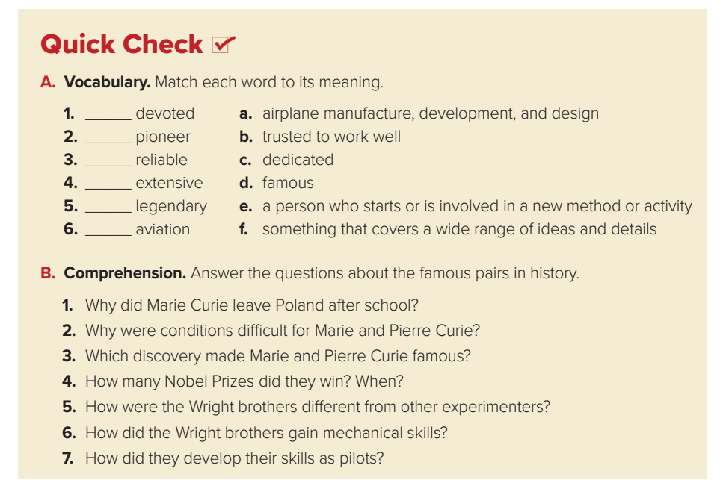
C
e
b
f
d
a

Slide 12
1-Because women were not able to attend university in Poland.
2. They had to work long hours in order to earn a living and their laboratory did not have a lot of facilities.
3. The discovery of radioactivity made them famous.
4. They received a Nobel Prize for Physics in 1903 and Marie Curie won another Nobel Prize in chemistry in 1911.
5. They focused on developing a reliable pilot control system, rather than more powerful engines.
6. They gained mechanical skills by working with bicycles, motors, and other machinery in their shop and they developed their skills as pilots by testing gliders.

Slide 13
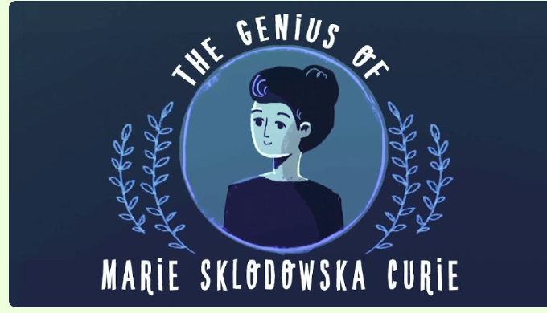



Slide 14


