Slide 1


Welcome to class
T.

Slide 2


Unit 3

Slide 3





workbook
2^{nd &} 3^{rd Grade}
Pages 61 , 62
workbook
^{4th & 5th Grade}
Pages 139 , 140

Slide 4

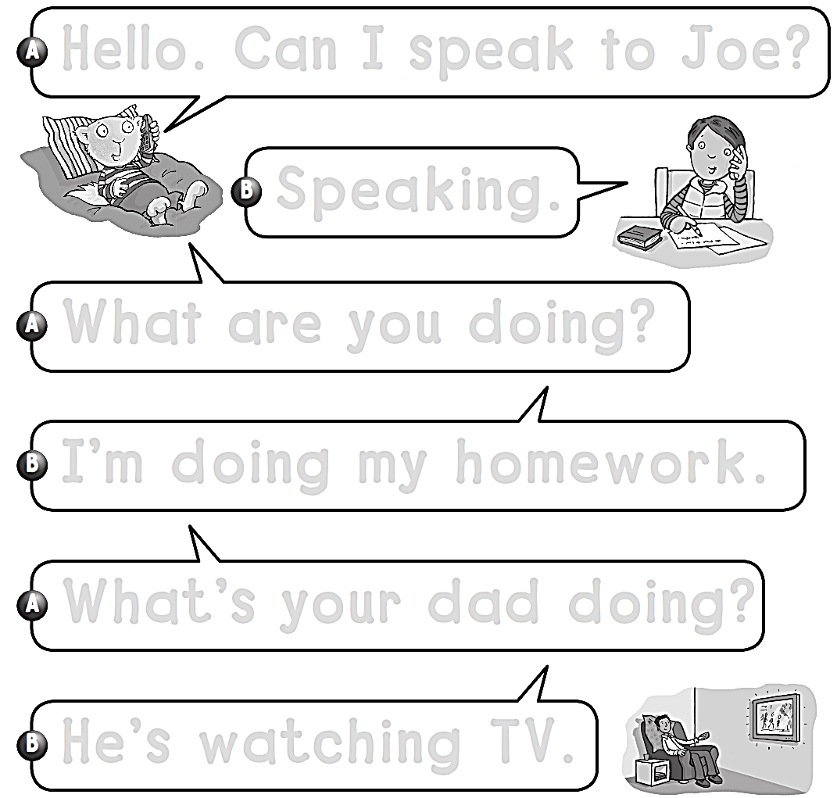
Hello . Can I speak to Joe ?
Speaking .
What are you doing ?
I’m doing my homework .
What’s your dad doing ?
He’s watching TV .

Slide 5
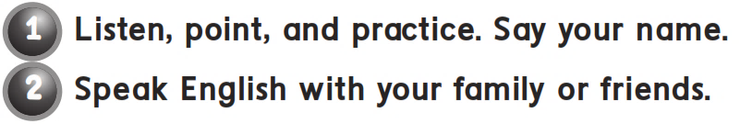
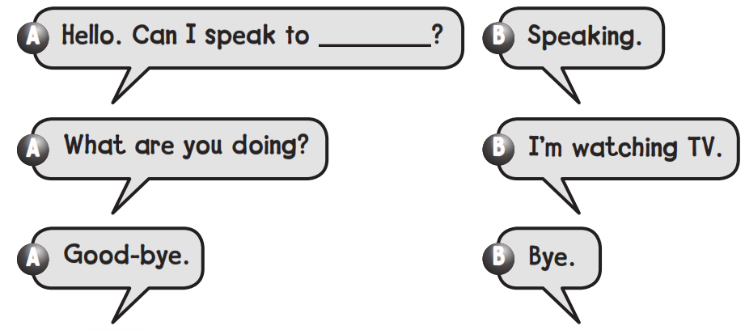
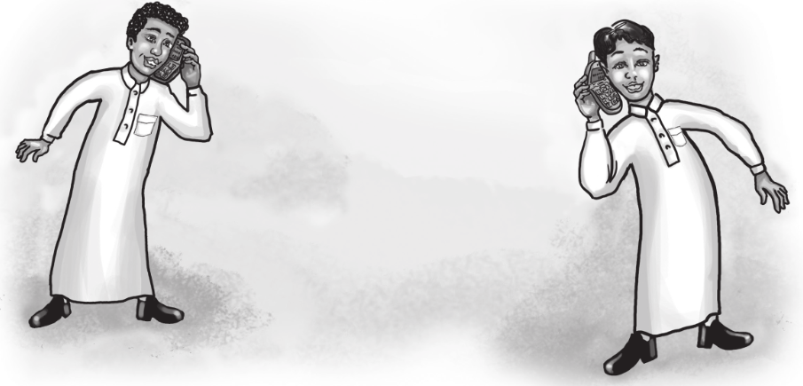
اسم الطالب

Slide 6
workbook
2^{nd &} 3^{rd Grade}
Pages 63 , 64
workbook
^{4th & 5th Grade}
Pages 141 , 142

Slide 7

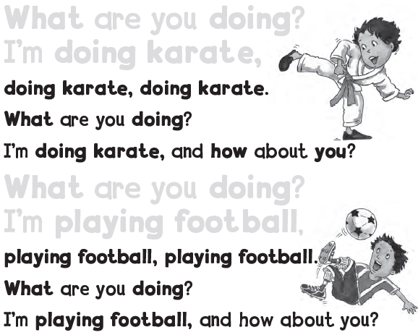
What are you doing ?
I’m doing karate,
What are you doing ?
I’m playing football,

Slide 8

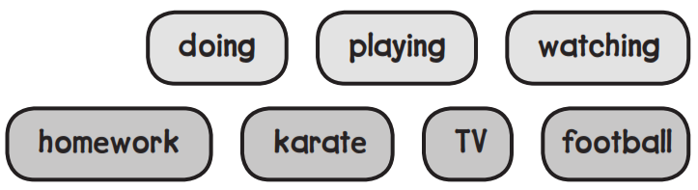

Slide 9
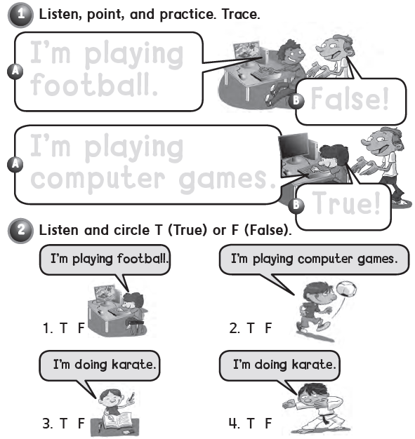
I’m playing football
False!
I’m playing computer games
True!

Slide 10
workbook
2^{nd &} 3^{rd Grade}
Pages 65 , 66
workbook
^{4th & 5th Grade}
Pages 143 , 144

Slide 11
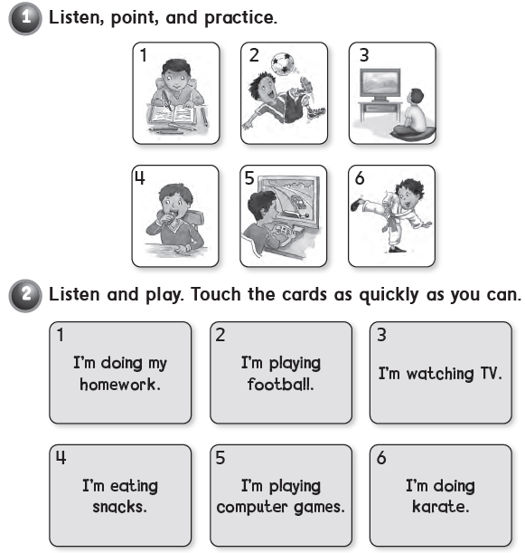

Slide 12

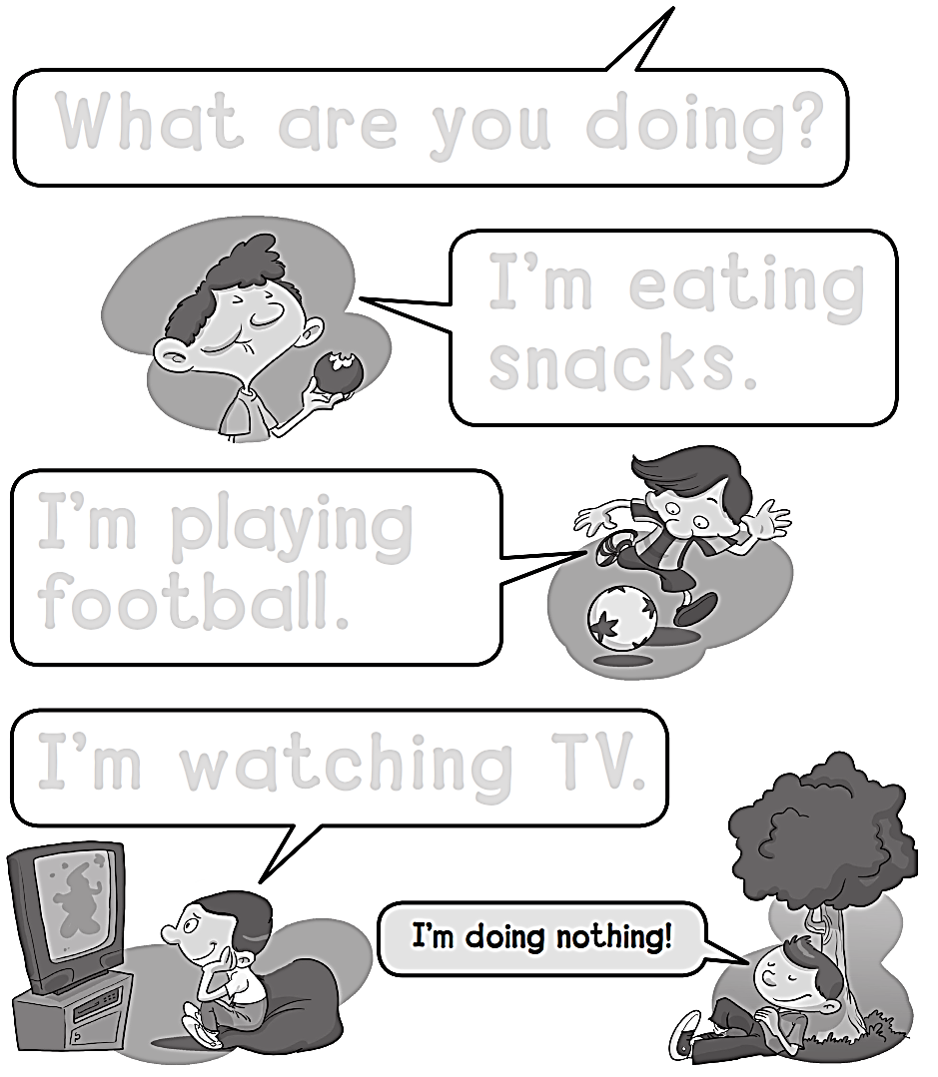
What are you doing ?
I’m eating snacks .
I’m playing football .
I’m watching TV .

Slide 13
workbook
2^{nd &} 3^{rd Grade}
Pages 67 , 68
workbook
^{4th & 5th Grade}
Pages 145 , 146

Slide 14
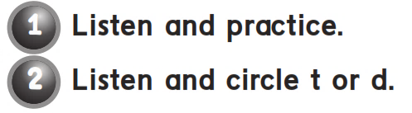
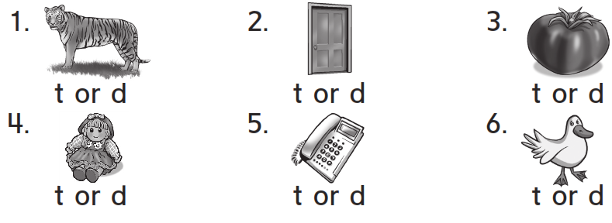

Slide 15
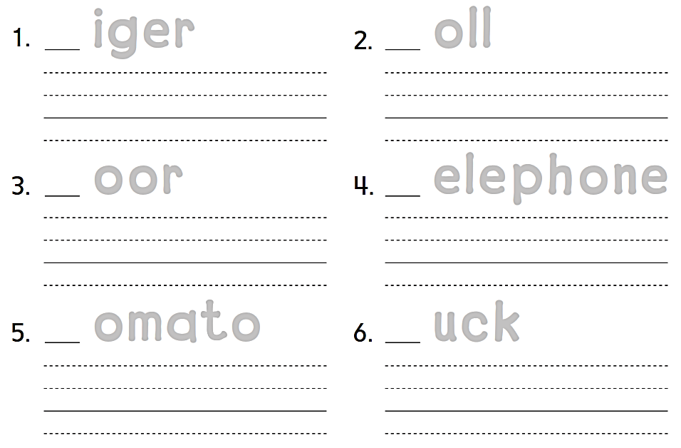
t iger
d oll
tiger
doll
d oor
t elephone
door
telephone
t omato
d uck
tomato
duck

Slide 16

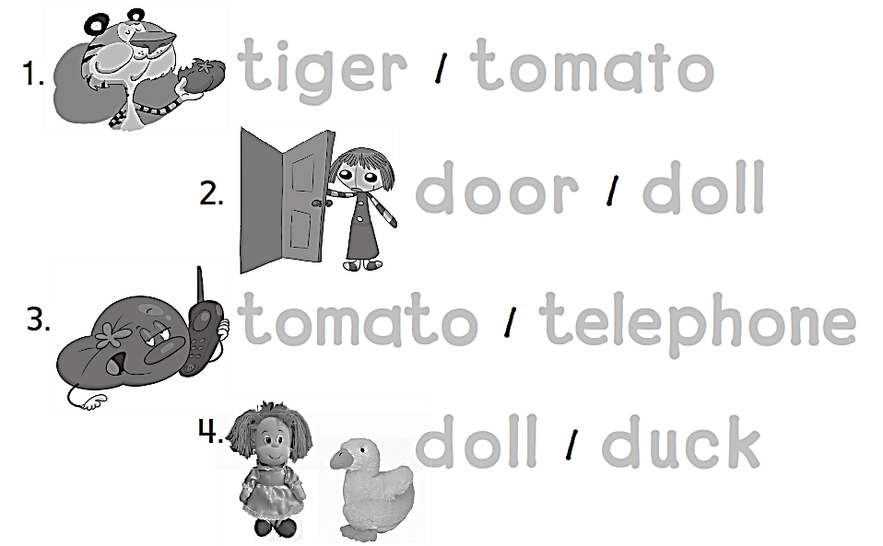
tiger tomato
door doll
tomato telephone
doll duck

Slide 17

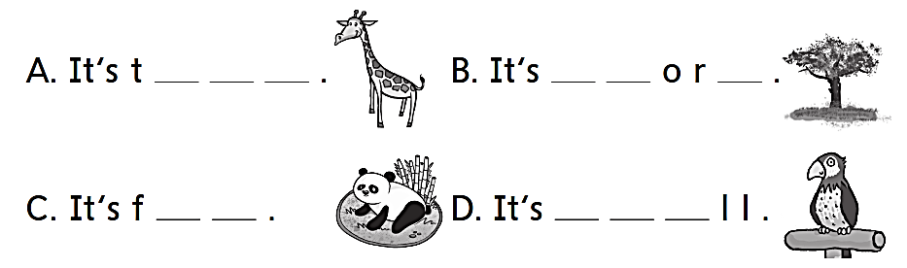
a l l
s h t
a t
s m a

Slide 18


