Slide 1


Welcome to class
T.

Slide 2


Unit 2

Slide 3




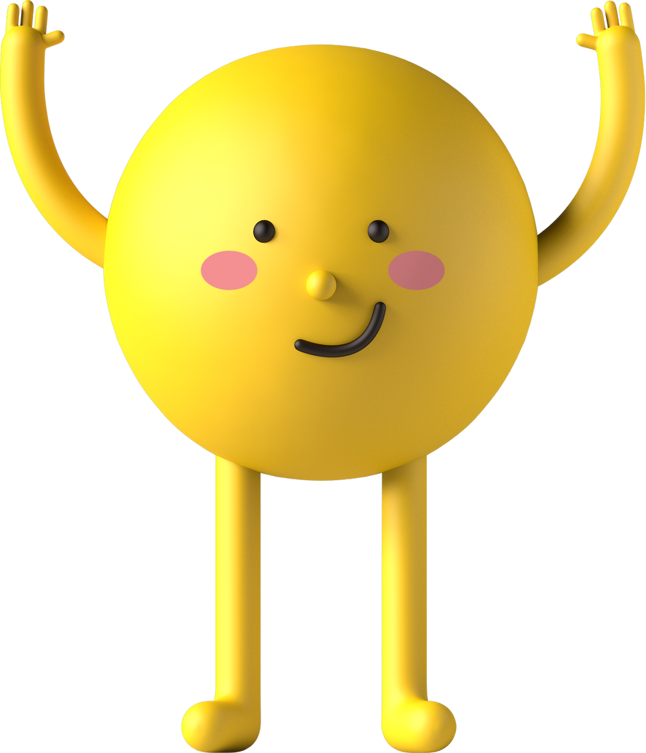
workbook
2^{nd &} 3^{rd Grade}
Pages 53 , 54
workbook
^{4th & 5th Grade}
Pages 131 , 132

Slide 4
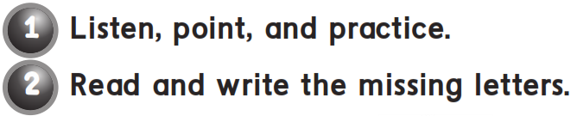
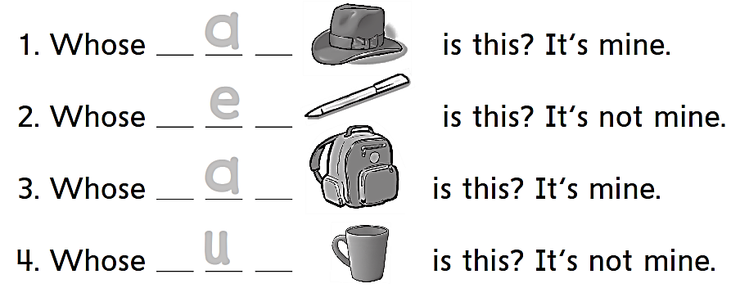
h a t
p e n
b a g
c u p

Slide 5

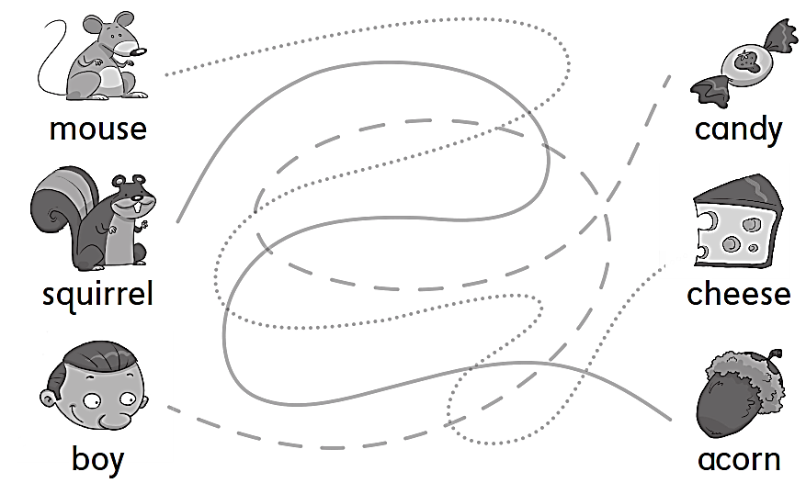

Slide 6

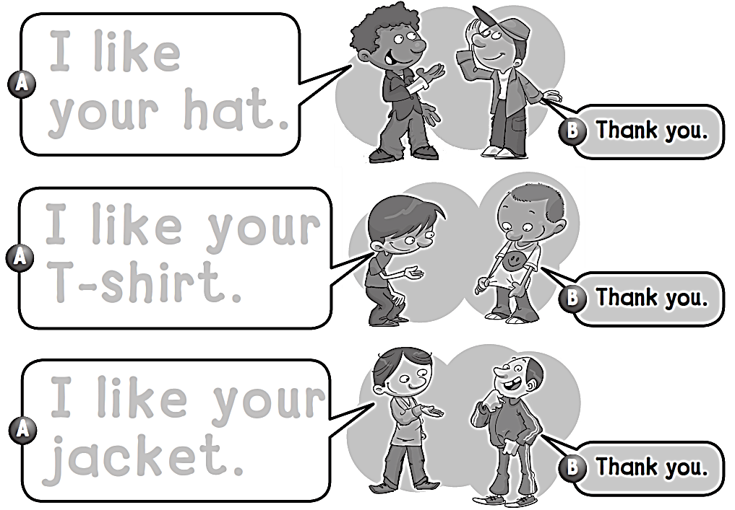
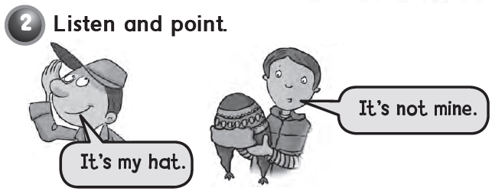
I like
your hat.
I like your T-shirt.
I like your jacket.

Slide 7
workbook
2^{nd &} 3^{rd Grade}
Pages 55 , 56
workbook
^{4th & 5th Grade}
Pages 133 , 134

Slide 8
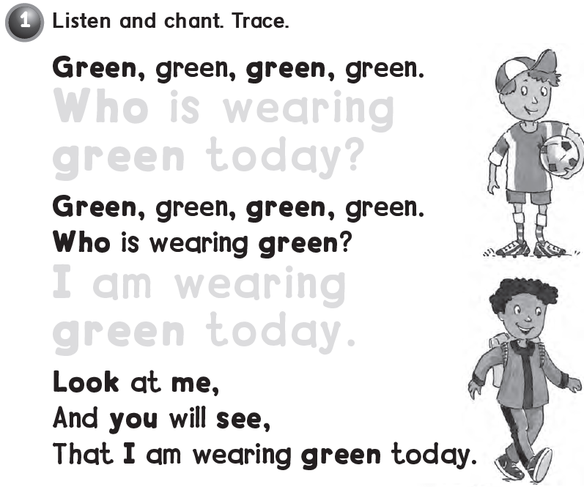
Who is wearing
green today ?
I am wearing
green today ?

Slide 9

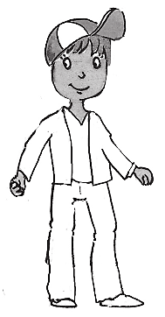
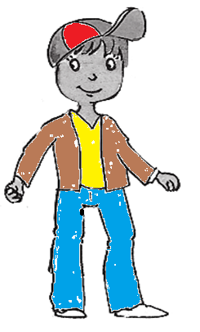
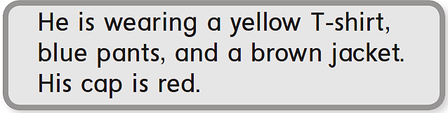

Slide 10

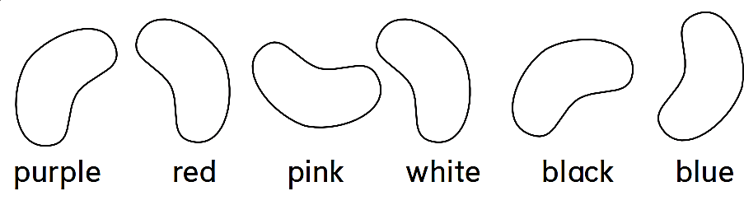
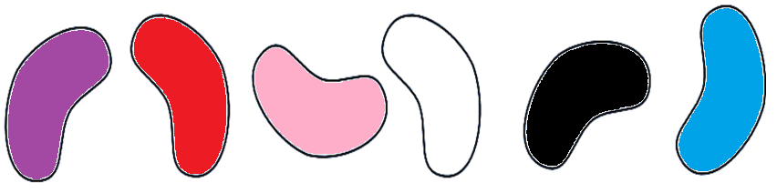

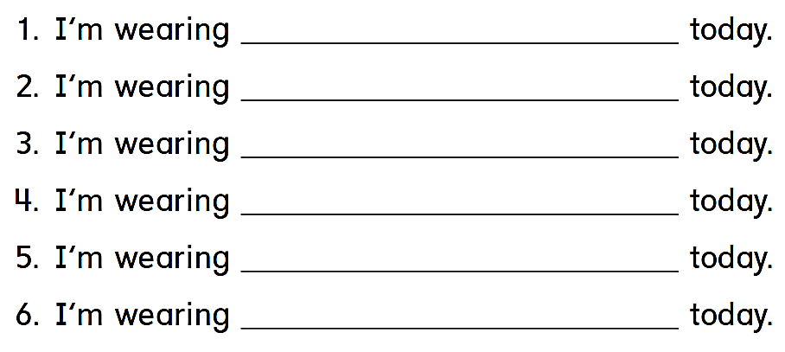
blue
red
white
pink
black
purple

Slide 11
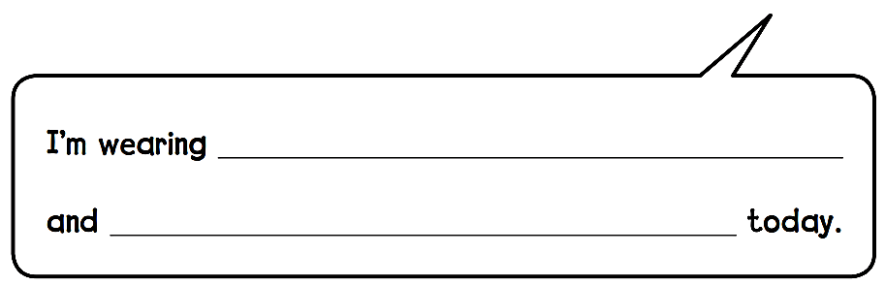
a hat
a thobe

Slide 12
workbook
2^{nd &} 3^{rd Grade}
Pages 57 , 58
workbook
^{4th & 5th Grade}
Pages 135 , 136

Slide 13
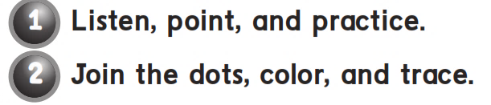
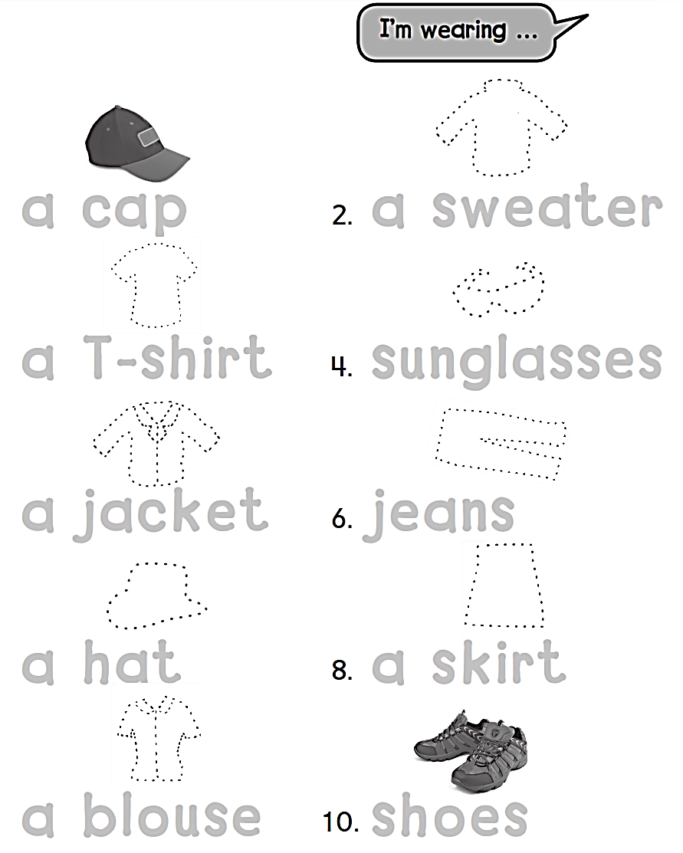

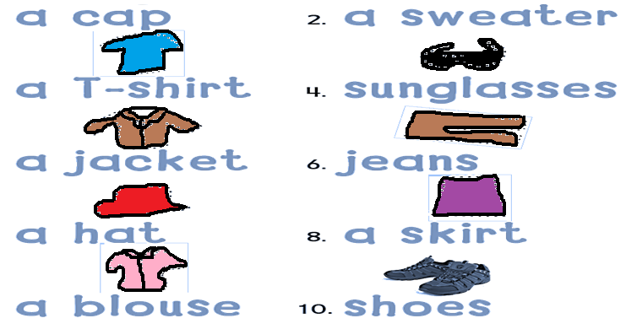

Slide 14
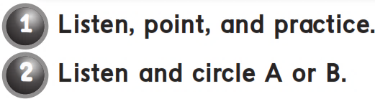
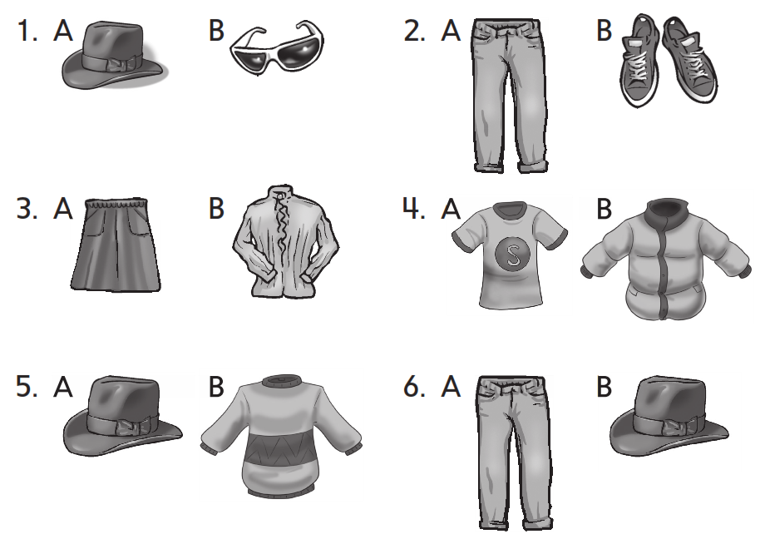

Slide 15
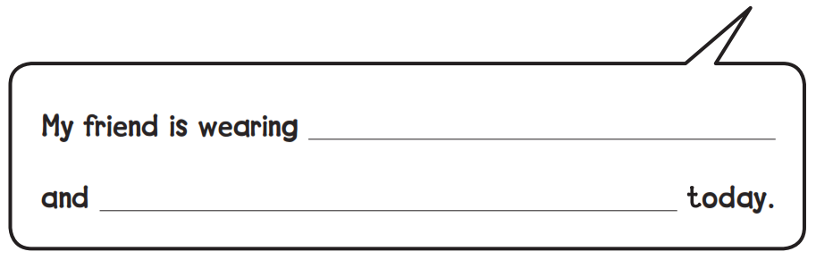
a jacket
a jeans

Slide 16
workbook
2^{nd &} 3^{rd Grade}
Pages 59 , 60
workbook
^{4th & 5th Grade}
Pages 137 , 138

Slide 17
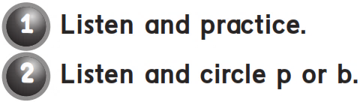
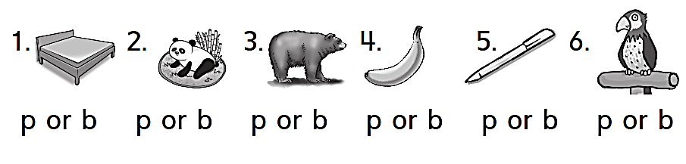

Slide 18

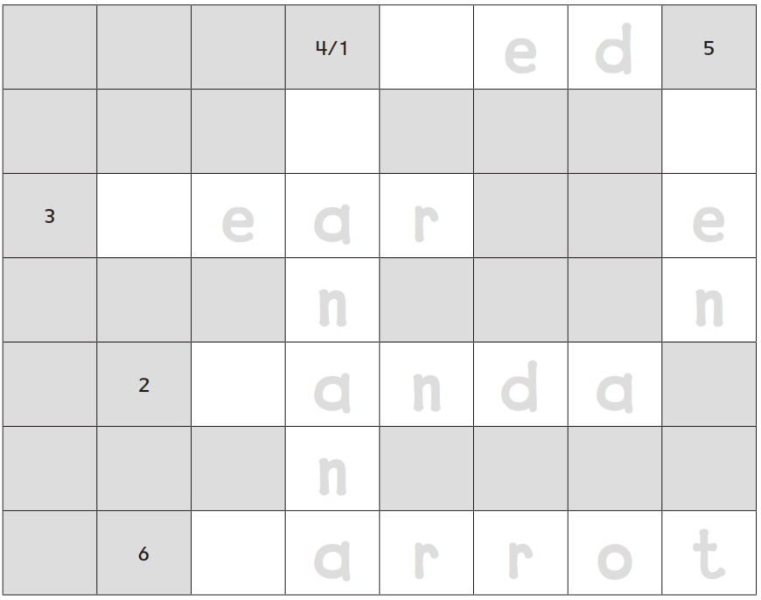
b
e d
b
p
b
e a r
e
n
n
p
a n d a
n
p
a r r o t

Slide 19

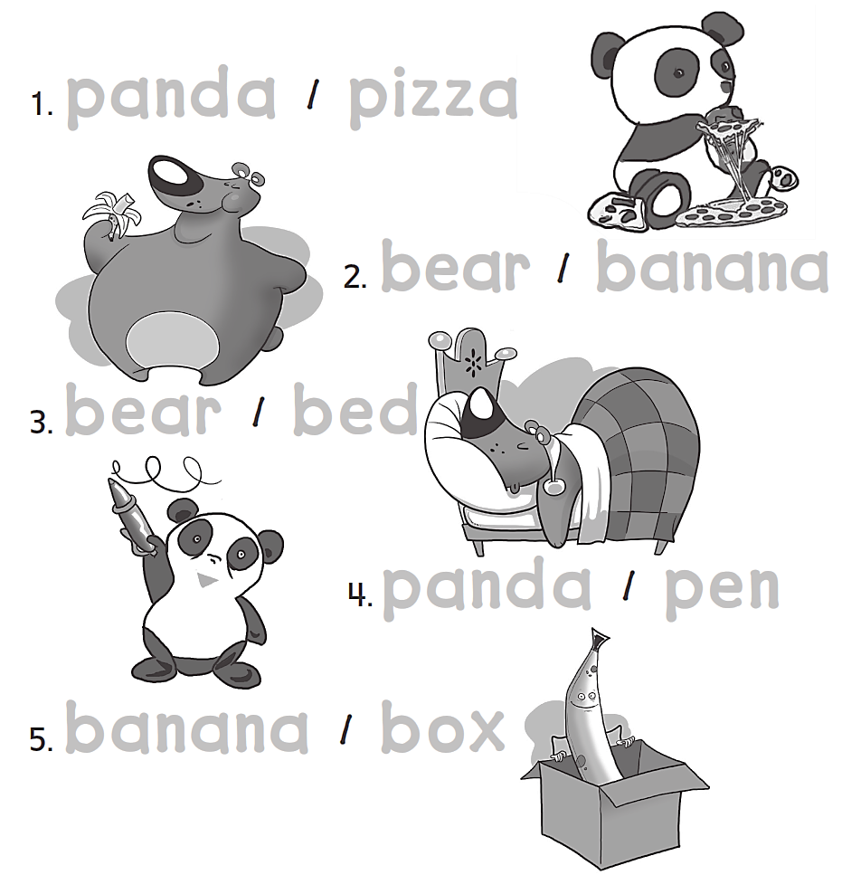
panda pizza
bear banana
bear bed
panda pen
banana box

Slide 20



Slide 21


