Slide 1


Welcome to class
T.

Slide 2


Unit 1

Slide 3





workbook
2^{nd &} 3^{rd Grade}
Pages 45 , 46
workbook
^{4th & 5th Grade}
Pages 123 , 124

Slide 4

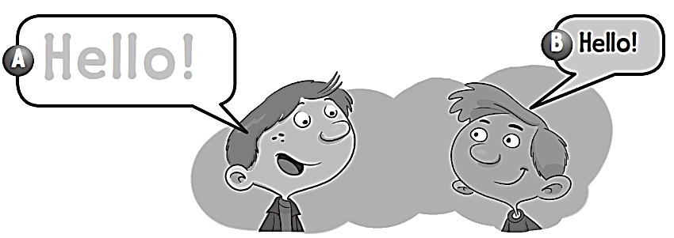
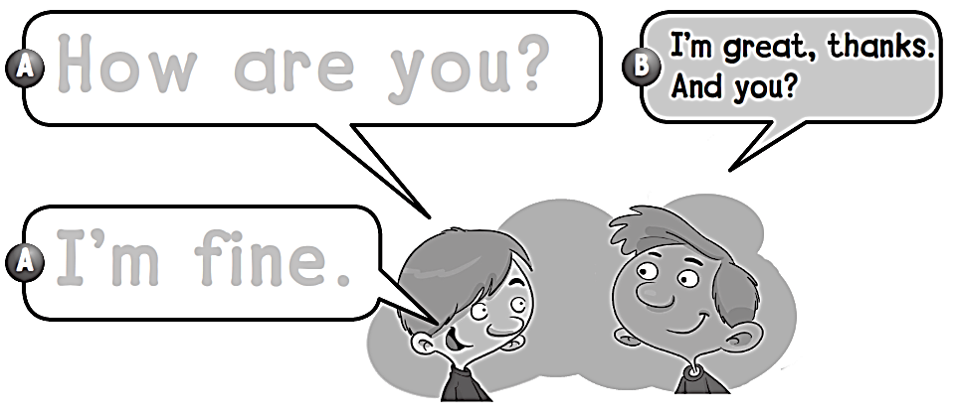
Hello!
How are you?
I΄m fine.

Slide 5

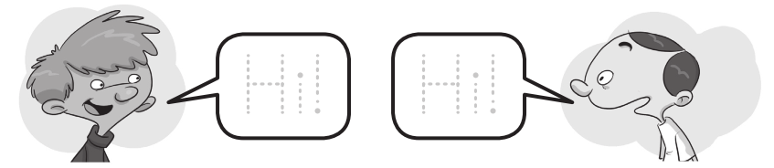

Slide 6
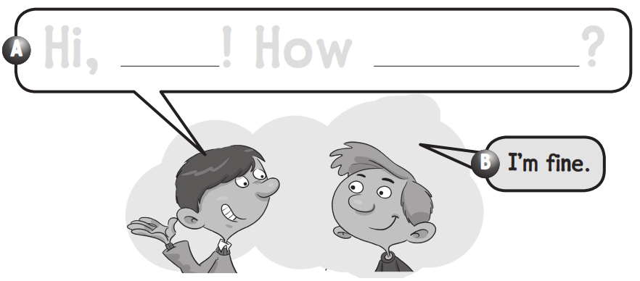
Hi ,Samir ! How are you ?

Slide 7

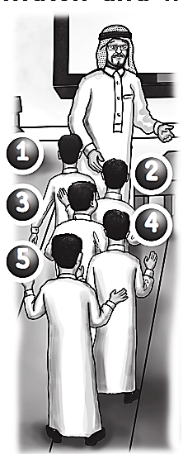
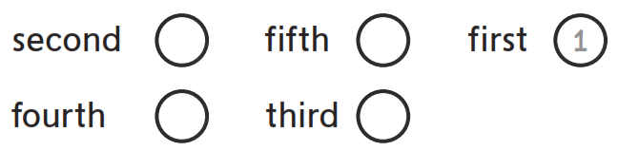
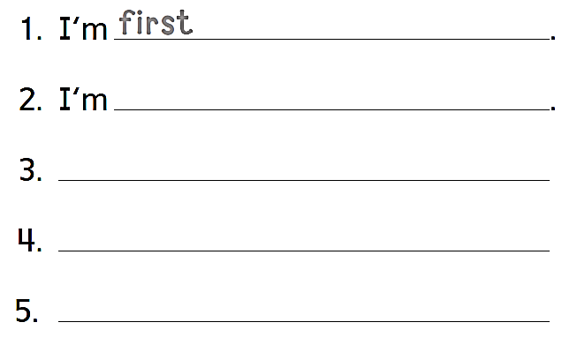
2
5
4
3
second
I’m third
I’m fourth
I’m fifth

Slide 8
workbook
2^{nd &} 3^{rd Grade}
Pages 47 , 48
workbook
^{4th & 5th Grade}
Pages 125 , 126

Slide 9

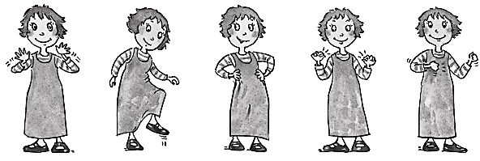

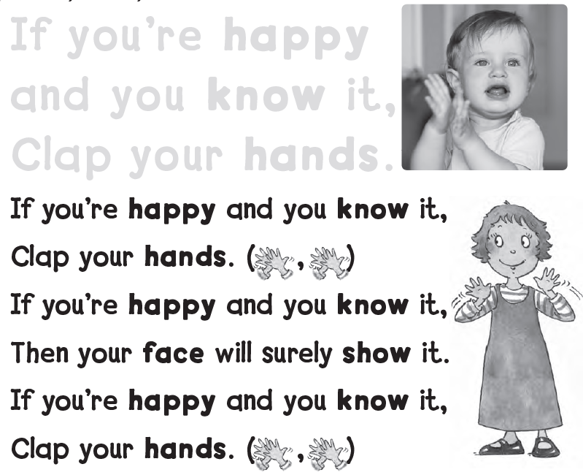
If you’re happy
and you know it,
Clap your hands.

Slide 10




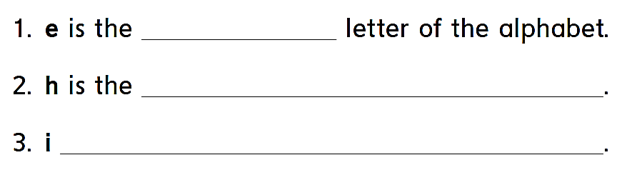
fifth
eighth letter of the alphabet
is the ninth letter of the alphabet

Slide 11


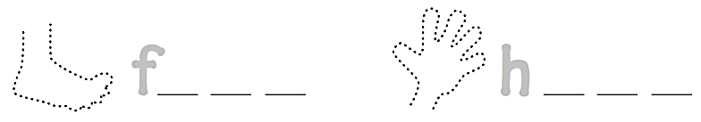
1
6
2
7
3
8
4
9
5
10
o o t
a n d

Slide 12
workbook
2^{nd &} 3^{rd Grade}
Pages 49 , 50
workbook
^{4th & 5th Grade}
Pages 127 , 128

Slide 13

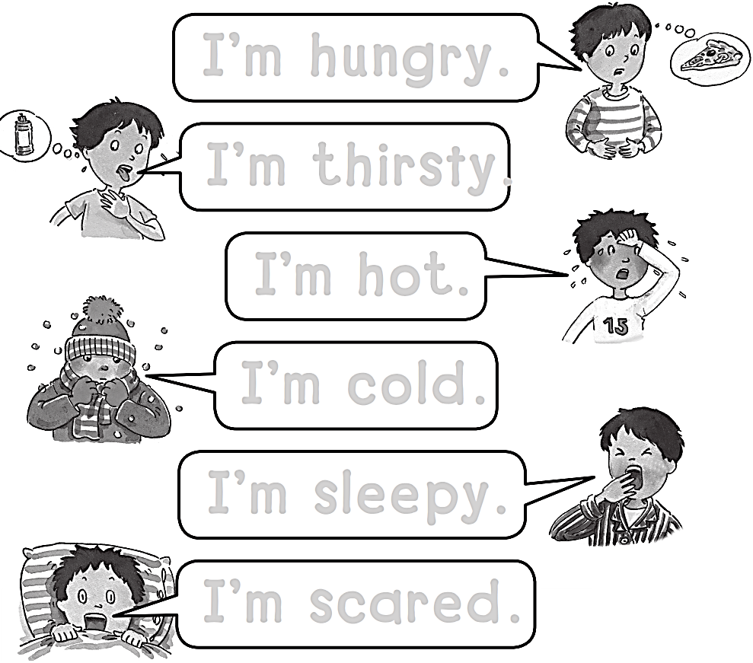
I’m hungry.
I’m thirsty.
I’m hot.
I’m cold.
I’m sleepy.
I’m scared.

Slide 14

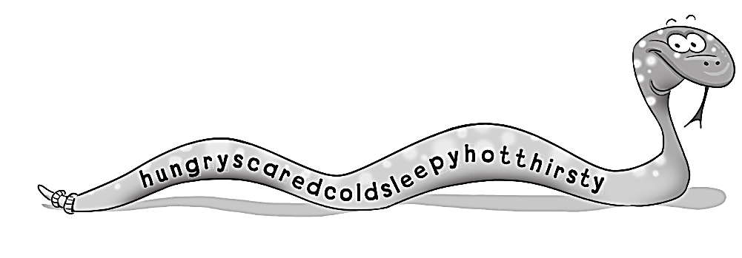
1- hungry
2- scared
3- cold
4- sleepy
5- hot
6- thirsty

Slide 15

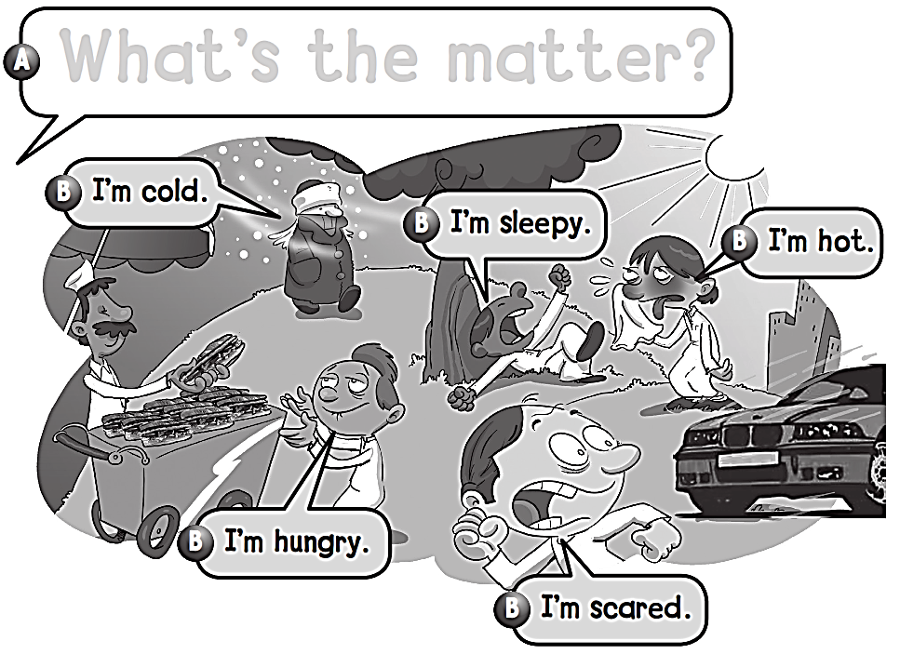
What’s the matter ?

Slide 16

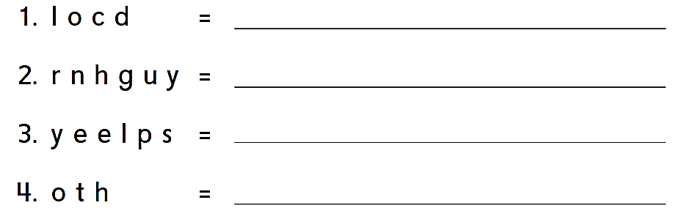
cold
hungry
sleepy
hot

Slide 17
workbook
2^{nd &} 3^{rd Grade}
Pages 51 , 52
workbook
^{4th & 5th Grade}
Pages 129 , 130

Slide 18
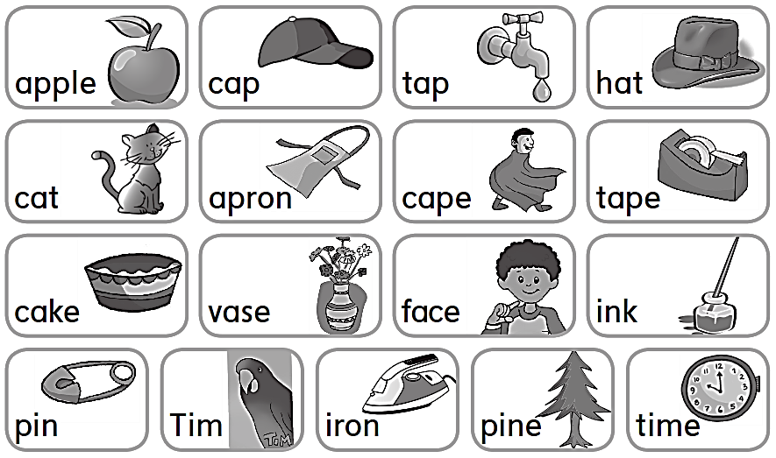

Slide 19

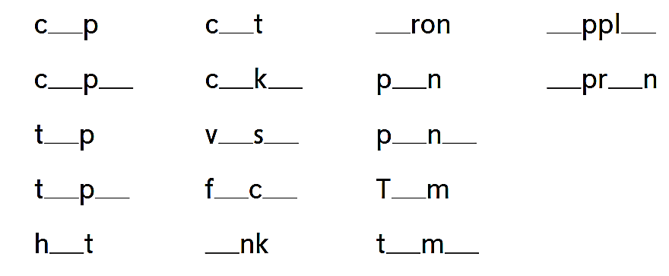
a
a
i
a
e
a
e
a
e
i
a
o
a
a
e
i
e
a
e
a
e
i
o
i
i
e

Slide 20
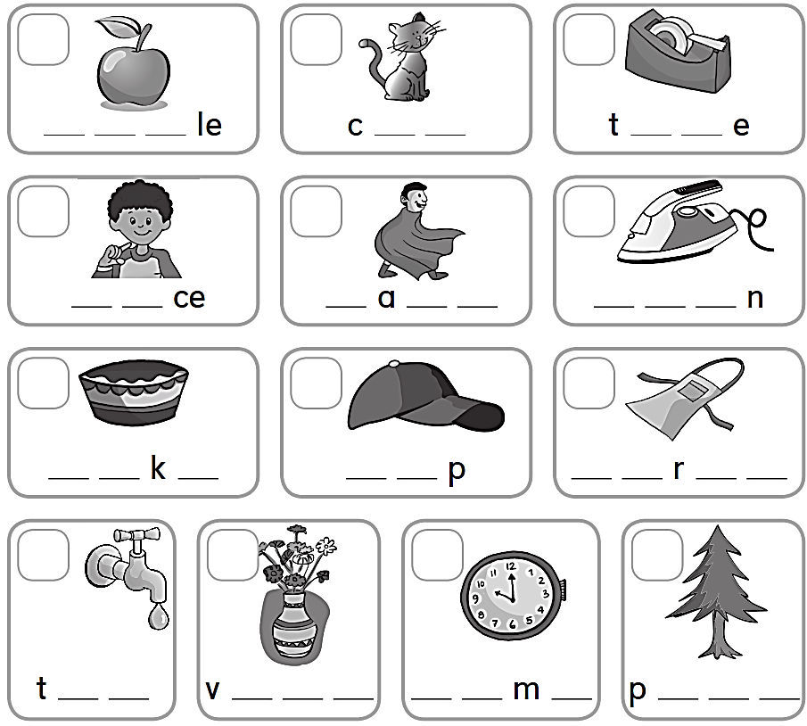
1
3
7
A p p
a t
a p
9
6
11
F a
C p e
I r o
8
4
2
C a e
C a
A p o n
5
10
13
12
a p
a s e
T i e
i n e

Slide 21


