Slide 1


Welcome to class
T.

Slide 2

3
Unit 4

Slide 3





workbook
Pages 163 , 164

Slide 4
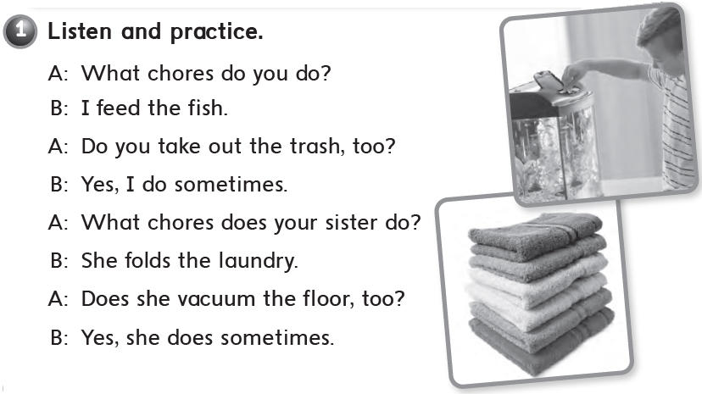

Slide 5
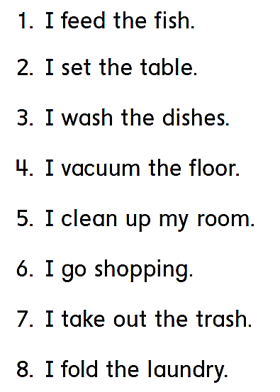
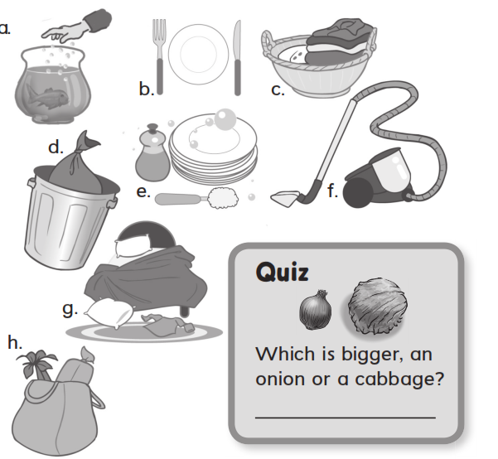
a
b
e
f
g
h
d
A cabbage
c

Slide 6

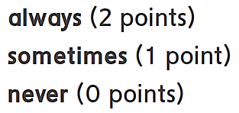
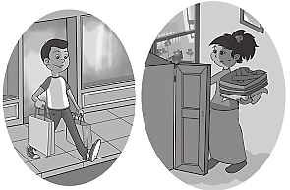
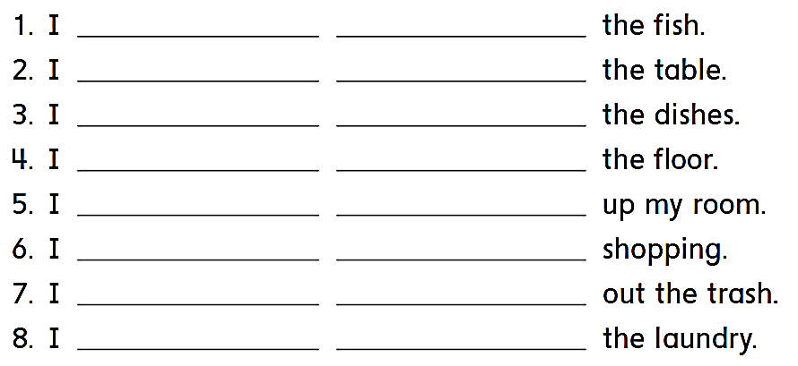
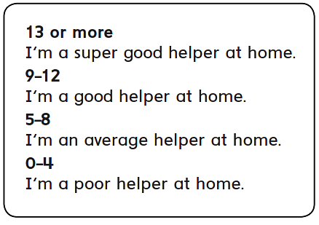
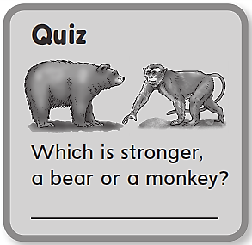

always feed
sometimes set
always wash
sometimes vacuum
always clean
sometimes go
always take
never fold
11
A bear

Slide 7
workbook
Pages 165 , 166

Slide 8

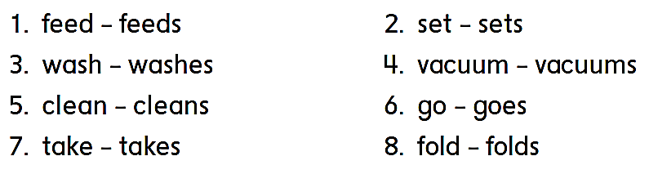

Slide 9

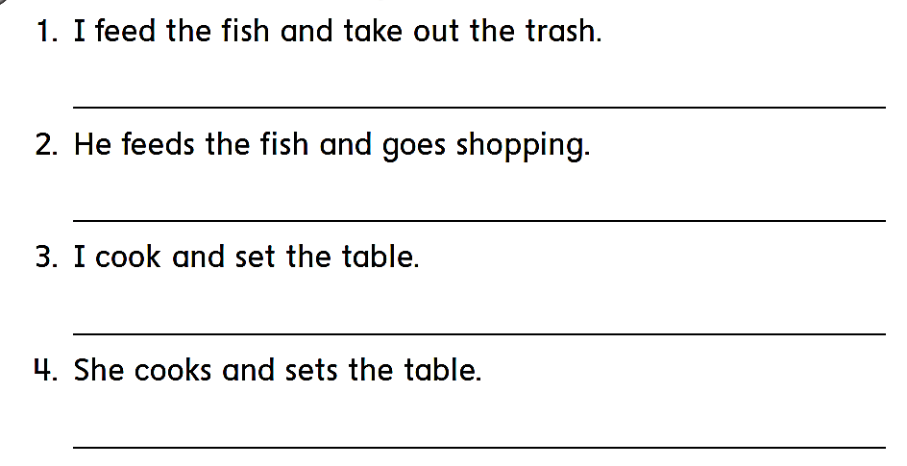
I feed the fish and take out the trash .
He feeds the fish and goes shopping .
I cook and set the table .
She cooks and sets the table .

Slide 10
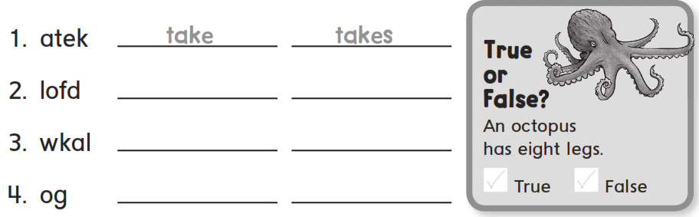

fold
folds
walk
walks
go
goes

Slide 11
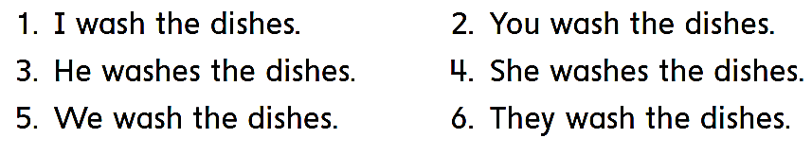

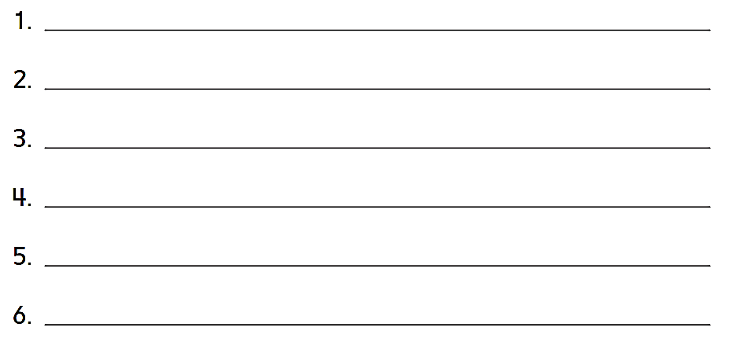
I wash the dishes .
You wash the dishes .
He washes the dishes .
She washes the dishes
We wash the dishes .
They wash the dishes .

Slide 12
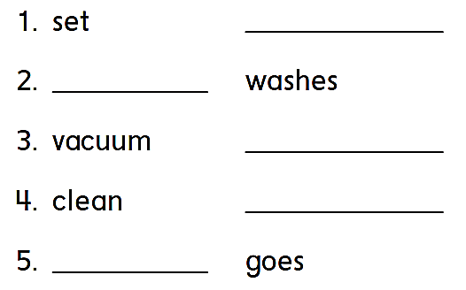
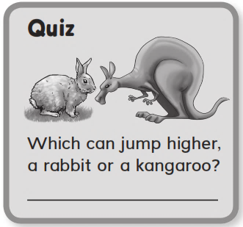
sets
wash
vacuums
cleans
go
A kangaroo

Slide 13
workbook
Pages 167 , 168

Slide 14

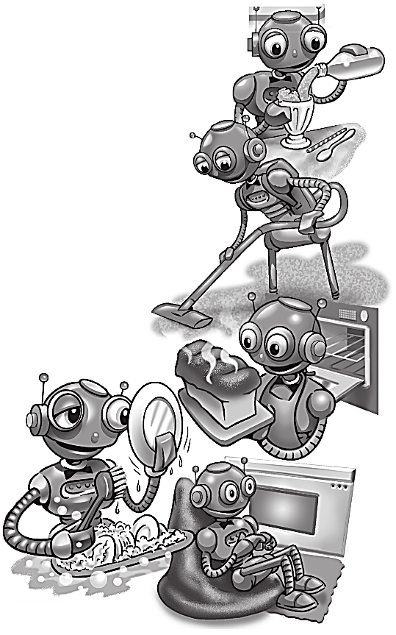
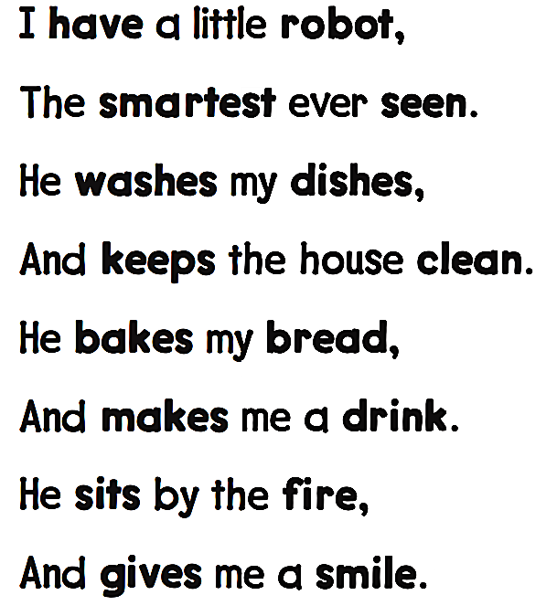

Slide 15
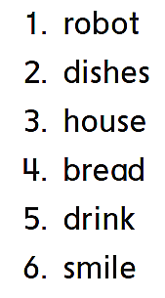
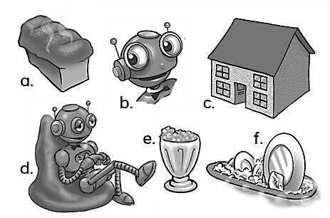
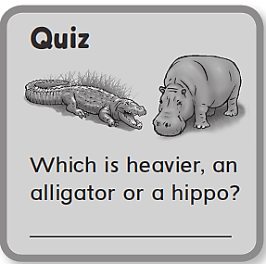
d
f
c
a
e
b
A hippo

Slide 16
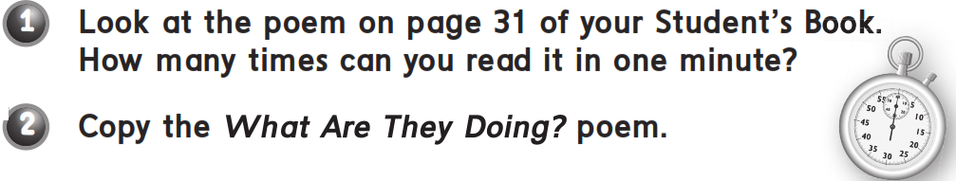
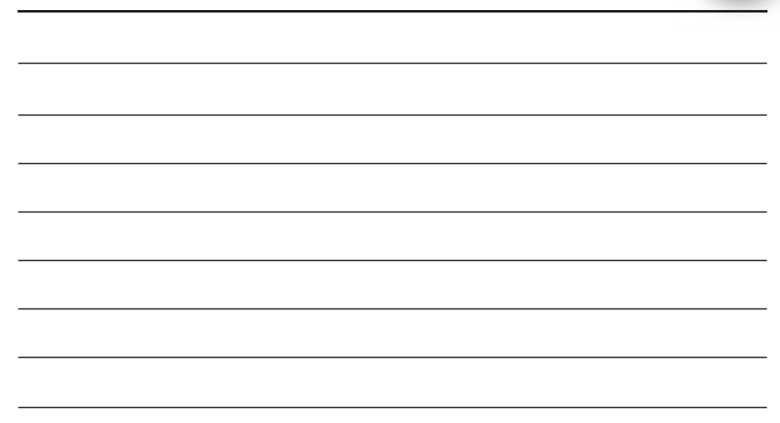
انظر للقصيدة ص 31 كتاب الطالب ثم انسخ .... ماذا يفعلون ؟
She usually vacuums and cleans up her room
She is watching TV and eating
She usually feeds the fish
She is playing games and sitting

Slide 17
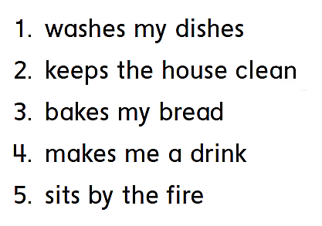
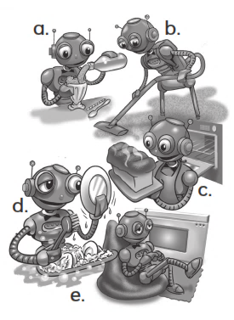
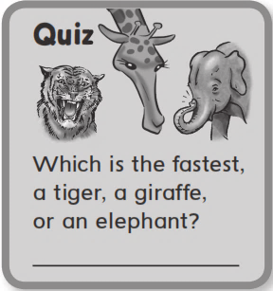
d
b
C
a
e
A tiger

Slide 18
workbook
Pages 169 , 170

Slide 19
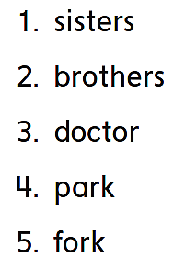
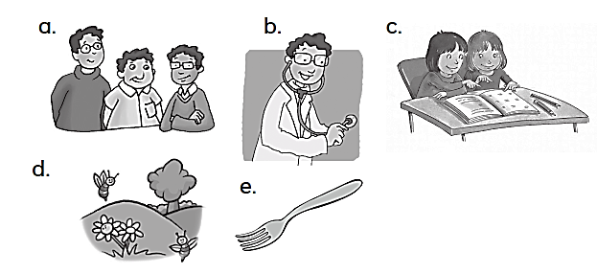
c
a
b
d
e

Slide 20
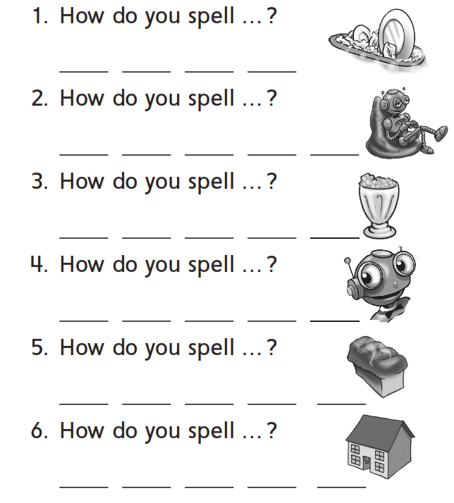
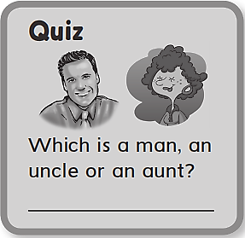
W a s h
R o b o t
d r i n k
S m i l e
b r e a d
h o u s e
An uncle

Slide 21
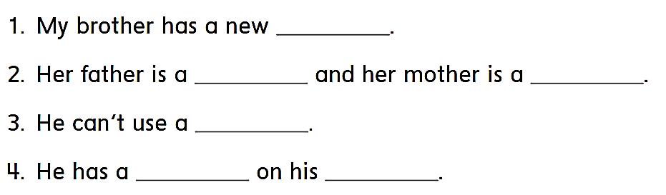
car
doctor
teacher
computer
horse
farm

Slide 22

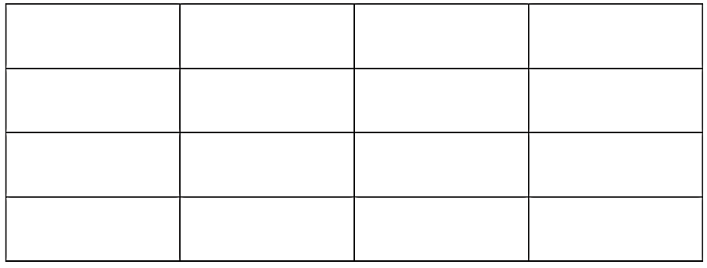
Car
Jar
Star
Scar
Door
Floor
Actor
Color
Over
Ever
Under
Power
Danger
Teacher
Doctor
Calendar

Slide 23
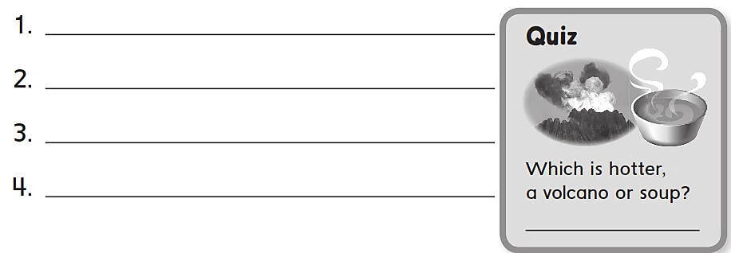
car
fork
farm
Teacher
A volcano

Slide 24
workbook
Pages 161 , 162

