Slide 1


Welcome to class
T.

Slide 2

3
Unit 3

Slide 3




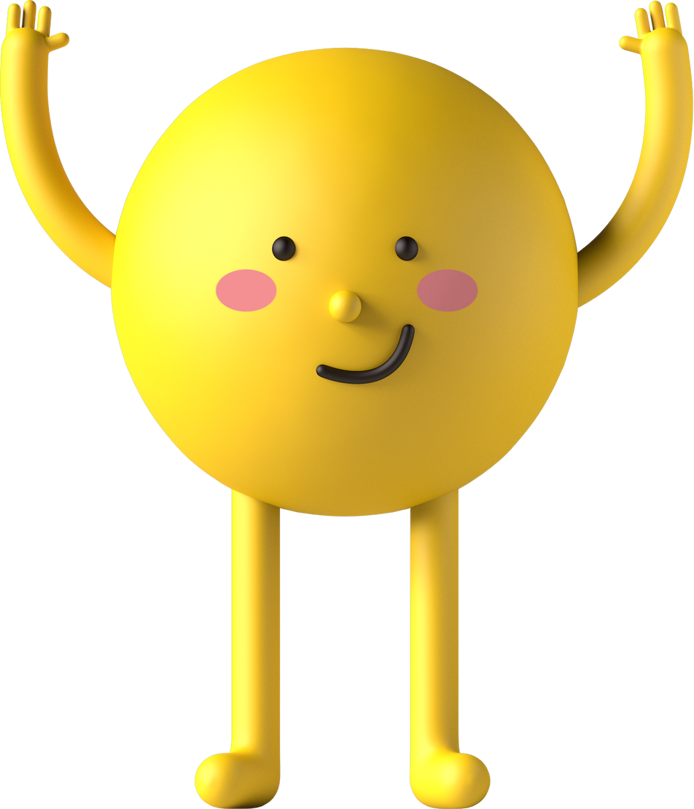
workbook
Pages 155 , 156

Slide 4
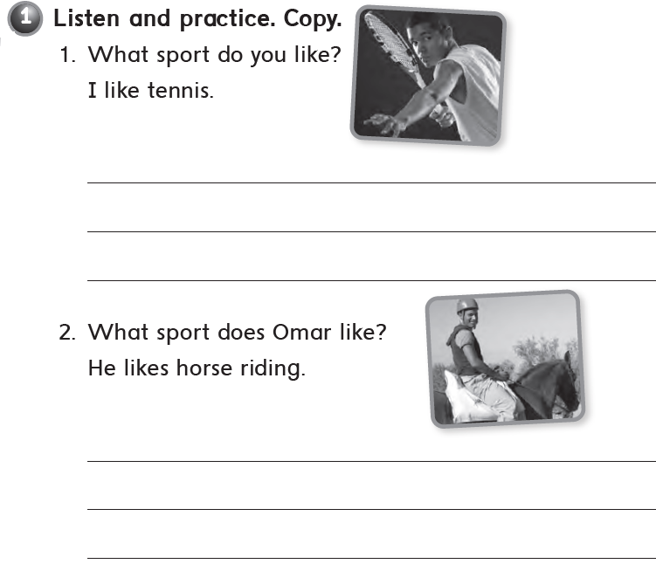
I like tennis.
I like tennis.
I like tennis.
He likes horse riding
He likes horse riding
He likes horse riding

Slide 5

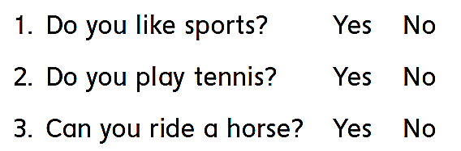
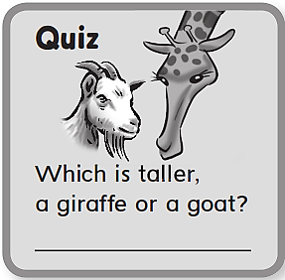
A giraffe

Slide 6
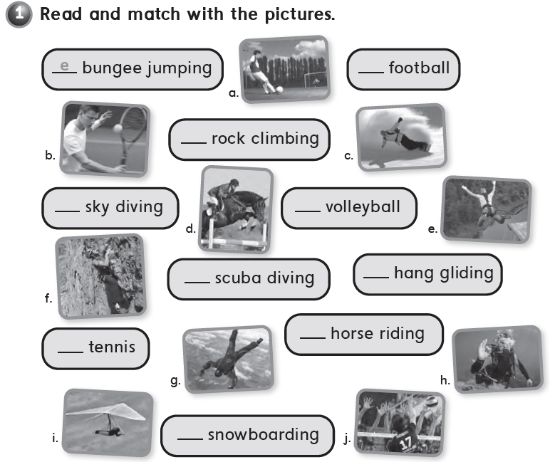
a
f
g
i
h
j
b
d
c

Slide 7

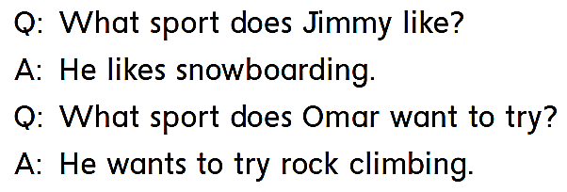
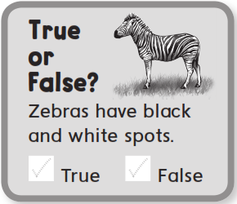


Slide 8
workbook
Pages 157 , 158

Slide 9

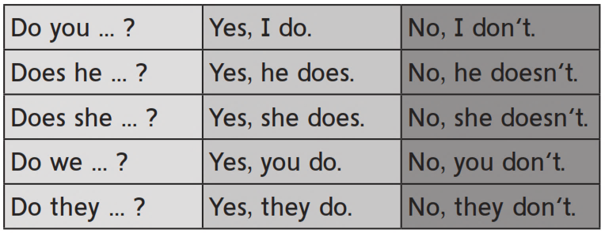

Slide 10
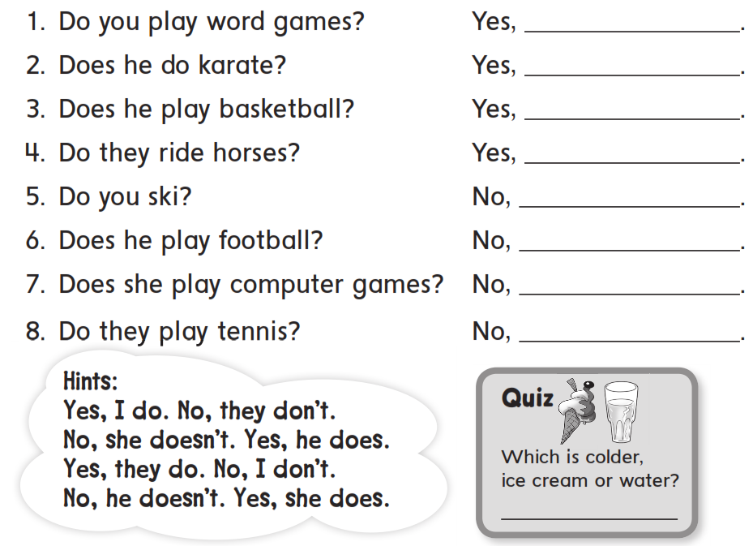
I do
he does
he does
they do
I don’t
he doesn’t
she doesn’t
they don’t
Ice cream

Slide 11

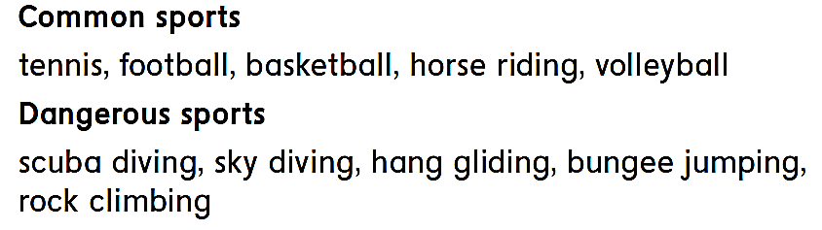

Slide 12
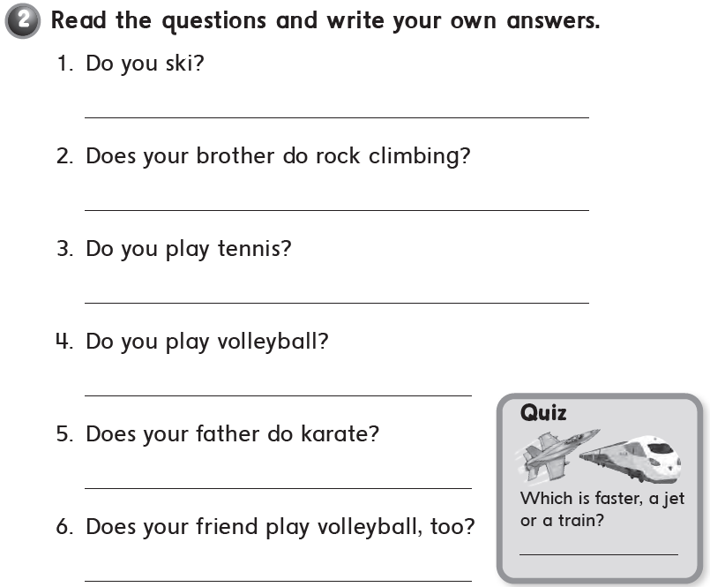
a jet

Slide 13
workbook
Pages 159 , 160

Slide 14
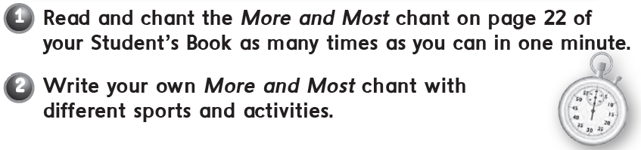
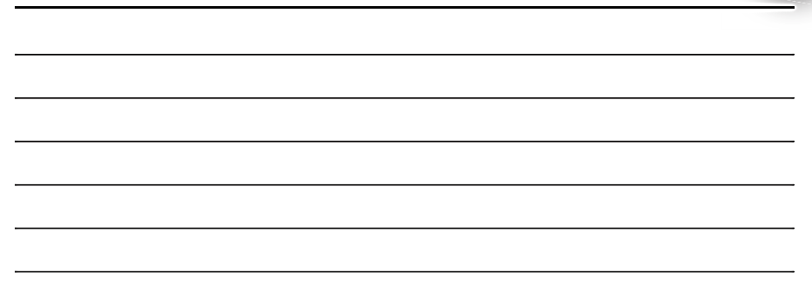

Slide 15
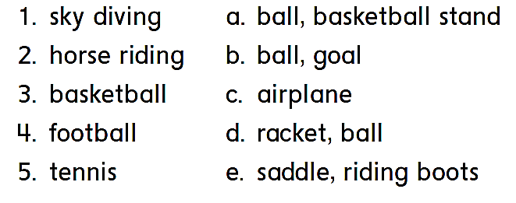
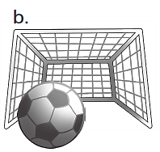
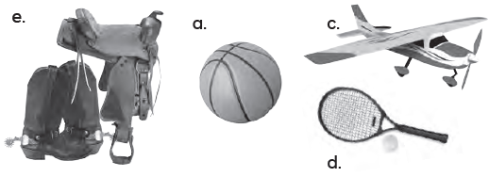
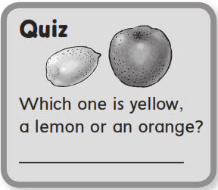
c
e
a
b
d
A lemon

Slide 16
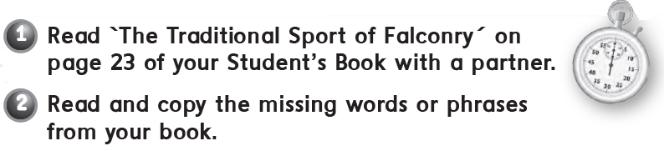
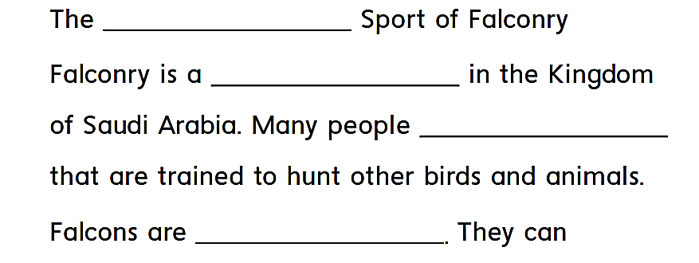
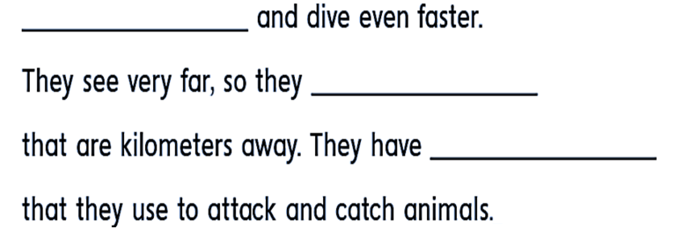
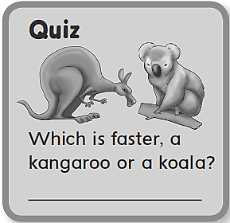

traditional
popular sport
have falcons
very strong birds
fly fast
can spot animals
very sharp talons
A kangaroo

Slide 17
workbook
Pages 161 , 162

Slide 18

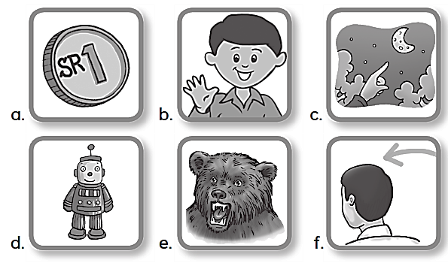
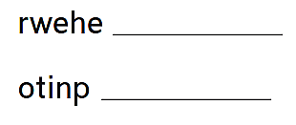
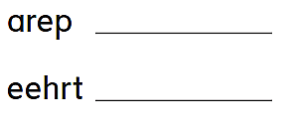
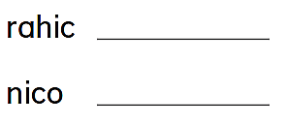
Where
Pear
Chair
Point
There
Coin

Slide 19

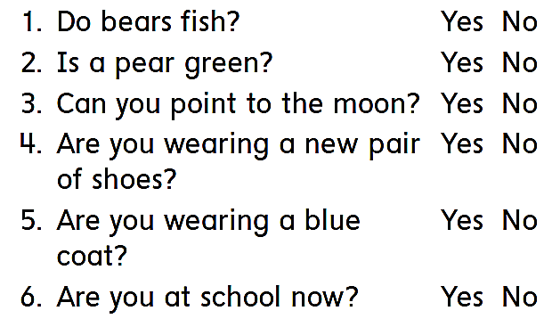
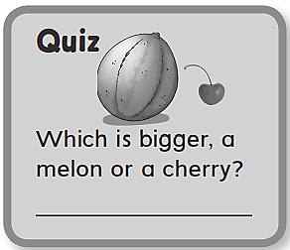
A melon

Slide 20
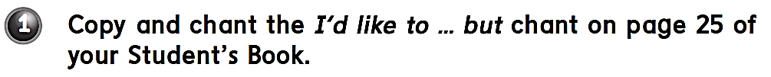
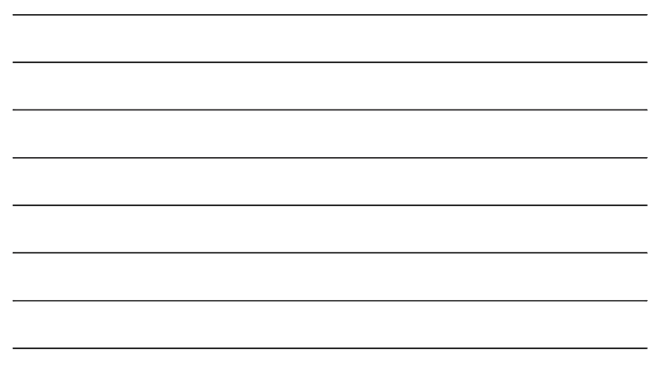
I’d like to play tennis but I have no racket
I’d like to try falconing but I have np falcon
I’d like to try riding but I have no horse
I’d like to try scuba diving but there is no sea
I’d like to try rock climbing but there is no rock
I’d like to try sky diving but there is no plane
I’d like to try cooking but I don’t know how
I’d like to try painting but I don’t know how

Slide 21
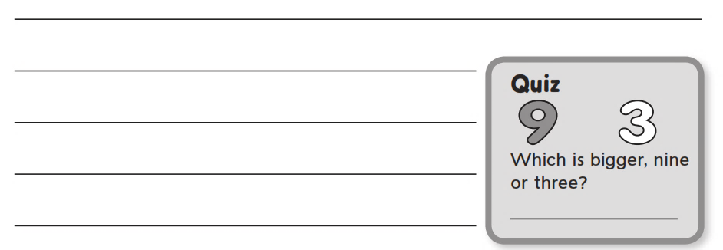
اختر رياضات او أنشطة مختلفة واكتب عنها في 3 اسطر
Nine

Slide 22


Slide 23
workbook
Pages 161 , 162

