Slide 1


Welcome to class
T.

Slide 2

3
Unit 2

Slide 3





workbook
Pages 147 , 148

Slide 4
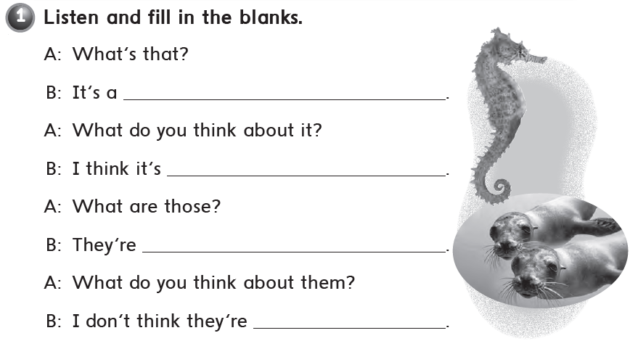
sea horse .
cute
seals .
cute

Slide 5
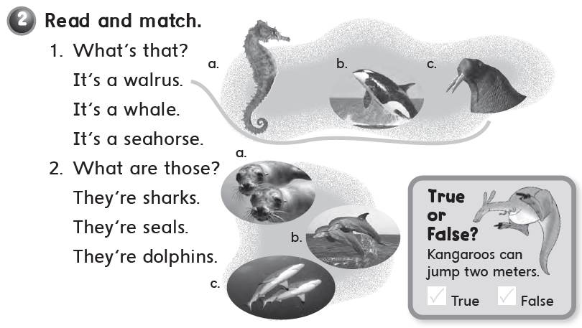


Slide 6
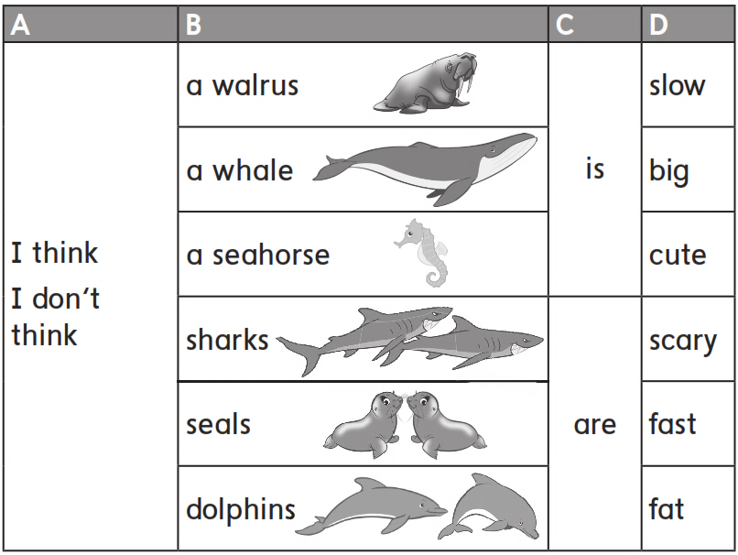

Slide 7
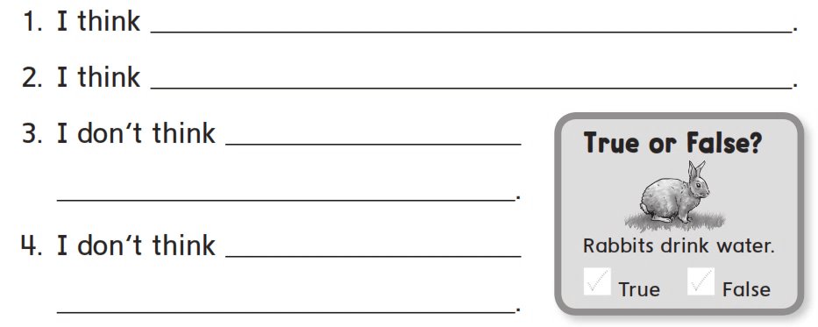
a sea horse is slow .
a whale is big .
a walrus is cute .
dolphins are scary .

Slide 8
workbook
Pages 149 , 150

Slide 9
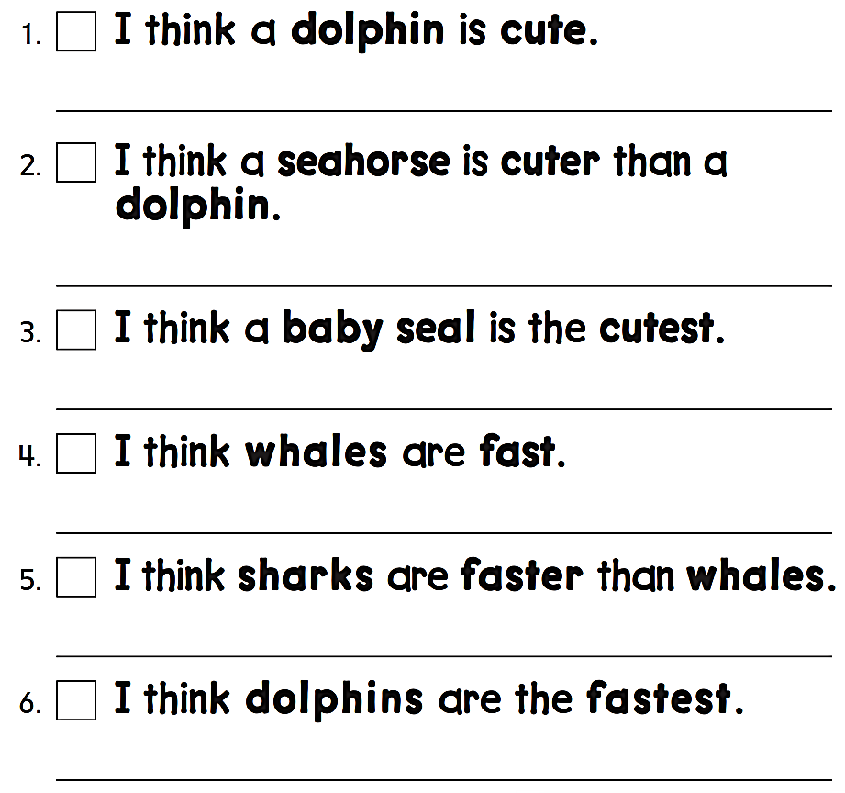
I think a dolphin is cute .
I think a seahorse is cuter than a dolphin .
I think a baby seal is the cutest .
I think whales are fast .
I think sharks are faster than whales .
I think dolphins are the fastest .

Slide 10
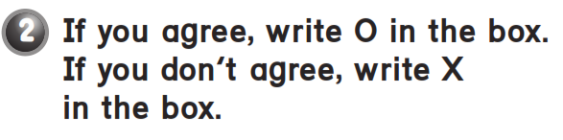

Slide 11
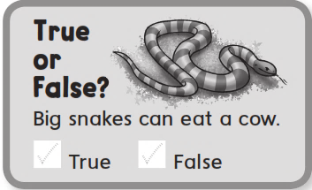

Slide 12
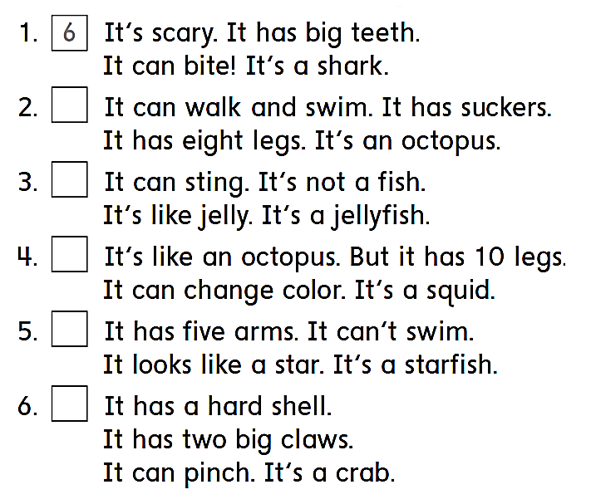
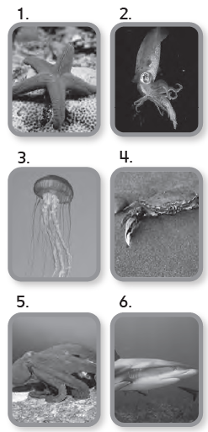
5
3
2
1
4

Slide 13

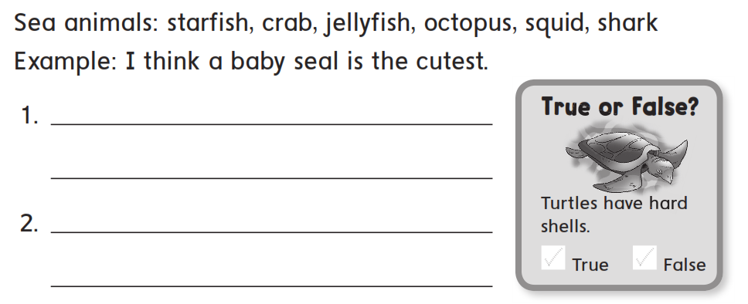
I think a seahorse is cute .
I think sharks are scary .

Slide 14
workbook
Pages 151 , 152

Slide 15
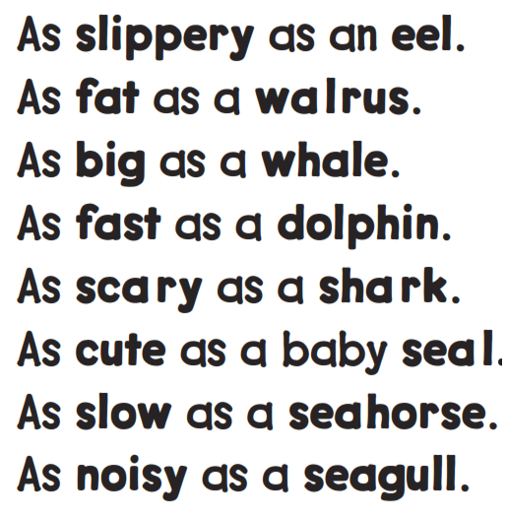
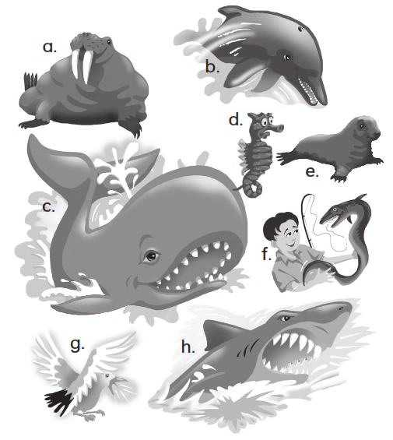

Slide 16
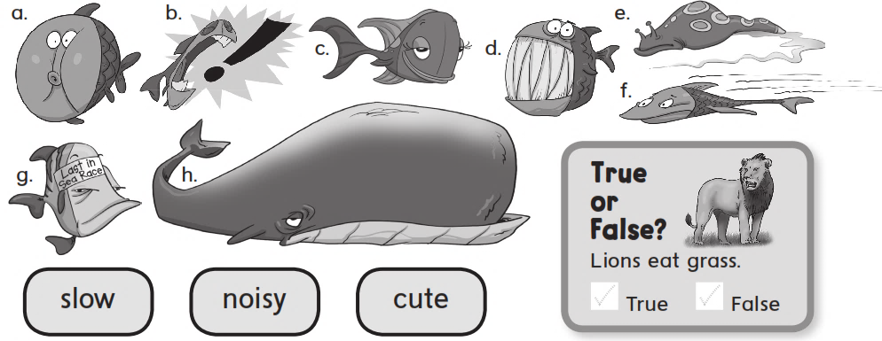

Slide 17


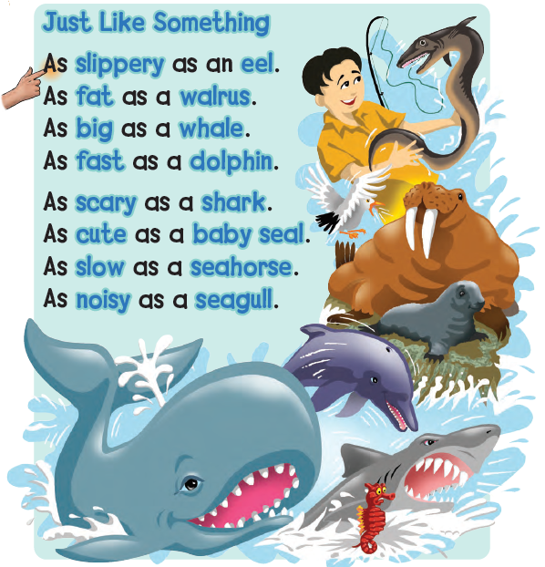

Slide 18
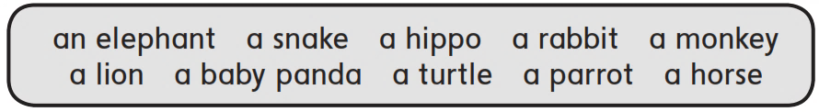
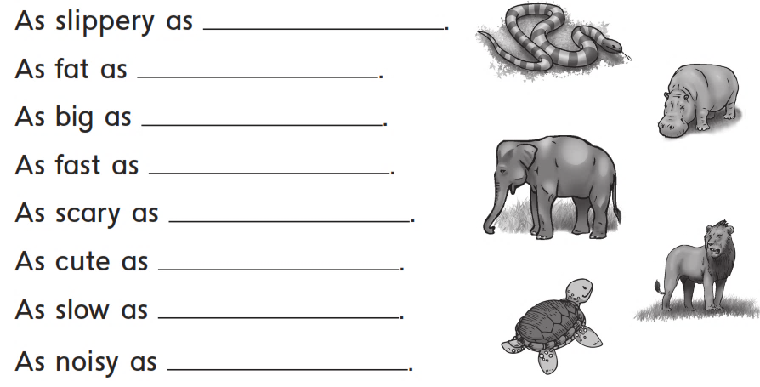
a snake
a hippo
an elephant
a horse
a lion
a rabbit
a turtle
a parrot

Slide 19
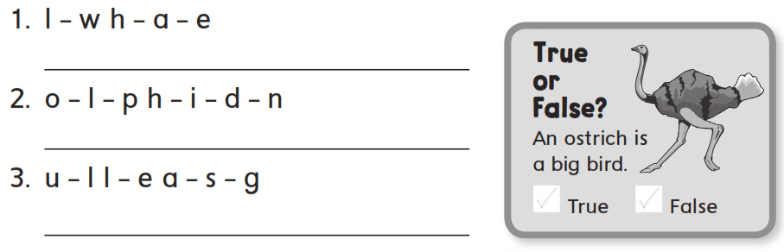
Whale
Dolphin
Seagull

Slide 20
workbook
Pages 153 , 154

Slide 21
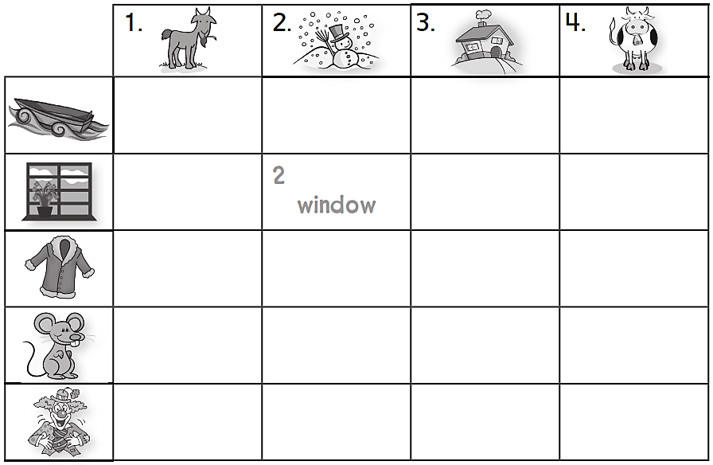
Goat
Snow
House
Cow
1. Boat
1. coat
3. Mouse
4. Clown

Slide 22

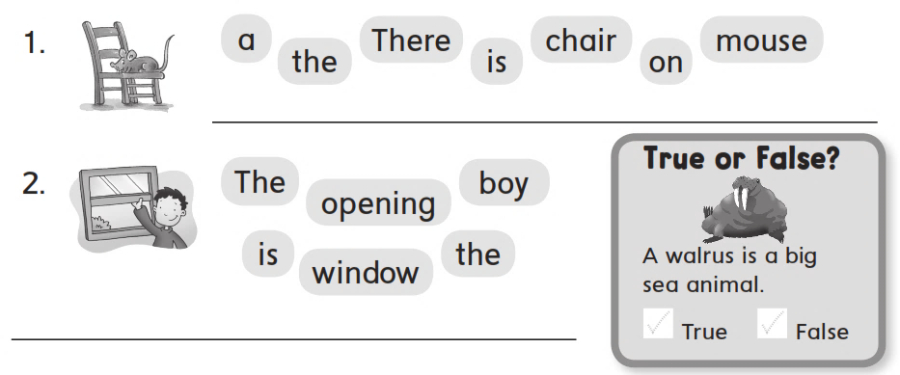
There is a mouse on the chair .
The boy is opening the window .

Slide 23
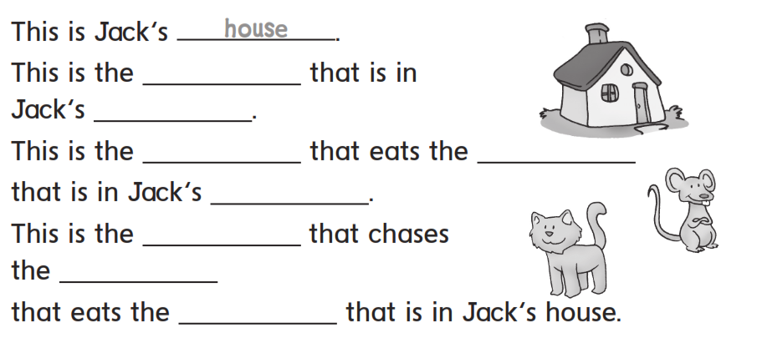
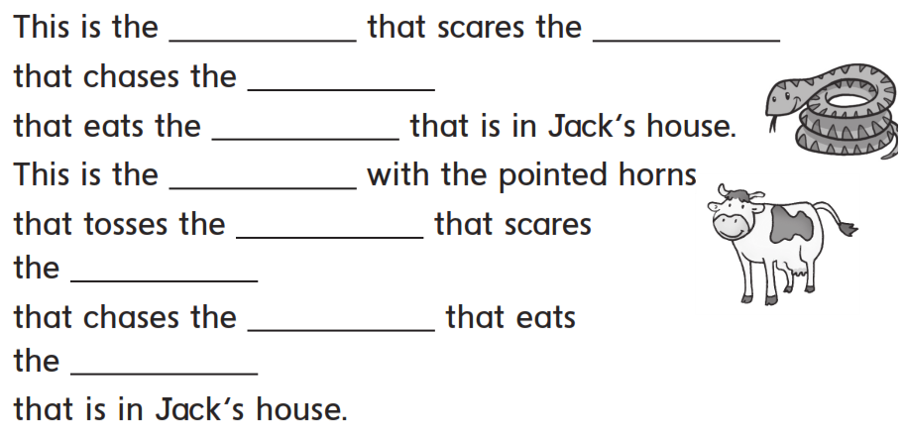
snake
cat
mouse
cheese
cheese
house
cow
mouse
cheese
snake
house
cat
cat
mouse
mouse
cheese
cheese

Slide 24
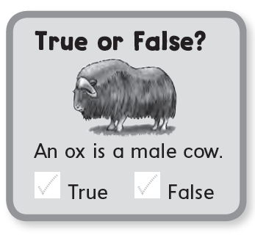

Slide 25


