Slide 1

Unit 1
Lifestyle
Part 2

Slide 2
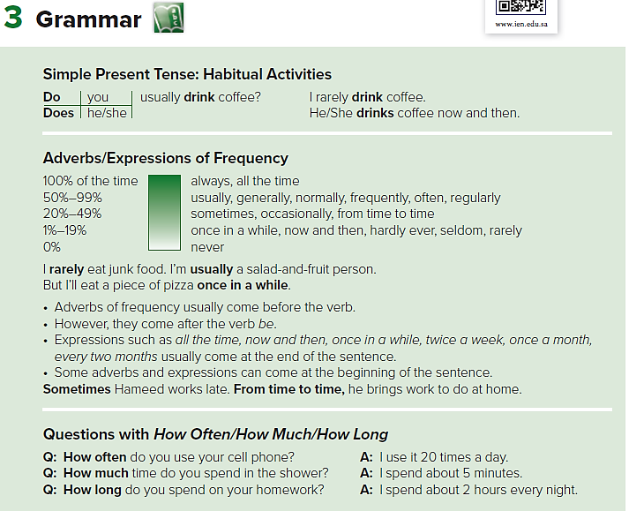

Slide 3
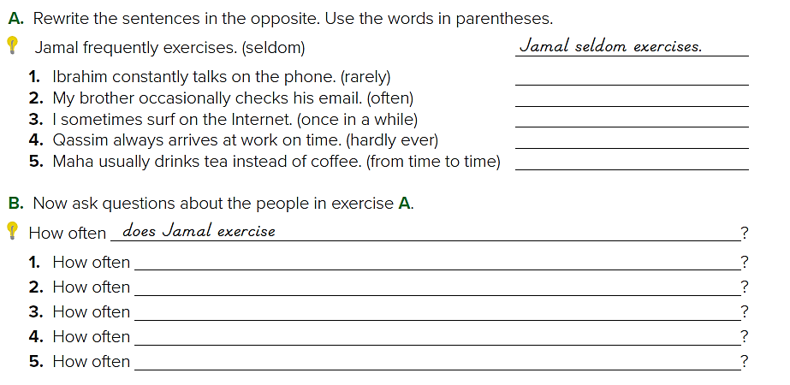
1. Ibrahim rarely talks on the phone.
2. My brother often checks his email. / My brother checks his email often.
3. I surf on the Internet once in a while.
4. Qassim hardly ever arrives at work on time.
5. Maha drinks tea instead of coffee from time to time.
does Ibrahim talk on the phone?
does your brother check his email?
do you surf on the Internet?
does Qassim arrive at work on time?
does Maha drink tea instead of coffee?

Slide 4
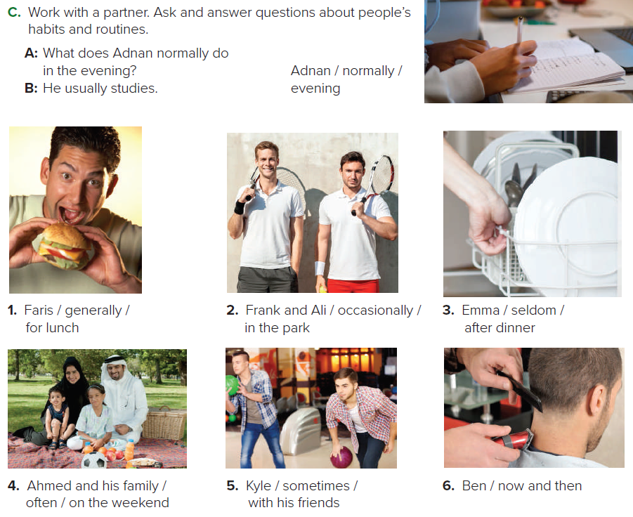
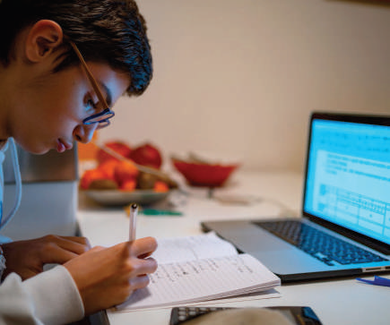
1. What does Kyle generally eat/have for lunch?
He generally eats/has a burger and a soda for lunch.
2. What do Faris and Ali occasionally do in the park?
Faris and Ali occasionally play tennis in the park. /
Faris and Ali play tennis in the park occasionally.
3. What does Emma seldom do after dinner?
Emma seldom does/washes the dishes after dinner.

Slide 5
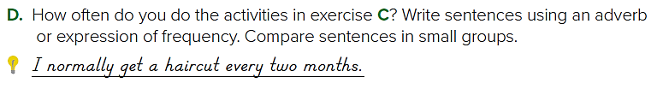
4. What do Ali and his parents often do on the weekend?
Ali and his parents often go to the park on the weekend.
5. What does Ismail sometimes do with his friends?
Ismail sometimes goes bowling with his friends.
6. What does Ben do now and then?
Ben gets a haircut now and then.
Sample answers:
1-I sometimes go bowling with my friends.
2-I often go to the park on the weekend with family

Slide 6
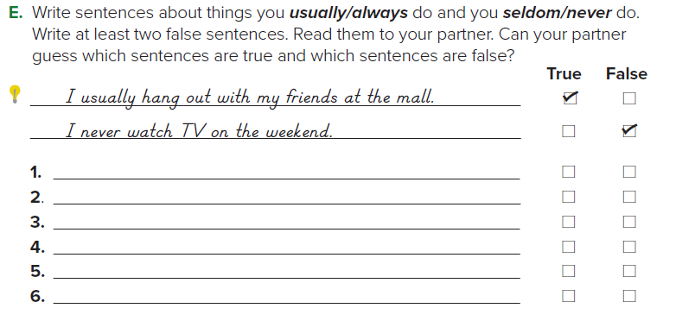

Sample answers
I seldom wash the dishes after dinner.
I occasionally play tennis in the park.
I generally eat a burger and a soda for lunch.
I sometimes go shopping on weekends

Slide 7
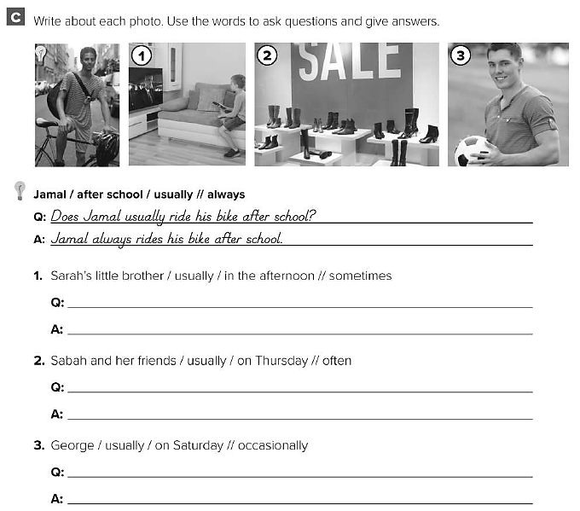
Does Mona’s little brother usually watch TV in the afternoon ?
Mona’s little brother sometimes watches TV in the afternoon .
Do Sabah and her friends usually go shopping on Thursday ?
Sabah and her friends often go shopping on Thursday .
Does George usually play football on Saturday ?
George occasionally plays football on Saturday .

Slide 8
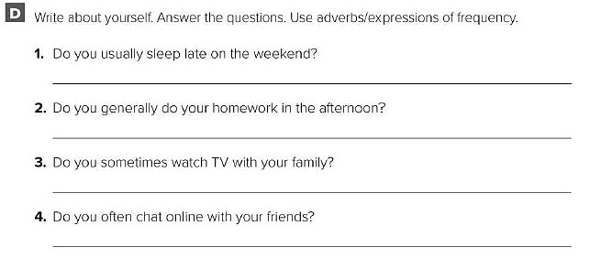
I rarely sleep late on the weekend .
I usually do my homework in the afternoon .
I often watch TV with my family .
I sometimes chat online with my friends .

Slide 9
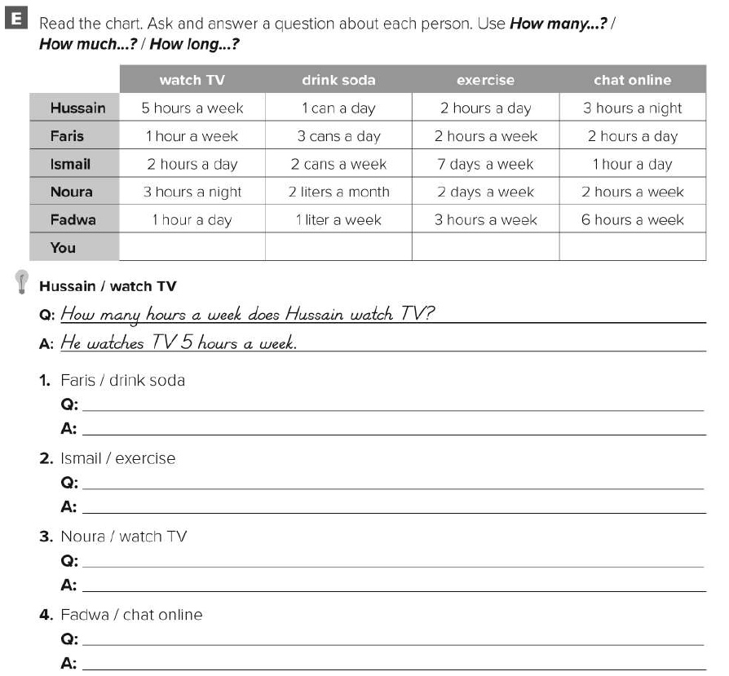
How many sodas does Faris drink ?
He drinks 3 cans of soda a day.
How many days does Ismail exercise per week ?
He exercises 7 days a week.
How many hours does Nura watch TV ?
She watches TV 3 hours a night .
How long does Fadwa chat online ?
She chats online 6 hours a week .

Slide 10
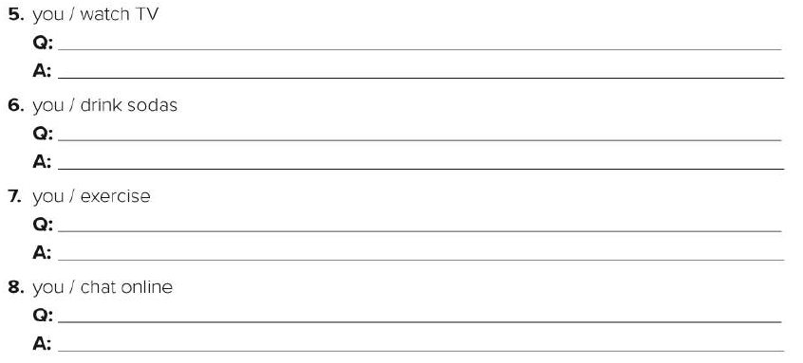
How many hours do you watch TV ?
I watch TV 2 hours a day .
How many sodas do you drink ?
I drink 4 cans of soda a day .
How much do you exercise ?
I exercise 1 hour a day .
How long do you chat online ?
I chat online 5 hours a day .

