Slide 1

Unit 1
Lifestyle
Part 1

Slide 2
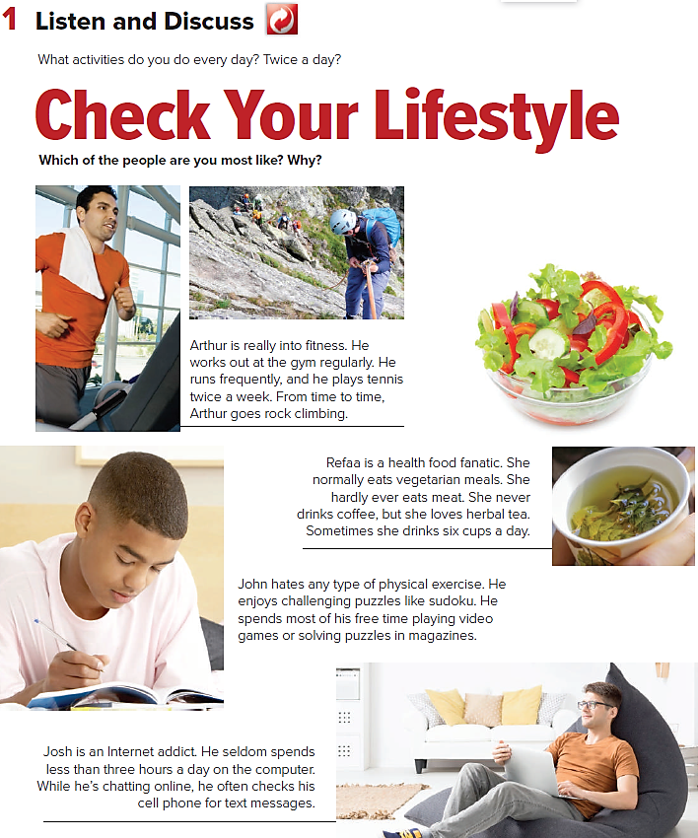


Slide 3
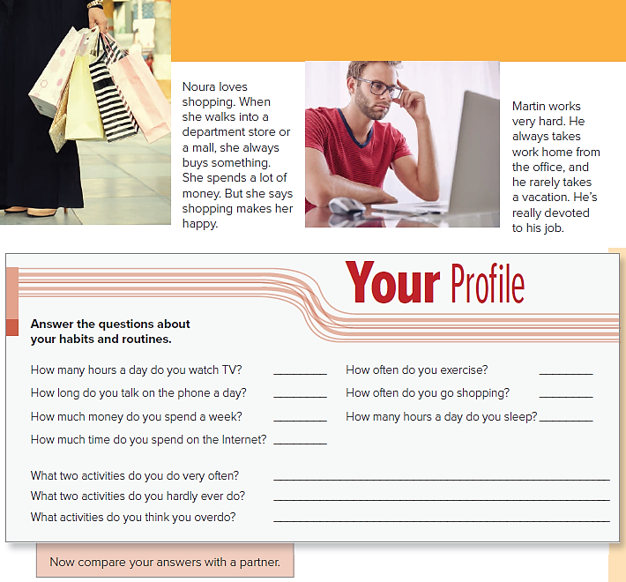

Slide 4
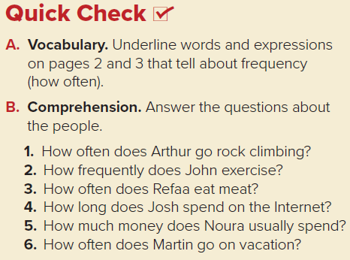

1-He goes rock climbing from time to time.
2-John never exercises.
3-Refaa hardly ever eats meat.
4-Josh seldom spends less than three hours a day on the computer.
5-Noura spends a lot of money.
6-Martin rarely takes a vacation.

Slide 5
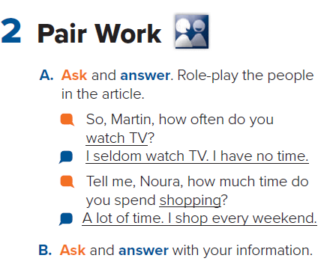

Slide 6
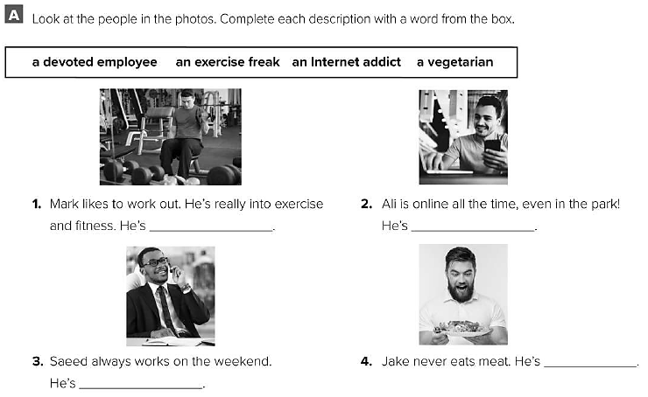
an exercise freak
an internet addict
a vegetarian
a devoted employee

Slide 7
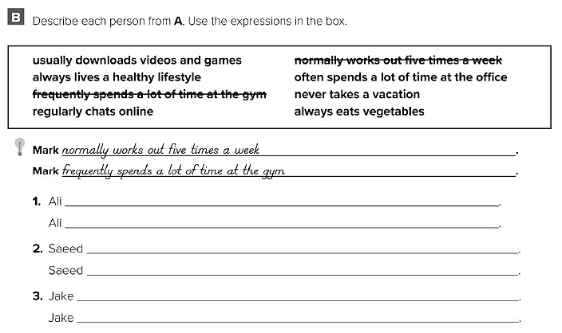
usually downloads videos and games .
regularly chats online .
often spends a lot of time at the office .
never takes a vacation .
always lives a healthy lifestyle .
always eats vegetables .

