Slide 1


Unit 1
Lifestyle
Grammar

Slide 2
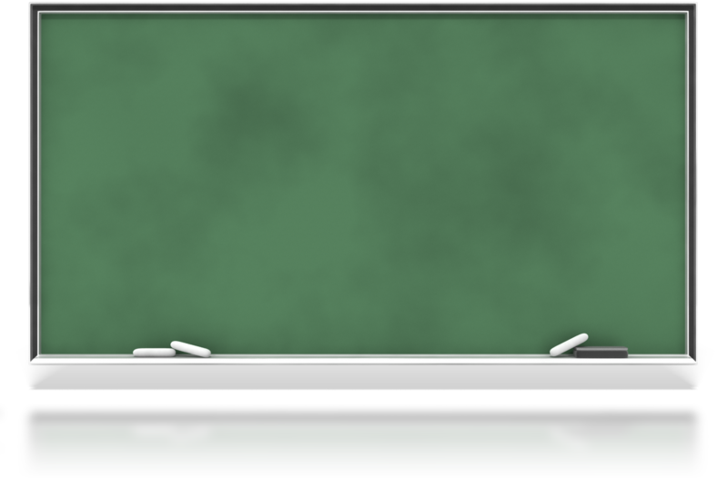
بسم الله الرحمن الرحيم
Day:
Date:

Slide 3
Learning Objectives
Ask Yes/ No questions in the simple present correctly
Classify adverbs of frequency correctly
use adverbs of frequency correctly
Ask questions using How often, How much or How long..
Write sentences about daily routines and habits.

Slide 4
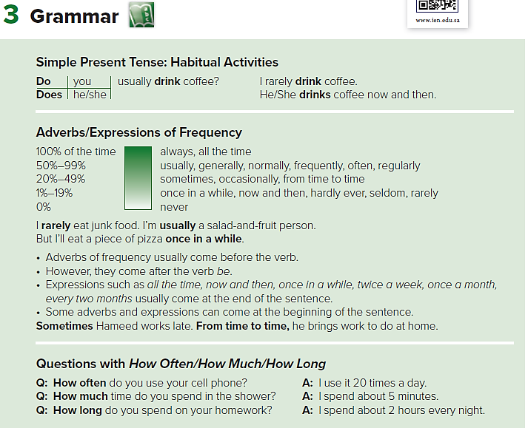
Pages 4 & 5

Slide 5
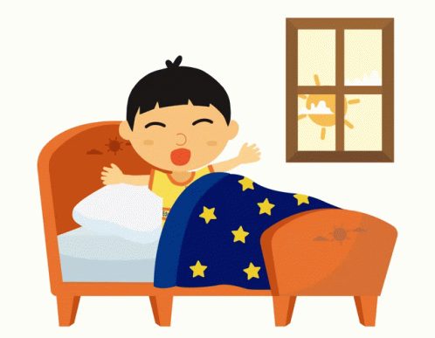
I wake up early every morning.

Slide 6
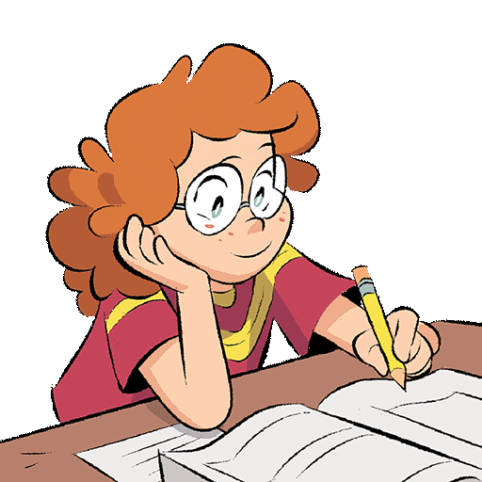
She writes her homework every evening.

Slide 7
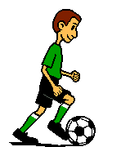
He plays football twice a week.

Slide 8
Forming the Present Simple (affirmative)
Subject | verb | C/ O.
I | get up | early.
We
They
You
Subject | verb | C/ O.
She | gets up | early.
He
It

Slide 9
Forming the Present Simple (affirmative)
Subject | verb | C/ O.
I | get up | early.
We
They
You
Forming the Present Simple (Negative)
Subject |  | verb | C/ O.
I | donot | get up | early.
We
They
You

Slide 10
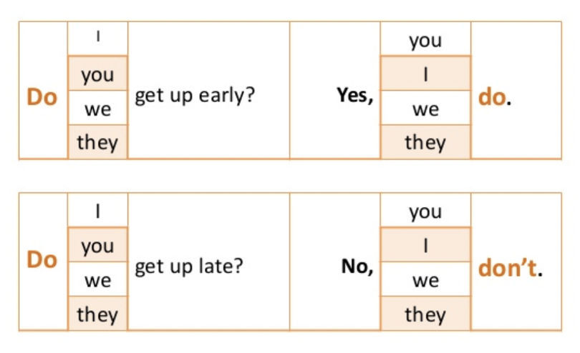
Forming the Present Simple (affirmative)
Subject | verb | C/ O.
I | get up | early.
We
They
You
Yes/No Questions

Slide 11
Forming the Present Simple (affirmative)
Subject | verb | C/ O.
She | gets up | early.
He
It
Forming the Present Simple (Negative)
Subject |  | verb | C/ O.
She | doesnot | get up | early.
He
It

Slide 12
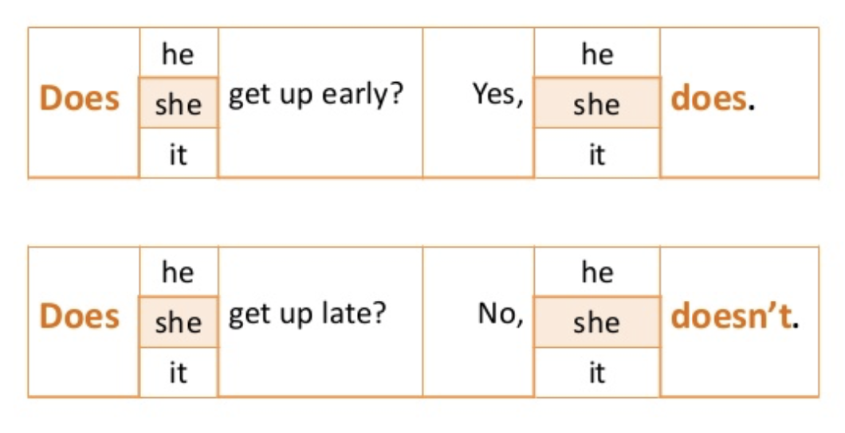
Forming the Present Simple (affirmative)
Subject | verb | C/ O.
She | gets up | early.
He
It
Yes/No Questions

Slide 13

Let’s Practice

Slide 14
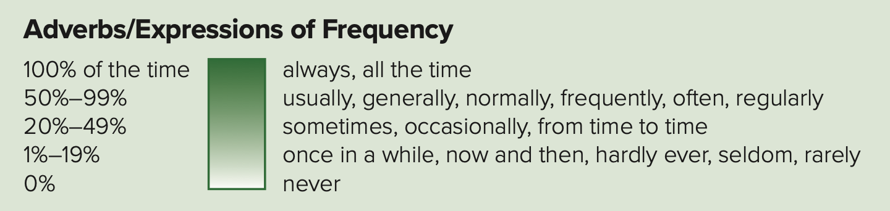
Adverbs of frequency
Frequency Adverbs with simple present:
Always Usually Often Sometimes Never | We always pray five times a day . He usually has a cup of tea . I often go to the match . Ahmad sometimes drinks coffee . They never have cigarettes .

Slide 15
Adverbs of frequency
Frequency adverbs follow verb " Be
I | am | always usually often sometimes never | late for school .
He She It | is
We They you | are

Slide 16

Let’s Practice

Slide 18
Asking Information Questions
Q-word | Helping verb | S | C/O | ?
How long | do | you…. They….. we ……
How often
How much ……. (time, money,…etc) | does | he …. She ….. It ……

Slide 19
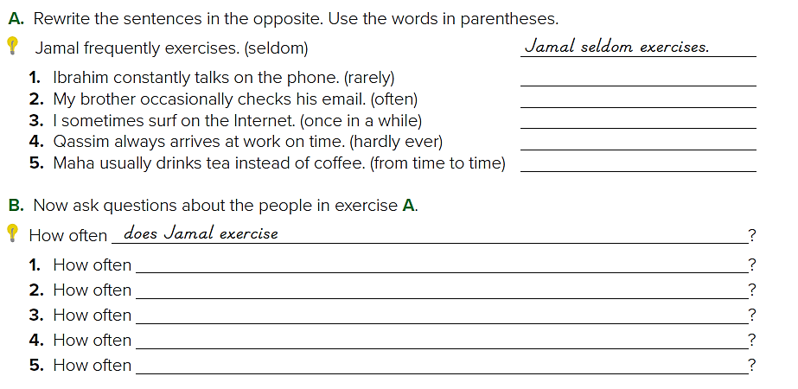
1. Ibrahim rarely talks on the phone.
2. My brother often checks his email. / My brother checks his email often.
3. I surf on the Internet once in a while.
4. Qassim hardly ever arrives at work on time.
5. Maha drinks tea instead of coffee from time to time.

Slide 20
does Ibrahim talk on the phone?
does your brother check his email?
do you surf on the Internet?
does Qassim arrive at work on time?
does Maha drink tea instead of coffee?

Slide 21
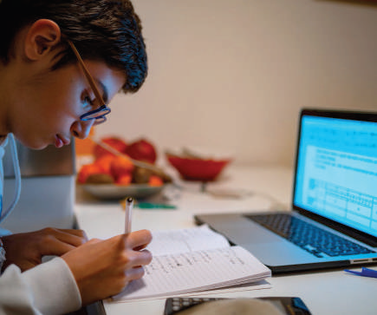
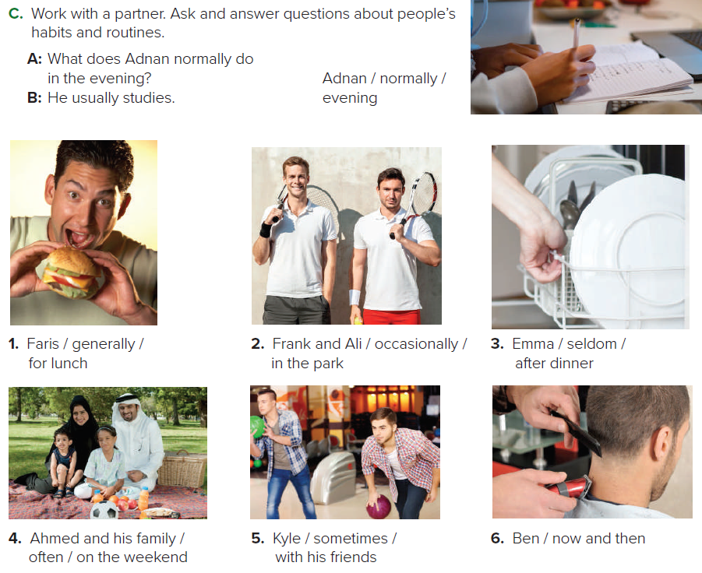
1. What does Faris generally eat/have for lunch?
He generally eats/has a burger and a soda for lunch.

Slide 22
2. What do Frank and Ali occasionally do in the park?
Frank and Ali occasionally play tennis in the park. /
Frank and Ali in the park occasionally.

Slide 23
3. What does Emma seldom do after dinner?
Emma seldom does/washes the dishes after dinner

Slide 24
4. What do Ali and his family often do on the weekend?
Ali and his family often go to the park on the weekend.

Slide 25
5. What does Kyle sometimes do with his friends?
Kyle sometimes goes bowling with his friends.

Slide 26
6. What does Ben do now and then?
Ben gets a haircut now and then.

Slide 27
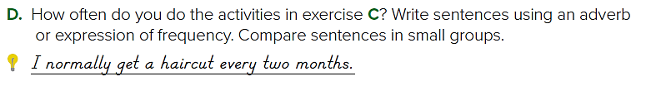
Sample answers:
1-I sometimes go bowling with my friends.
2-I often go to the park on the weekend with family

Slide 28
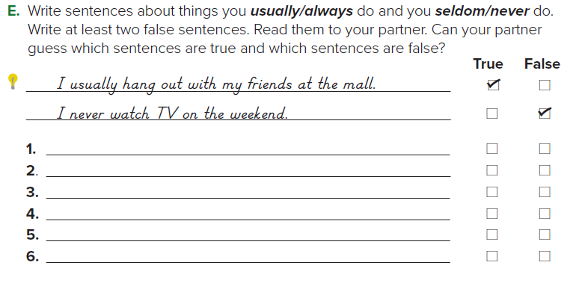

Sample answers
I seldom wash the dishes after dinner.
I occasionally play tennis in the park.
I generally eat a burger and a soda for lunch.
I sometimes go shopping on weekends

Slide 29
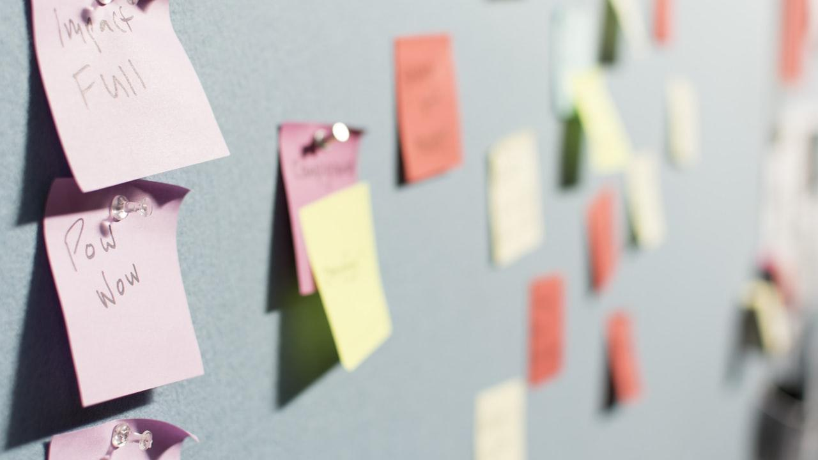
Homework
1
Workbook Page 168

Slide 30
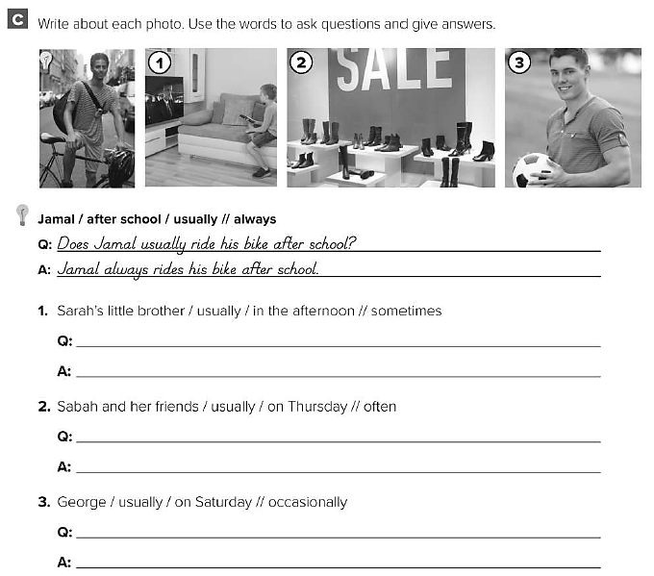
Does Mona’s little brother usually watch TV in the afternoon ?
Mona’s little brother sometimes watches TV in the afternoon .
Do Sabah and her friends usually go shopping on Thursday ?
Sabah and her friends often go shopping on Thursday .
Does George usually play football on Saturday ?
George occasionally plays football on Saturday .

Slide 31
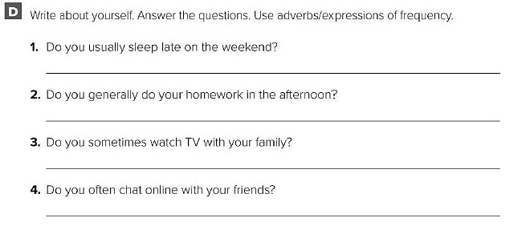
I rarely sleep late on the weekend .
I usually do my homework in the afternoon .
I often watch TV with my family .
I sometimes chat online with my friends .

Slide 32
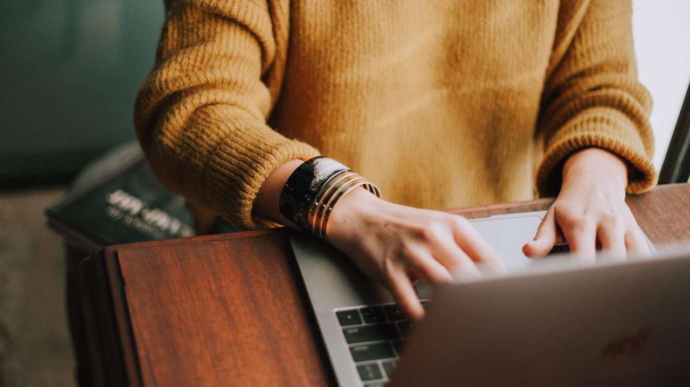
Done

