Slide 1




Slide 2

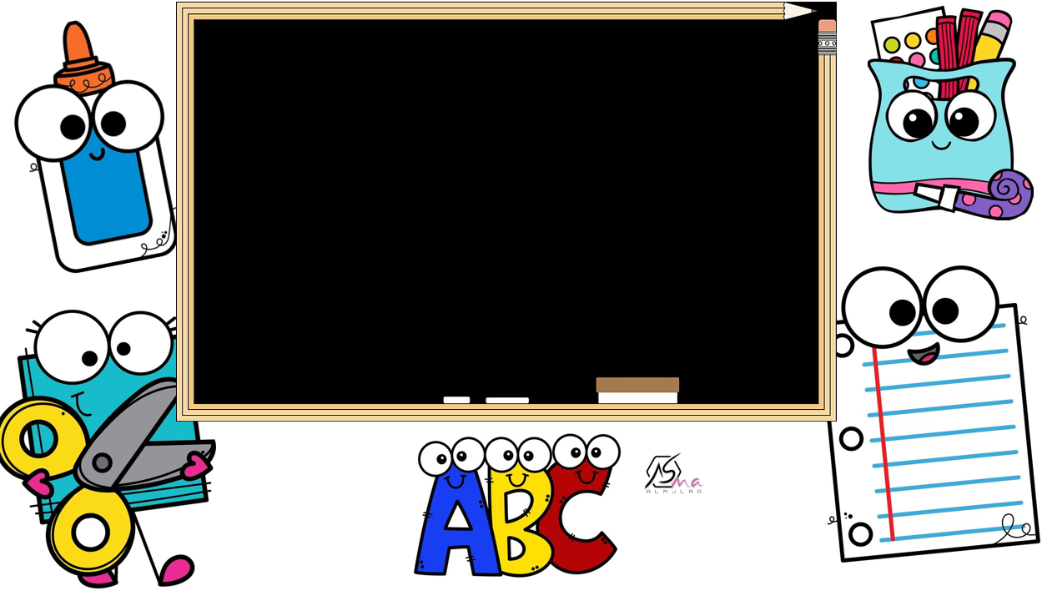



Slide 3
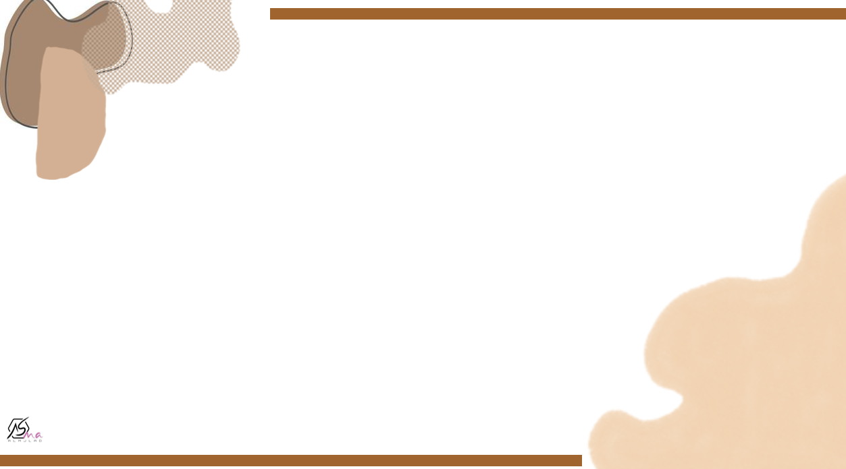
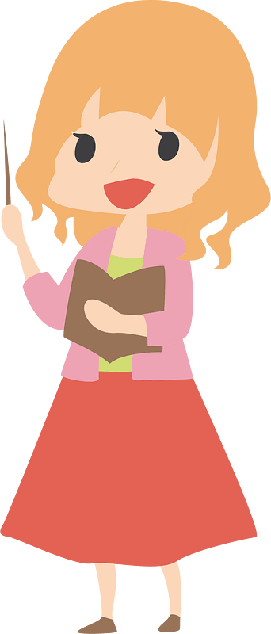
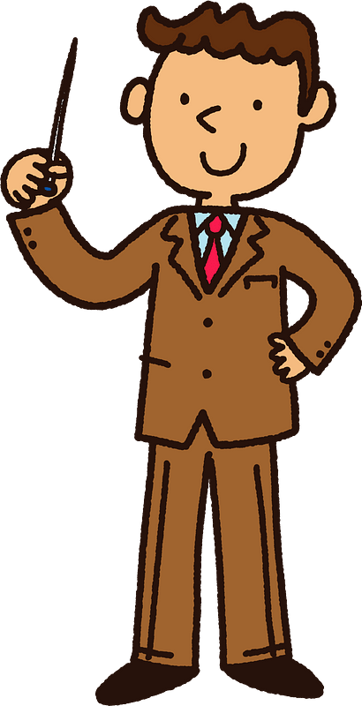
Hello
How are you?
My name is …………………….
I am your English teacher

Slide 4



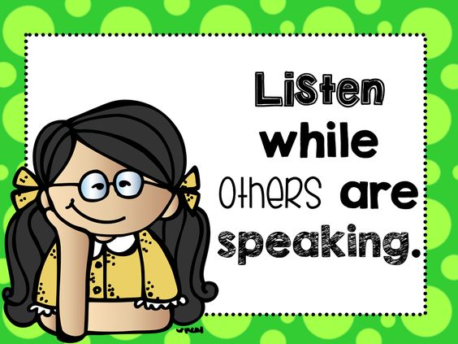


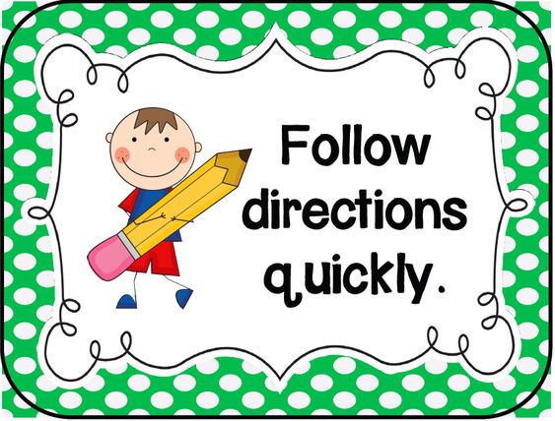
Classroom Rules

Slide 5
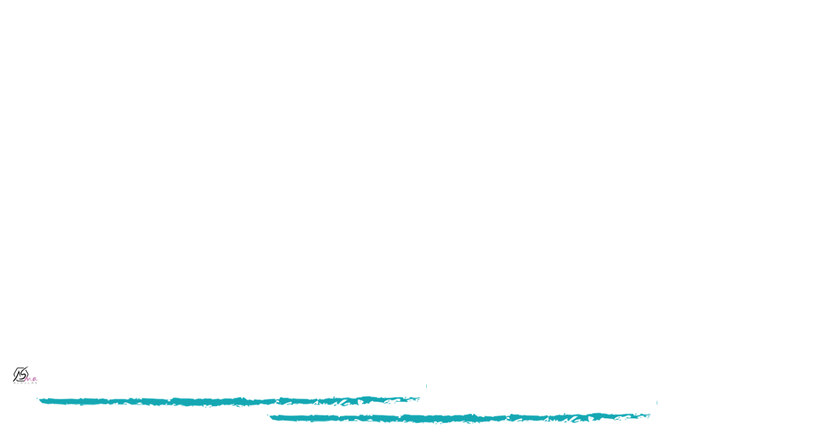



Slide 6
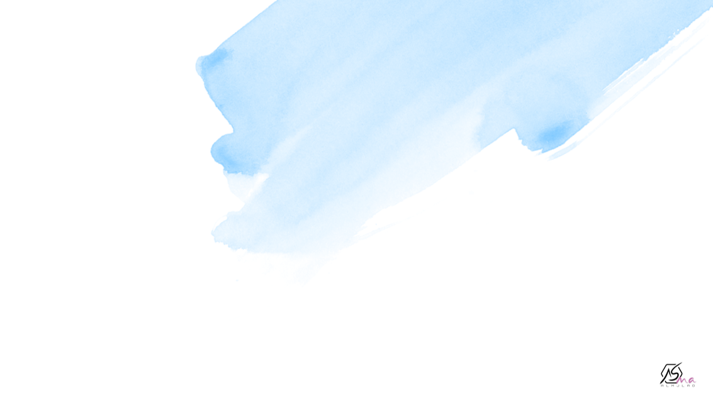

My name is ………………….
I am …………years old.
My favorite color is………………..
My favorite subject is………………..

Slide 7
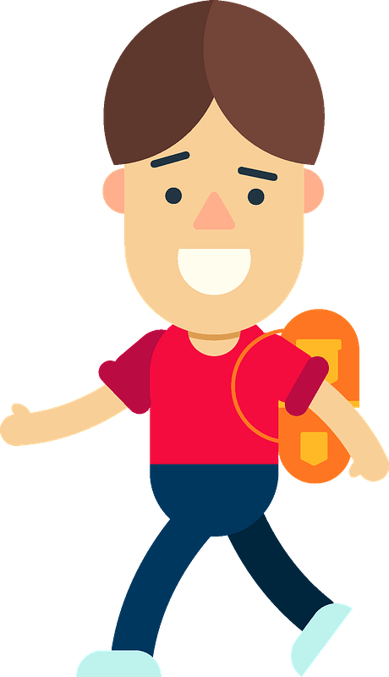
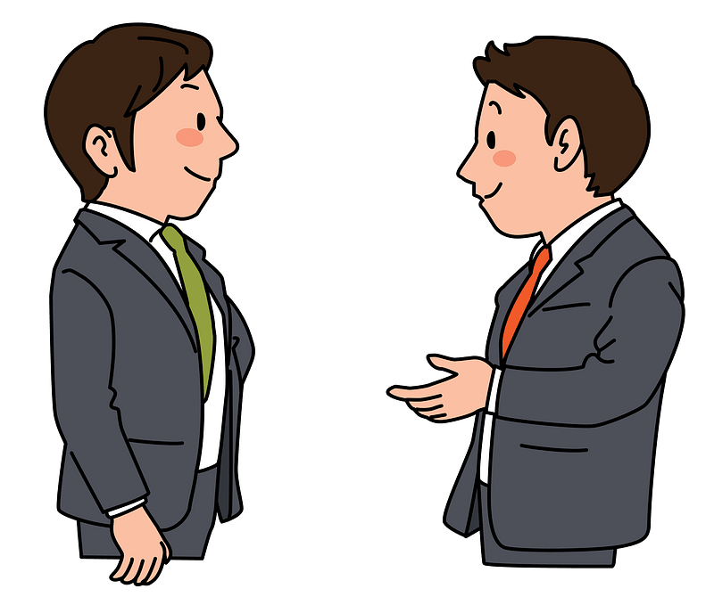
What’s your name ?
Nice to meet you, too.
My name is _____
Nice to meet you.
Hello!
Hi!

Slide 8


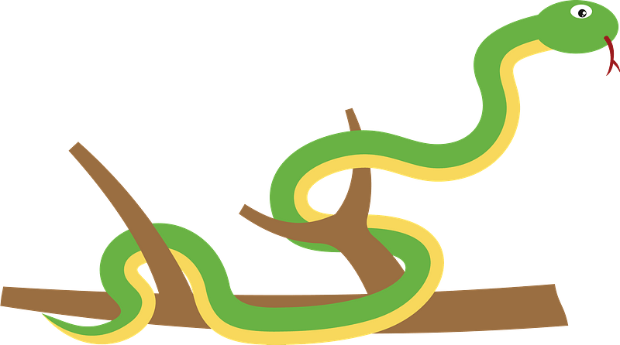


An elephant can fly.
A snake can run
A fish can swim
A lion can’t run

Slide 9


Count from 1 to 30

Slide 10



The 3 words game…
Name 3 different vegetables
Name 3 different family members
Name 3 different nationalities
Name 3 different jobs
Name 3 different illnesses
Name 3 different wild animals
Name 3 different daily routines
Name 3 different school subjects
Name 3 different type of meat

Slide 11




Find something that …………..
Is blue
Is longer than a pencil
Has 4 sides

Slide 12

Find something that …………..
Has the letter B on it
Start with the first letter in your name
Smells good

Slide 13
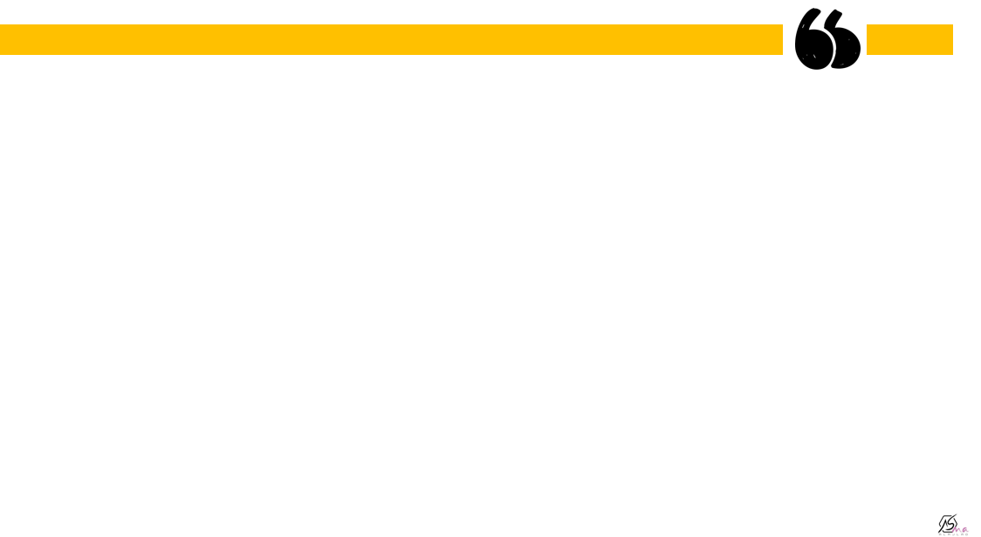
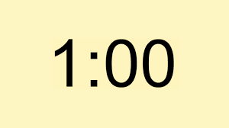
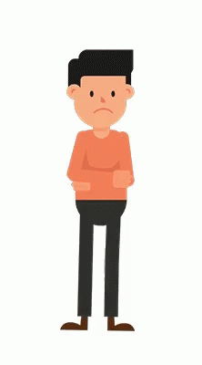
Talk for a about…..
How to cook your favorite dish
Your family
The weather
Your town or city
How to improve your English
Your self
3 things you did last week

Slide 14
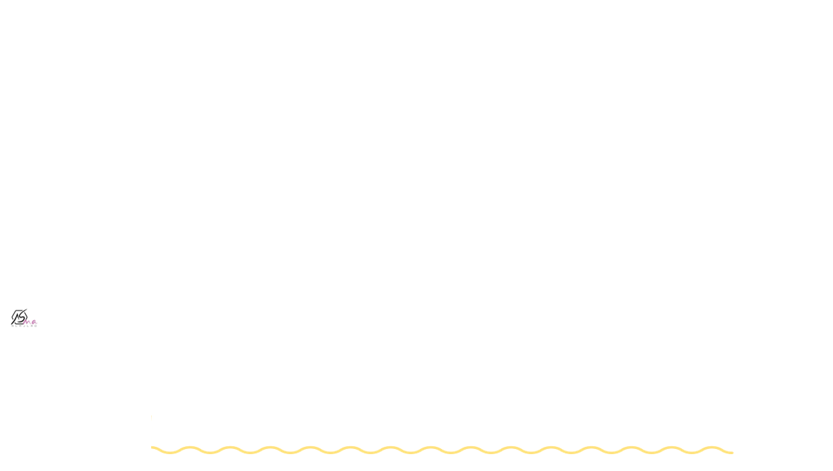
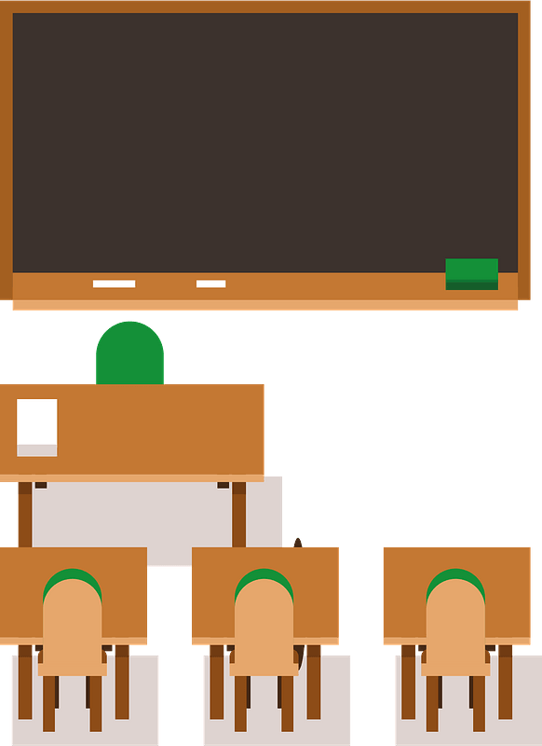

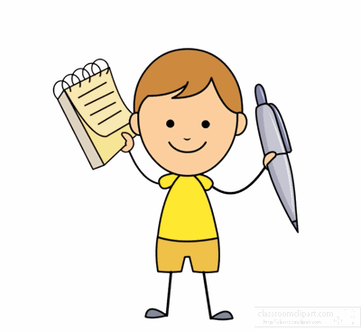


Teacher
Banana
Welcome
House
Park
Water

Slide 15
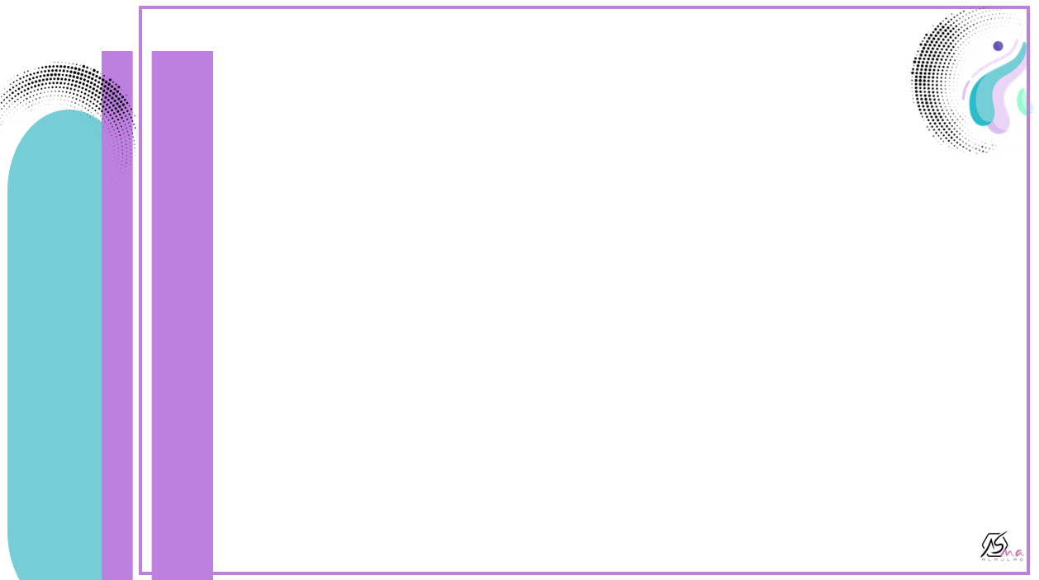

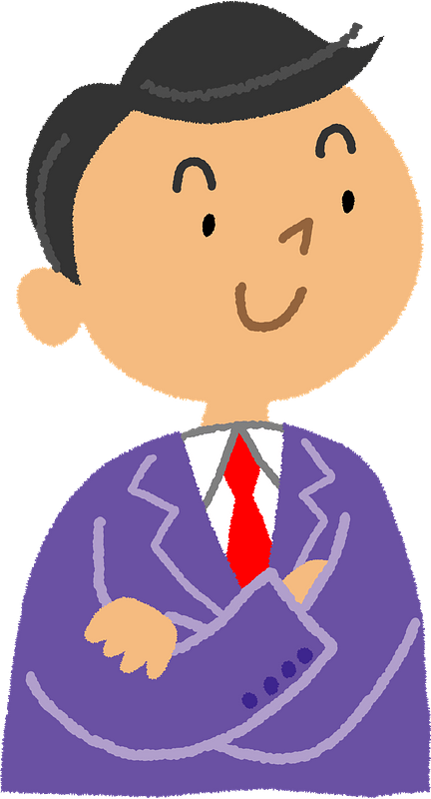
What am I ?
I am used for writing.
I am used for drawing.
You can use an eraser if you make a mistake when using me.

Slide 16

What am I ?
I have 4 legs.
I am in your classroom.
You sit at me do your school work,

Slide 17

What am I ?
I am found in the freezer.
I taste good on sunny day.
I come in many different flavours.
I made with cream.

Slide 18
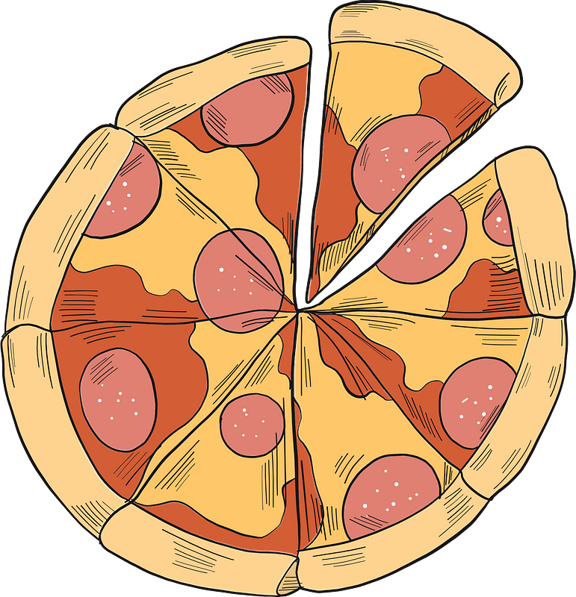

What am I ?
I am round.
I have many different toppings
I usually have a tomato and chasse topping

Slide 19

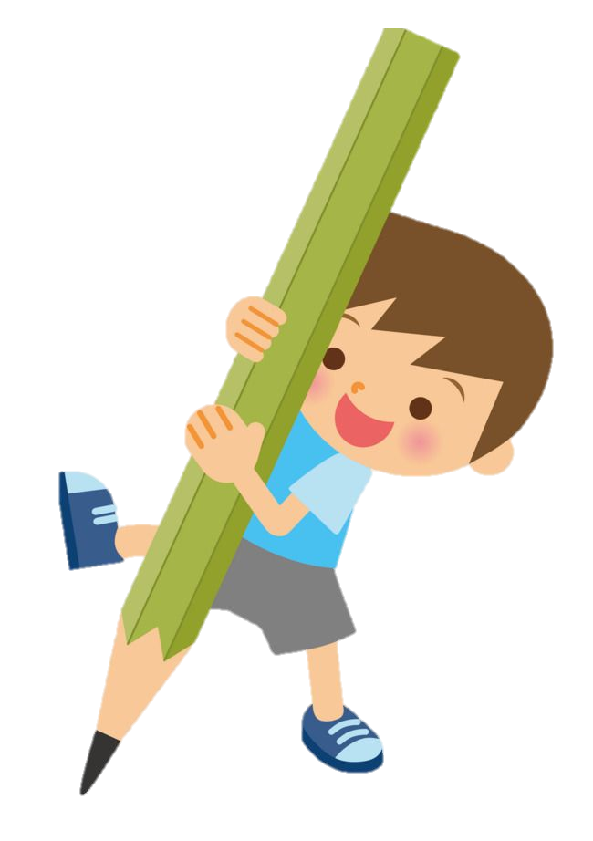
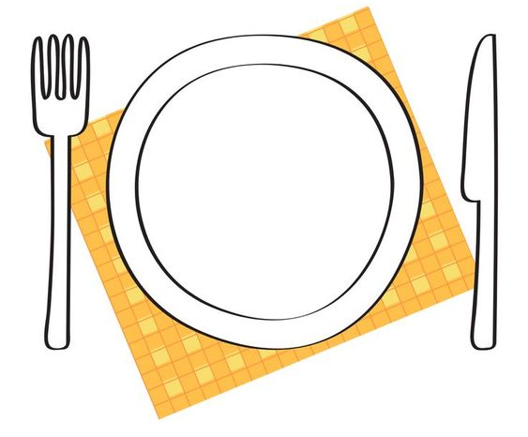
What do you like to eat ?

Slide 20

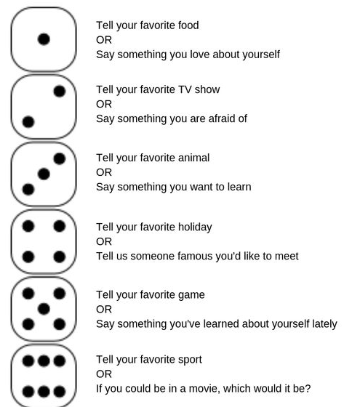
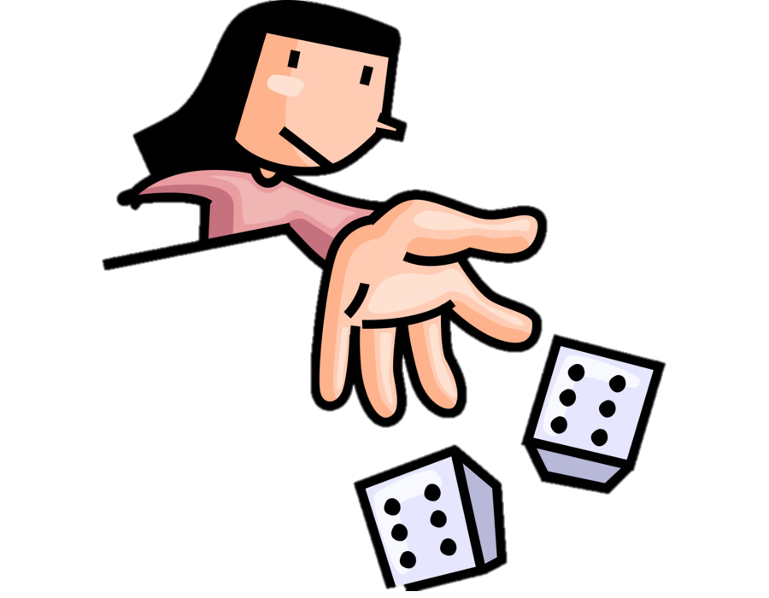

Slide 21



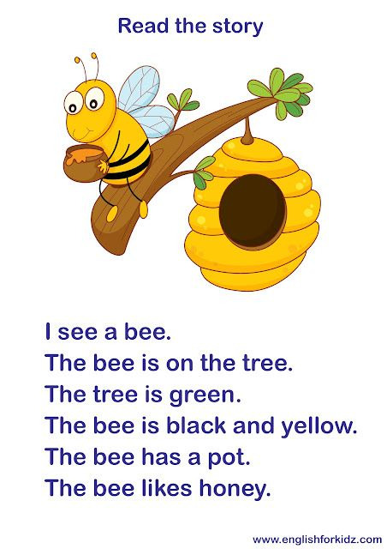

Read the story

Slide 22
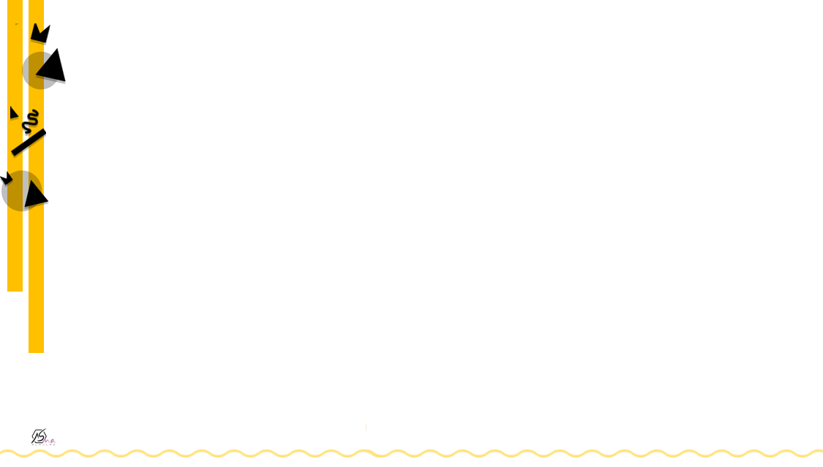
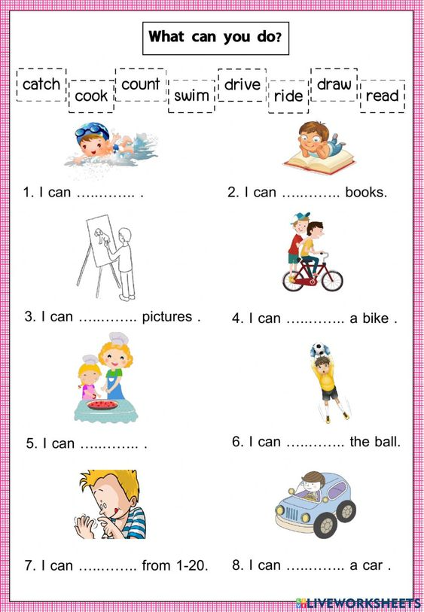
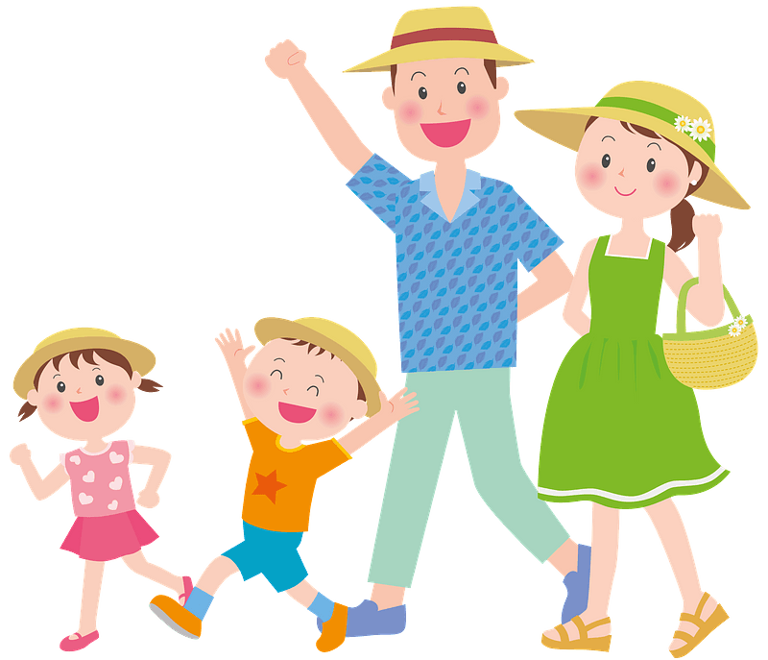

Slide 23
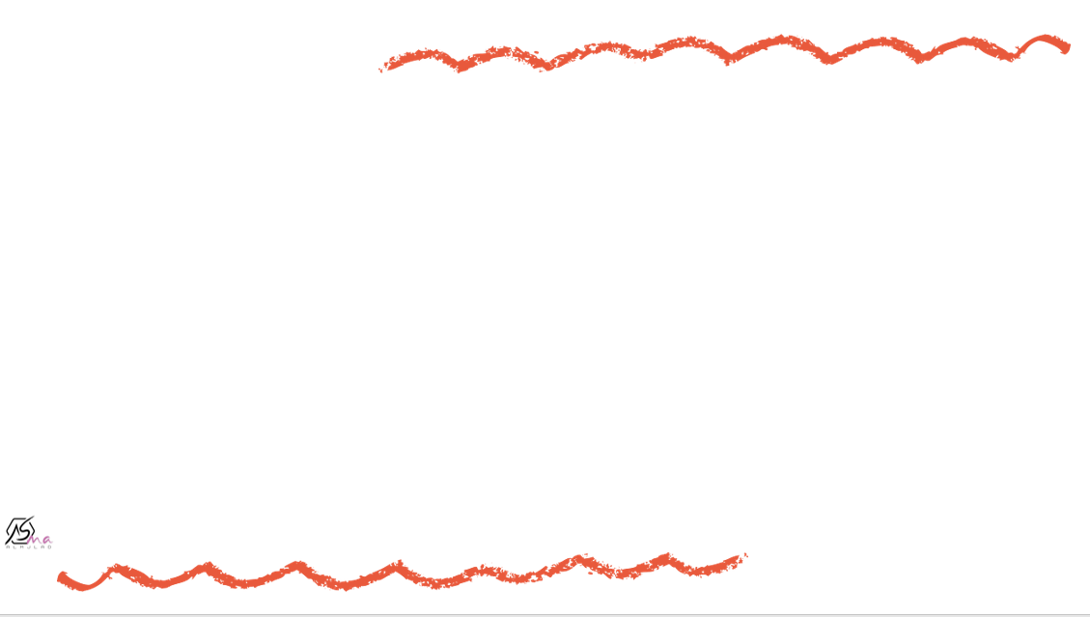
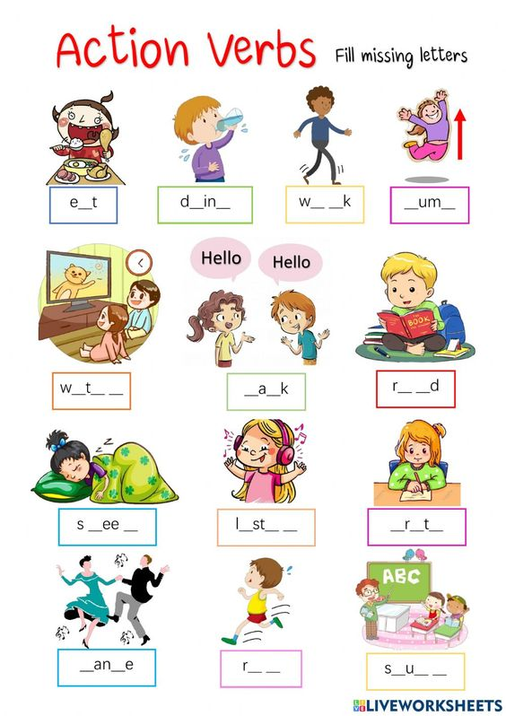
Fill missing letters

Slide 24
Fill missing letters

Slide 25
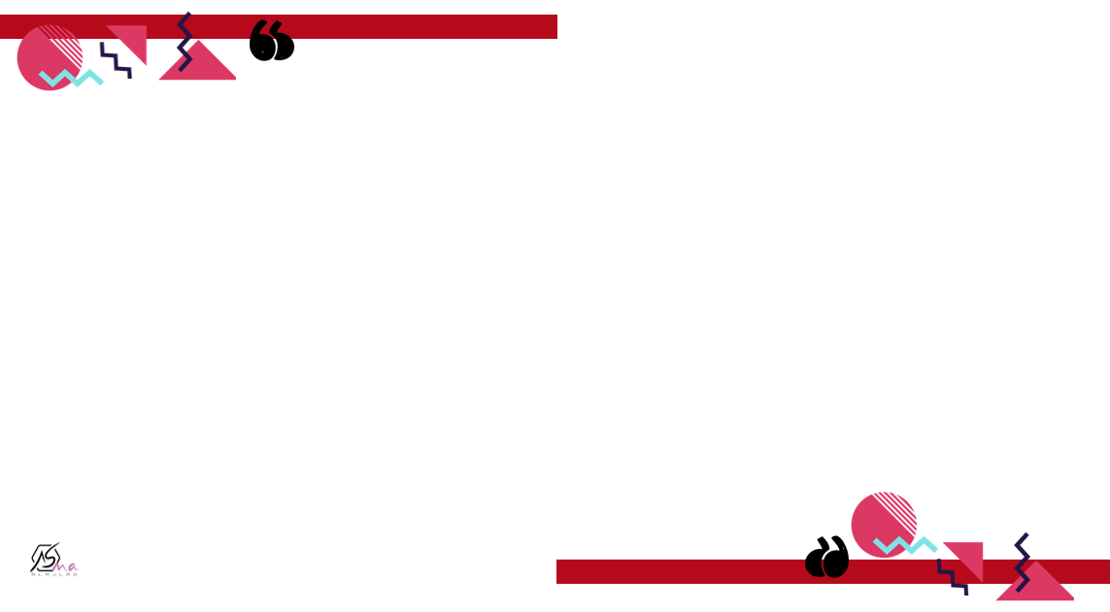

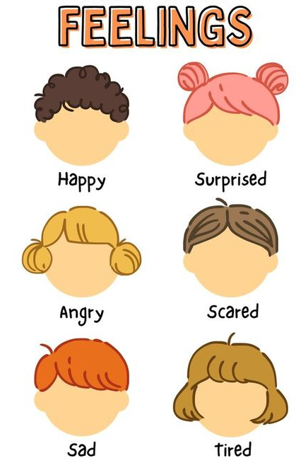

Slide 26
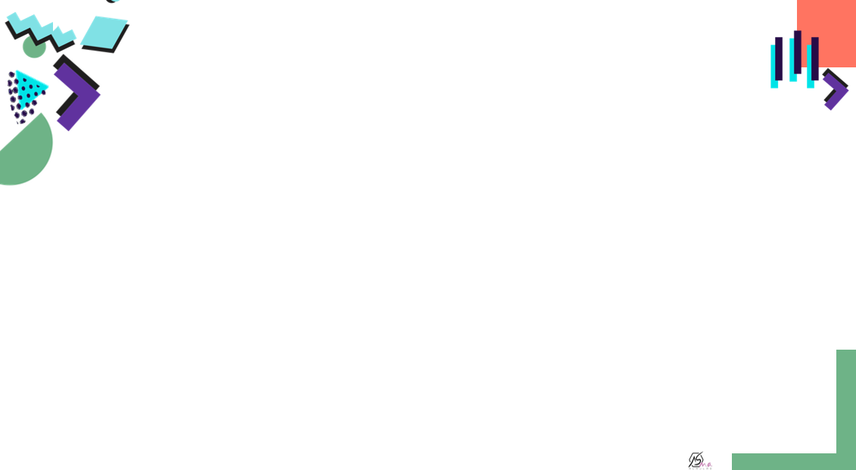
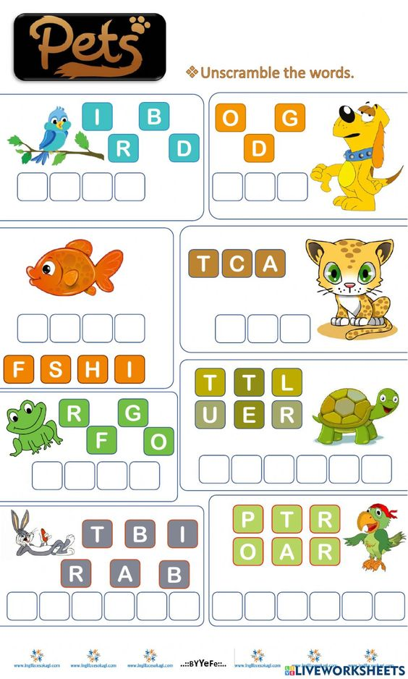

Unscramble the words,

Slide 27
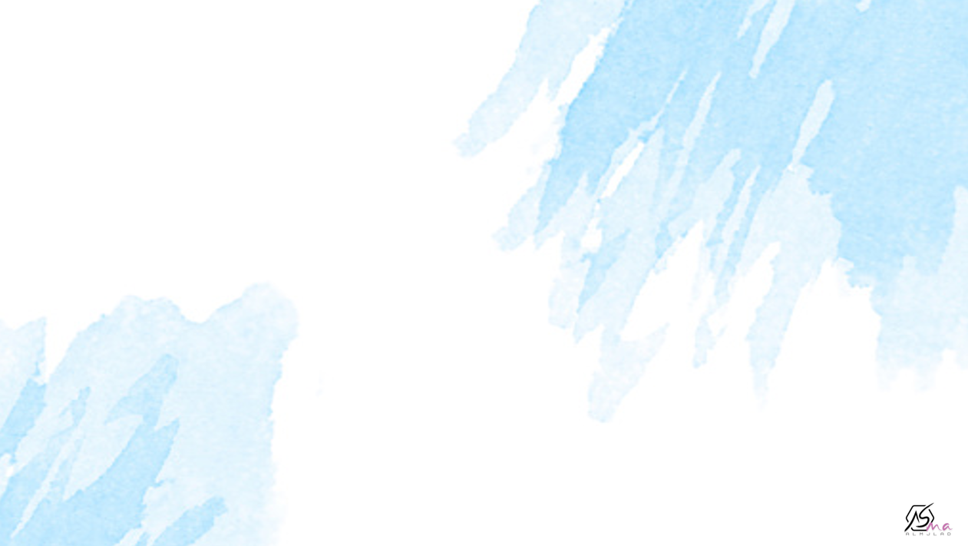
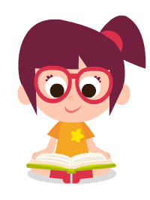
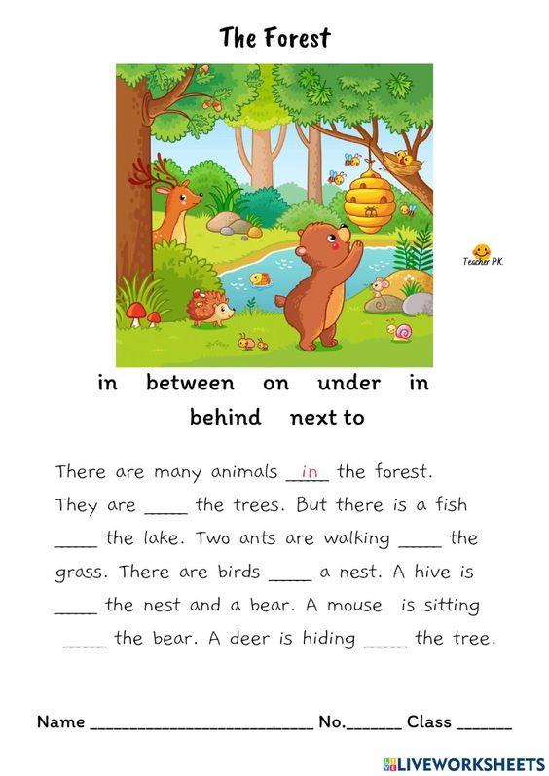

Slide 28
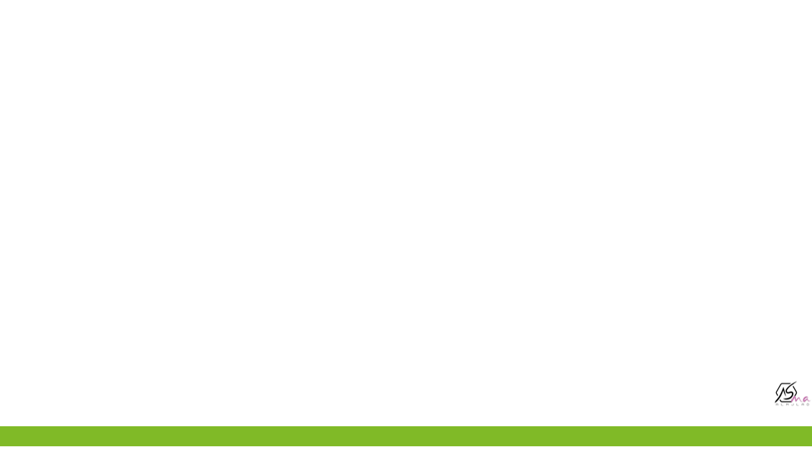

Tuesday
Monday
Wednesday
Thursday
Sunday
Friday
Saturday

Slide 29
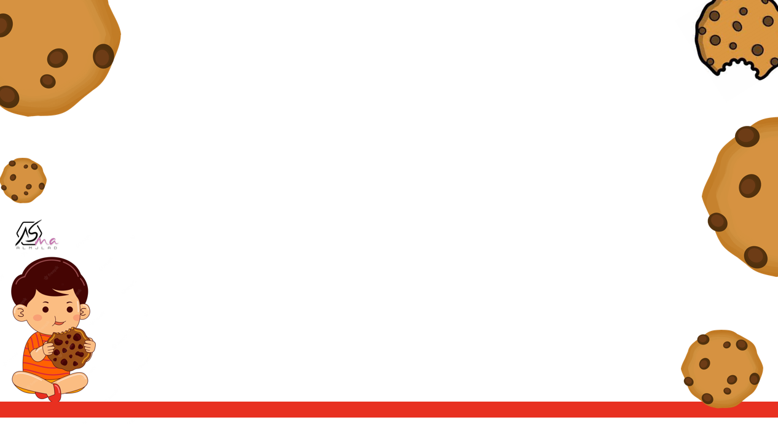



arm
pasta
arm
pasta
Food
Body part

Slide 30
Salad
leg
pasta
arm
salad
leg
Food
Body part

Slide 31

ear
burger
pasta
arm
salad
leg
ear
burger
Food
Body part

Slide 32
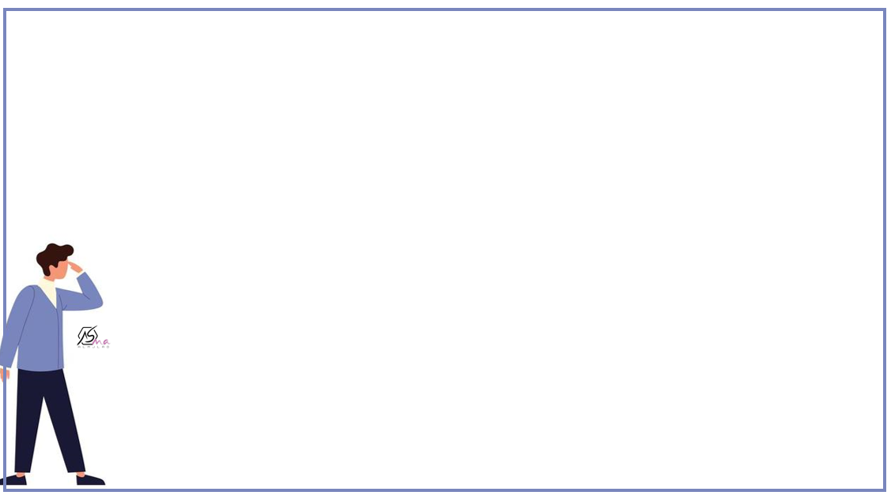
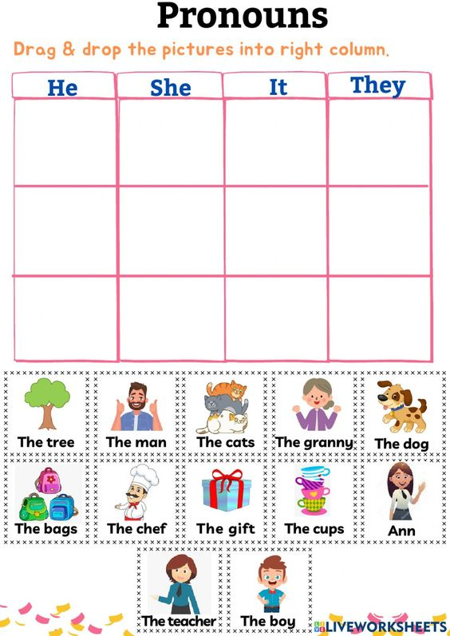

Slide 33
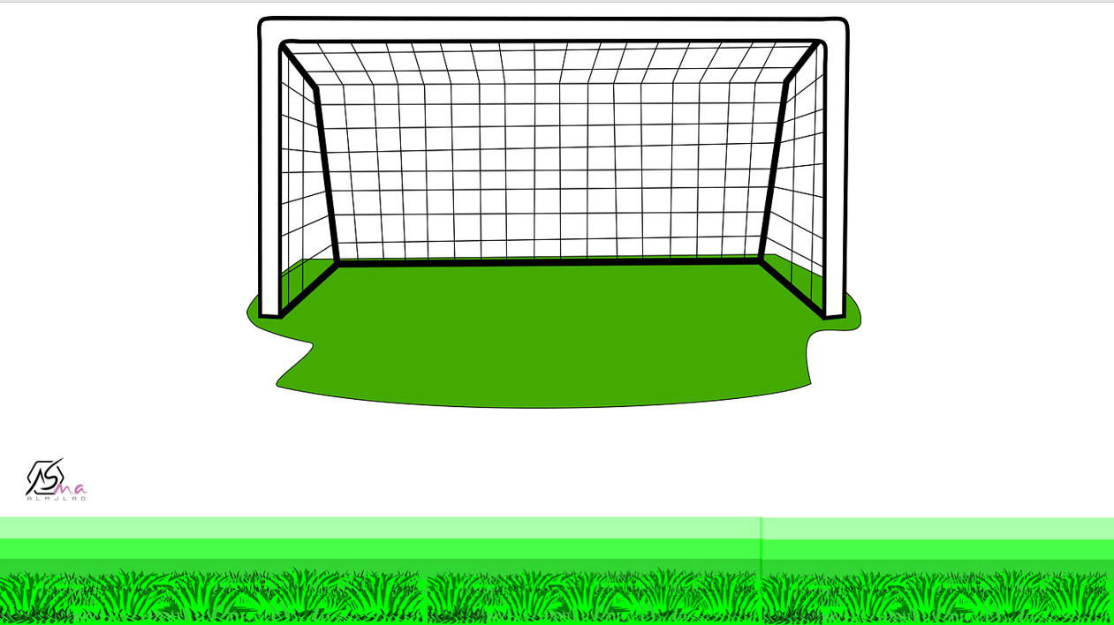
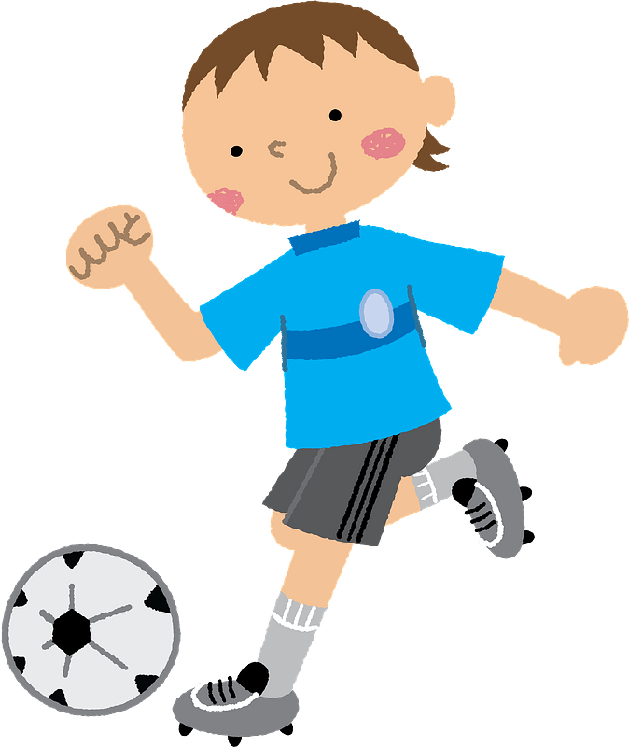

They …..students.
am
are

Slide 34
He …………a doctor.
is
are

Slide 35
I ………..Saudi
am
is

Slide 36
You ……….a teacher.
am
are

Slide 37
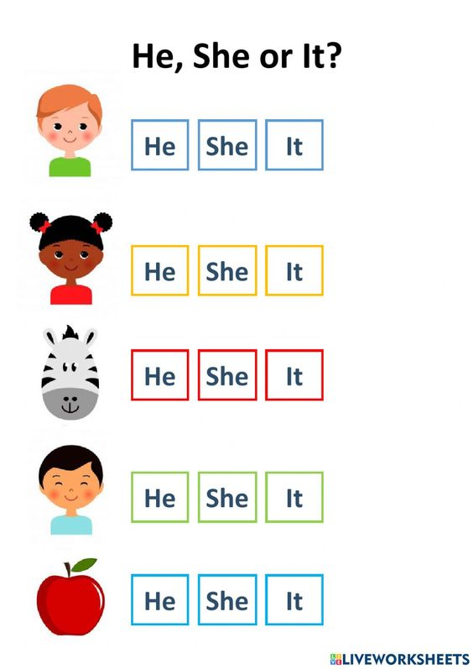
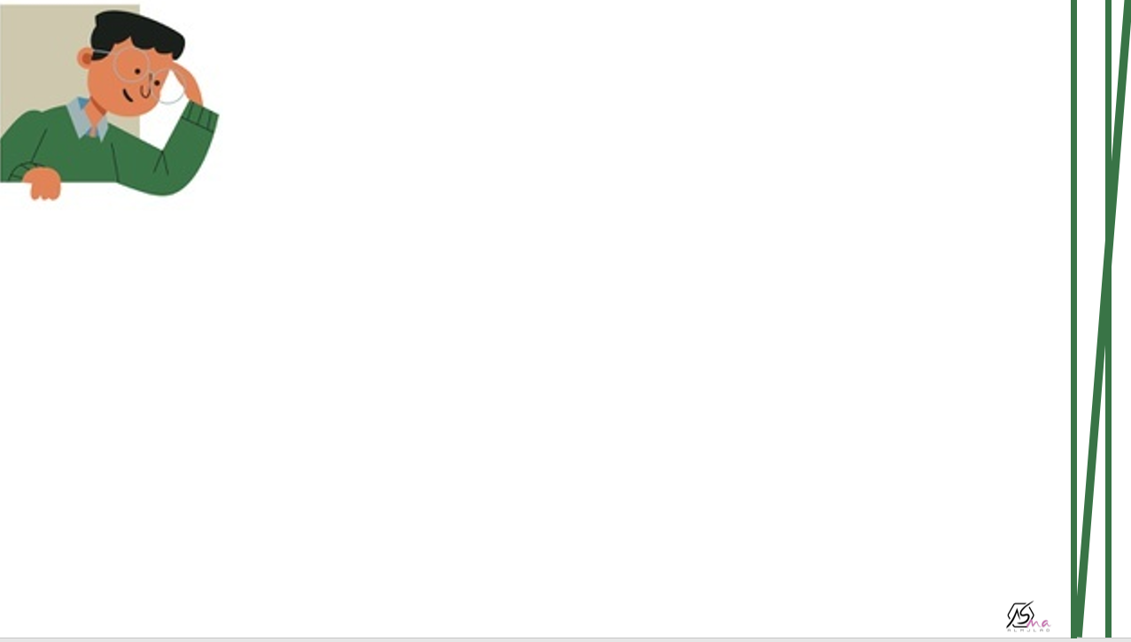
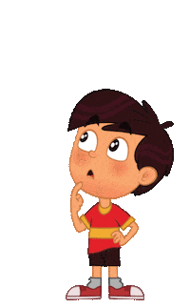


Slide 38
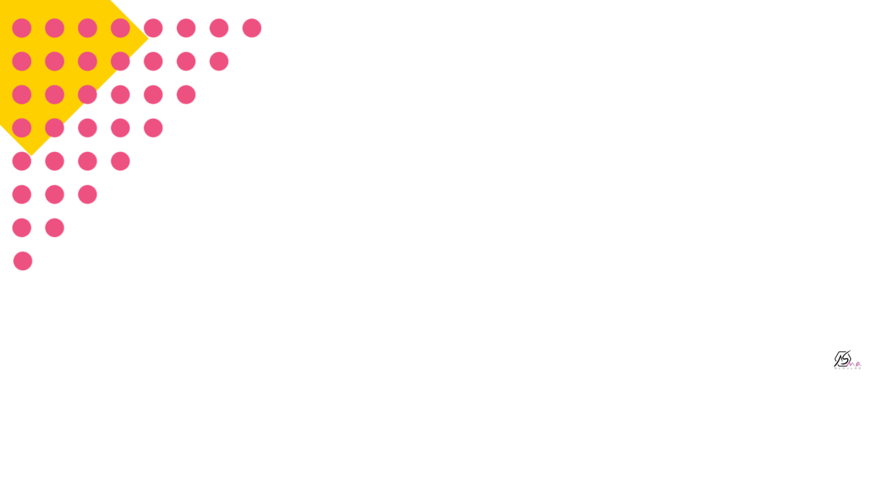
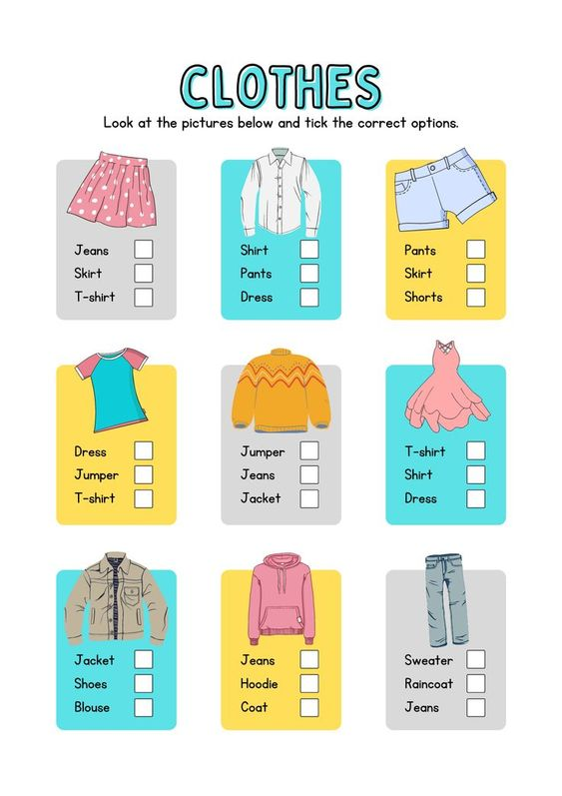


Tick the correct options

Slide 39
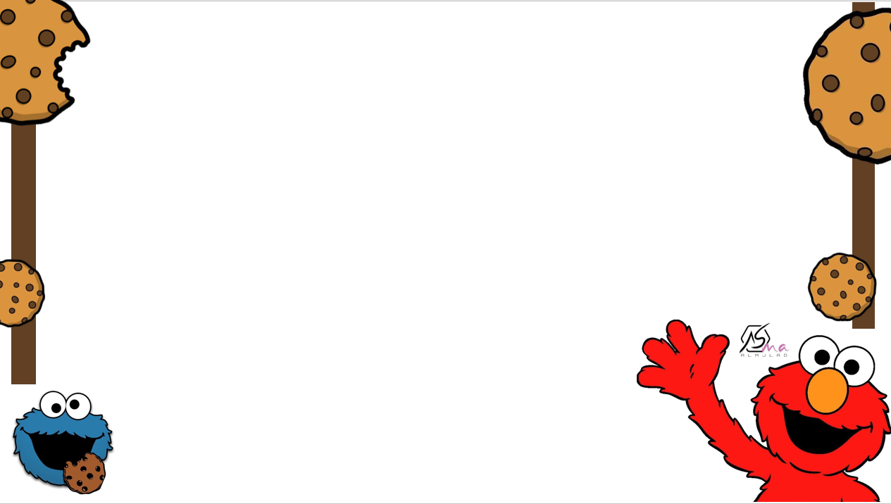


plural
singular
apple
apple

Slide 40
plural
singular
men
men

Slide 41
plural
singular
tables
tables

Slide 42
plural
singular
book
book

Slide 43
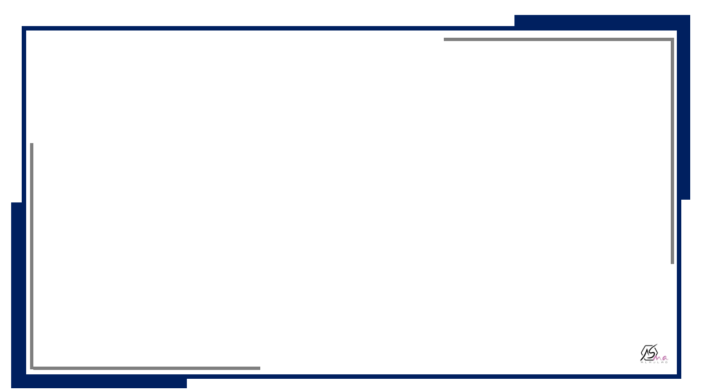


Who
Action
What
Where
When

Slide 44




I like……
I enjoy…….
start
I’m crazy
about……
I hate…….
I dislike…..

Slide 45





Slide 46




