Slide 1



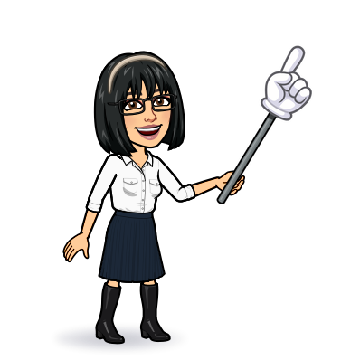


9 Writing
10 project
Today:
Date:
- -
Page 8
By: Dalal Al-Juaid

Slide 2


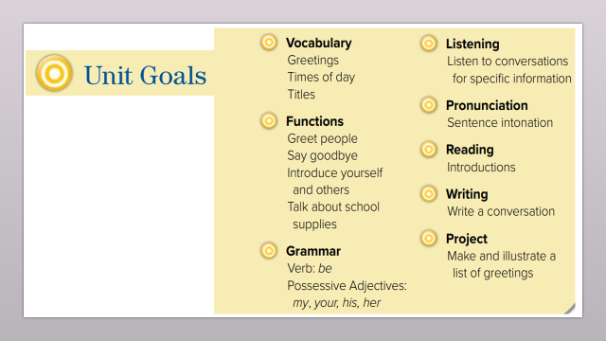
relate questions to their answers
Write a conversation to welcome a new student
Warm up
Writing corner
Write a list of formal and informal greetings
capitals
write
summative

Slide 3
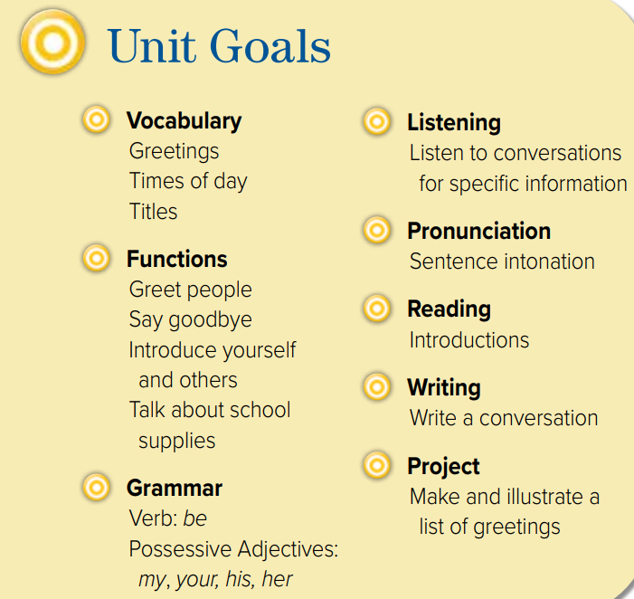

Slide 4

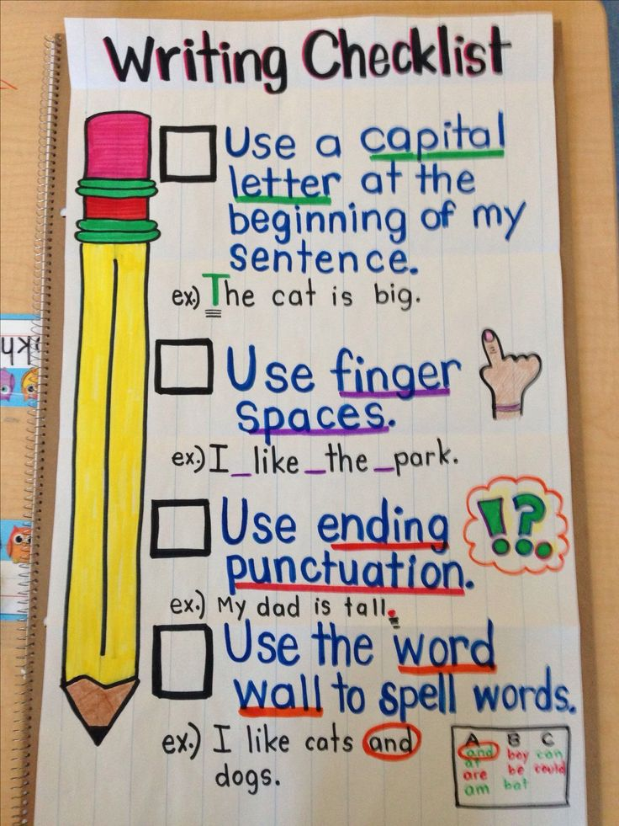

Warm up
Writing corner
capitals
write
summative

Slide 5


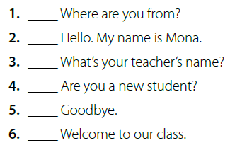
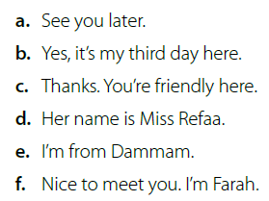
Page 8
e
f
Role play
d
b
Warm up
a
Writing corner
c
capitals
write
summative

Slide 6
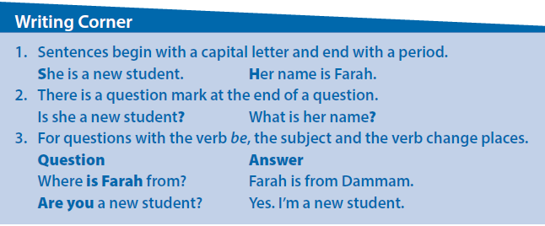


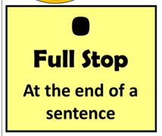
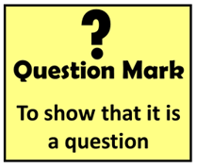
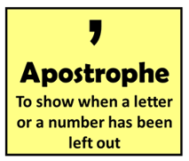
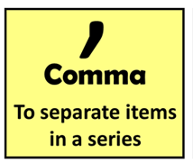



Page 8
Find examples on page 7 for
☺ capital letters,
☺ periods,
☺ question marks.
Warm up
Writing corner
capitals
write
summative

Slide 7
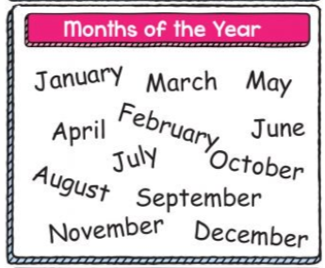
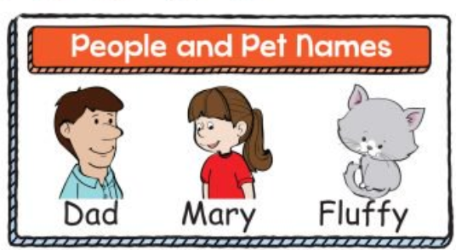


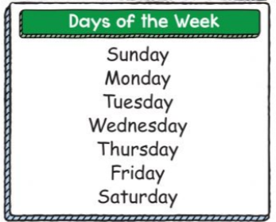
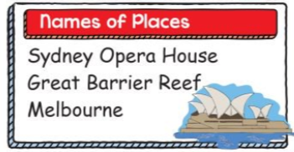
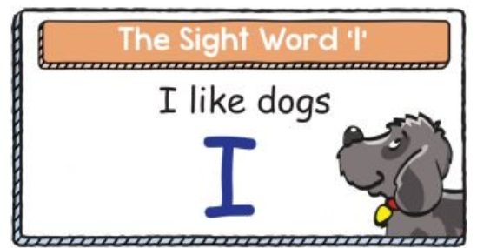

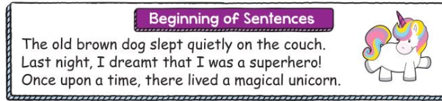

Slide 8



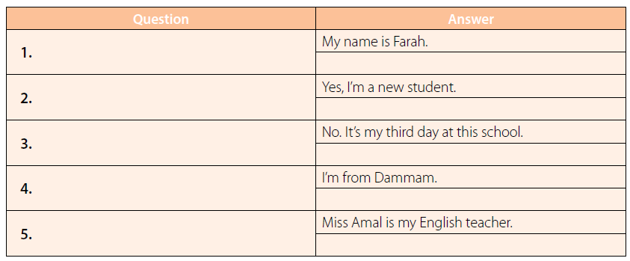



Read aloud
Think pair share
What’s your name?
Are you a new student?
Warm up
Is this your first day at this school?
Writing corner
Where are you from?
capitals
Who is your English teacher?
write
summative

Slide 9


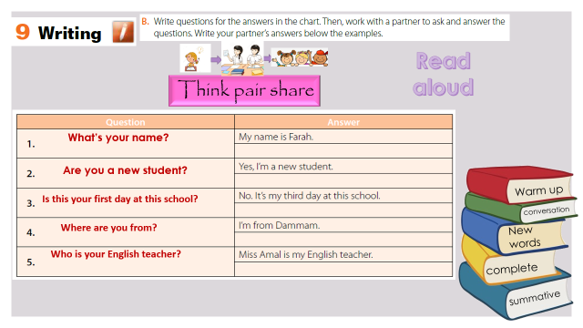

pair work
Wafa: Hi. My name’s Wafa. What’s your name?
Sara: Nice to meet you, Wafa. My name’s Sara.
Wafa: Are you a new student?
Sara: Yes, today is my first day here.
Wafa: Welcome to the class, Sara. Where are you from?
Sara: I’m from Riyadh.
Wafa: Welcome to Jeddah.
Sara: Thank you. It’s a wonderful place
Warm up
Writing corner
capitals
write
summative

Slide 10

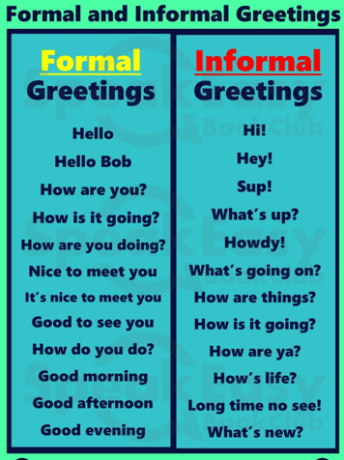
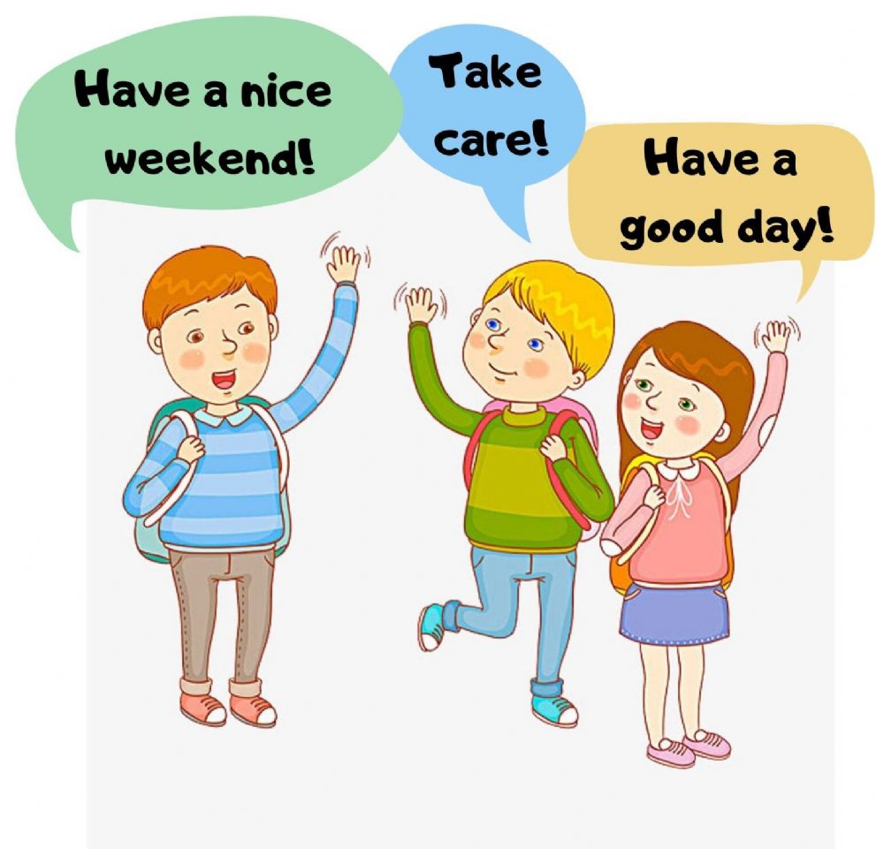


Slide 11





page 190 Ex (G)
for practice with writing
Warm up
Writing corner
capitals
write
summative

Slide 12

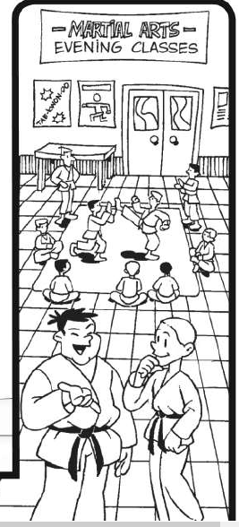
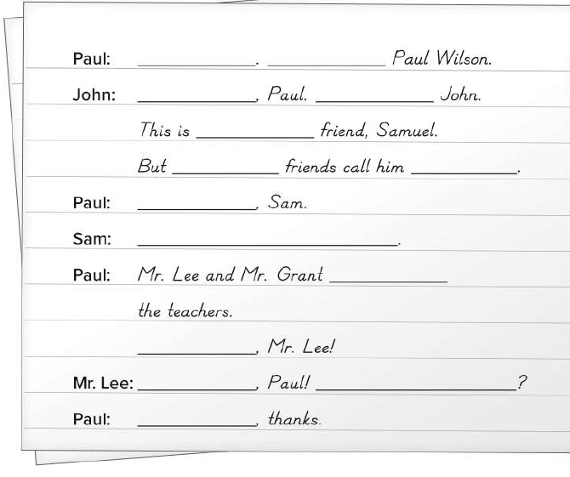
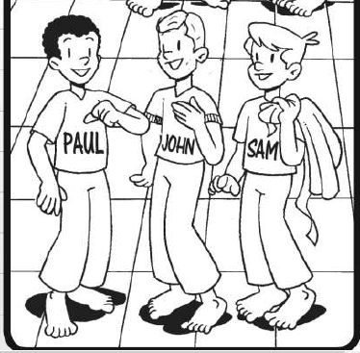
p.190
Hi
I’m
Hello
I’m
my
his
Sam
Nice to meet you
Nice to meet you, too
Warm up
are
Writing corner
Hello
capitals
Good evening
How are you
write
fine
summative

