Slide 1
Unit 4
The Art of Advertisement
Listen & Discuss
Mega Goal 1.1
Done by: Entisar Al-Obaidallah

Slide 2
Lesson Objectives
01
04
02
05
03
List
Answer
words related to the photos
Some questions about the text correctly
Describe
List
given products using their own words correctly
The words that describe the products
Deduce
The meaning of new words correctly

Slide 3
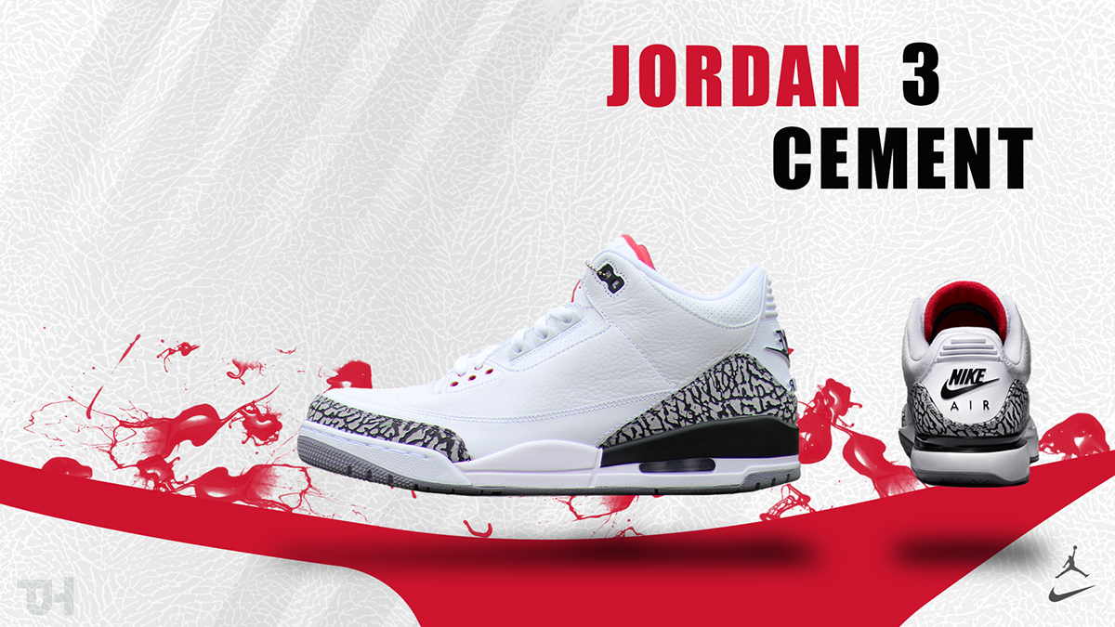


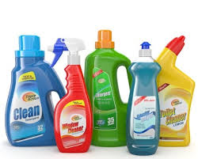

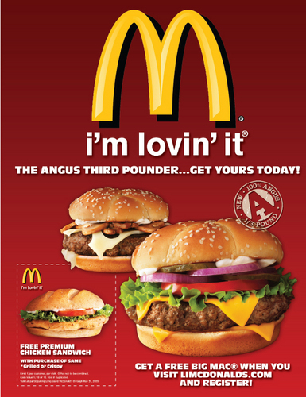
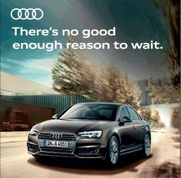

Warm Up
What does these photos show ?

Slide 4


What is advertisement ?
Advertisement announces new products and educate people about their benefits.

Slide 5

What is the purpose of advertisement?
Advertising has three primary objectives:
To inform
To persuade
To remind

Slide 6


Where can we find and see the ads?

Slide 7

ADS is the abbreviation of “ advertisement”

Slide 8
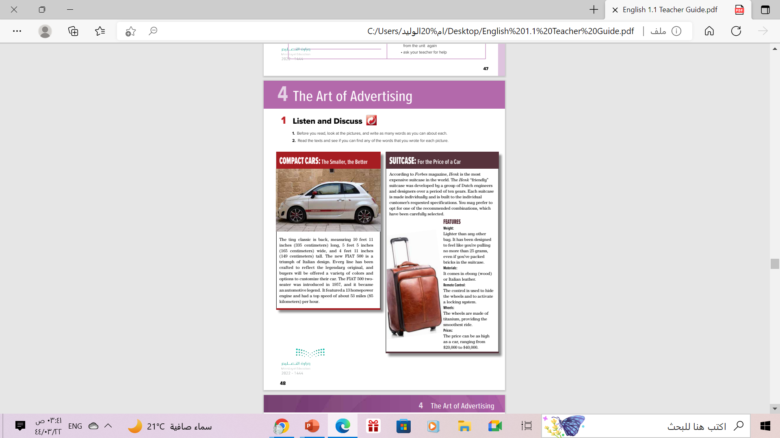
Open
your student’s book
p. ( 48)

Slide 9
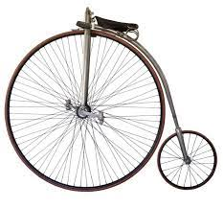
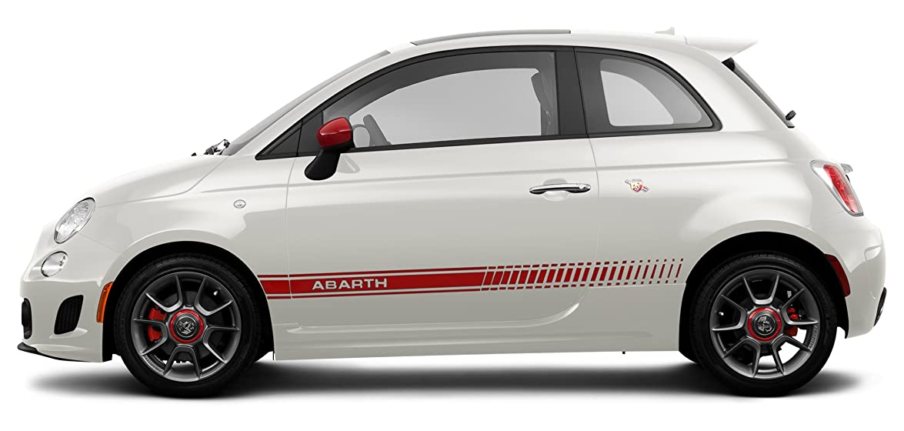
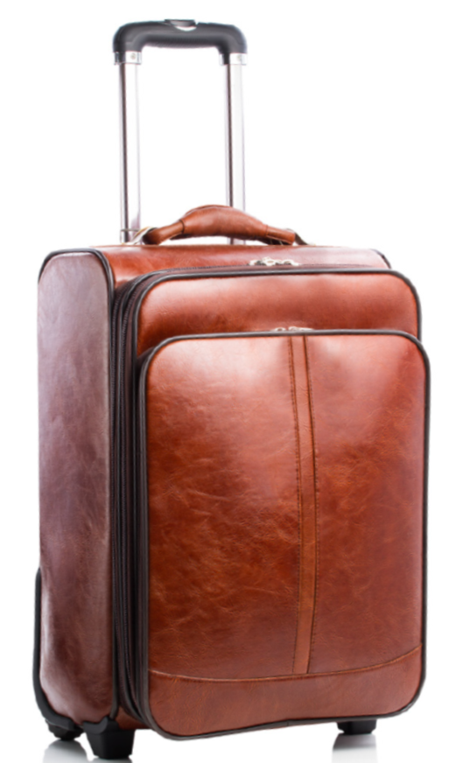
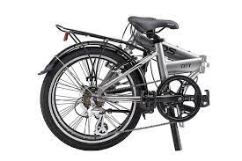
Before Reading
Write as many words as you can about each
What is each photo of?

Slide 10
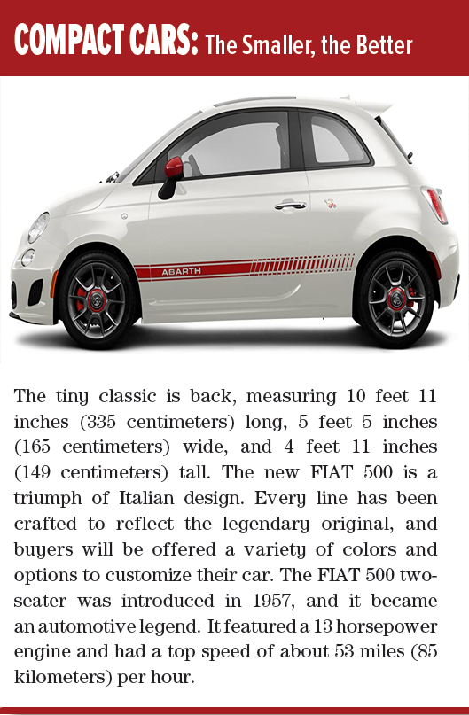
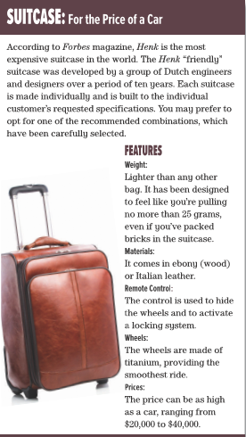
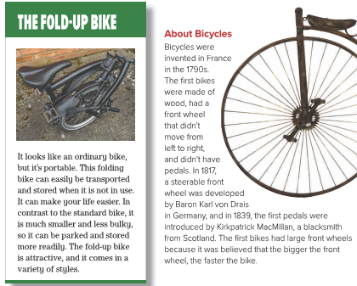
What is the theme of each part??
an advertisement &promoting a product

Slide 11
What is the product in each photo ?
4
2
3
1

Slide 12
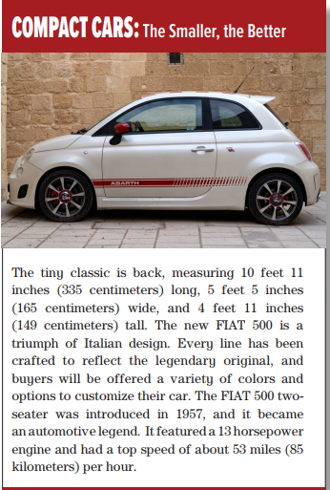

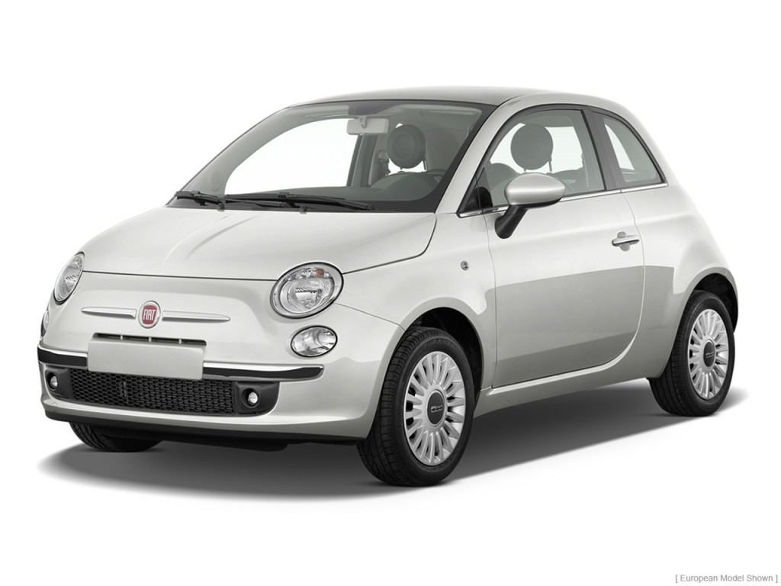
Listen & follow along
How would you Describe the product in this ad?
Compact car
a small and economical car
Triumph
a very great success, achievement, or victory

Slide 13
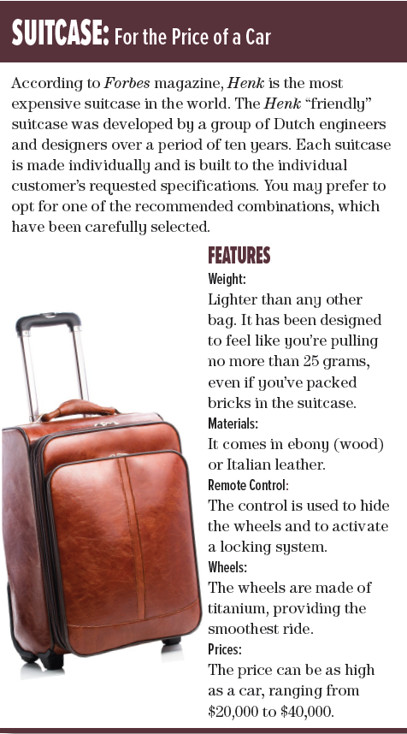
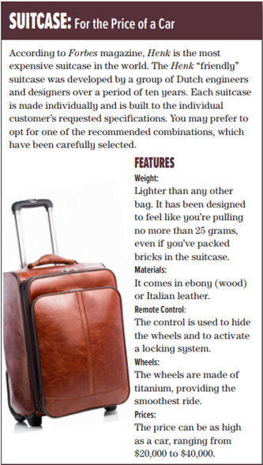
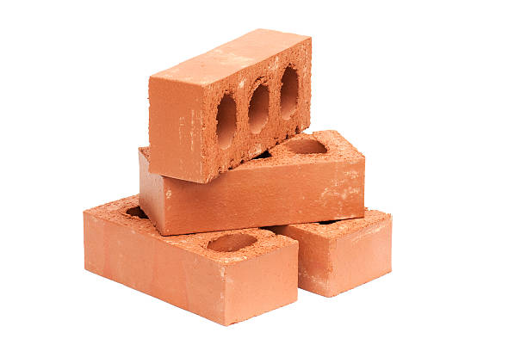
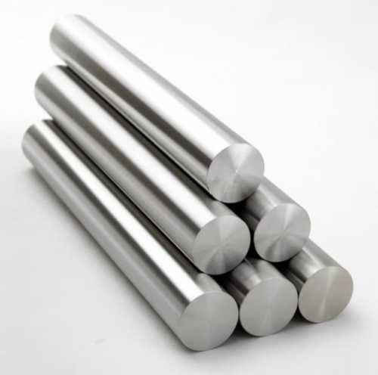
Listen & follow along
How would you Describe the product in this ad?
brick
a small, hard block of baked
claythat is used in building
Titanium
a light strong white metal.

Slide 14
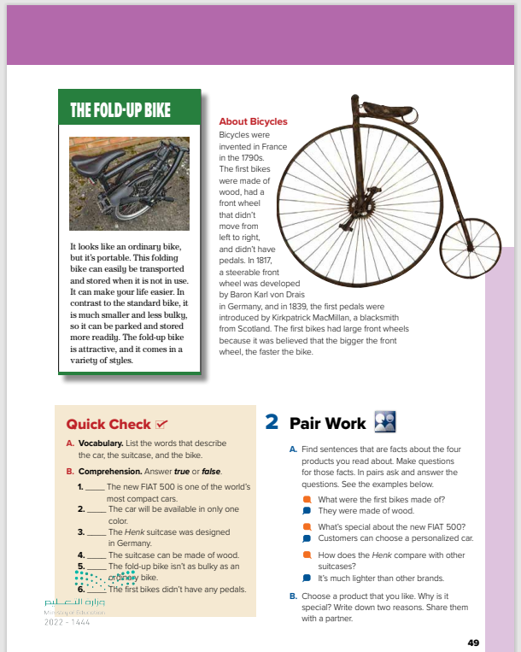
Open
your student’s book
p. ( 49)

Slide 15
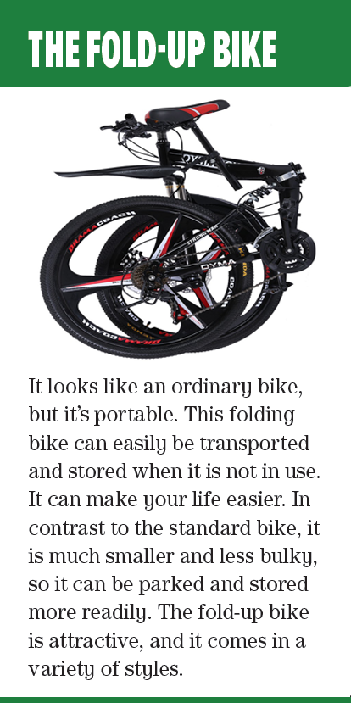
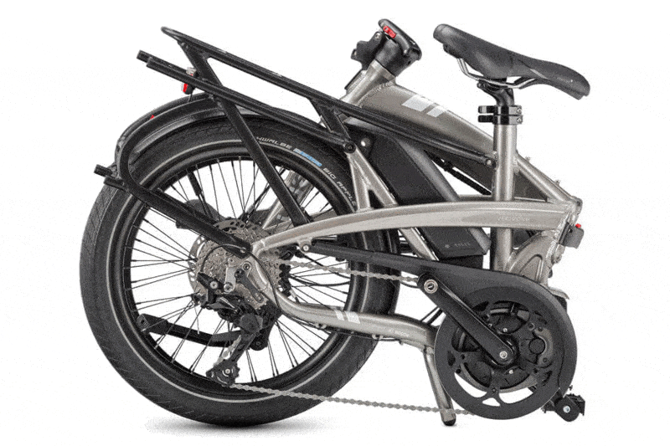
Listen & follow along
How would you Describe the product in this ad?
The Fold –Up Bike
a bicycle designed to fold into a compact form, for easy transportation and storage.

Slide 16
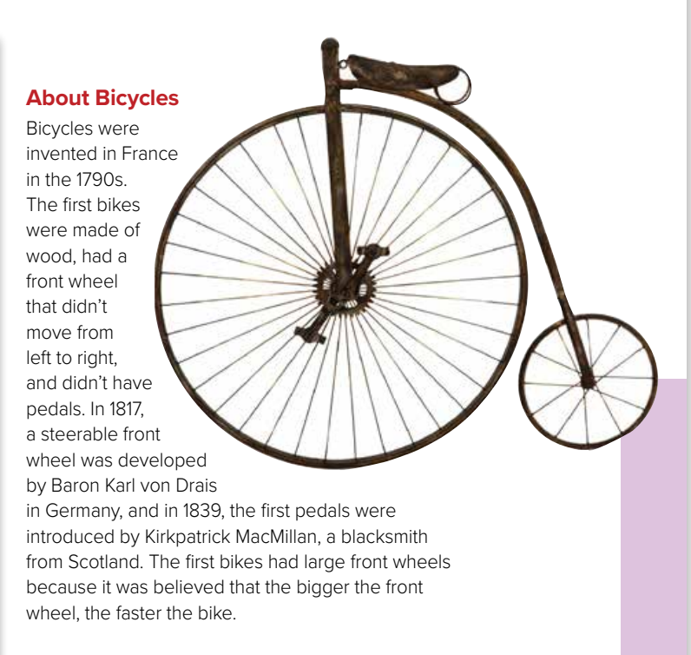
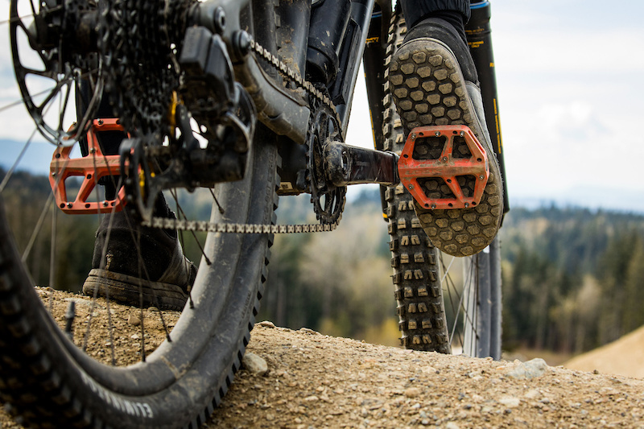
Listen & follow along
How is the old bicycle different
from bicycles today?
Pedals
a flat piece that you push with your foot to make a bike move

Slide 17
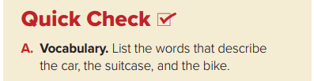
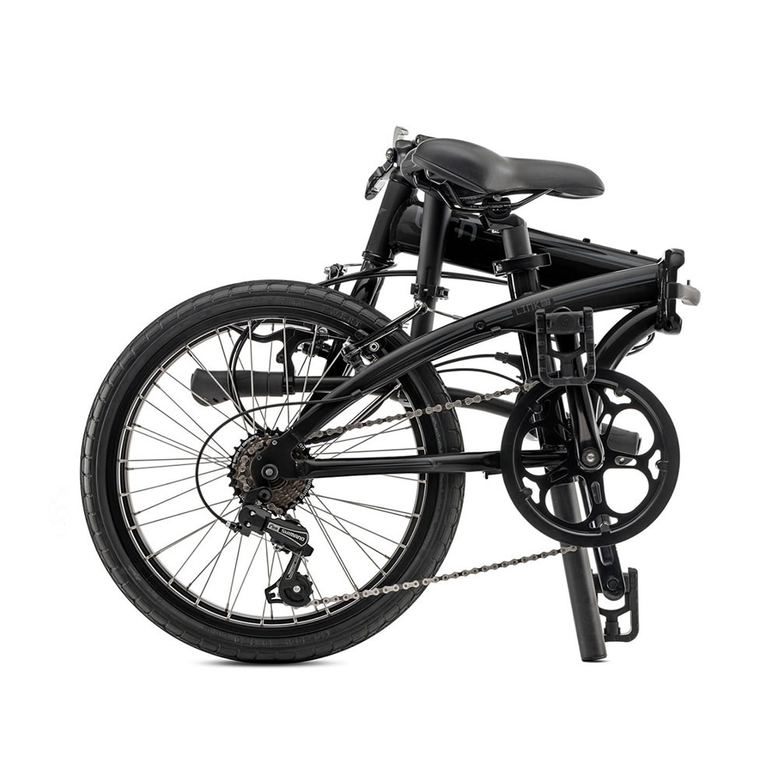
Car: tiny classic, new
Suitcase: most expensive, “friendly,”
lighter than any other bag, price as high as a car
Bike : portable , smaller and less bulky , attractive

Slide 18
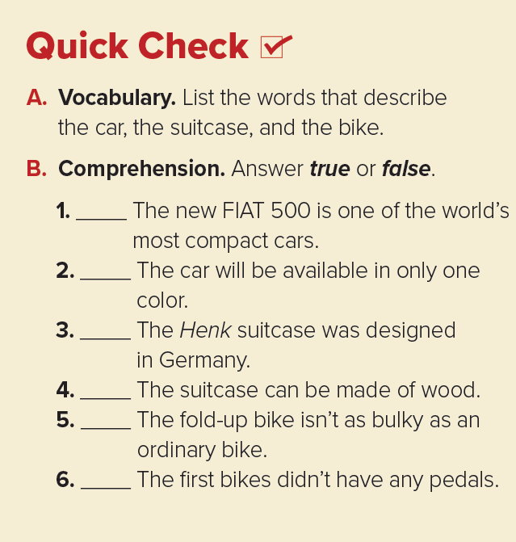
True
False
False
True
True
True

Slide 19
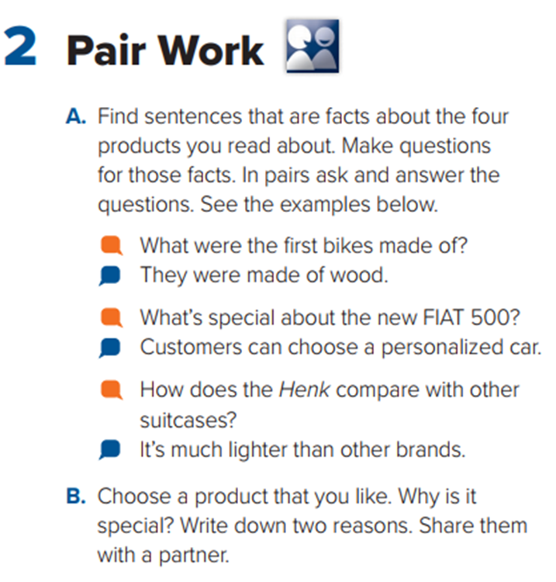


Slide 20
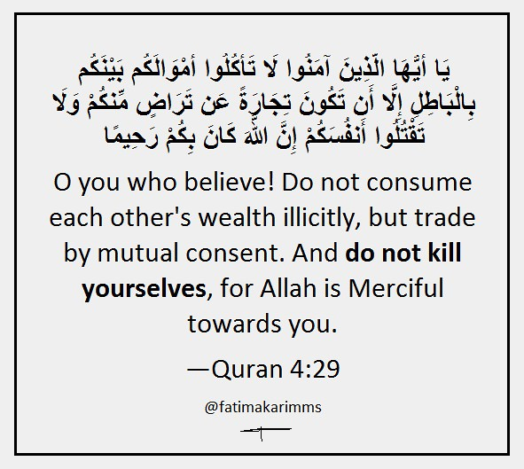
From The Holy Quran

Slide 21
Homework
Work book
P. (109) , Exercise (A)

Slide 22

Thanks!

