Slide 1
Mega Goal 1.1
Unit 3 - What will be will be
10 Writing
By: Essa Al Hussaini

Slide 2



Slide 3

Objectives
Make notes on a heard / read story “hidden treasure”
Use the notes to write a story

Slide 4
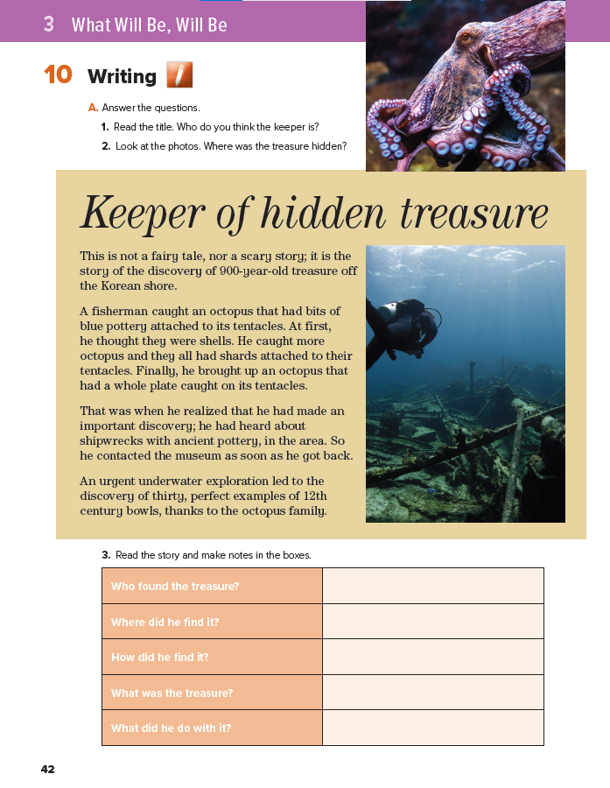
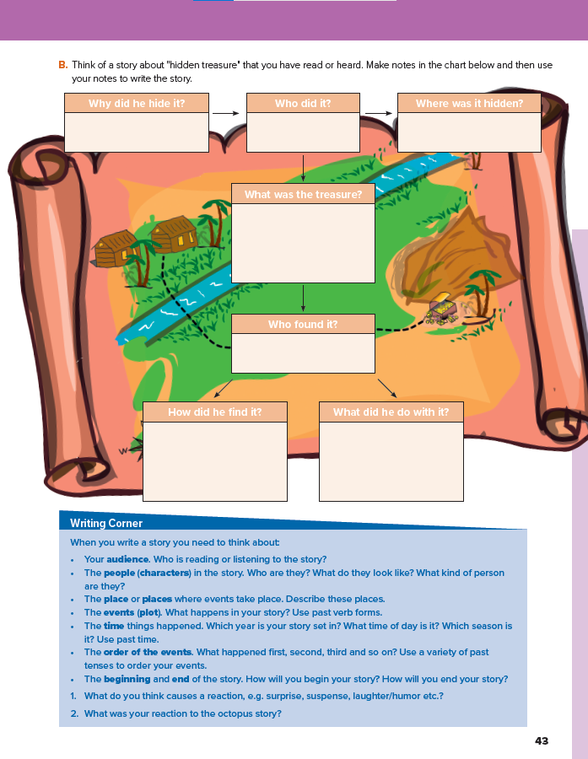
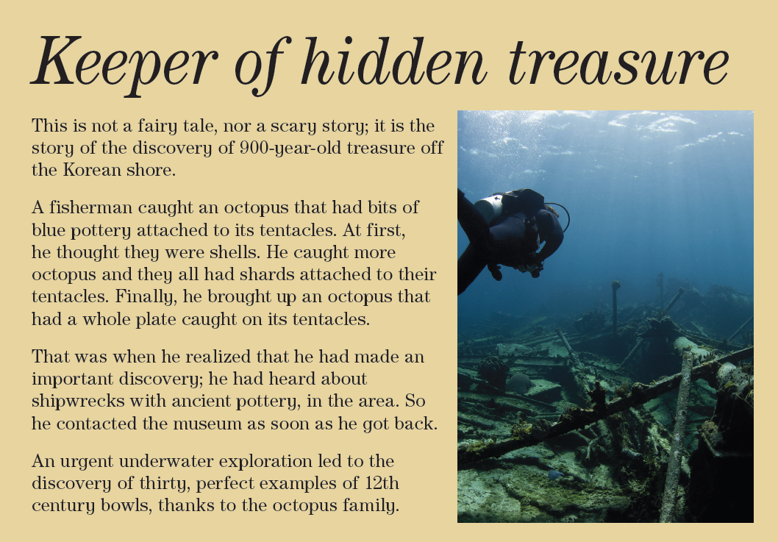

42-43

Slide 5

42
In the pictures,
I can see ..
I think the
blue is..
I think the
keeper is ..
Notes:
A keeper = caretaker = is someone who is responsible for something
Tentacle = feeler = arm and leg
A shipwreck is the ruins of a ship that is sunken to the bottom of sea
Treasures is a quantity of precious metals, gems, or other valuable objects

Slide 6



42
Listen & follow
Make Notes
I think the
treasure might be …
Who found the treasure?
Where did he find it?
How did he find it?
What was the treasure?
What did he do with it?
I think the
treasure was hidden in ..
Notes:
A keeper = caretaker = is someone who is responsible for something
Tentacle = feeler = arm and leg
A shipwreck is the ruins of a ship that is sunken to the bottom of sea
Treasures is a quantity of precious metals, gems, or other valuable objects

Slide 7

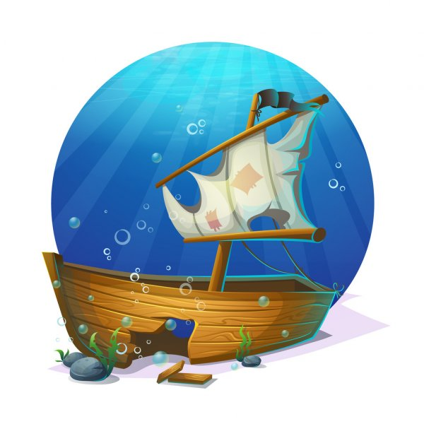
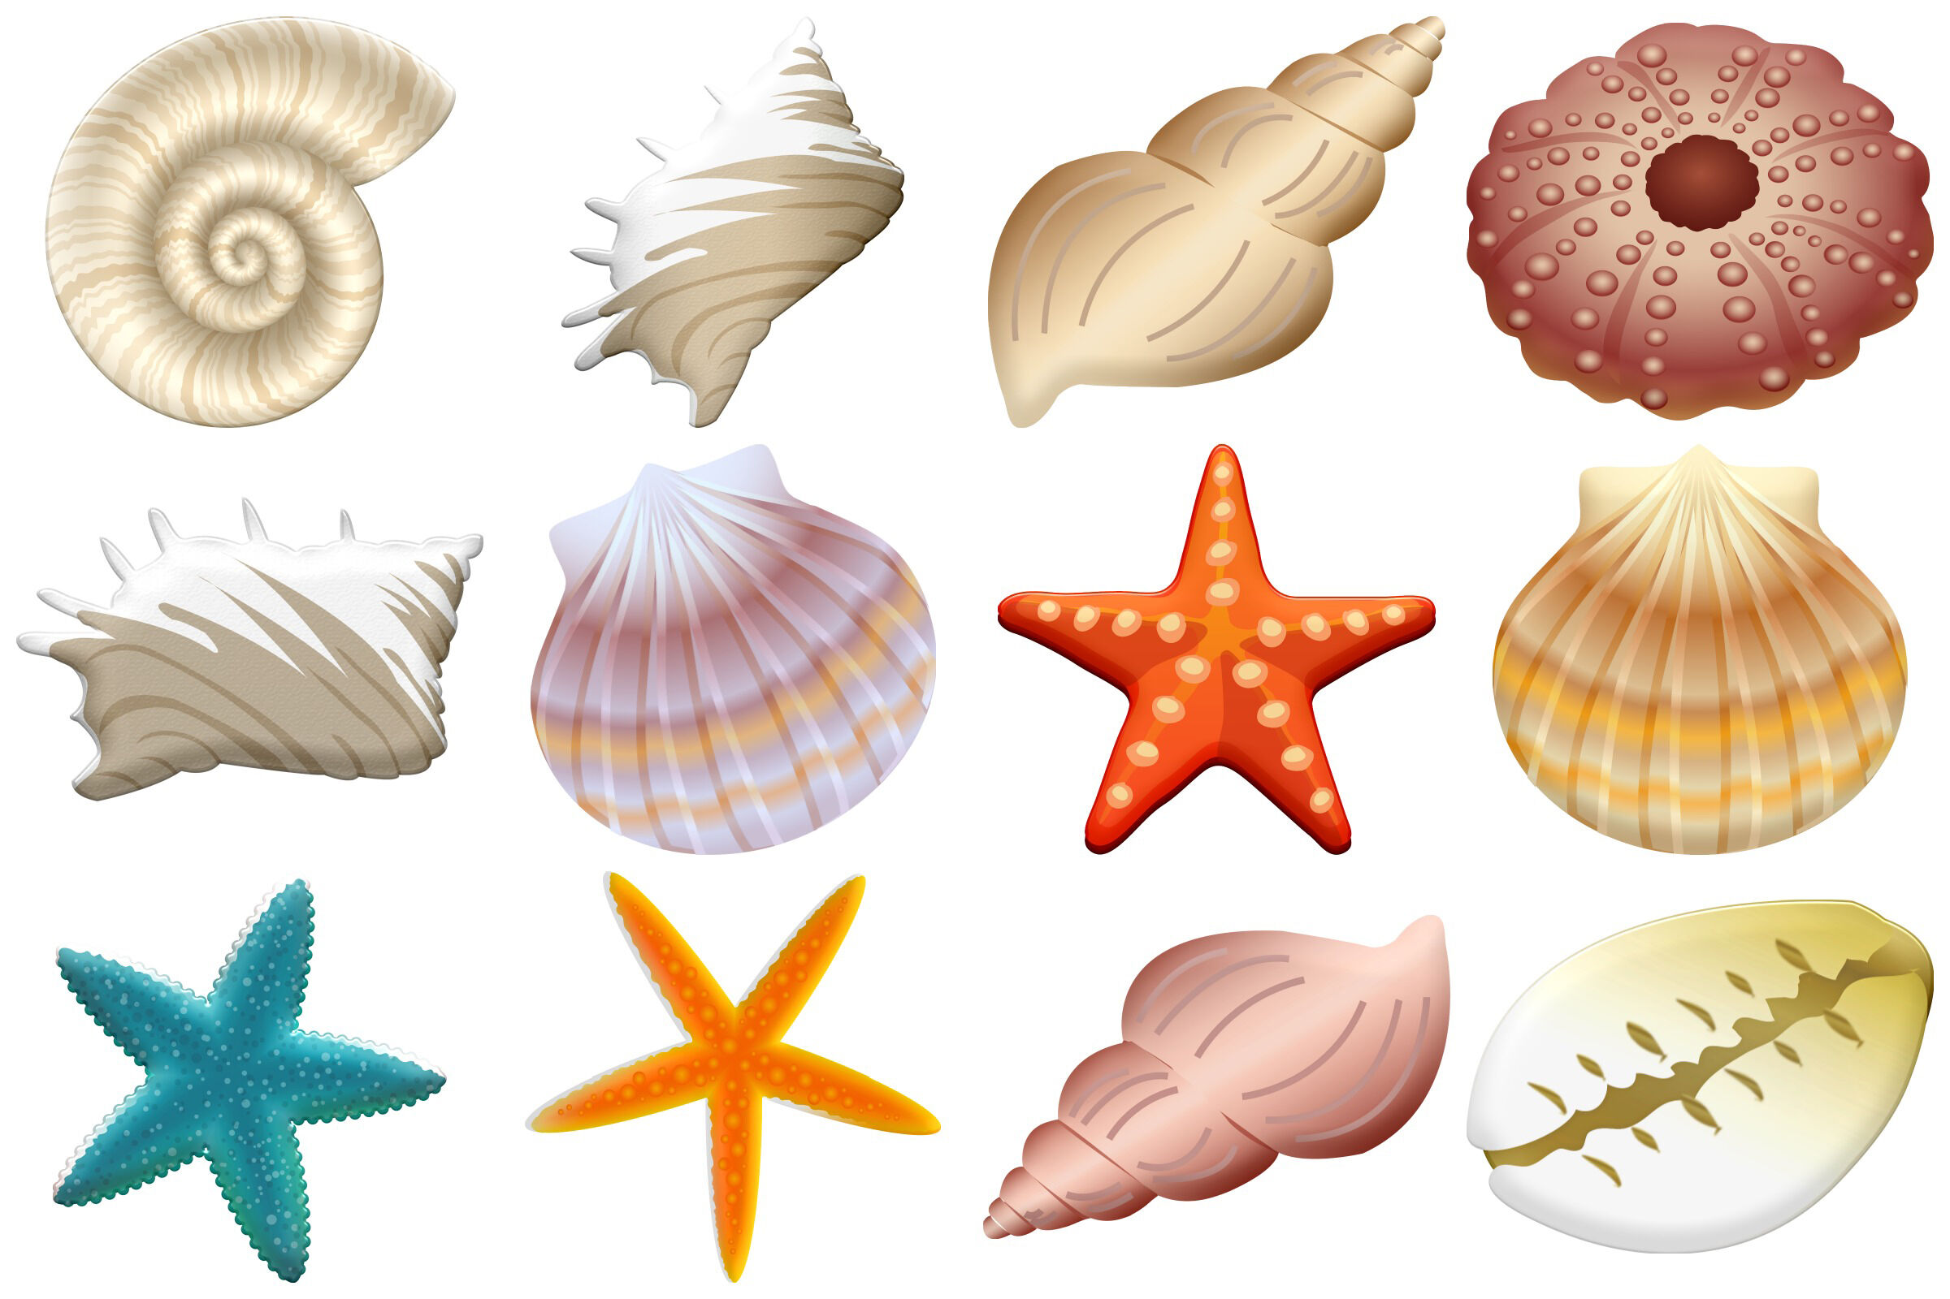

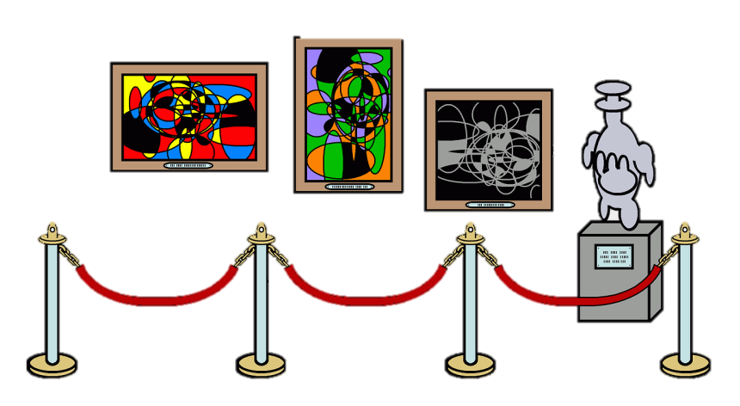
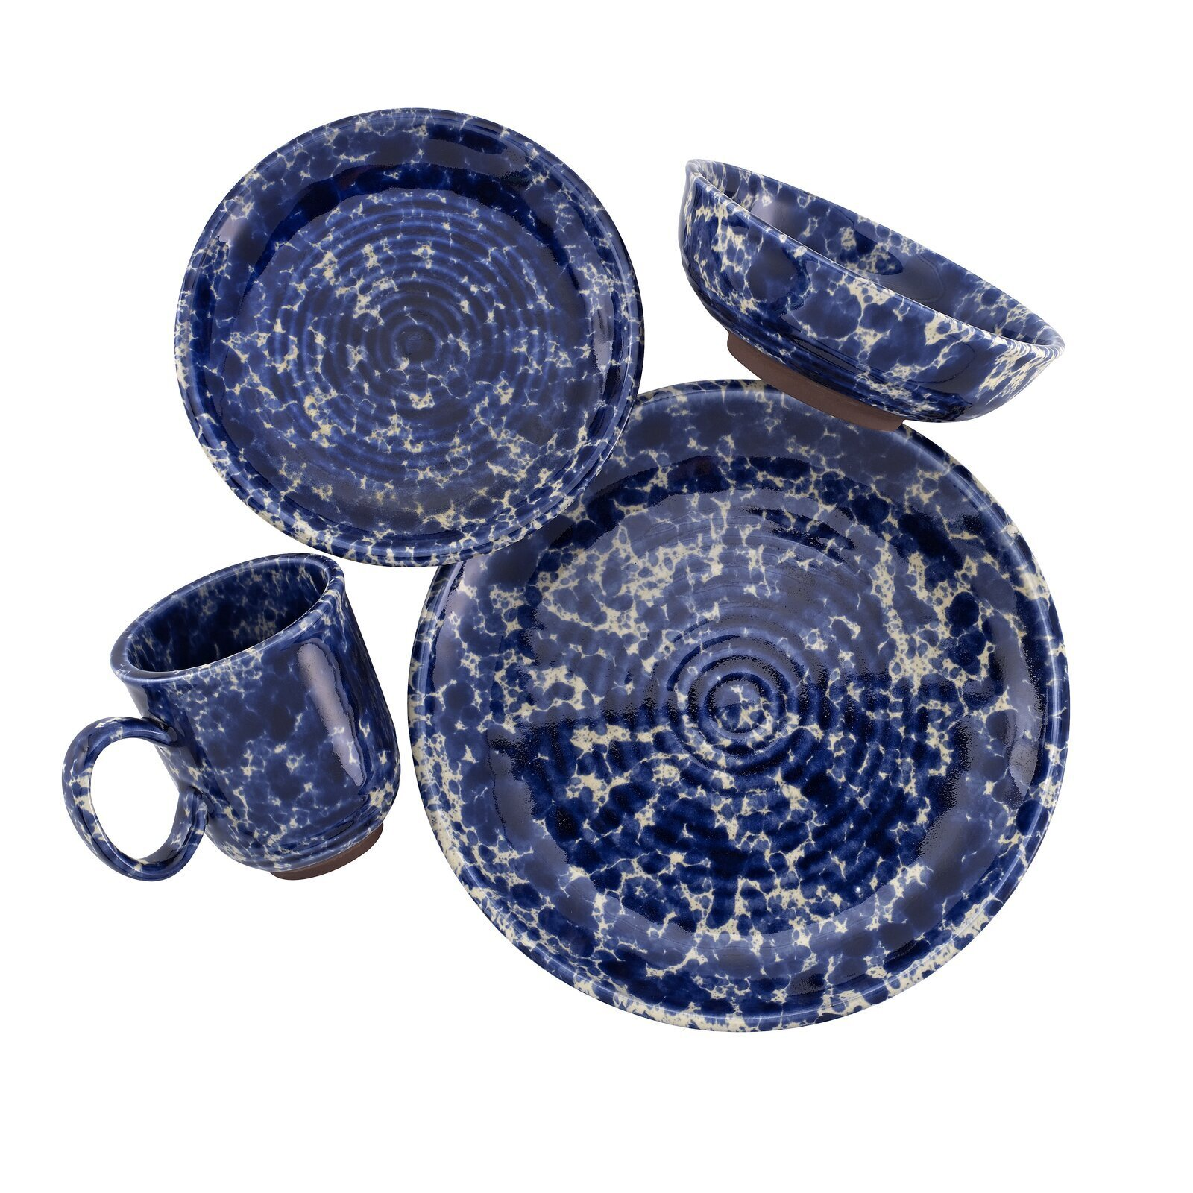
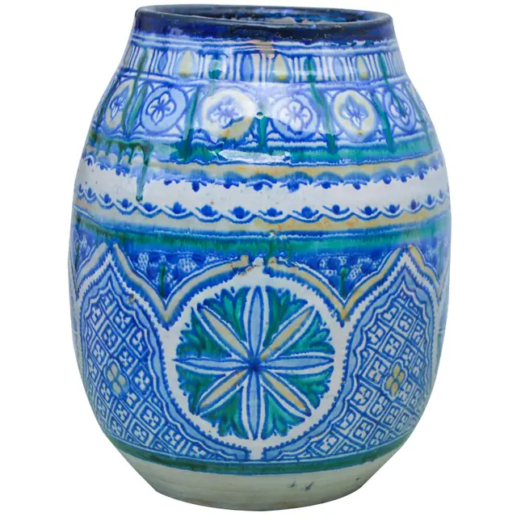
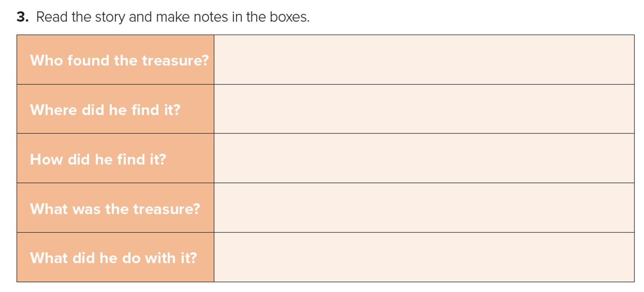
42
Listen & follow
Make Notes
Who found the treasure?
Where did he find it?
How did he find it?
What was the treasure?
What did he do with it?
Notes:
A keeper = caretaker = is someone who is responsible for something
Tentacle = feeler = arm and leg
A shipwreck is the ruins of a ship that is sunken to the bottom of sea
Treasures is a quantity of precious metals, gems, or other valuable objects

Slide 8

42
a fisherman
Would / wouldn’t
you have done
the same? WHY?
near the Korean shore
He caught an octopus with blue shards attached to its tentacles.
Then caught another octopus with a whole plate
Your opinion on
fisherman’s decision
Thirty perfect 12th century bowls
He contacted the museum

Slide 9


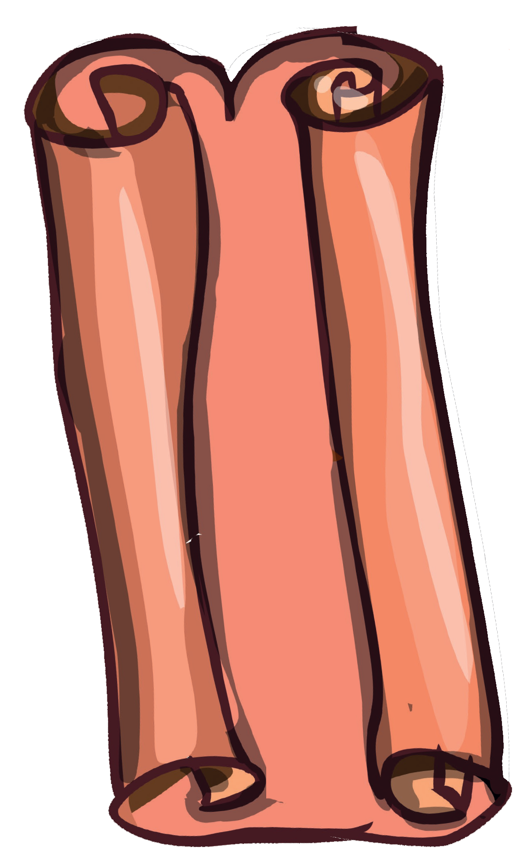
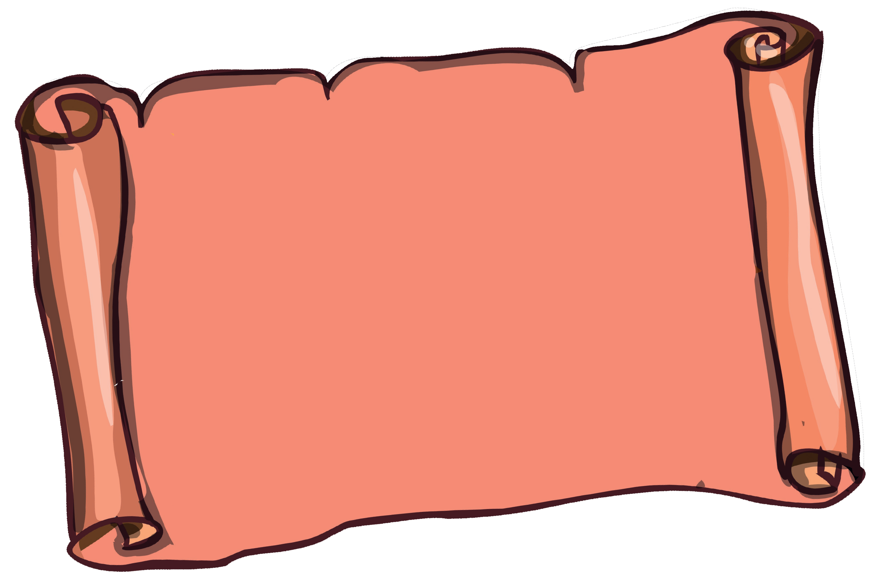


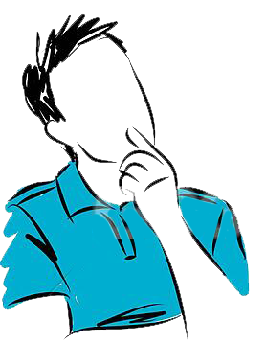





43
Why did he hide it?
Who did it?
Where was it hidden?
What was the treasure?
Who found it?
How did he find it?
What did he do with it?
NOTES on a story "hidden treasure" you have
read or heard

Slide 10
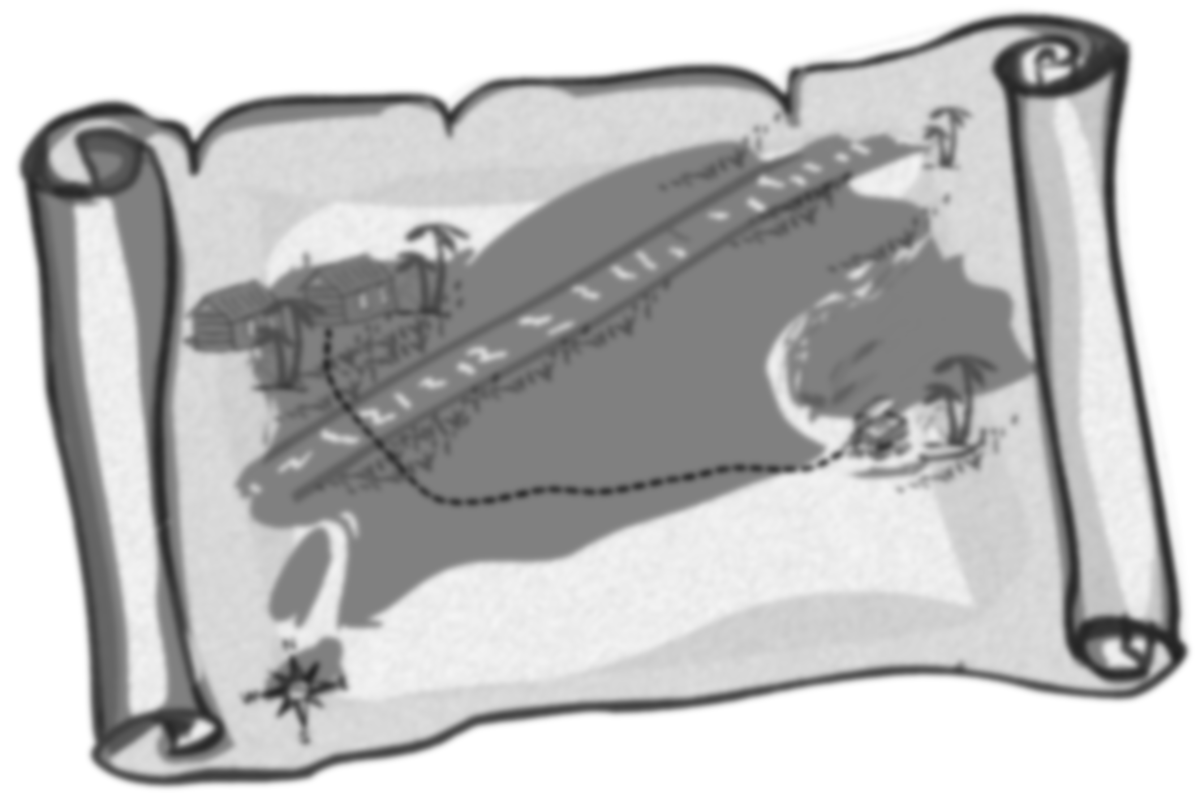
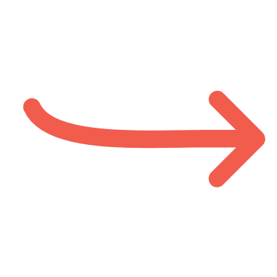

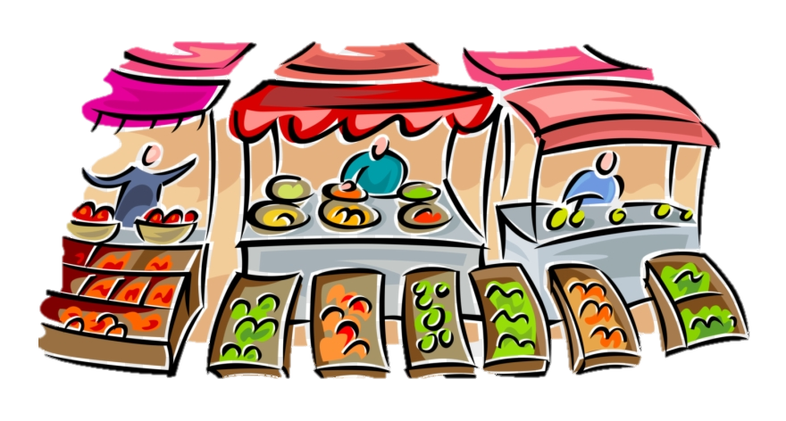
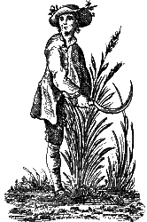
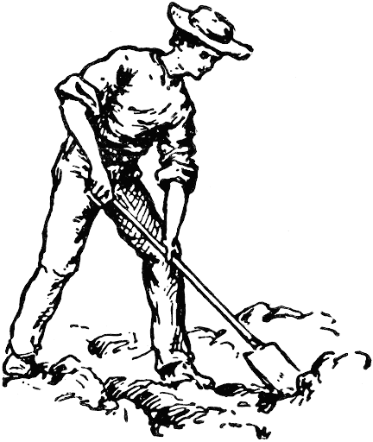
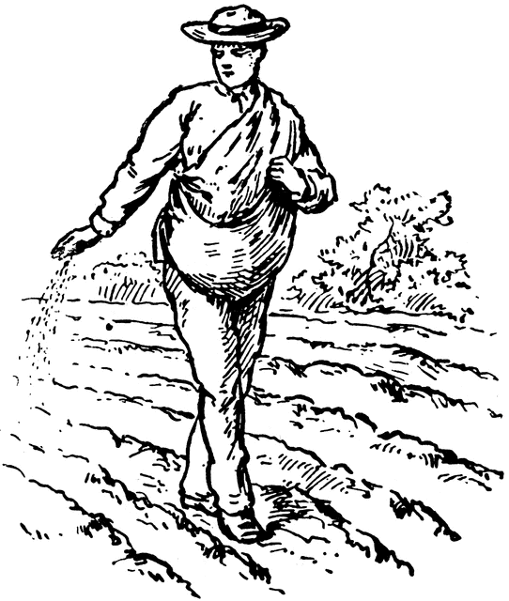
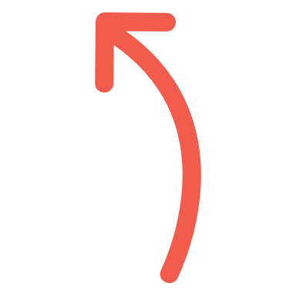
43
Why did he hide it?
Who did it?
Where was it hidden?
to motivate his son to work hard
an old farmer
in the farmer’s field
What was the treasure?
NOTES on a story "hidden treasure" you have
read or heard
The value of hard work
Who found it?
the son
How did he find it?
What did he do with it?
digging the field
Planting seeds
sold the crops

Slide 11
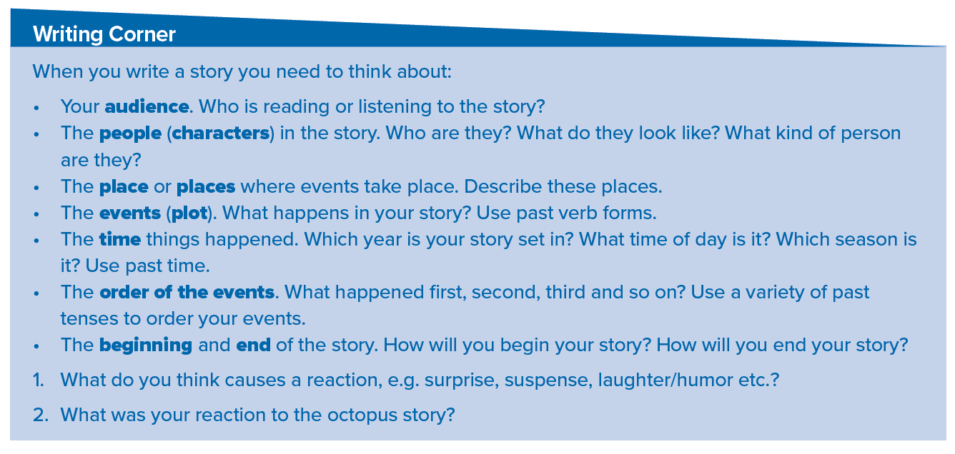
43

Slide 12
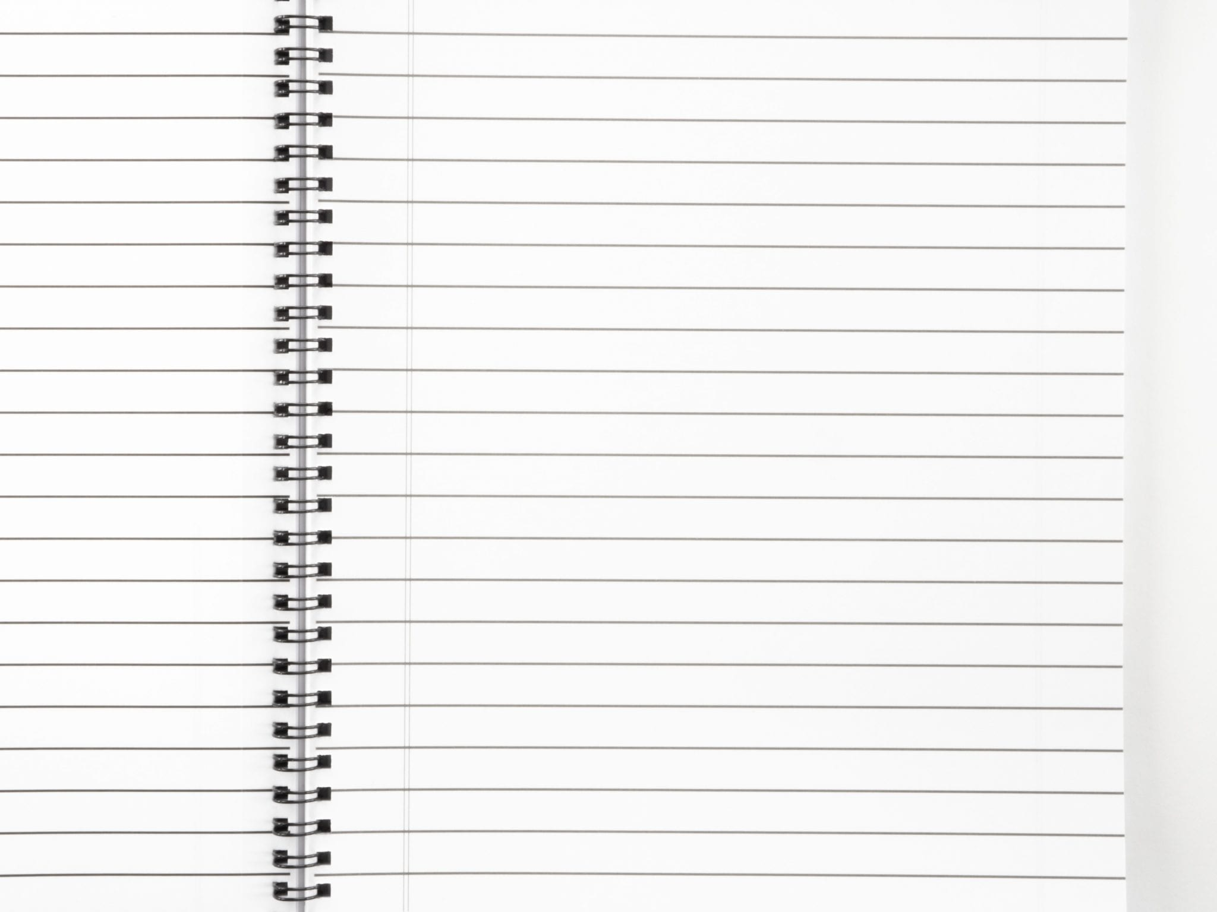
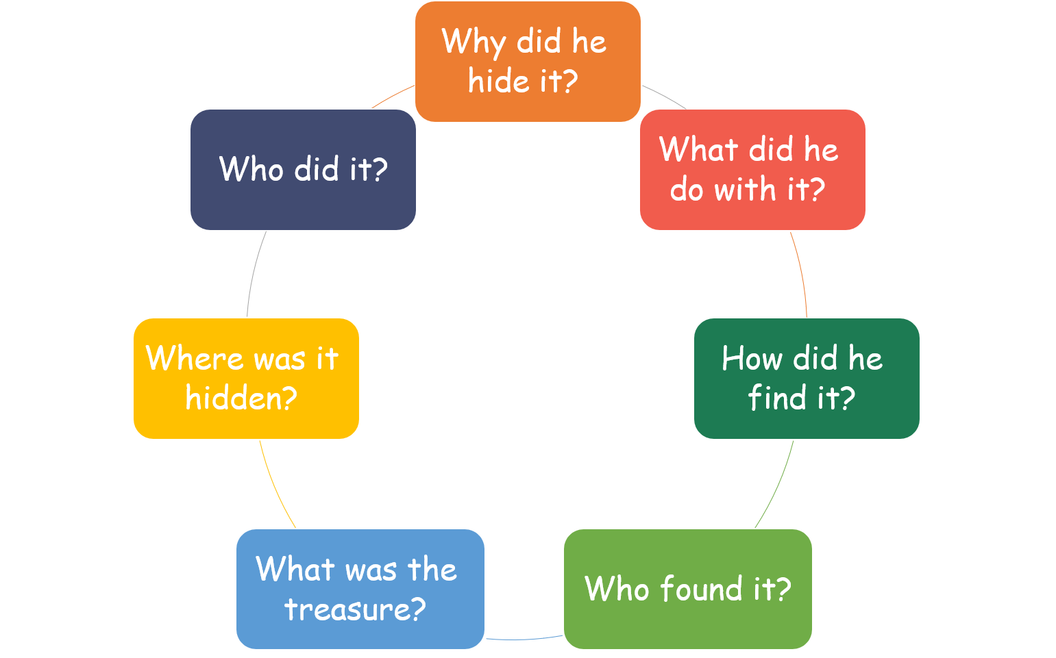

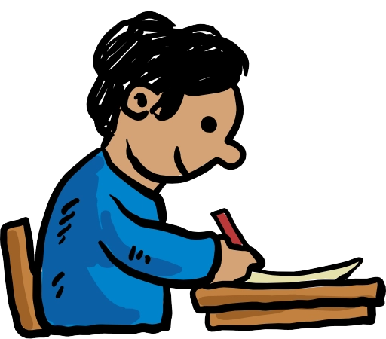
MODEL
Hard Work Pays Off
There lived a son. He was lazy and poor. One day, he remembered his father's talk about a treasure that his father had buried in his field before he died but he forgot the place.
The son started digging the field and kept digging for days but he found no treasure.
In meantime, a passerby came and advised the son to plant some seeds. He acted upon his advice. Soon the seeds grew into crops. He sold the crops in the market. He became a rich.
Then he realized his father trick that is the value of hard work.
to motivate his son to work hard
an old farmer
sold the crops
in the farmer’s field
dig the field
plant seeds
The value of hard work
the son

Slide 13
HOMEWORK
Use your notes to write your story

Slide 14


