Slide 1
Unit2
Careers
Writing
Done by: Entisar Al-Obaidallah

Slide 2
Lesson Goals
1
Take
2
Analyze
3
Find
4
Write
notes on a written text
a cover letter correctly
the information to fill in the chart
a cover letter correctly

Slide 3
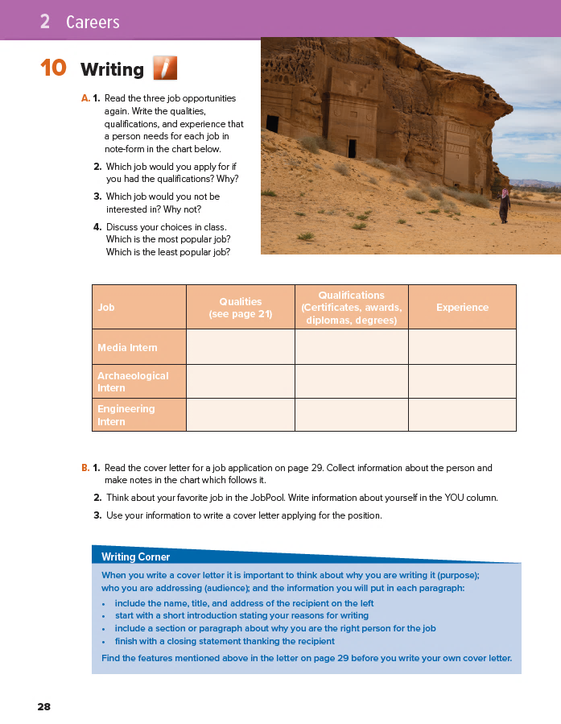
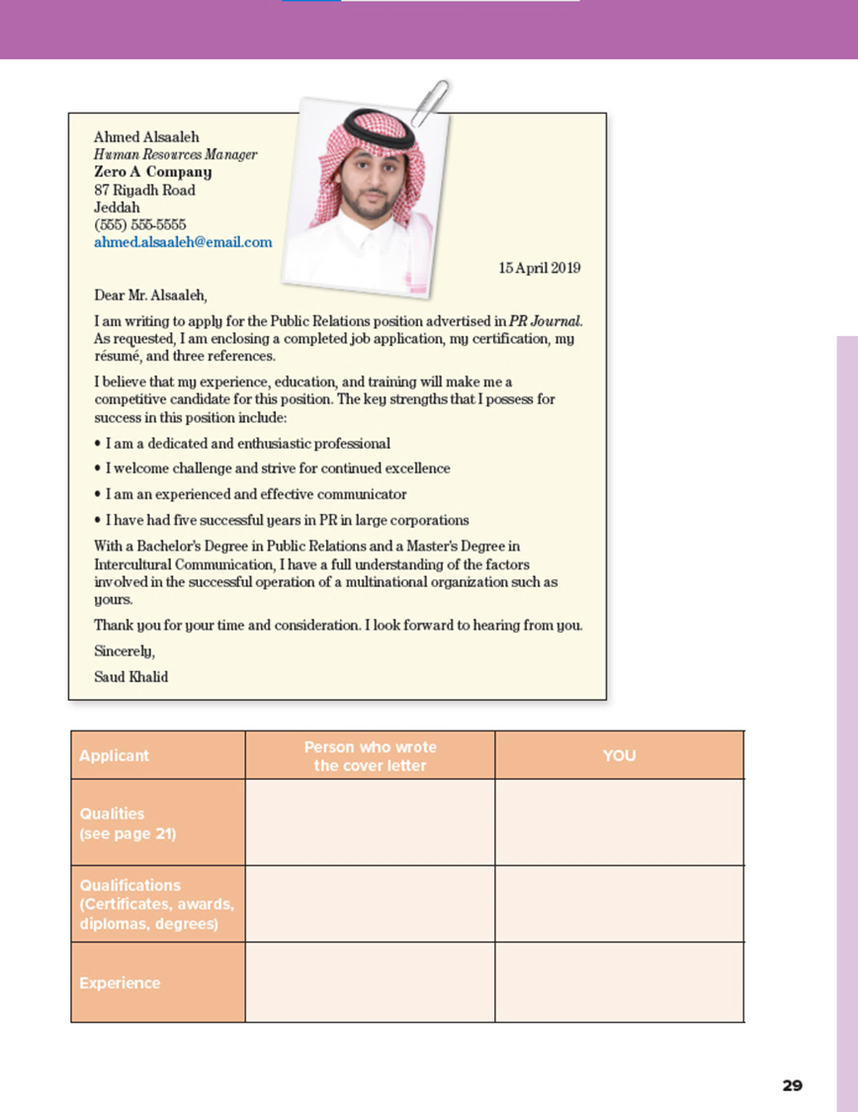

Book Open
pages.(26- 27)

Slide 4
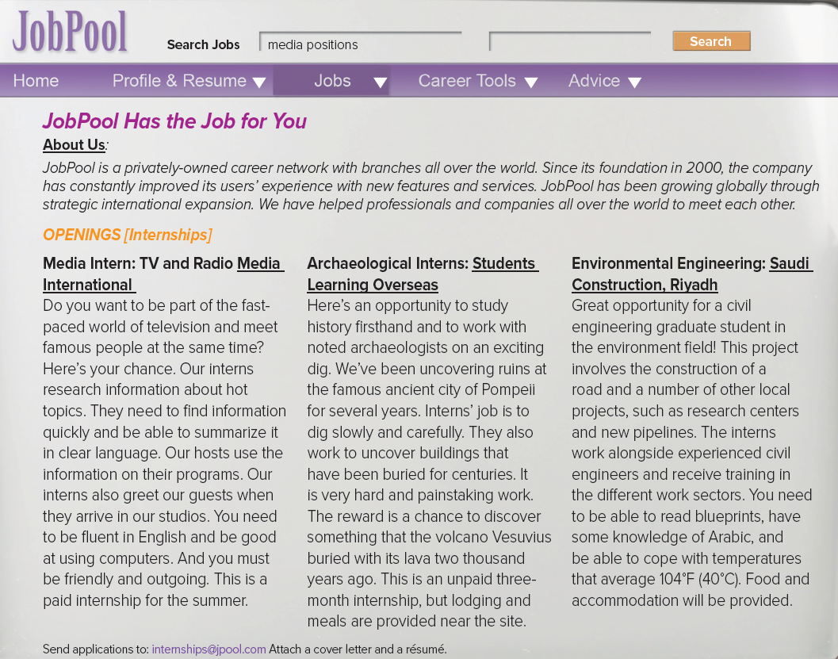
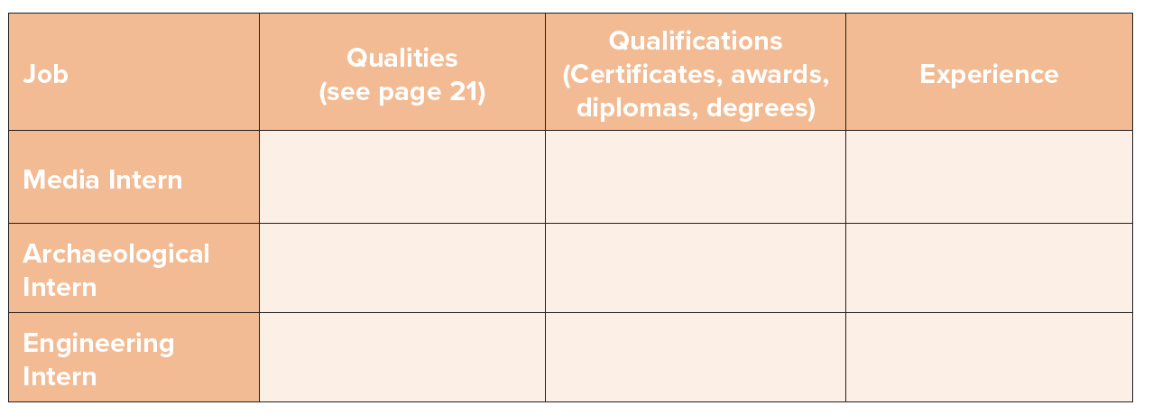
Read & Find

Slide 5
Find information quickly
Summarize - clear language
Fluent English
Computer Skills
Friendly & outgoing
Not applicable
( no mention )
Research and public
relations
Careful & methodical
interested in history
Interested in archeological
working with noted
archeologists
Not applicable
no mention probably
experience is not
a necessary requirement
Not applicable
( no mention )
ability to read blueprints
knowledge or Arabic
tolerance to high
temperatures
Degree in civil engineering
graduate student
Not required

Slide 6
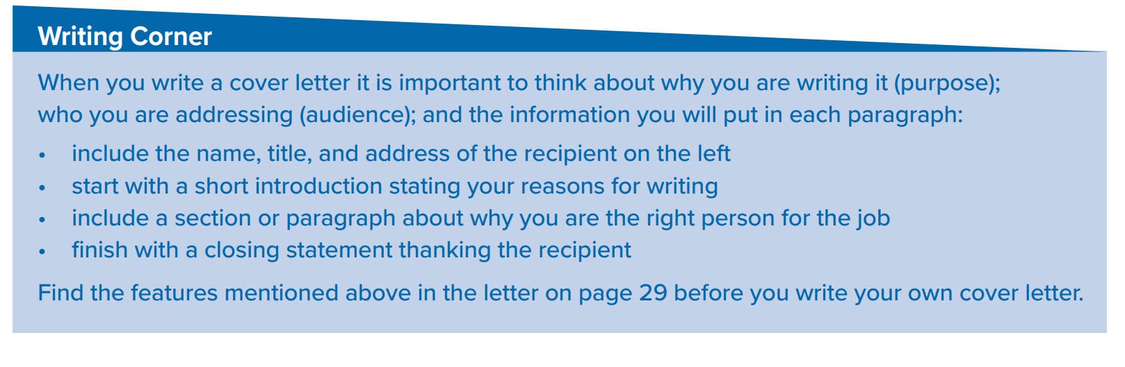
Follow these steps to write a cover letter

Slide 7
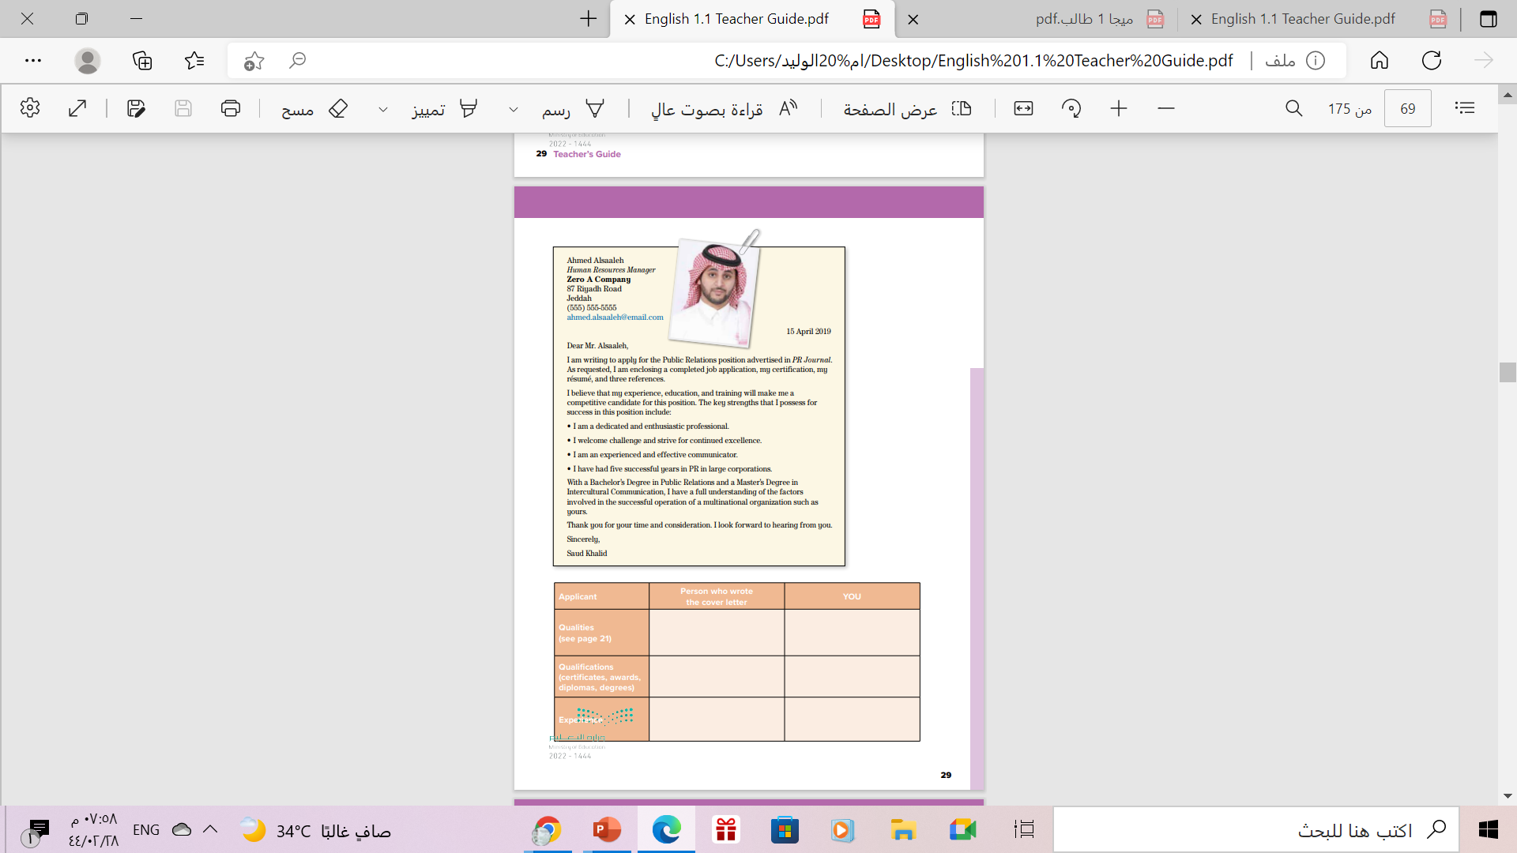
Open
Student’s book ,
Page ( 29 )

Slide 8
What is a cover letter?
A cover letter is a one-page document that you include in a job application (along with your resume). Your cover letter should introduce you to an employer, and give them additional information about your qualifications and character.

Slide 9

The goal of a cover letter is to convince employers that you’re interested in and qualified for a job.
Your cover letter is also a great place to provide additional details about your work history, skills, or life situation to a prospective employer.
When written well, your cover letter provides important information that your resume isn’t able to communicate.

Slide 10
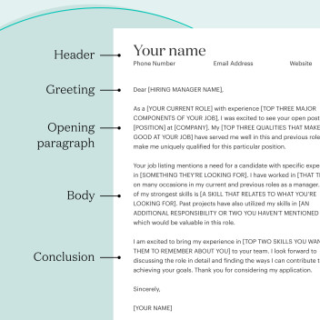
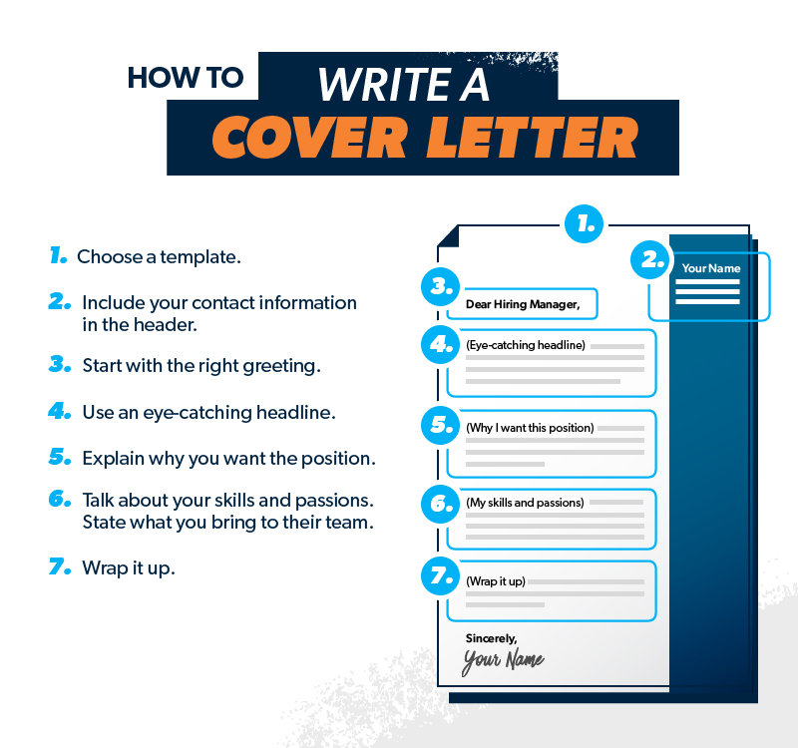
Parts of
a Cover Letter

Slide 12
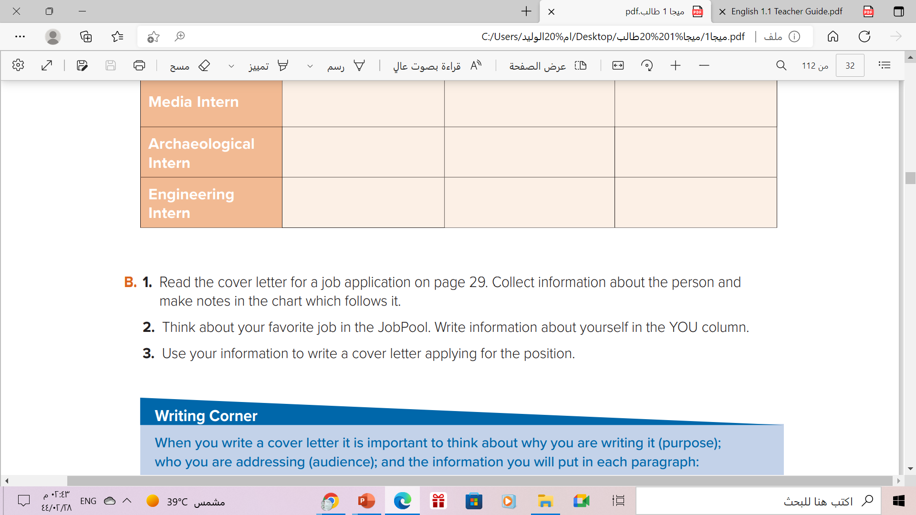
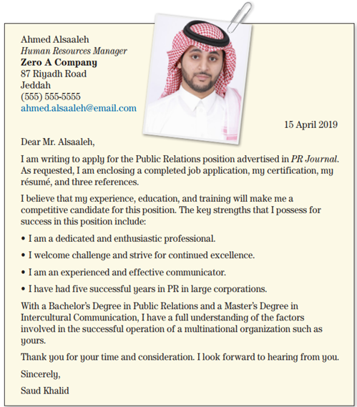
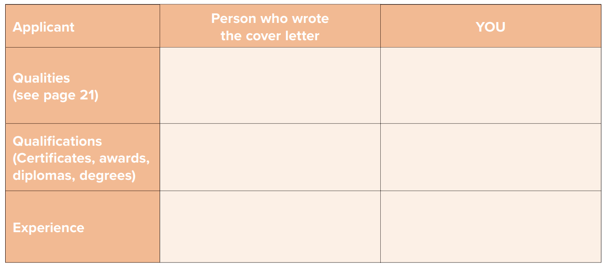

Slide 13
a dedicated & enthusiastic
professional.
an experienced & effective
communicator
Communication skills
Interpersonal skills
Teamwork
a Bachelor’s Degree in
Public Relations & a Master’s Degree in Intercultural Communication
Degree in Media
Diploma course in English
Five successful years in
PR in large corporations
Three years experience as
TV reporter

Slide 14
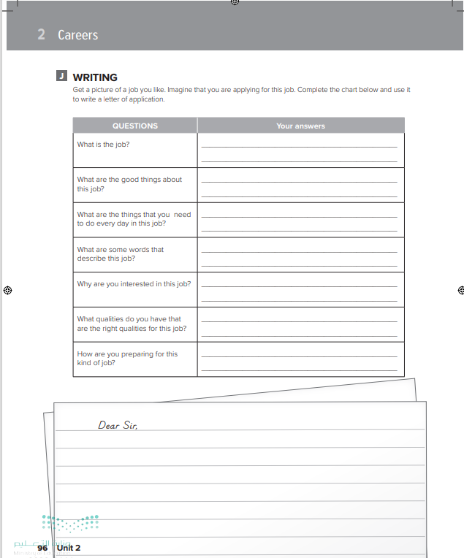
Homework
Workbook P. (96) ,
exercise ( J )

Slide 15

From The Holy Quraan

Slide 16

Thanks!

