Slide 1
Unit2 Careers Language in context+ Conversation
Done by:
Entisar Al-Obaidallah

Slide 2
Lesson Objectives
Creat
Differentiate
01
03
Complete
Listen
02
04
a job profile
the sounds /m/ ; /n/ ; /ŋ/
a chart from a job interview
for specific information about the conversation

Slide 3
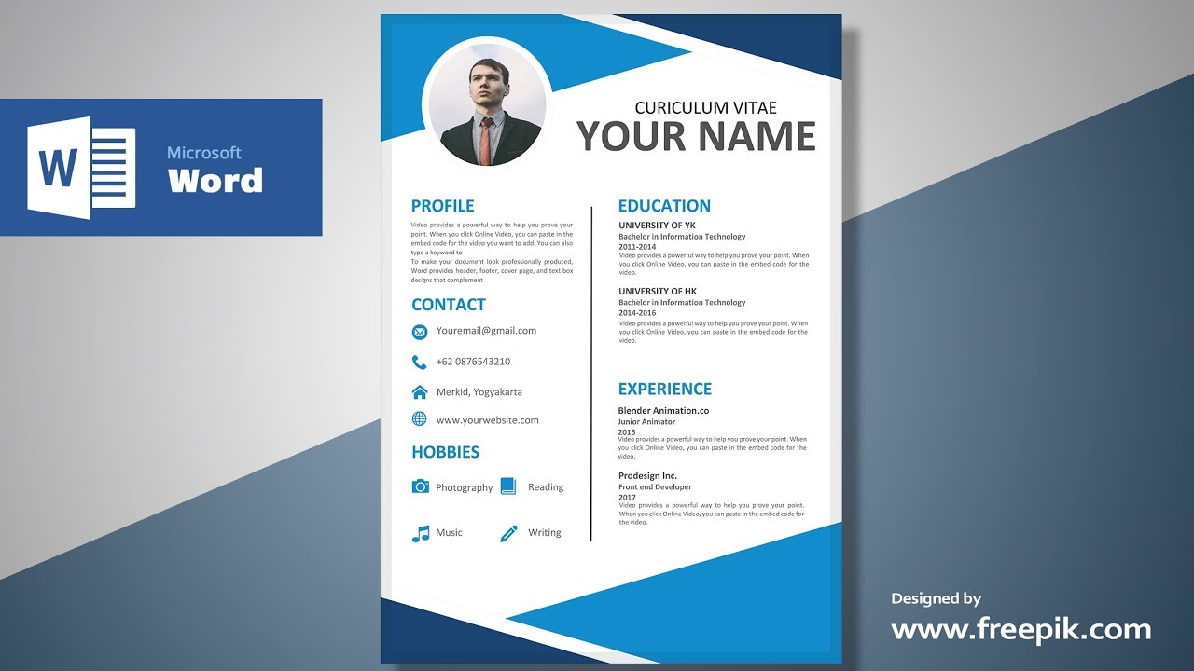
Warm up
Job Profile
What is this ?
Qualifications
What is it for ?
Personality
Special Skills
What does it highlight?

Slide 4
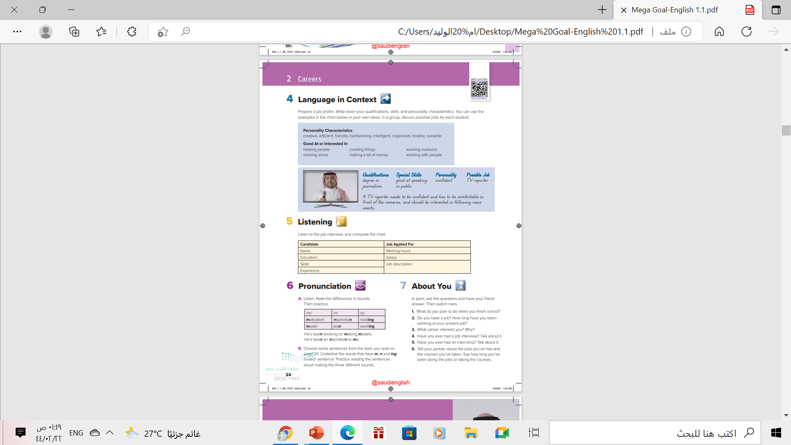
Open
Student’s book p. ( 24)

Slide 5
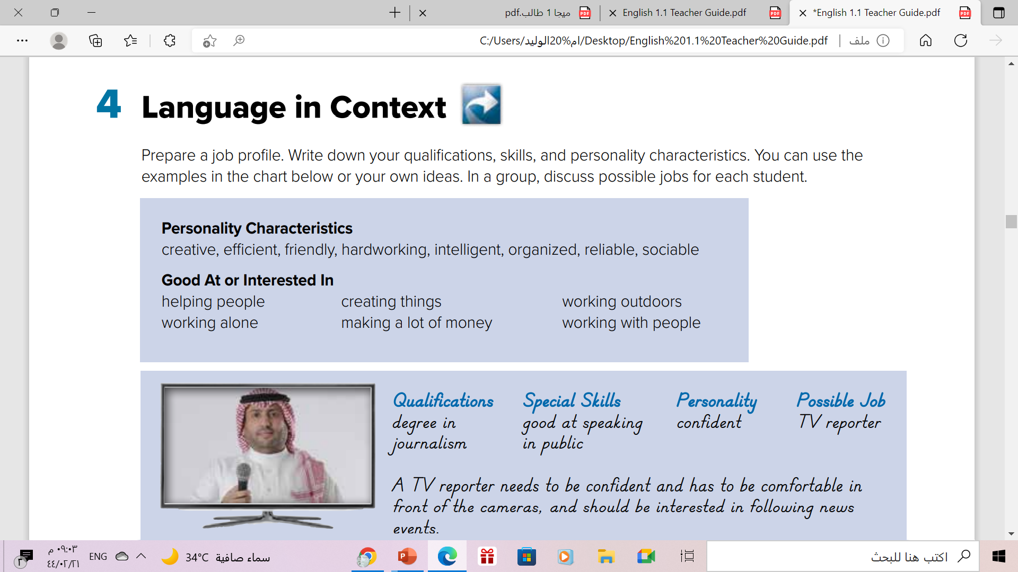

Slide 6







prepare your own job profile.
e.g.
Degree in …..
Course in …..
Majored in …
Qualifications
e.g.
good at // interested in ..
speaking – typing -
working outdoors
making a lot of money
helping people
Personality
Special Skills
e.g.
Creative – friendly –
hardworking – organized –
sociable - reliable

Slide 7
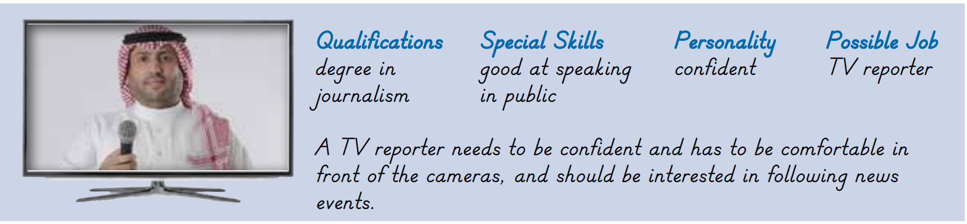


TV reporter
Read and say your ideas on characteristics & skills that would be good for
a TV reporter

Slide 8
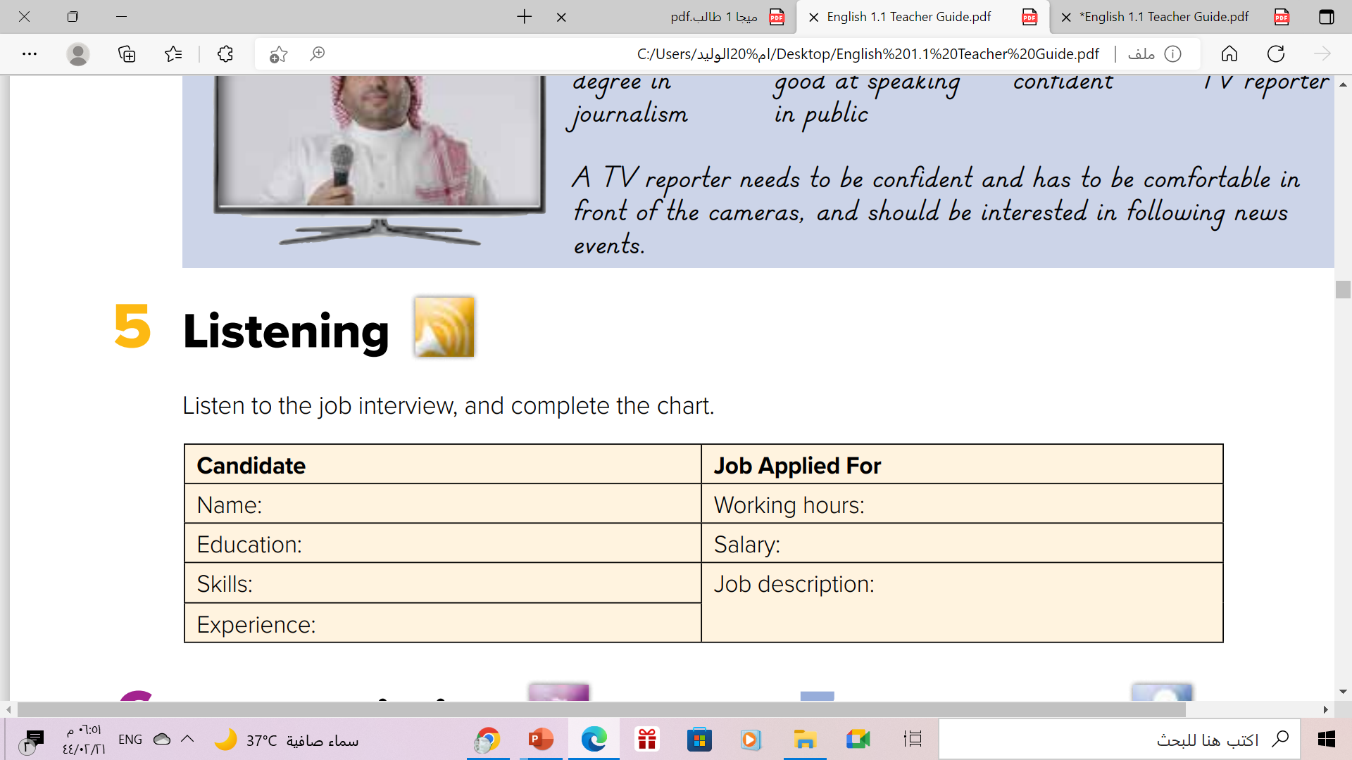


Slide 9
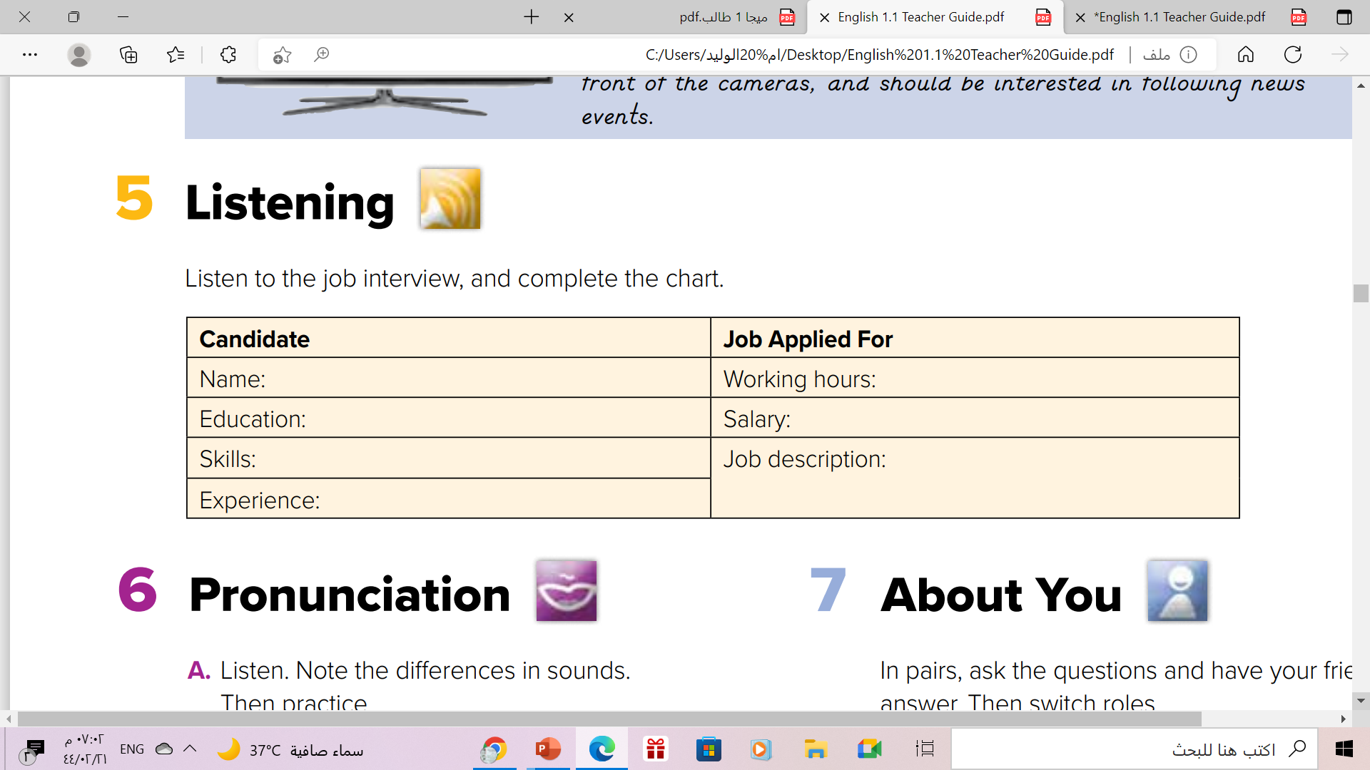
Michael
50-60 hours a week .
majored in art architecture,
courses in marketing .
high-paying
good at communication with
people, architectural skills .
be involved in work through all stages, from selling to client, to designing and putting up exhibit stands .
3 years as architect in a apartment –
building company , part-time sales job in college .

Slide 10
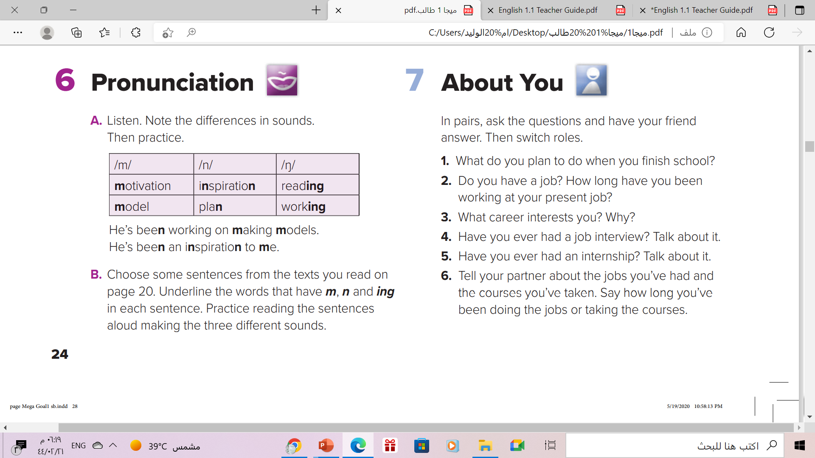
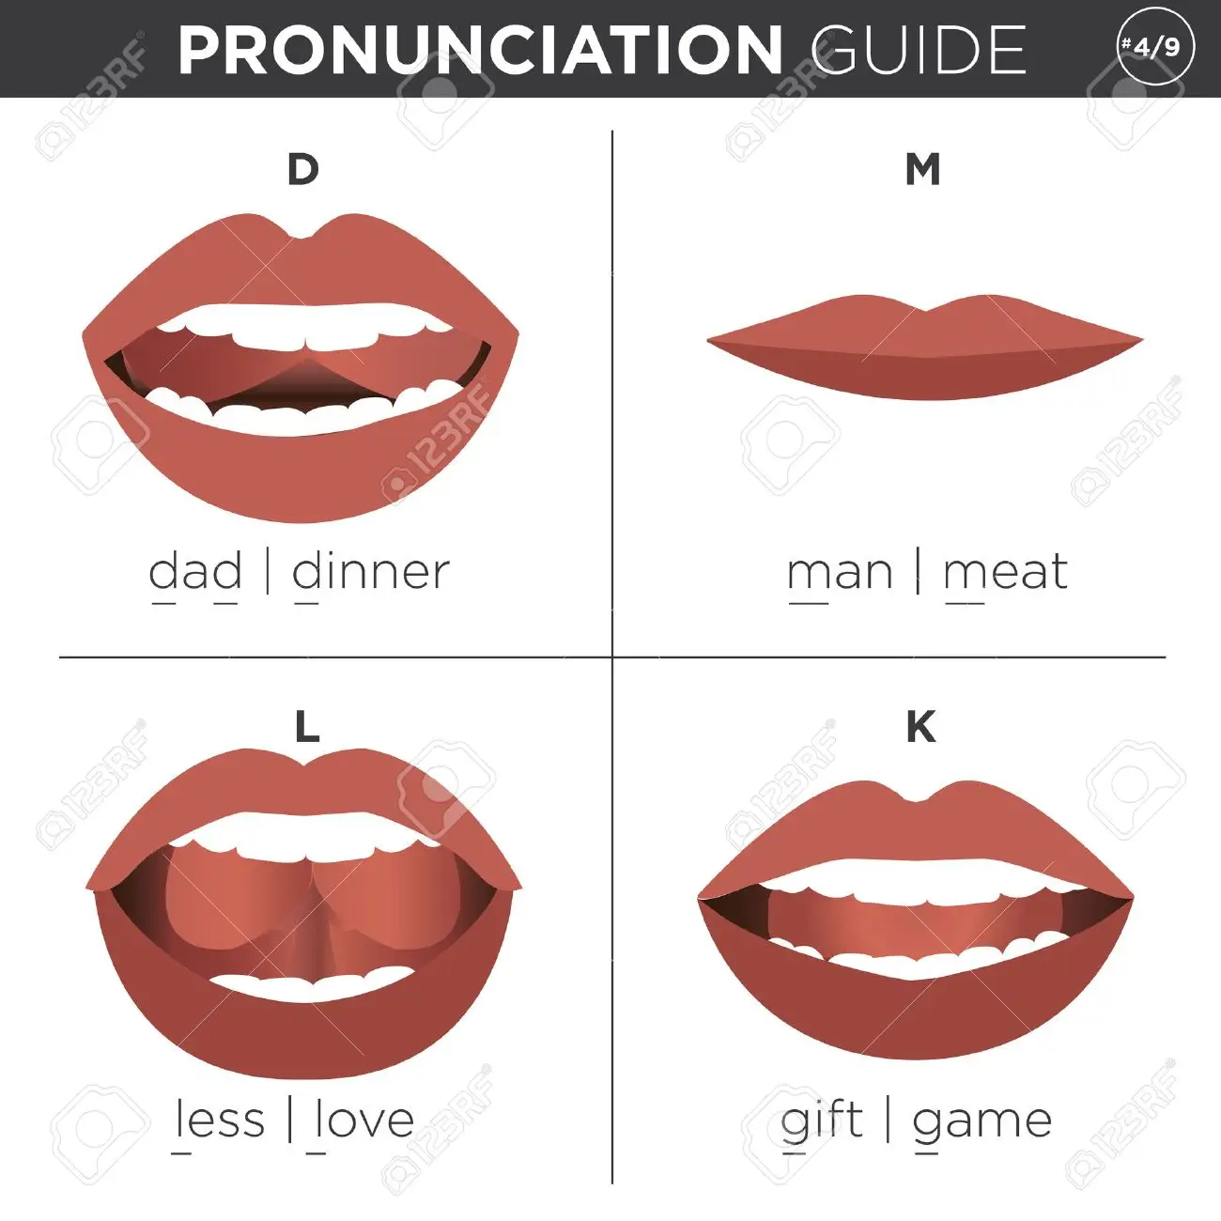
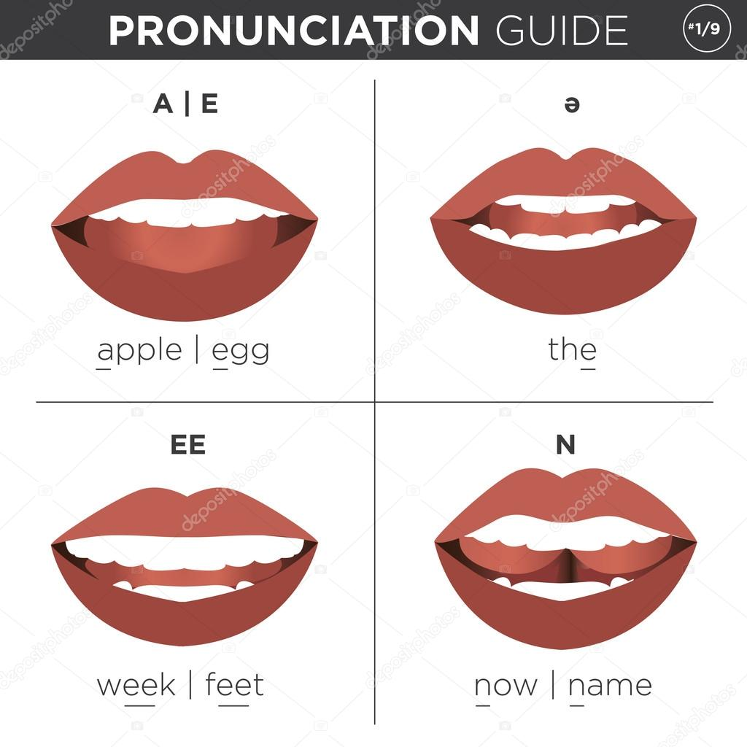
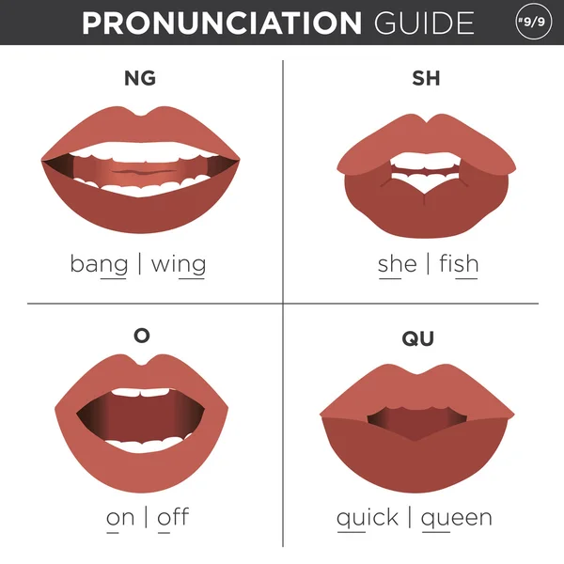

Slide 11

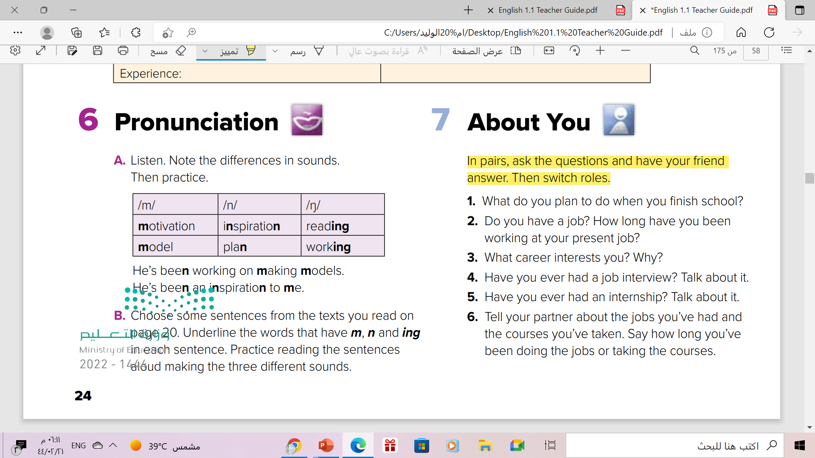

Slide 12
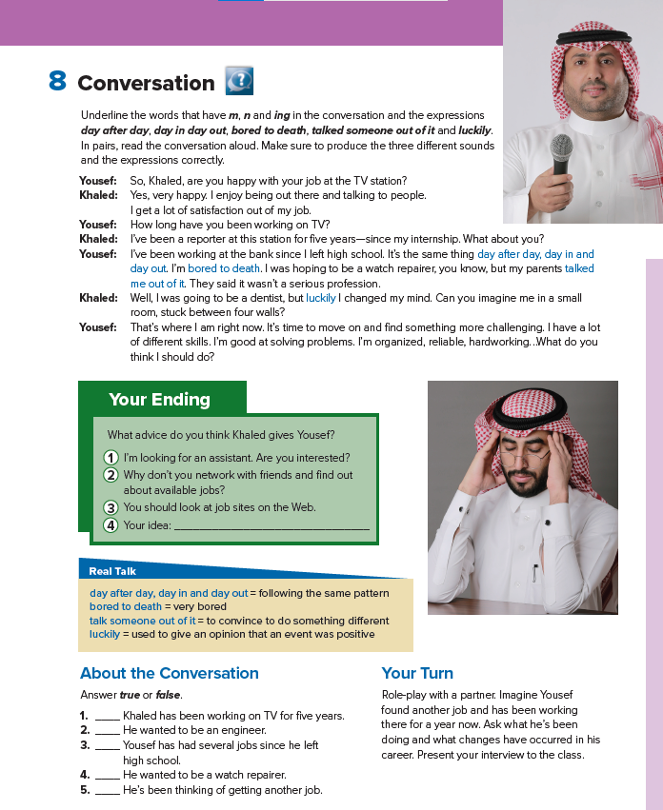
Open student’s book p.(25)

Slide 13
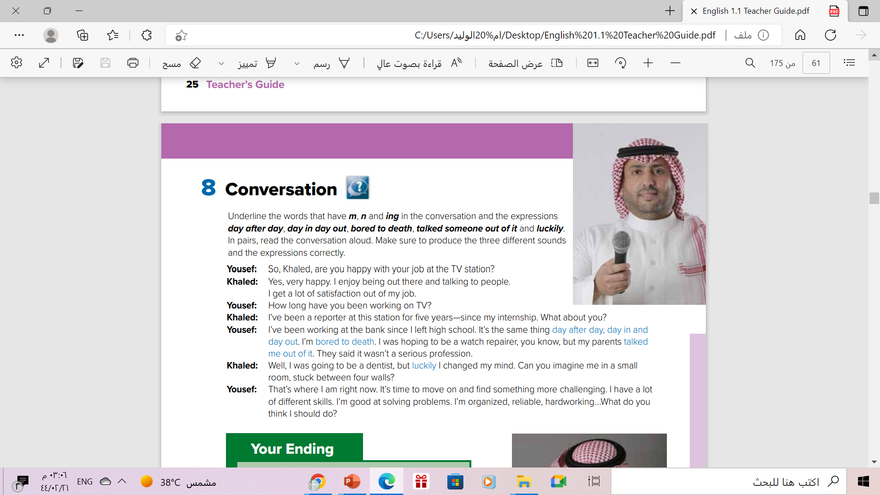
Listen & Answer

Slide 14
Do they like their jobs?
Khalid does, Yousef doesn’t
What is Khalid’s job?
He’s a TV reporter
Why doesn’t Yousef like his job?
Why does Khalid like his job?
It’s boring
He enjoys being out talking to people
He is good at solving problems, organized, reliable, and hardworking
What skills does he say he has?

Slide 15
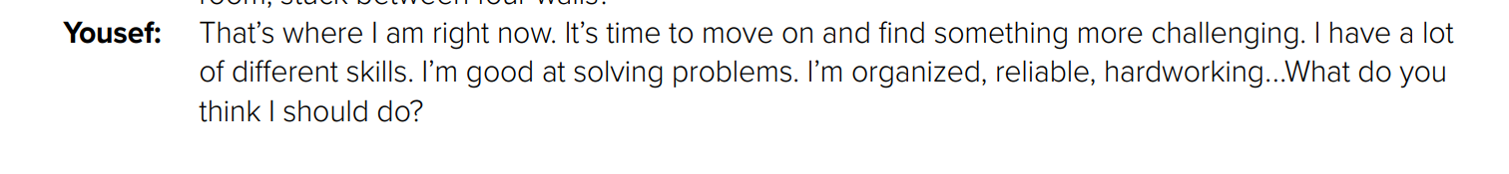
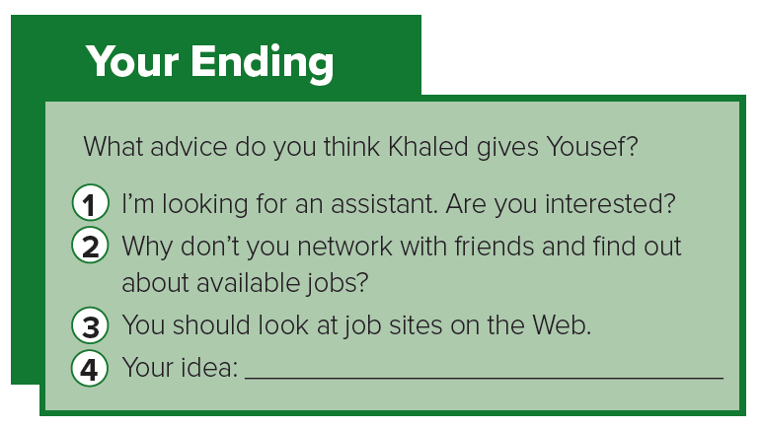
Ask for advice..

Slide 16



Slide 17


What does he mean ?
Who says ………
day after day, day in and day out?
It’s the same thing
all the time.
Yousef

Slide 18
What does he mean ?
Who says ………
bored to death??
to show he’s extremely bored
Yousef

Slide 19
What does he mean ?
Who says ………
luckily??
He’s happy he changed his mind
Yousef

Slide 20
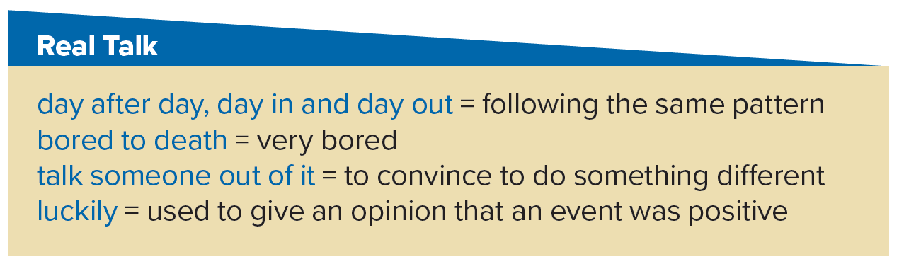
Read the phrases and their meaning:
Yousef is the one who uses
all these expressions.

Slide 21
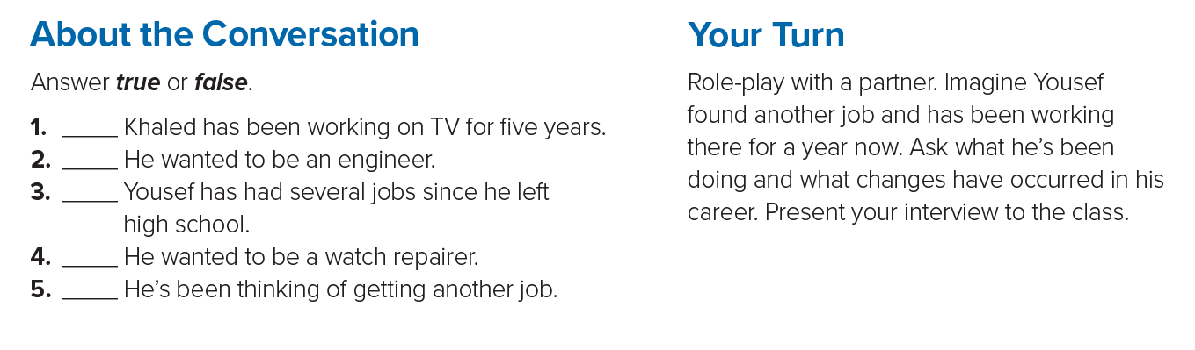
T
F
F
T
T

Slide 22

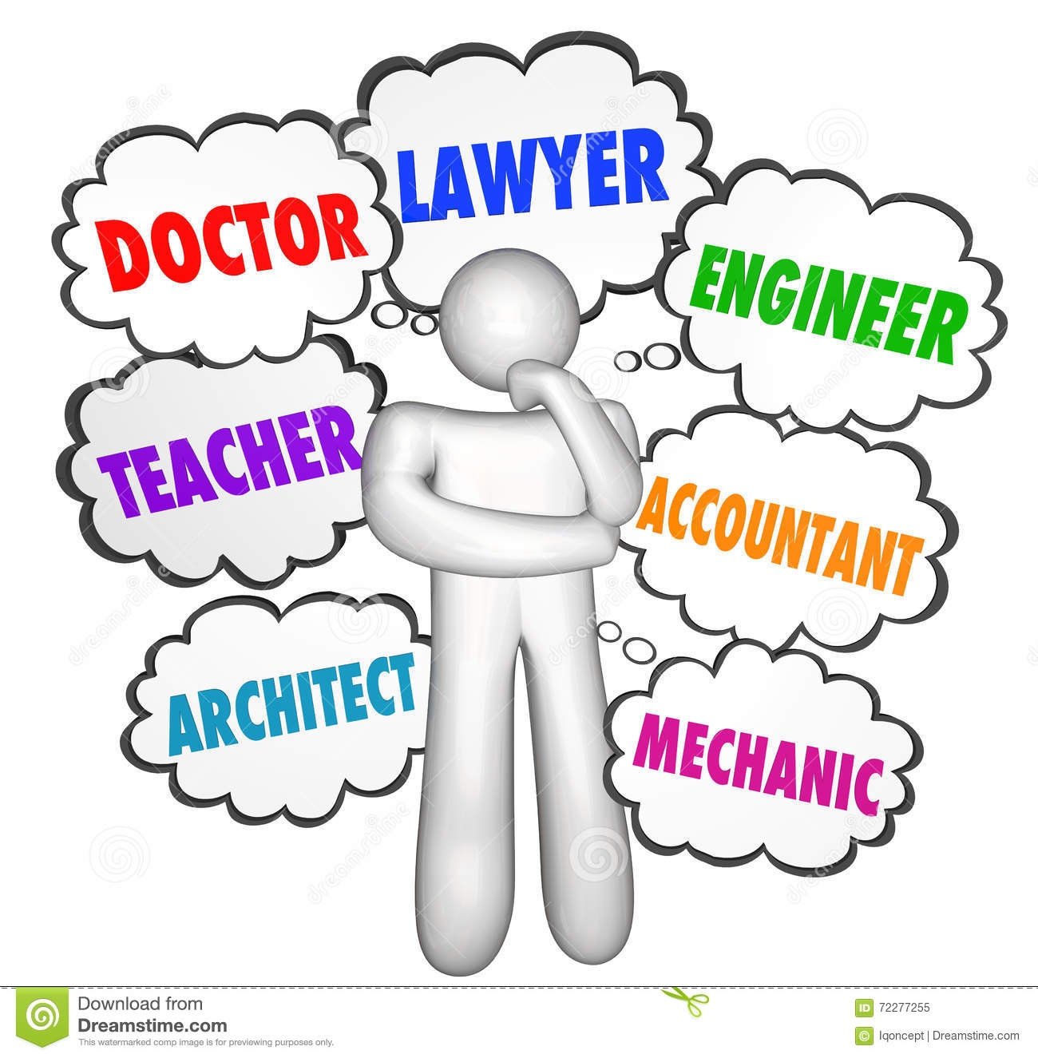

Slide 23


Slide 24

Watch & Guess

Slide 25


Extra Activities
https://www.liveworksheets.com/ek138280tx
https://wordwall.net/play/784/413/775

Slide 26
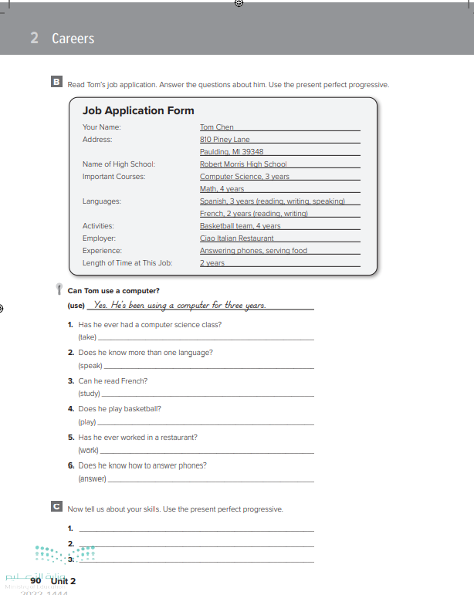
Homework
Workbook P. ( 90 )
Exercise (B)

Slide 27

Thanks

