Slide 1

Unit 2
Careers
Grammar
Mega Goal 1.1
Done by : Entisar Al-Obaidallah

Slide 2
Lesson Objectives
01
02
03
Use
Use
Distinguish
04
05
06
Ask
Form
Apply
the present perfect progressive .
the present perfect simple correctly
beween the present perfect simple & present perfect progressive
question using How long .? / How many ..? / How much ..?
sentences using adjective + preposition + gerund
The rules to do the exercices

Slide 3
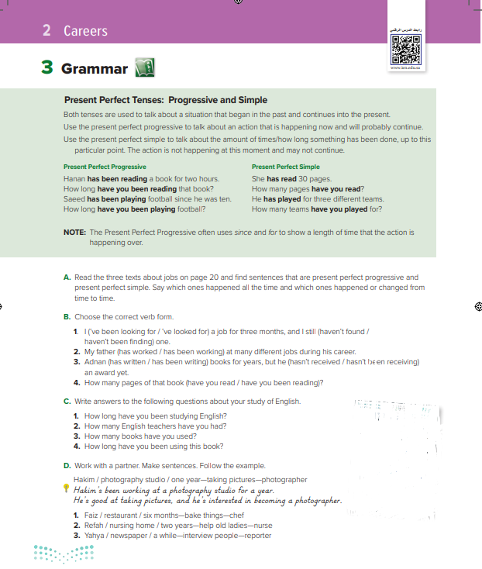
Open book p.( 22)

Slide 4
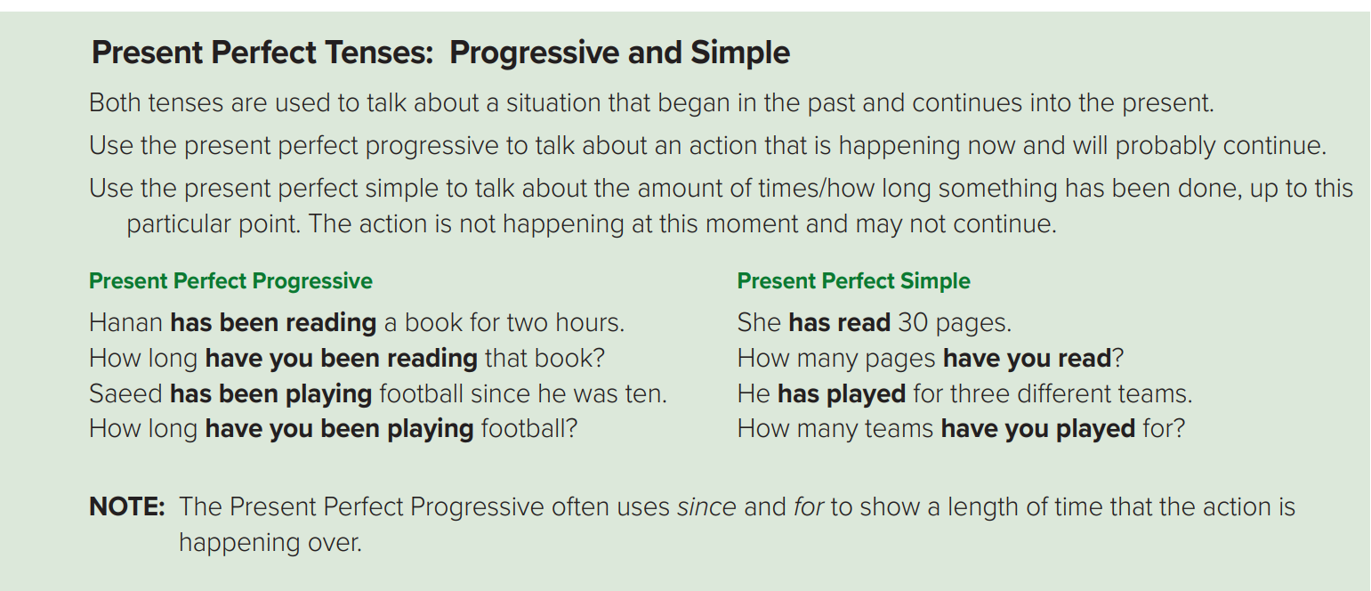

Slide 5

We use the Present Perfect Progressive:
to talk about an action that started in the past and has a connection with the present time.
The action may or may not have finished.
to emphasize the results of the action.
to say how long something has been happening.
Form :
She
He
It
Singular
You
I
We
They
plural
The beginning of action
has + been + v-ing
He has been working since 7:00 a.m.
The duration of action
have + been + v-ing
He has been working for eight hours
How long has he been working?

Slide 6
We use the Present Perfect Simple:
to say how many things have been done. ( quantity)
to talk about recently completed action.
She
He
It
Singular
You
I
We
They
plural
Form :
He has played 5 games . (play)
has + v p.p 3
I have written 3 pages. (write)
have + v p.p 3
Countable nouns
Uncountable nouns
How many programs have you watched?
How much money have you spent?

Slide 7
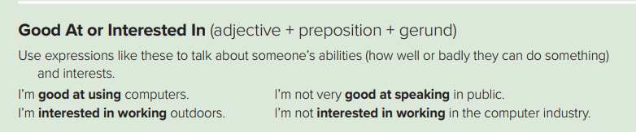

adjective + preposition + gerund( V-ing)
Good at
Interested in
I’m good at using computers.
I’m interested in reading short stories.
I’m good at taking pictures.
I’m interested in making cake.

Slide 8
In Summry:
Present Perfect Progressive | Present perfect Simple
(Have / Has) + been + v + ing | (Have / Has) + P.P.3
I have been playing for one hour | I have played three times .
How long | How many – How much

Slide 9
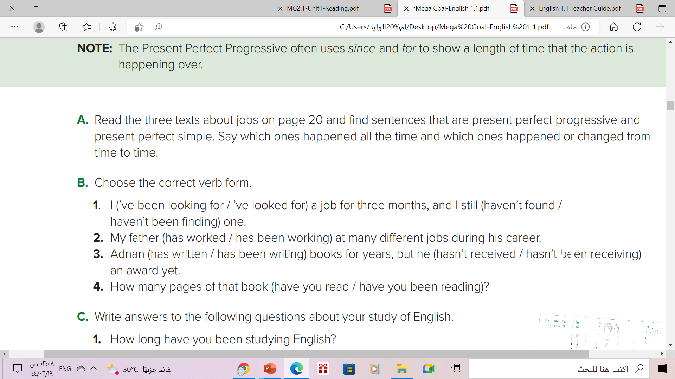

Slide 10
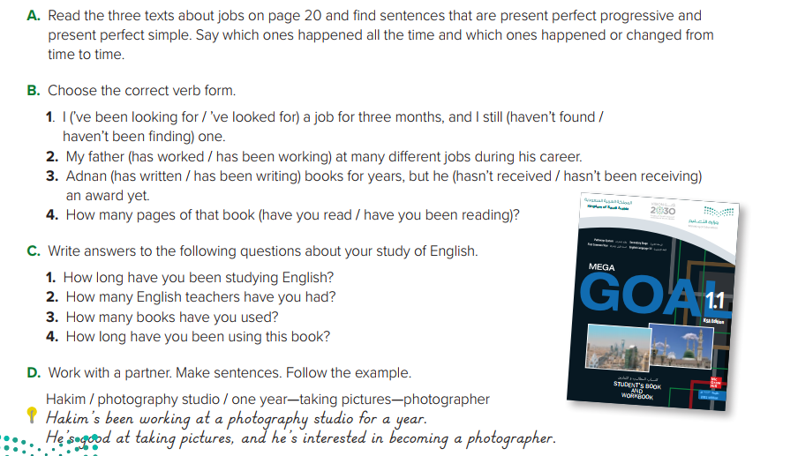
Answers will vary. Sample answers:
1. I’ve been studying English for six years.
2. I’ve had three teachers.
3. I’ve used six books.
4. I’ve been using this book for three weeks

Slide 11
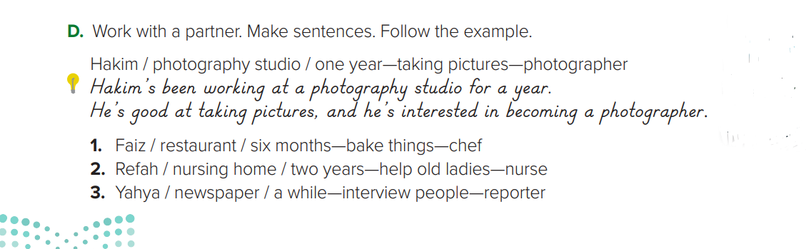
1. Faiz has been working in a restaurant for six months. He’s good at baking
things, and he’s interested in becoming a chef.
2. Refah’s been working in a nursing home for two years. She’s good at helping
old ladies, and she’s interested in becoming a nurse.
3. Yahya’s been working for a newspaper for a while. He’s good at interviewing
people, and he’s interested in becoming a reporter.

Slide 12
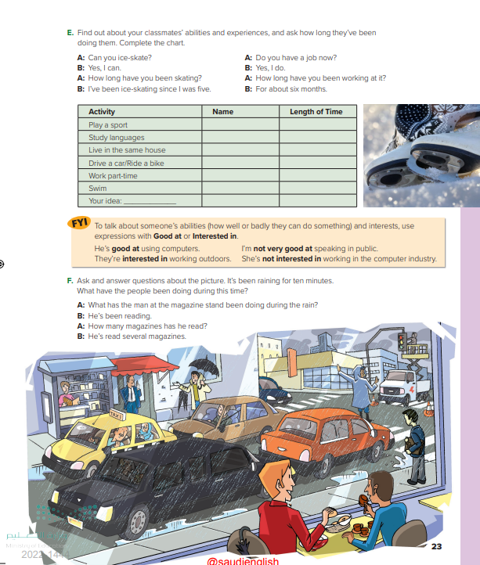
Open
Book , p.( 23 )

Slide 13
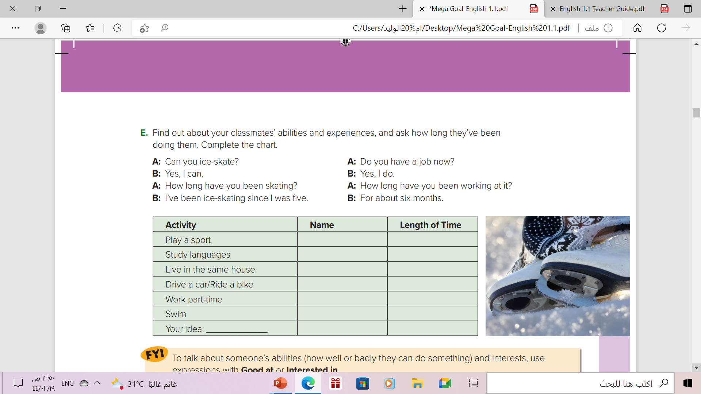
Khaled
The Answers will Vary
Three years
Alwaleed
6 months
Ali
Ten years
Saad
3 months
Abdullah
Two years
Ahmed
One year

Slide 14
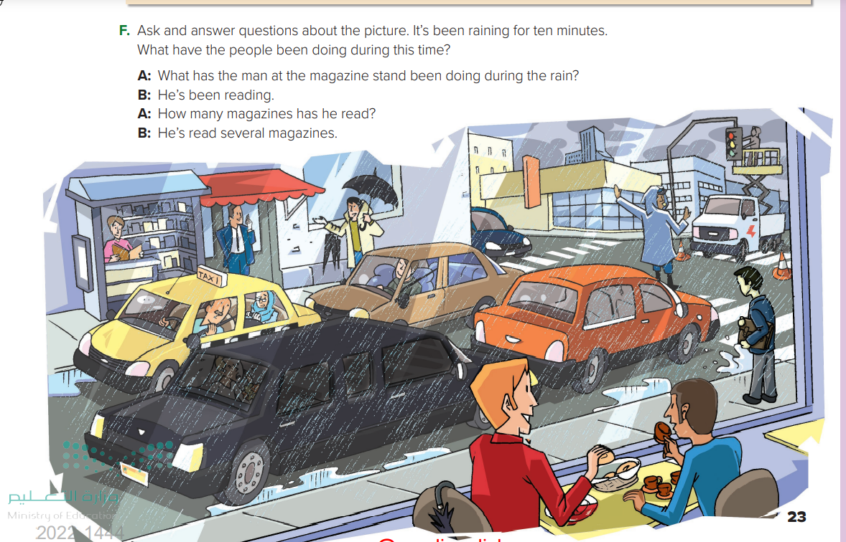
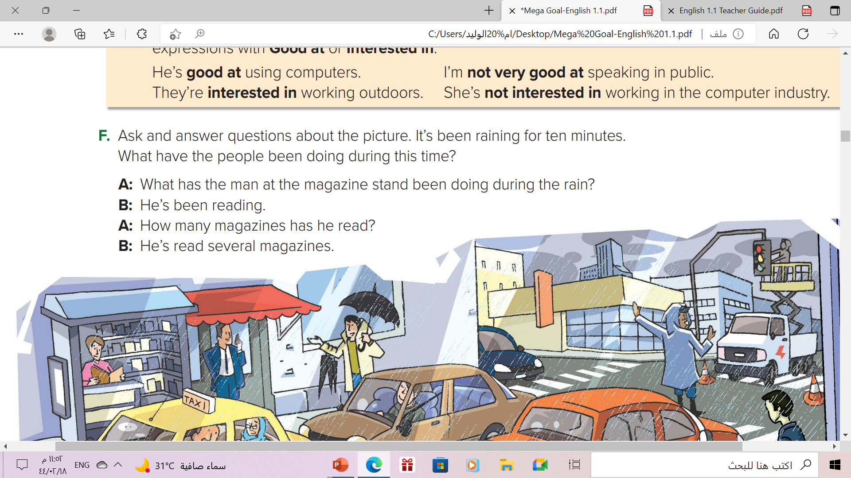

Slide 15
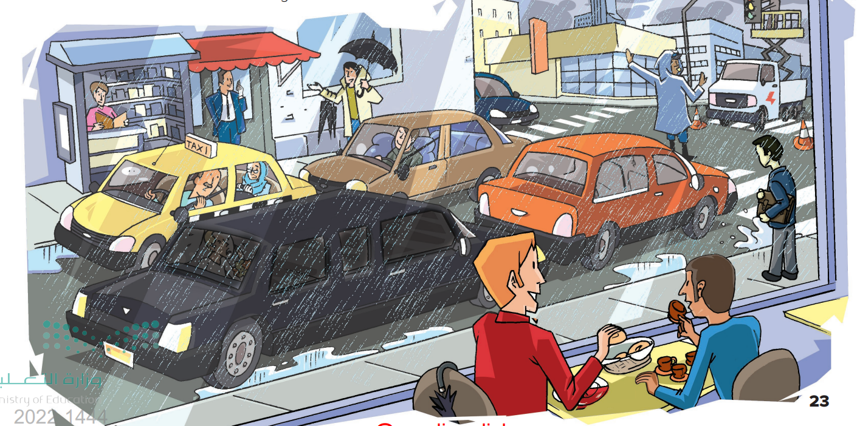
A: What has the man under the umbrella been doing?
B: He’s been waiting for the rain to stop.
A: What have the people in the café been doing?
B: They’ve been drinking coffee.
B: He’s been looking at the limousine.
A:What has the taxi driver been doing?

Slide 16
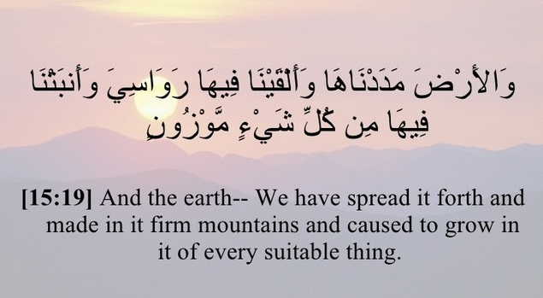
Present Perfect in The Holy Quran

Slide 17
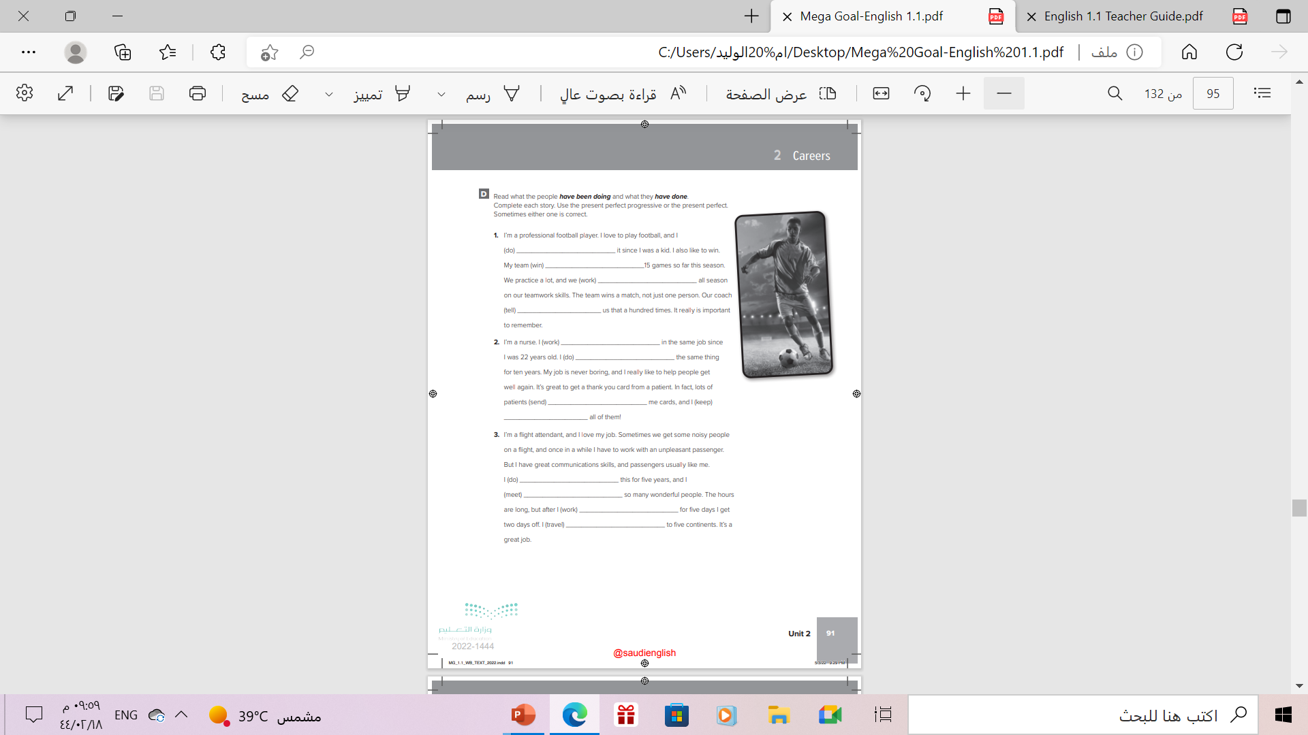
Homework
Work book , p.( 91) , exercise( D)

Slide 18

Thanks

