Slide 1


Mega Goal 1
U: 1
Big Changes
Language in context
Conversation
By: Yousef Hilal Alyazedi

Slide 2

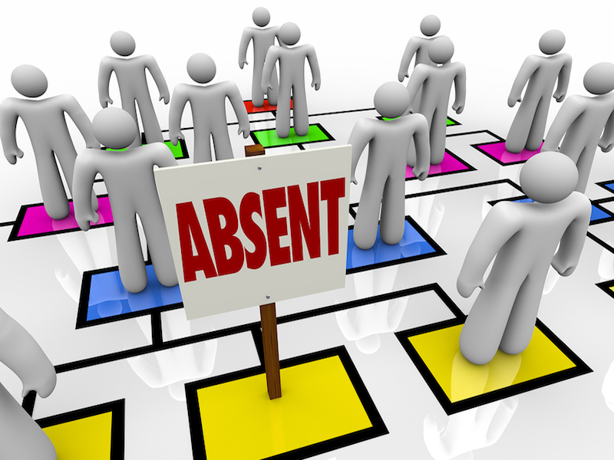

Slide 3

Lesson Objectives
The students will be able to :
Give a clear introduction about a person .
Recognize some new vocabulary .
Use stress in a sentence correctly .
Answer questions on a listening text.
Answer questions on a conversation.
Use real talk in a conversation .

Slide 4


Open your Student’s book at page: 10

Slide 5
If you’re going to describe a person , we have many things to know .
Name
Age
Place
Interest
Background
Grow Up
Family

Slide 6
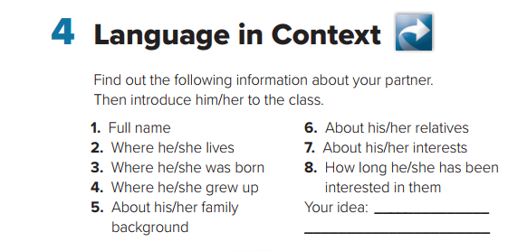

Slide 7
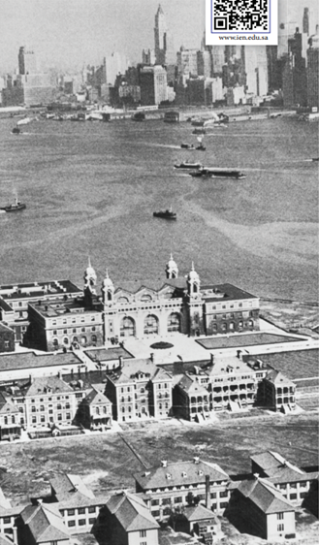

Where did people emigrate from ?
Why did they emigrate from ?
Why did they emigrate from ?
What was at Ellis Island ?

Slide 8
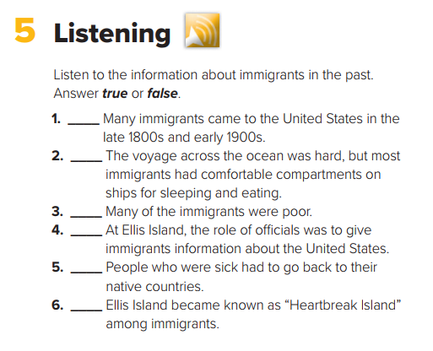

Slide 9
true
false
true
false
true
true

Slide 10

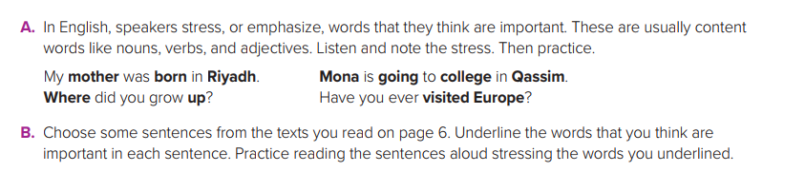
Pronunciation
The way in which a word pronounced .
Stress
The force or emphasis that you put on a word or part of a word when you say it .

Slide 11
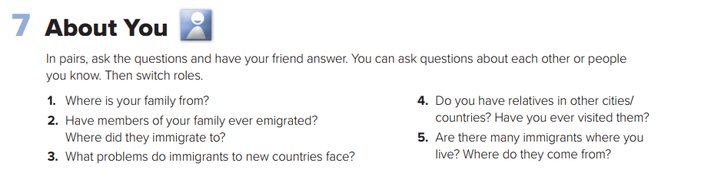

Slide 12
Open your Student’s book at page: 11

Slide 13
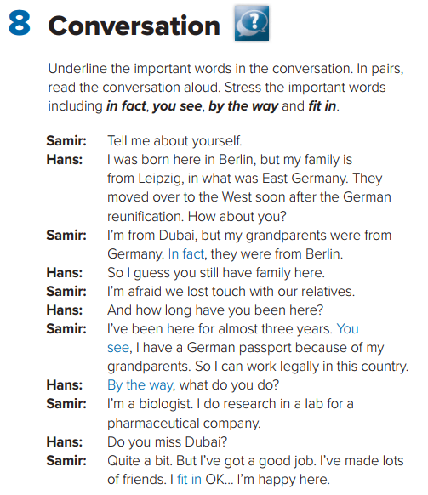

Who are the speakers ?
Where does the conversation take place ?
Name of Places ?
Where was Hans born ?
Berlin

Slide 14
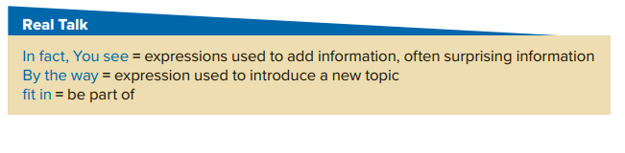
Did he pass his driving test ? ‘ Yes, he did; in fact, he’s was now taking an advanced driving test .
Oh, by the way, my name’s Salman .
It’s no surprise she’s leaving – she never really fitted in

Slide 15
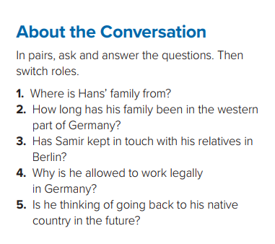
1- They are from Leipzig, Germany.
2- His family has been in the western part of Germany since soon after the reunification.
3- No, he hasn’t .
4- He’s allowed to work legally in Germany because his grandparents were from Germany.
5- No, he isn’t. He is happy in Germany.

Slide 16
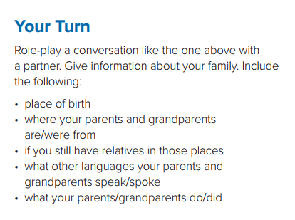

Slide 17

Workbook P. 4 ( H )

Slide 18
