Slide 1




Unit 4
TV Around the World
Form , Meaning & Function
Mega Goal 2.1
Done by: Entisar Al-Obaidallah

Slide 2



Lesson Objectives:
Use the indefinite article ( a/an ) correctly.
Use the definite article (the) correctly.
Use adjective clauses & relative pronouns correctly.
Distinguish between relative pronouns as subjects of adjective clauses.

Slide 3
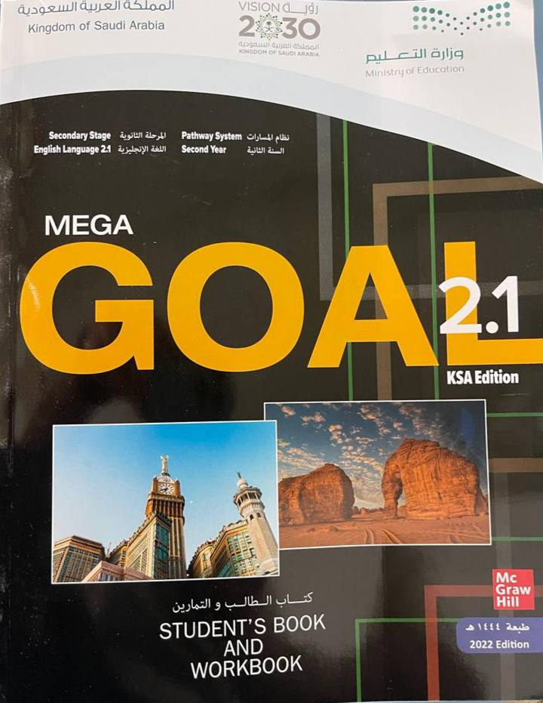

BOOK OPEN
..............pages ( 58 - 59 ).

Slide 4
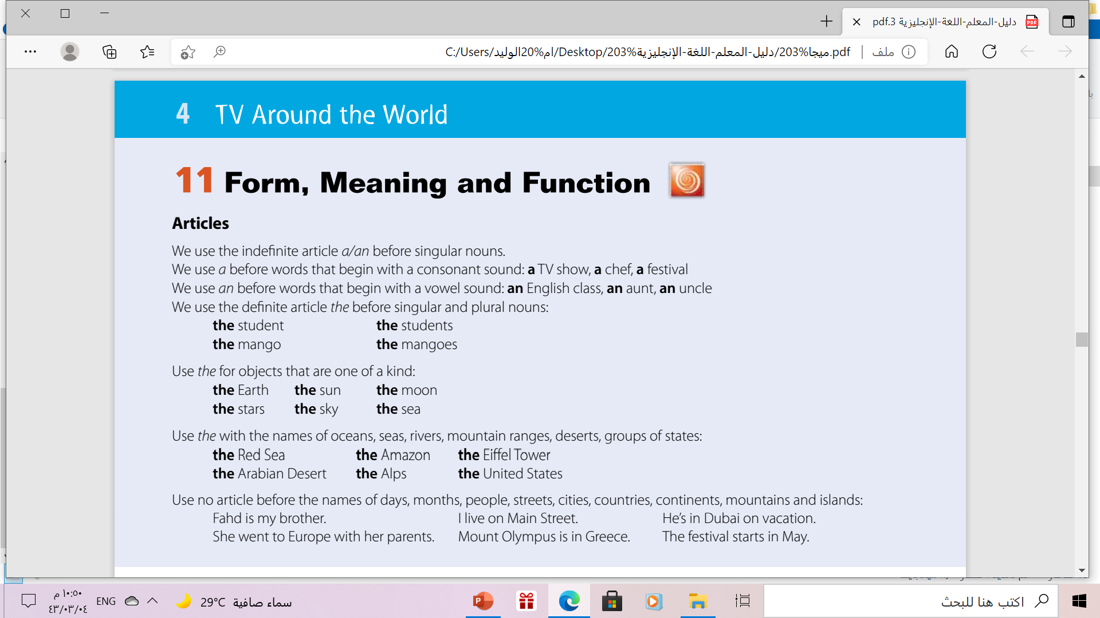

Slide 5


Articles
indefinite article
definite article
a
an
the
a book
an egg
The sun

Slide 6



The Uses of Articles !
indefinite
indefinite
definite
We use a before words that begin with a consonant sound:
a TV show, a chef, a festival
We use an before words that begin with a vowel sound: ( a , e , o , u )
an English class, an aunt, an uncle.
We use the definite article the before singular and plural nouns:
the student the students

Slide 7



When we use the definite article“ The” ??
2
3
1
Use the with the names of oceans, seas, rivers, mountain ranges, deserts, groups of states
We use the definite article the before singular and plural nouns:
Use the for objects that are one of a kind:
Example:
the Earth the sun
the moon the stars
the sky the sea
Example:
the Red Sea the Amazon
the Alps the United State
the Arabian Desert
Example:
The student ➔the students
The book ➔the books

Slide 8

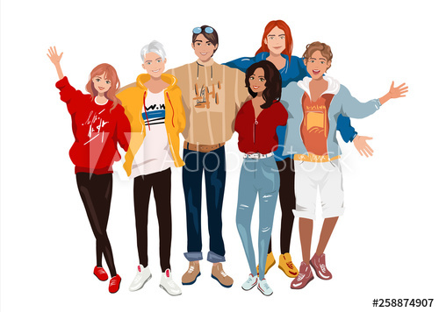
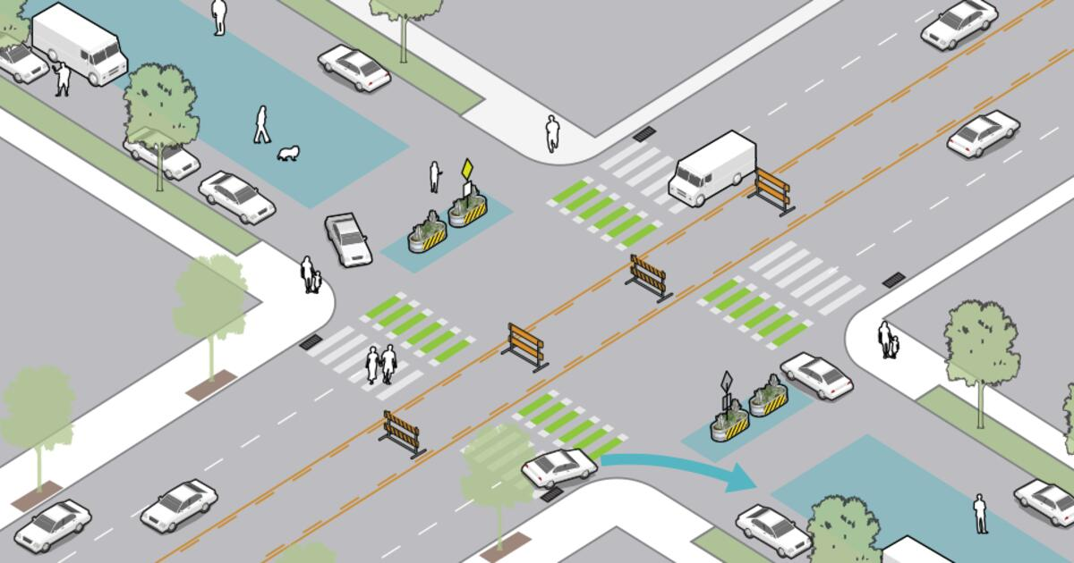
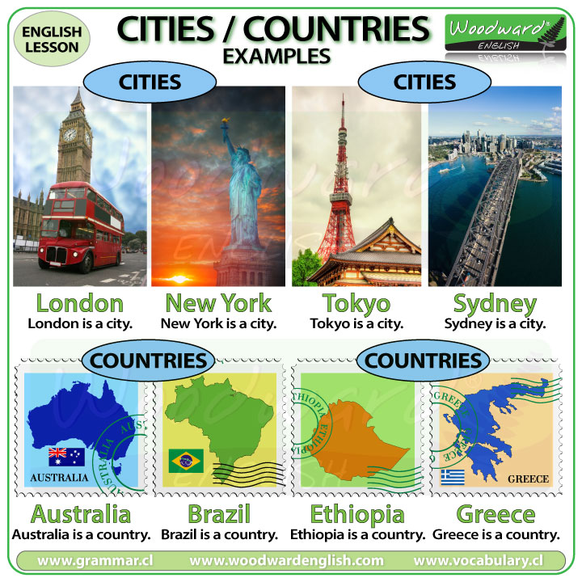
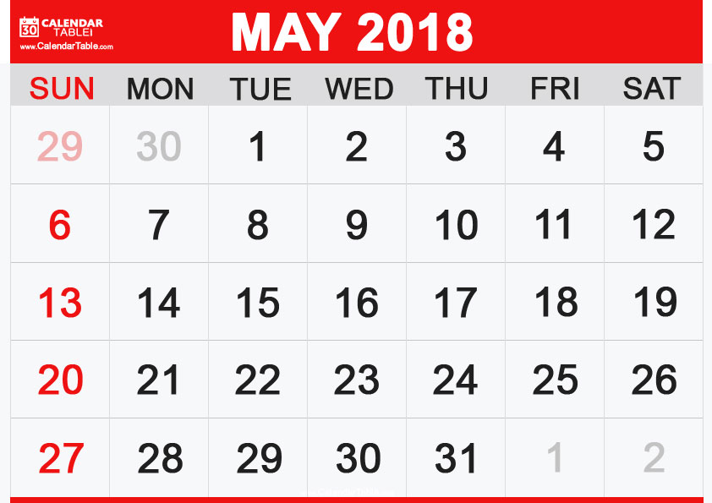
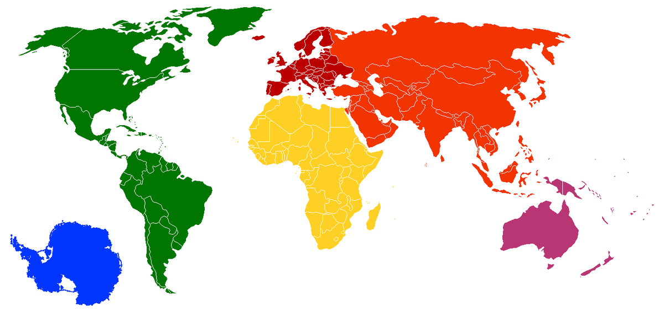
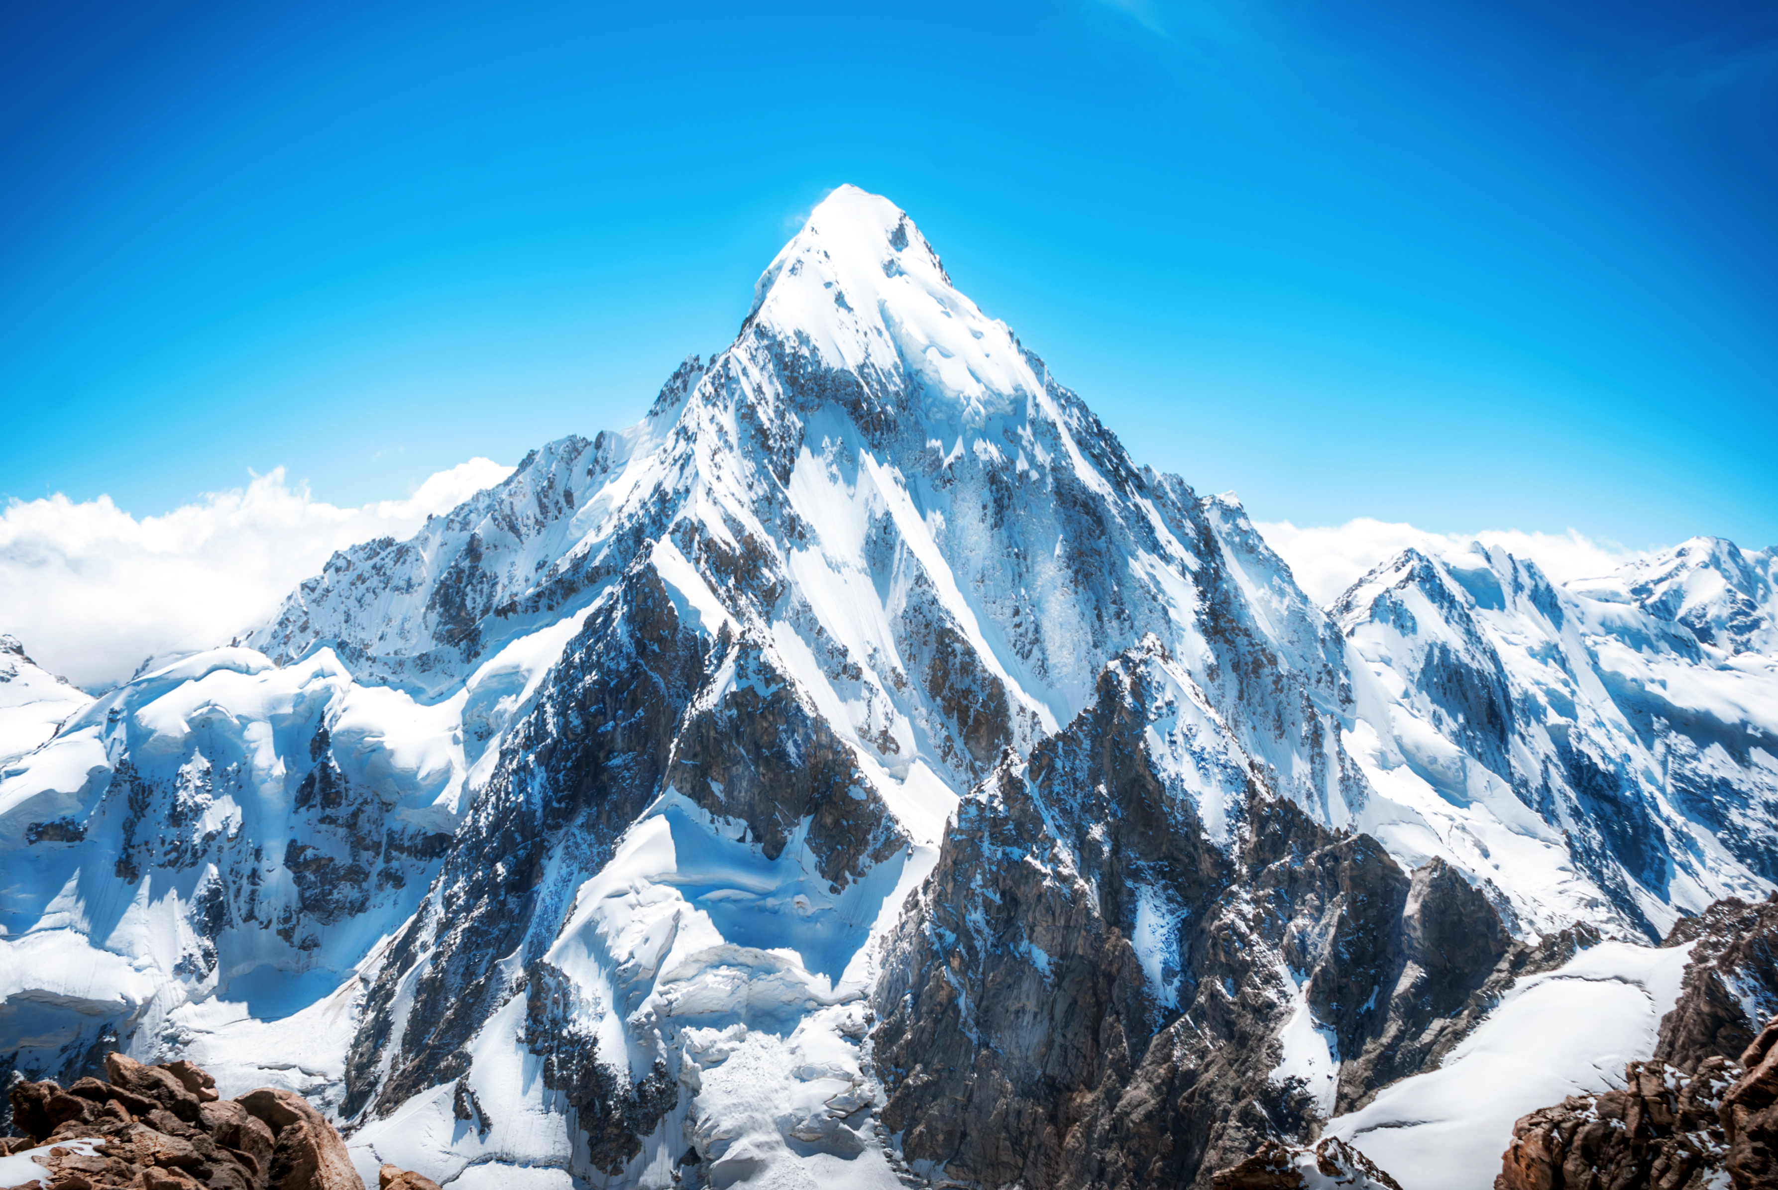

Use No article before the names of:
streets
cities & countries
people
Days & months
islands
continents
mountains

Slide 9
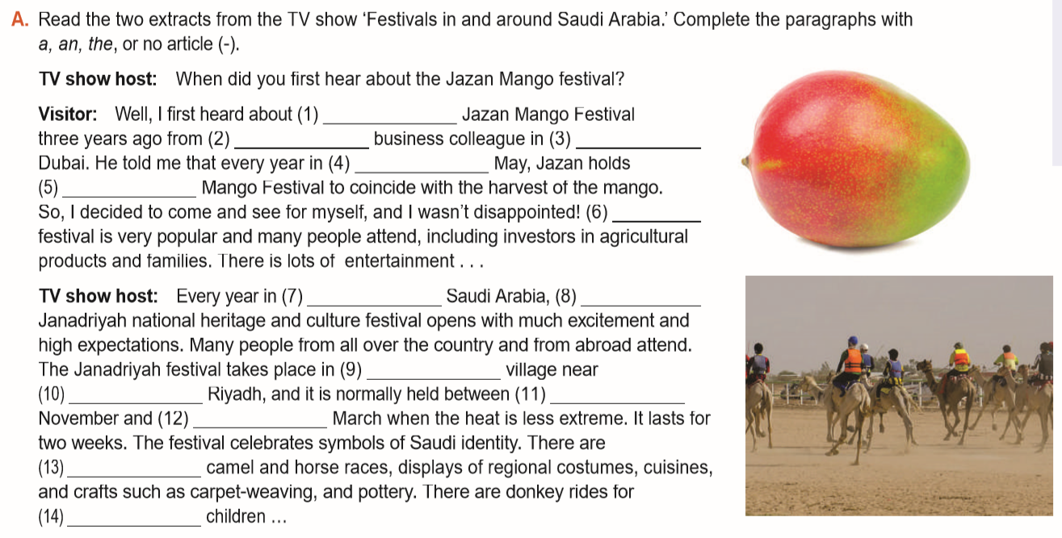
the
-
a
-
the
the
-
-
-
the
-
-
-
the

Slide 10
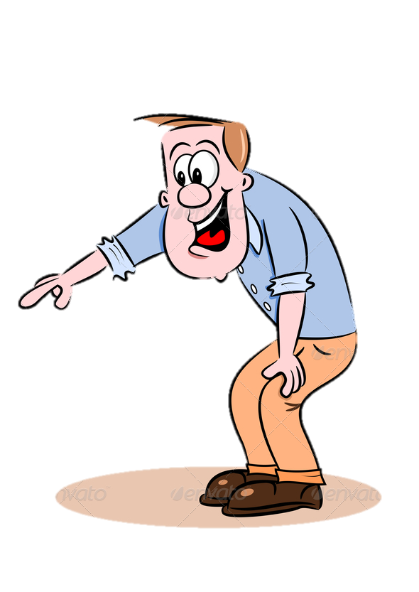
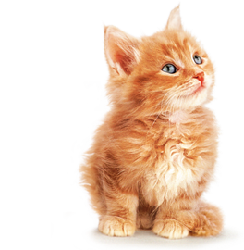
Fill in the space using the suitable article:
;
a
“I see ___ cat!”
The
“___ cat is cute ”

Slide 11

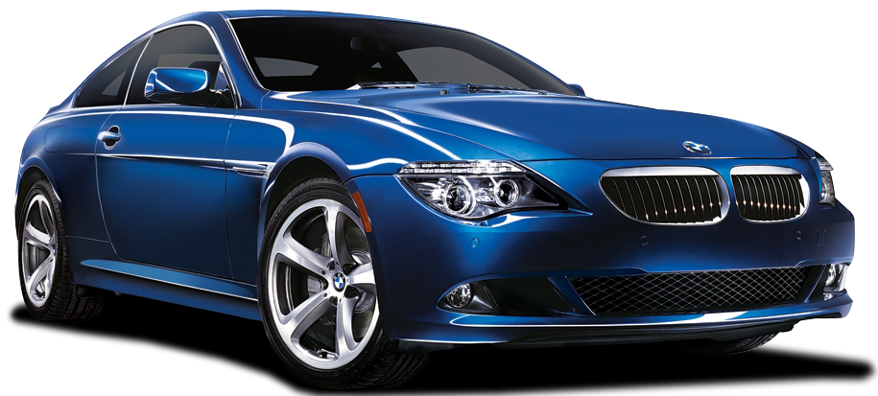
Fill in the space using the suitable article:
;
a
“I see ___ car!”
The
“___ car is blue ”

Slide 12
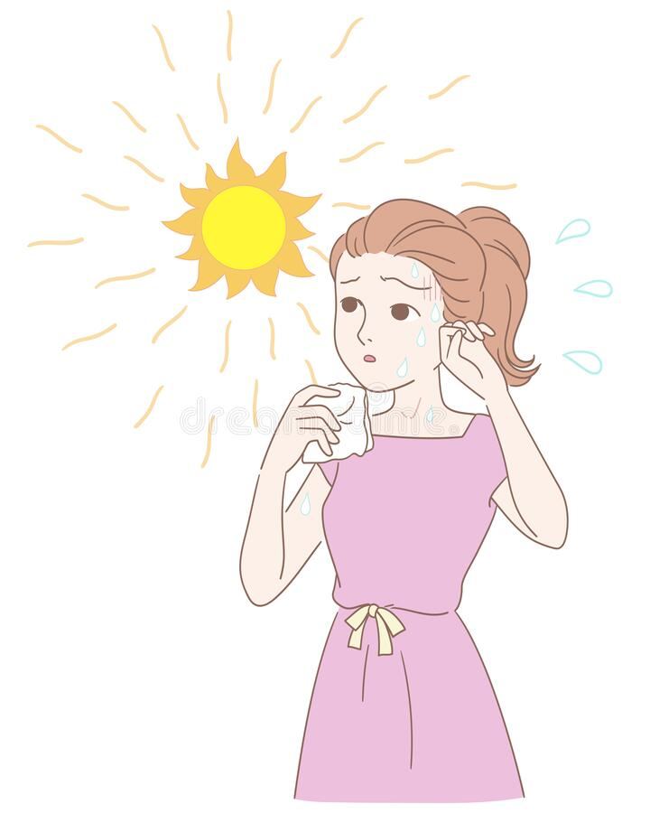
Fill in the space using the suitable article:
;
The
“___ Sun is very hot today.””

Slide 13


Fill in the space using the suitable article:
;
an
I see ___ eagle in the sky

Slide 14
BOOK OPEN
..............pages ( 59 ).

Slide 15
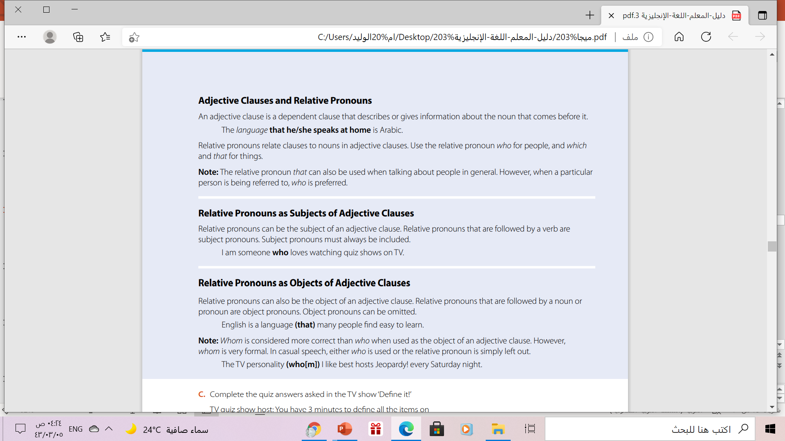

Slide 16

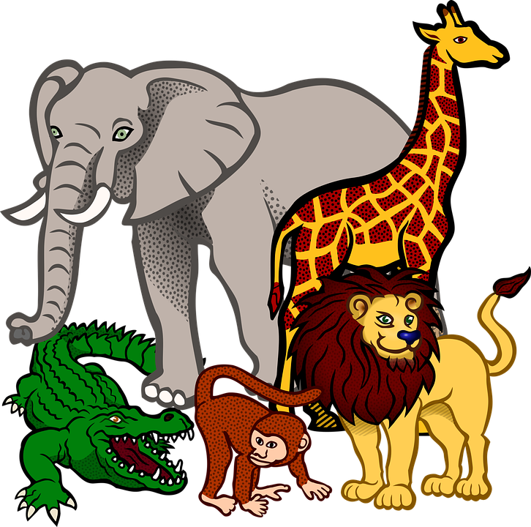

Relative pronouns:-
who
which
that
People ( persons)
Things & animals
Both ( people and things )

Slide 17

Relative Pronouns.
Relative pronouns combine two clauses together
A clause
is a sentence with subject and verb…
Example
✓ subject
I like friends .They are honest
✓ subject
I like friends who are honest
Relative pronouns

Slide 19
Relative pronouns
can be
Subject or Object
Object pronouns can be omitted
I saw the man
who took the car.
I saw the girl Who
you told me about.
Relative pronouns that are followed by a verb are subject pronouns.
Relative pronouns that are followed by a noun orpronoun are object pronouns..

Slide 20
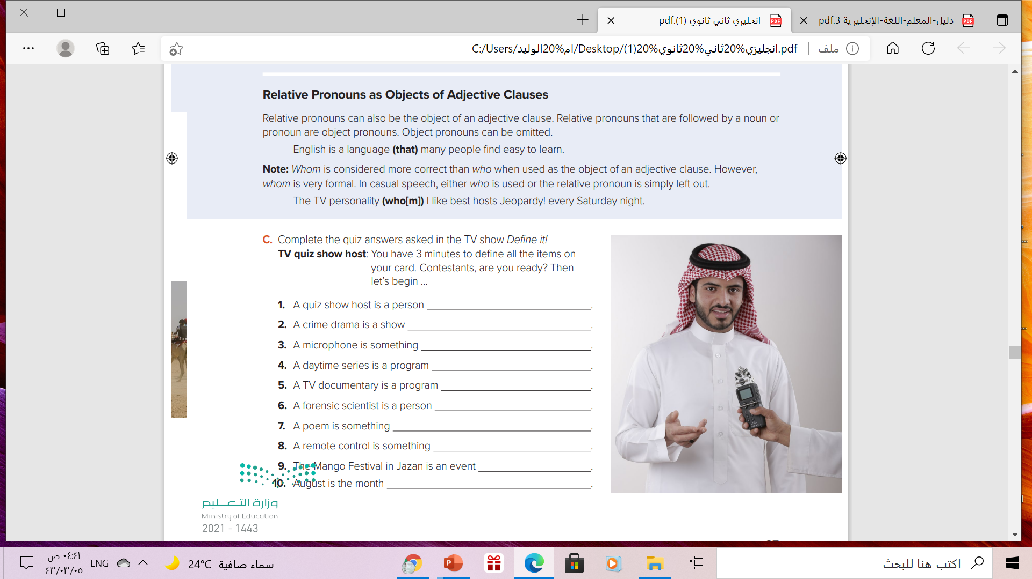
Who introduces contestants.
that investigates crimes.
that converts sound waves into an electrical signals.
that is produced to air in the morning.
That broadcasts documentaries.
who collects scientific evidence during an investigation.
that expresses feelings .
that controls another device from a distance.
that is very popular.
-that I want to have my vacation.

Slide 21

Homework
Workbook page ( 121 ) , exercises ( M, N)

Slide 22

Thank you!

