Slide 1
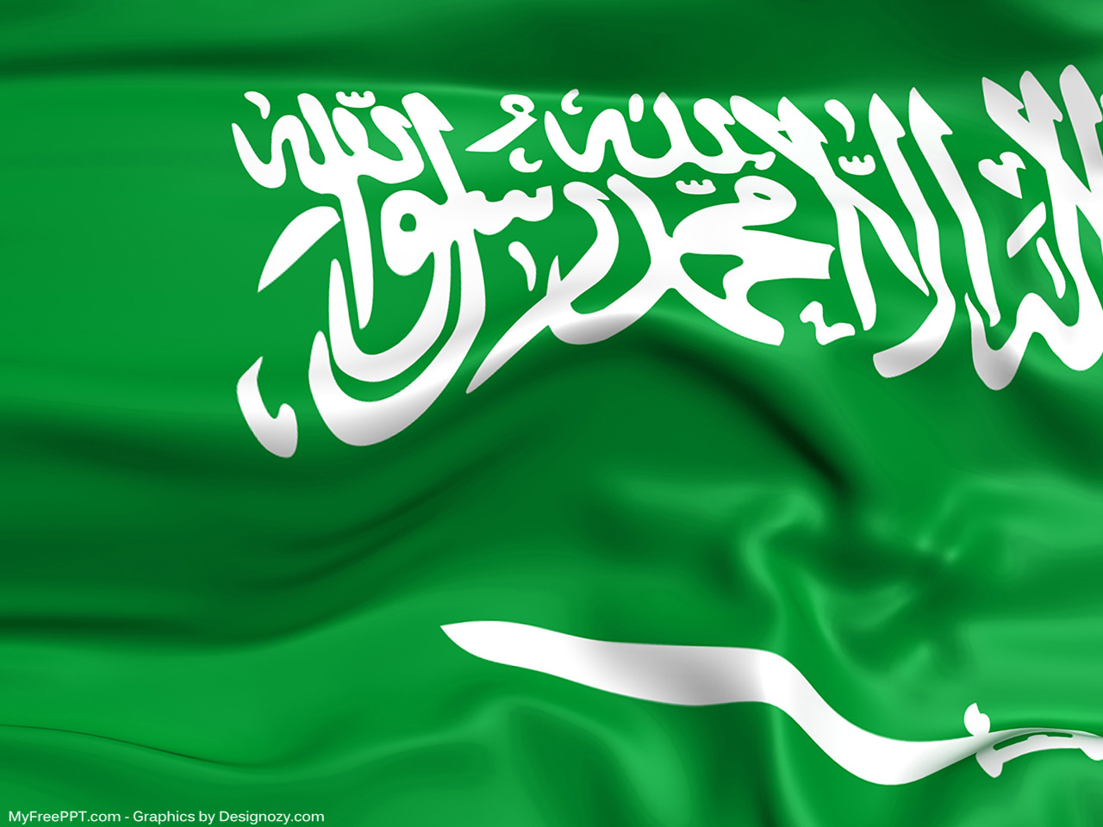
Unit 3
Far And Away
Writing
Done by: Entisar Al-Obaidallah

Slide 2
Lesson Objectives
Read
the passage for specific information
Discuss
the topic of Vision 2030 Kingdom of Saudi Arabia
Match
the words with their meanings
Write
a letter about place to visit in Saudi Arabia

Slide 3
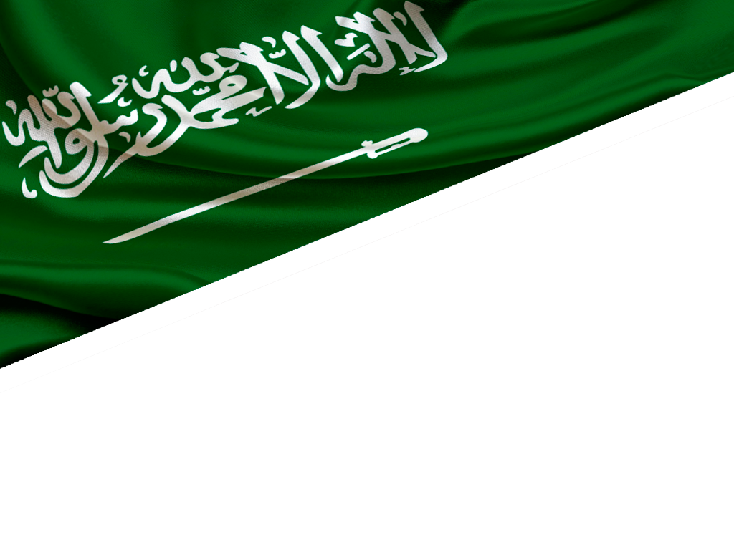
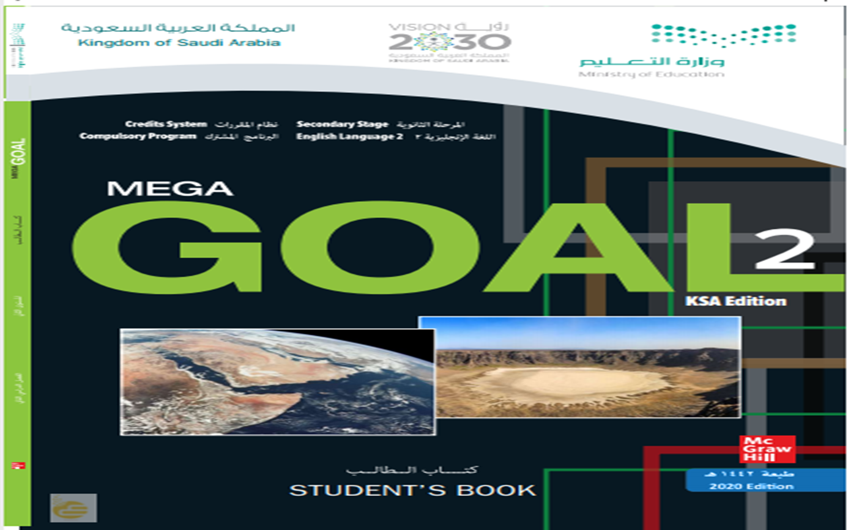
Open Book p.( 42)

Slide 4
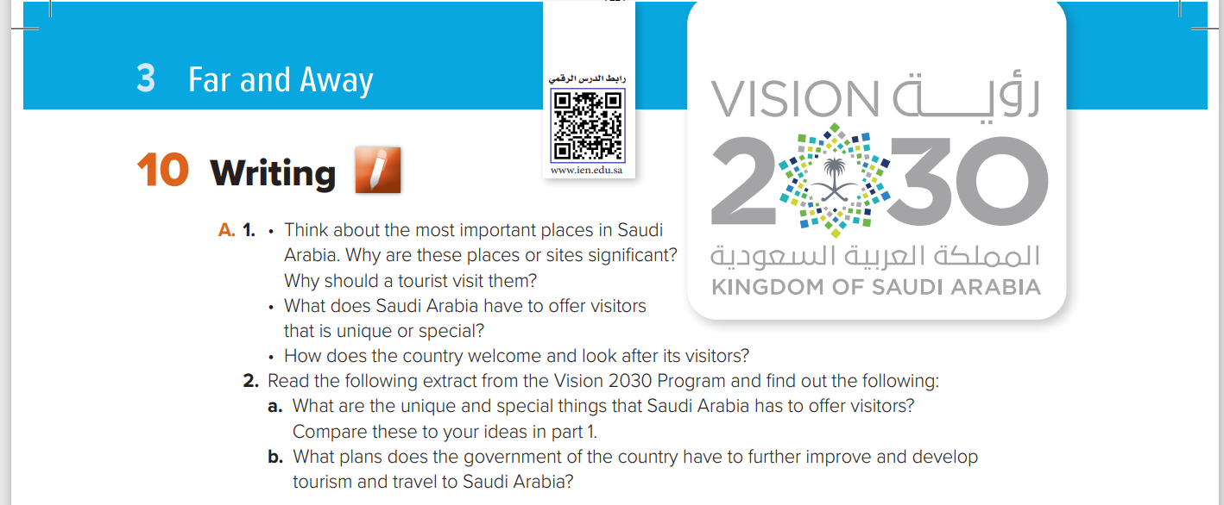

Slide 5
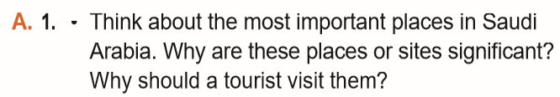
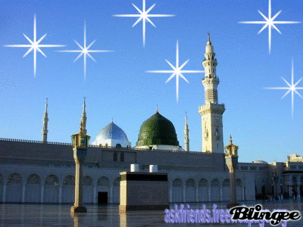
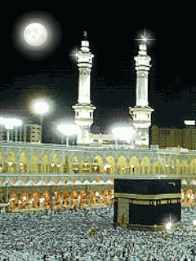

Slide 6
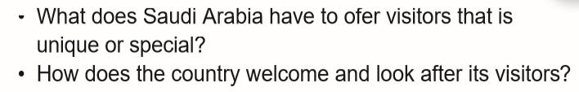

Slide 7
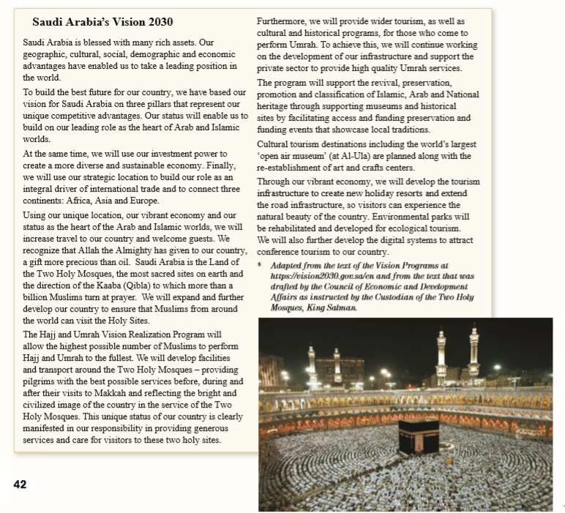
6
What is the title of the passage?
1
2
7
Saudi Arabia’s Vision 2030
3
8
How many paragraphs are there?
4
9
9 paragraphs
5
What does the picture show?
The Holy Mosque at Makkah

Slide 8

Read as long U listen

Slide 9
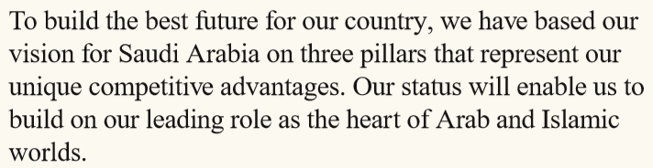
How many pillars have Saudi vision built on?
?
3 pillars.

Slide 10
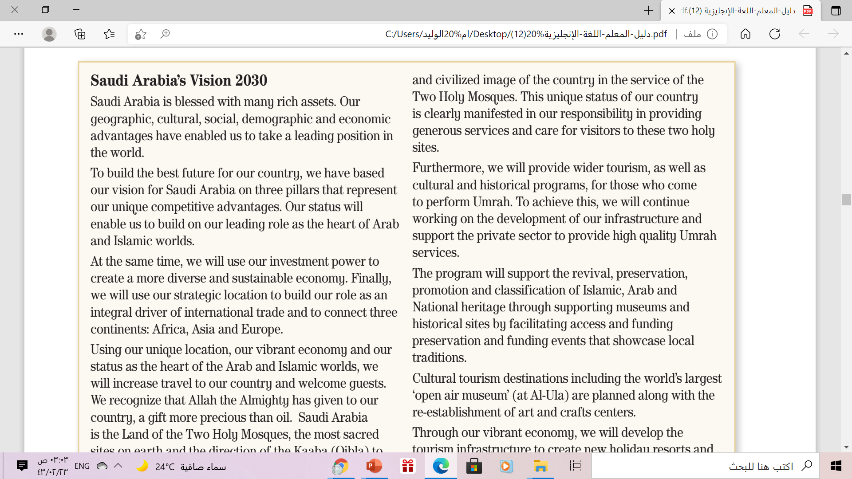
What are the 3 pillars that
Saudi vision based on ?
1-leading role as the heart of Arab
and Islamic worlds.
2- economy
3- strategic location

Slide 11
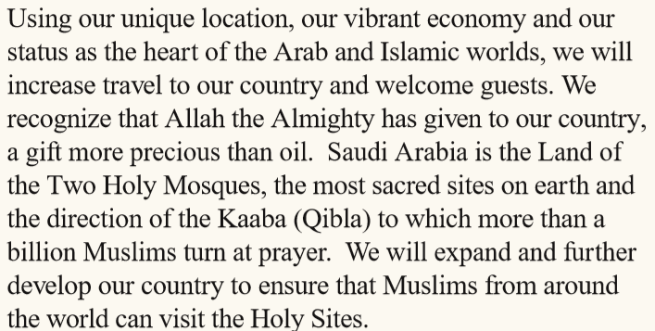
what is ‘the gift more precious than oil’ that Saudi Arabia has been blessed with?
The Two Holy Mosques

Slide 12
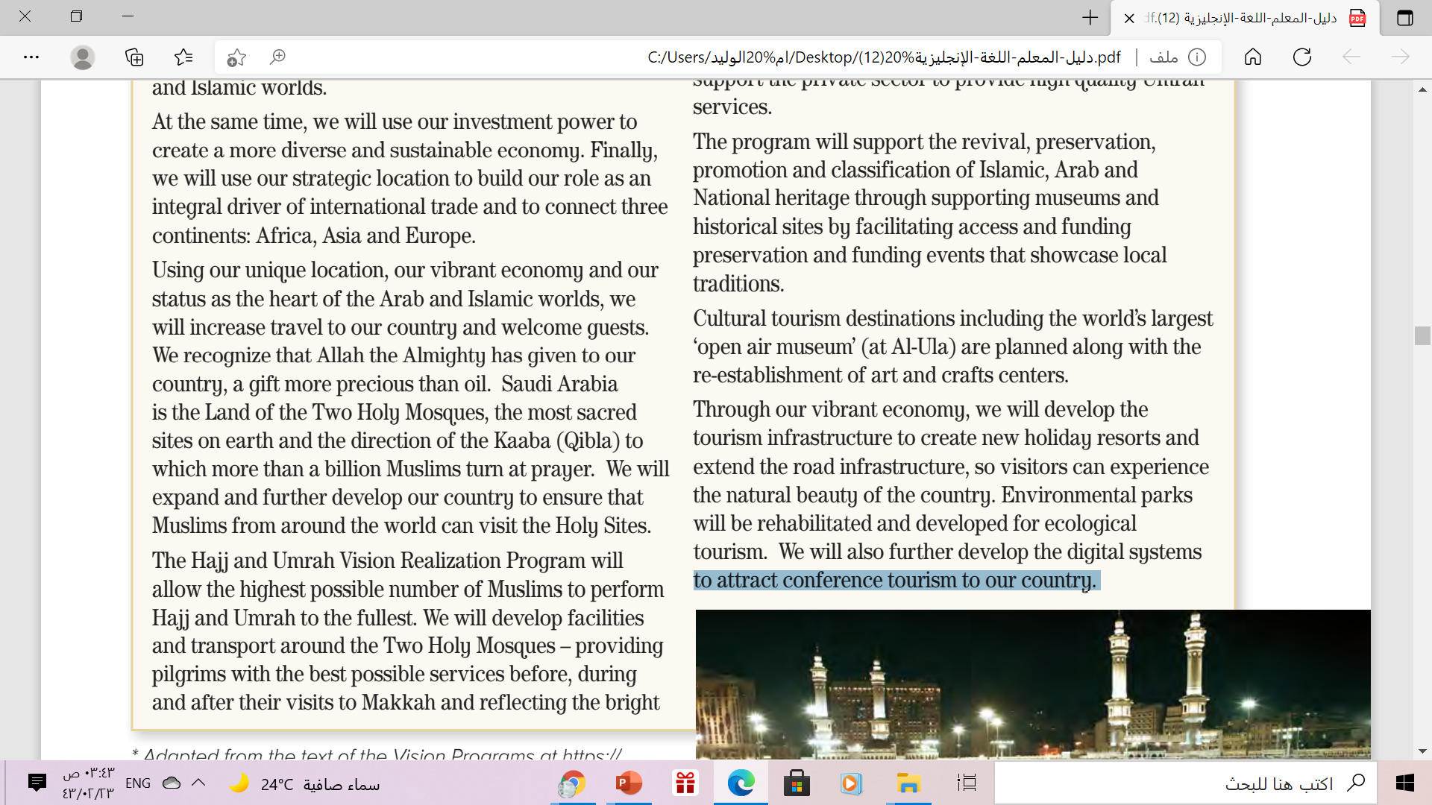
Where is the world’s largest
‘open air museum
(at Al-Ula)

Slide 13
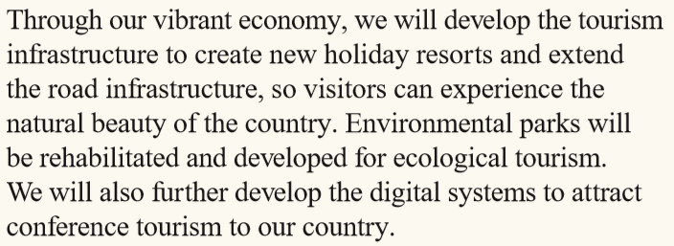
Why will we further develop the digital systems ?
to attract conference tourism to our country.

Slide 14
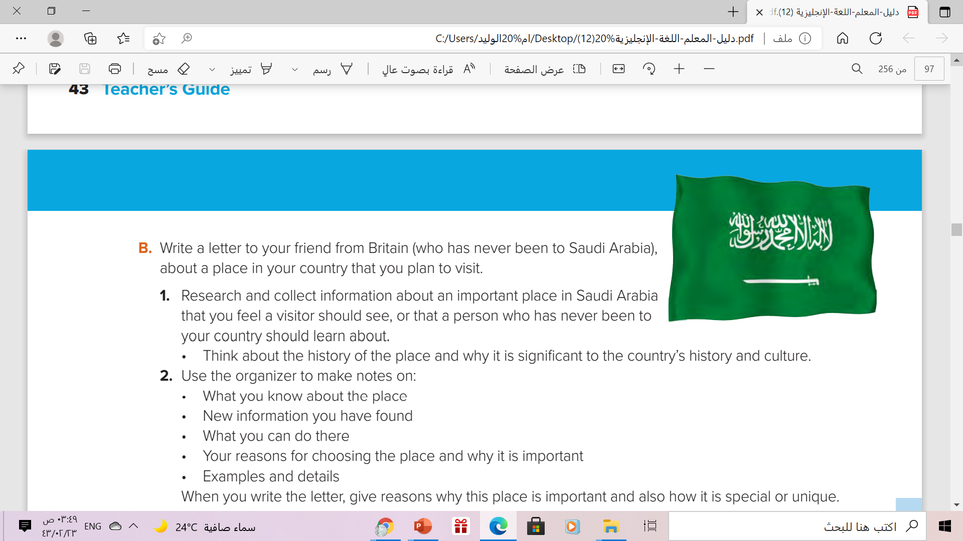

Slide 15
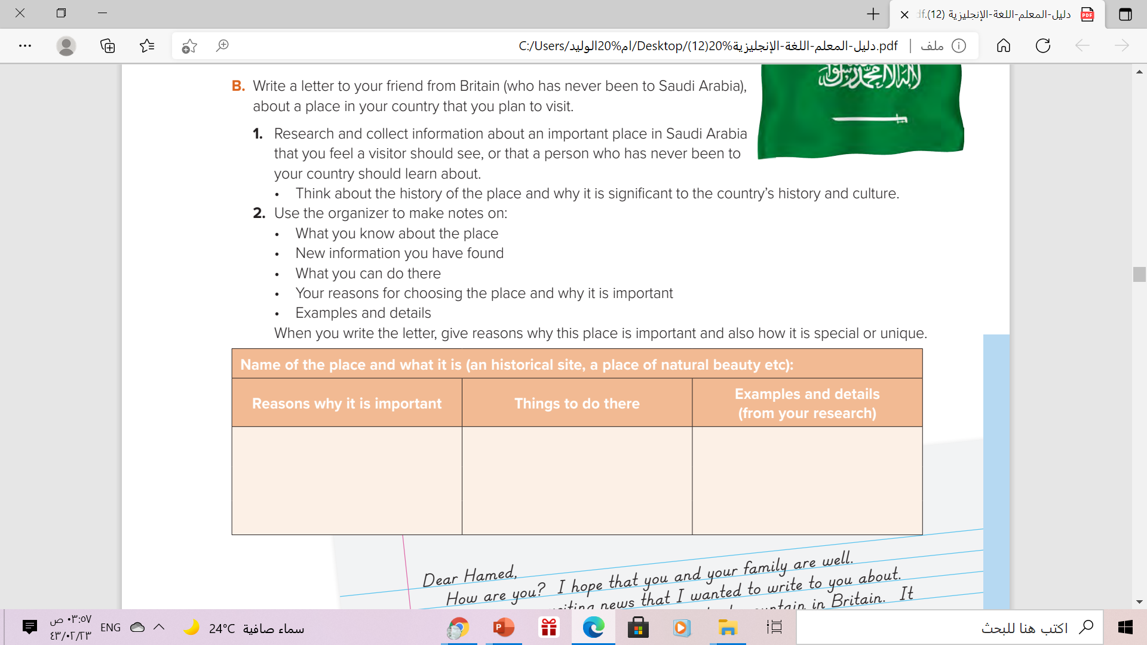

Slide 16
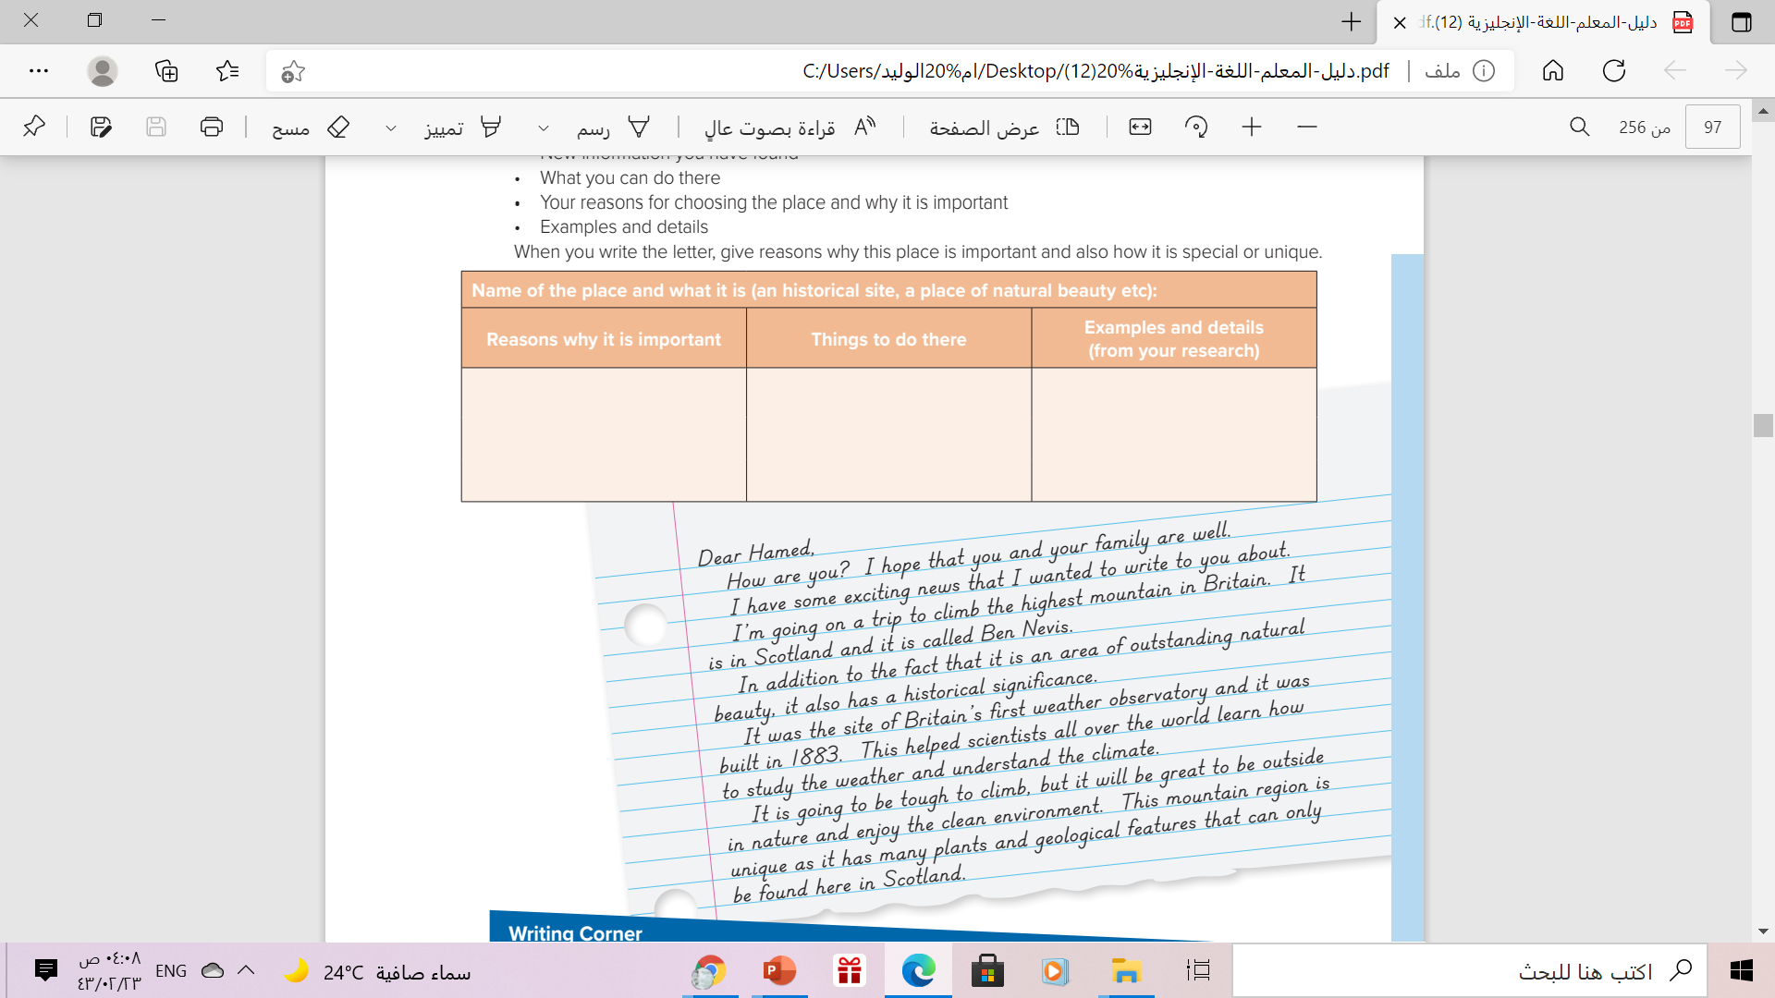

Ben Nevis Mountain
It was the site of Britain’s first weather observatory
- climb the mountain
- Enjoy the clean environment
-The highest mountain in Britain
-has a historical significance
-has many plants & geological features
The notes used in the chart from this letter

Slide 17
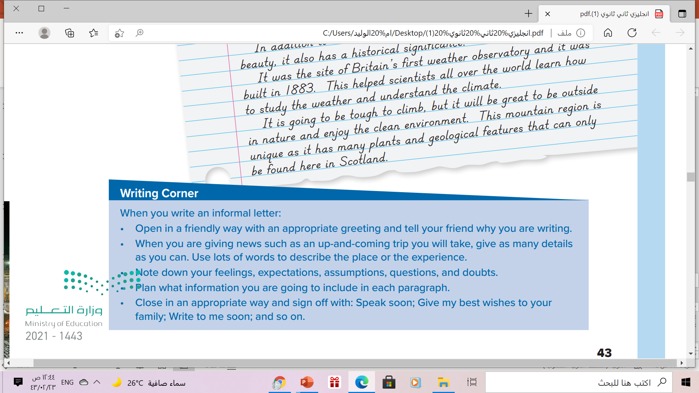
Follow these steps to write an informal letter

Slide 18
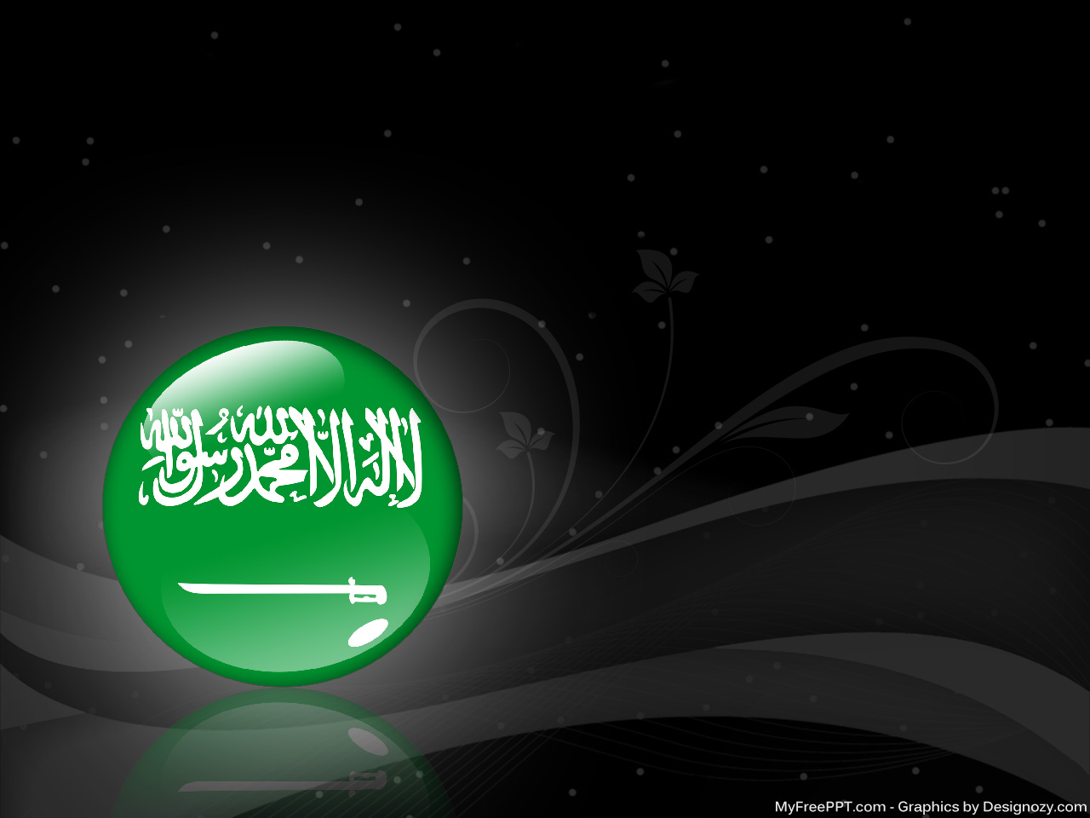
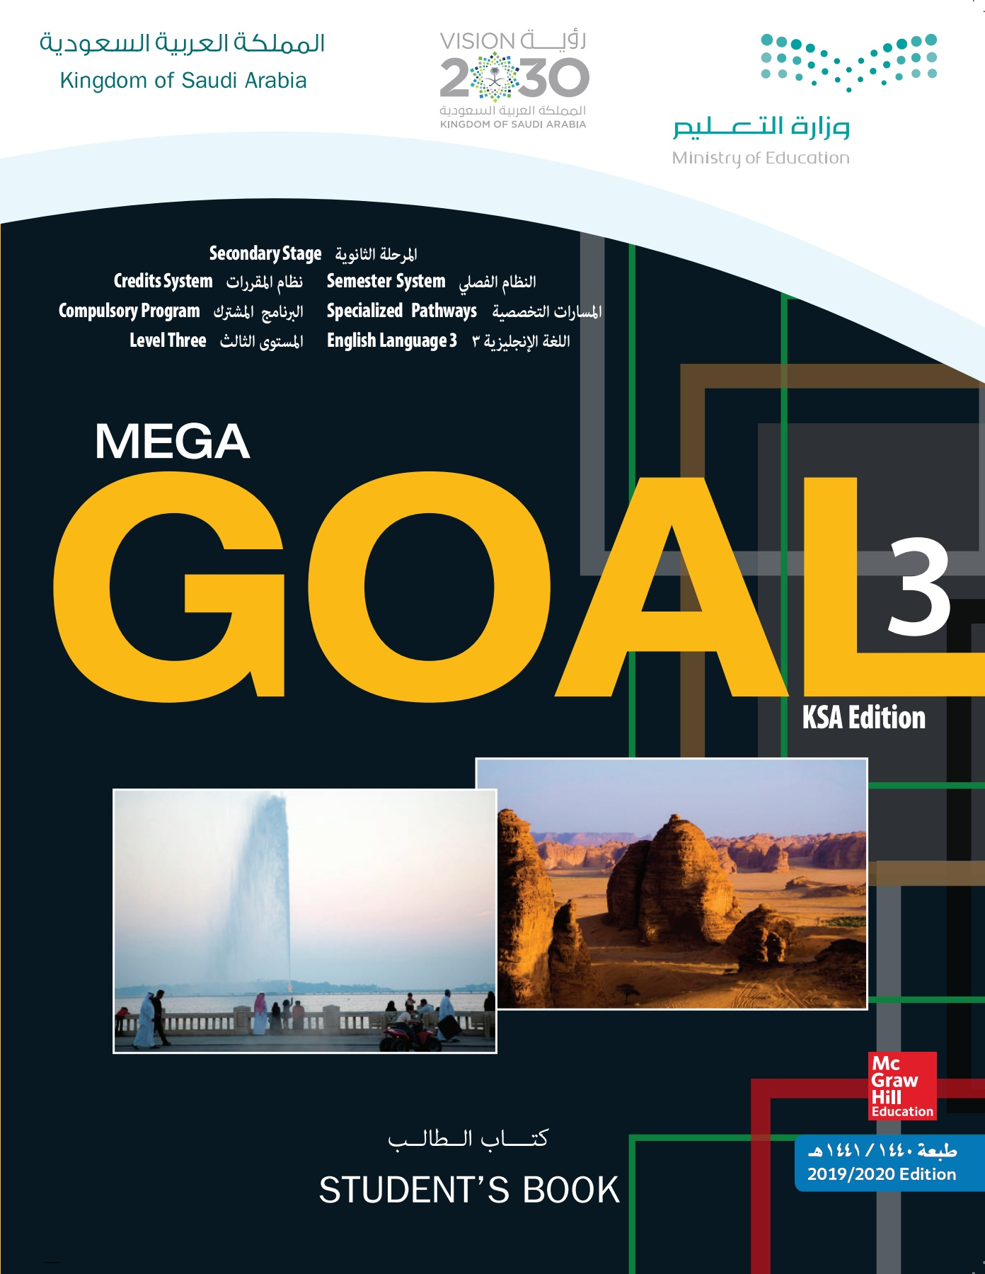
Homework Workbook p.(110) ,exercise (L)

Slide 19


Slide 20
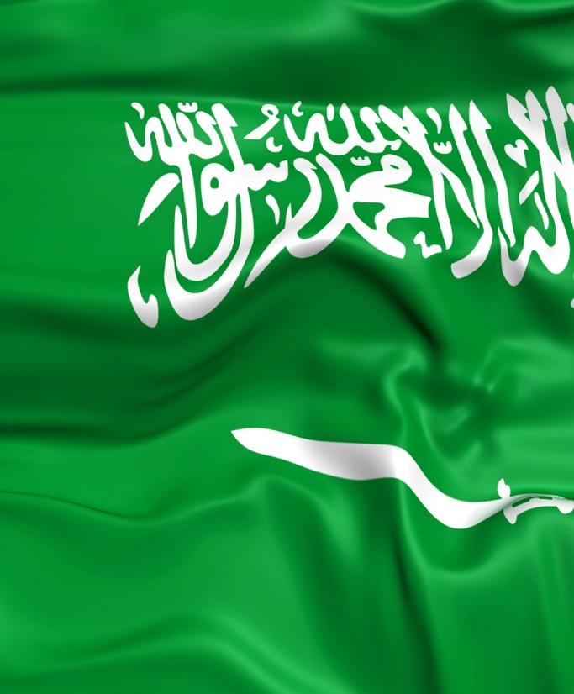

Thanks!

