Slide 1
Unit 2 Crime Doesn’t Pay Conversation& Listening
Mega Goal 2.1
Done by: Entisar Al-Obaidallah

Slide 2
Lesson Goals
Answer some questions about the conversation.
Make use of real talk phrases in a real conversation.
Listen for specific information
Use the new words in sentences.

Slide 3
What’s happening to the people with the wallet?
They are pickpocketed

Slide 4

What’s happening to the people with the wallet?
wallet
They are pickpocketed

Slide 5
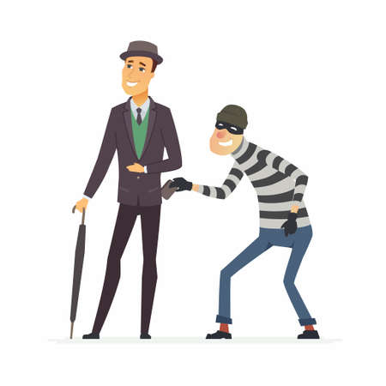
a pickpocket – pickpocket - pickpocketed
pickpocketed
a pickpocket
To pickpocket

Slide 6
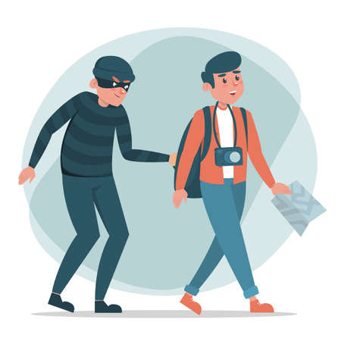
Pickpocket as ( V – N)
To pickpocket
to steals things from another person’s pockets
A pickpocket
A pickpocket is someone who does this

Slide 7

Open
Student’s book p. (24)

Slide 8
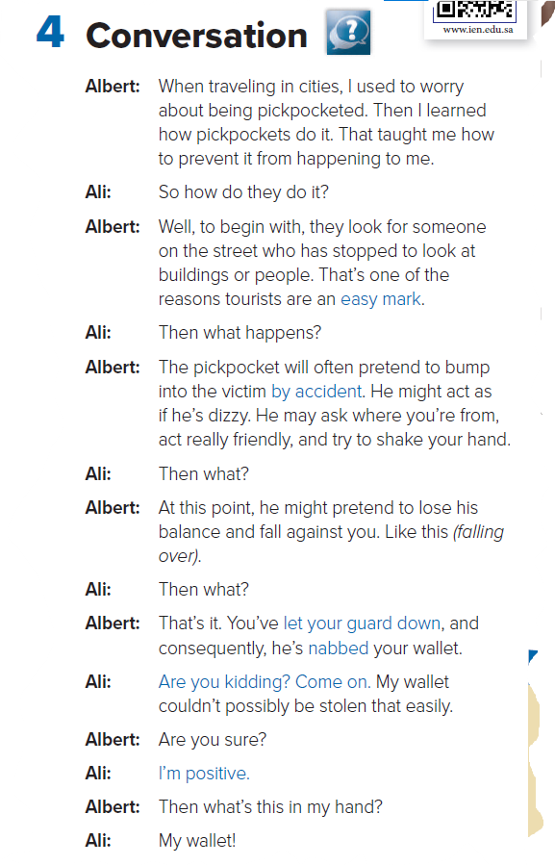


Open UR book p.(10)
Read along as u listen

Slide 9
How do pickpockets choose their victims?
They look for people who are looking at buildings and other things. They often choose tourists.
What do they do before they commit the crime?
They bump into their victim, or act very friendly and
shake the victim’s hand

Slide 10
What do you think Albert does when he says, Like this?
He acts out what the pickpocket does.)
Why is Ali surprised at the end of the conversation?
Albert has stolen his wallet from his pocket

Slide 11
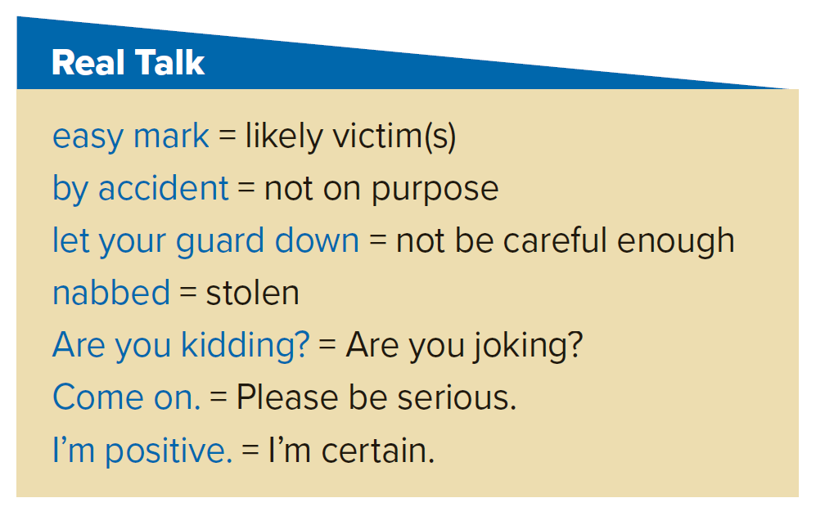
Who says, “easy mark” ?
Albert
Who says, “by accident” ?
Albert
Who says, “let your guard down ” ?
Albert
Who says, “nabbed” ?
Albert

Slide 12
Who says, “Are you kidding” ? Come on
Ali
Who says, “I’m positive” ?
Ali

Slide 13
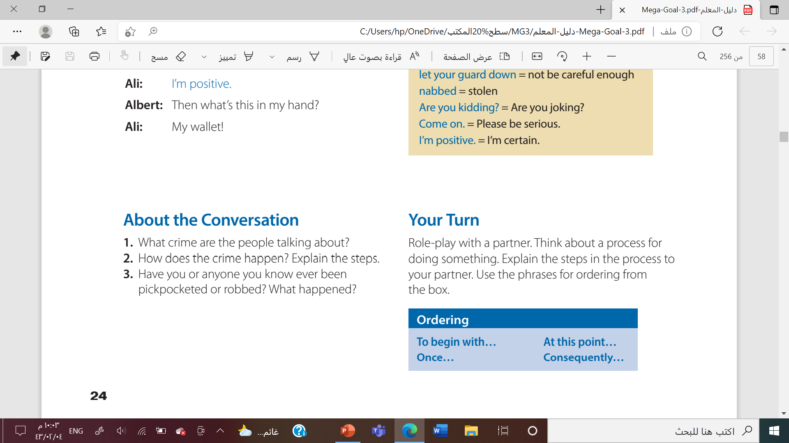
1- about pickpocketing.
2. Look for someone who isn’t walking; pretend to bump into the victim by accident; shake victim’s hand, act friendly; take wallet and walk away.

Slide 14


Which one does Albert use ?

Slide 15
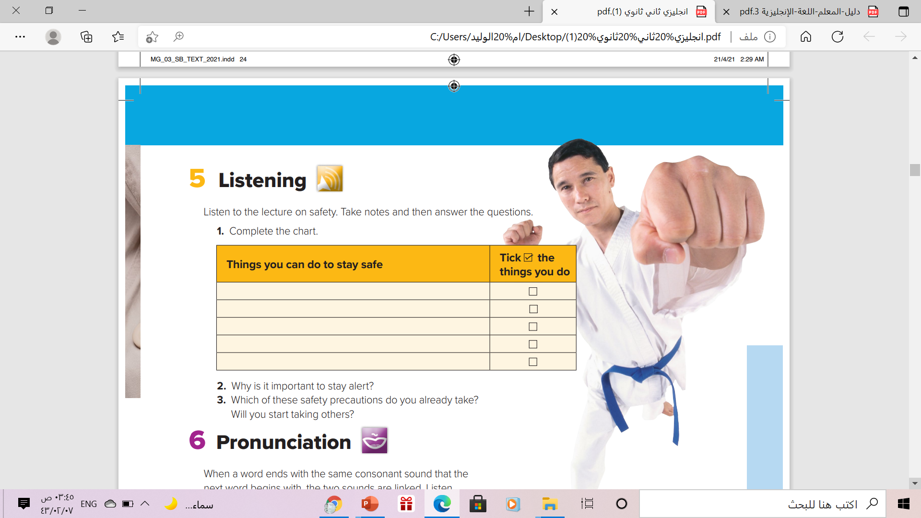

Keep valuables out of sight.
Don’t travel alone.
Stay alert
Avoid unfamiliar locations.
Take a self-defense class.
You can recognize dangerous people or situations

Slide 16
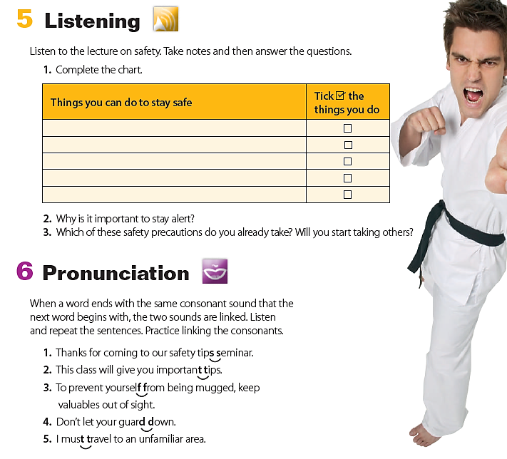

Slide 17
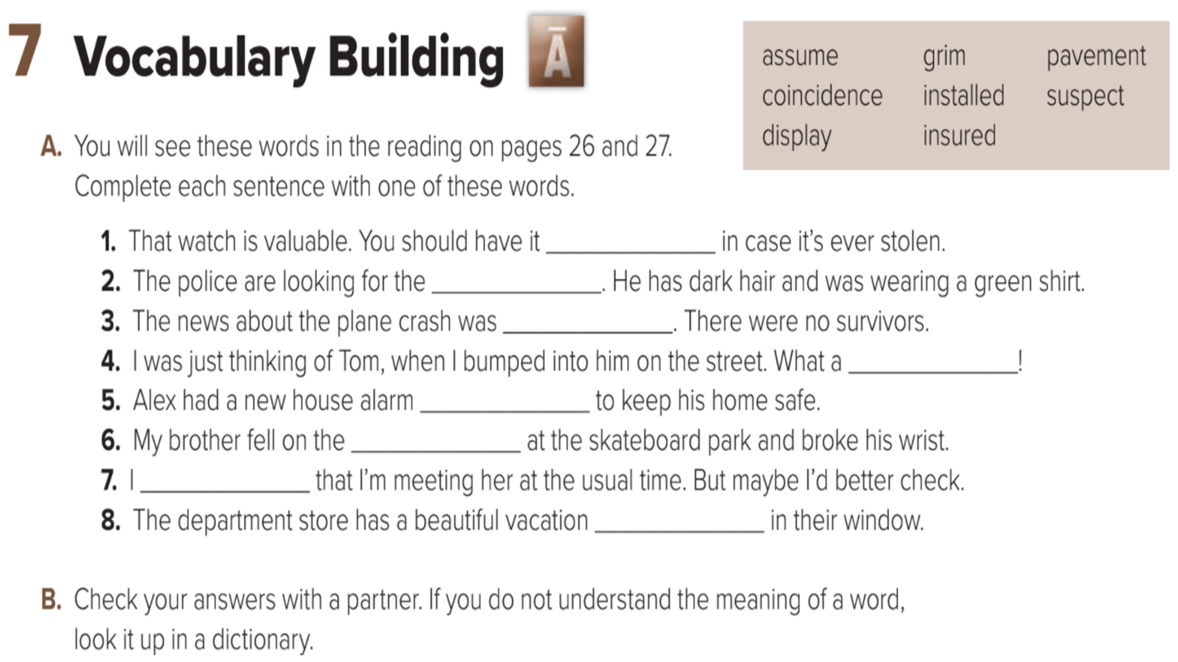
insured
suspect
grim
coincidence
installed
pavement
assume
display

Slide 18
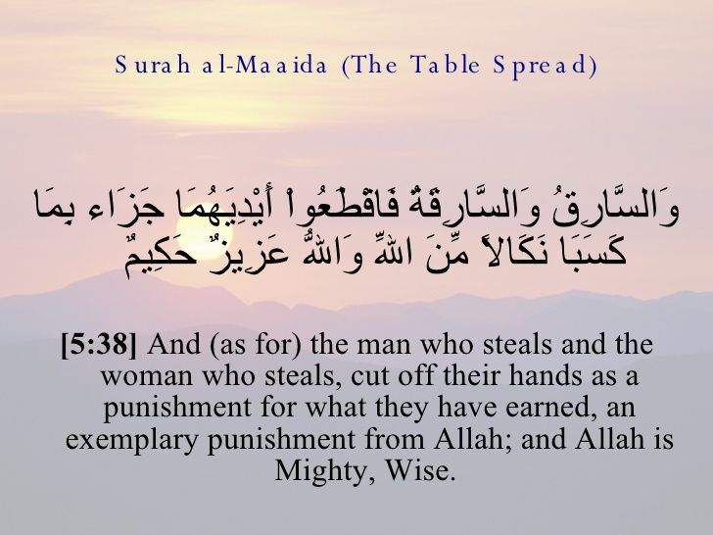

Slide 19
Homework
workbook p. (93), exercise ( A)

Slide 20


