Slide 1
Unit1
Connected By Technology
Writing
Done by : Entisar Al-Obaodallah

Slide 2
01
03
02
04
Lesson Objectives
Find
Use
the similarities and differences between socializing types
phrases to state differences .
Use
Write
phrases to state similarities .
a comparative essay correctly

Slide 3
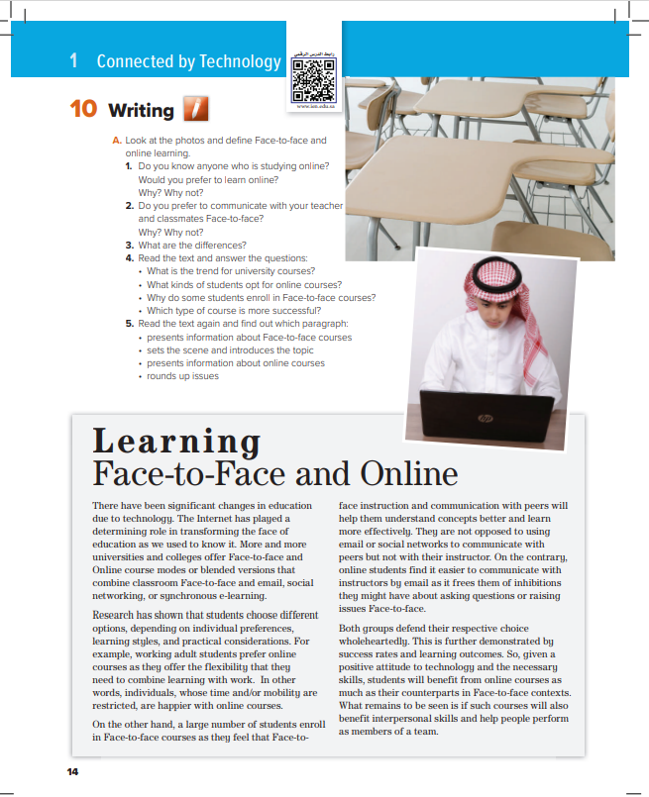
Open
Your book p.( 14 )

Slide 4
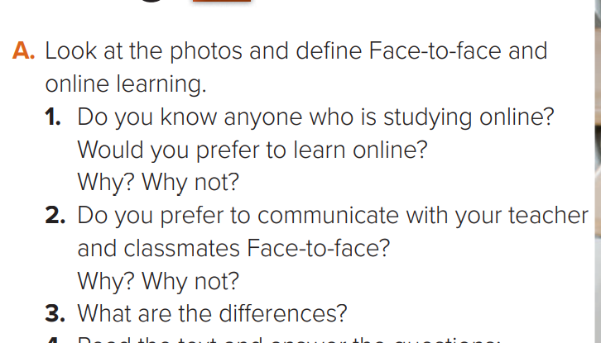


Warm up

Slide 5
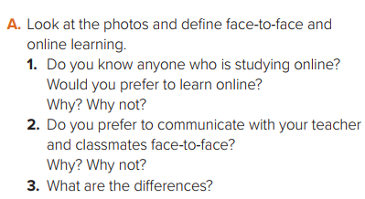
Brain storming

Slide 6
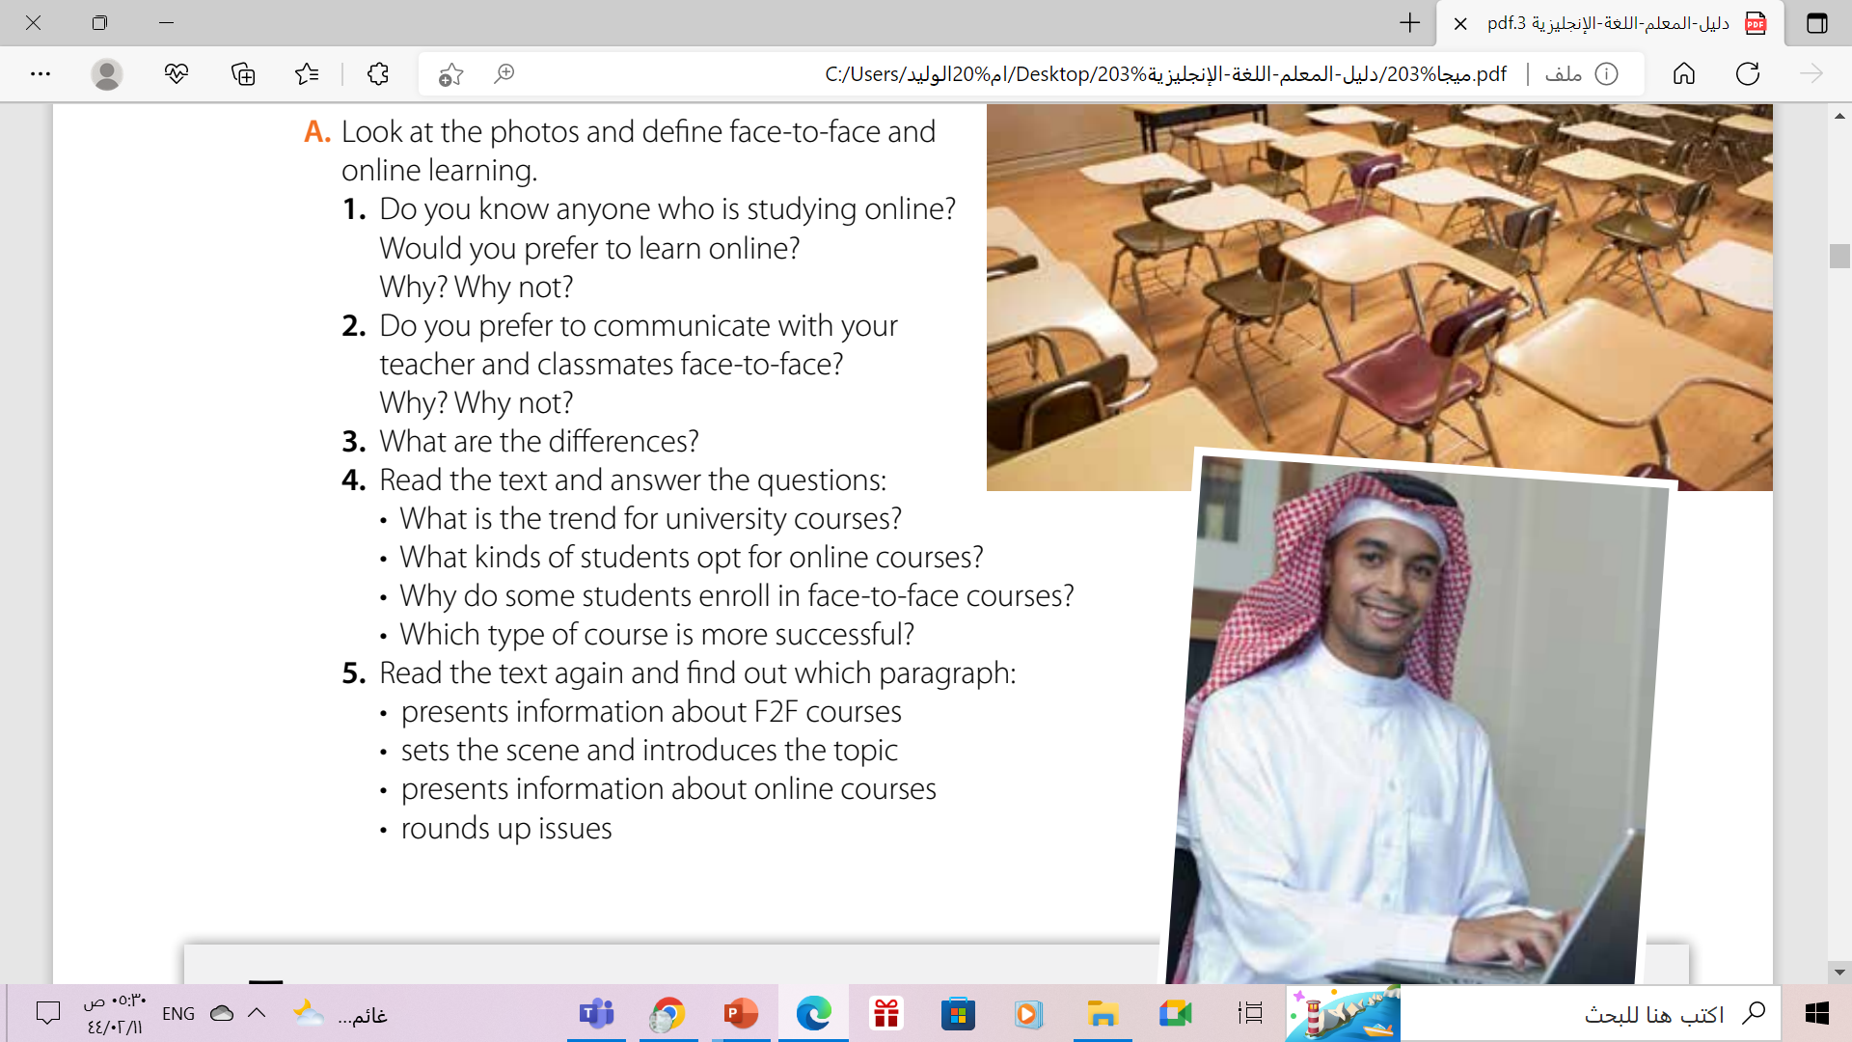
More universities and colleges offer F2F (Face-to-face) and Online course modes or blended versions that combine classroom F2F and email, social networking, or synchronous e-learning.
working adult students prefer online courses as they offer the flexibility that they need to combine learning with work. In other words, individuals, whose time and/or mobility are restricted, are happier with online courses.
They feel that face-to-face instruction and communication with peers will help them understand concepts better and learn more effectively.
Both groups defend their respective choice wholeheartedly. This is further demonstrated by success rates and learning outcomes.

Slide 7

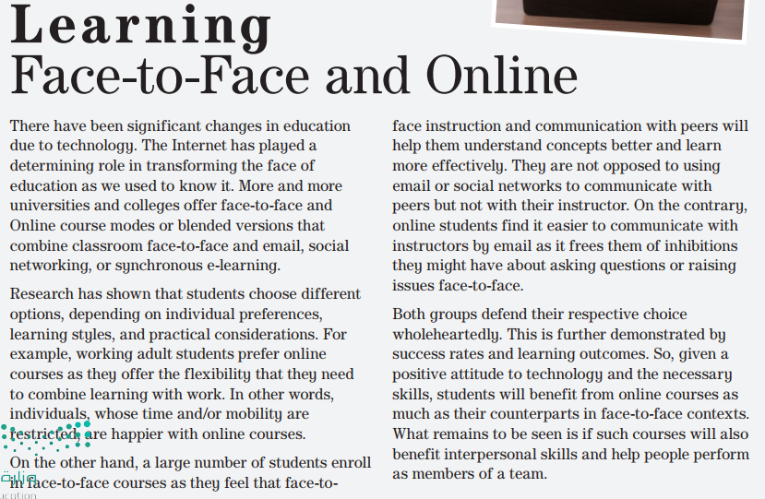


Slide 8
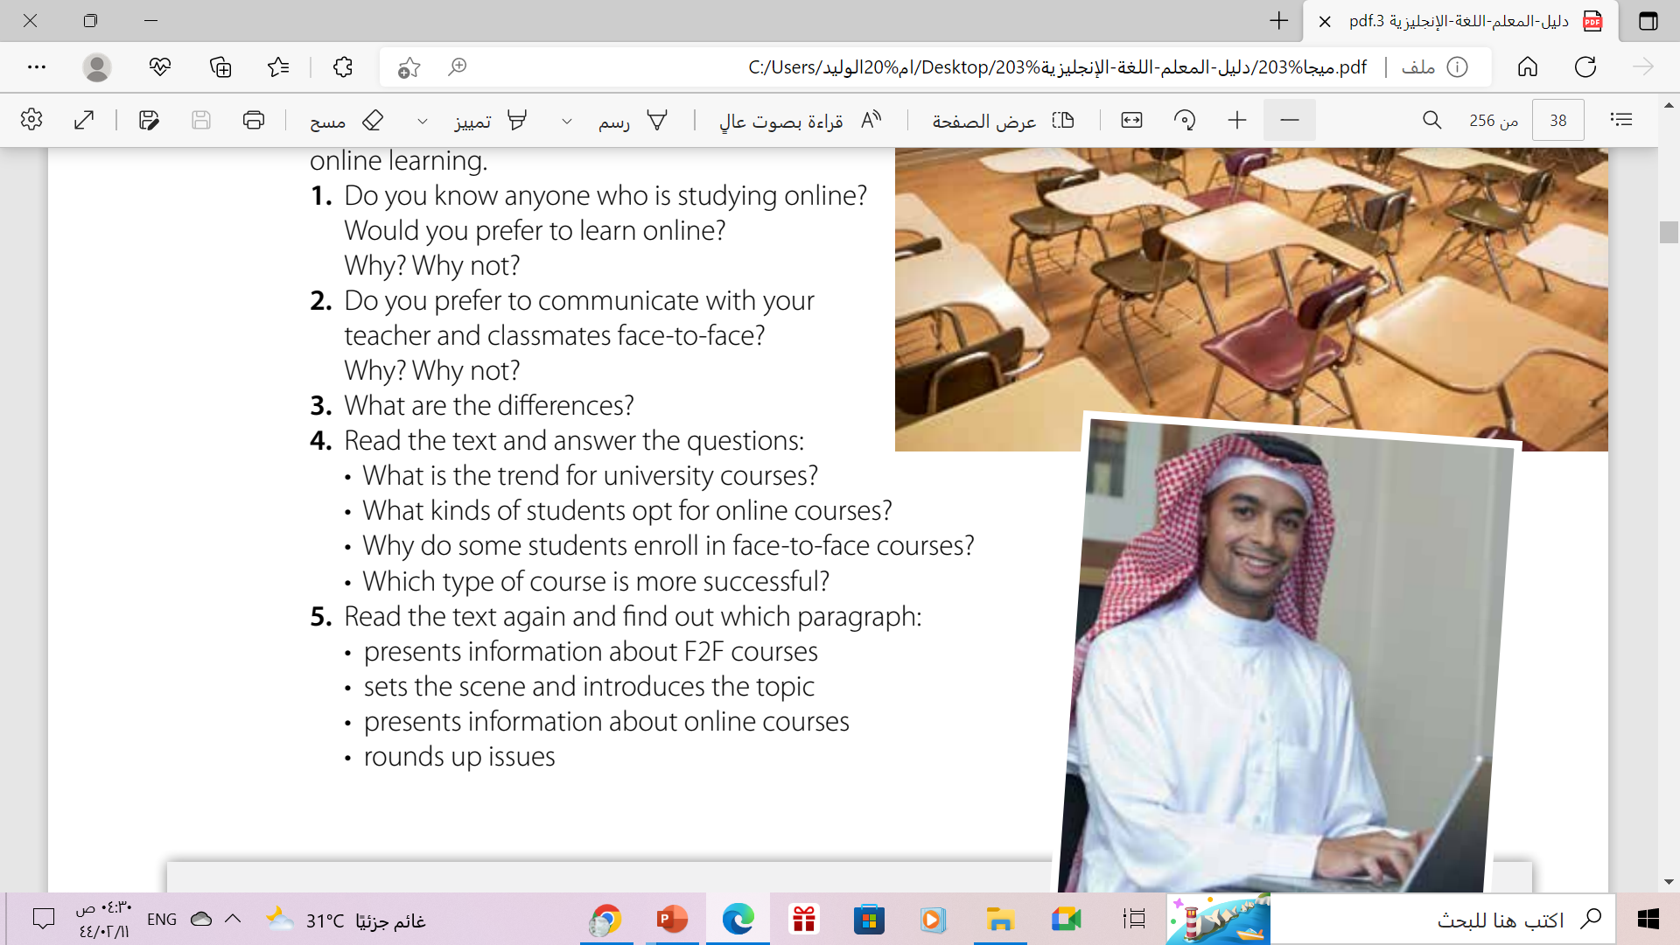
paragraph 3
Paragraph 1: significant changes in education due to technology, Internet/determining role/ transforming face of education/ universities and colleges/ F2F/ Online course mode/ blended/ synchronous e-learning
Paragraph 2: and end of paragraph 3 choose different options, individual preference, practical considerations/ flexibility/ combine learning and work
Paragraph 4 :both groups/defend choice/ success rates/ learning outcomes/benefit from online courses / face-to-face contexts

Slide 9
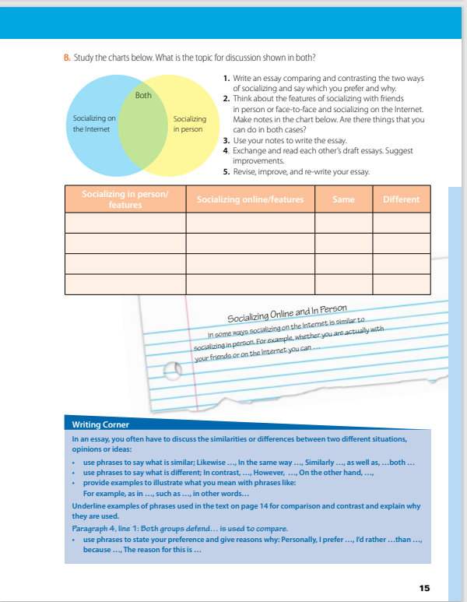
Open
Your book p.( 15)

Slide 10
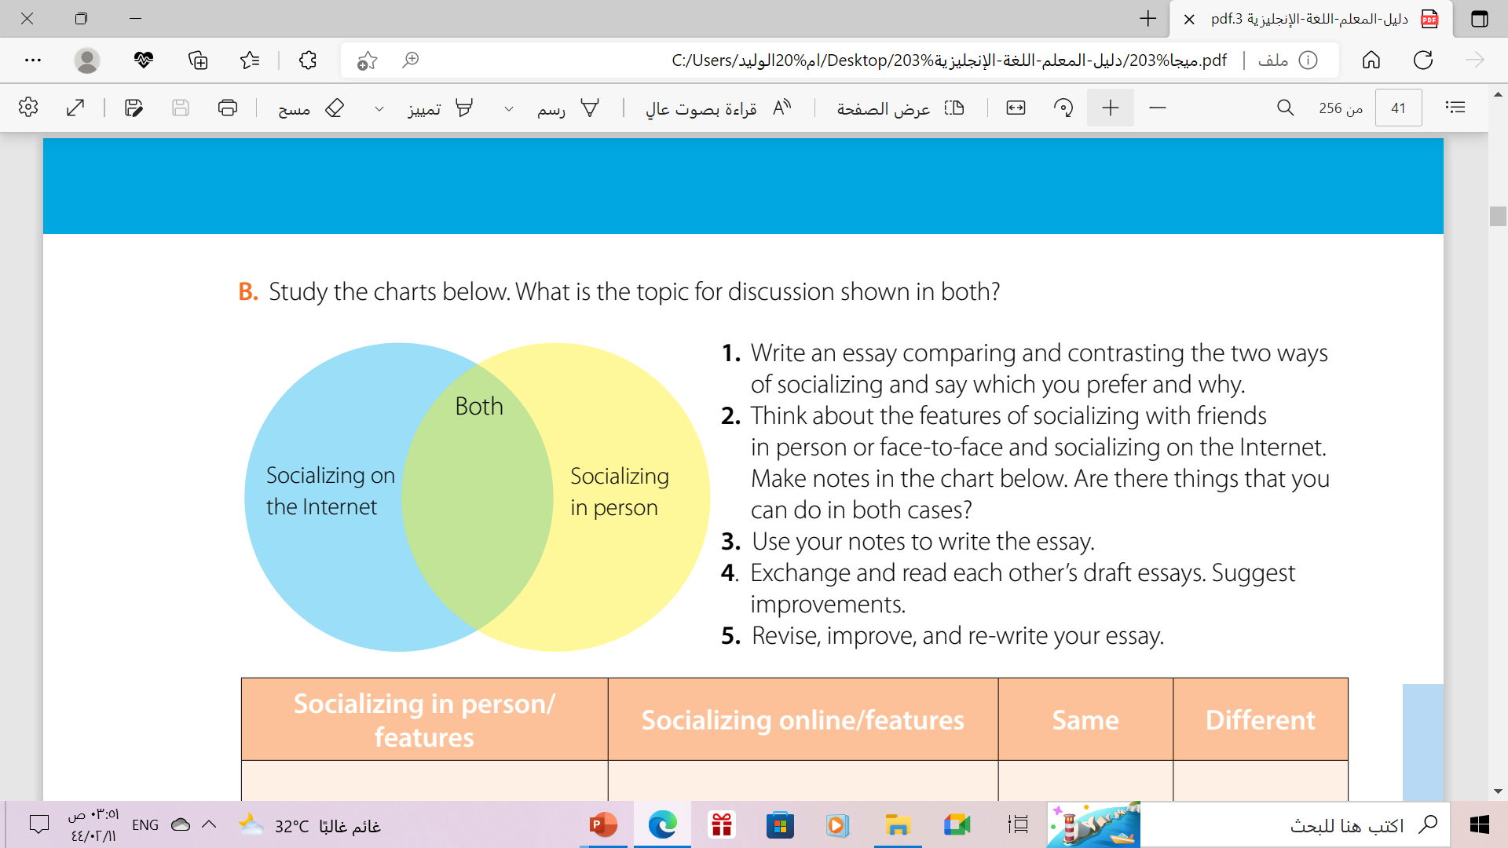
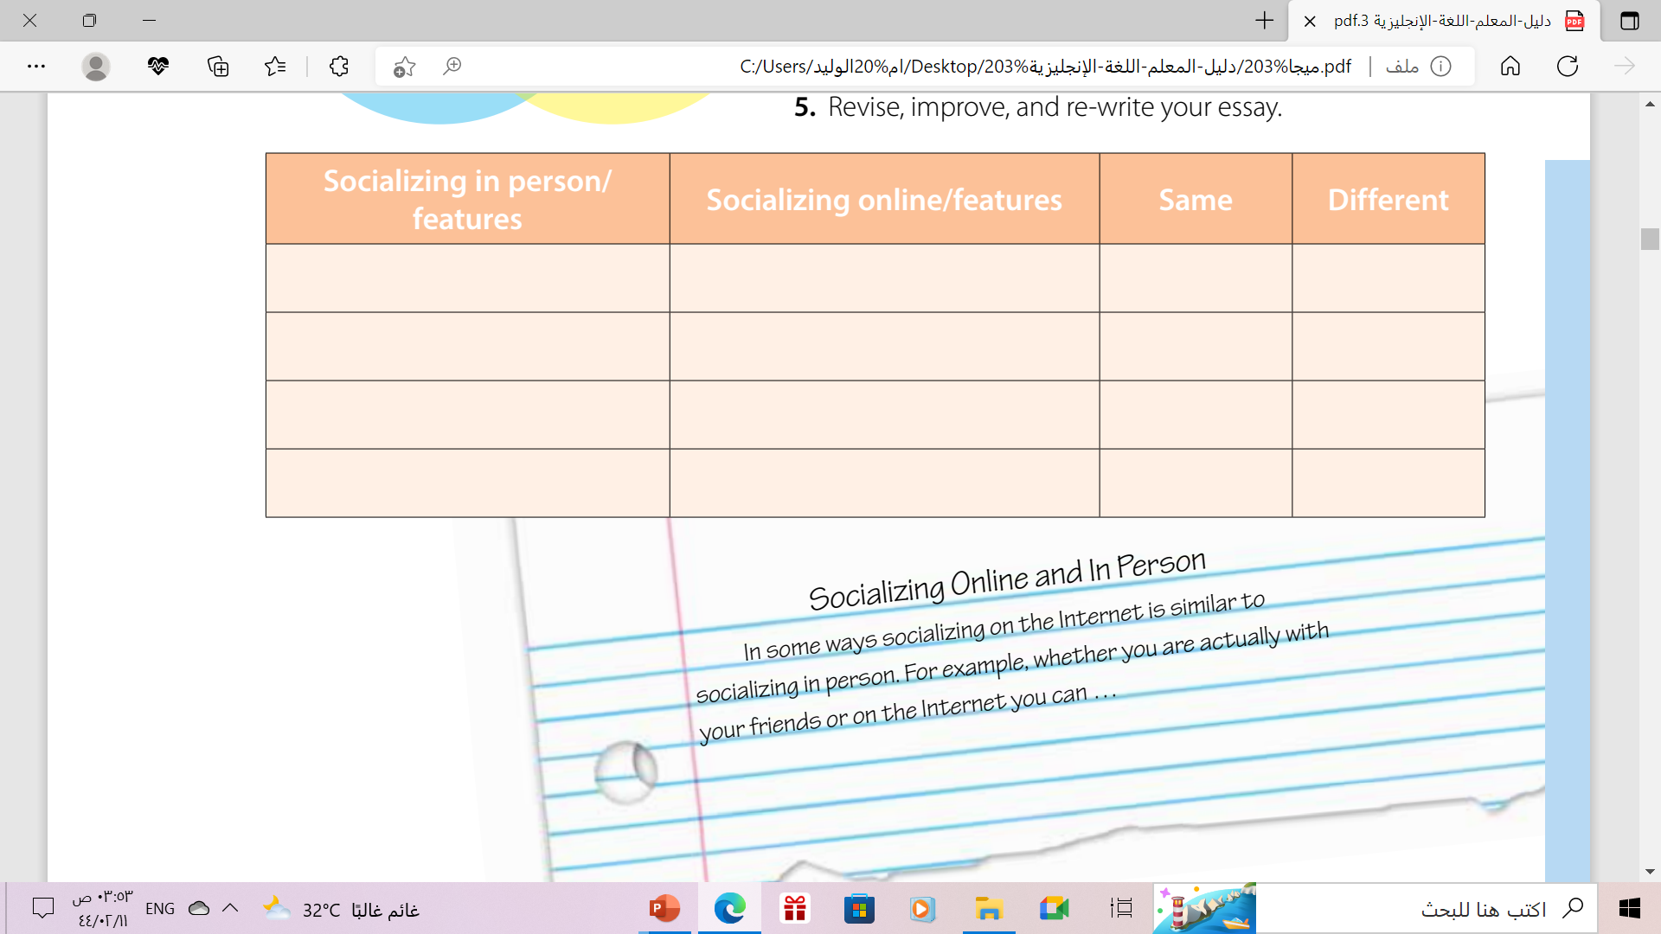
build crucial social skills
can create delusional reality
the ability to observe
people’s expressions
you can’t tell what the person looks like
clear any type of misunderstanding
easily misunderstood situation can happen
important for the quality of one’s mental health
you don’t have to spend money outdoors to socialize

Slide 11
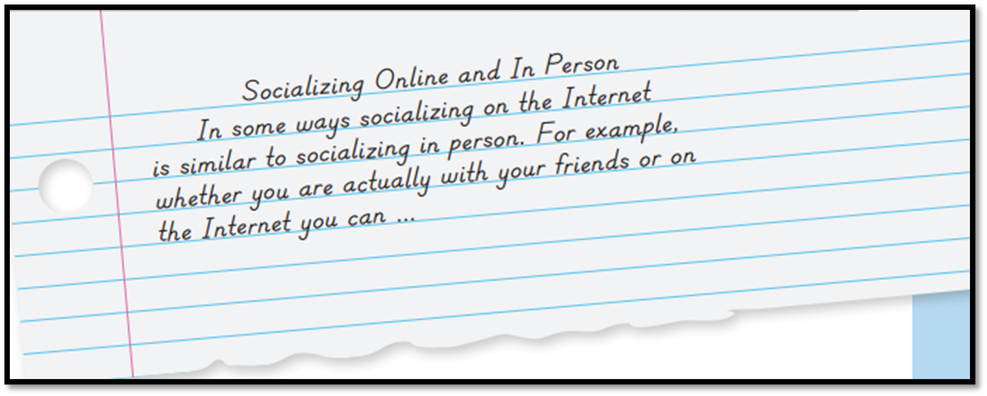
Complete the essay using your notes
Introduction

Slide 12
How to write a comparative essay?
1st paragraph
1- The introduction ( hook & revealing the two topics )
2nd paragraph
2-Explain Similarities (alike , the same , likewise , as well as , similarly , both )
3rd paragraph
3-Explain differences(but , however ,on the other hand , whereas , although)
4th paragraph
4- Conclusion ( summarize what has been written )

Slide 13
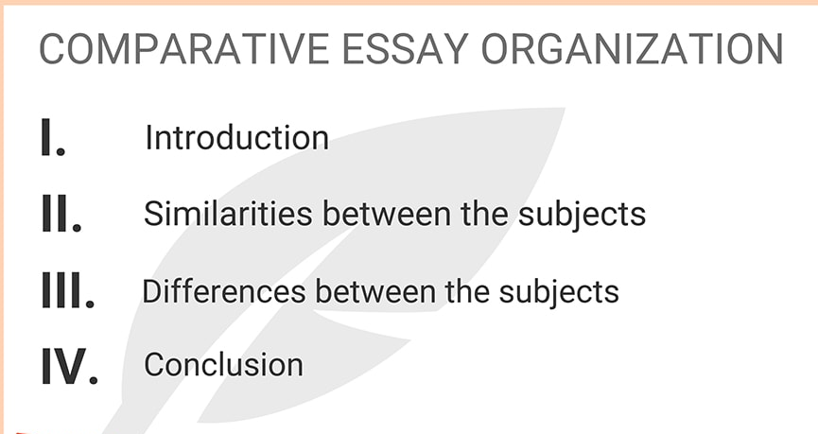
How to write a comparative essay

Slide 14
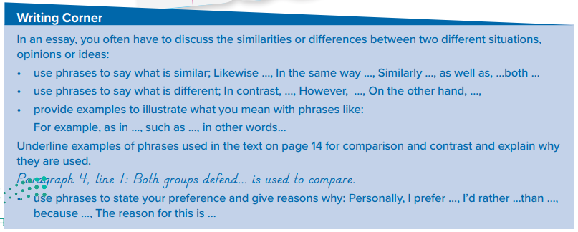
Remember: Follow these steps when you discuss differences & similarities

Slide 15


Slide 16
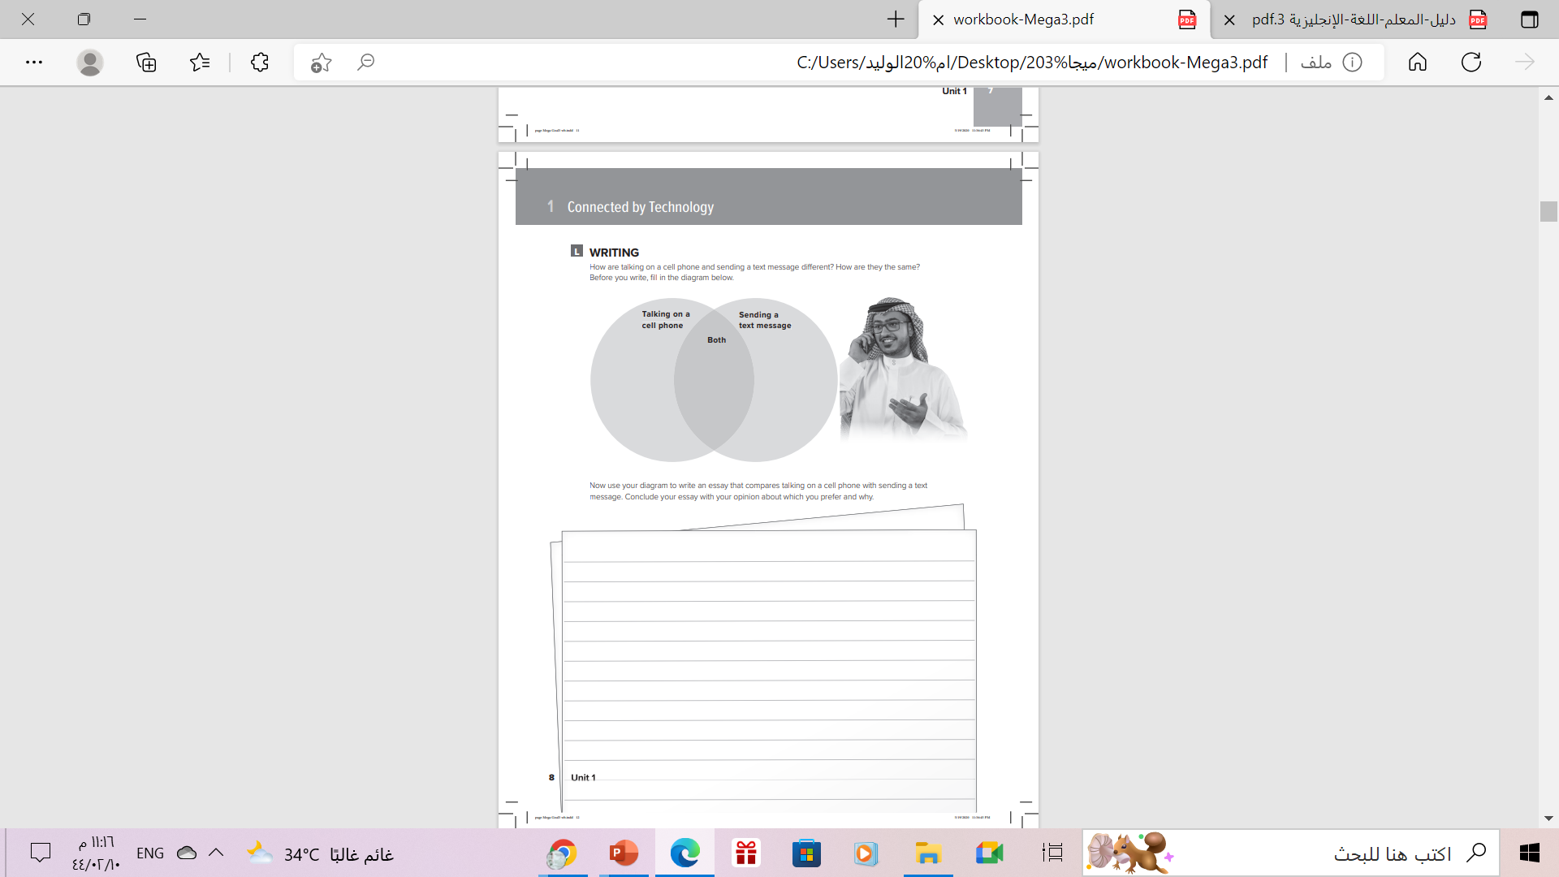

Homework
Workbook P. ( 90 )
Exercise ( L )

Slide 17

THANKS!

