Slide 1

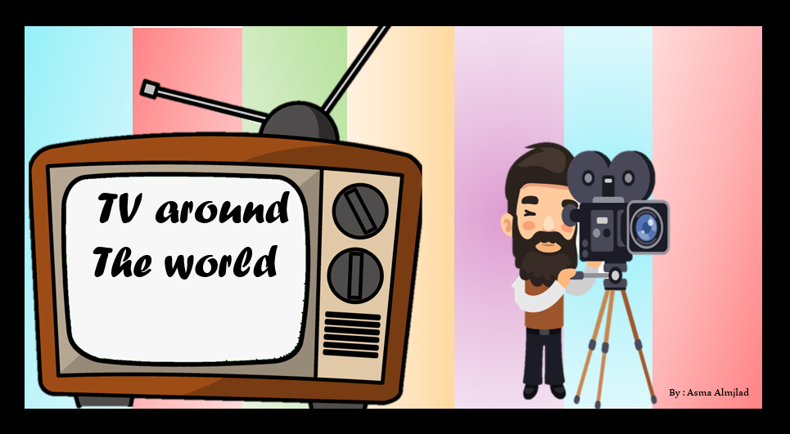

Listening

Slide 2
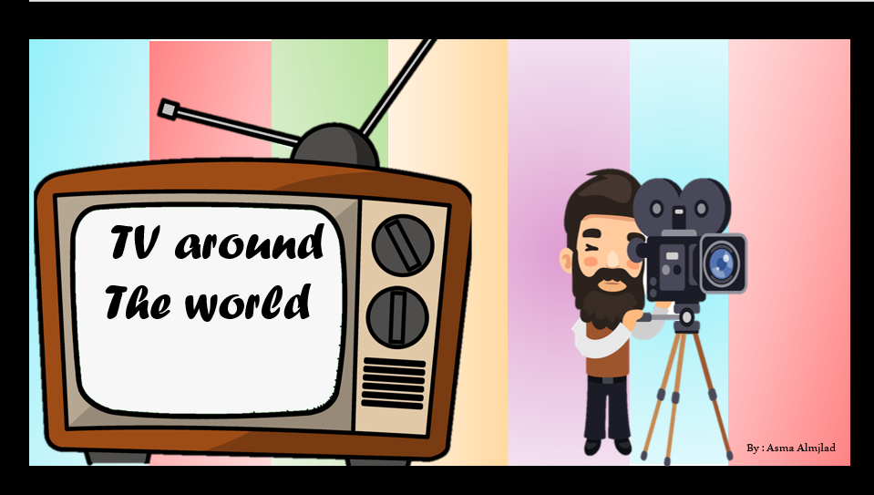

Listening

Slide 3
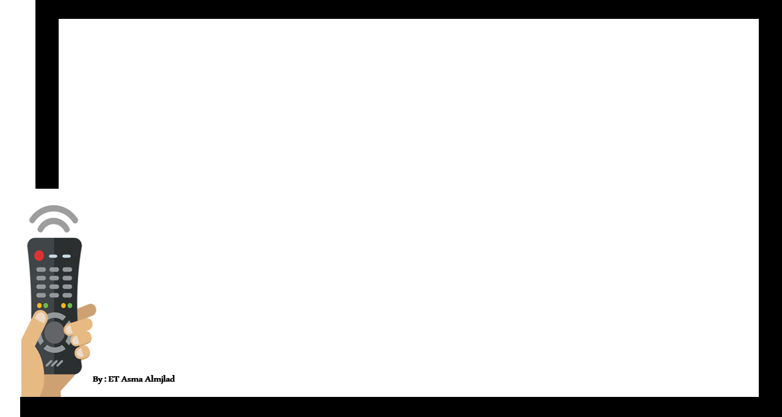

Objectives
Answer the question in the book
Practice using ( gonaa ) and ( wanna)
Match the words with their meaning

Slide 4
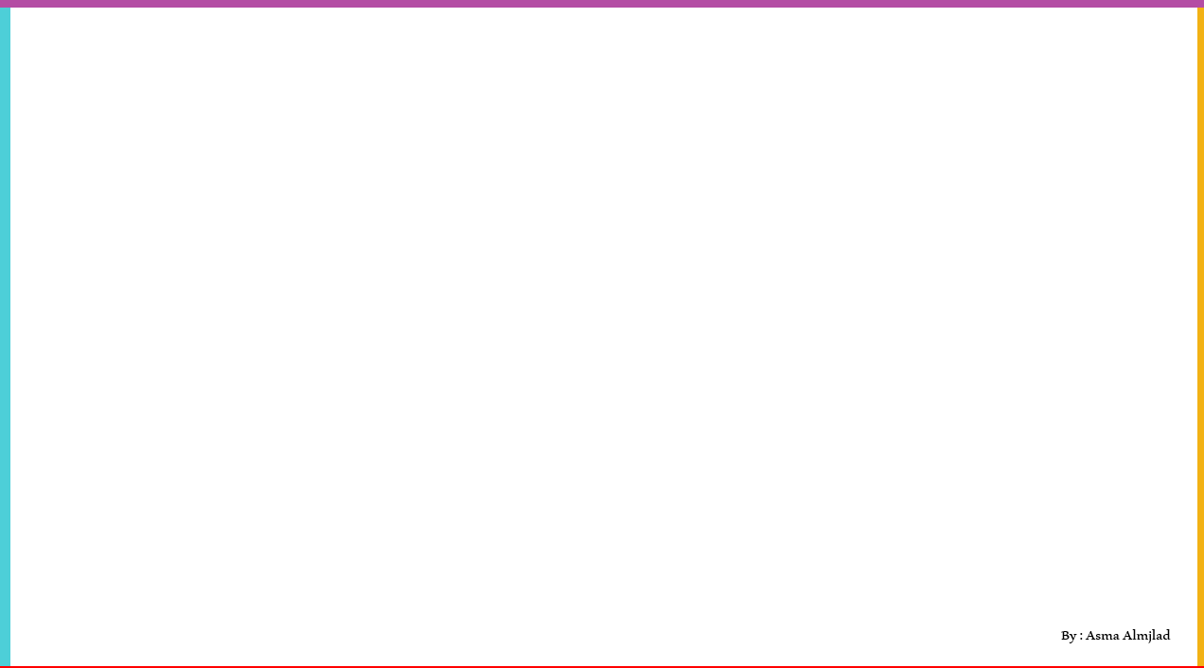


By : Asma Almjlad

Slide 5
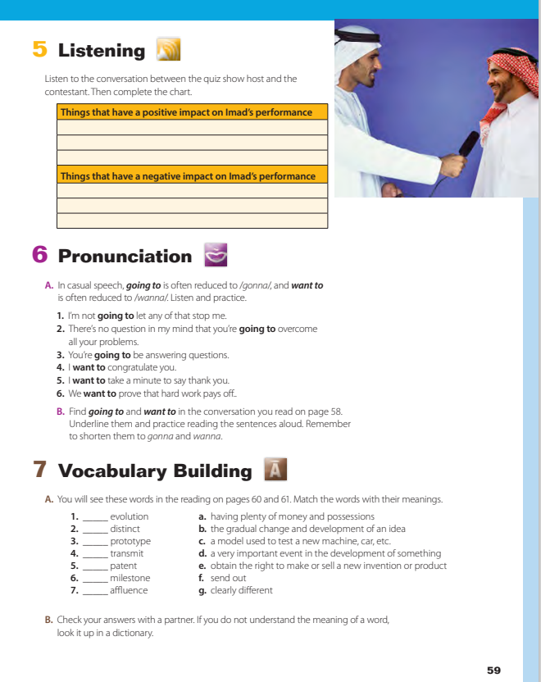
@ page 59

Slide 6
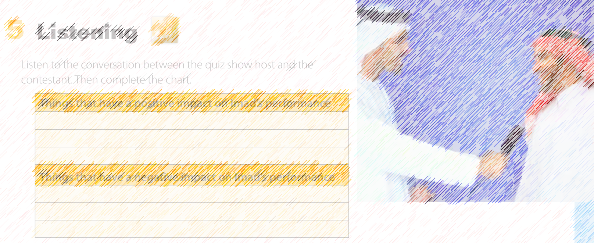


Listen

Slide 7
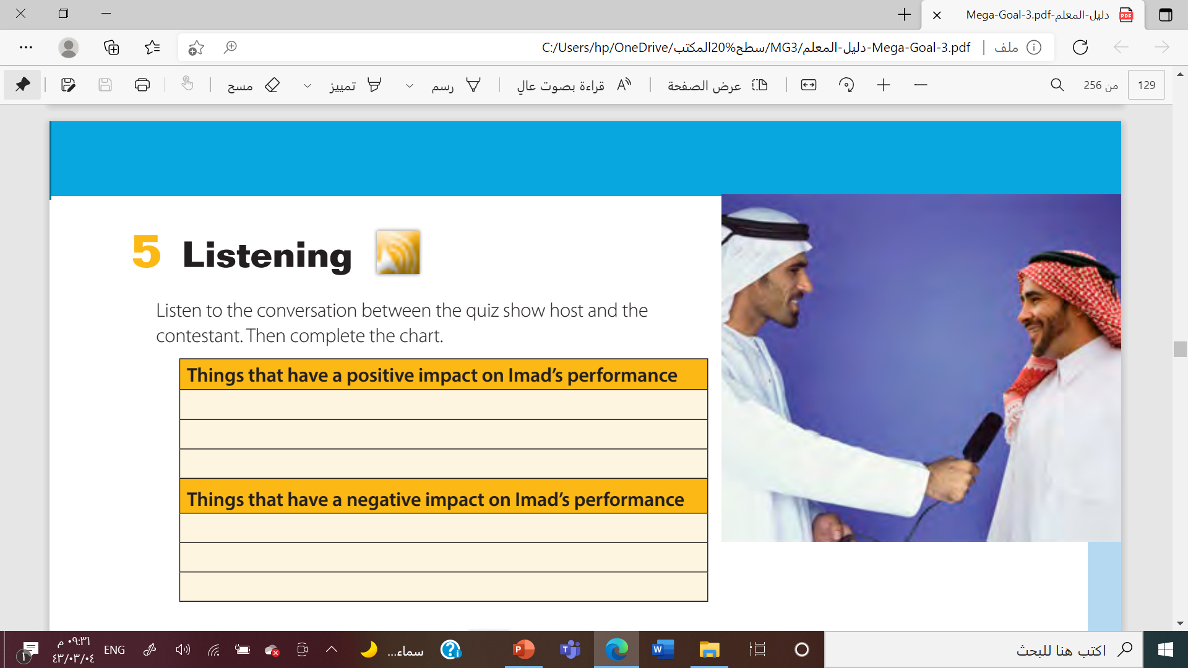
fantastic trainer
in the best physical and mental shape
wonderful, supportive family
a broken toe
father in the hospital
A cold

Slide 8
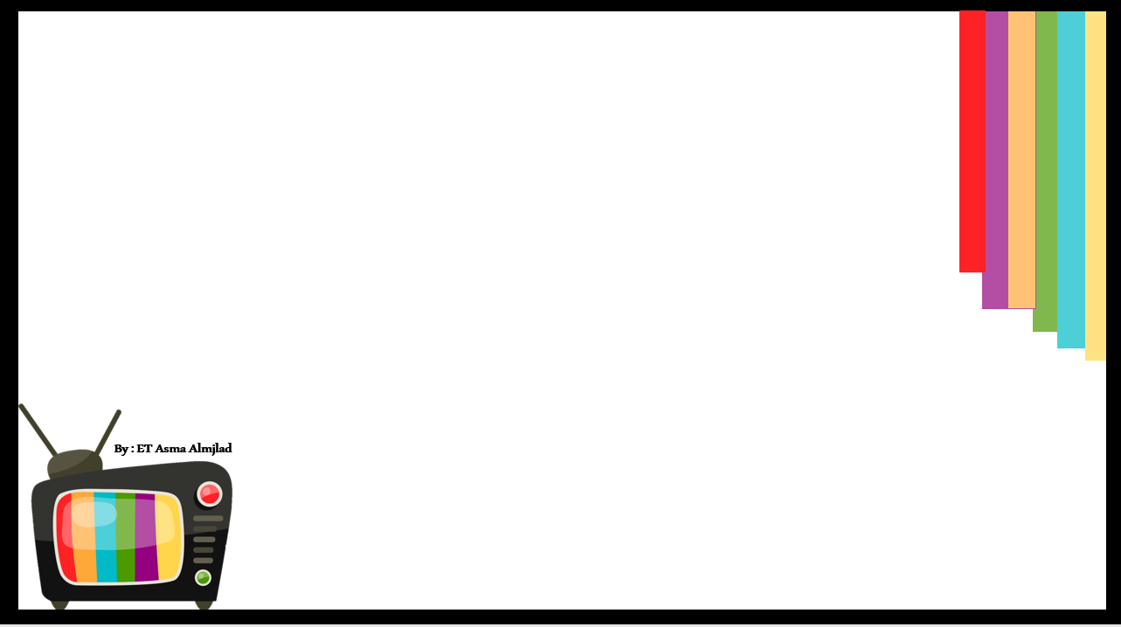



Slide 9
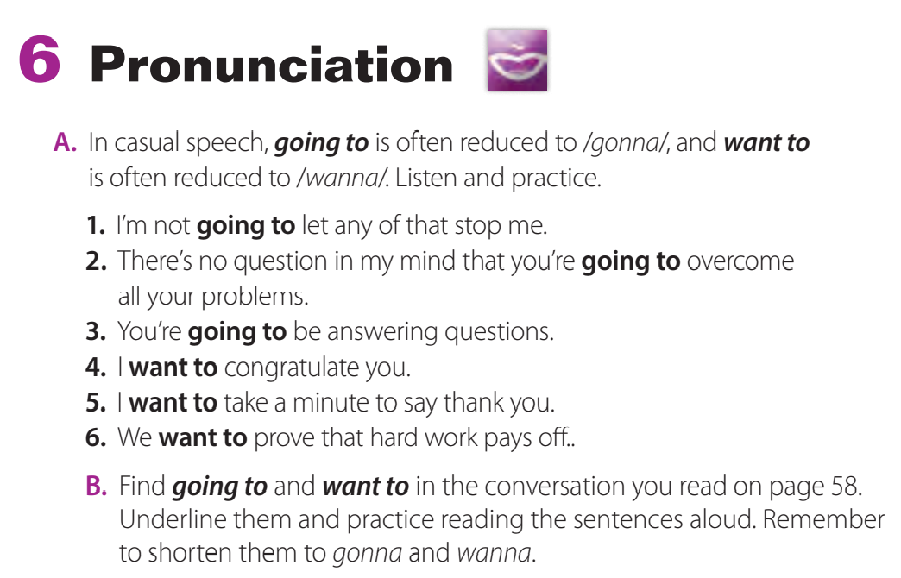

Slide 10

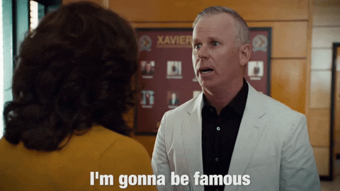



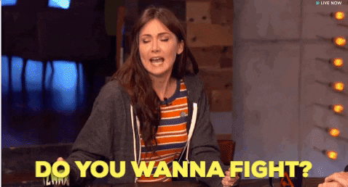

Slide 11
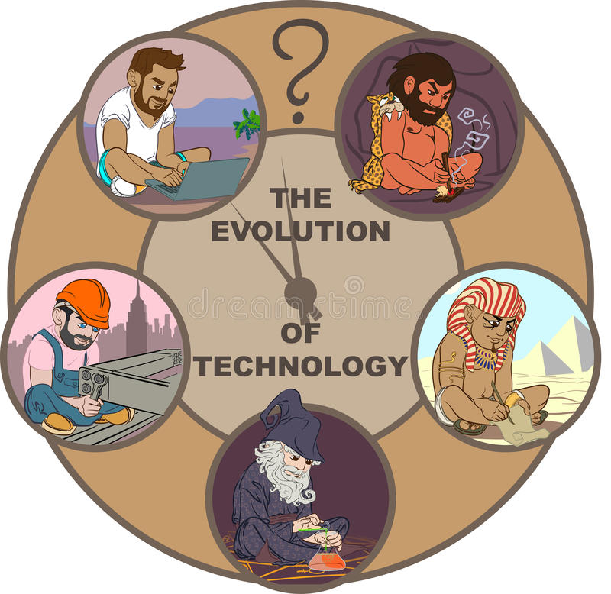




Prototype
evolution
distinct
transmit

Slide 12
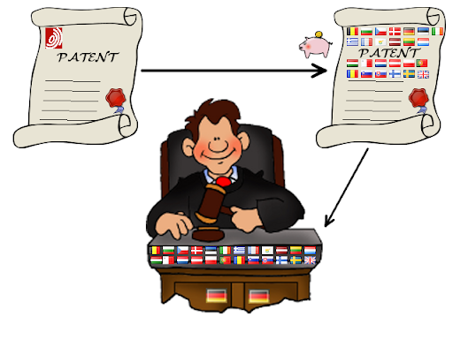


patent
affluence
milestone

Slide 13
clearly different
distinct
a model used to test a new machine, car, etc.
the gradual change and development of an idea
prototype
Evolution
send out
transmit
patent
obtain the right to make or sell a new invention or product
milestone
a very important event in the development of something
affluence
having plenty of money and possessions
By ET Talal AlHazmi

Slide 14

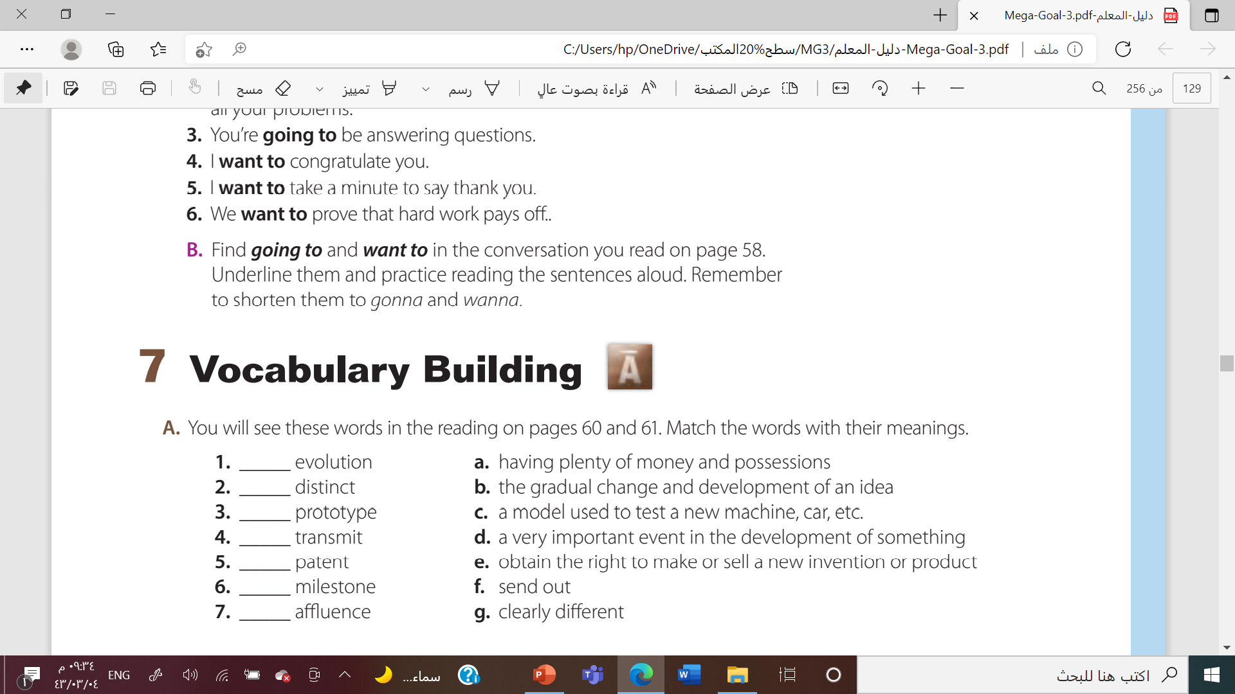

b
g
c
f
e
d
a

Slide 15






Slide 16



