Slide 1

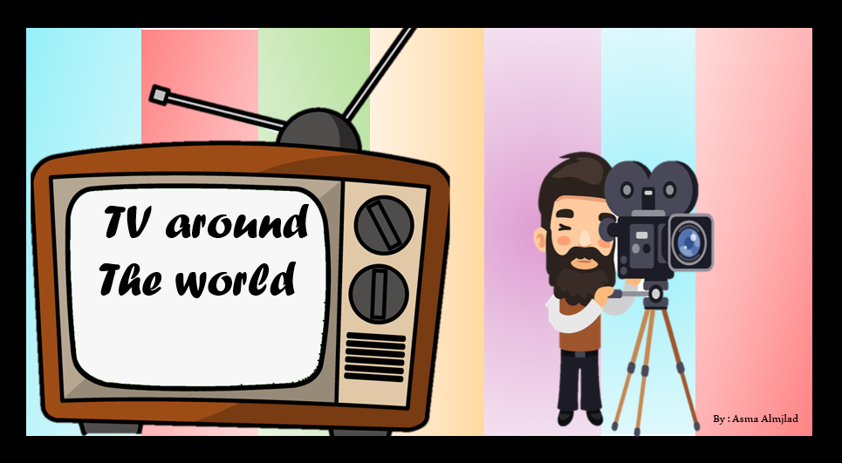

Listen and discuss

Slide 2
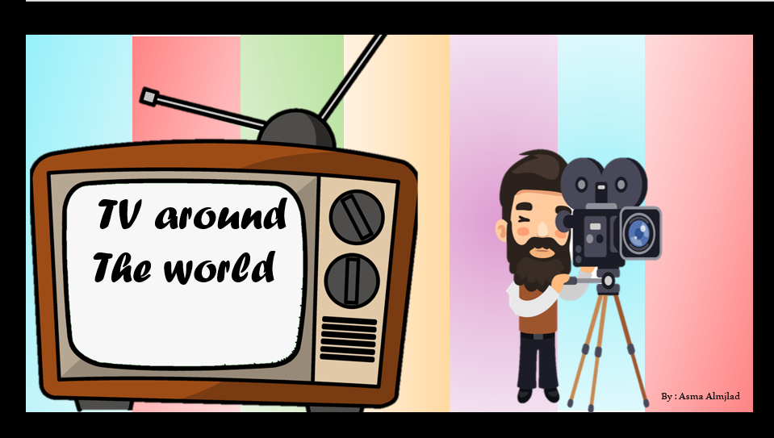


Slide 3
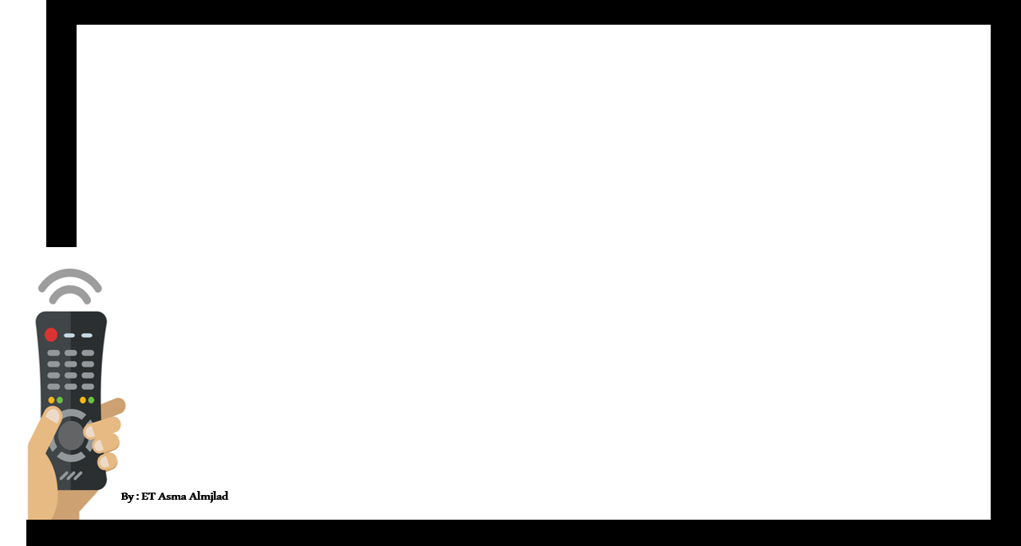

Objectives
Find out information about TV show through an audio text
Name the program show you got its description
Use the (real talk) phrases in new sentences

Slide 4
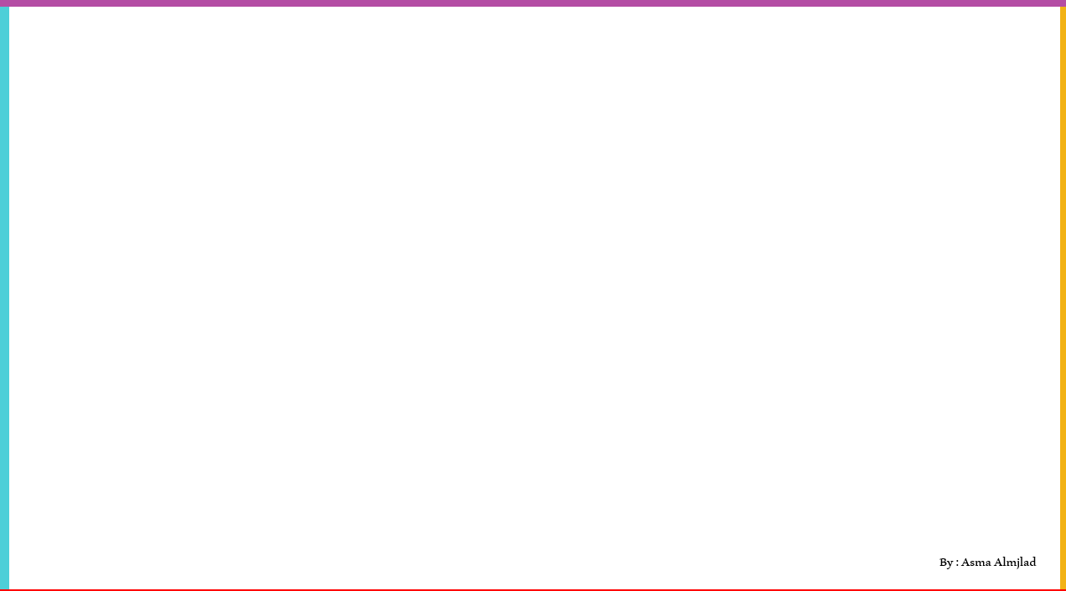


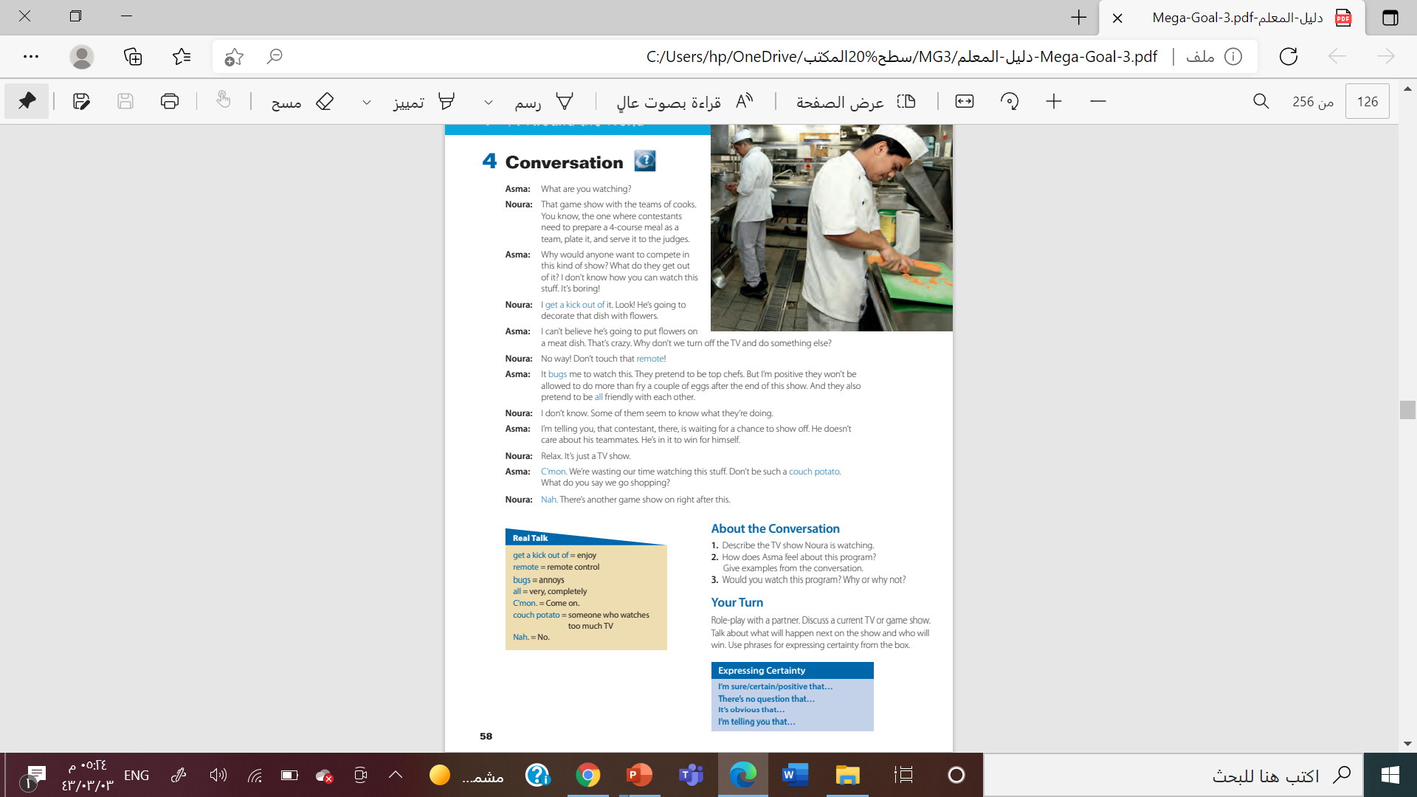
@ page 58

Slide 5
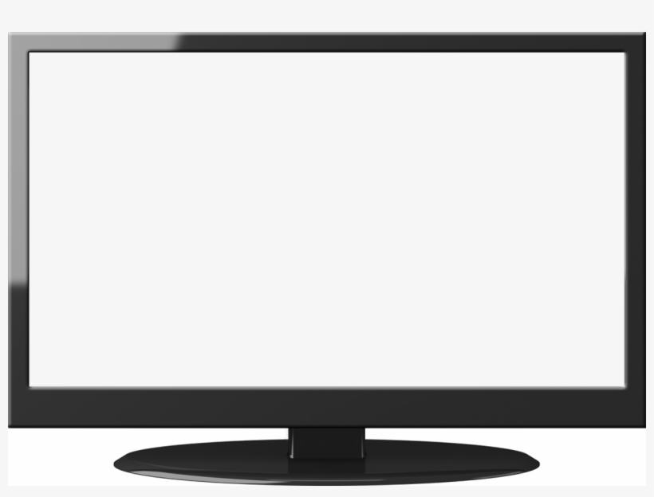
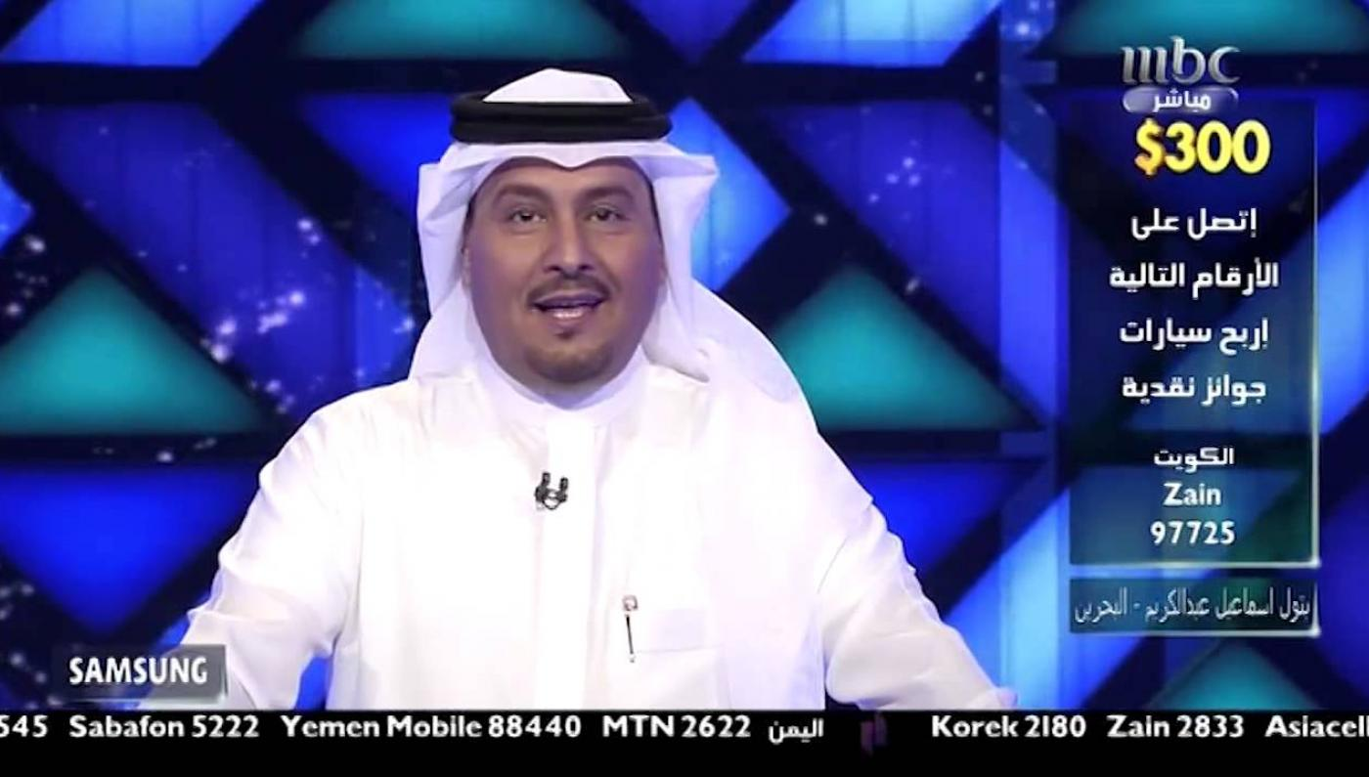


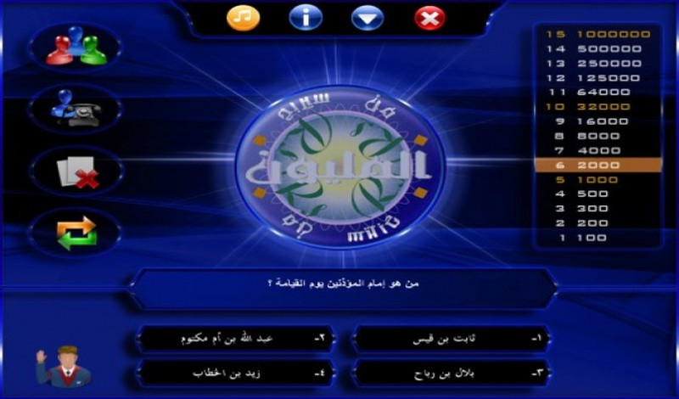


What is the kind of TV program we’re going to introduce?
Reality shows

Slide 6
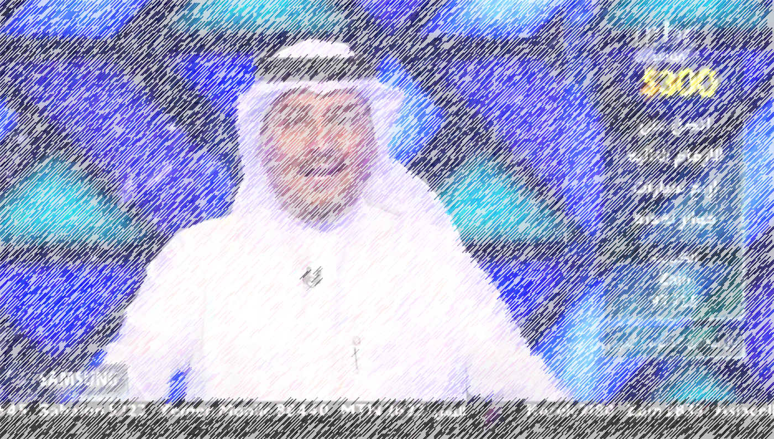
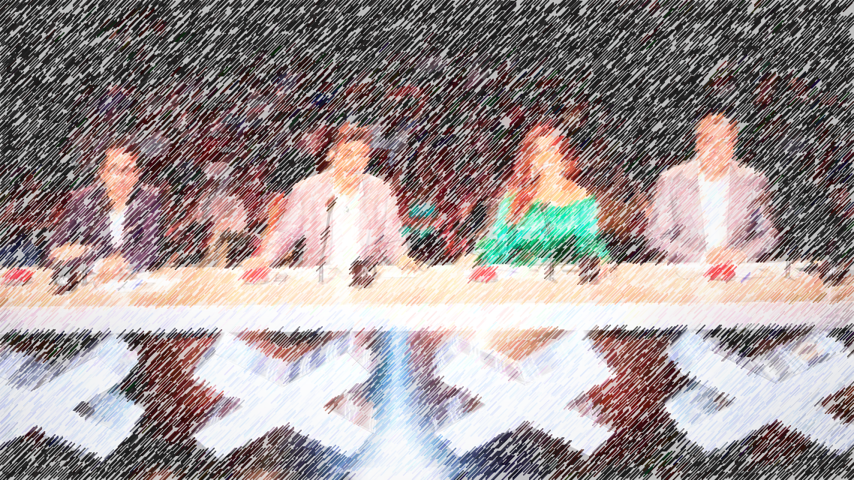



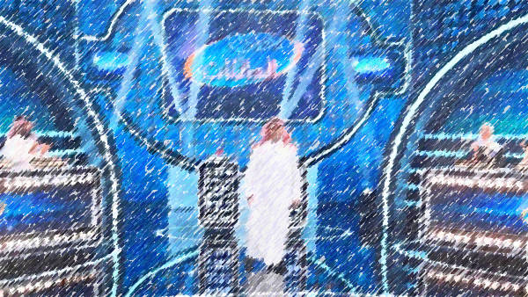
Do you watch reality shows ?
Do you like it ?
Why ? Why n’t?
Name some of reality shows that you watch ?

Slide 7
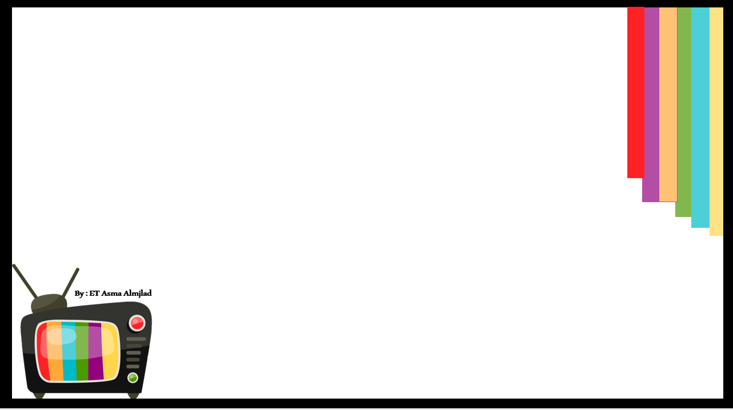



What is that ?
remote
Television

Slide 8

Who is he ?
nurse
Chef

Slide 9
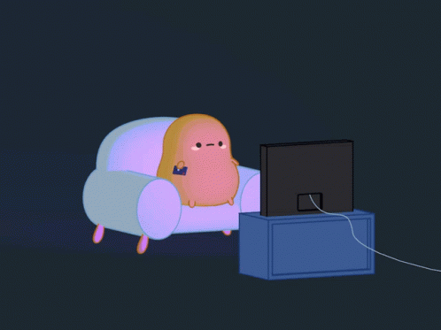
What is that ?
Couch potato
Chips

Slide 10
What is that ?
Plate
plant

Slide 11
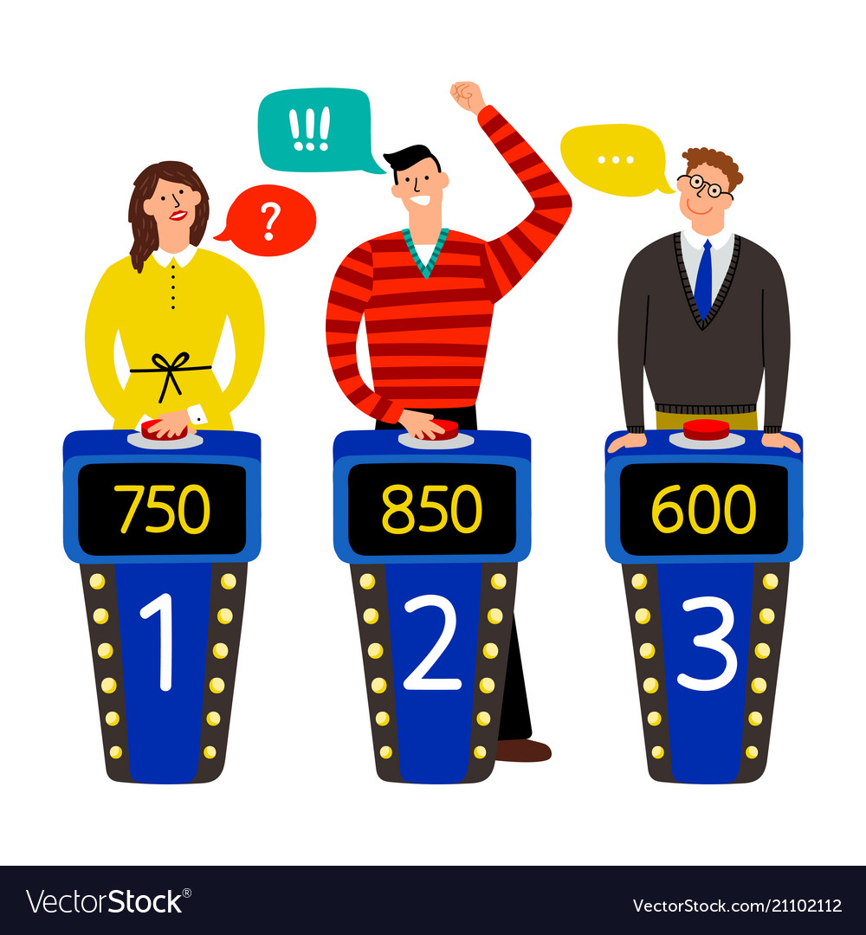
Who are they ?
contents
Contestants

Slide 12
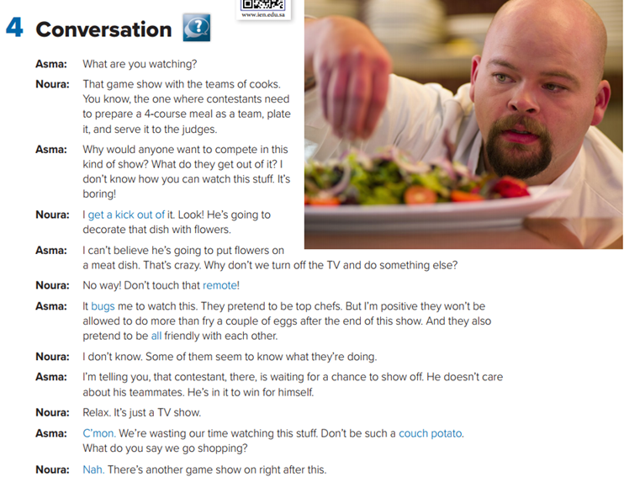
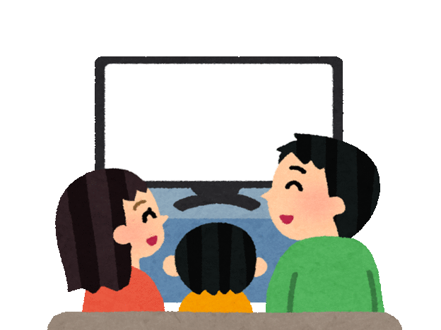
What is the picture show?
How many characters in this conversation ?
Who are they ?
What do you think they will talk about?

Slide 13

Listen

Slide 14



Slide 15
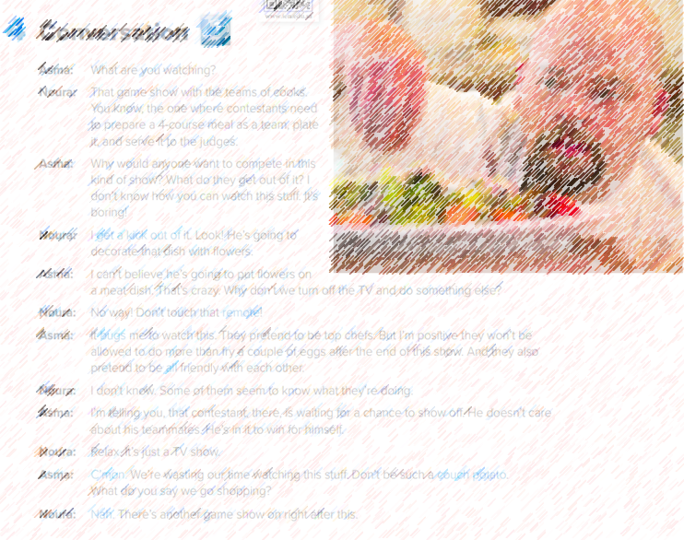
Do you think that Noura like this show ?
Do Asma like this show ?
What is one of the contestants waiting for?
What did Noura want to do ?
What did Asma response ?

Slide 16
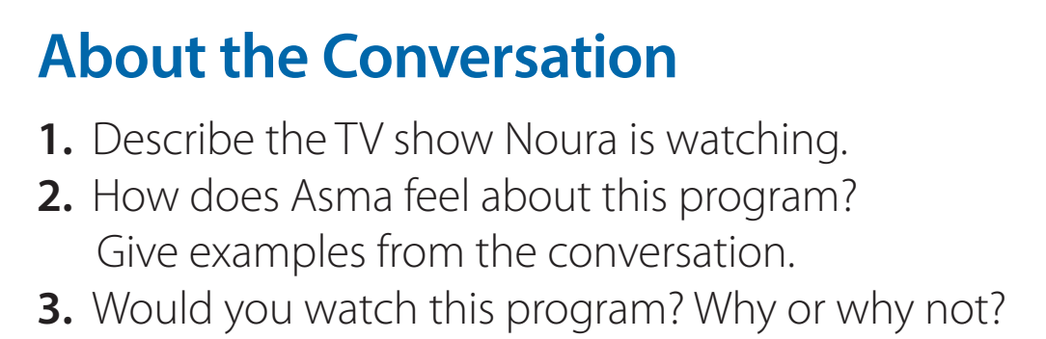
t is a game show on which a team of cooks need to prepare a meal and serve it to the judges.
She doesn’t like it. (What do they get out of it, It bugs me to watch this, etc.)

Slide 17


Who says …?
get a kick out of

Slide 18
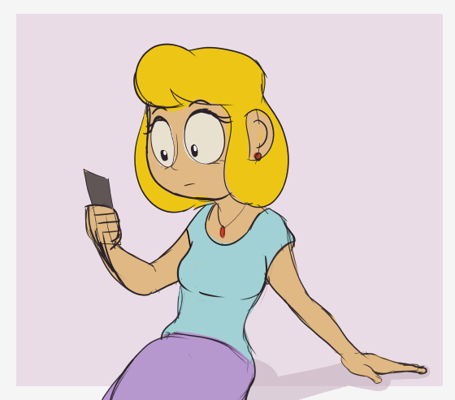
Who says …?
Bugs

Slide 19
Who says …?
C’mon.

Slide 20
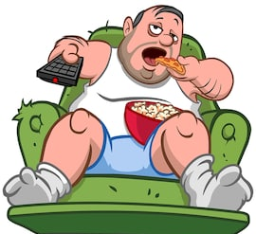
Who says …?
couch potato

Slide 21

Who says …?
Nah

Slide 22
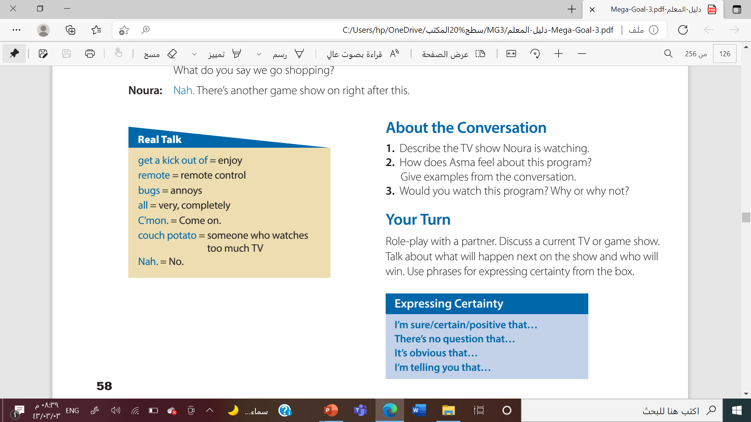

Slide 23
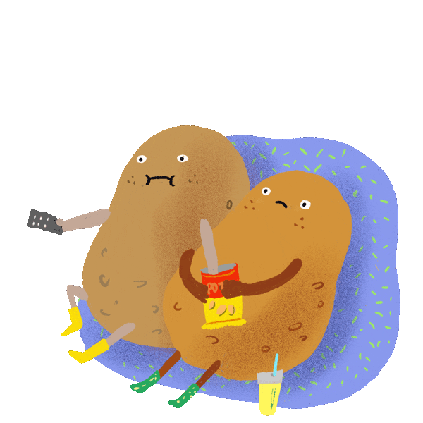


Slide 24
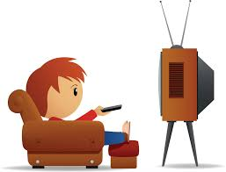
get a kick out of
enjoy
remote control
remote
annoys
bugs
all
very, completely
C’mon
Come on
Couch potato
someone who watches too much TV
No.
By : ET Talal AlHazmi
Nah
someone tries to show how clever or skilled he is
Show off

Slide 25


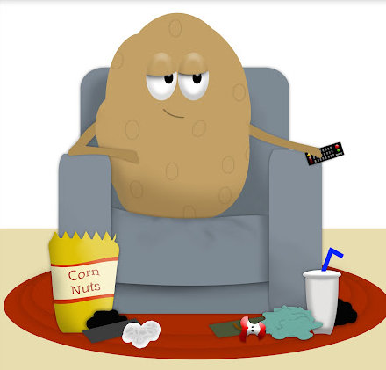
What do you get a kick out of?
What bugs you?
Have you met anyone who likes showing off?
Are you a couch potato?

Slide 26
Work
book
By : Asma Almjlad

Slide 27
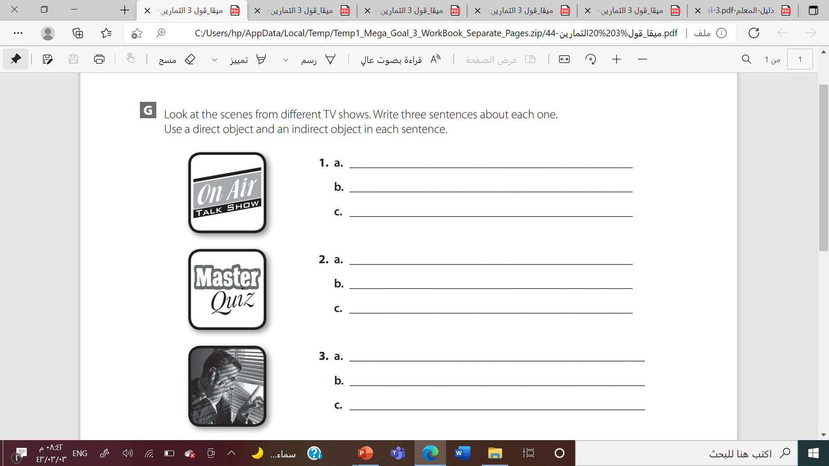

Slide 28
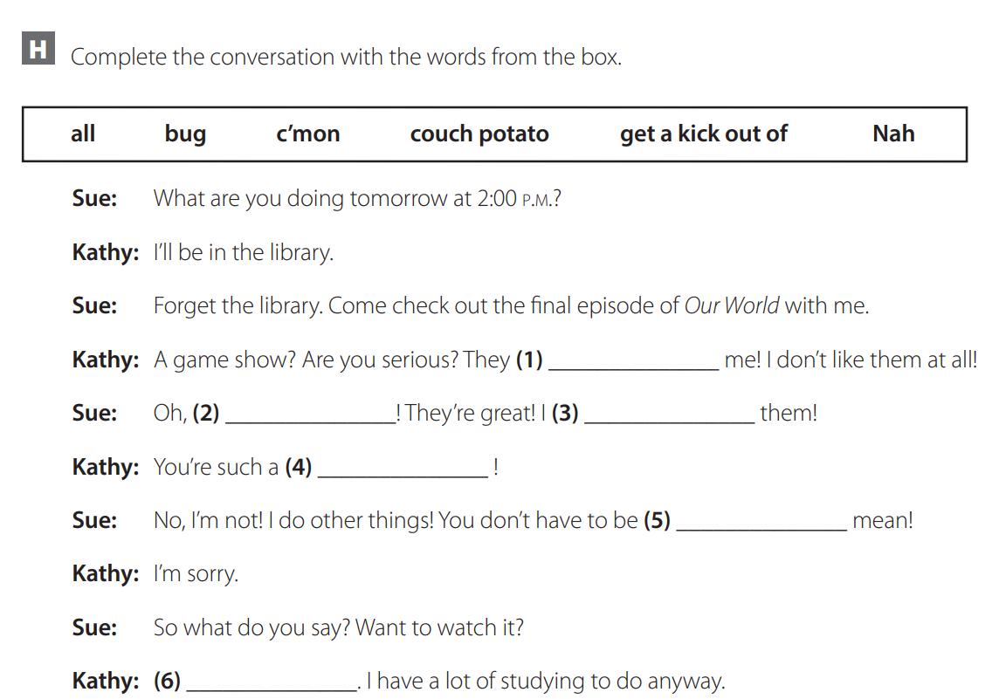

Bugs
c’mon
Get kick out of
couch potato
all
nah

Slide 29






Slide 30



Slide 31
