Slide 1

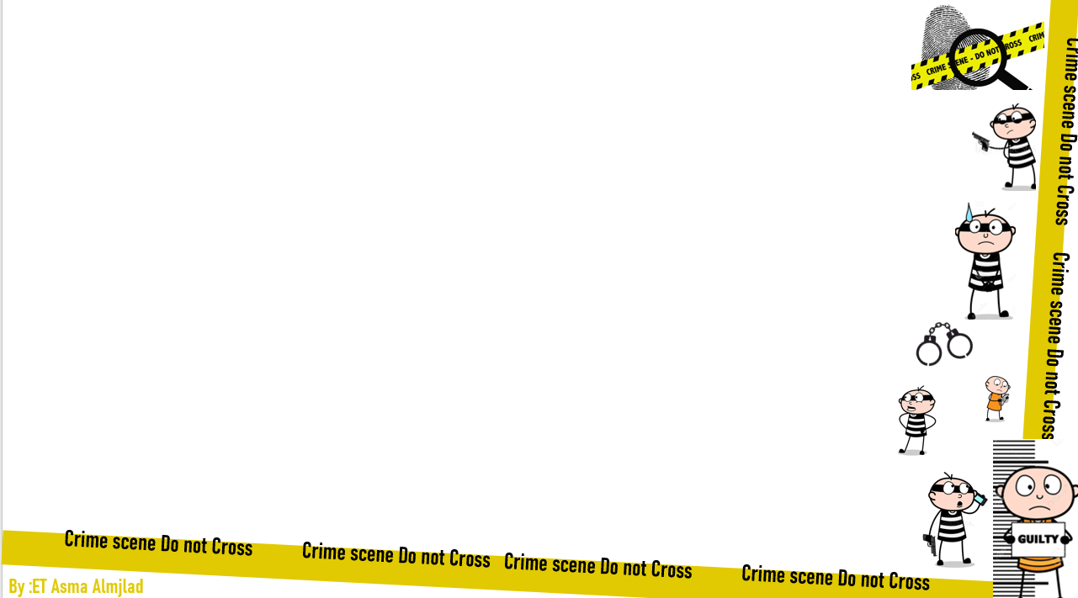


U:2
Doesn’t pay
reading
By : ET Asma Almjlad

Slide 2
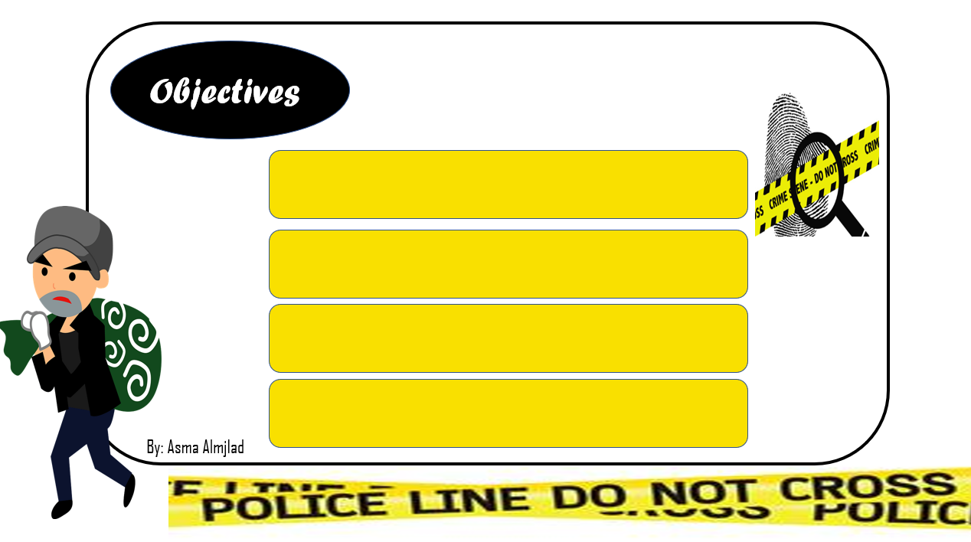
Find the meaning of new words in the text.
Find the reason behind the crime cases.
Organize pieces of crime puzzle.
Retell the case using students’ own words.

Slide 3
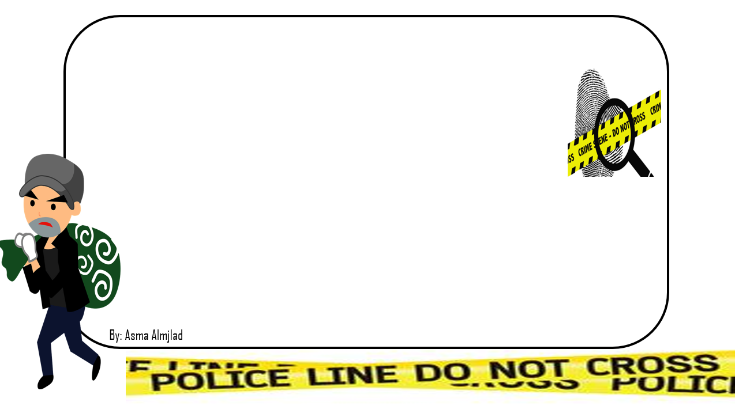
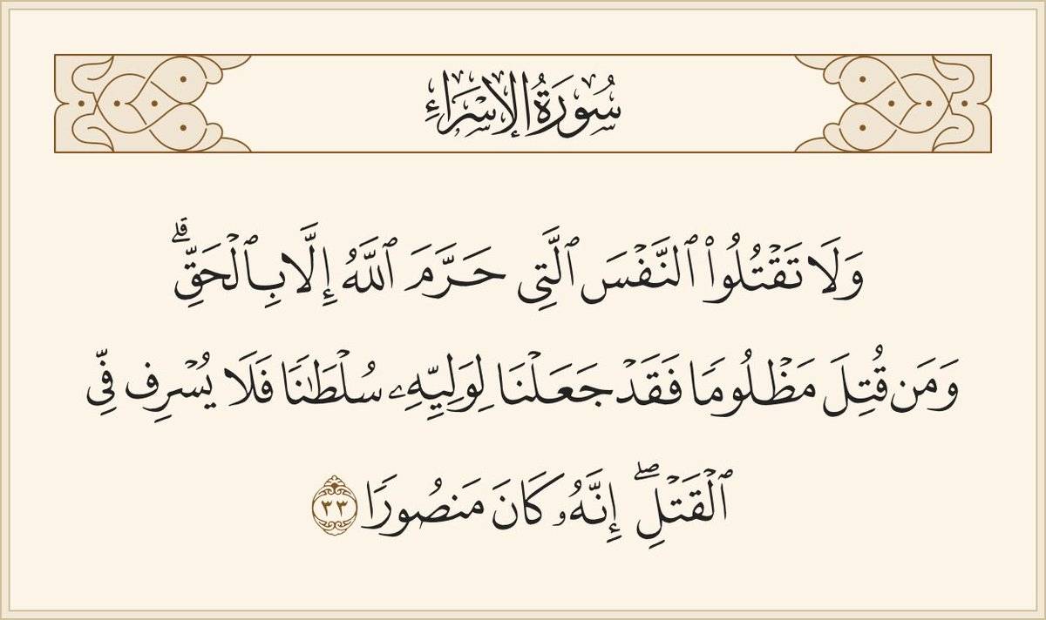

Slide 4
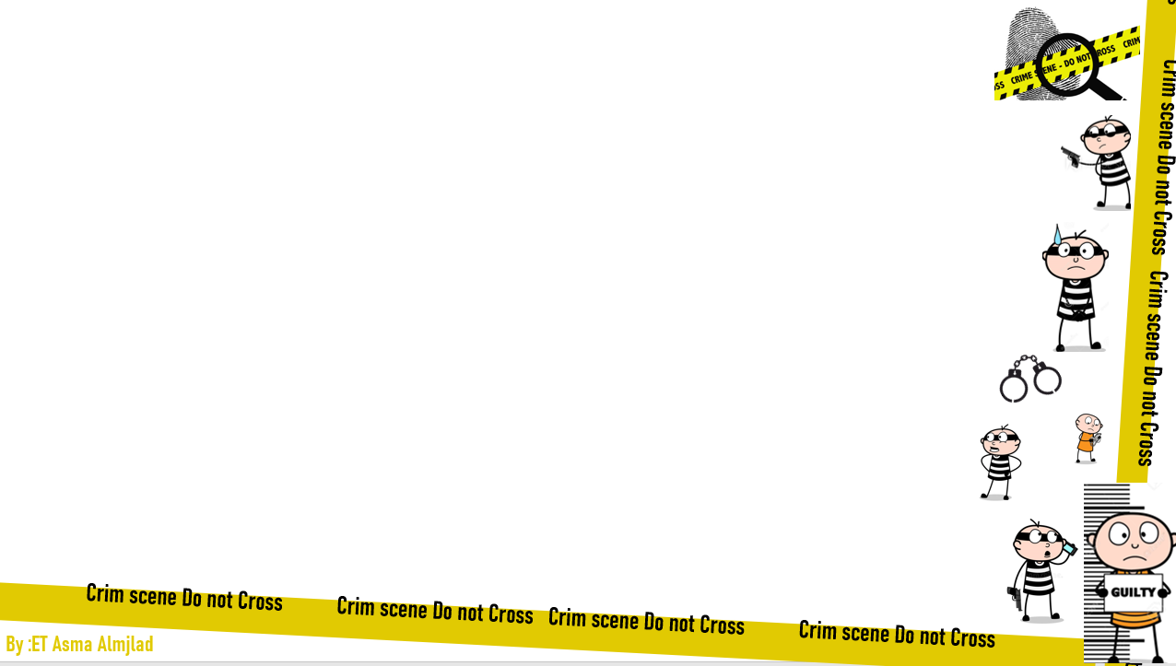
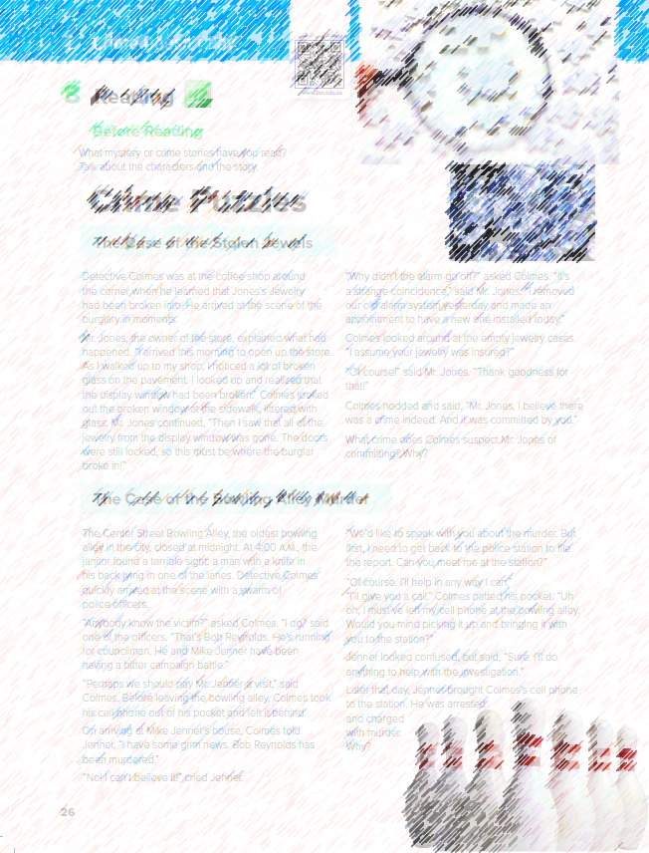
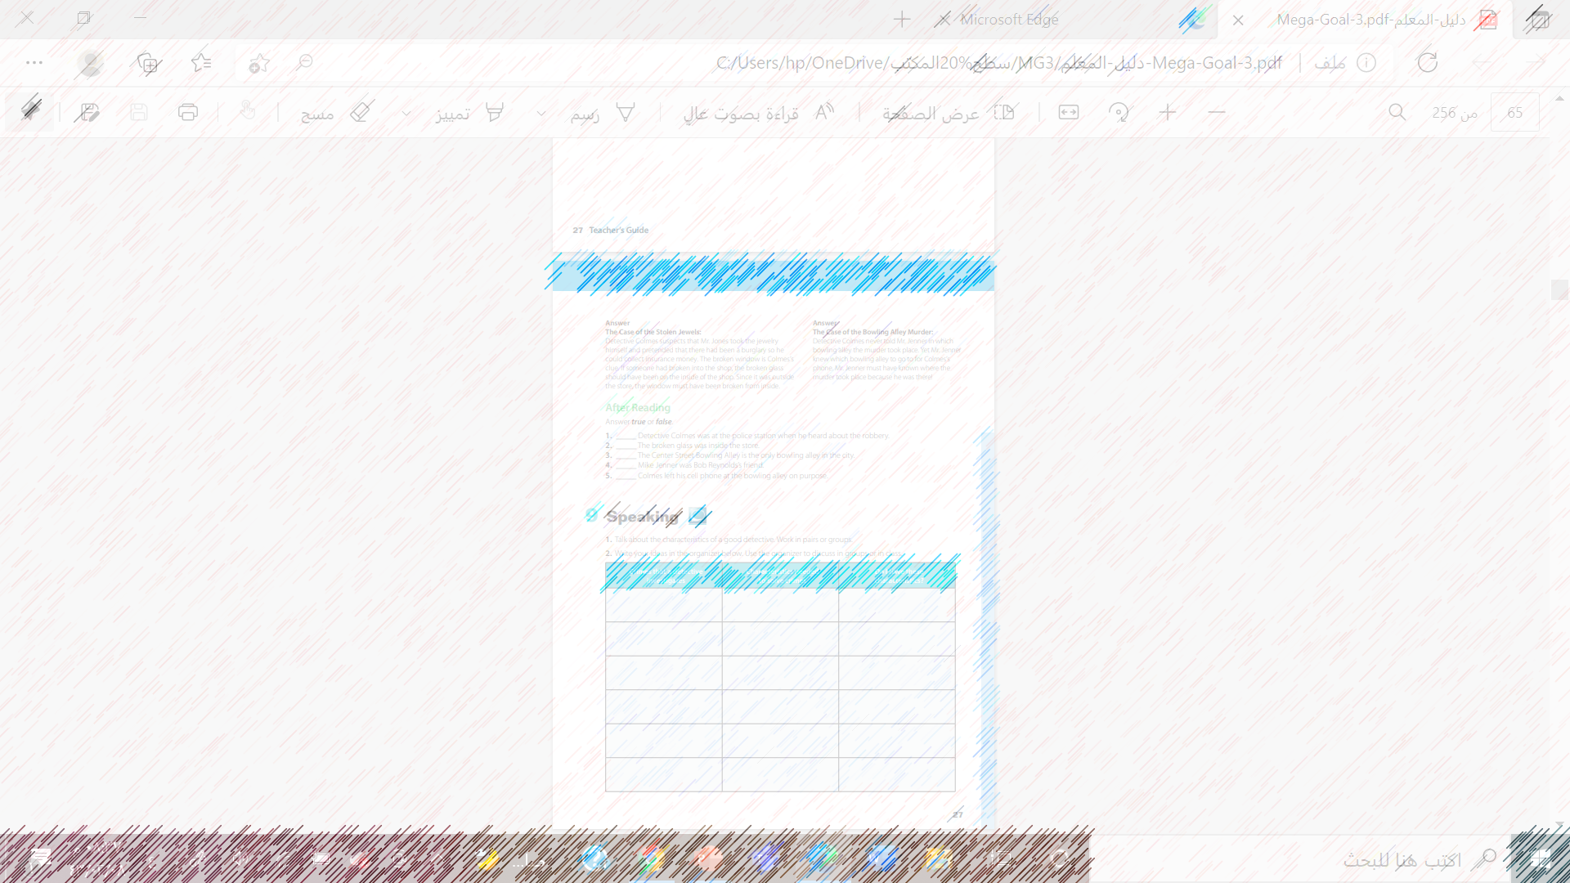

What is the title ?
@ page 26+27
Who many articles are they ?
What are the pictures show ?

Slide 5
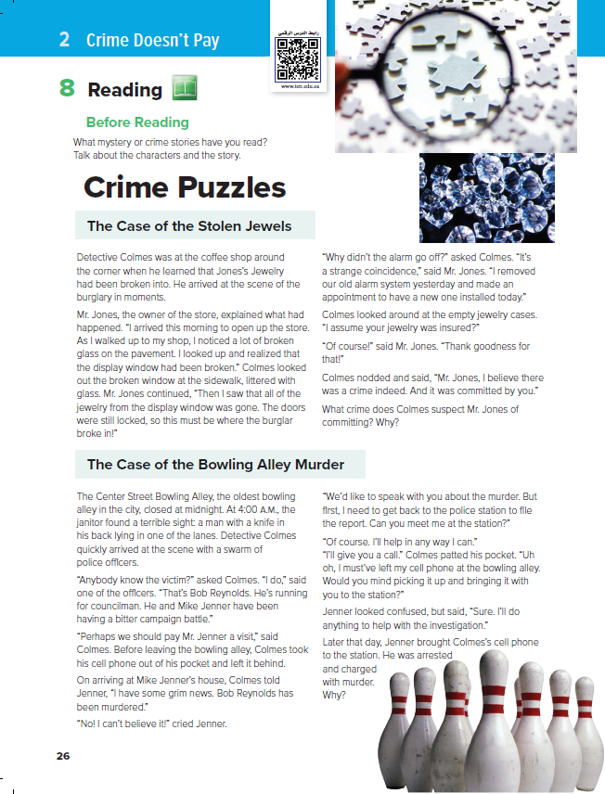
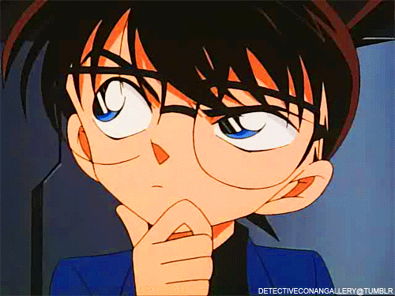
Tell ma about mystery or crime story
read or watched on TV?
Who is your favorite detective characters?

Slide 6


Listen

Slide 7
How many stories are there?
What is the first story about?
What is the second story about?

Slide 8
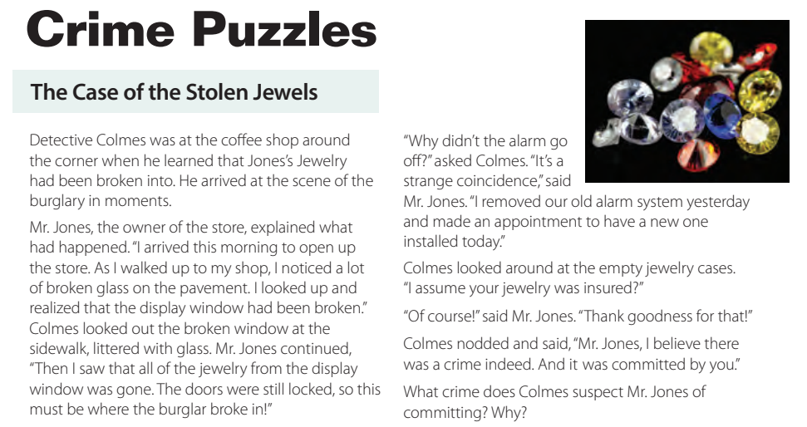

Slide 9
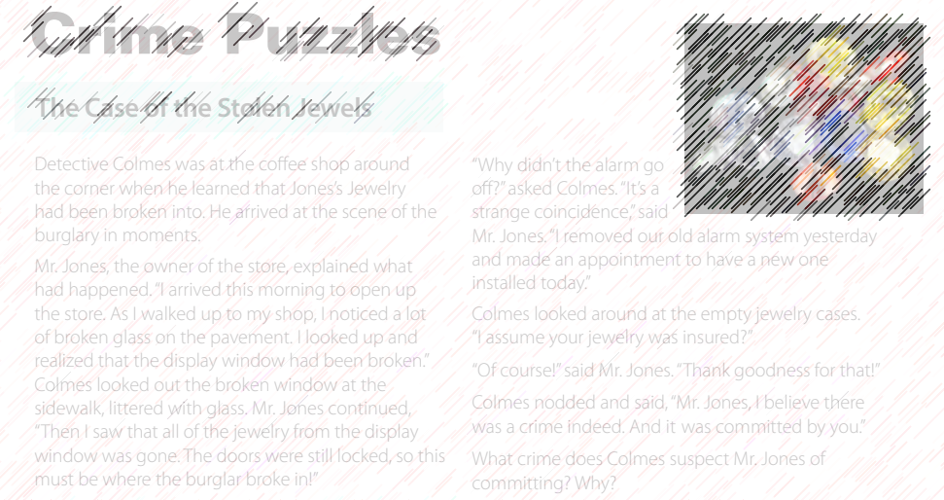
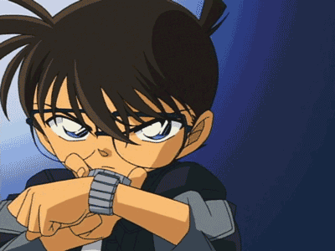
What is the detective’s name?
Who is the Jewelry’s owner?
When is the Crime time?
Was the jewelry insured?
Why didn’t the alarm go ff?

Slide 10
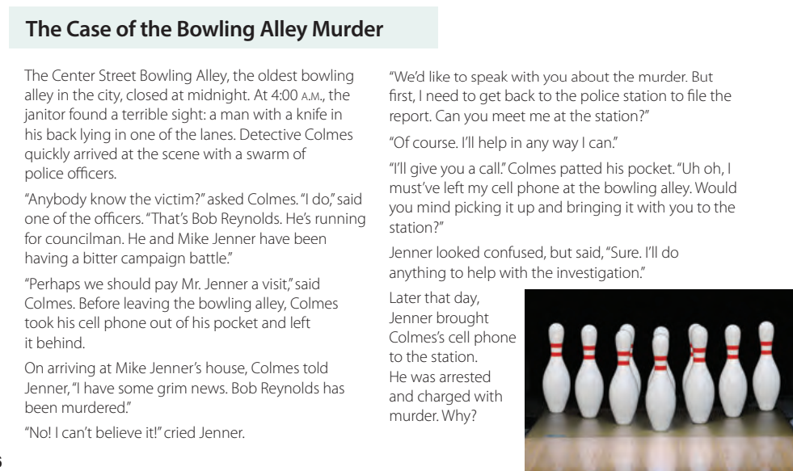

Slide 11
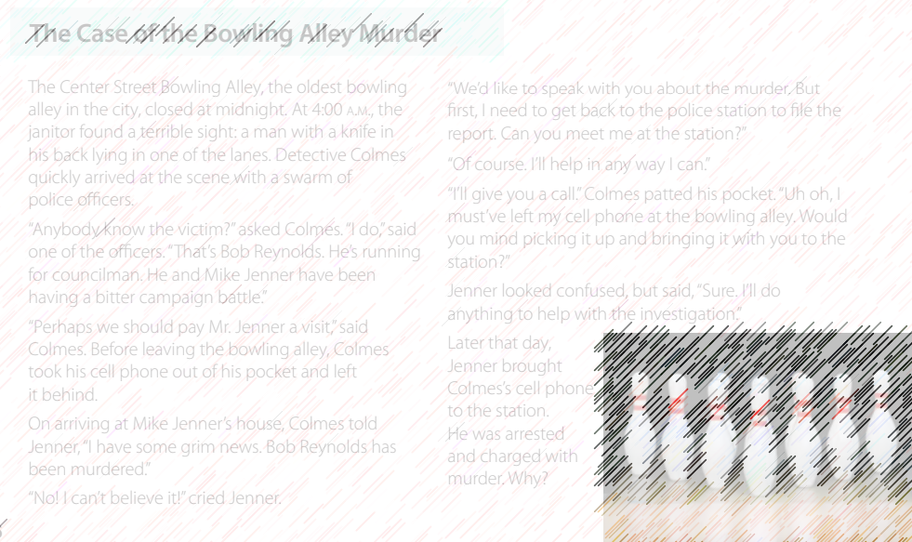

Where does the story take place ?
When is the Crime time ?
Who found the stabbed man?
What was the name of the stabbed man ?
What did detective Colmes leave behind in the bowling alley ?

Slide 12
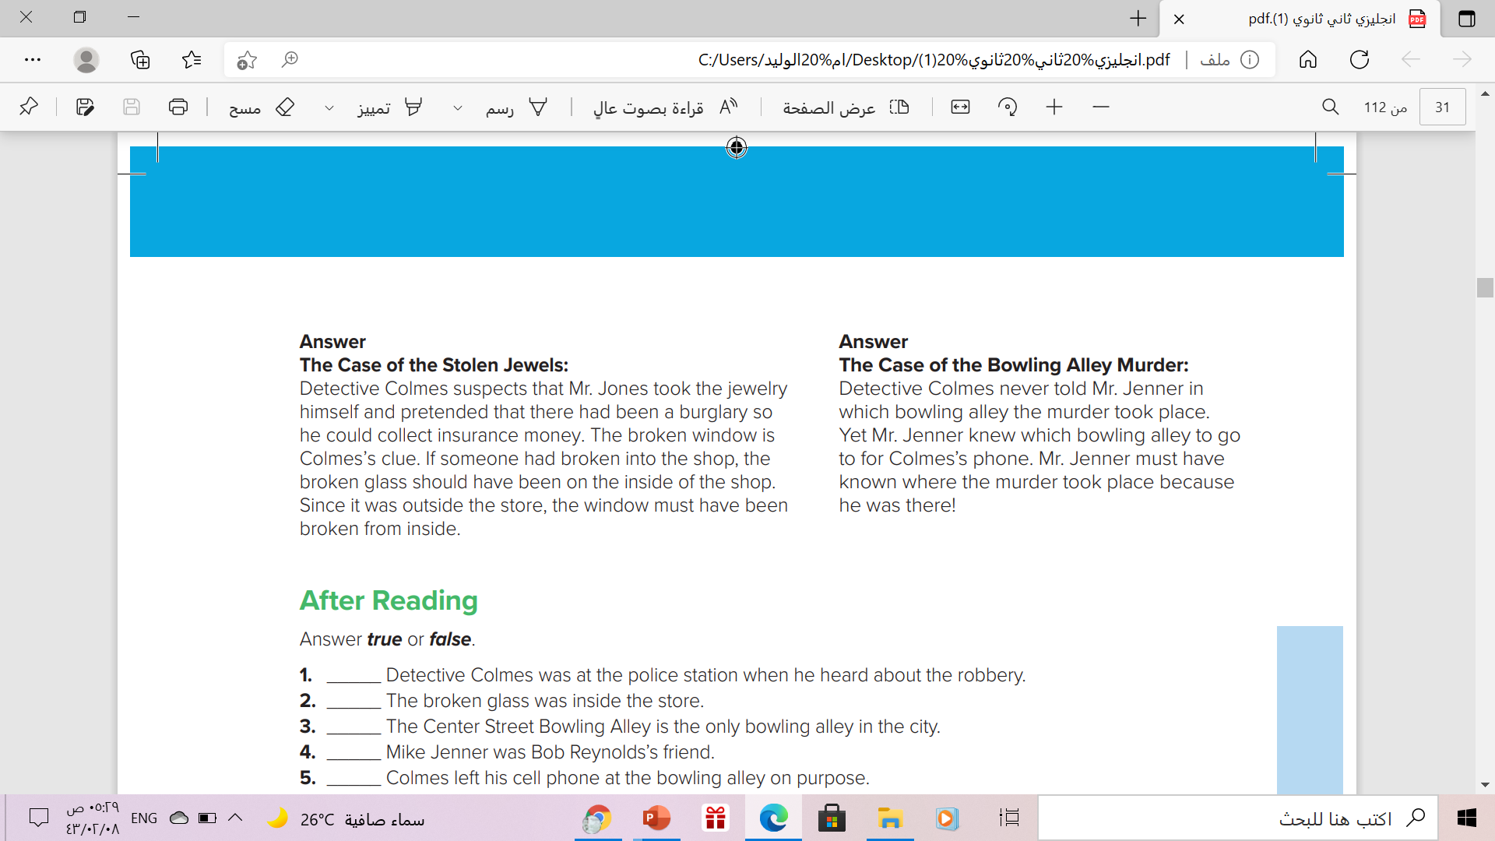

Slide 13



Slide 14
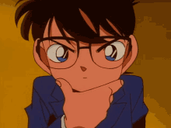


moved the head up and down to agree ..
Nodded
Nabbed

Slide 15
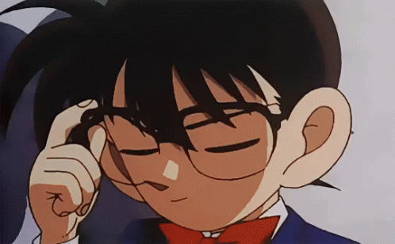
a large number of something
A storm
A swarm

Slide 16
full of angry, unhappy feelings
bitter
litter

Slide 17
touch quickly with the flat part of the hand
pat
Bat

Slide 18
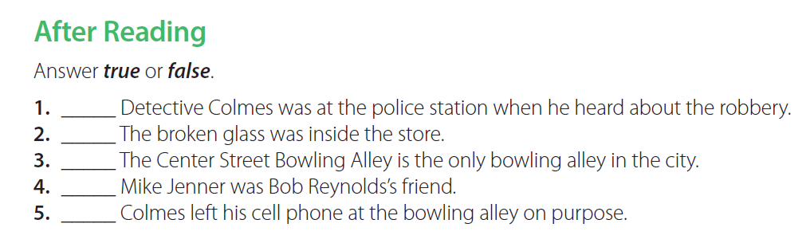
false
false
false
false
true

Slide 19
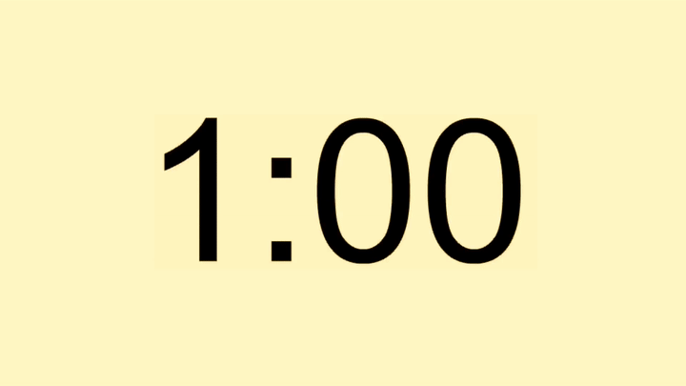
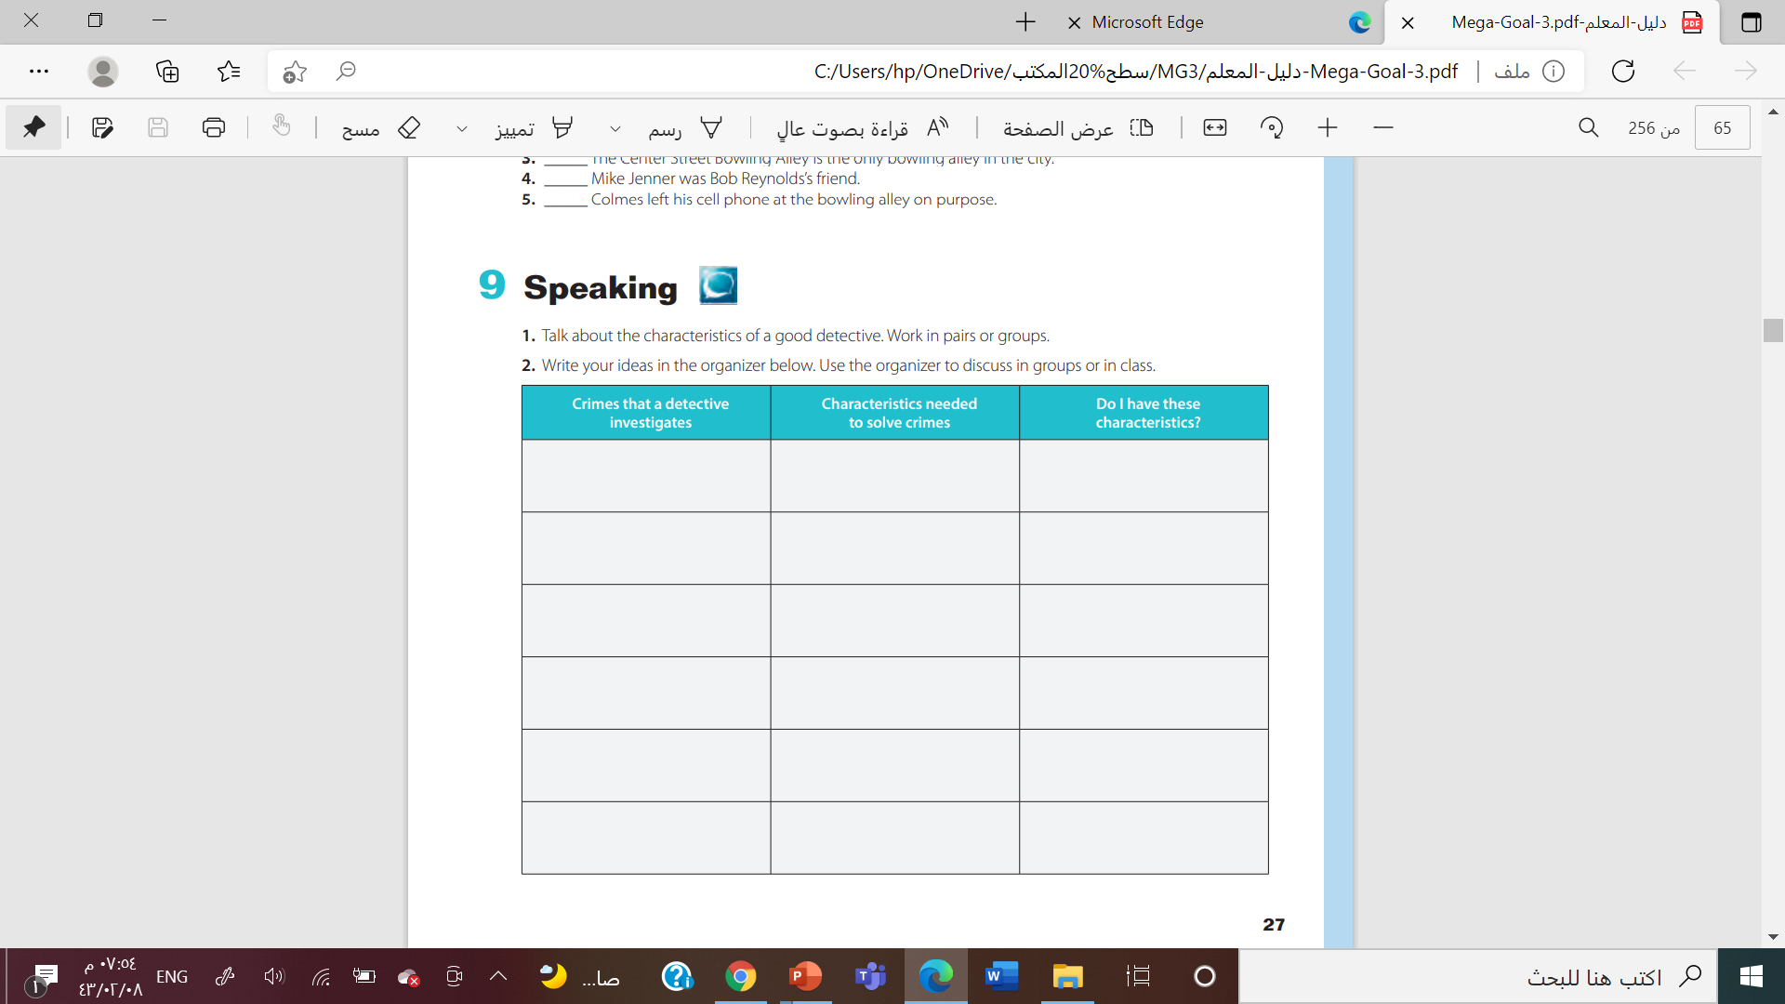
robbery
Take photographs at crime scenes
burglary
Analyze information
Murder
Attention to detail
kidnapping
Patience
blackmail
Critical thinking
shoplifting
Communication skills

Slide 20



Slide 21


