Slide 1

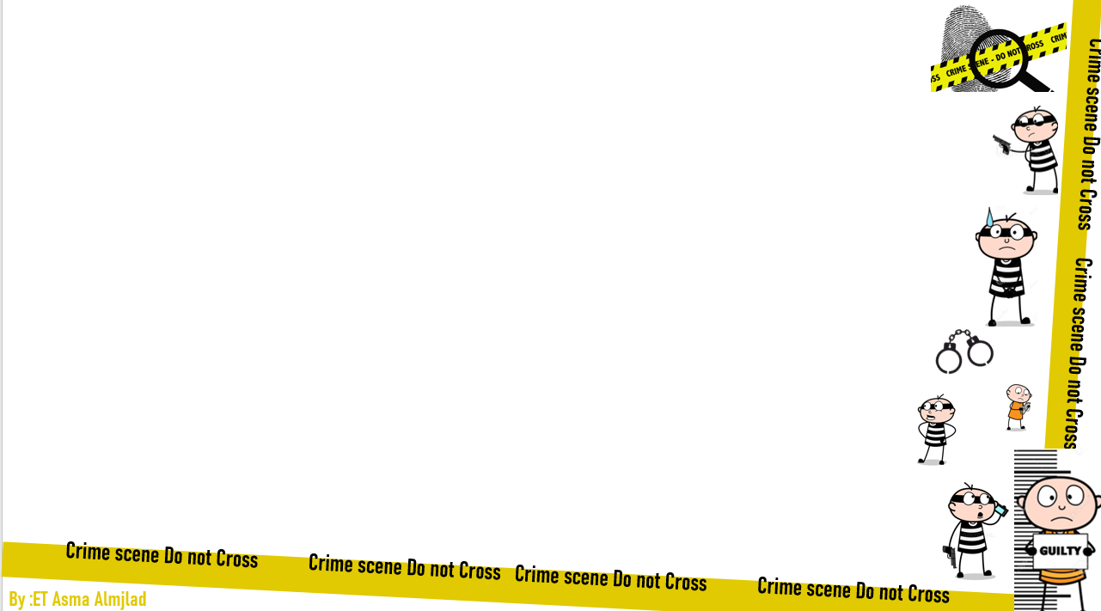


U:2
Doesn’t pay
Grammar
By : ET Asma Almjlad

Slide 2
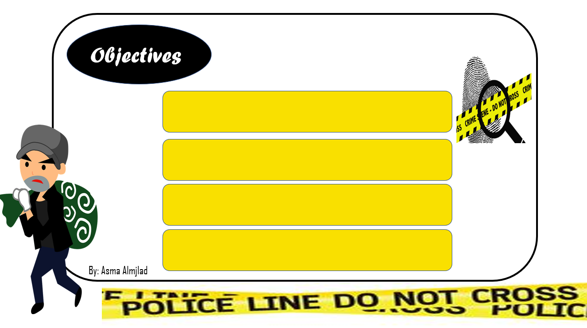
identify the tense of passive
use the correct form verb to be
(is – are – was – were)
use past participle in passive
Answer the questions in the book

Slide 3
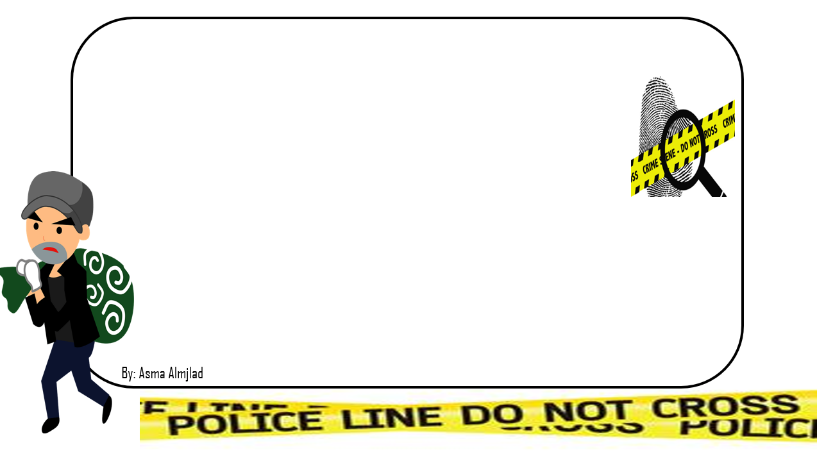


Slide 4
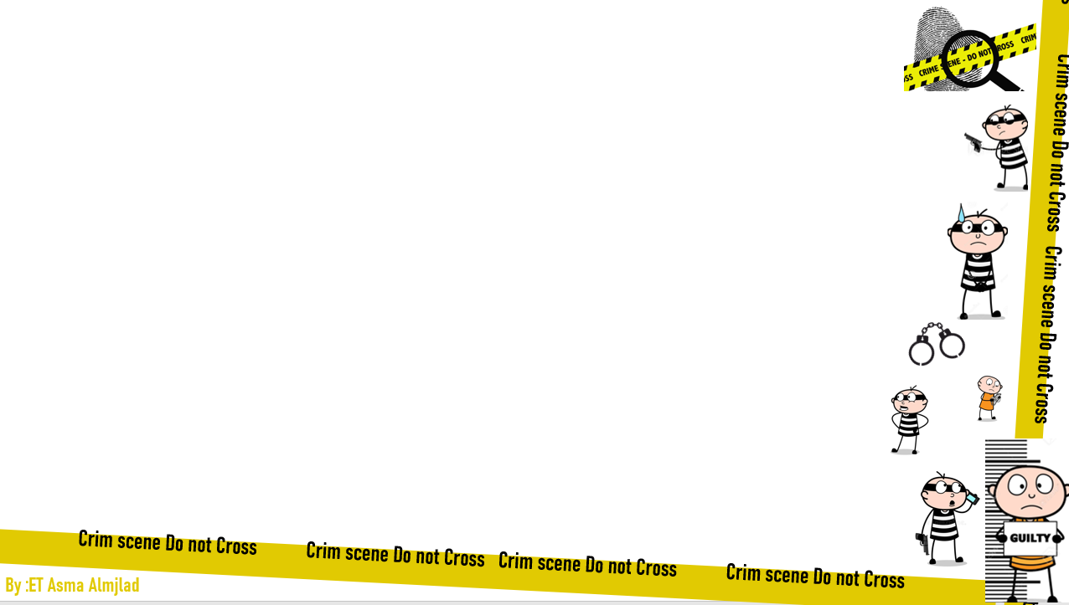
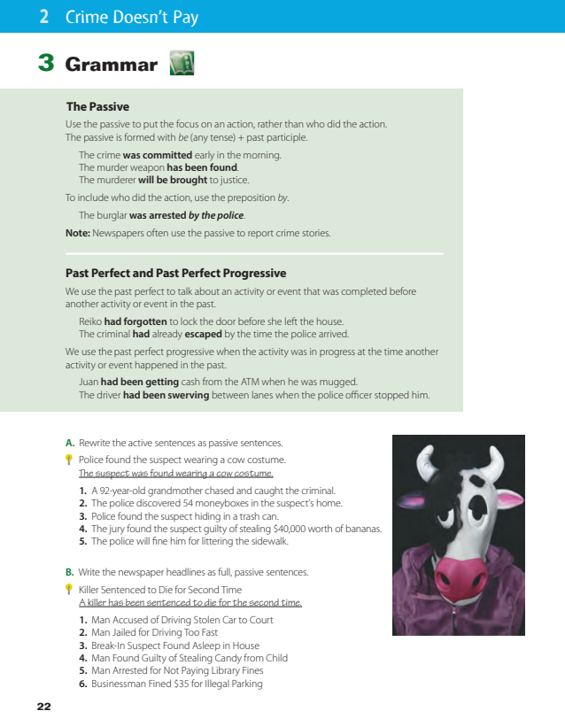
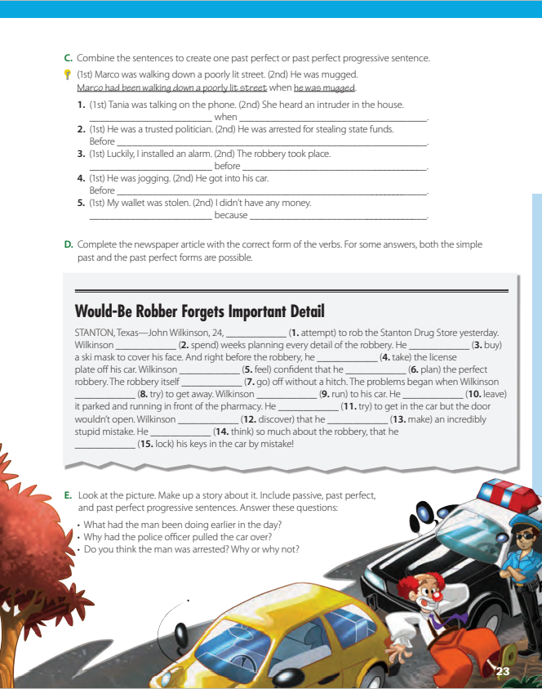
Page 22 + 23

Slide 5
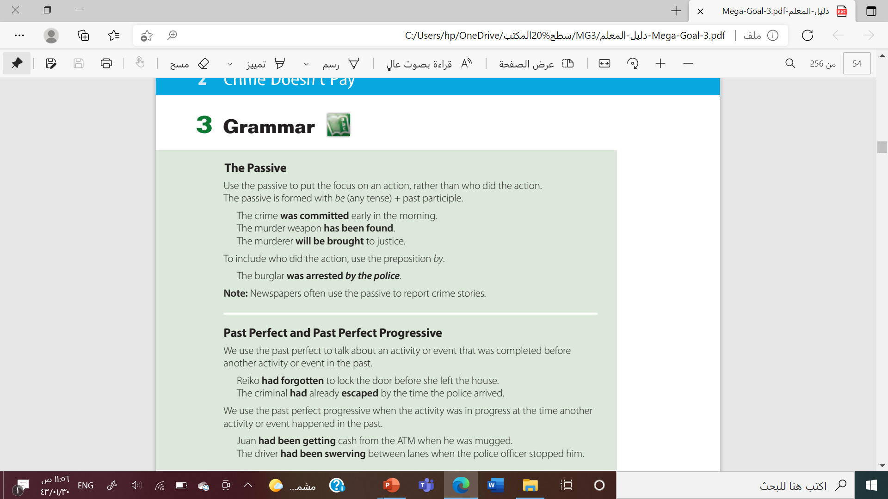

Slide 6

Let’s remember
Active or Passive ?
Omar plays football .

Slide 7
Let’s remember
Active or Passive ?
I visited my friend yesterday .

Slide 8
Let’s remember
Active or Passive ?
The window is opened by Ali .
Who open the door ?

Slide 9
Let’s remember
Active or Passive ?
A letter was written .
Who write the letter ?

Slide 10
The passive
Use the passive to put the focus on an action, rather than who did the action.
It is formed with be (any tense) + past participle.

Slide 11








Active
Sara cleans the room
The subject
Verb
( present simple)
The object
passive
The room is cleaned ( by Sara)
O
be
V3
The subject

Slide 12







Active
Ali read the book yesterday
The object
The subject
Verb
( past simple)
passive
The book was read by Ali
O
be
V3
The subject

Slide 13


Active
Ahlam is writing the lesson now
The subject
Verb
( present progressive )
The object
passive
The lesson is being cooked by Ahlam
O
be
V3
The subject

Slide 14
Active
I have made some tea
The subject
Verb
( present perfect)
The object
passive
tea has been made (by me)
O
be
V3
The subject

Slide 15
Present simple
O + Be ( is – are – am ) + V3 + by + S
Past simple
O + Be ( was – were ) + V3 + By + S
Present progressive
o + be + being + v3 ( + by + S)
Future
o + will be + v3 ( + by + S)
Present \ past perfect
o + (has + have )\ (had) + been + v3 ( + by + s)

Slide 16


Slide 17
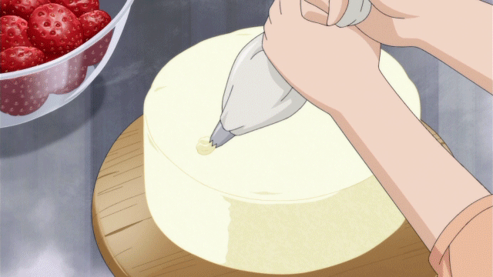
Noura makes a cake
A cake is made ( by Noura )

Slide 18

Sami bought a car
The car was bought by Sami

Slide 19
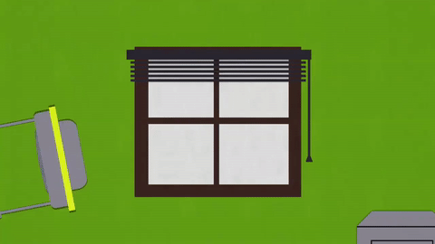
They have broken the window
The window has been broken By they

Slide 20

Ahmad will do the H.W
The H.W will be done by Ahmad

Slide 21
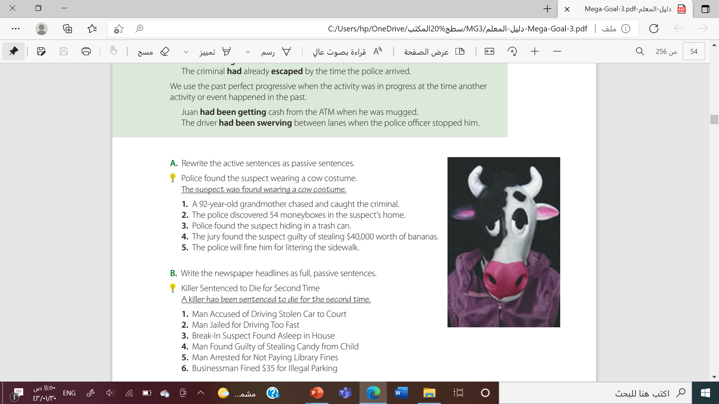
1. The criminal was chased and caught by a 92-year-old grandmother.
2. Fifty-four moneyboxes were discovered in the suspect’s home
3. The suspect was found hiding in a trash can

Slide 22
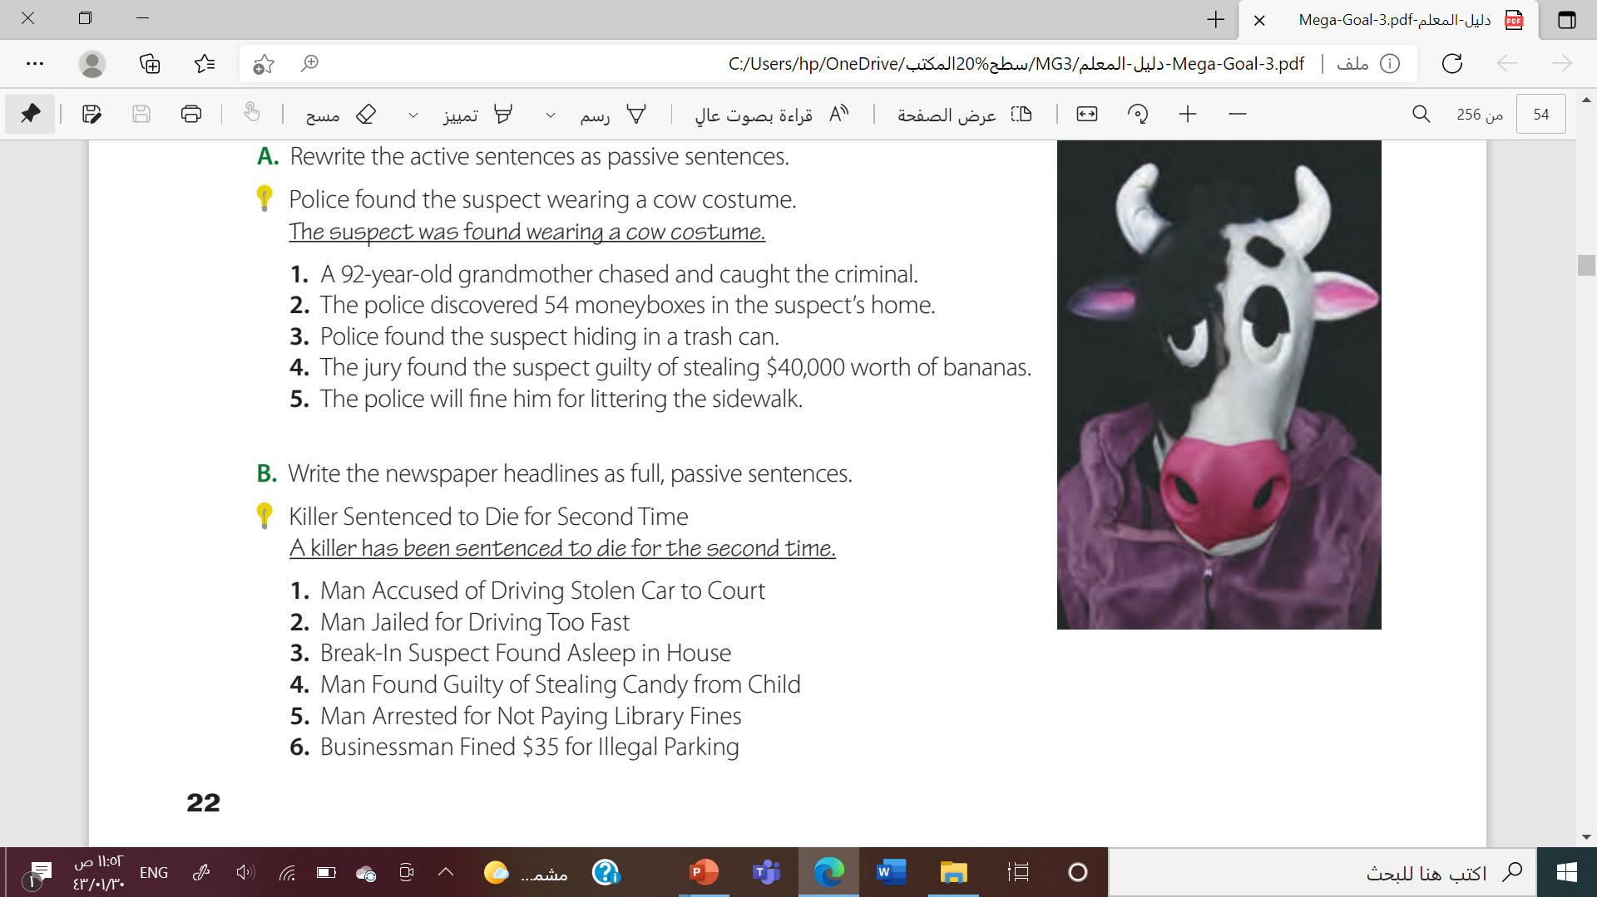
1. A man has been accused of driving a stolen car to court
2. A man was jailed for driving too fast.
3. A break-in suspect was found asleep in the house.

Slide 24
Past perfect
We use the past perfect to talk about an activity or event that was completed before another activity or event in the past.
Had + V3
e.g
After Sofie had finished her work, she went to lunch
(First she finished her work and then she went to eat lunch.)

Slide 25
Choose :
After she had ( moves – move -moved )out, I found her notes.
After I’d (used – use – using )the phone, I paid the bill
I had not ( eat -eaten – ate )at that restaurant before today.

Slide 26
Past perfect progressive
We use the past perfect progressive when the activity was in progress at the time another activity or event happened in the past.
Had + been + V-ing
e.g
I had been studying for 12 years by the time I graduated from high school.

Slide 27
Choose :
She had been( live - lived -living ) there since she was a child.
He had been( taught – teaching- teach ) for 12 years before he was certified.
Sara had been ( talk – talks – talking ) for an hour.

Slide 28
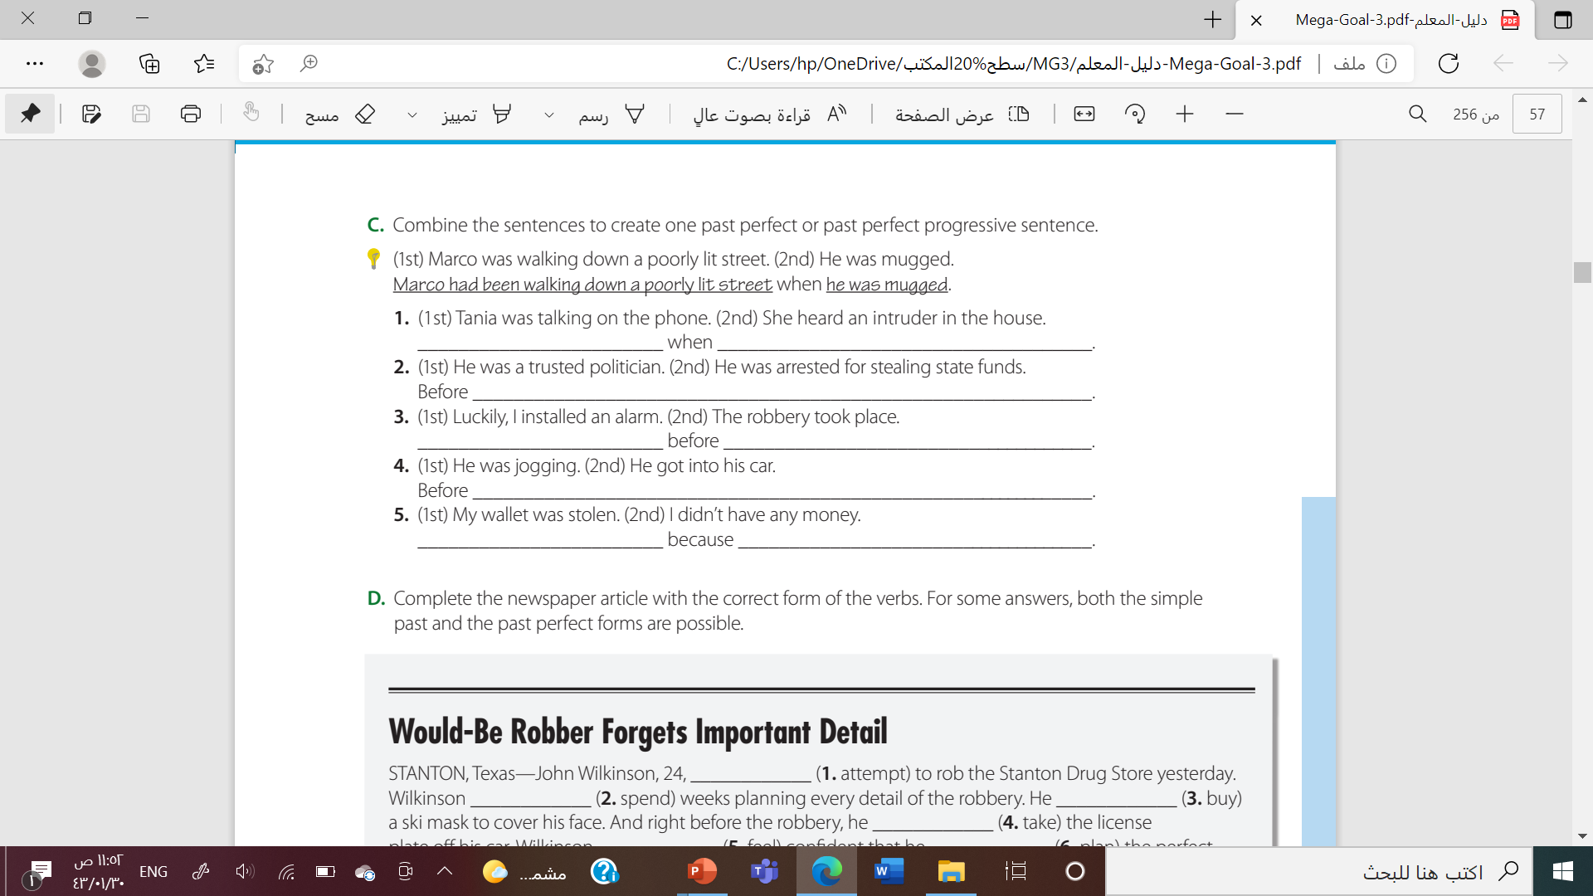
Tania had been talking on the phone she heard an intruder in the house.
he was arrested for stealing state funds, he had been a trusted politician.
Luckily, I had installed an alarm the robbery took place

Slide 29
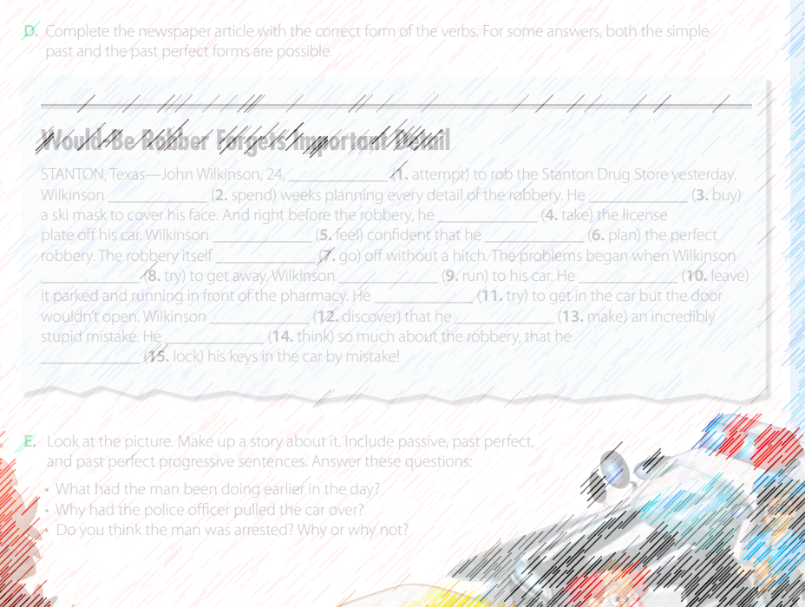
What kind of crime did John Wilkinson plan?
Where did he leave his car?
Why couldn’t he get into his car after the robbery?

Slide 30
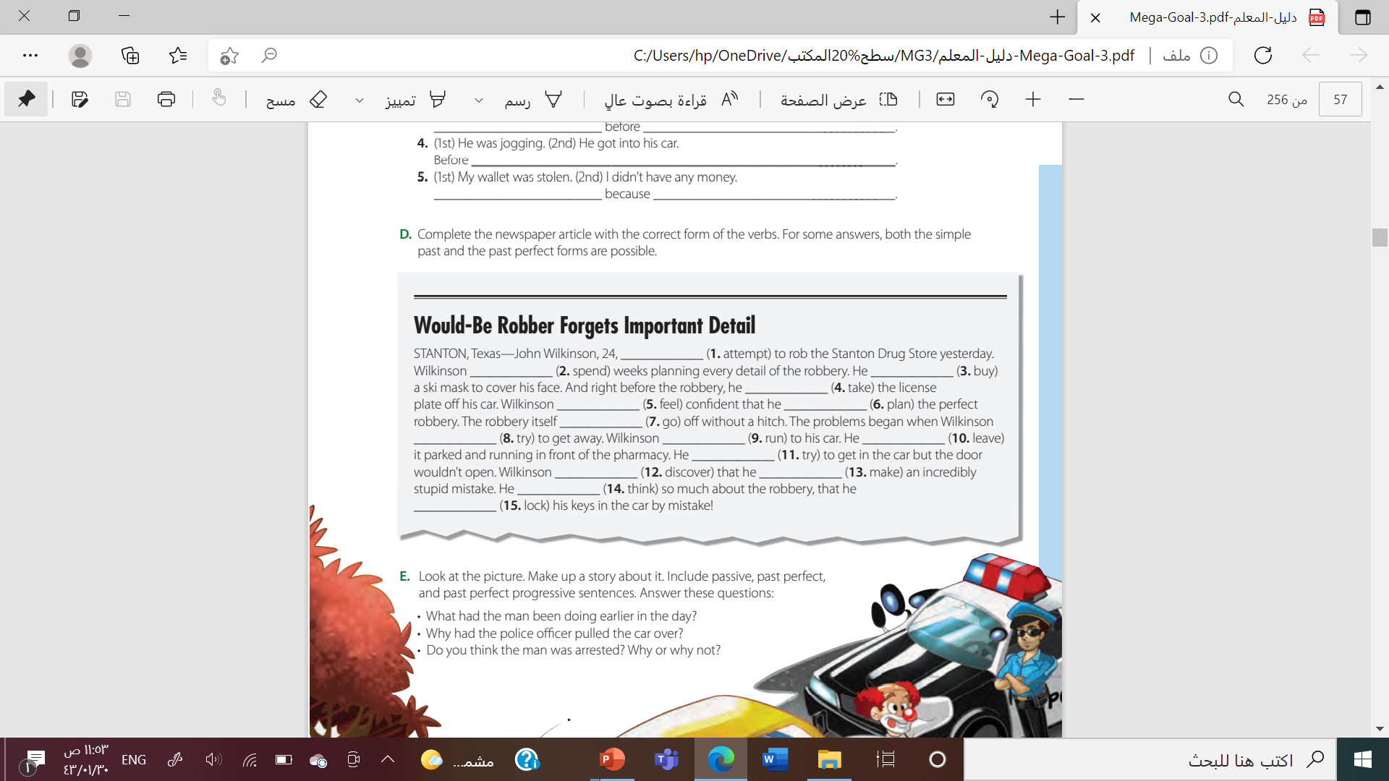

Slide 31

Work
book

Slide 32
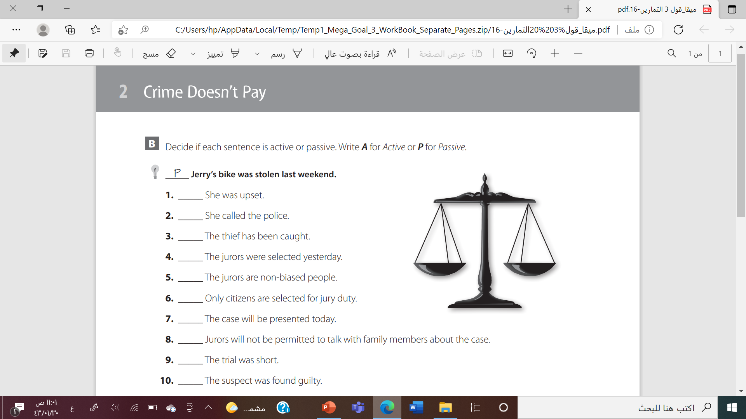

A
A
p
p
A
p
p
p
A
p

Slide 33
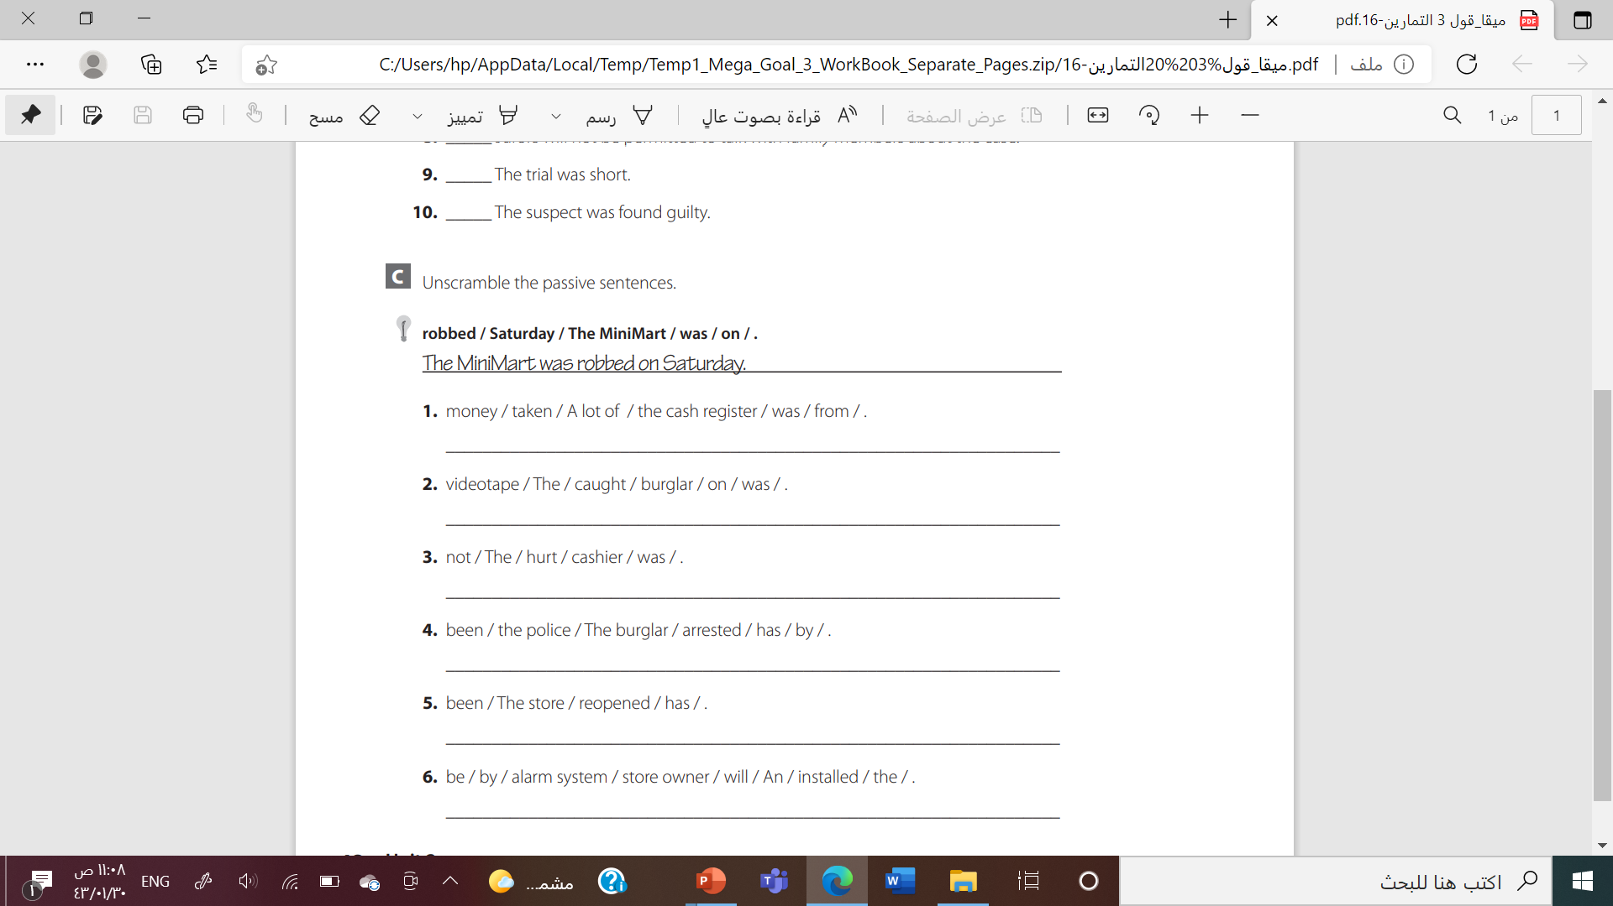
A lot of money was taken from the cash register
the burglar was caught on videotape
The cashier was not hurt.
The burglar has been arrested by the police.
The store has been reopened
An alarm system will be installed by the store owner

Slide 34
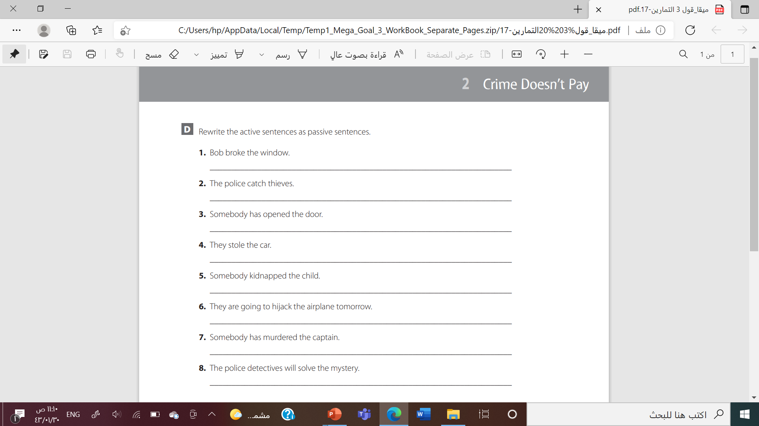
The window was broken by Bob
Thieves are caught by the police.
The door has been opened
The car was stolen.
The child was kidnapped.
The airplane is going to be hijacked tomorrow.
The captain has been murdered.
. The mystery will be solved by the police detectives

Slide 35
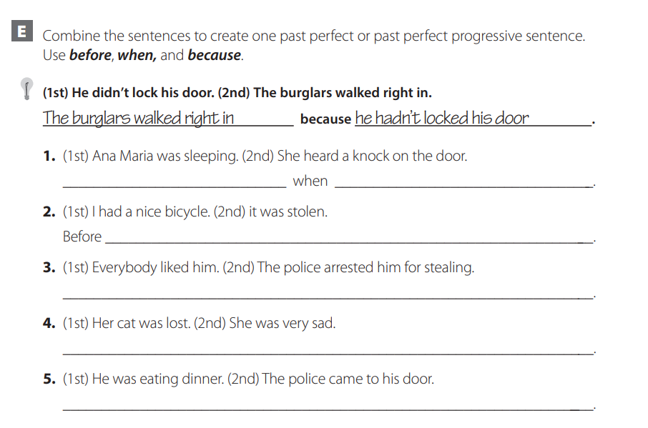

Slide 36
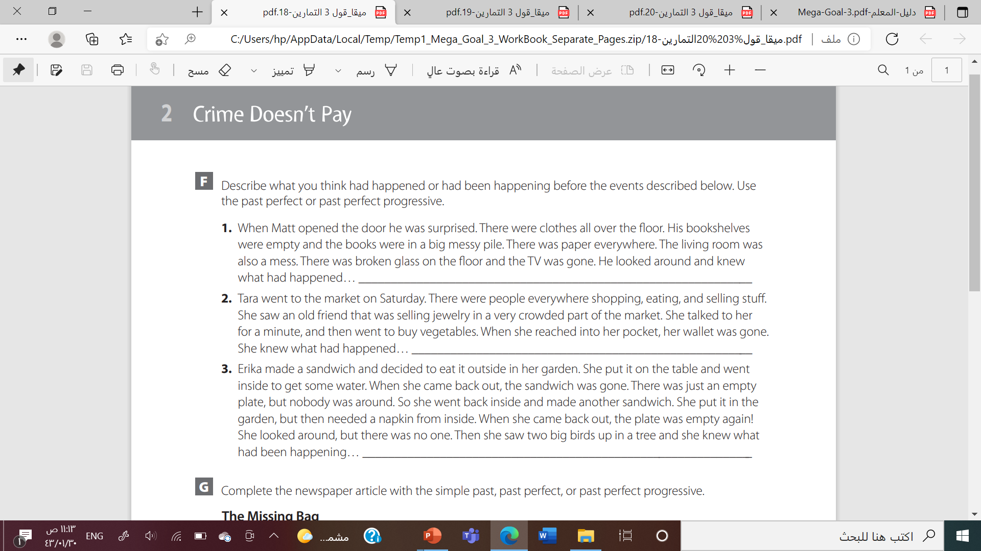

Slide 37
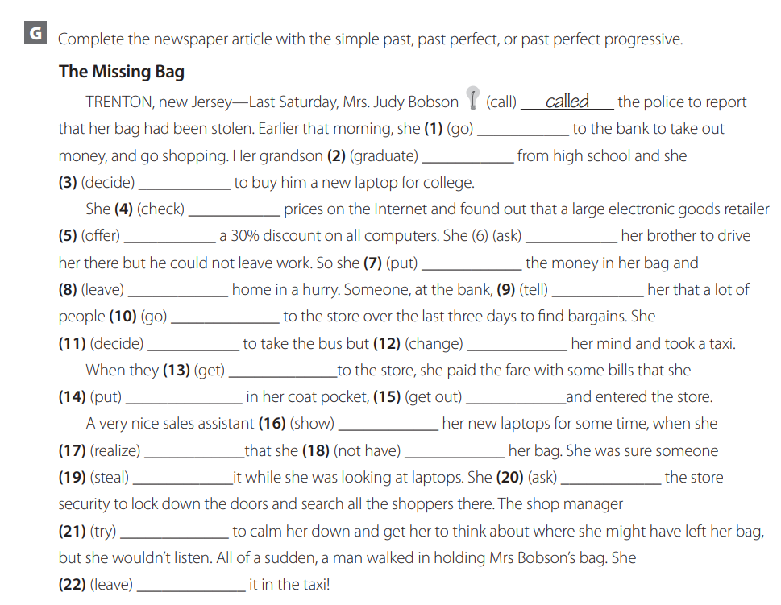

Slide 38



Slide 39



Slide 40


