Slide 1

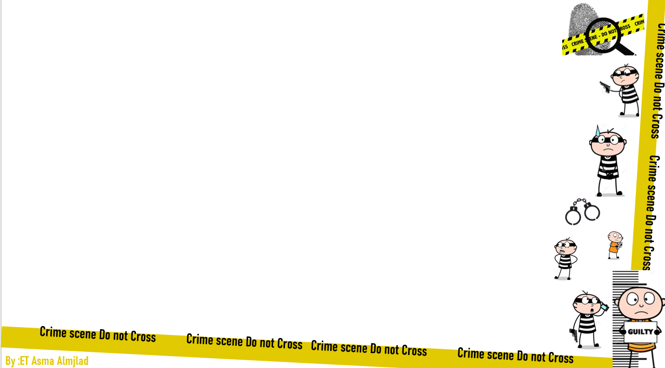


U:2
Doesn’t pay
Listen and discuss
By : ET Asma Almjlad

Slide 2
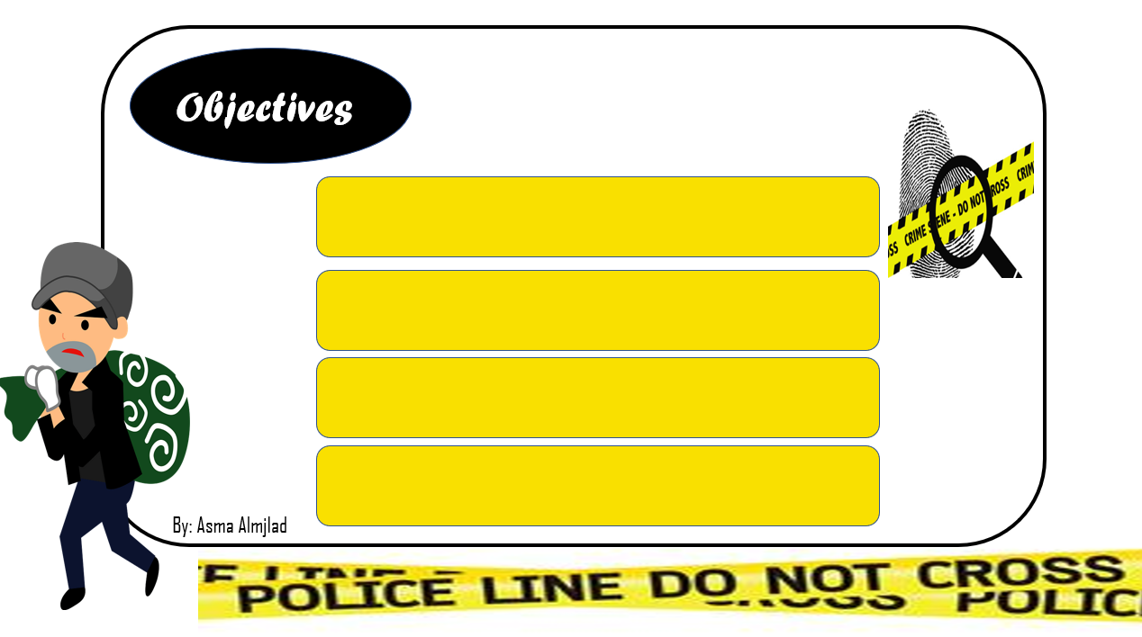
Match the headline with the article.
Match words with their meanings.
Find the most foolish criminal.
Answer true or false about crime's information.

Slide 3
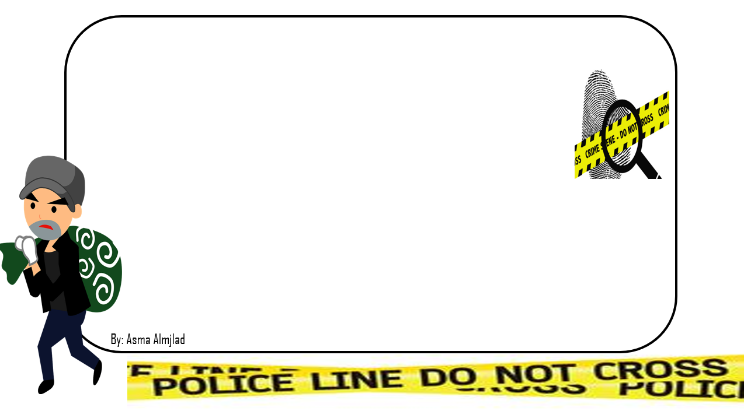


Slide 4
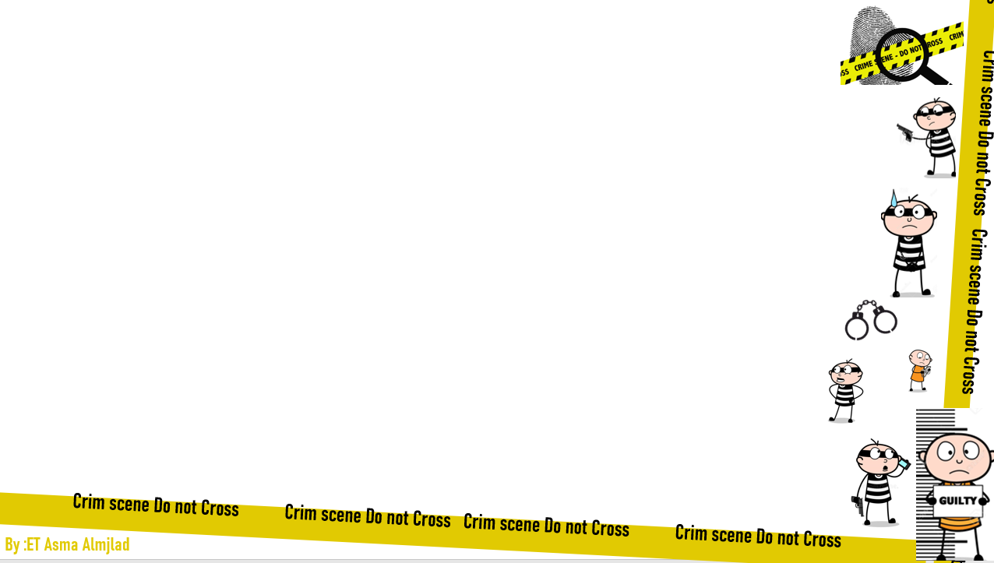

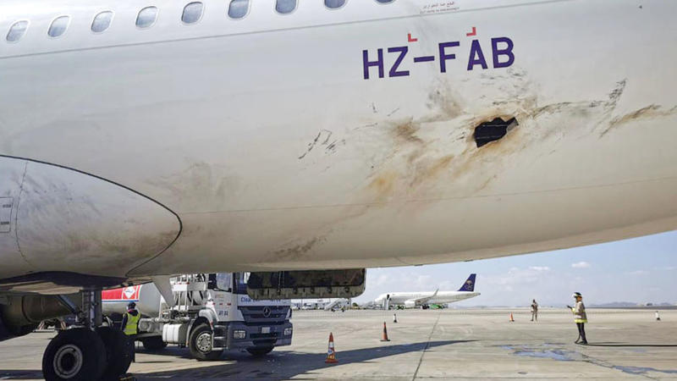

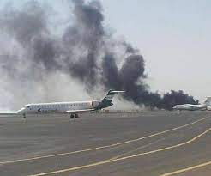
Discuss a famous crime.
Who was involved?
What happened?
Where and when did it happen?

Slide 5


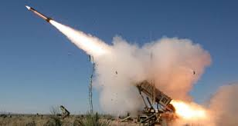

Slide 6

What do you think
( crime doesn’t pay )
means ?
a crime does not benefit the criminal, and only results in negative consequences.

Slide 7


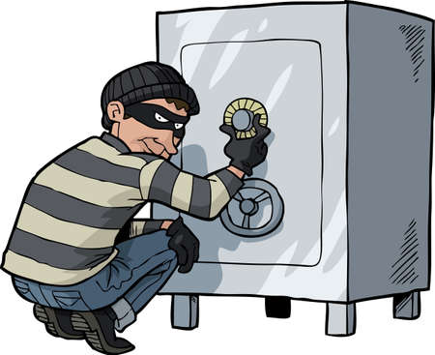
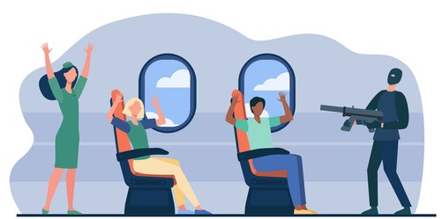

Sentence (V)
Steal
theft.
Hijack
crime words

Slide 8



burglar
robber
Thief but with the use of fear or violence to accomplish the theft
A person who enter a structure – such as a bank or home with intent to commit a crime inside
Thief
Taking the property of another without permission.

Slide 9


Jail
prison
prisoner

Slide 10
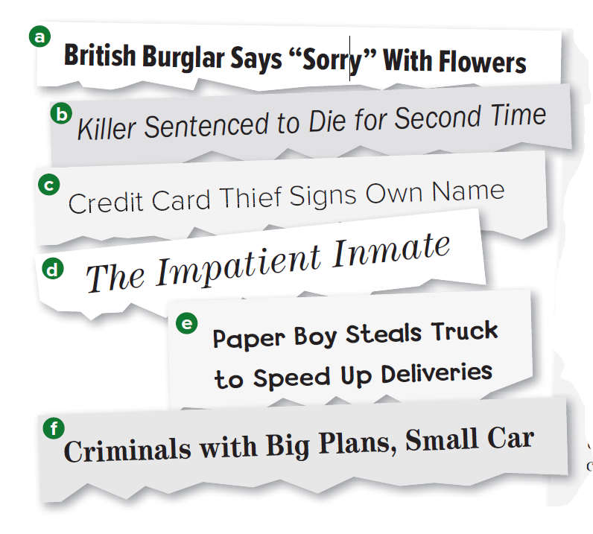
What are these ?
How many newspaper headlines are they??
How many articles……?
What are they about ?

Slide 11
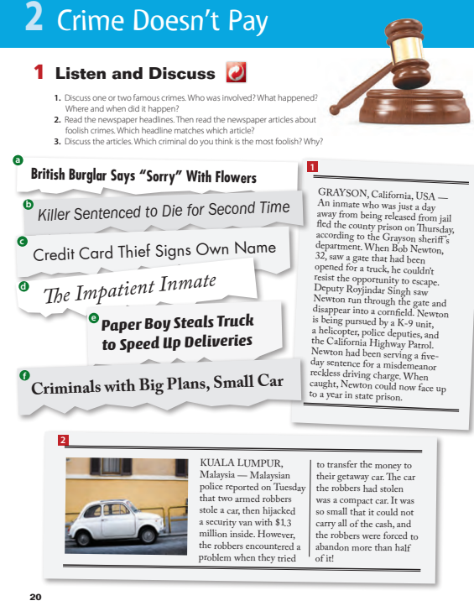
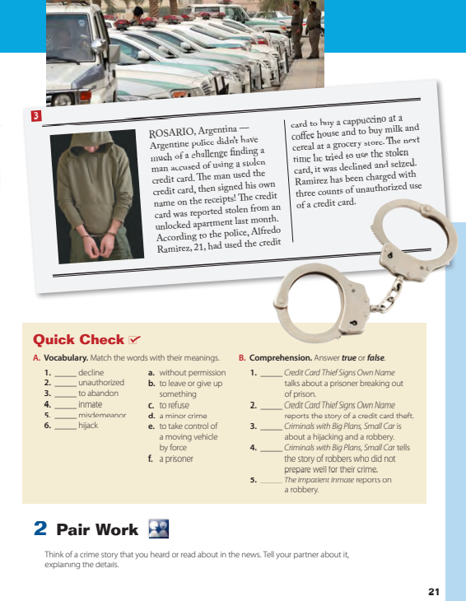
Open Your book @ PAGE 20+21

Slide 12


LISTEN

Slide 13
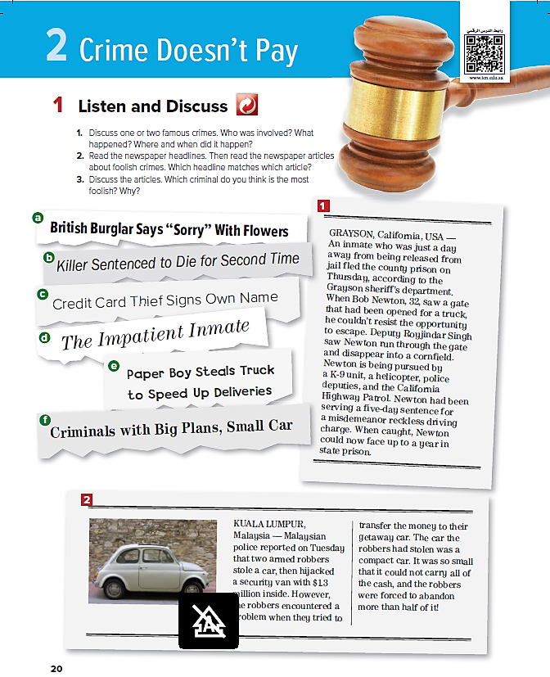
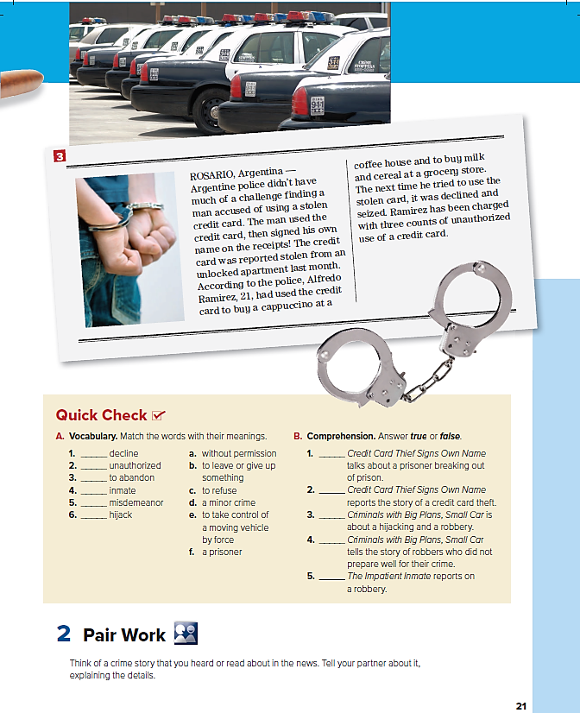

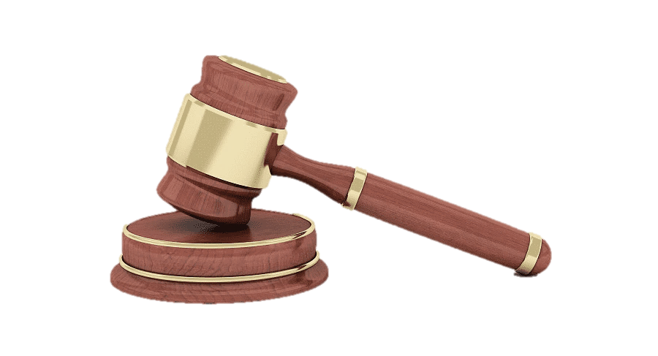

about?
c
d
Skim & match
stories with headlines
f

Slide 14

Where does the story take place?
How did Newton escape?
What was Newton’s crime?
How long was his sentence?
How long might Newton be in prison now when they catch him?

Slide 15
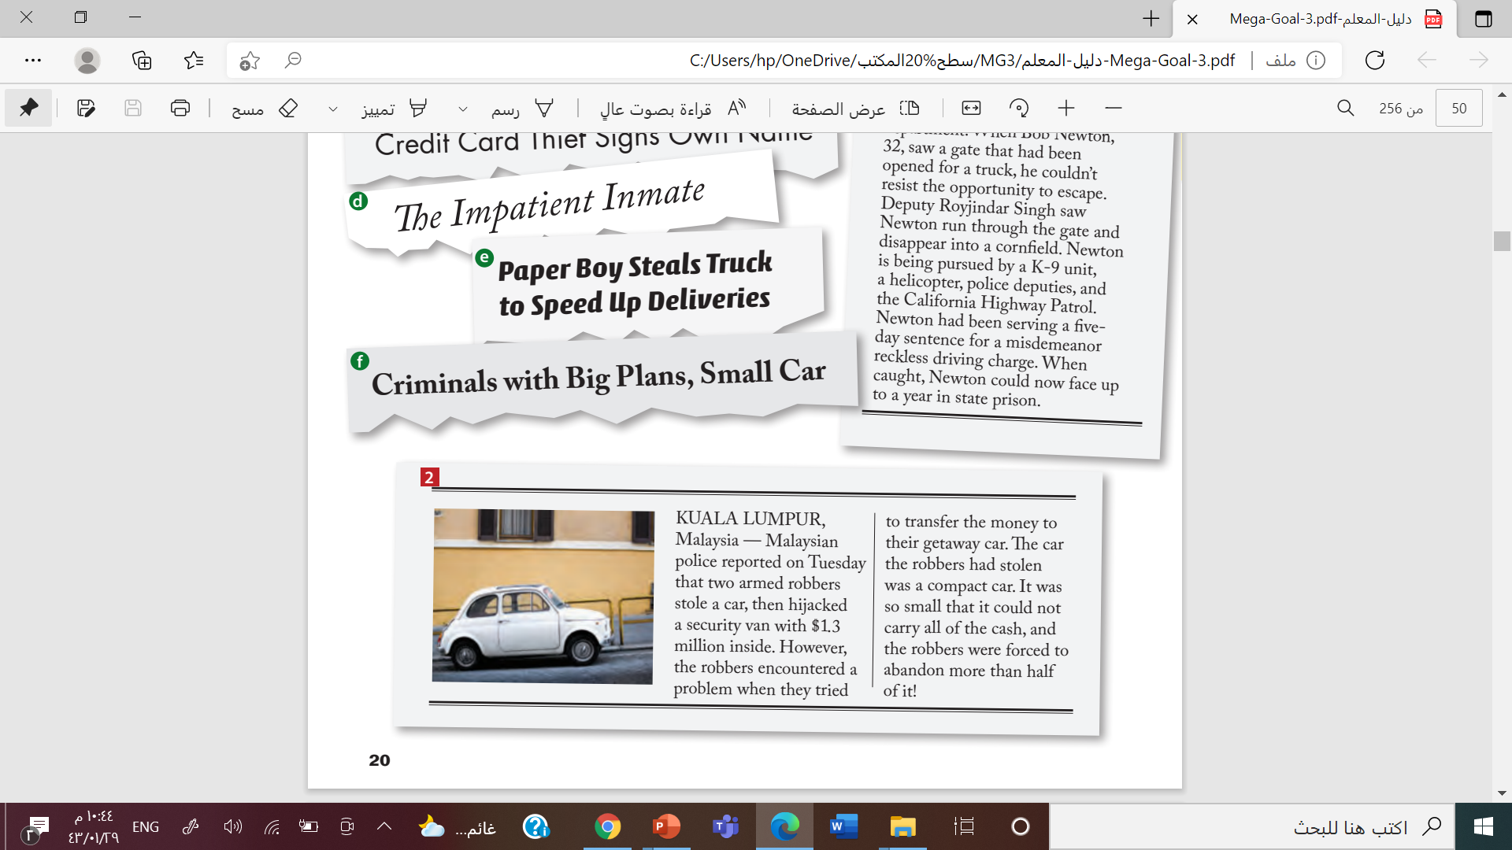
What did the robbers do?
What kind of car did they steal for the getaway car?
What problem did they have?

Slide 16
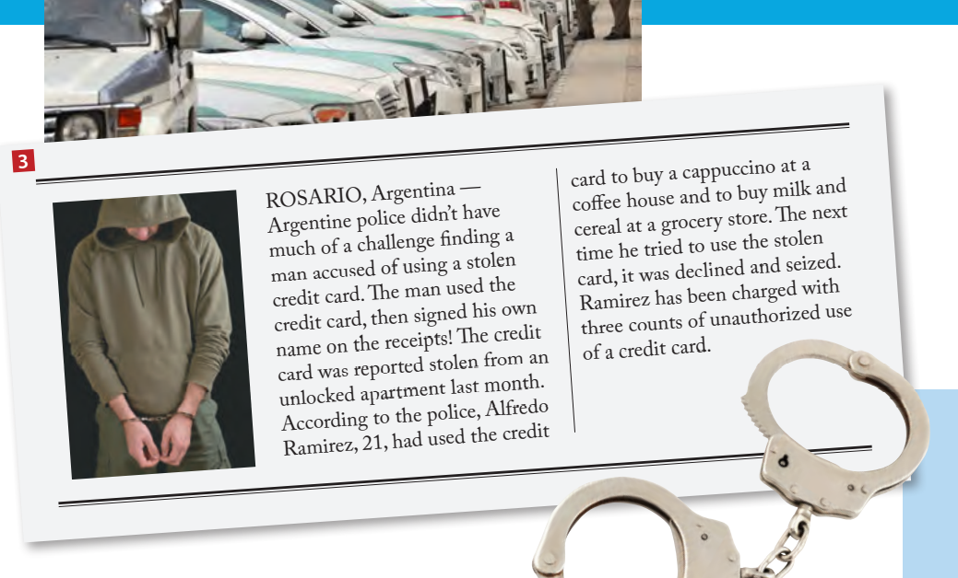
What did the criminal steal?
What mistake did he make when he used the credit card?
Did he buy expensive things with the card?

Slide 17

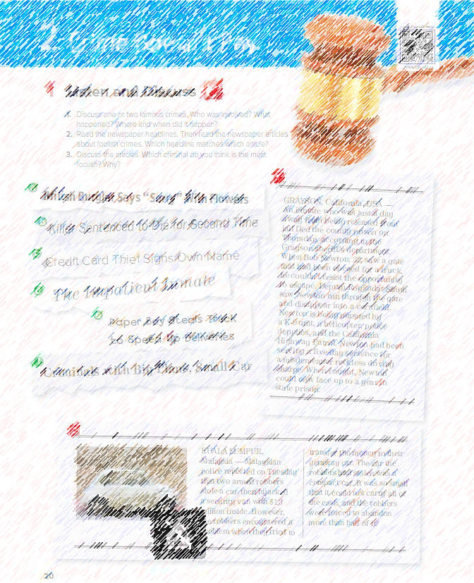
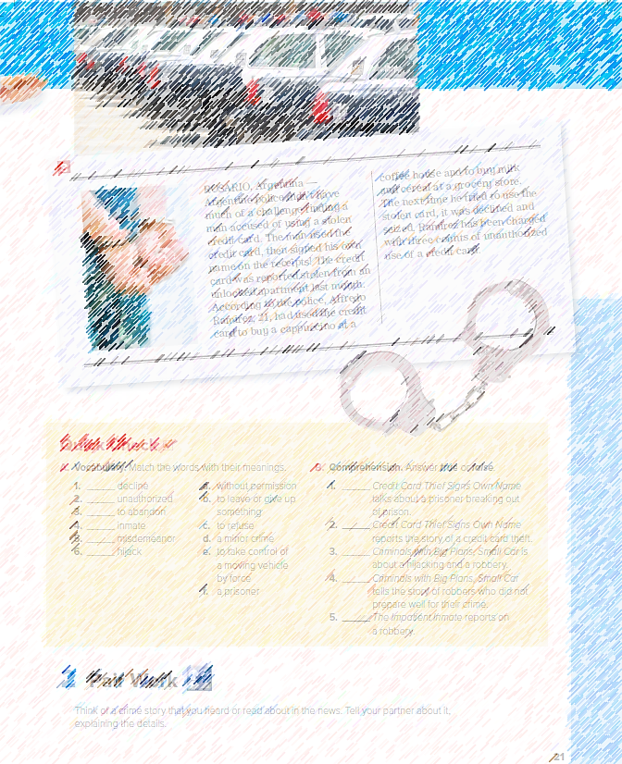
Why?
What is the most
foolish criminal?
Why ?

Slide 18

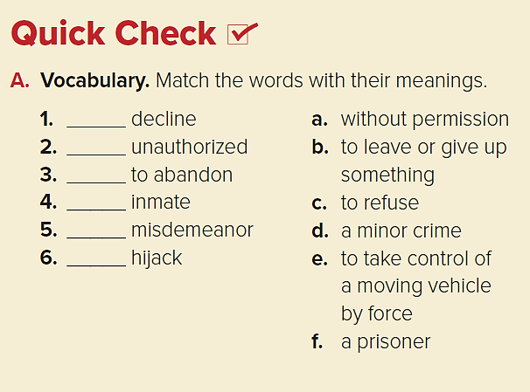
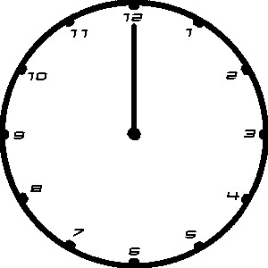
c
a
b
f
d
e

Slide 19

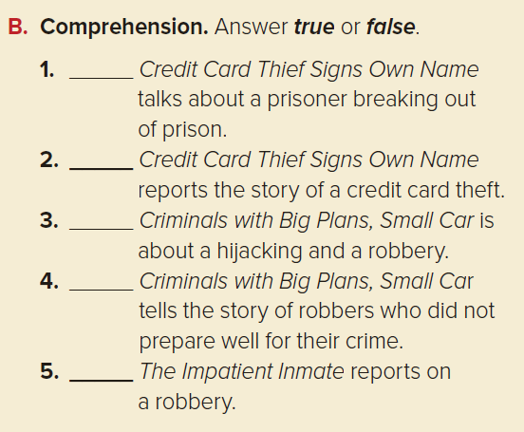
False
true
true
true
False

Slide 20
Work
book

Slide 21
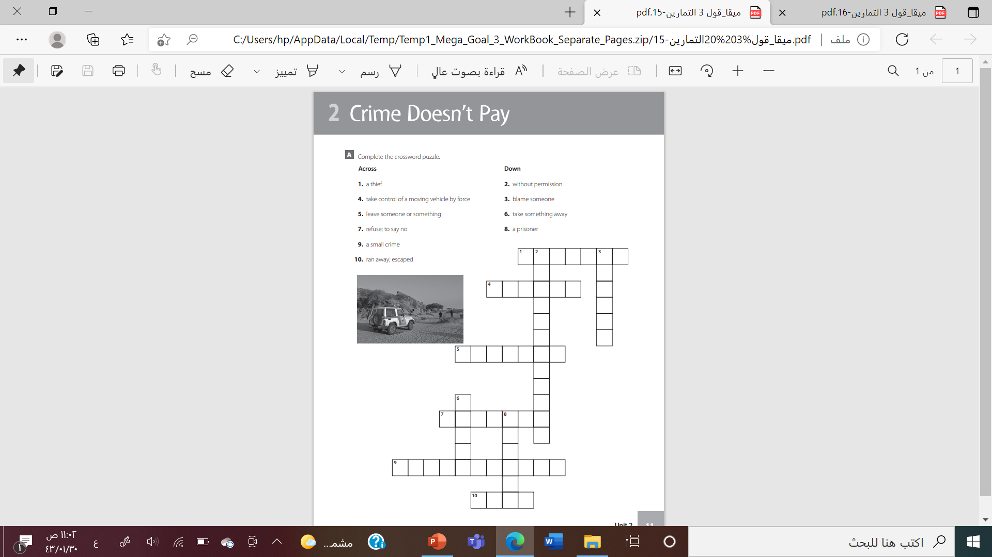

Slide 22



Slide 23


