Slide 1
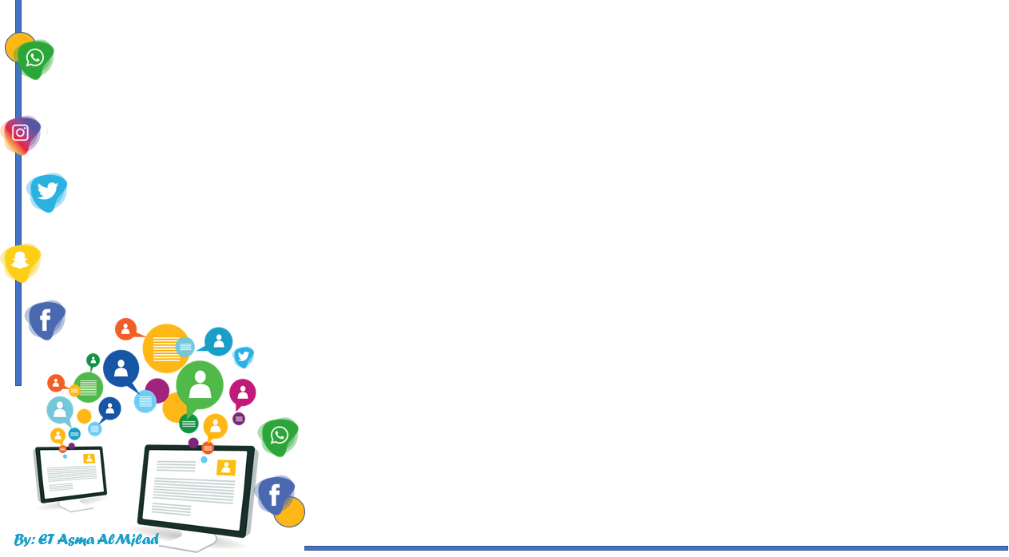

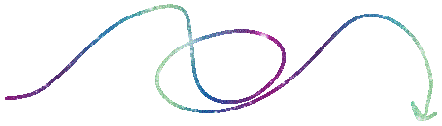
    Connected by
conversation
By : Asma AlMjlad

Slide 2
Objectives
1
Answer question in the book
2
Match a word with its category.
3
Determine stress in number teens and tens

Slide 3
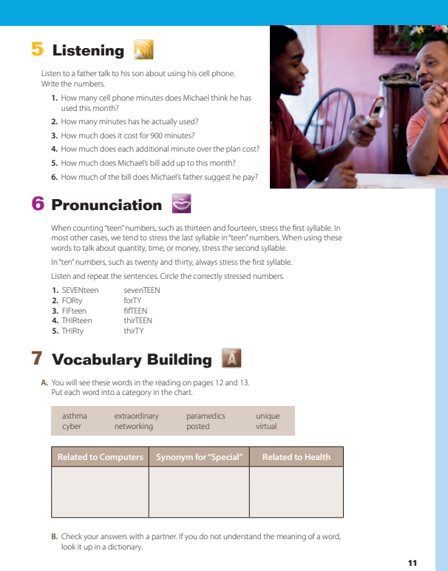

@ page 11

Slide 4
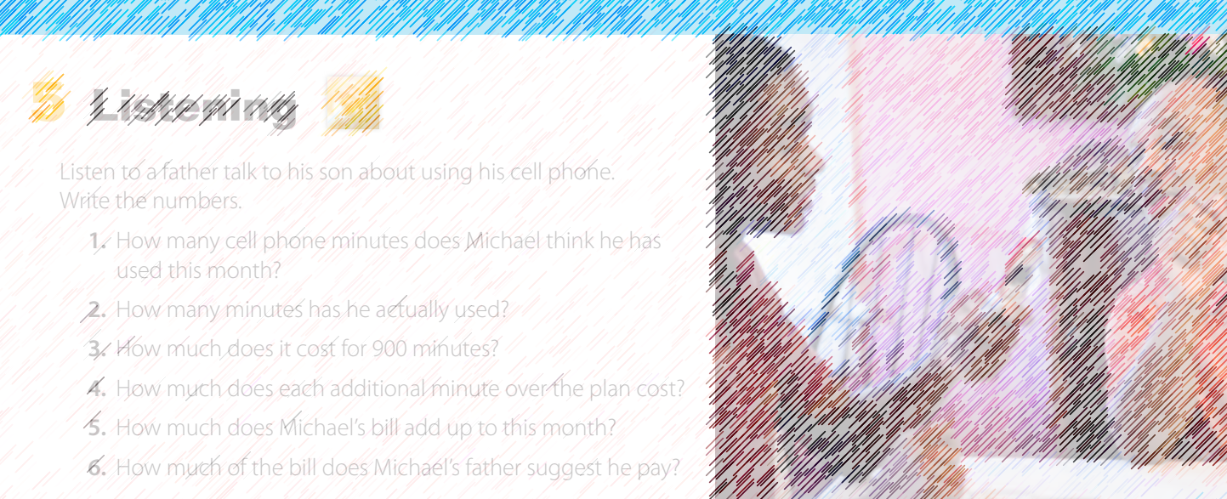



What do you think the father is saying?
What do you think his son is saying?

Slide 5
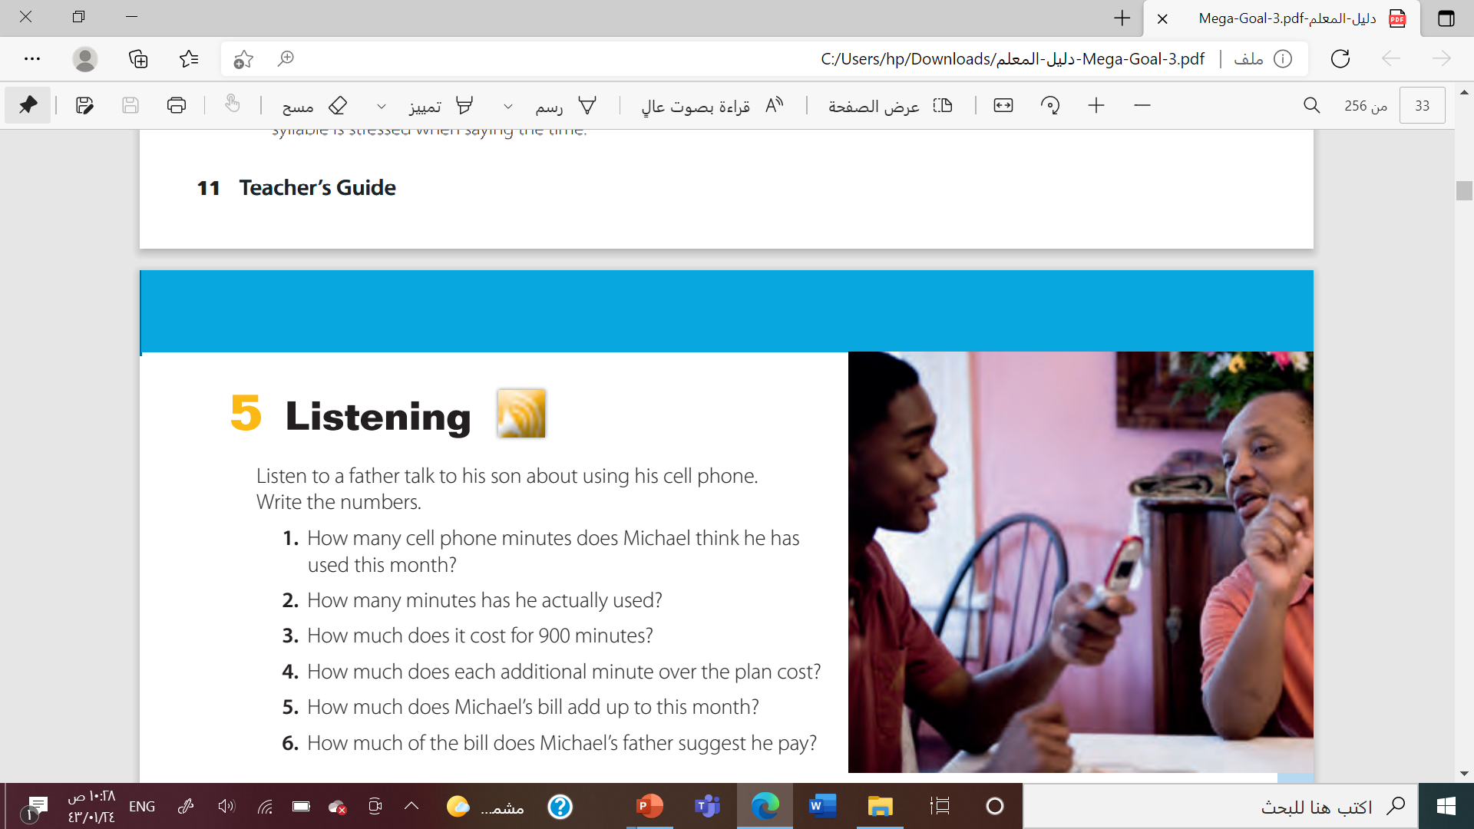
300
950
$79
$0,40
$20
one-third

Slide 6

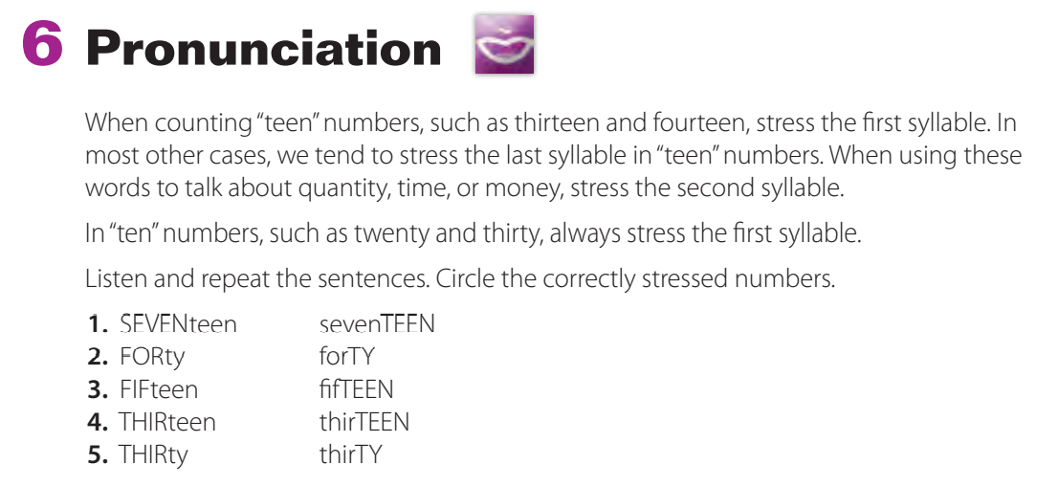

Slide 7




Slide 8





Slide 9




asthma
extraordinary
Cyber
Networking

Slide 10
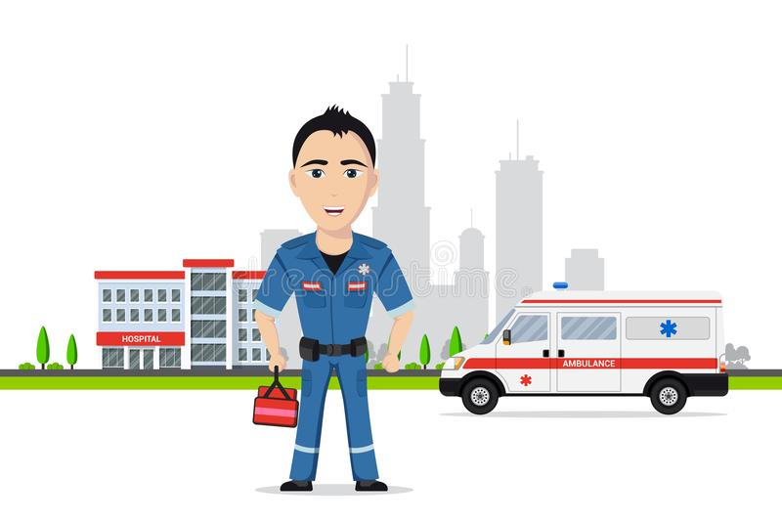



paramedics
unique
posted
virtual

Slide 11
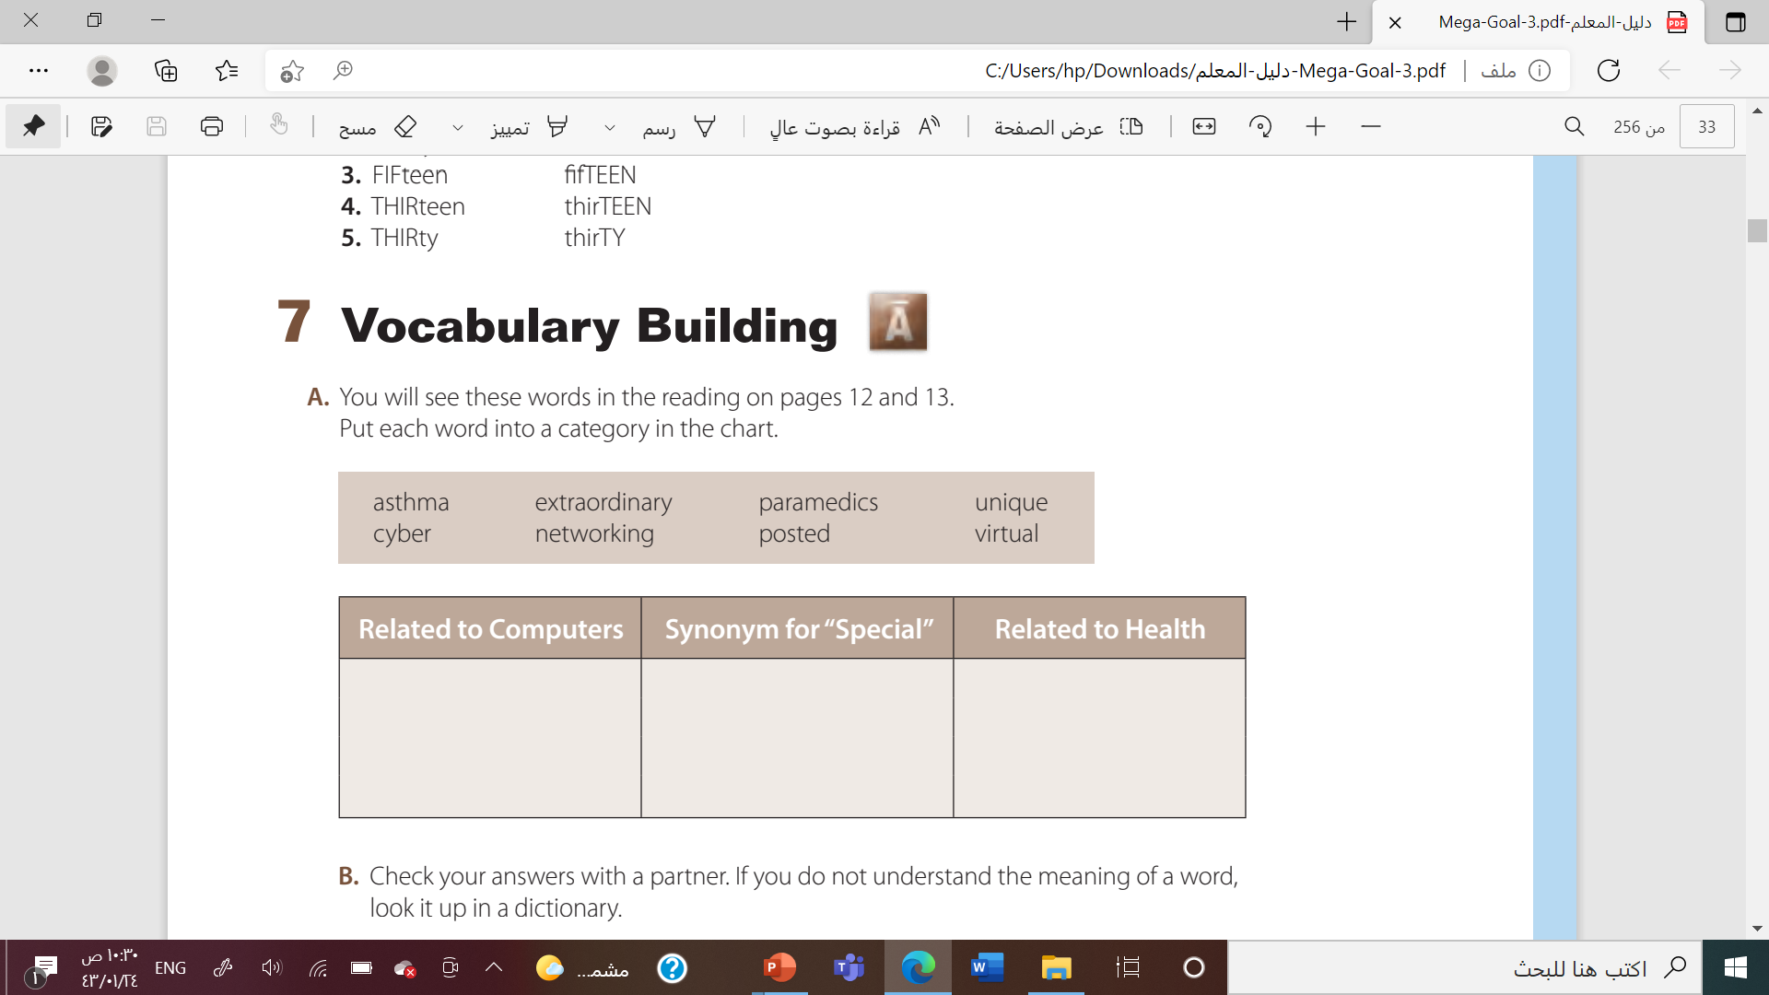

Networking
Unique
Asthma
Virtual
cyber
Extraordinary
Paramedics
Posted

Slide 12

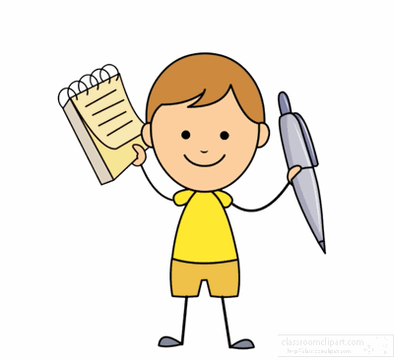


Slide 13
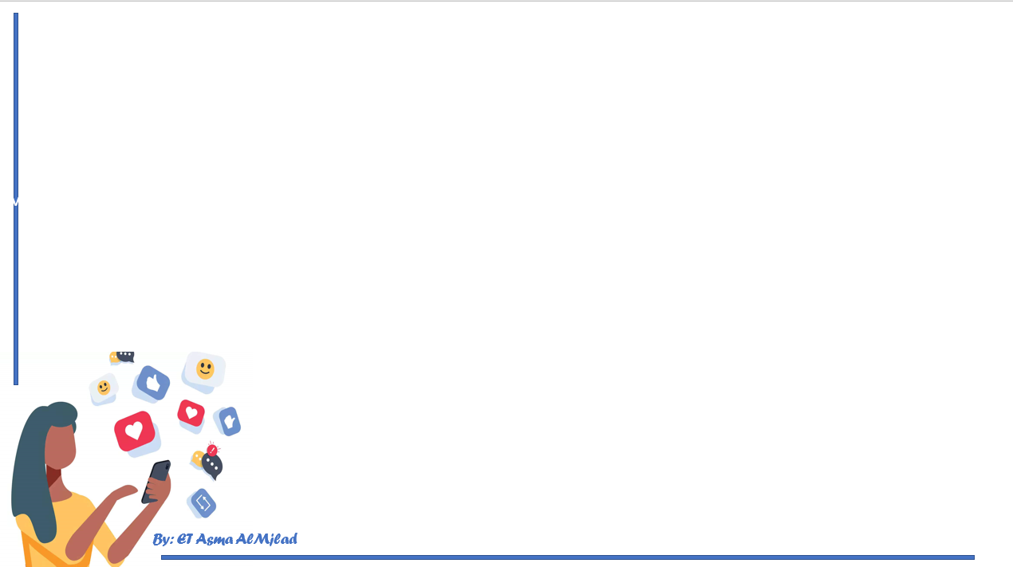

By: ET Asma AlMjlad

