Slide 1
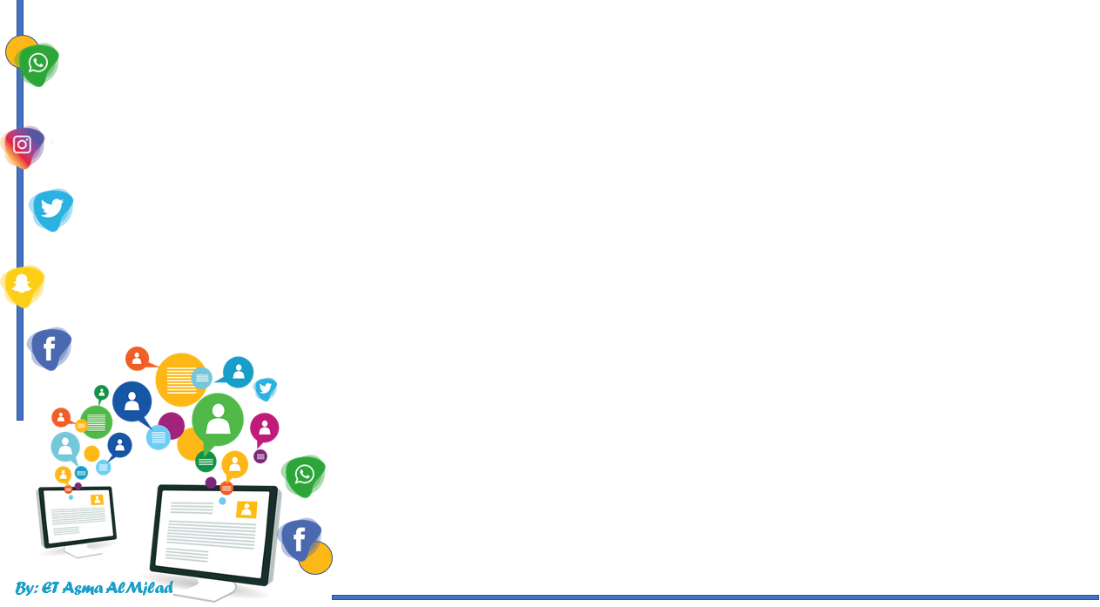


    Connected by
Form , Meaning and function
By : Asma AlMjlad

Slide 2


Slide 3
Objectives
Write the comparative and superlative form of an adjective
Form irregular comparative for some adjectives
Use "need to be (done) "correctly
Use past participles as an adjective
Use "have or get something (past participle)" correctly

Slide 4



Slide 5
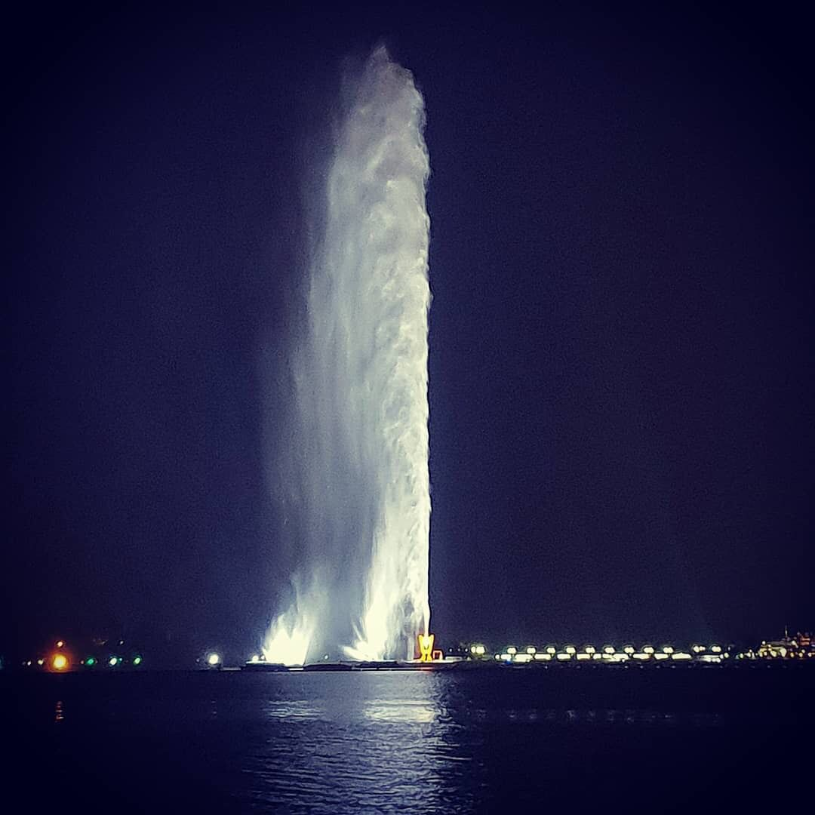



King Fahd's Fountain
What is the tallest fountain in the world?

Slide 6
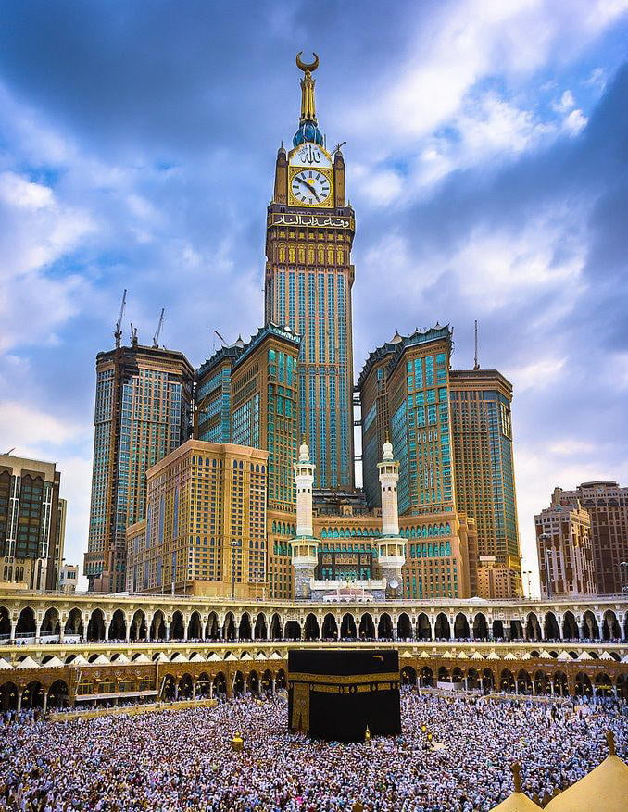
What is the tallest tower in Saudi Arabia?
The clock tower

Slide 7
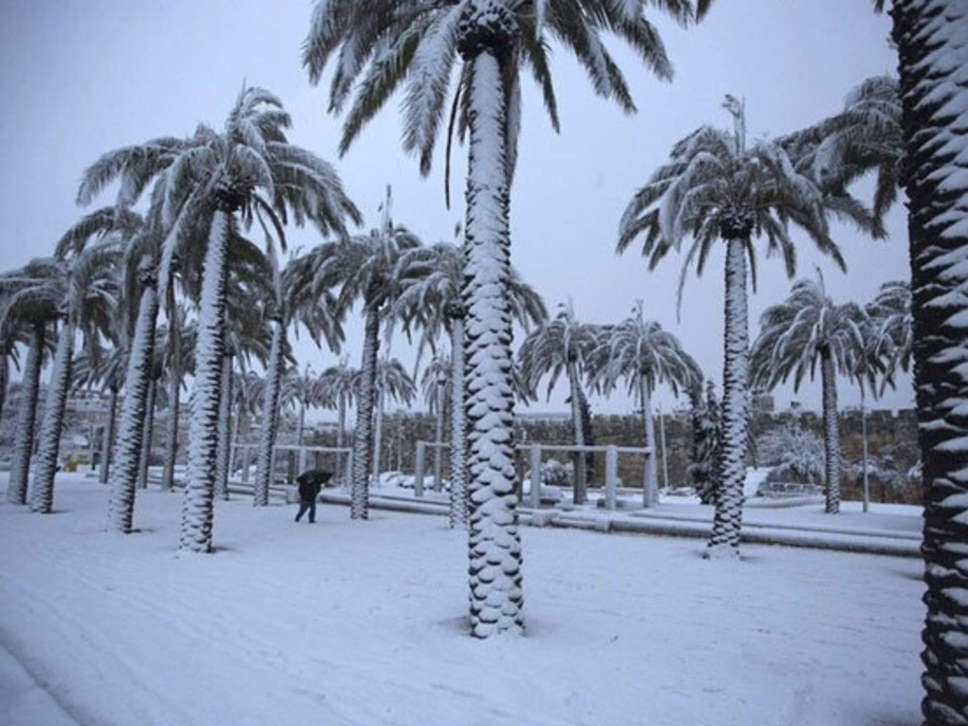
What is the coldest city in Saudi Arabia
Turaif
The clock tower

Slide 8


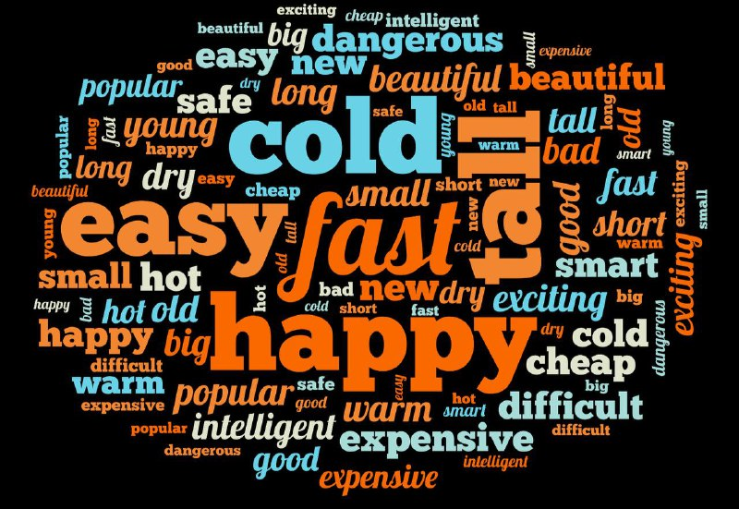
Write more adjectives as you can

Slide 9

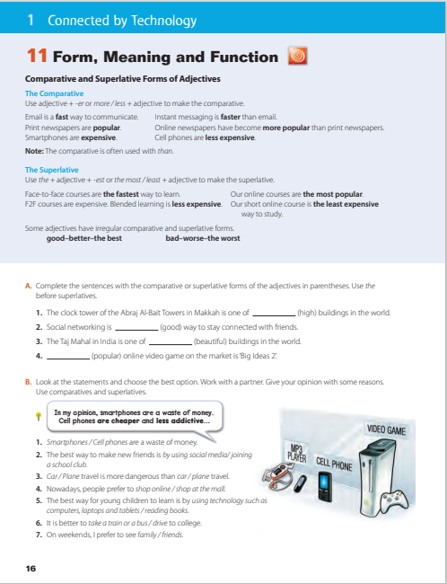
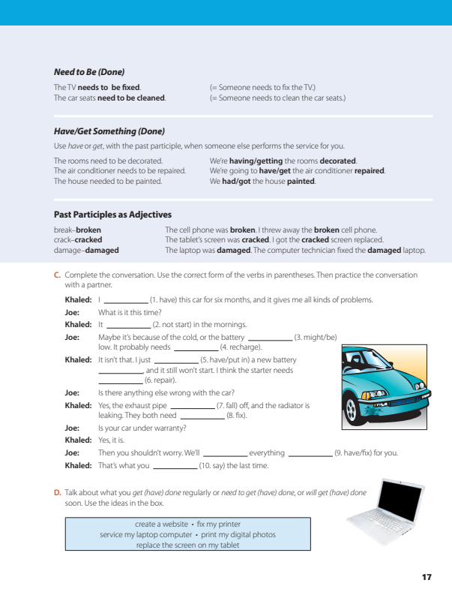

Open your book @ page 16+17

Slide 10
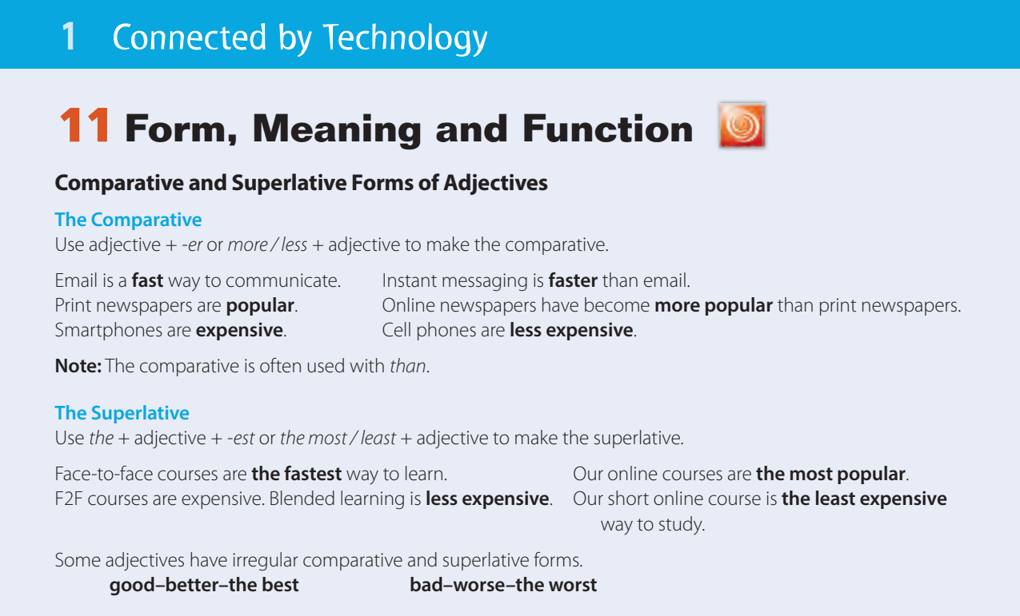

Slide 11
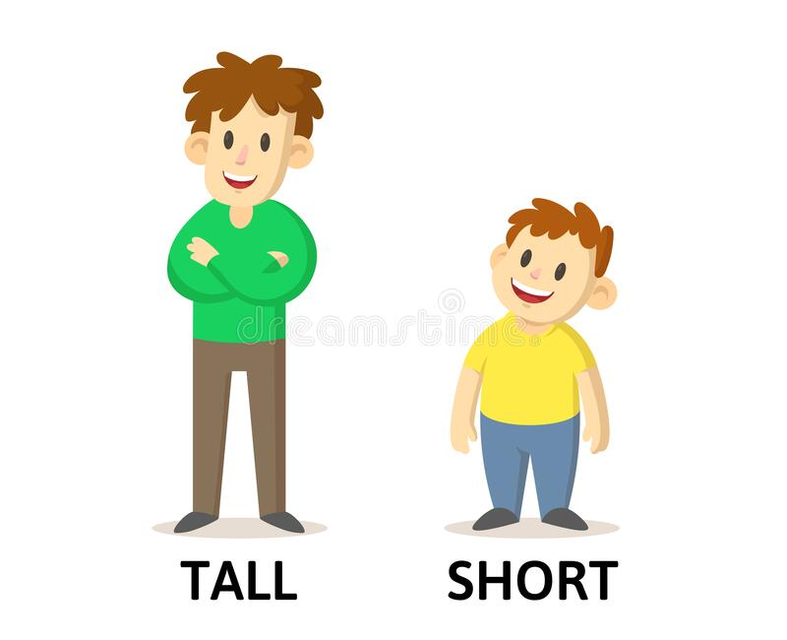

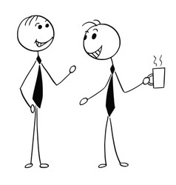
Fahad is tall
Khalid is short

Slide 12
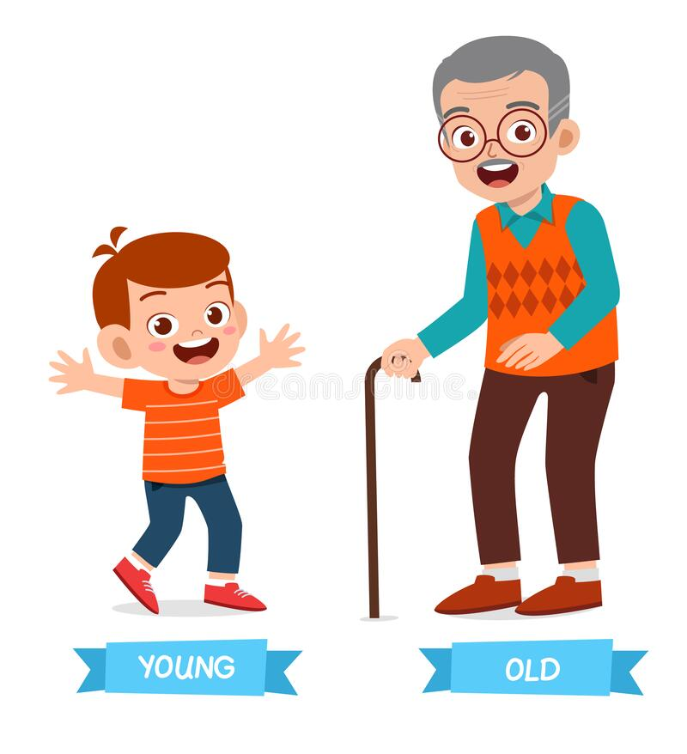
The boy is young
His grandfather is old

Slide 13
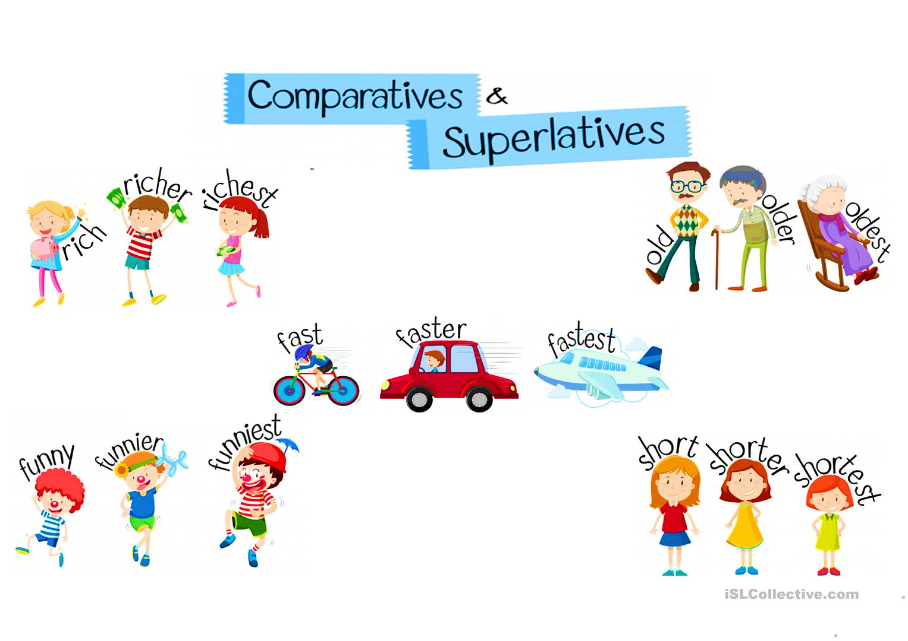

Slide 14
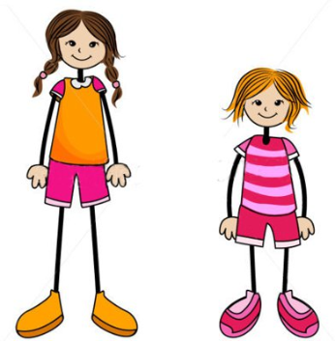
Sara is taller than Amal
Noun
Adj + er
Noun

Slide 15
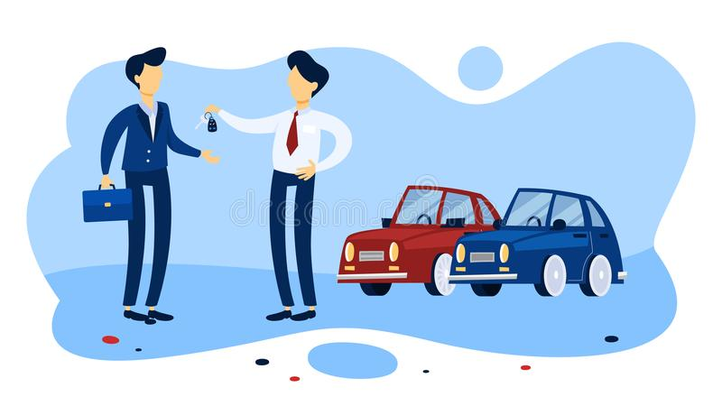
The red car is more expensive than the blue car
noun
More + adj
noun

Slide 16

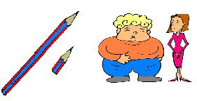
The comparative
It is between 2 nouns
We used
than

Slide 17
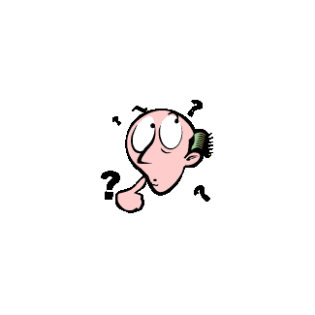
Long adjectives
Short adjectives
expensive
tall
Taller
More expensive
Adj + er
More + adj

Slide 18

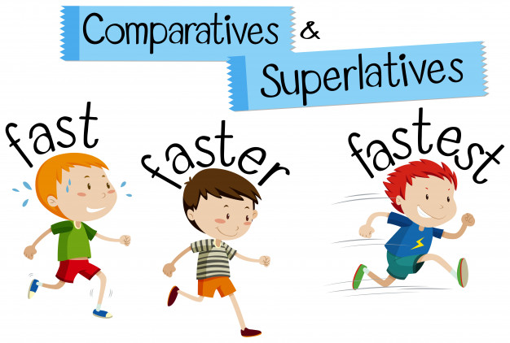

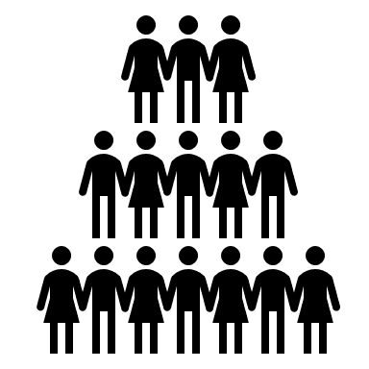
superlatives
Between three or more nouns

Slide 19

superlatives
Sara is the shortest girl in the class
1
+2
the +Adj + est

Slide 20
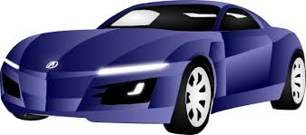

Omar has the most expensive car in the city
1
The + most + adj
+2

Slide 21
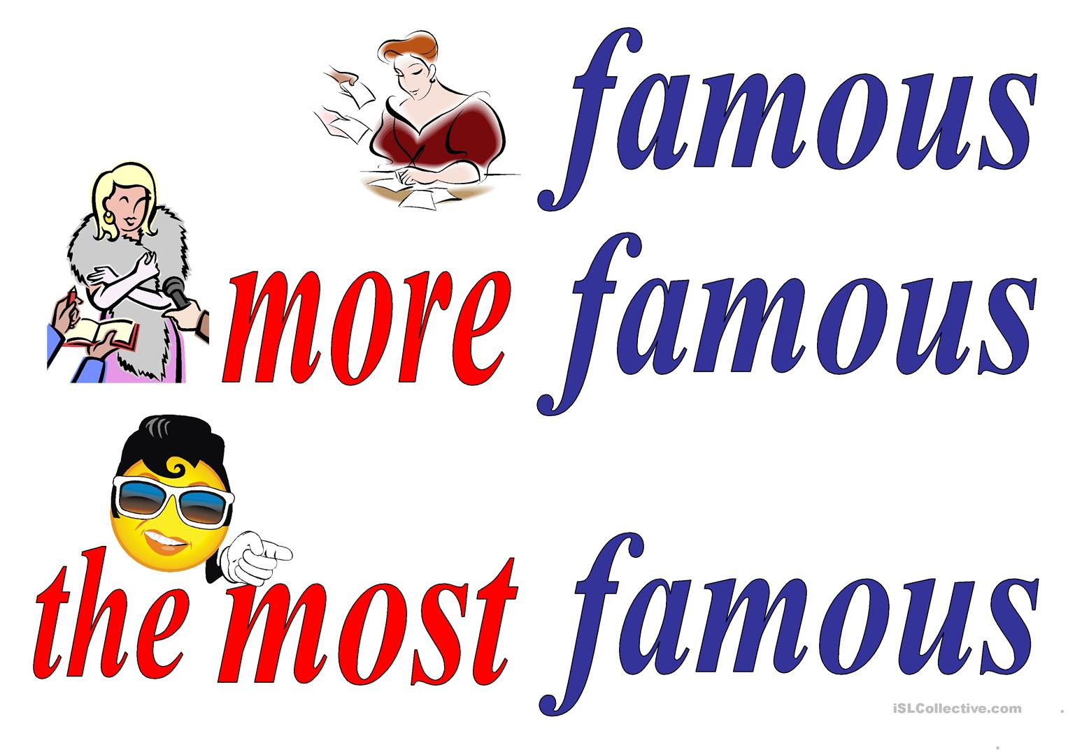
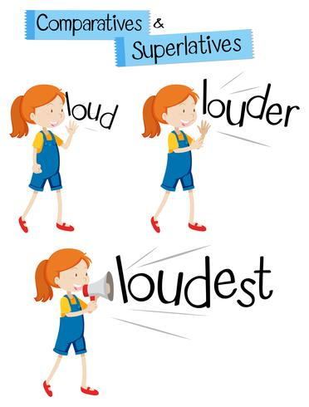
Long adjectives
short adjectives

Slide 22


Irregular adjectives
good
bad

Slide 23
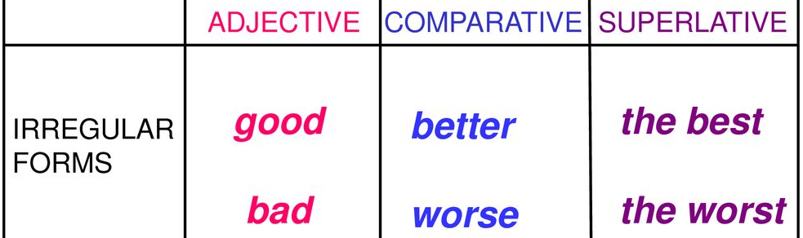
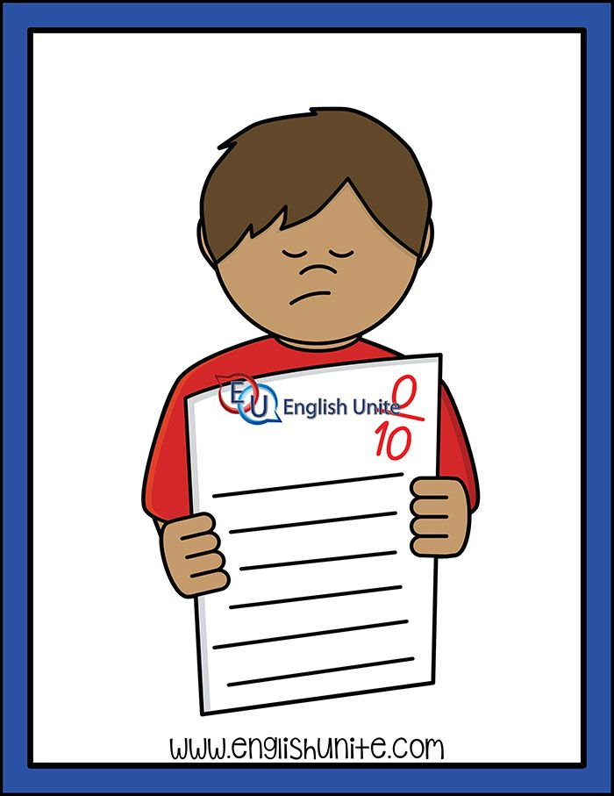

Jack gets the worst mark in the class
Ali gets the best mark in the class.

Slide 24

Add er est
Most adjectives :
Old – older - oldest
Adjectives ending in e
Nice – nicer - nicest
Adjectives ending in y :
Happy - happier - happiest
Adjectives ending in one vowel followed by
one consonant :
Hot – hotter - hottest

Slide 25



Slide 26

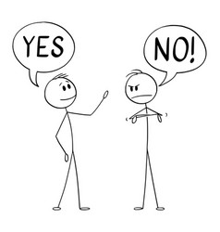
Who is …..?
Let’s practice
Who is the smartest?
Who is shorter?
Who is taller?

Slide 27




Slide 28

The biggest project in Saudi Arabia

Slide 29
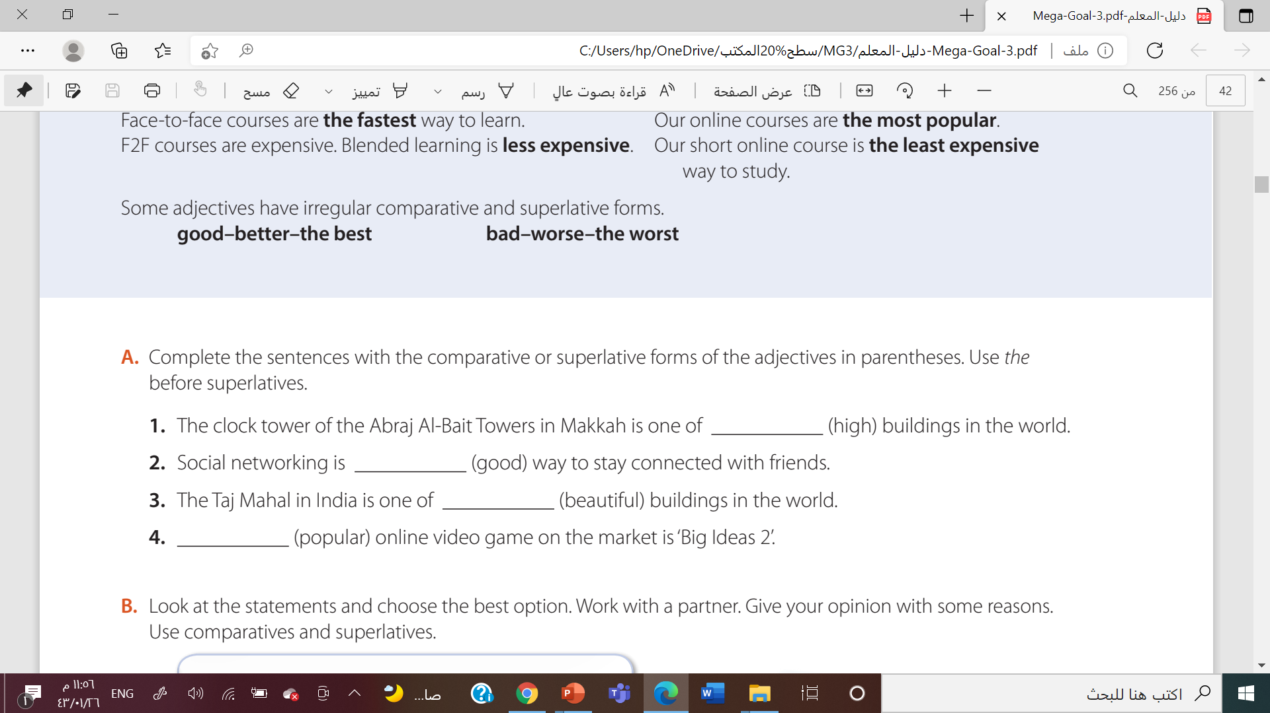

The highest
The best
The most
The most

Slide 30
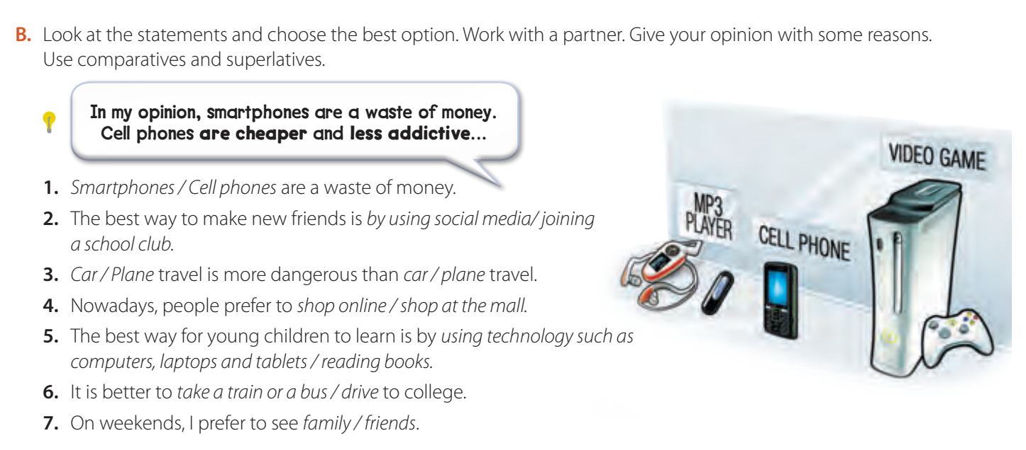


Slide 31
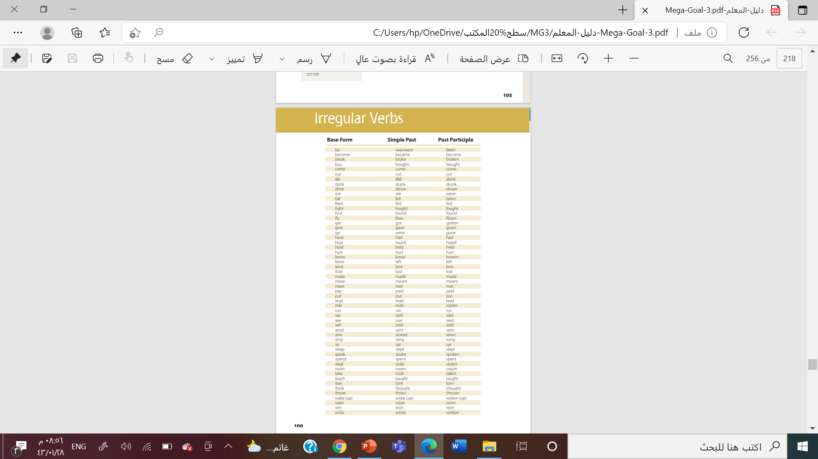

Past participle ( V3 )

Slide 32
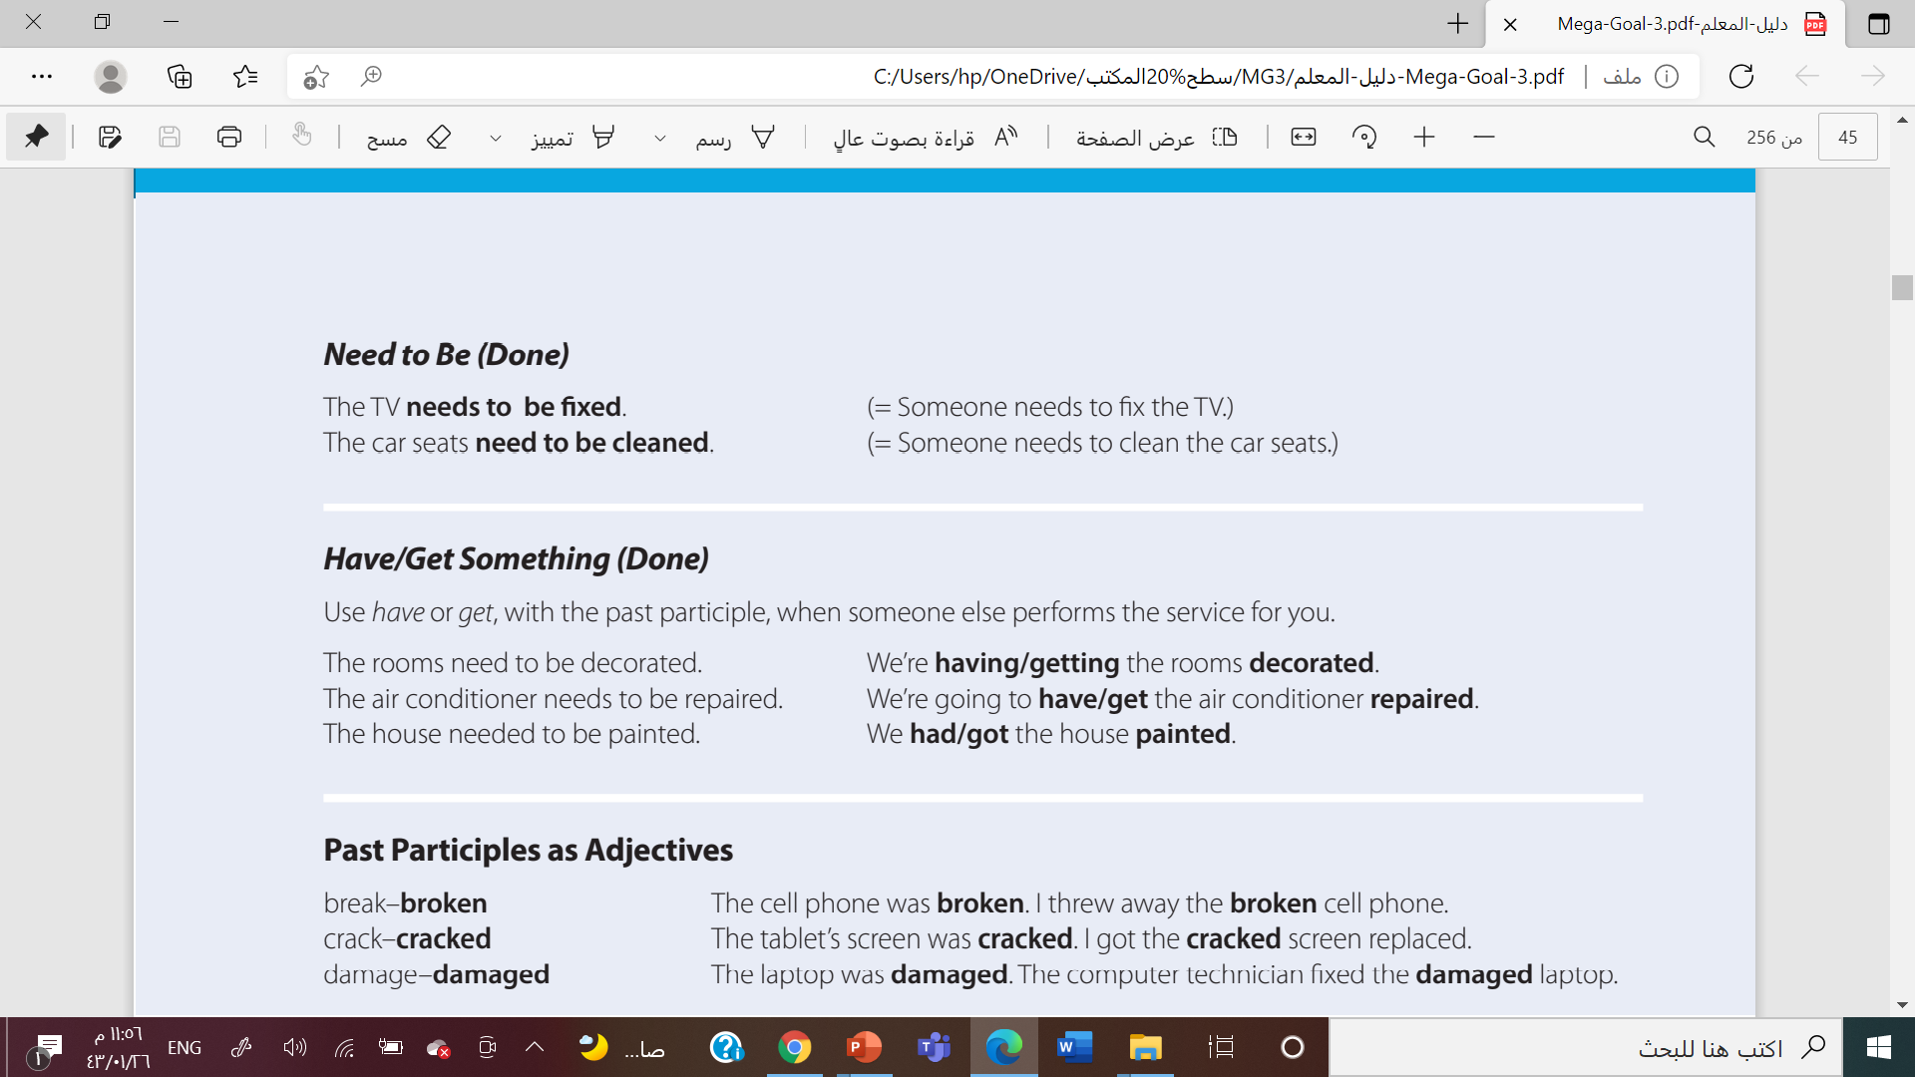


Slide 33



Need to be + V3
I clean my car ( present )
My car needs to be cleaned
They build their houses
Their houses need to built
Omar delivered the pizza
The pizza needed to be delivered

Slide 34
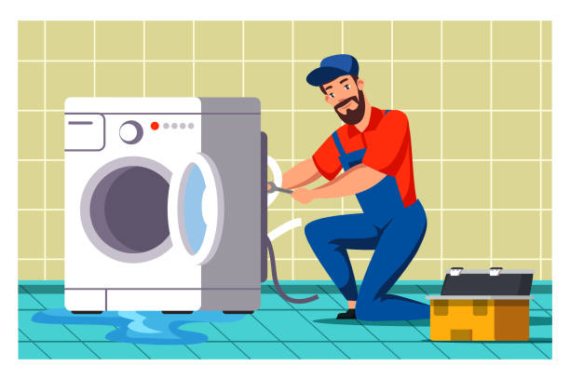
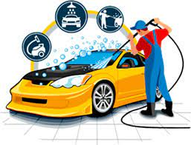
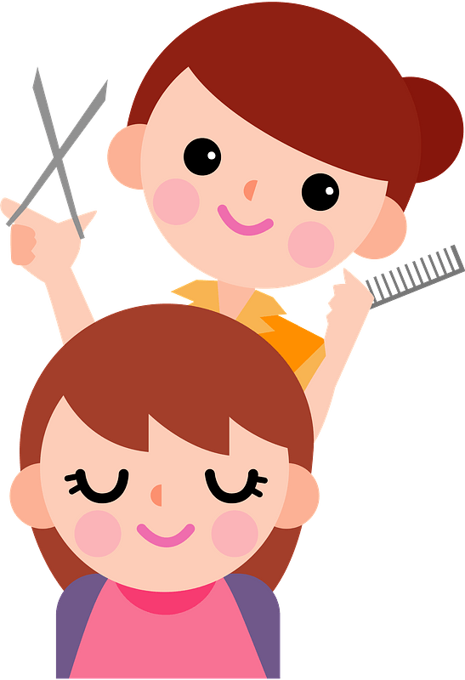
Use the phrase need to be
The washing machine …………………………………( fix )
Needs to be fixed
My car ……….…………………………………( wash )
Needs to be washed
Her hair ………………………………….( cut)
Needs to be cut

Slide 35


Slide 36

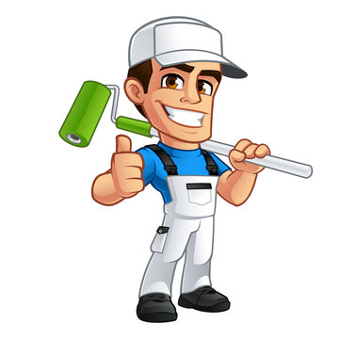

Have \ get ( something ) done
You get someone to do something for you
I painted my house
I did it myself
I had my house painted
Someone did if for me

Slide 37
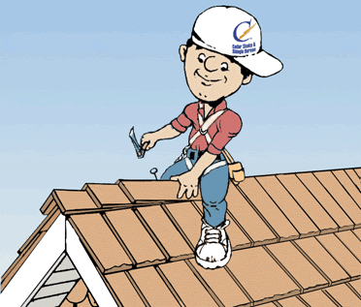
Had
The roof need to be repaired
We had the roof repaired

Slide 38


Slide 39
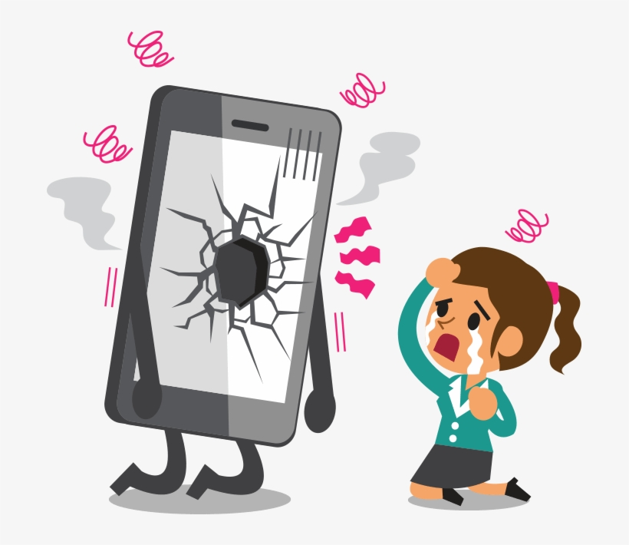
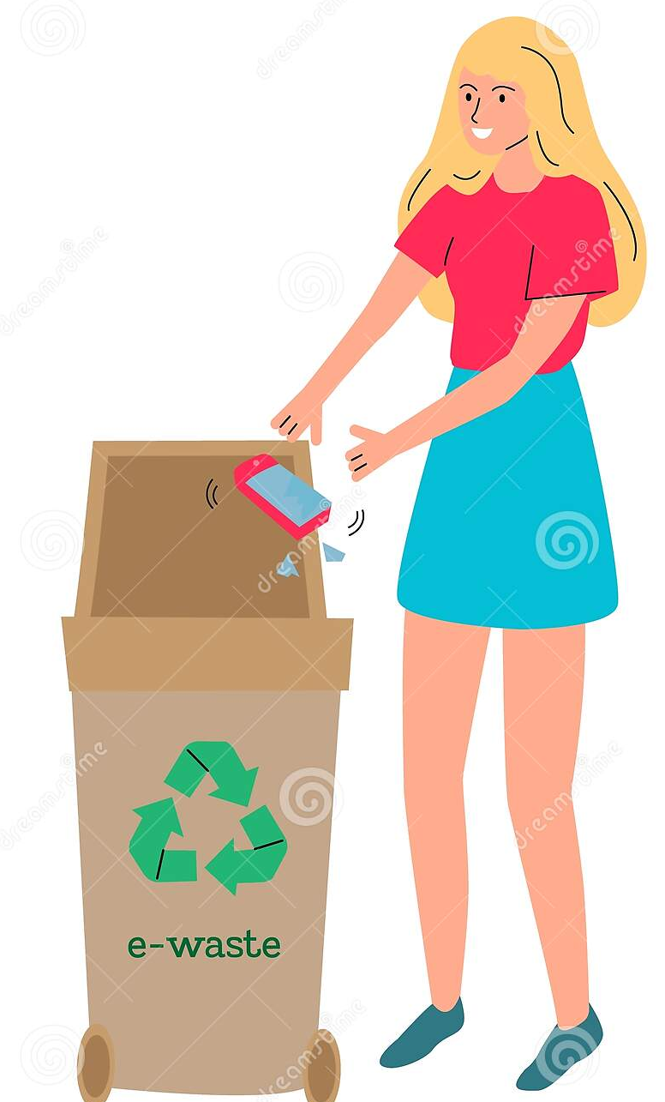
The cell phone was broken
v3
adj
I threw away the broken cell phone

Slide 40
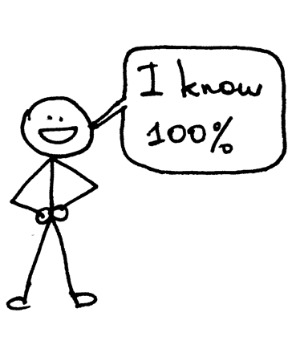

Summarize

Slide 41
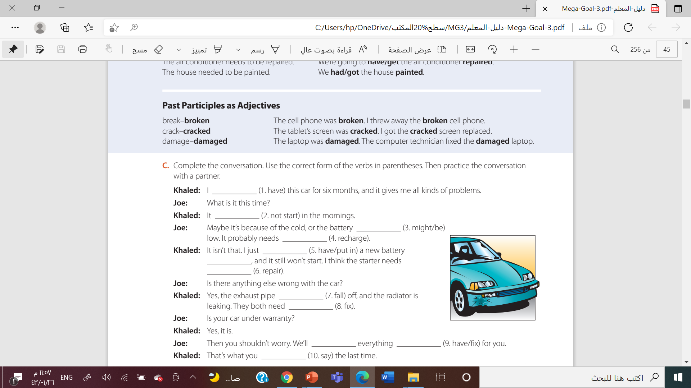
have had
doesn’t start
might be
to be recharged
had
Put in
to be repaired

Slide 42
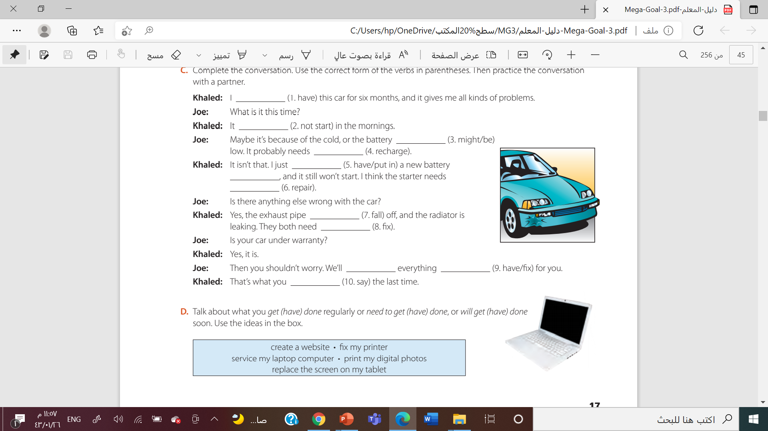


Slide 43

Work book

Slide 44
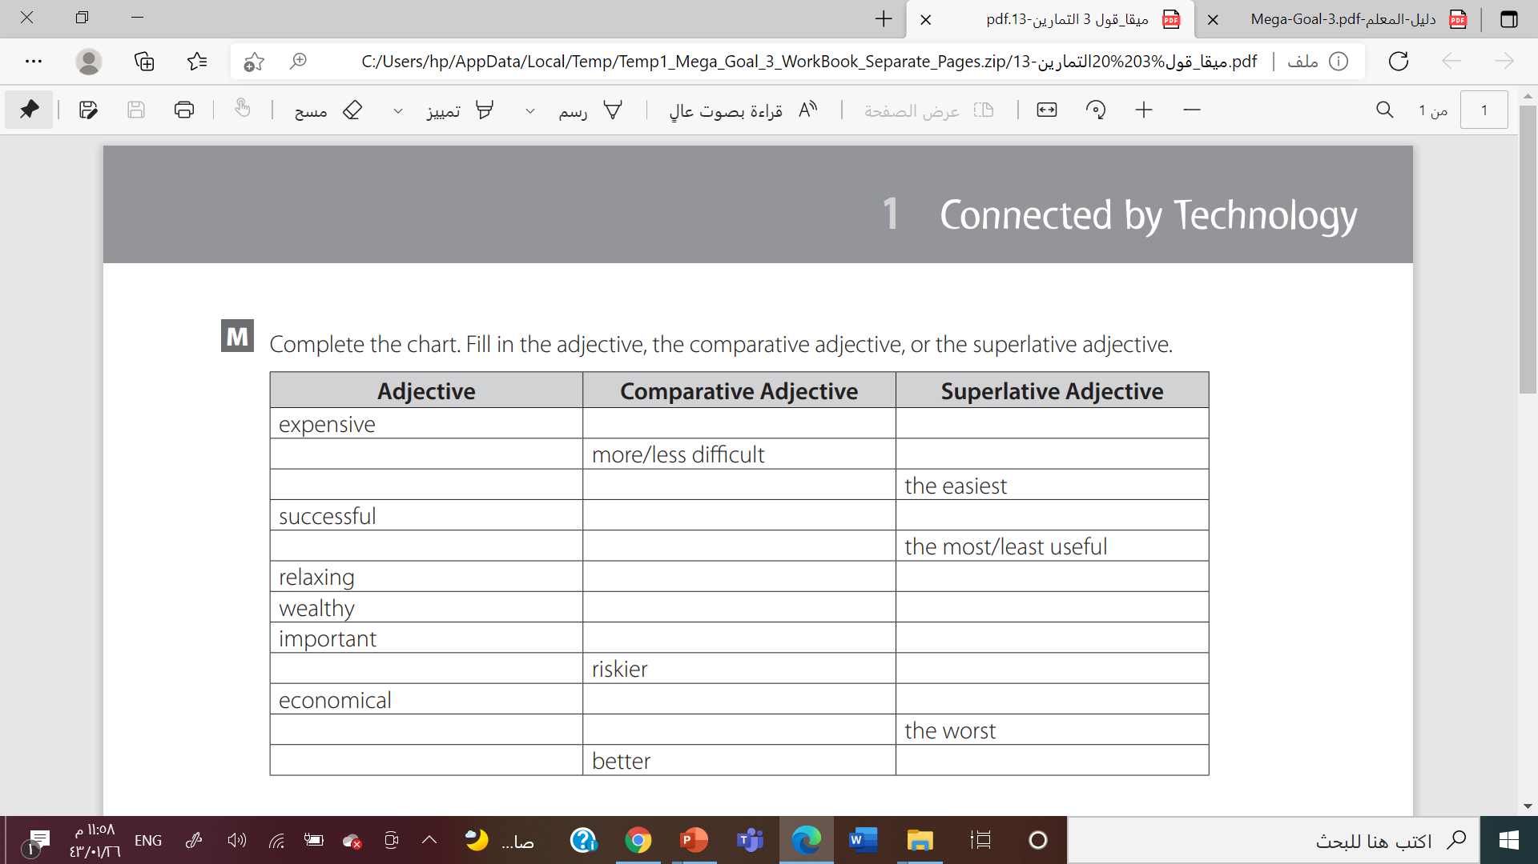

More expensive
The most expensive
Difficult
The most difficult
Easy
Easier
More successful
The most successful
Useful
More useful
more/less relaxing
The most relaxing
wealthier
The wealthiest
More important
The most important
Riske
The riskiest
More economical
The most economical
Bad
Werst
good
The best

Slide 45
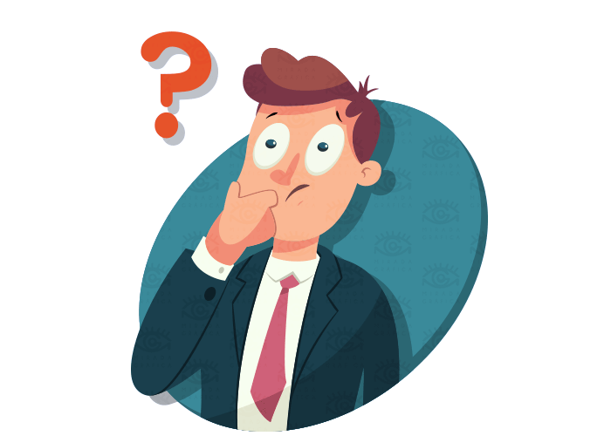
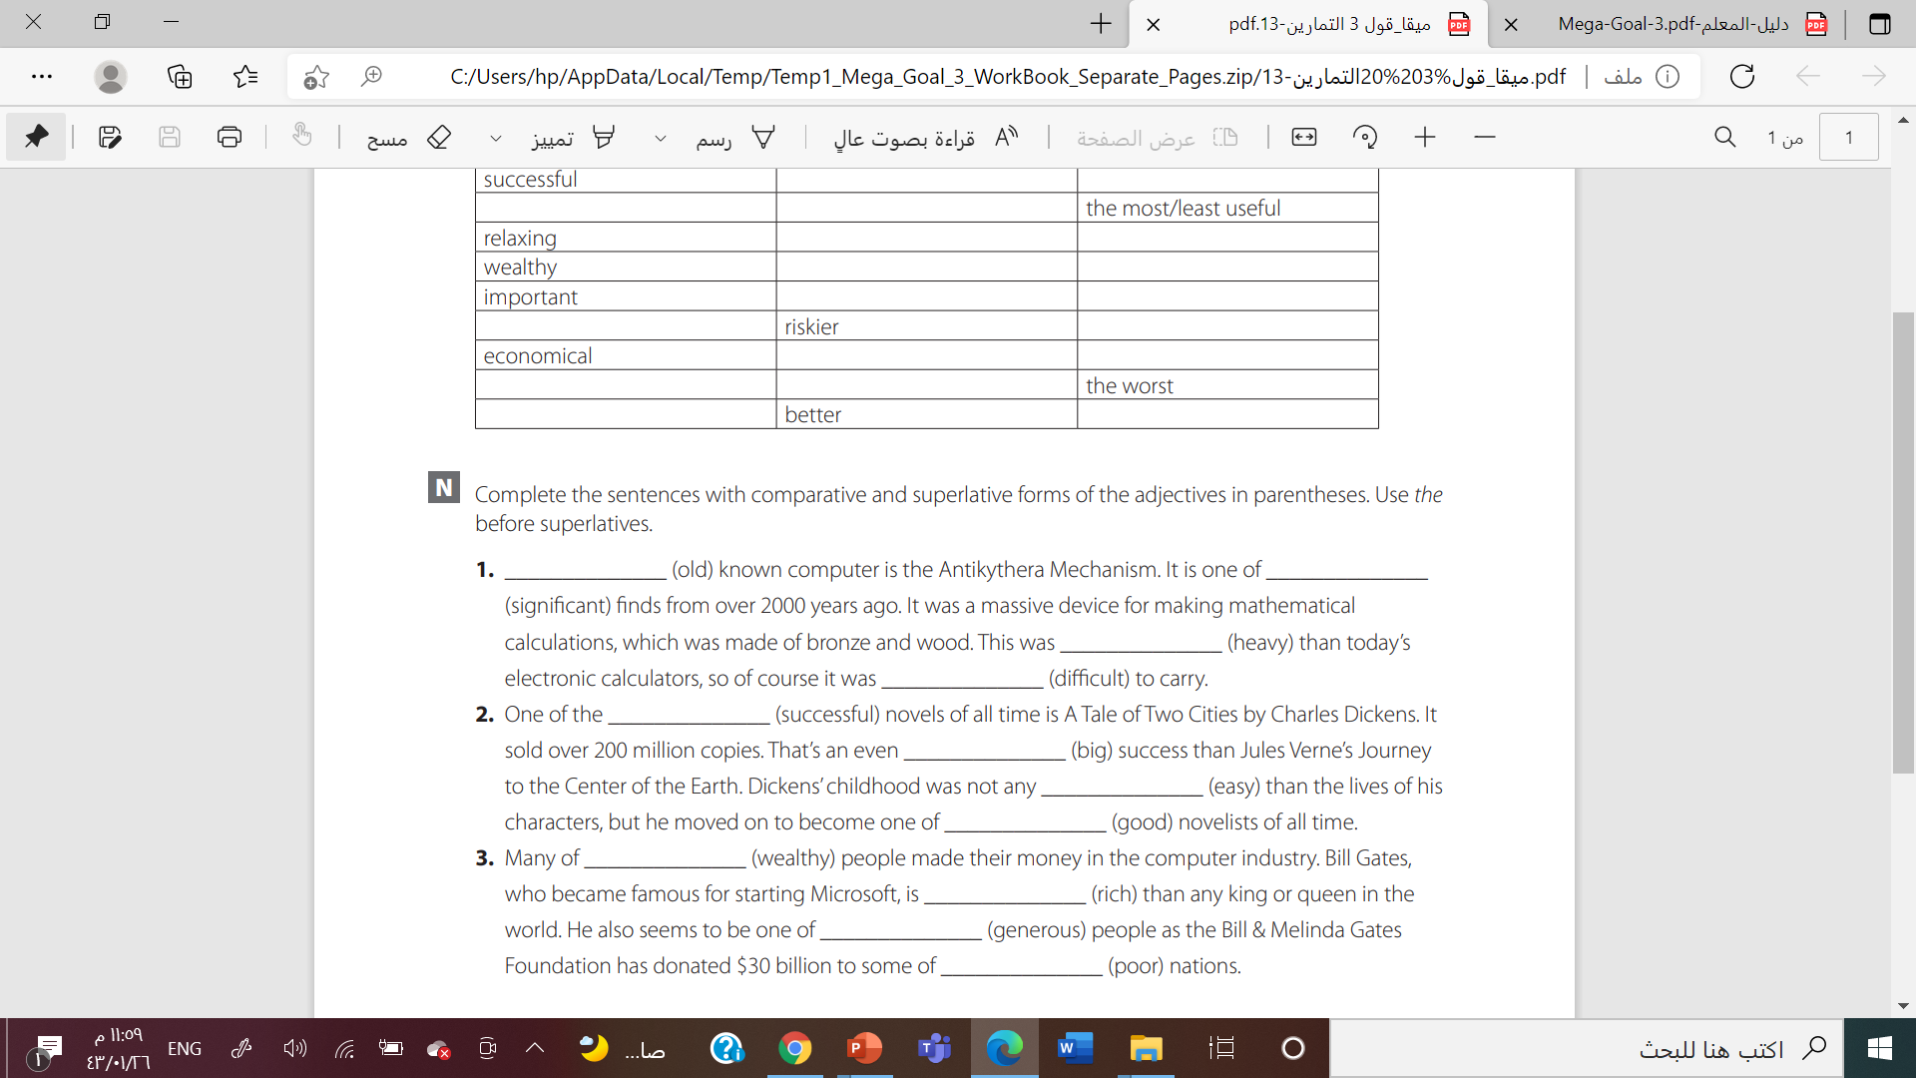
the most significant
The oldest
Heavier
More difficult
most
bigger
easier
The best

Slide 46
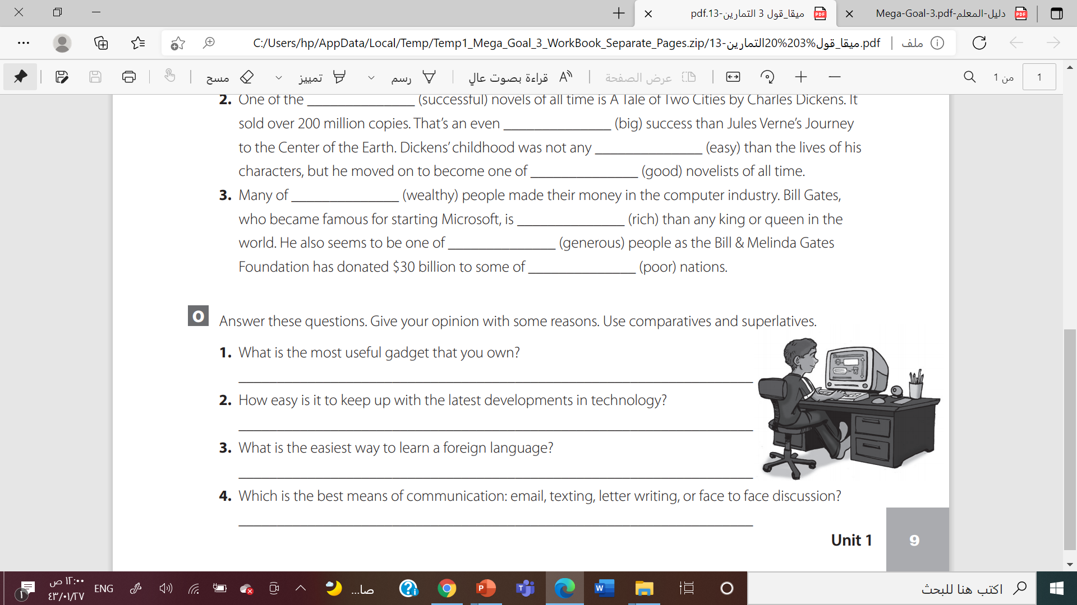


Slide 47
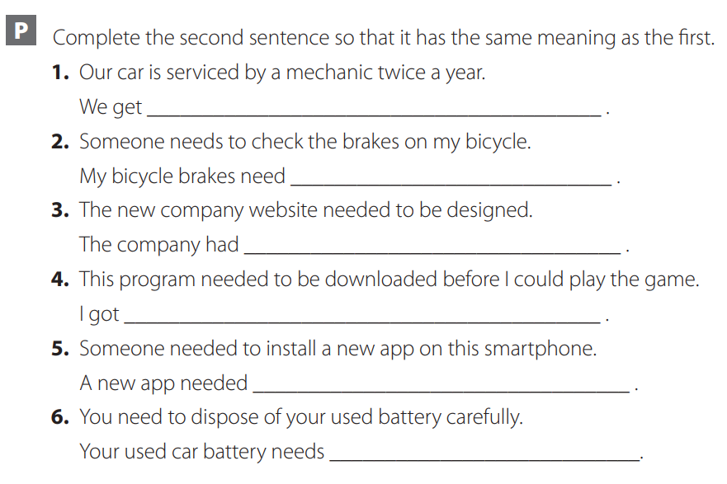
our car serviced twice a year
to be checked
the new website designed
this program downloaded before I could play the game.
to be installed on this smartphone
to be disposed of carefully

Slide 48
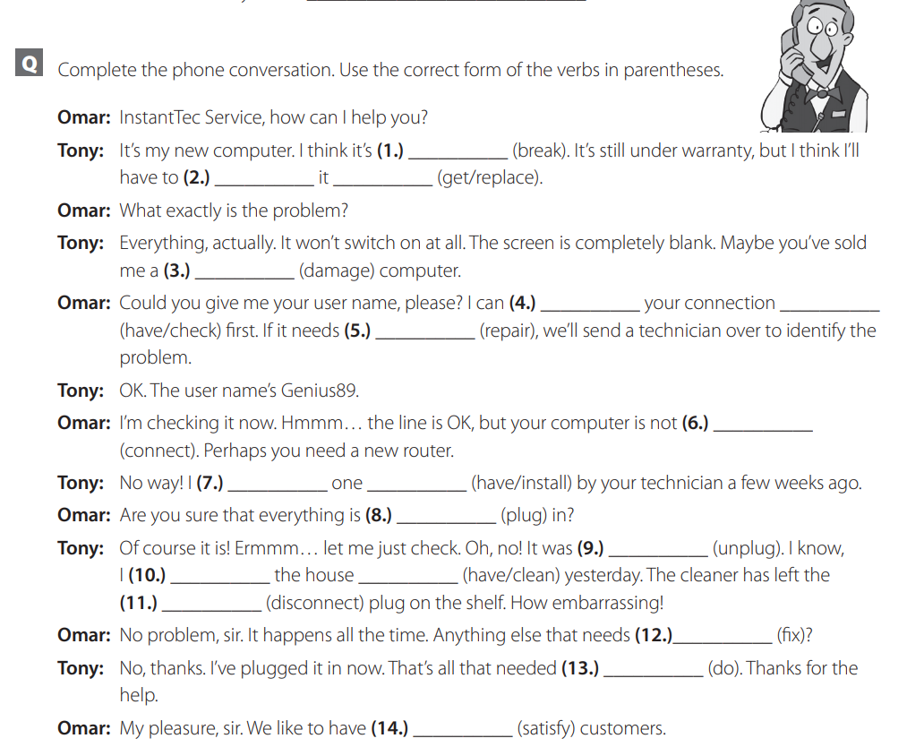


Slide 49





Slide 50
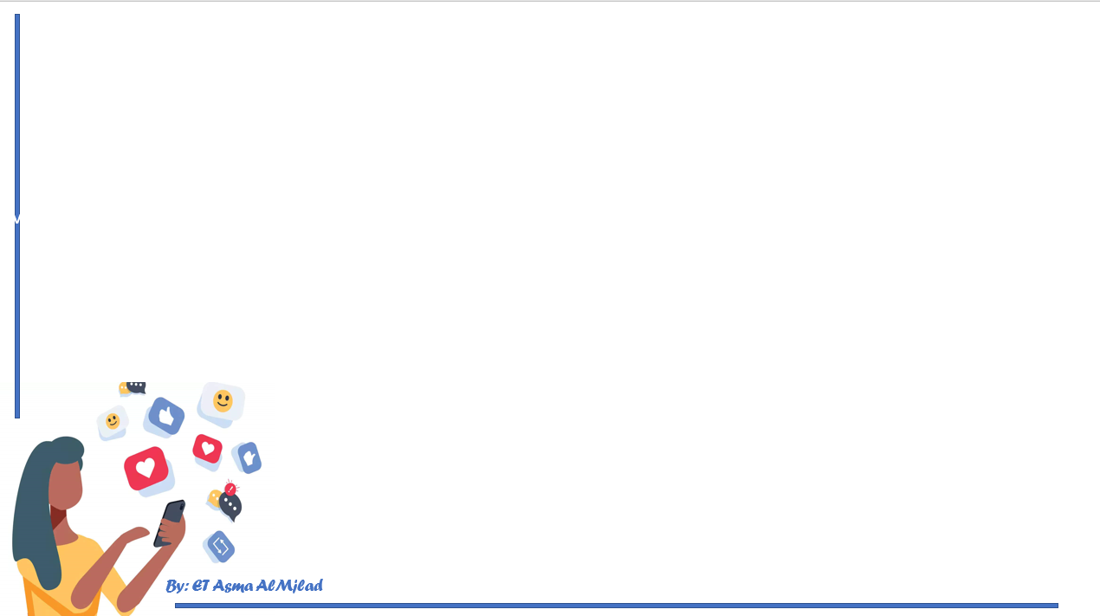

By: ET Asma AlMjlad

