Slide 1


U 4
Grammar p 28
Tr. Nora Khalid

Slide 2

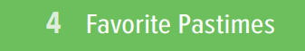
What is the title of the lesson?

Slide 3
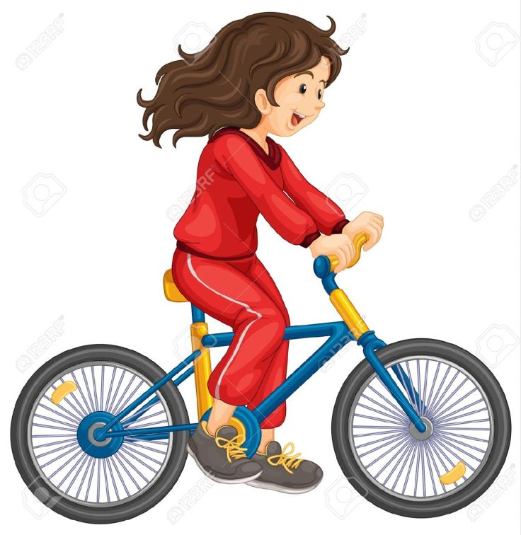
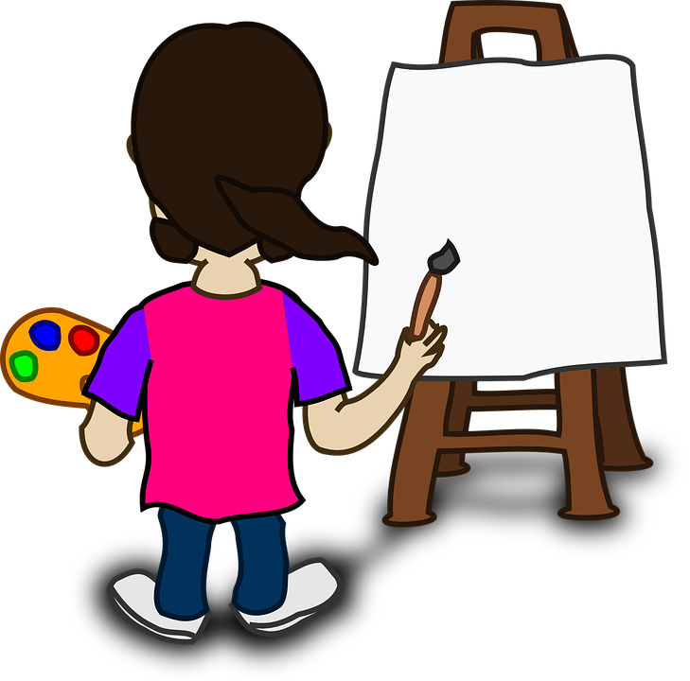




Ride a bike
Read books
Paint
Cook
Play video
games
Swim

Slide 4


How often do you ………?
Cook food?
Read books?
Swim?
Ride a bike?
Play video games?
Paint?

Slide 5

How often do you ………?
Cook food?
Read books?
Swim?
Ride a bike?
Play video games?
Paint?
1 = once
2 = twice
3 = three times
7 days = every day

Slide 6

Always
Often
I …….. read stories.
Usually
Sometimes
Seldom
Never

Slide 7

Always
Often
I …….. go shopping.
Usually
Sometimes
Seldom
Never

Slide 8
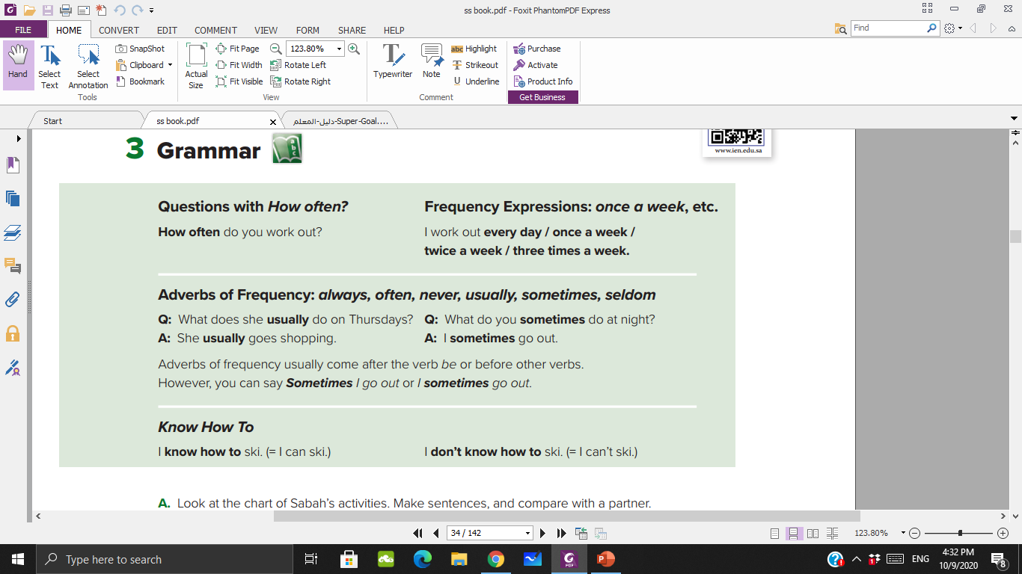

Slide 9
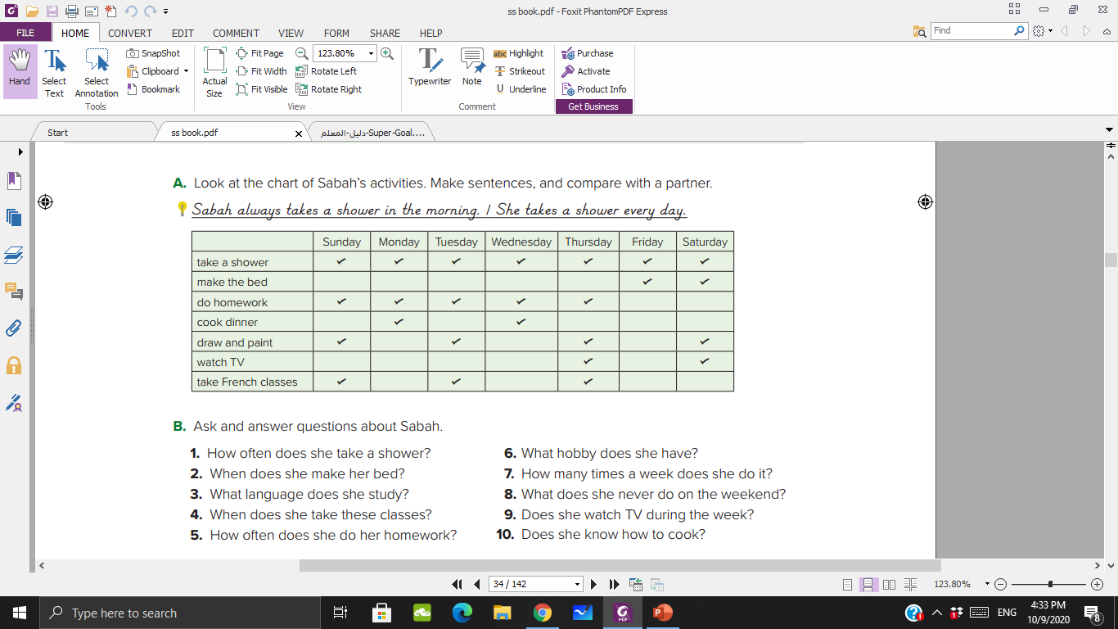
every day
twice a week
five times a week
twice a week
four times a week
twice a week
three times a week

Slide 10
Every day
Twice a week
Once a week
Three times a week
Four times a week
Always
Usually
often
sometimes
seldom

Slide 11
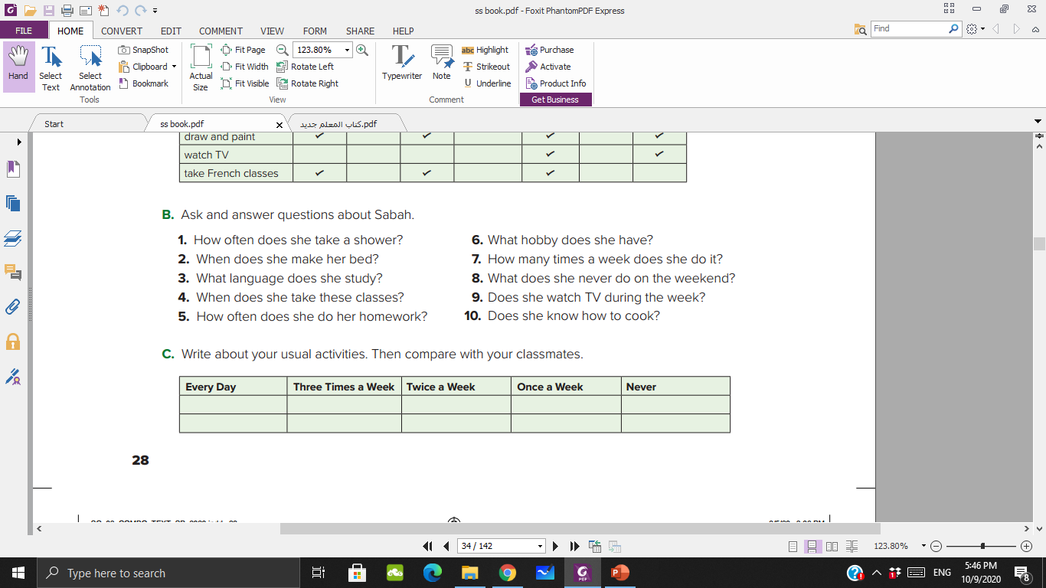

Slide 12
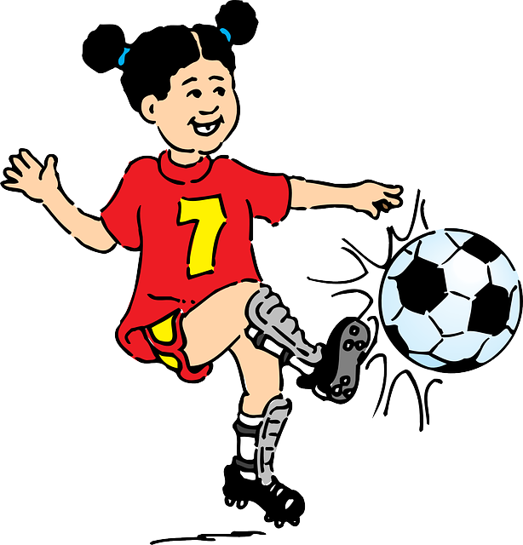

Know to …….
She can play football..
He can cook..

Slide 13

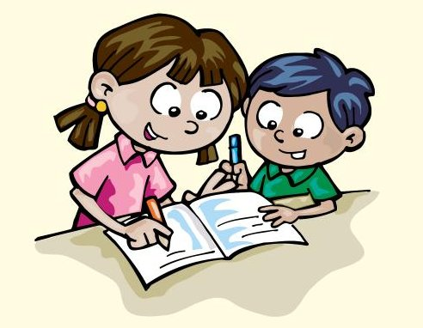
Know to …….
He can take photos..
They can write stories..

Slide 14

Ask your classmates how they spend their free time.
A: What’s your favorite pastime?
B: Text messaging.
A: How often do you do it?
B: I do it all the time.

Slide 15
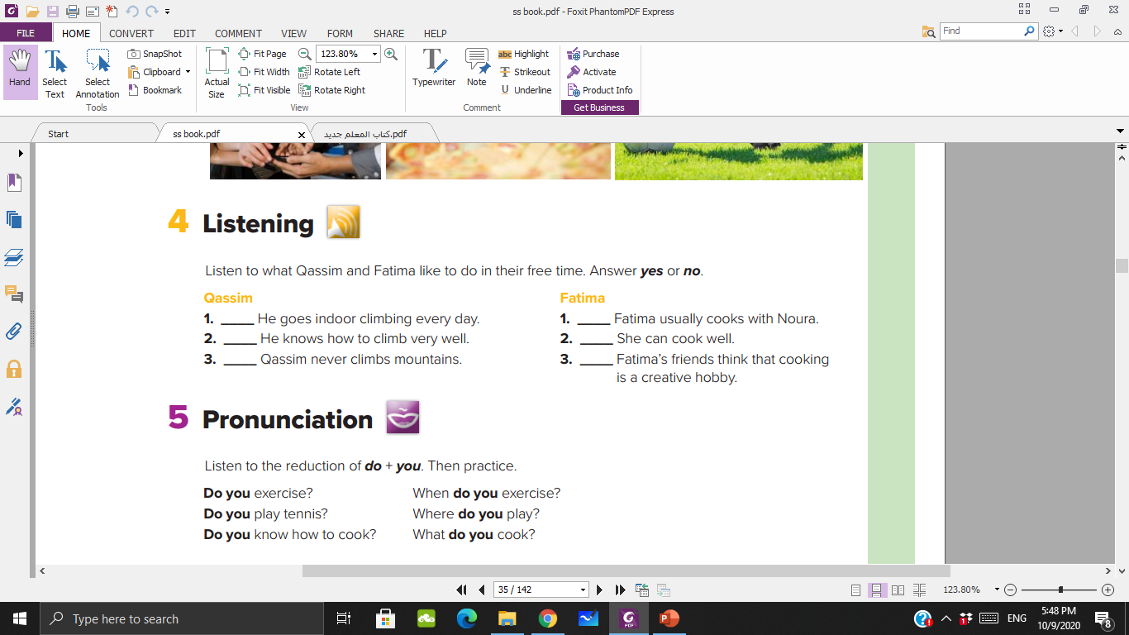
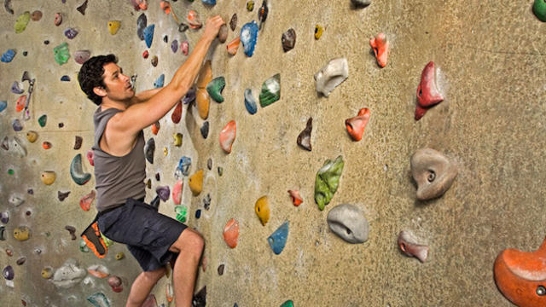

Slide 16
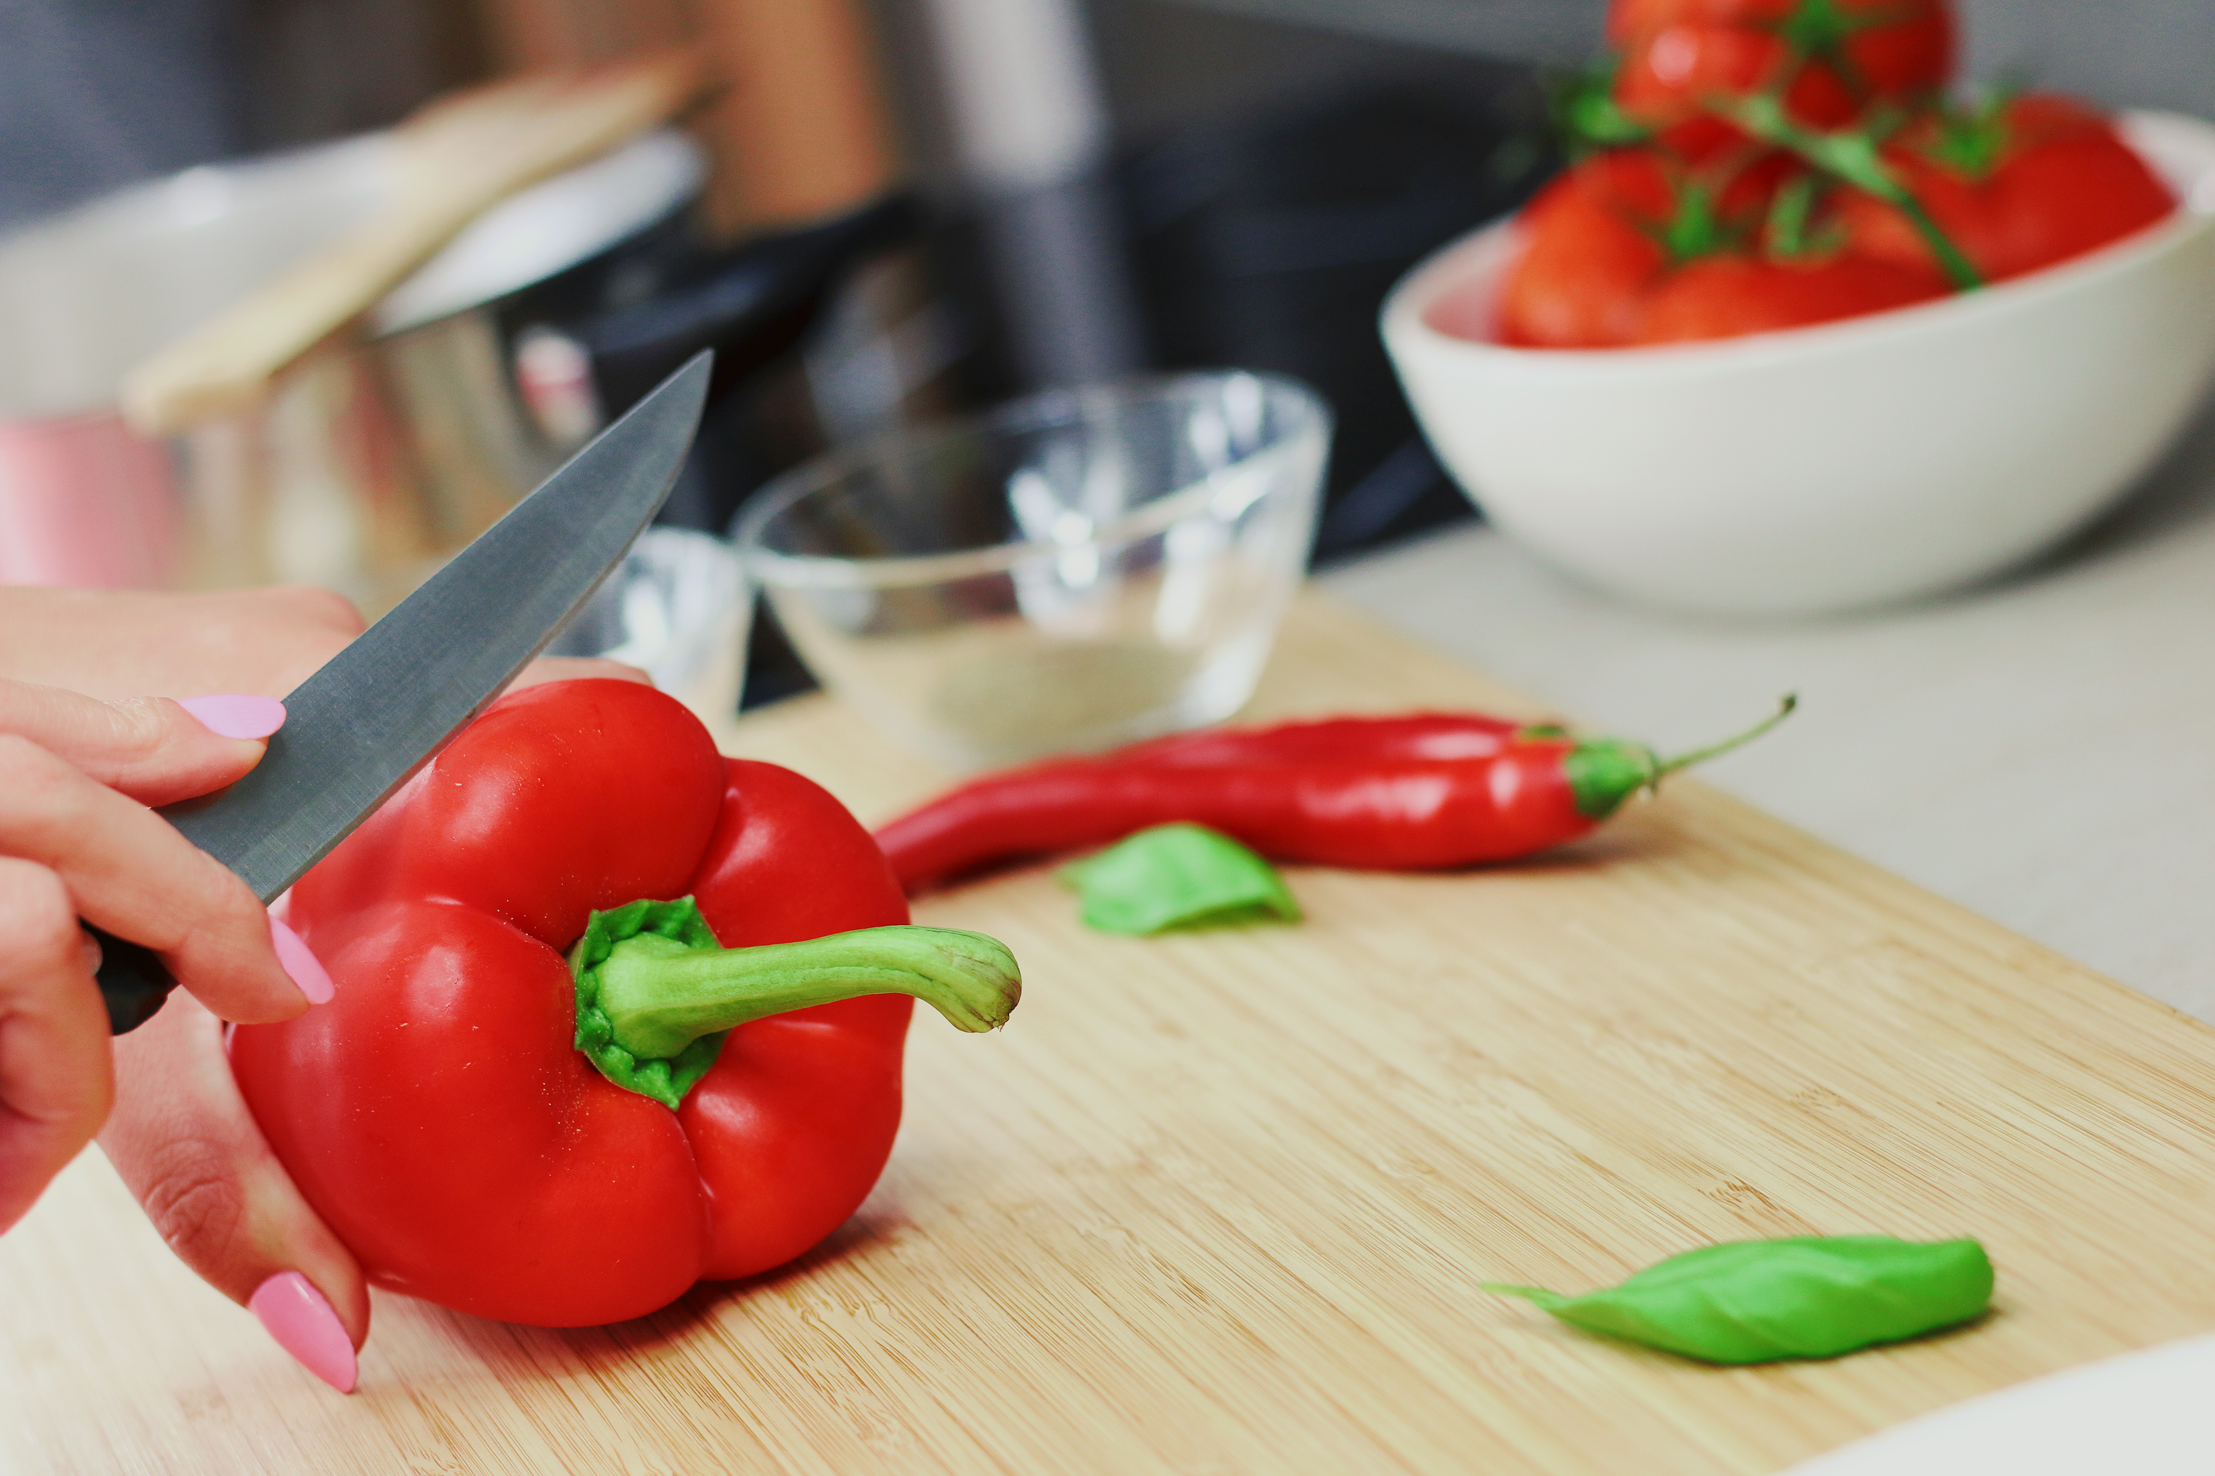

Slide 17

no
yes
no
yes
yes
no

Slide 18
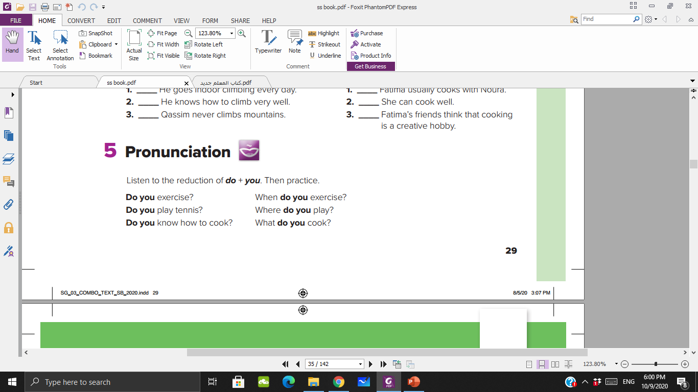

Slide 19
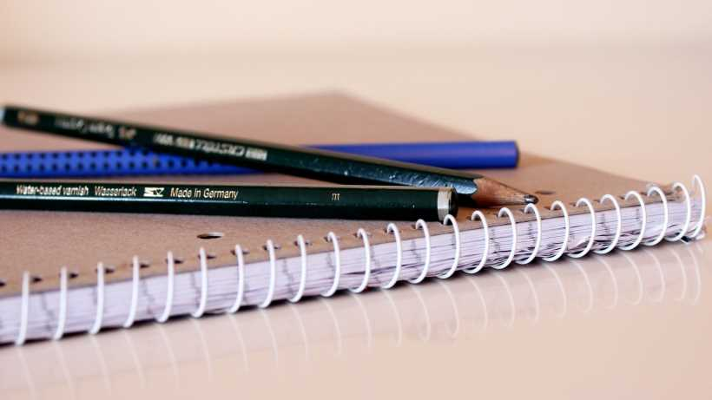
P 102- 103

Slide 20

https://www.liveworksheets.com/1-xv1326586qs

