Slide 1

Form, meaning, and function
Nora Khalid

Slide 2
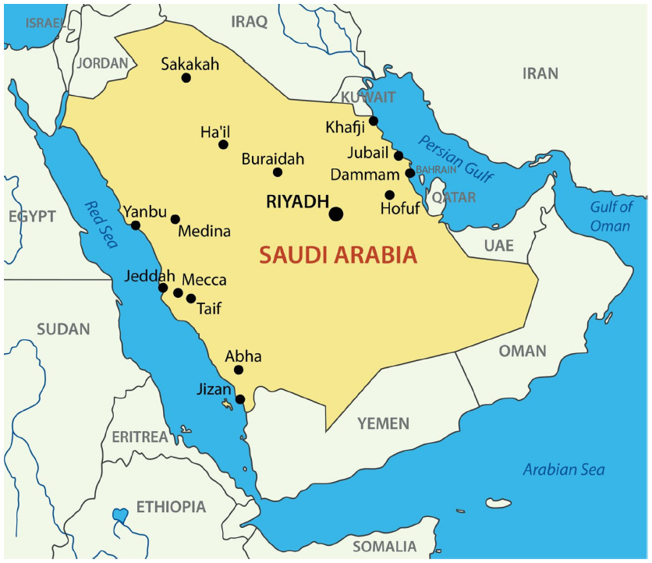
Jeddah is near Makkah
Ha’il is far from Abha

Slide 3
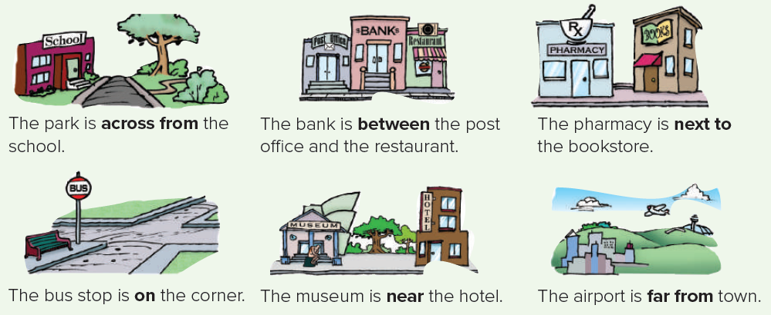
Read:

Slide 4
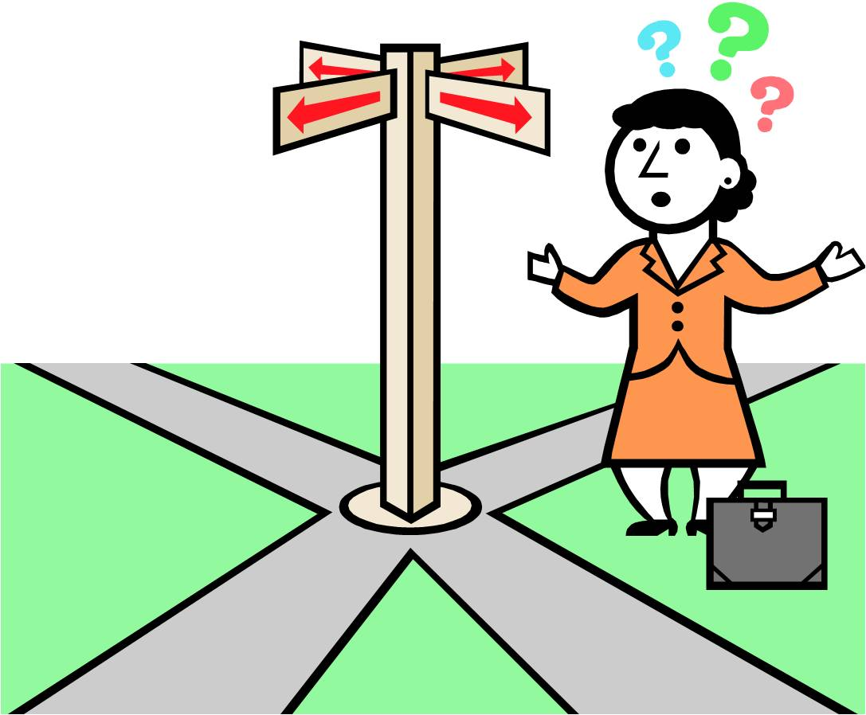



Directions
Turn right
Turn left
Turn straight ahead

Slide 5
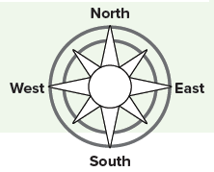
Directions

Slide 6
Directions
Ha’il is north of Makkah
Ha’il is south of Skaka

Slide 7
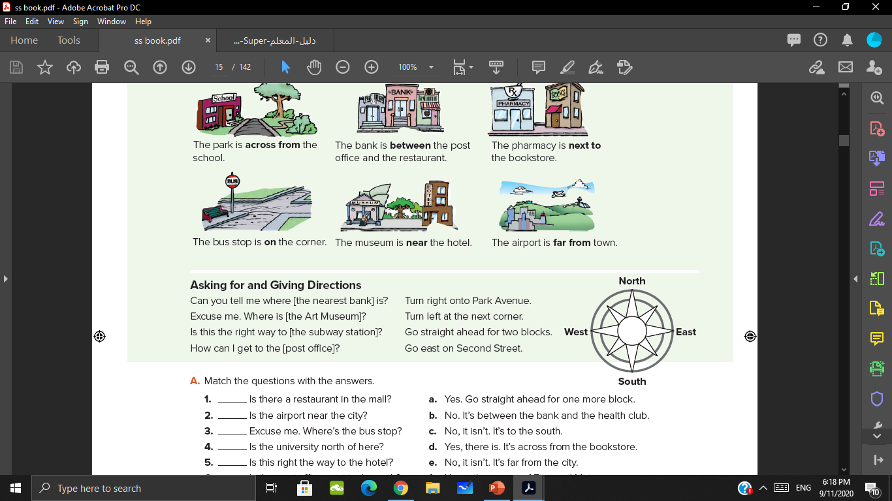
Read:

Slide 8
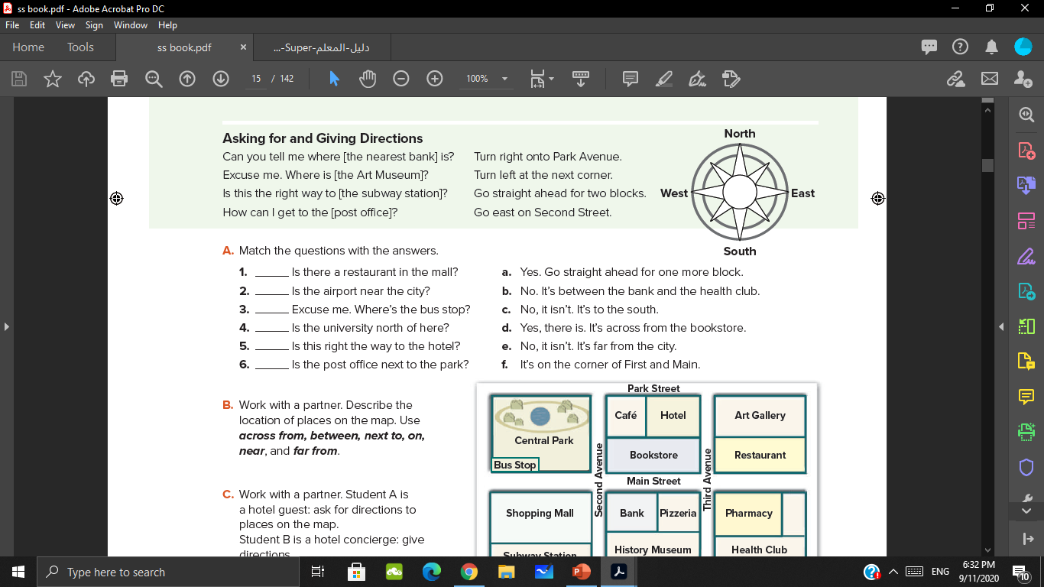
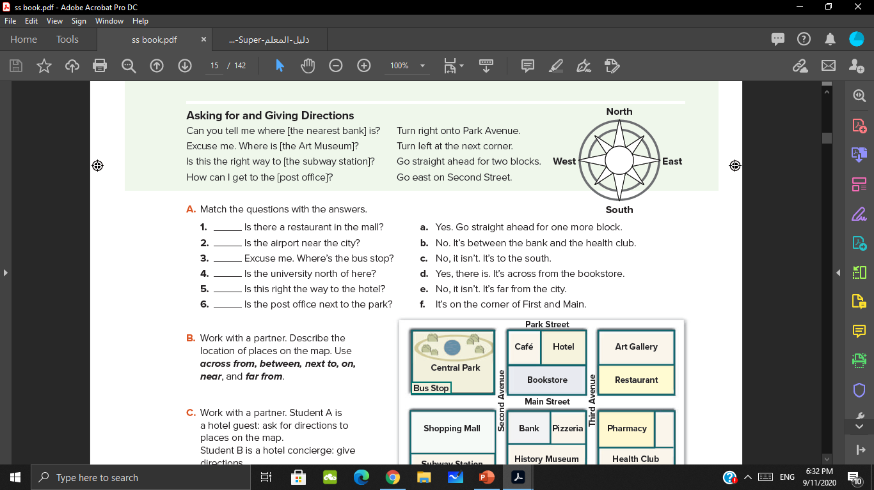
d
e
f
c
a
b

Slide 9
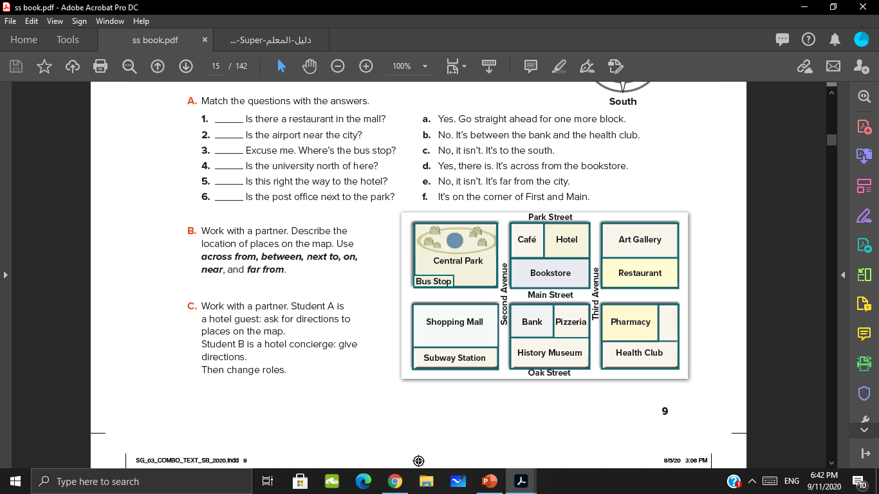
The café is next to the hotel
The bus stop is across from the shopping mall
The pizzeria is between the bank and the pharmacy

Slide 10
The restaurant is near the hotel
The bank is on the corner of Main and Second

Slide 11
The subway station is not far from the hotel

Slide 12
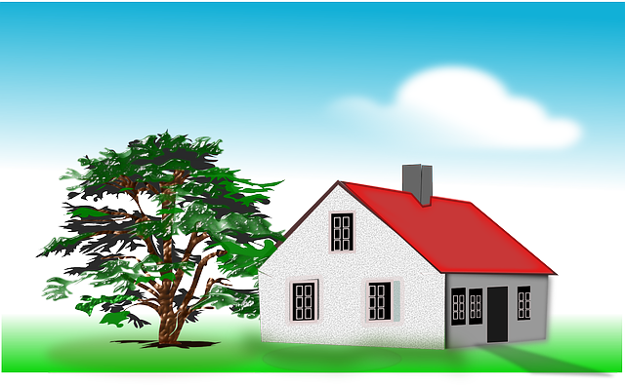
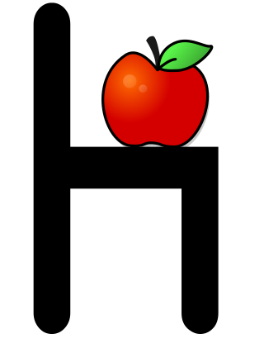
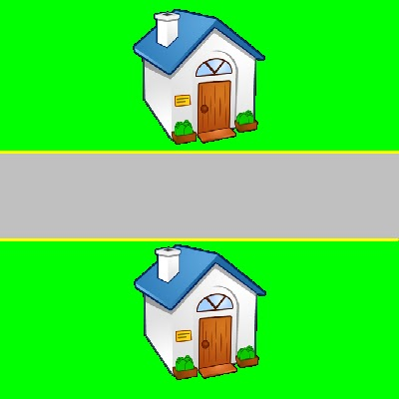
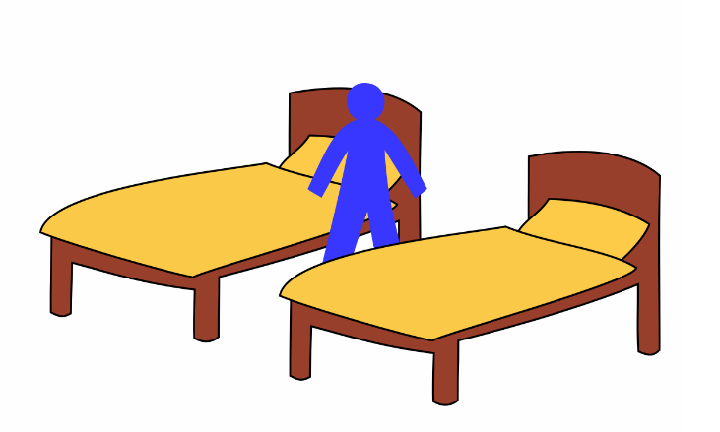
Role play
The house – the tree
The apple– the chair
My house – my friend’s house
The boy– the beds

Slide 13
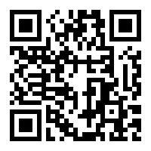
https://wordwall.net/resource/4235878

Slide 14


