Slide 1

Reading p ( )
Nora Khalid

Slide 2
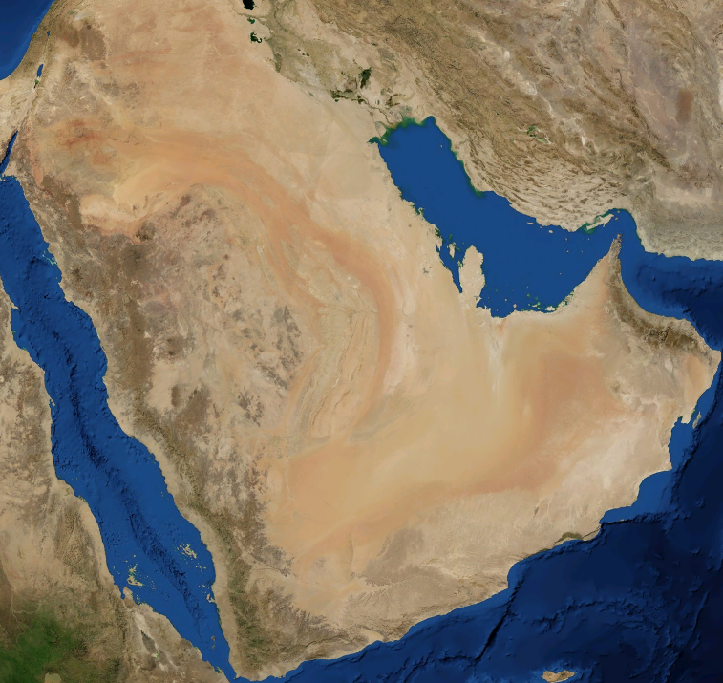


Suggest the best places in Saudi Arabia for the following visitors:
Backpackers in their 20s
A businessman
A family with small children
A retired couple

Slide 3
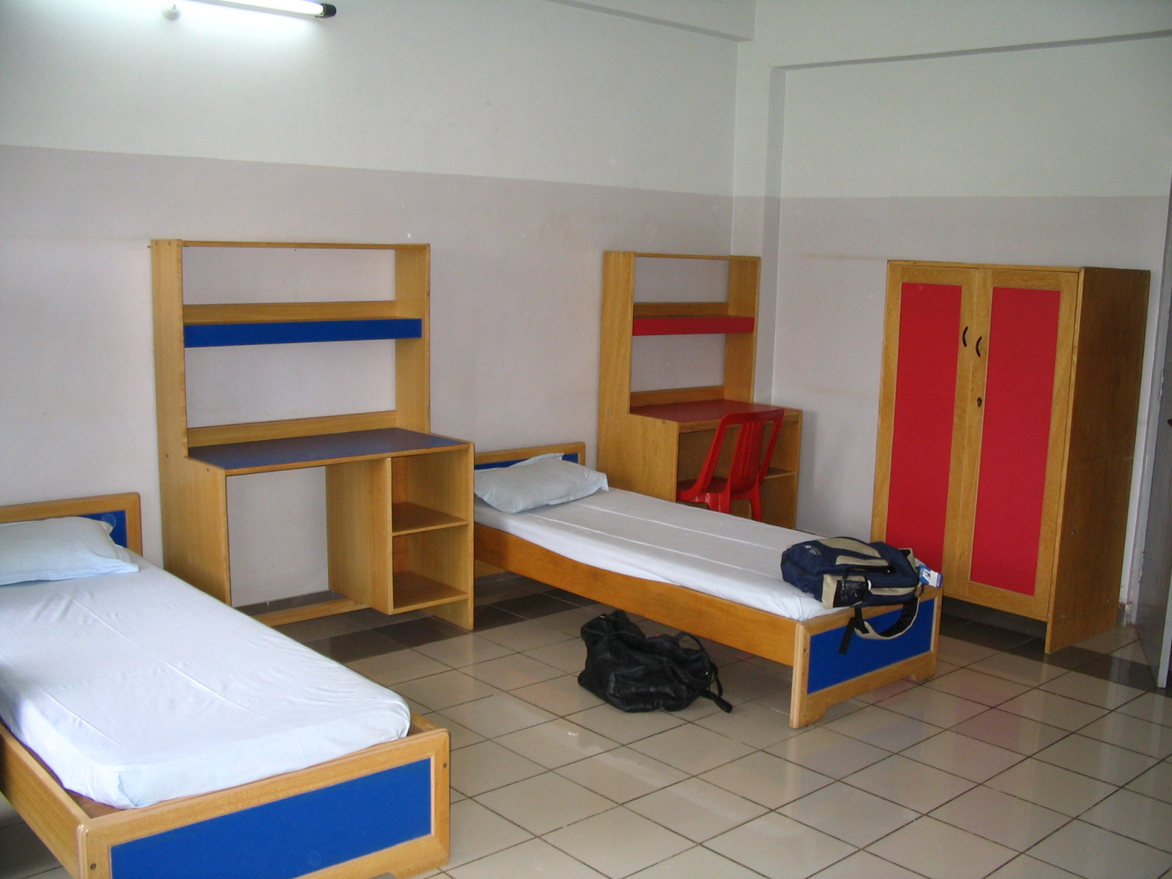


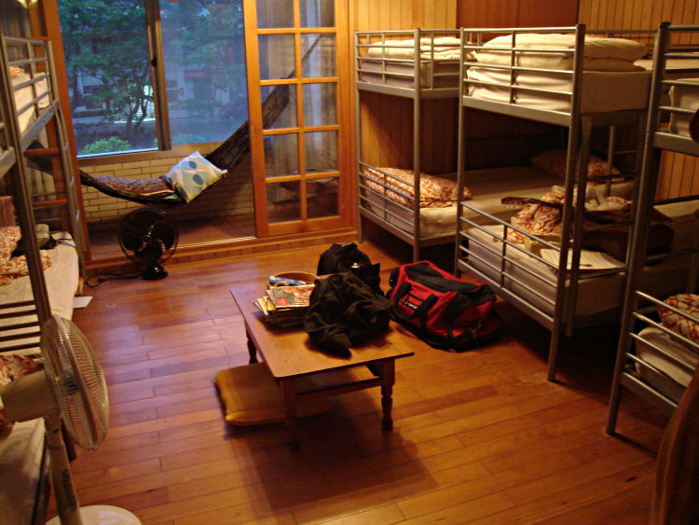
Look at these pictures, what’s the difference?
Hostel
Hotel
Hotel

Slide 4



What do you know about “youth hostels”?
A youth hostel is a place where people can stay cheaply when they are travelling.
Hostel

Slide 5
What do you know about “S.A.Y.H.A”?
http://sayha.org.sa/index.php

Slide 6
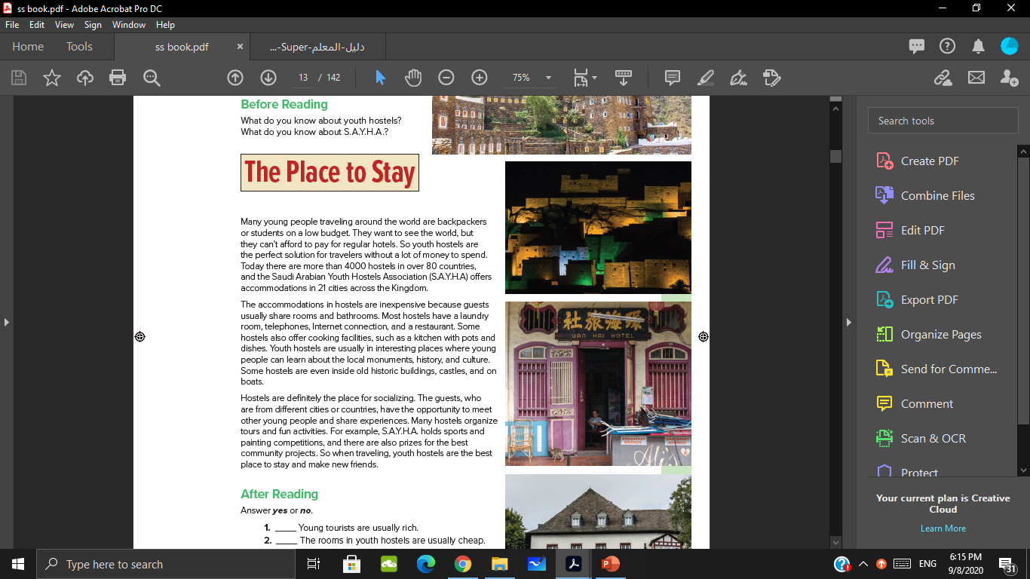

listen & read

Slide 7
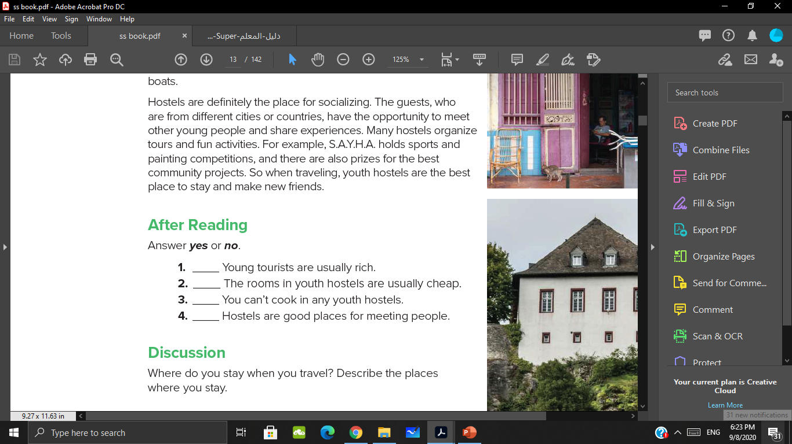
Read the sentences

Slide 8
Underline the part of the reading that provide the answers.

Slide 9
Answer!
No
yes
No
yes

Slide 10

Where do you stay when you travel? Describe the places where you stay.

Slide 11


