Slide 1


Slide 2



Slide 3
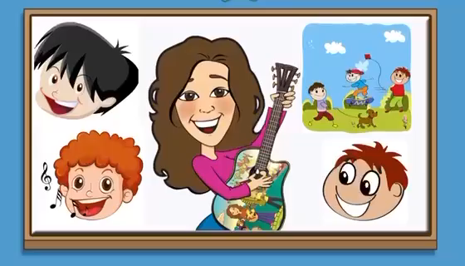

Slide 4


Slide 5


She has……
a brown hair and black eyes

Slide 6

He has……
a short and black hair and black eyes

Slide 7
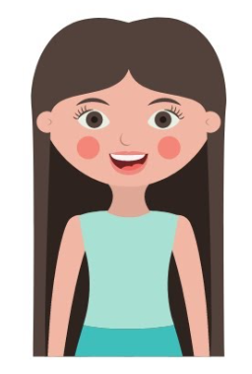
She has……
a long hair

Slide 8
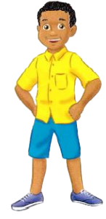
He is wearing……
a yellow shirt, blue short and blue shoes.

Slide 9
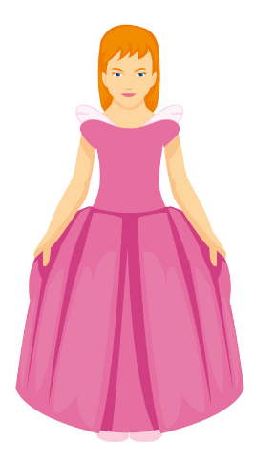
She is wearing……
a pink dress

Slide 10
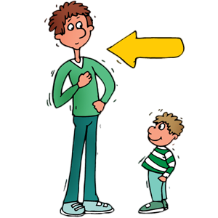
He is ……
tall

Slide 11


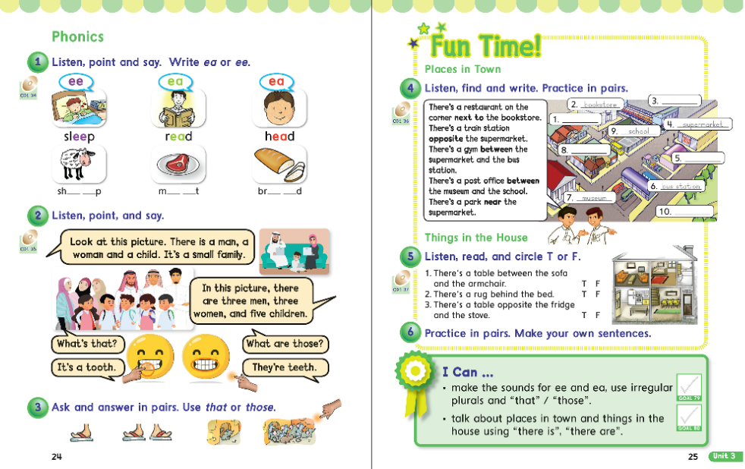
24
25

Slide 12
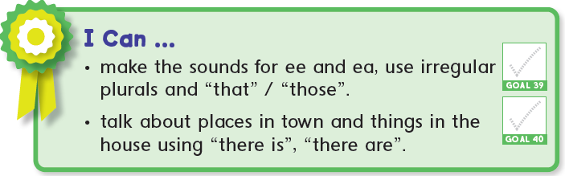

Slide 13
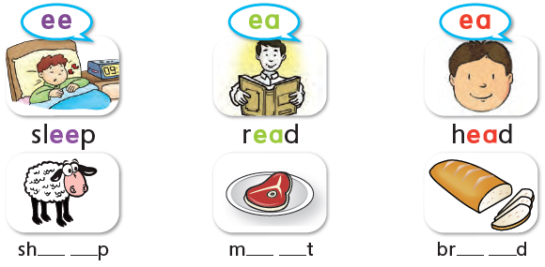

1
Listen, point and say. Write ea or ee.
e e
e a
e a

Slide 14
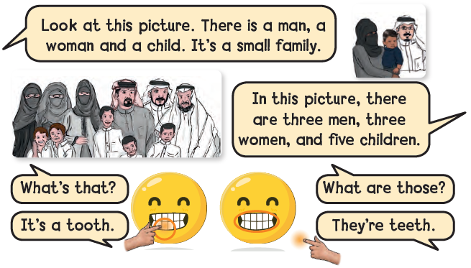

2
Listen , point , and say

Slide 15

There is a
There are

Slide 16

There is a
There are

Slide 17

There is a
There are

Slide 18


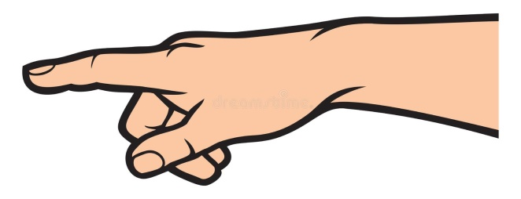
What’s that?
What are those

Slide 19
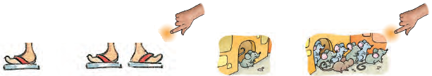
3
Ask and answer in pairs. Use that or those

Slide 20
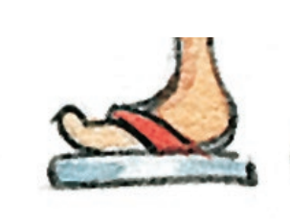
1- What is that?
1- What is that?
1- What is that?
2- What are those?
foot
It is a foot

Slide 21
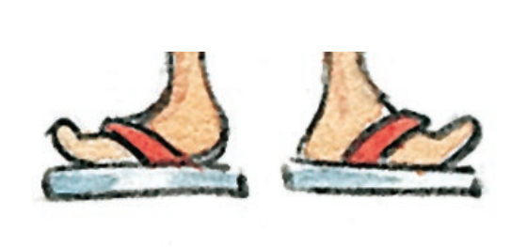
1- What is that?
1- What is that?
2- What are those?
2- What are those?
feet
They are feet

Slide 22
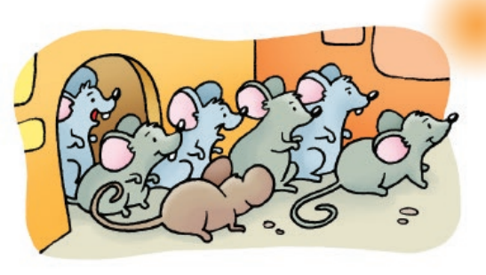
1- What is that?
1- What is that?
2- What are those?
2- What are those?
mice
They are mice

Slide 23
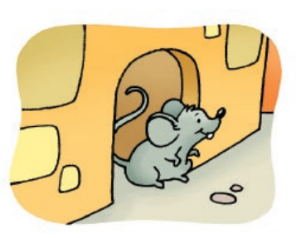
1- What is that?
1- What is that?
1- What is that?
2- What are those?
mouse
It is a foot

Slide 24

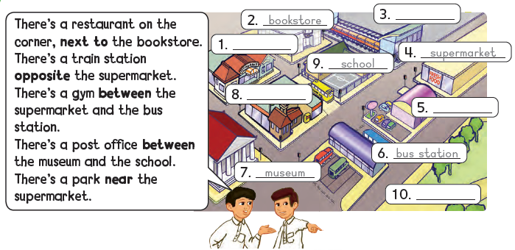
Places in town
Listen, find and write. Practice in pairs.
4

Slide 25

3.Train station
1.restaurant
8. Post office
gym
park

Slide 26
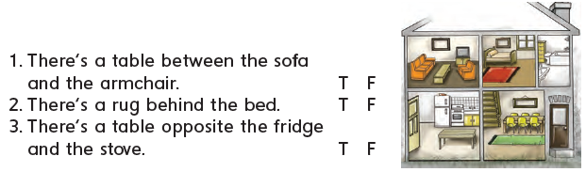

5
Things in the house
Listen, read , and circle T or F
6
Practice in pairs. Make your own sentences

Slide 28


Slide 29


Slide 30


Slide 31


Slide 32
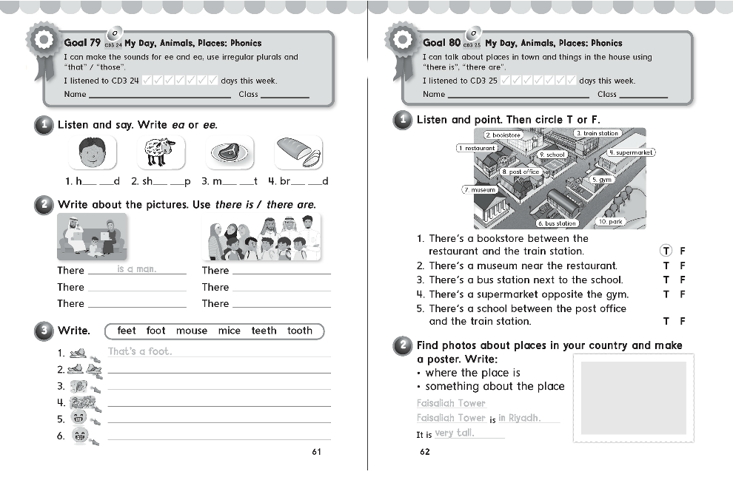
61
62

Slide 33

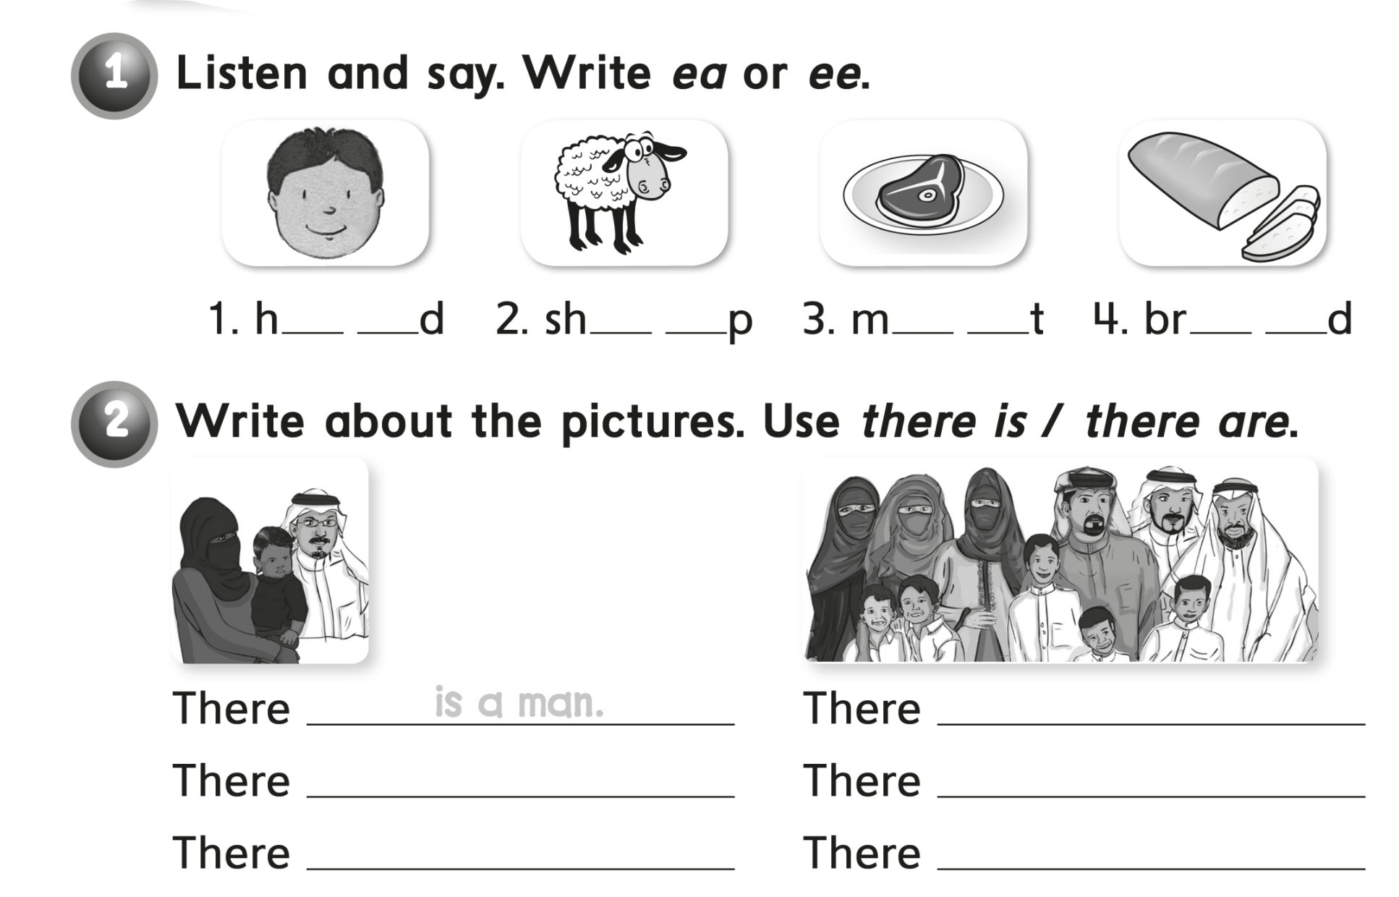
e a
e e
e a
e a
are three men
is a woman
are three women
is a child
are five children

Slide 34
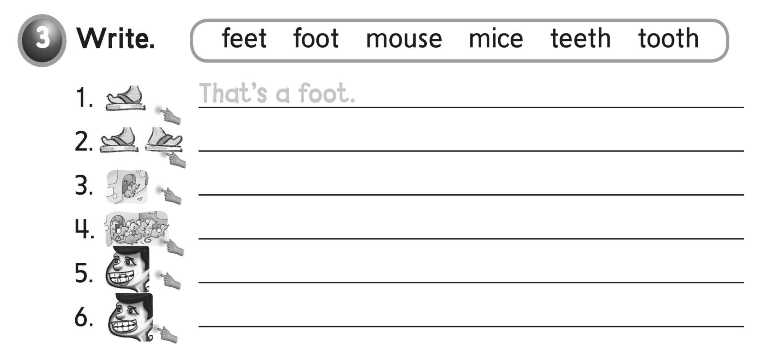
These are feet
That’s a mouse
These are mice
That’s a tooth
These are teeth

Slide 35
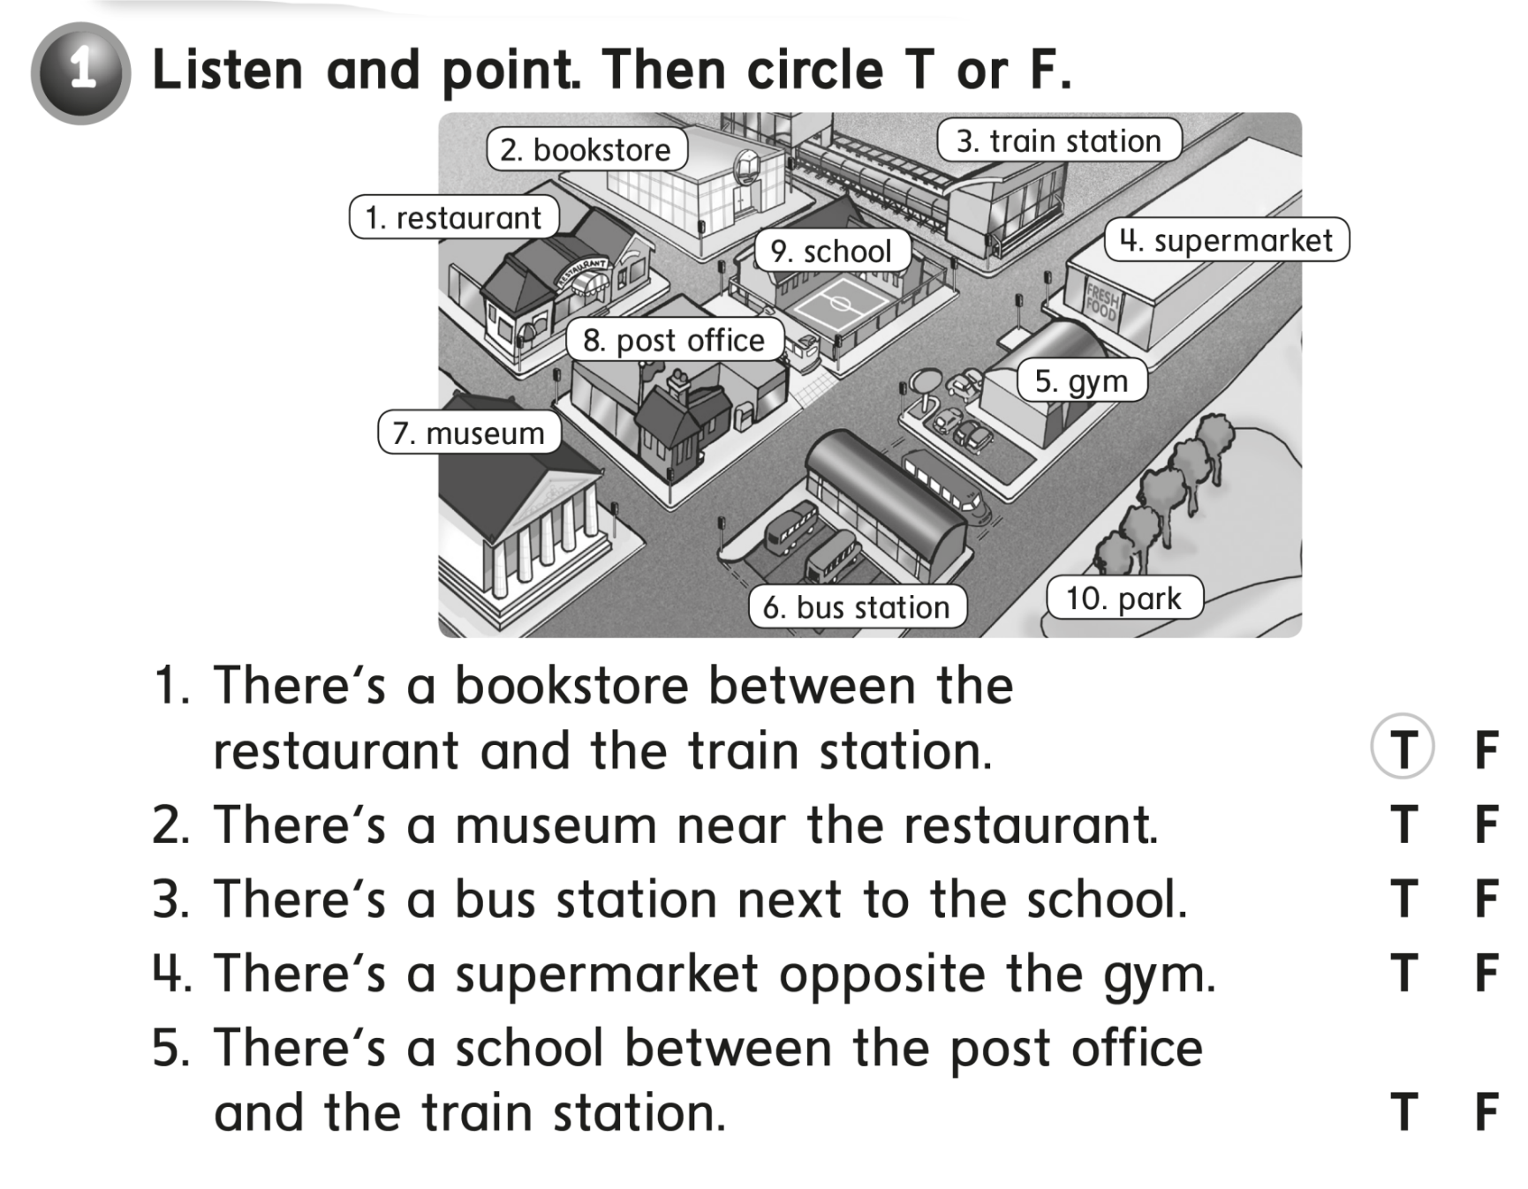


Slide 36
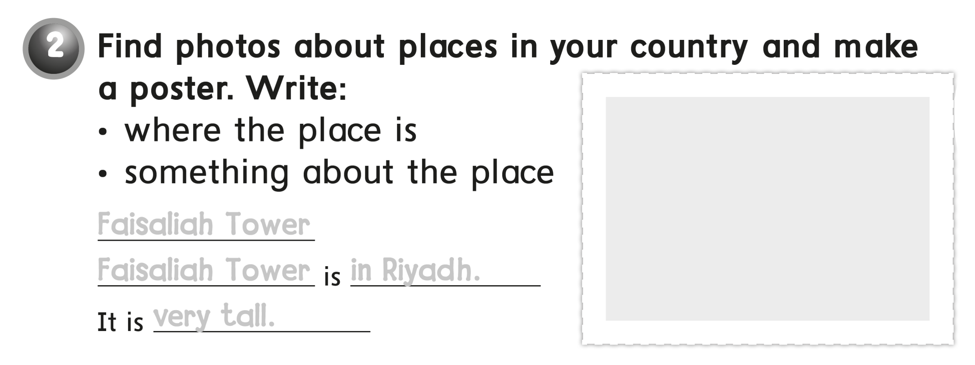
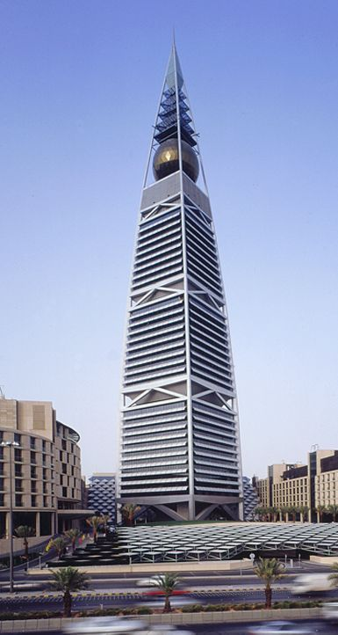
Faisaliah Tower
Faisaliah Tower in Riyadh
very tall

