Slide 1
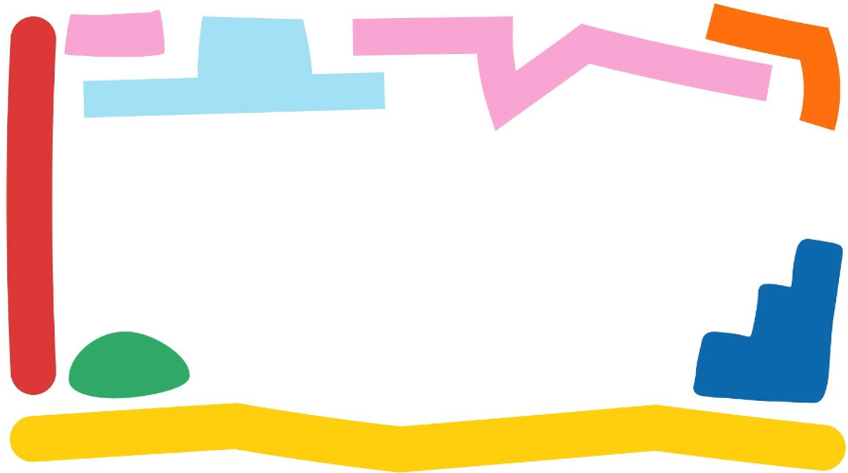


Slide 2
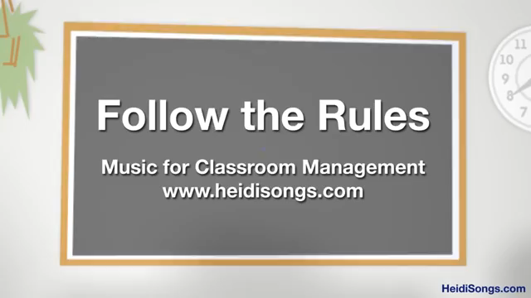

Slide 3


Slide 4

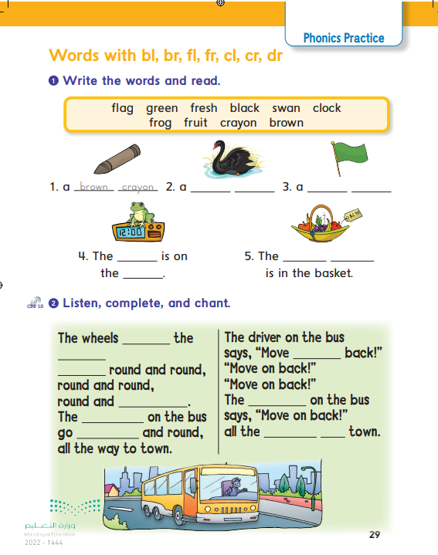
29

Slide 5

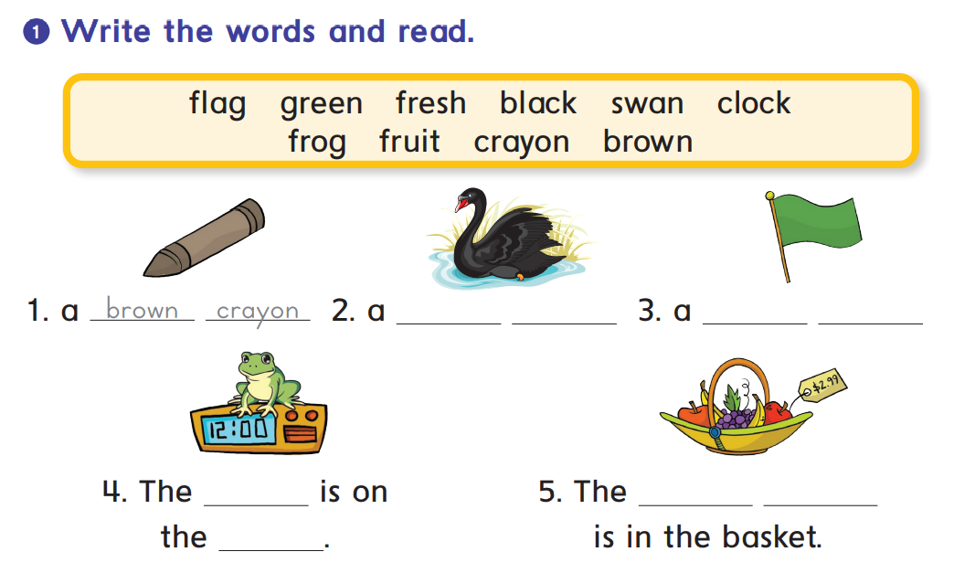
black
swan
green
flag
frog
fresh
fruit
clock

Slide 6
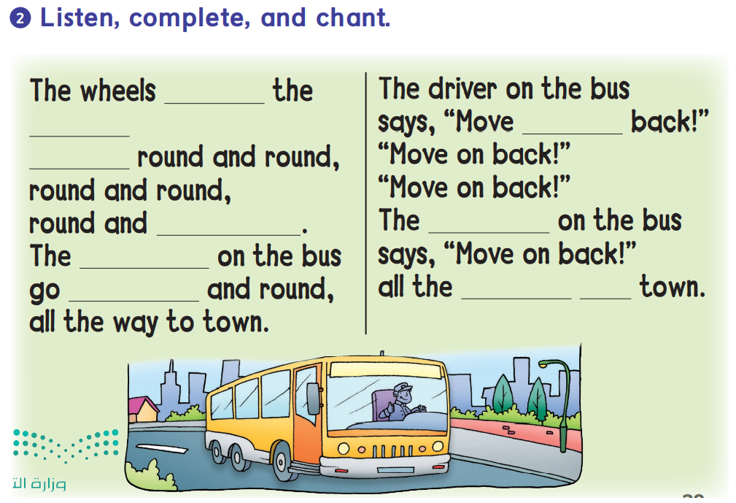

on
bus
on
go
round
driver
wheels
round
way
to

Slide 7
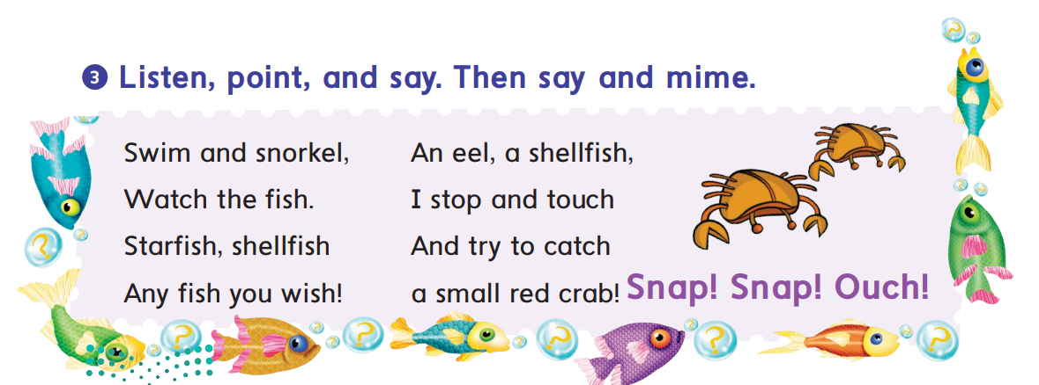

Slide 8

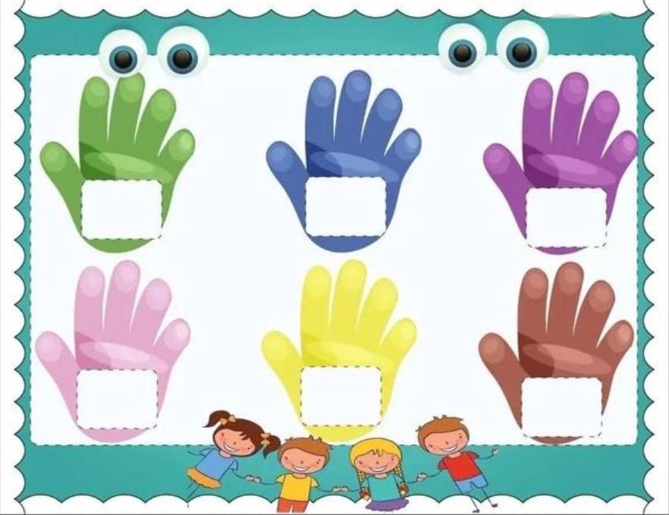
High five the correct word
cl
br
cr
dr
bl
fl
*Two students game. Teacher says randoms words from the picture

Slide 9
High five the correct sound
cr
br
dr
cl
fr
bl
*Two students game. Teacher says randoms words from the picture

Slide 10

Awesome
job

