Slide 1



Slide 2
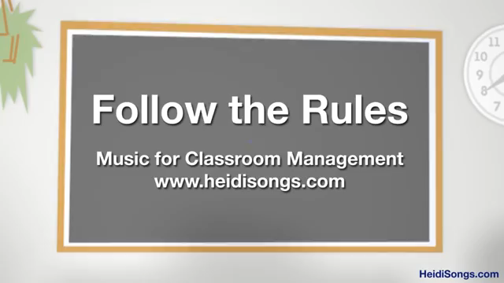

Slide 3


Slide 4

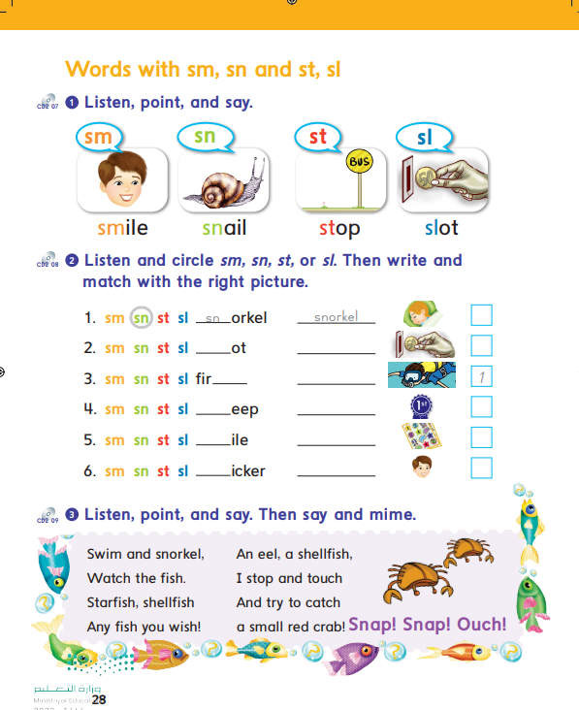
28

Slide 5


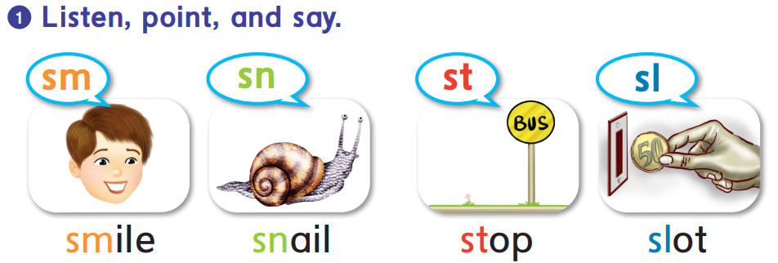

Slide 6
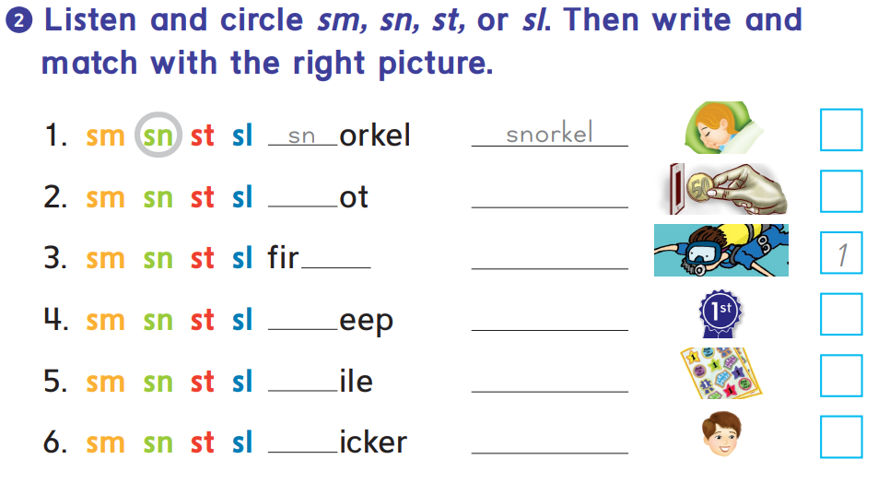
4
sl
slot
2
st
first
sl
sleep
3
sm
smile
6
st
sticker
5

Slide 7
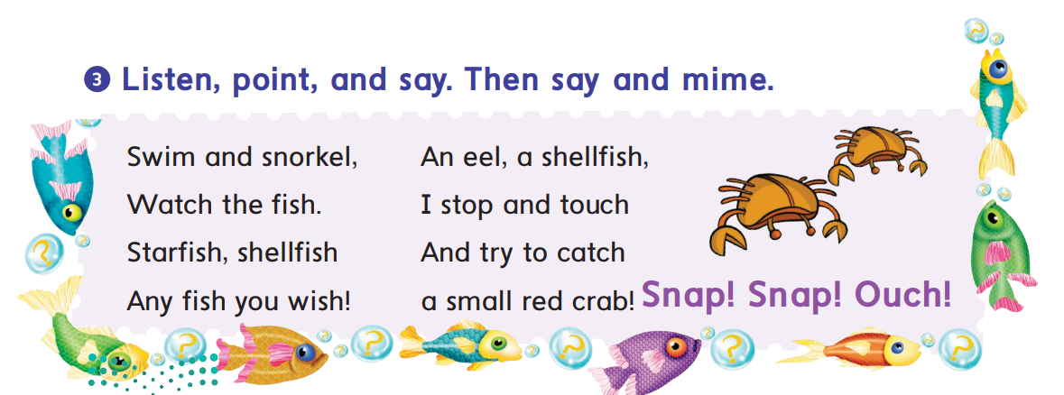

Slide 8

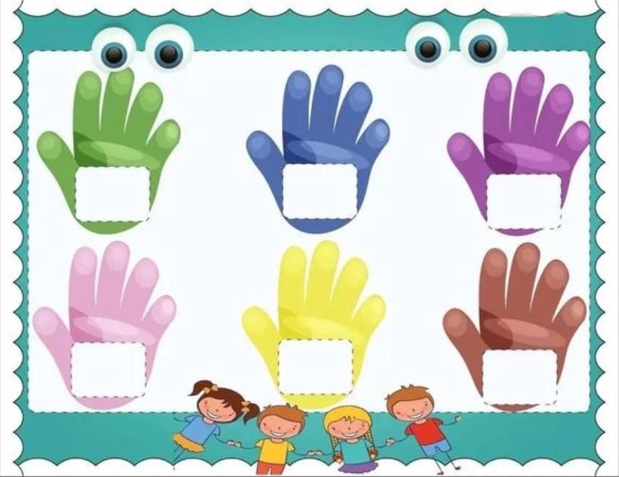
High five the correct sound
sl
st
sn
sh
sm
wh
*Two students game. Teacher says randoms words from the picture

Slide 9

Awesome job

