Slide 1



Slide 2
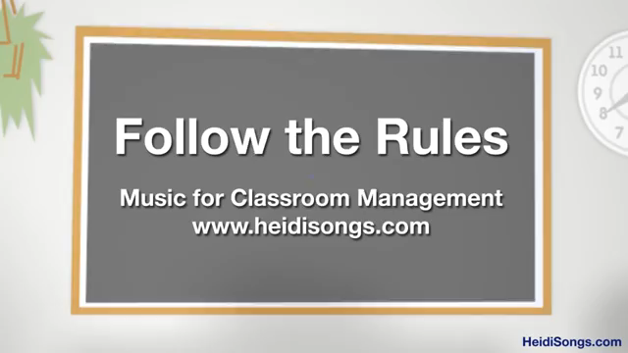

Slide 3


Slide 4

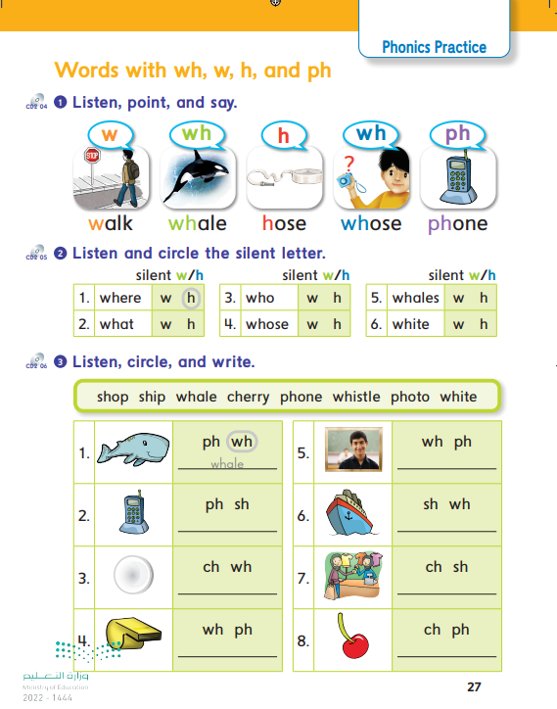
27

Slide 5


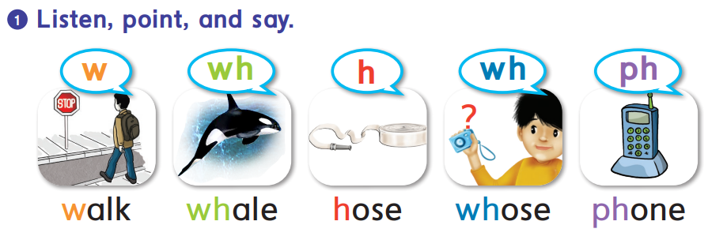


Slide 6
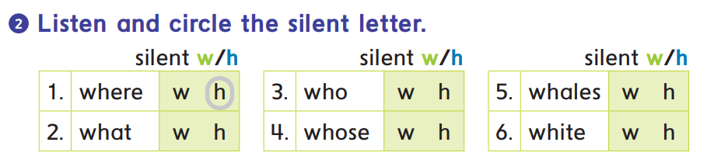

Slide 7
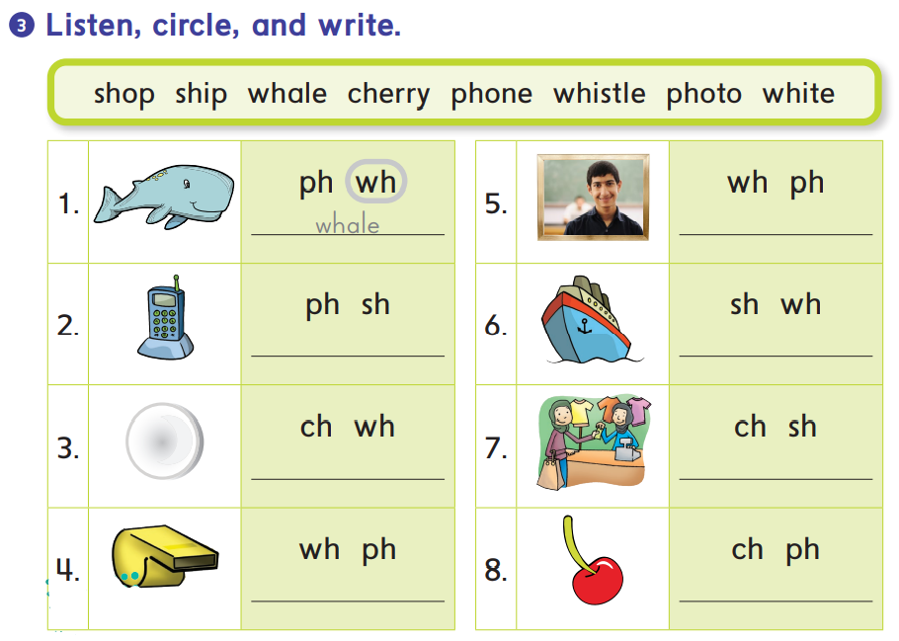
photo
phone
ship
white
shop
whistle
cherry

Slide 8

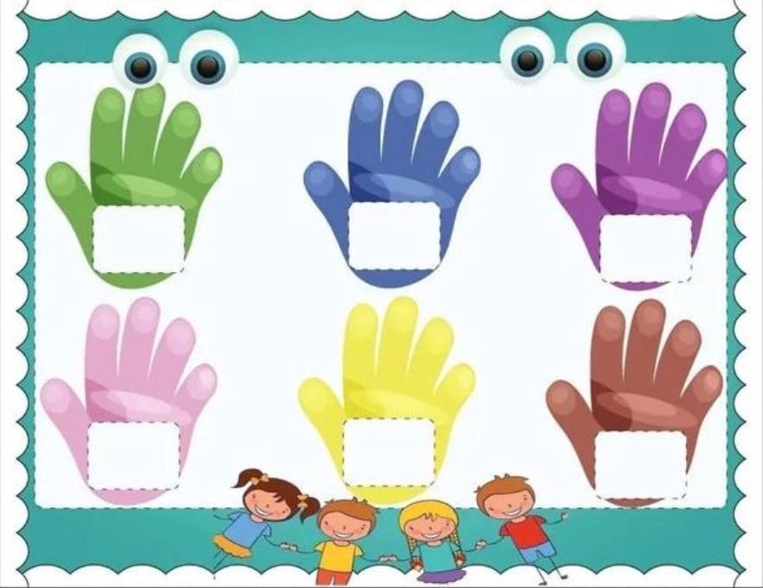
High five the correct word
wh
whale
h
hose
w
walk
ph
phone
sh
ship
ch
cherry
*Two students game. Teacher says randoms words from the picture

Slide 9

Awesome
job

