Slide 1



Slide 2
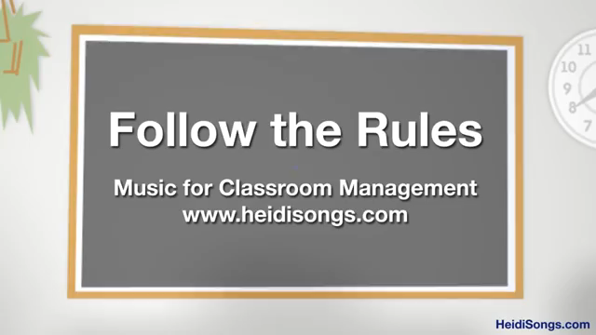

Slide 3


Slide 4

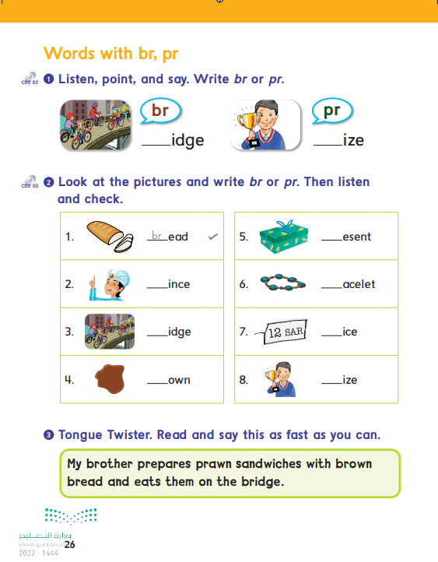
26

Slide 5



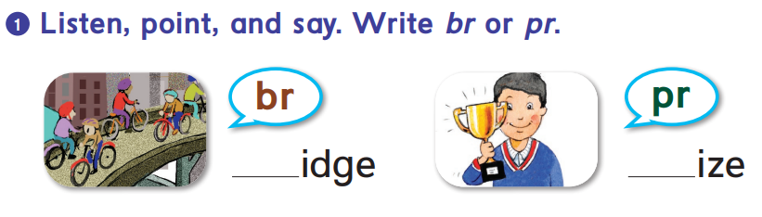
br
pr

Slide 6
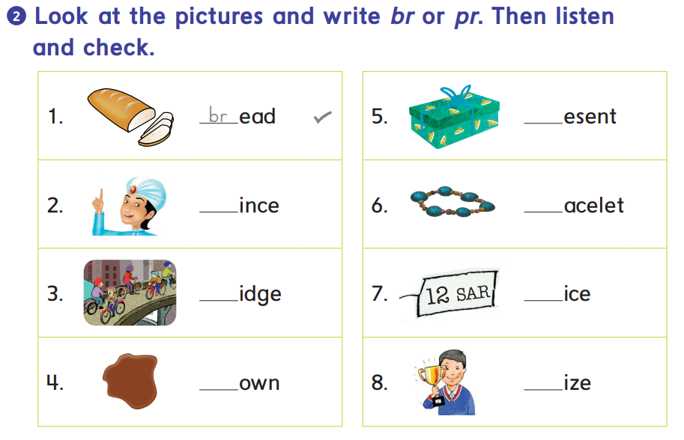
pr
pr
br
br
pr
br
pr

Slide 7
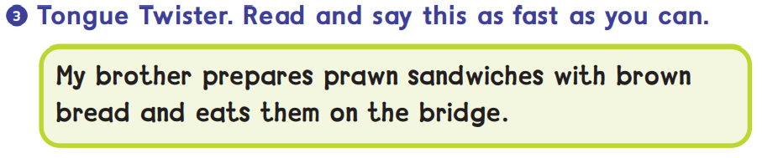

Slide 8

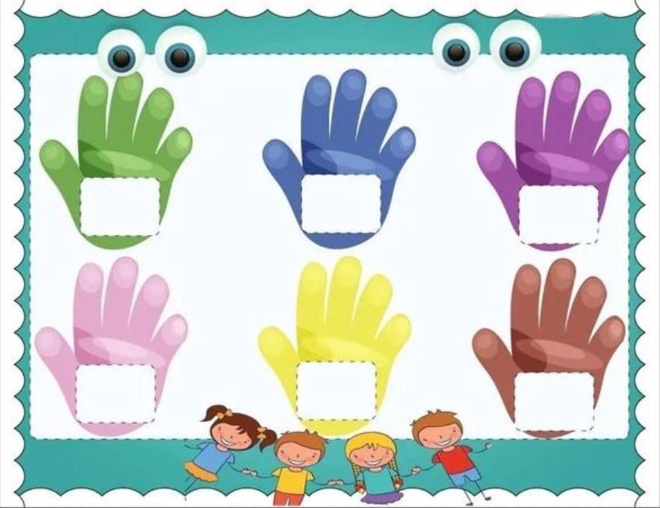
High five the correct word
brown
bread
price
present
bridge
prince
*Two students game. Teacher says randoms words from the picture

Slide 9

Awesome
job

