Slide 1


لعبة كنز المعلومات
Revision units 1+2
MG5
T. Entisar Al-Obaidallah

Slide 2
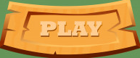
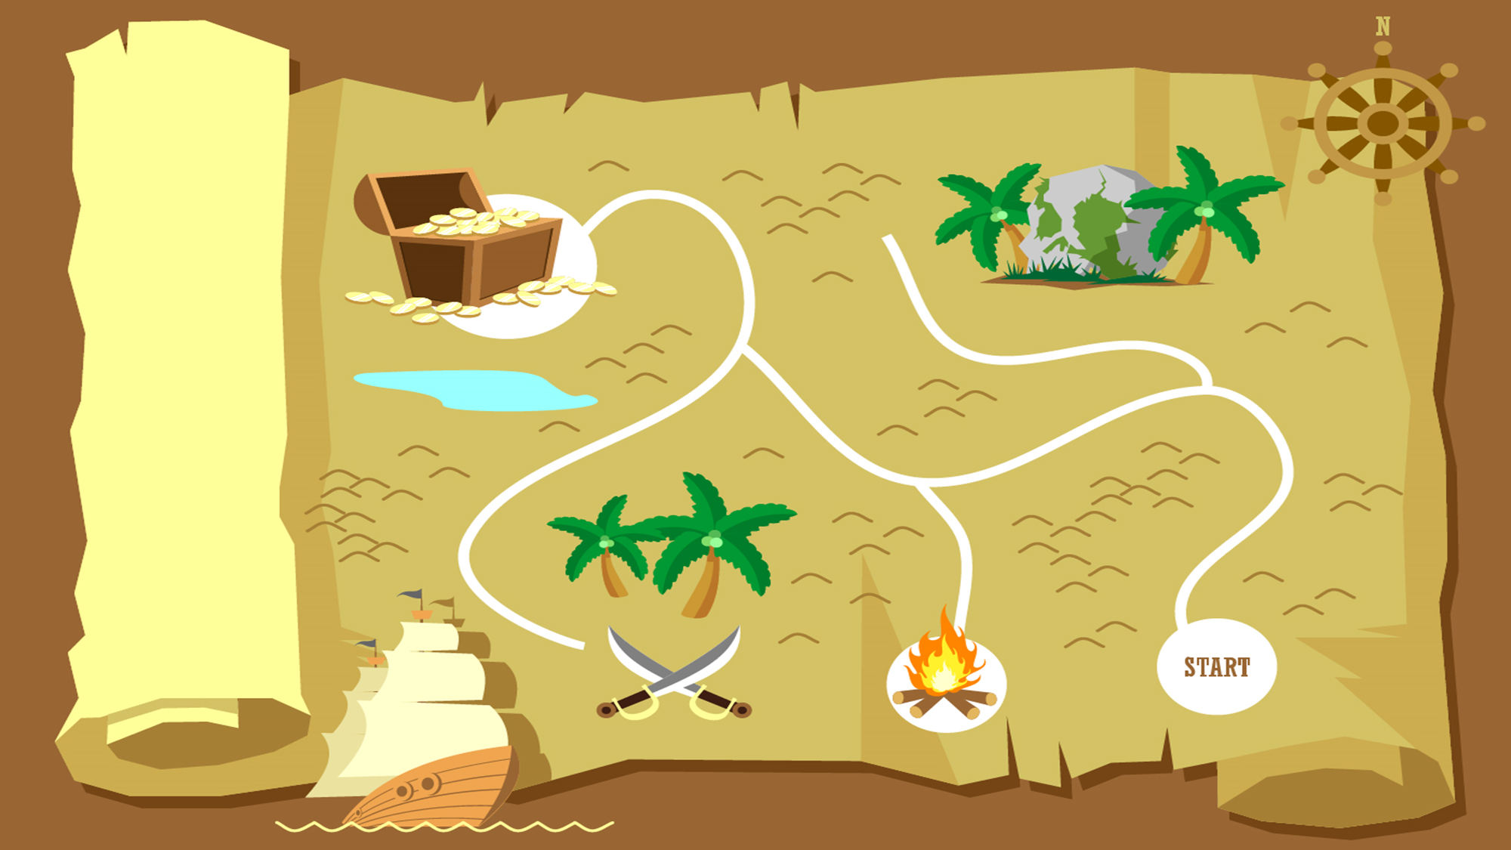
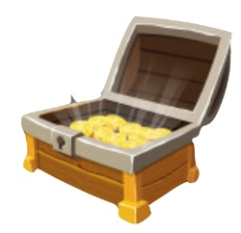
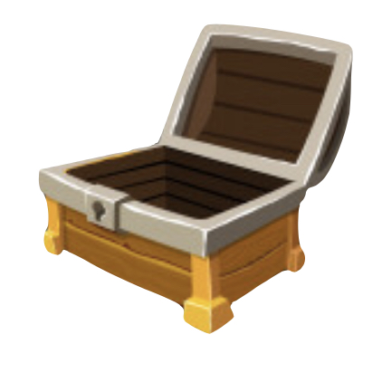
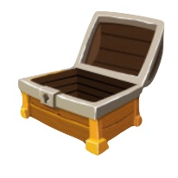
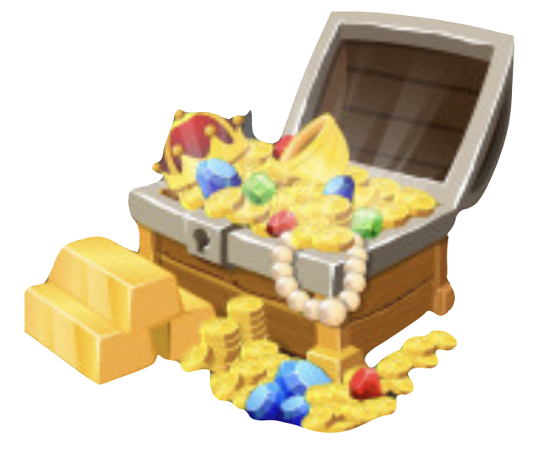
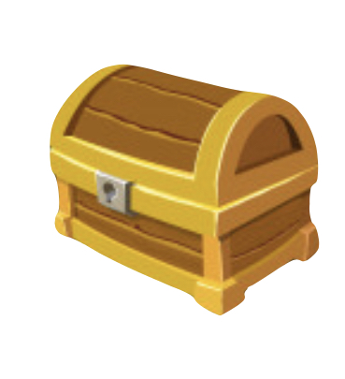
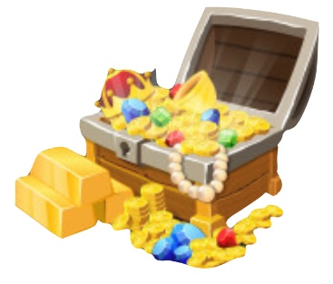

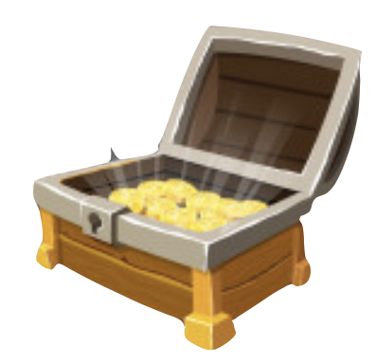

Slide 3
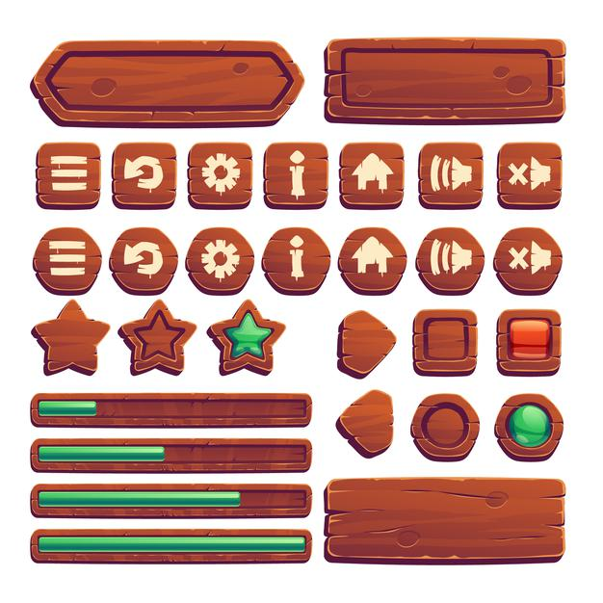

Would you like ….cup of coffee ?
another
other
others

Slide 4
I ……..sleeping all weekend long.
use to
am used to
used to

Slide 5



Slide 6



famous
cash
causing great fear
legendary
money
fearsome
إجابة خاطئة

Slide 7



Choose the correct word for
this picture:
prize
competition

Slide 8
I haven't finished my project…..
yet
already
so far

Slide 10
Lions , Tigers and bears are examples of …...............animals .
( Choose the correct answer: )
predators
pets

Slide 12
I …….try this cake, it's delicious .
does
do
did

Slide 13
urban
flee
poverty
rural
stay
wealth
إجابة خاطئة

Slide 15
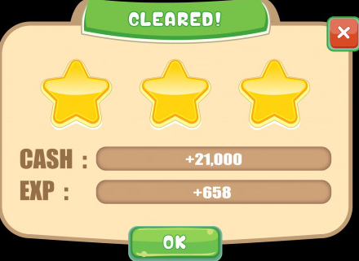

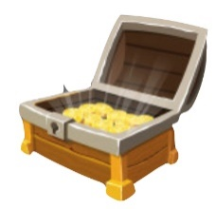


ممتاز لقد حصلت على الكنز

