Slide 1
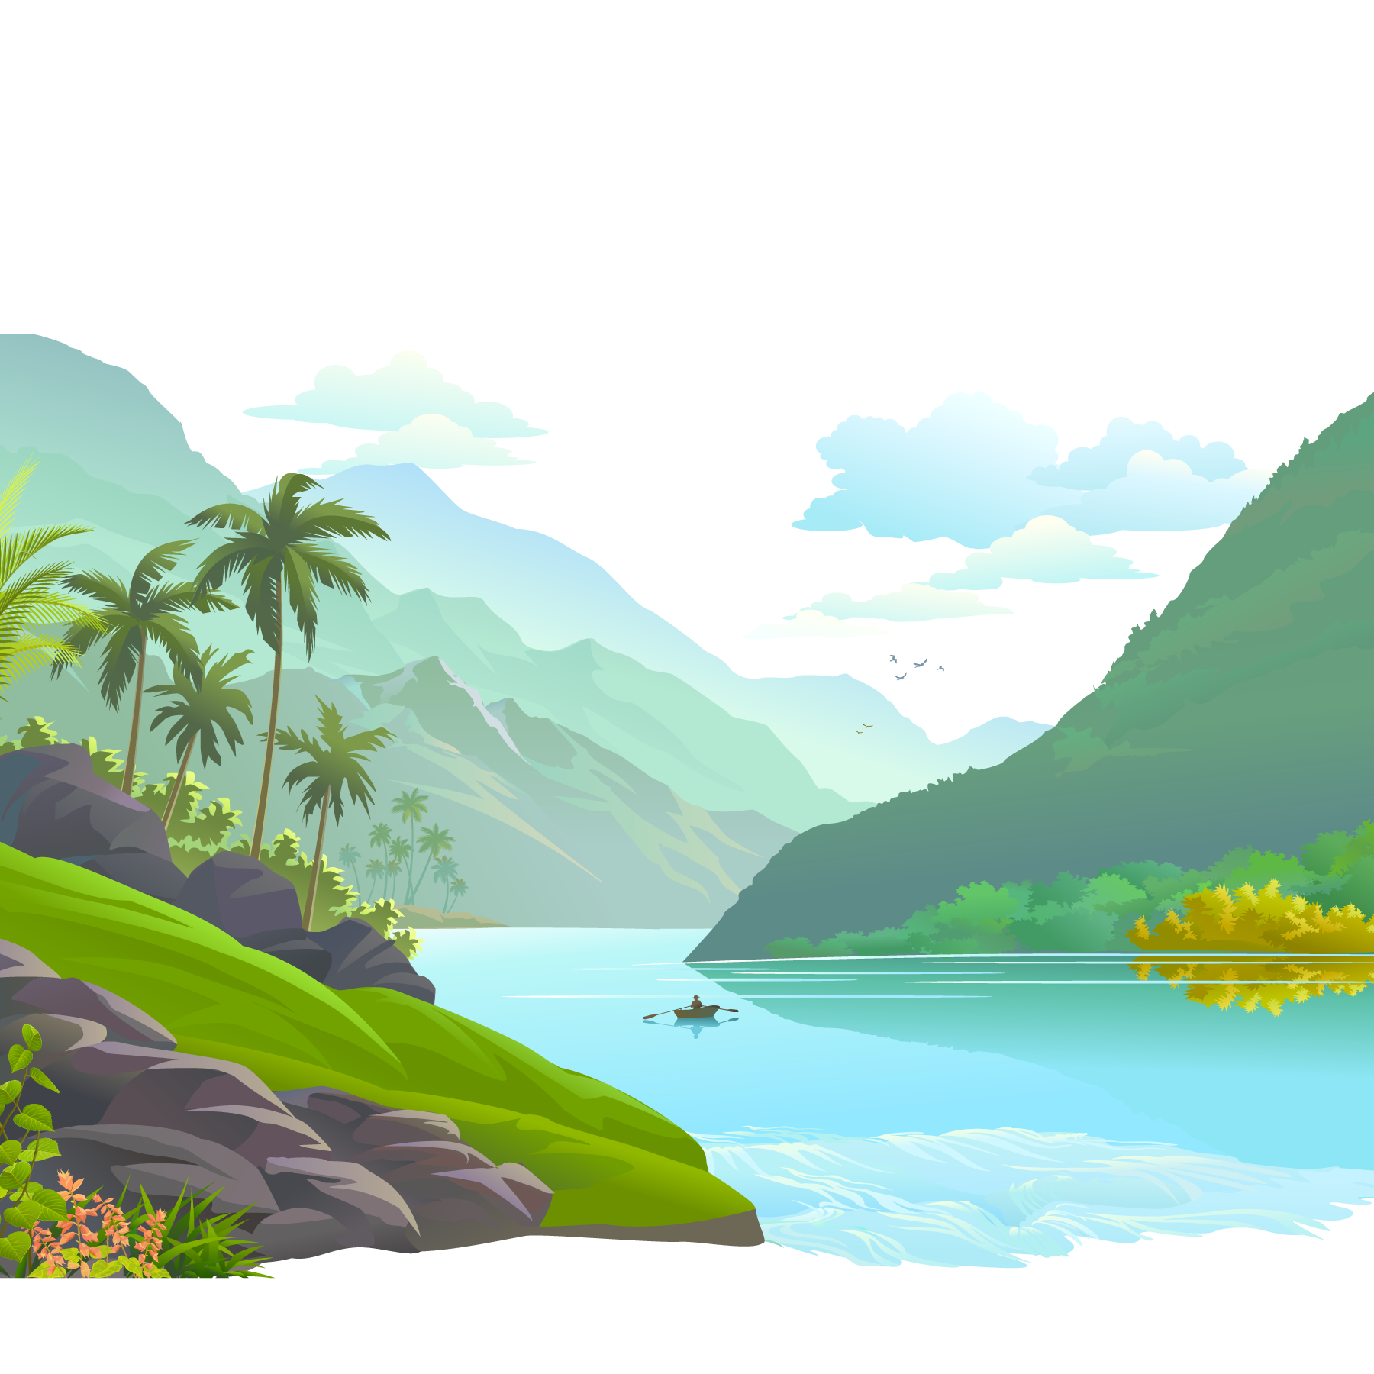
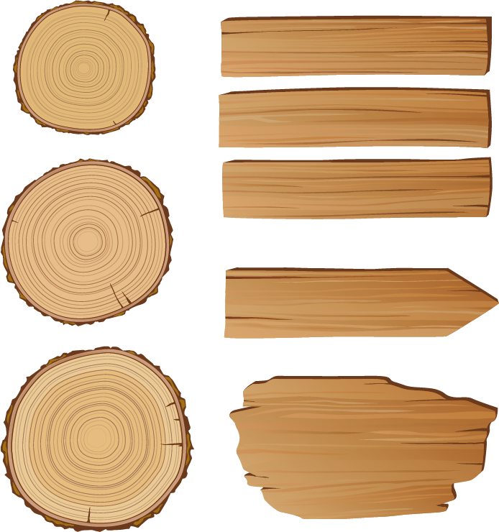
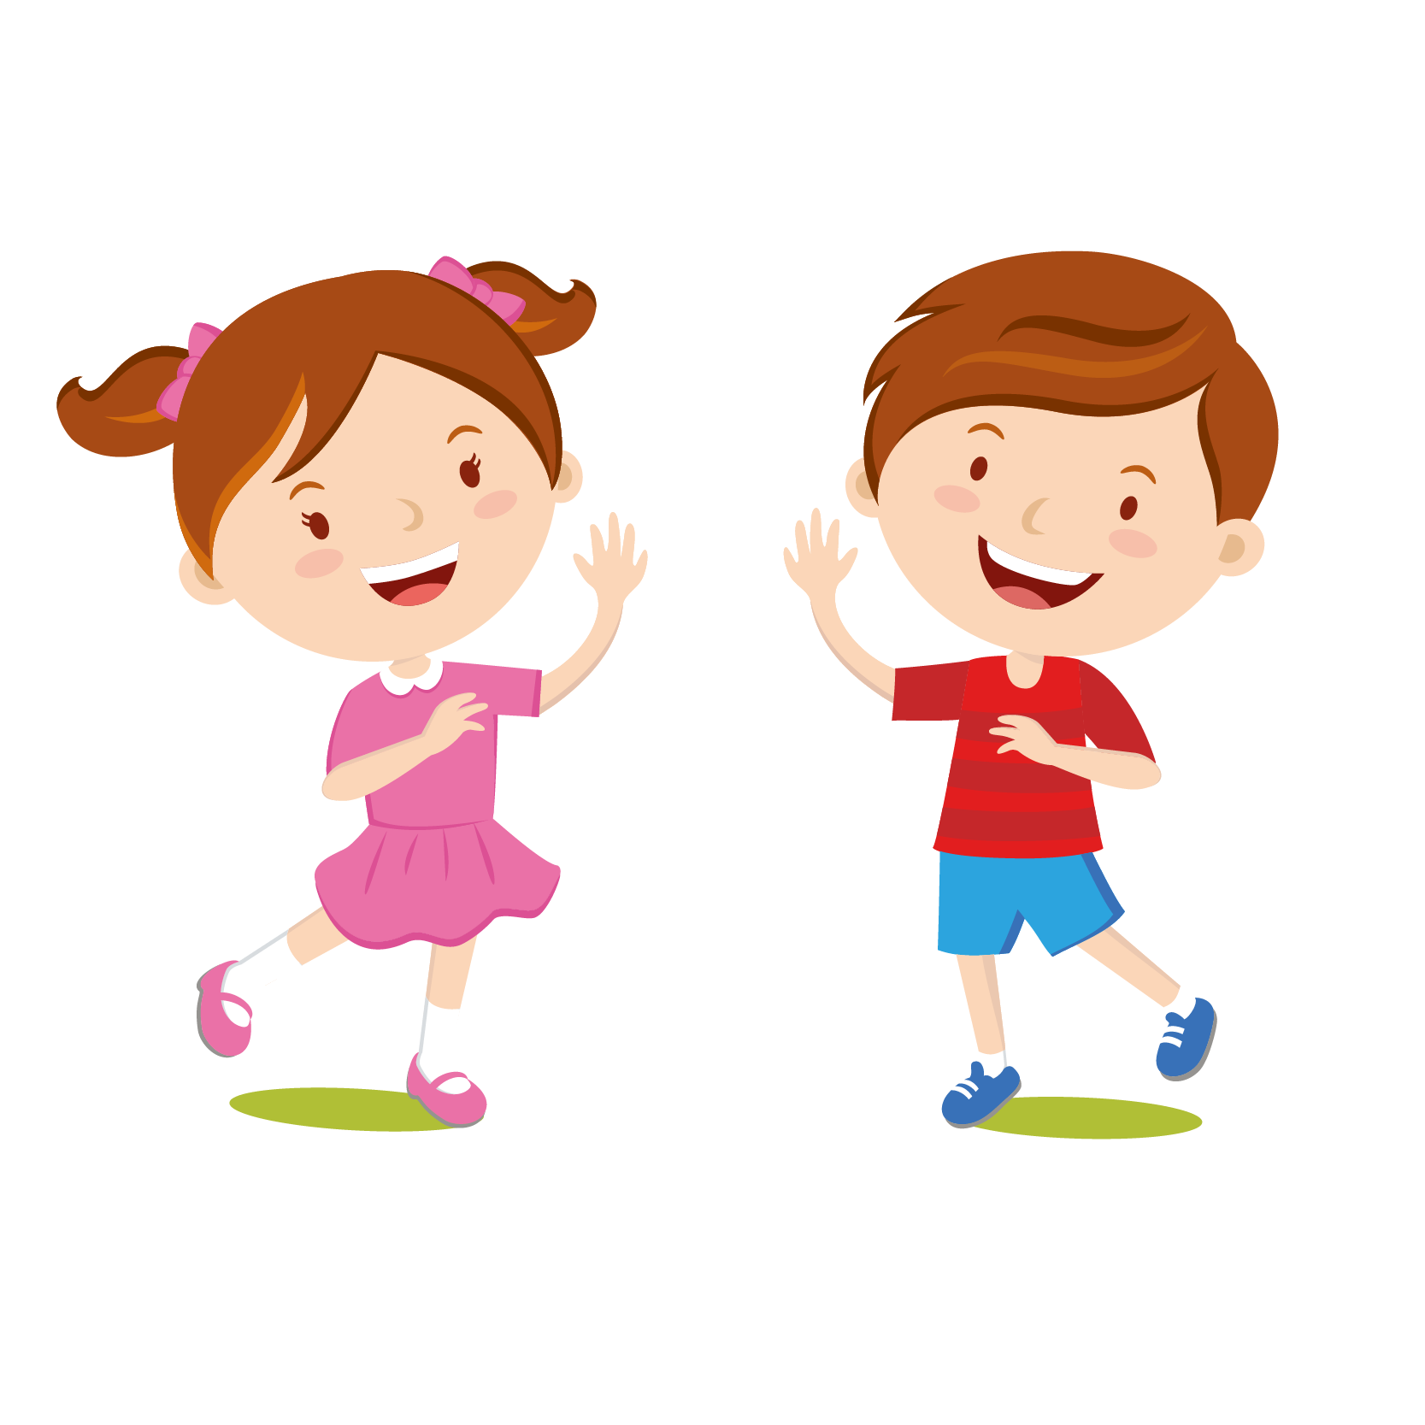
لعبة الخروج من الغابة
Revision units 3-4-MG5
T.Entisar Al-Obaidallah
1
3
2
6
5
4
9
8
7

Slide 2
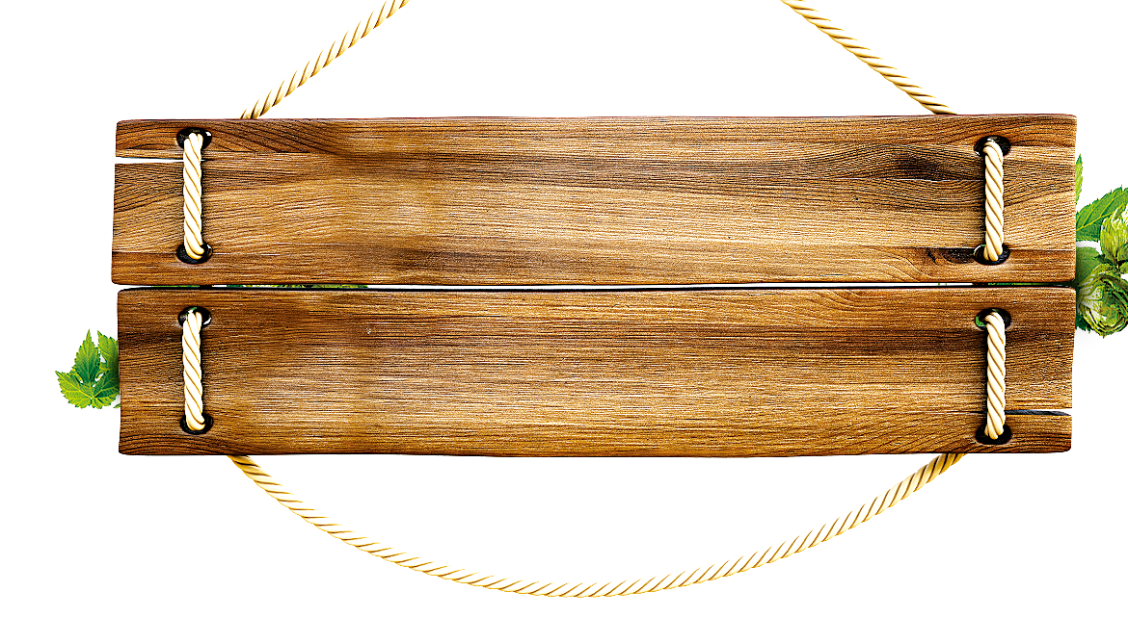

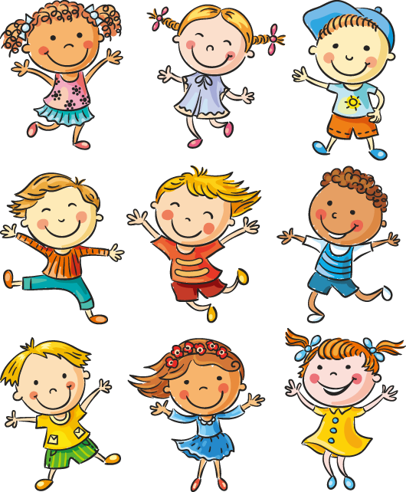
By next summer , they will have ………the bridge .
build
built
building

Slide 3
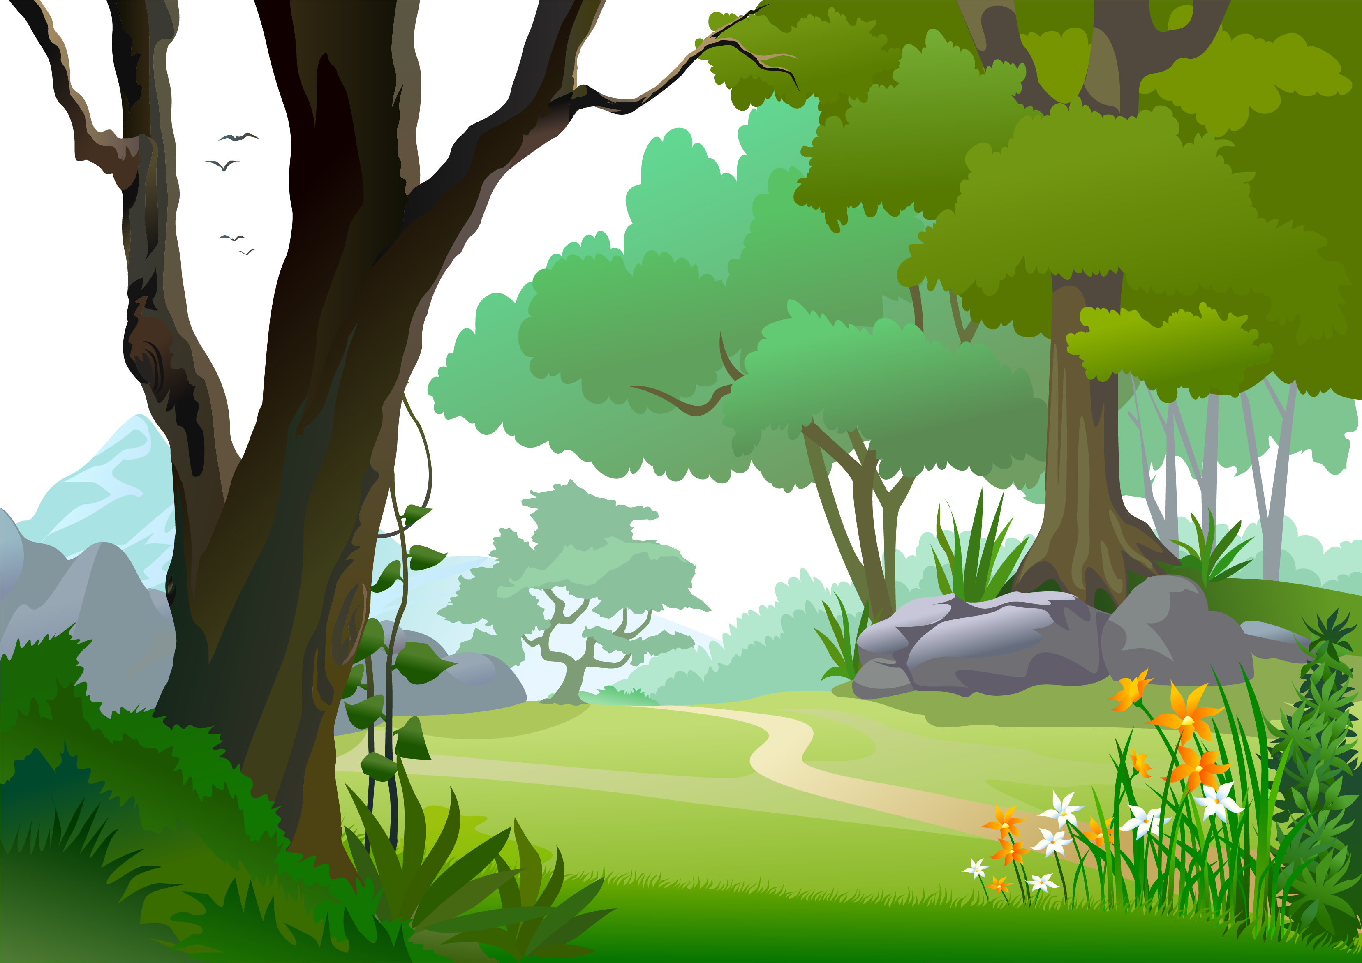


She …….milk every morning .
drinks
drink
drinking

Slide 4
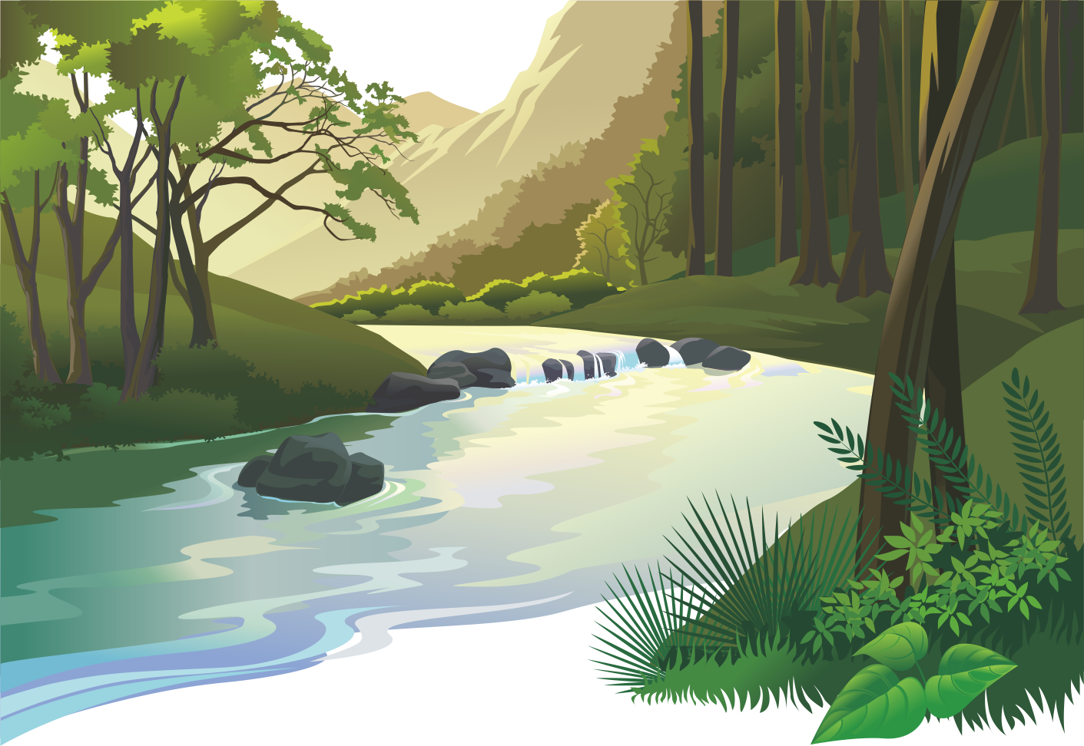
The odd word:
train
robot
car

Slide 5

He can have ….. Tea
coffee.
but
and
or

Slide 6
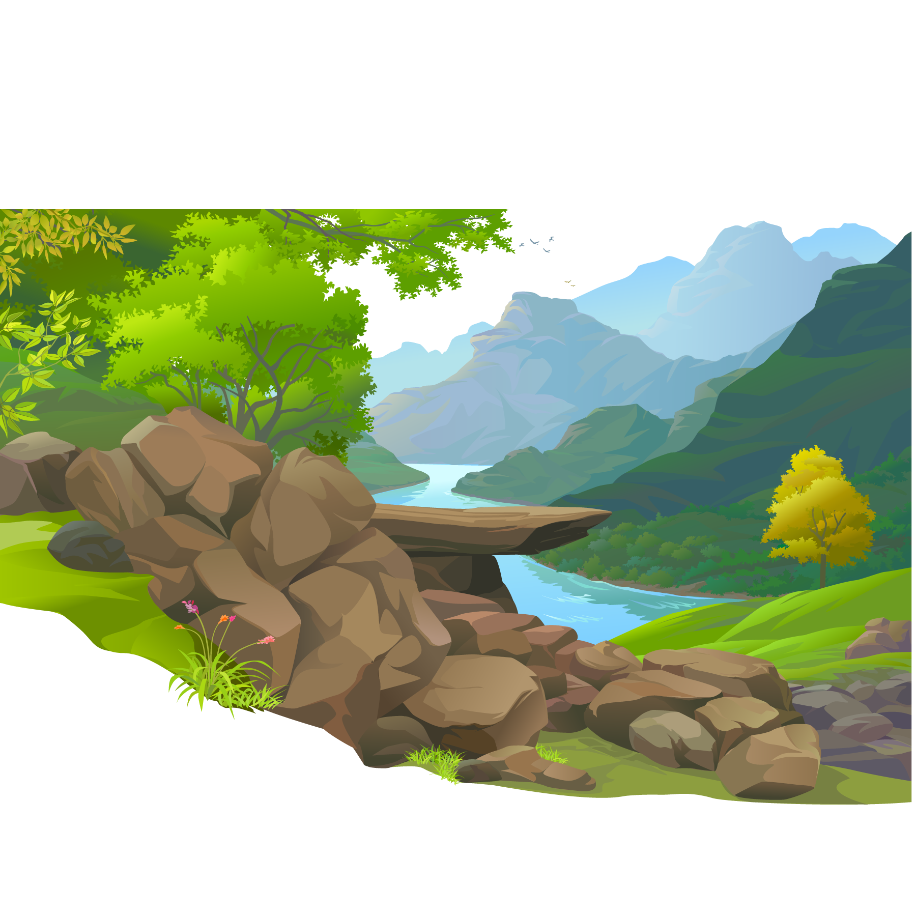
English is ….. than French .
More easy
easier
easiest

Slide 7
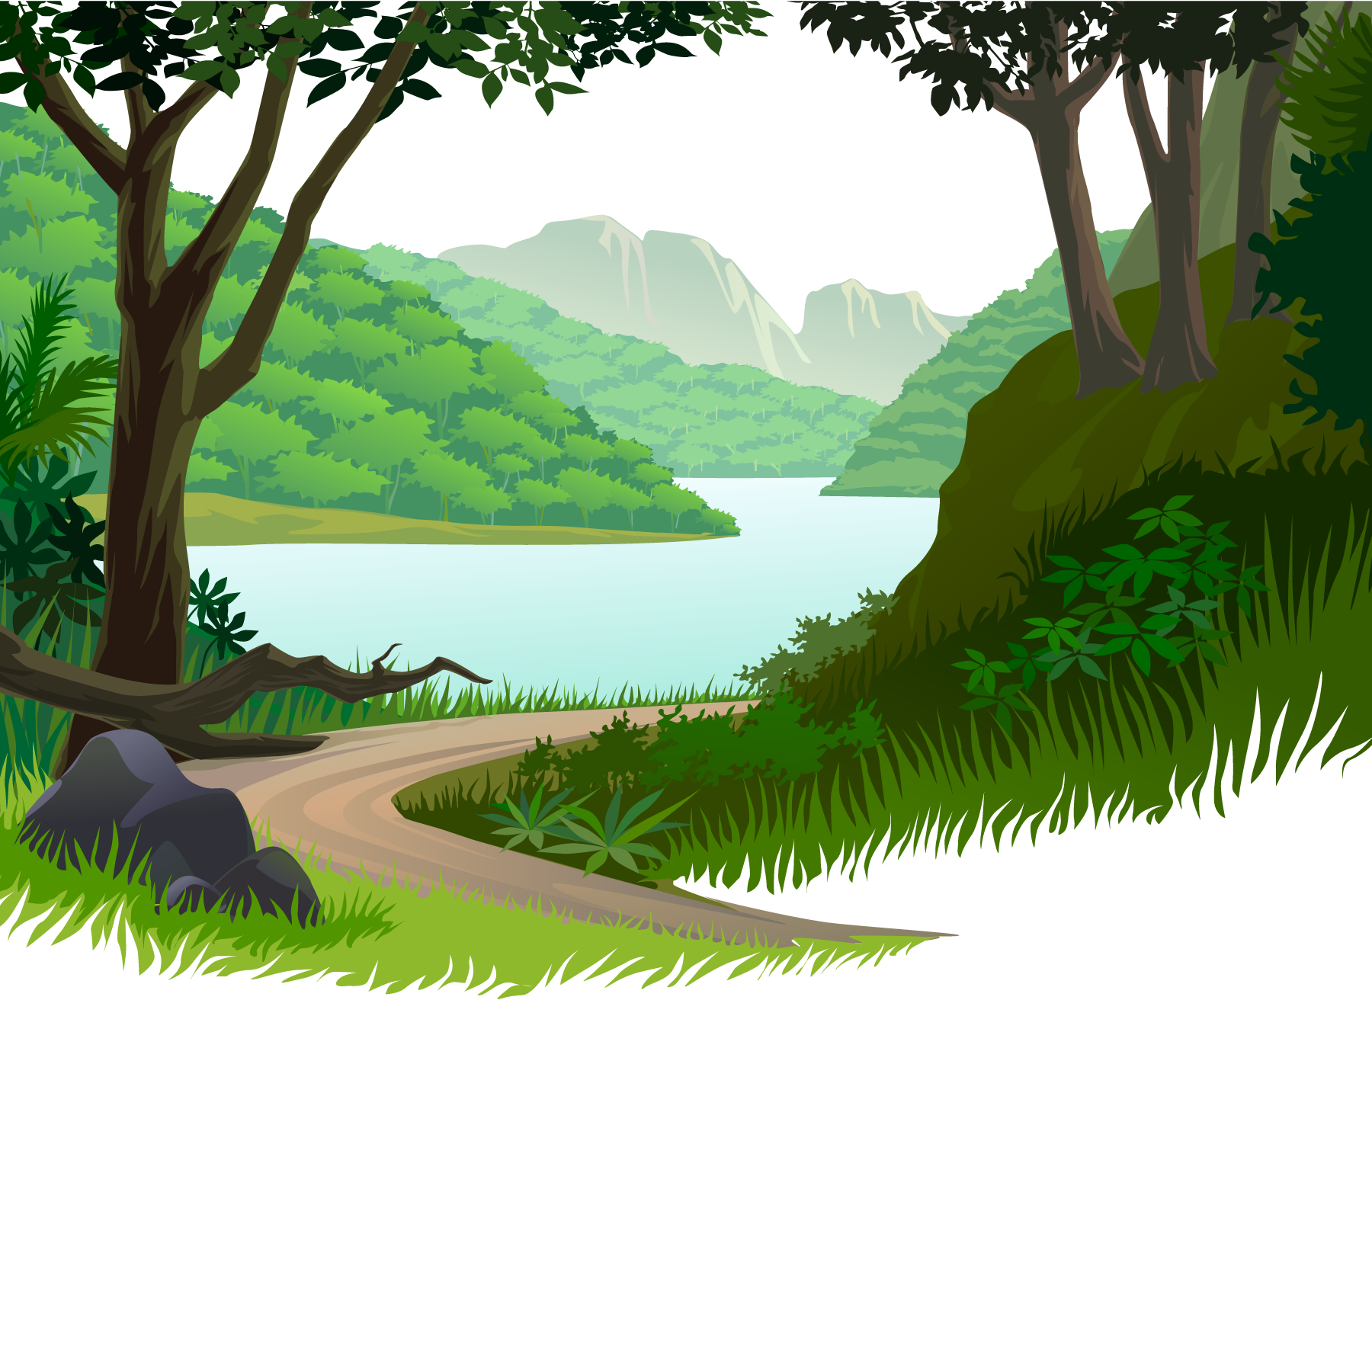
The opposite of comedy:
drama
action
tragedy

Slide 8

The word (commonplace) means….
frequent or usual
flexible
modern

Slide 9
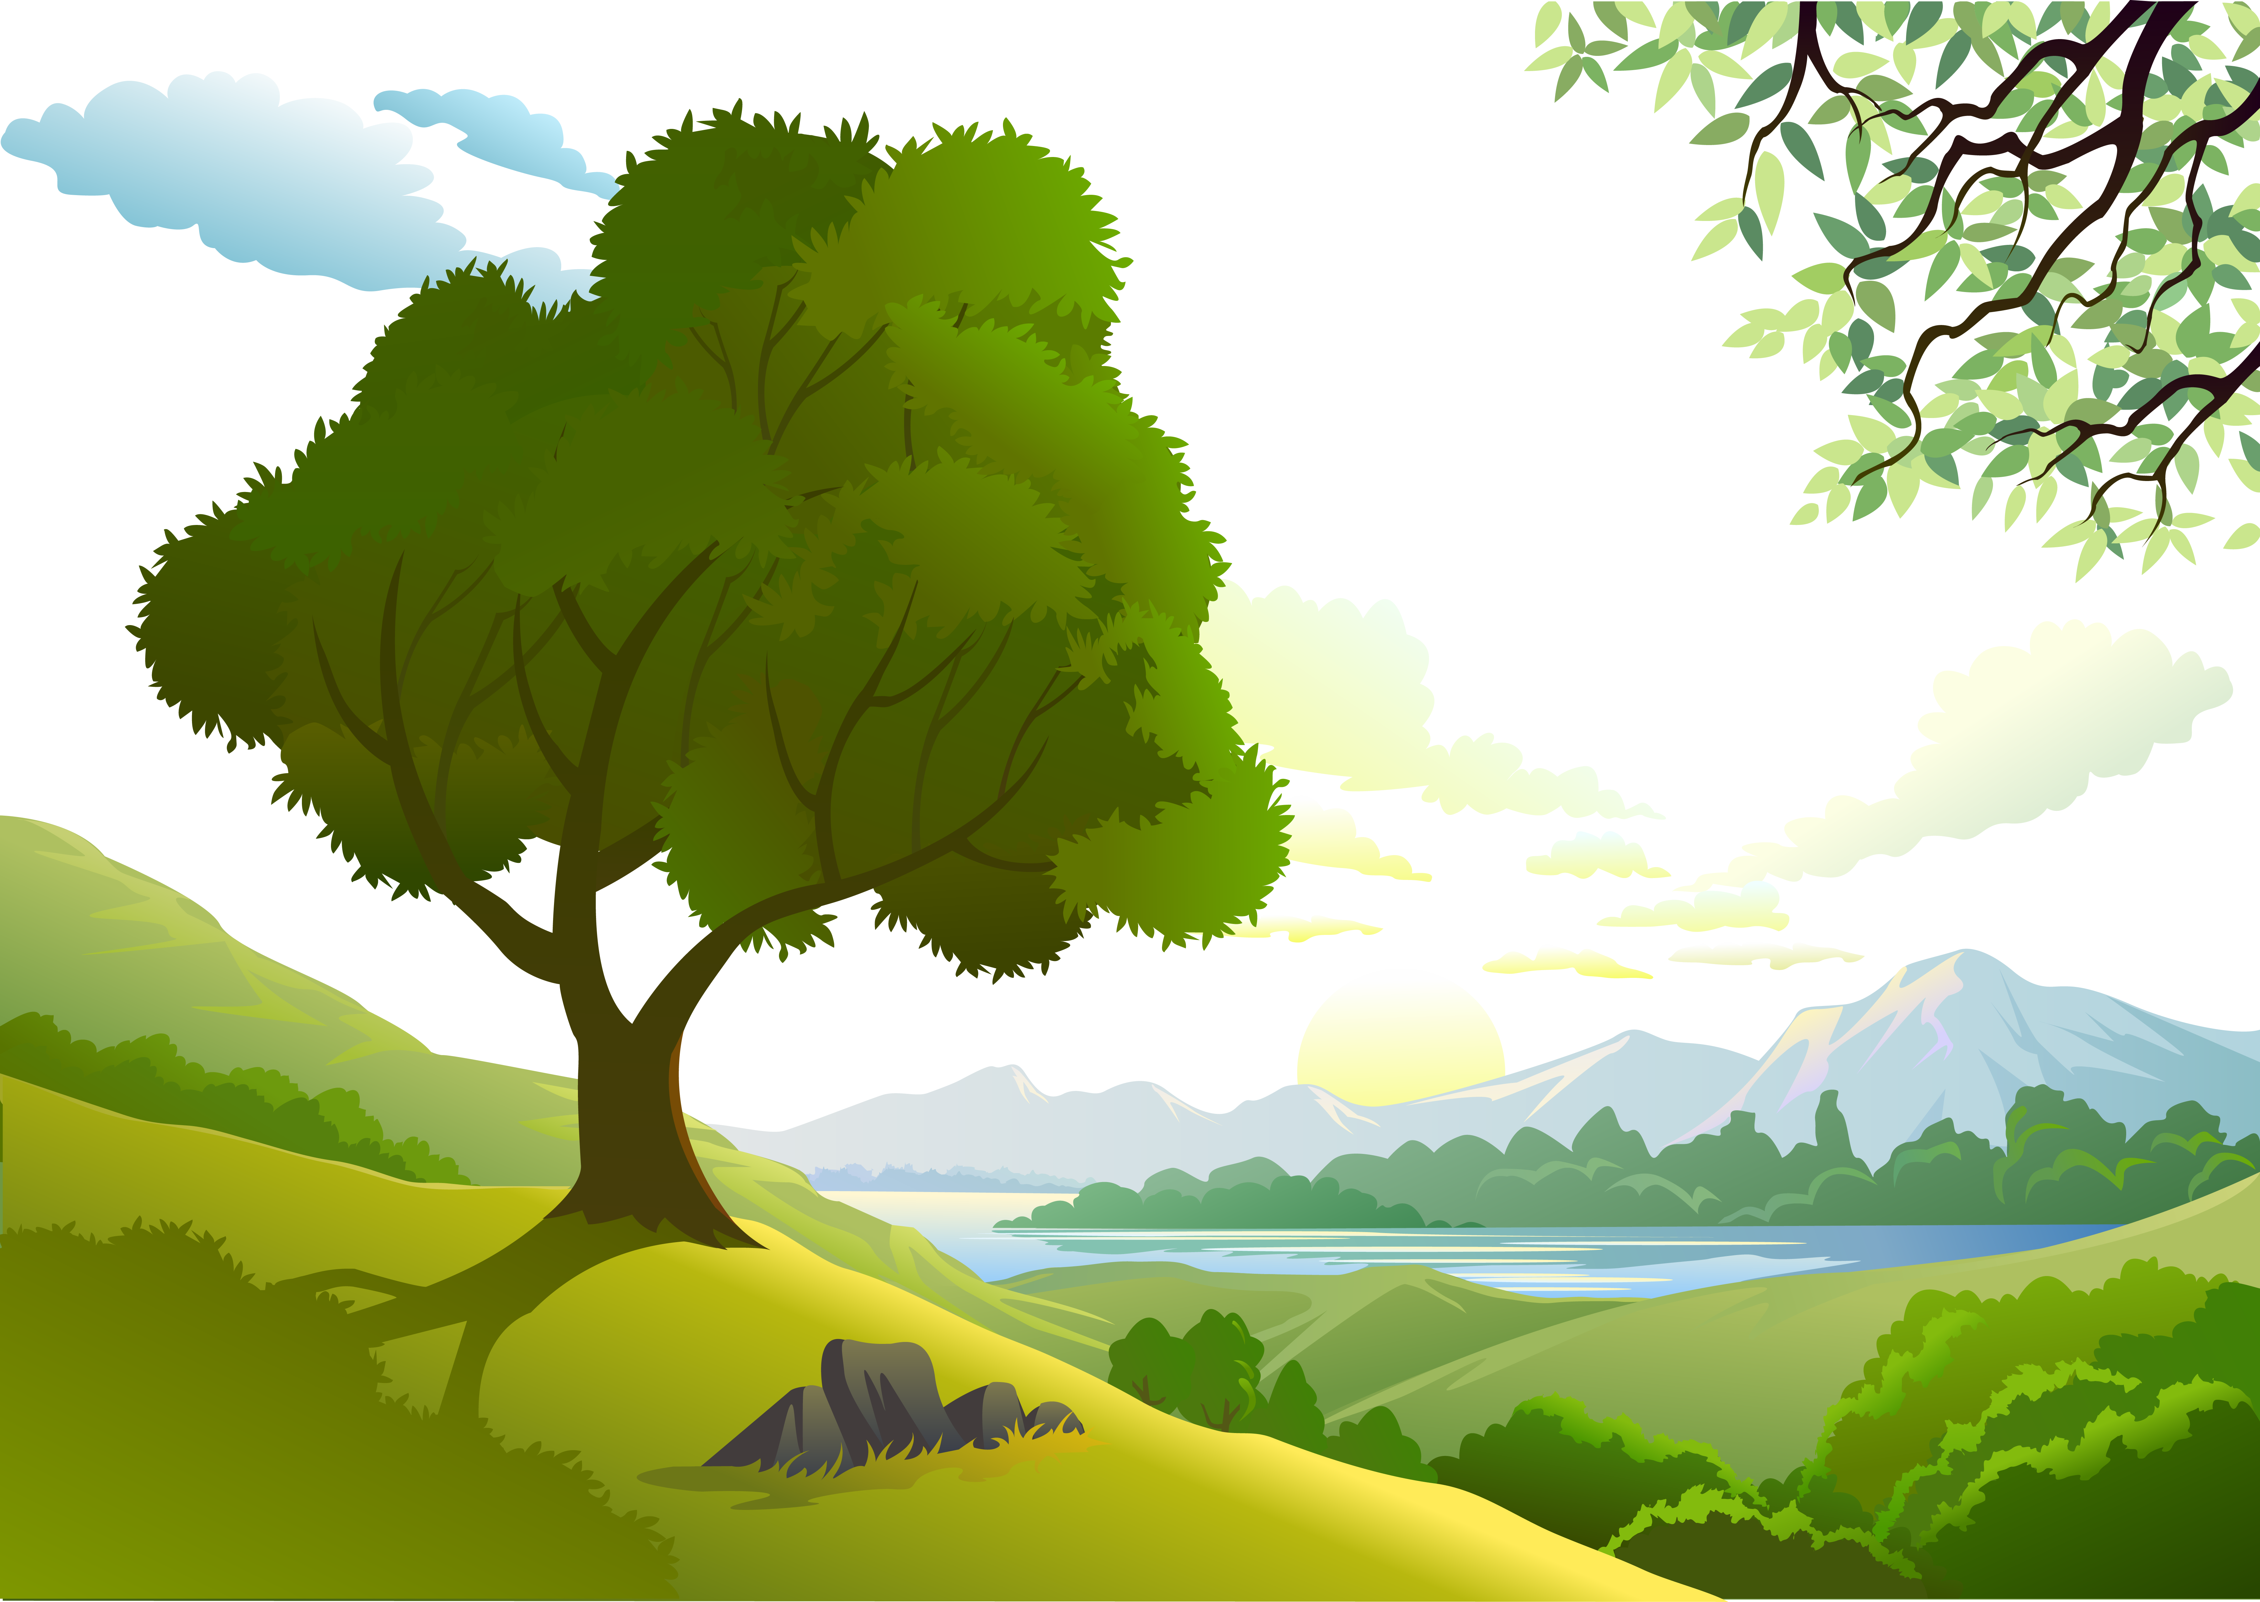
Toy Story & The Lion King
are two examples of .…films.
horror
action
animated

Slide 10
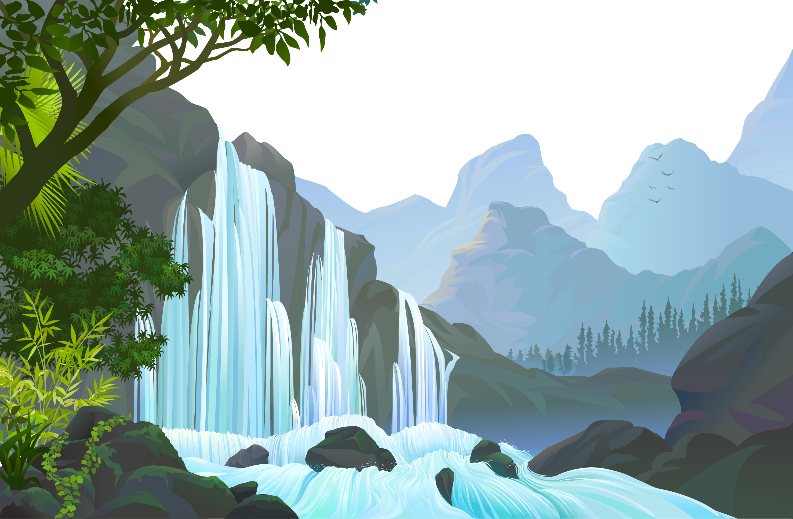

The picture shows…
drama
horror
action

Slide 11
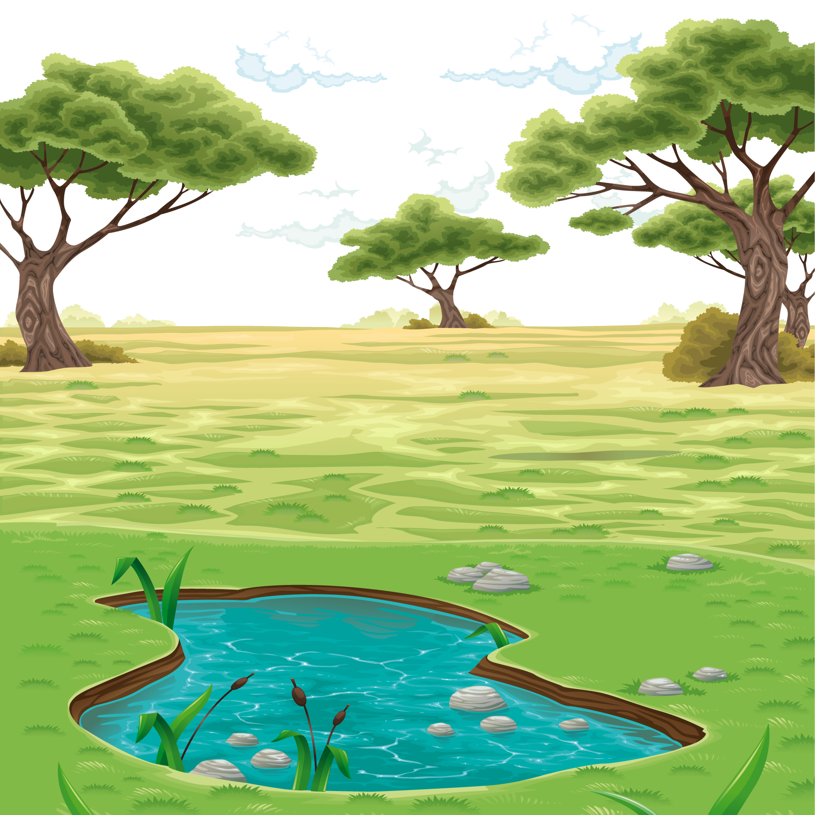


ممتاز يا مغامرين

