Slide 1






MG4
There’s No Place Like Home
Revision Unit 1

Slide 2
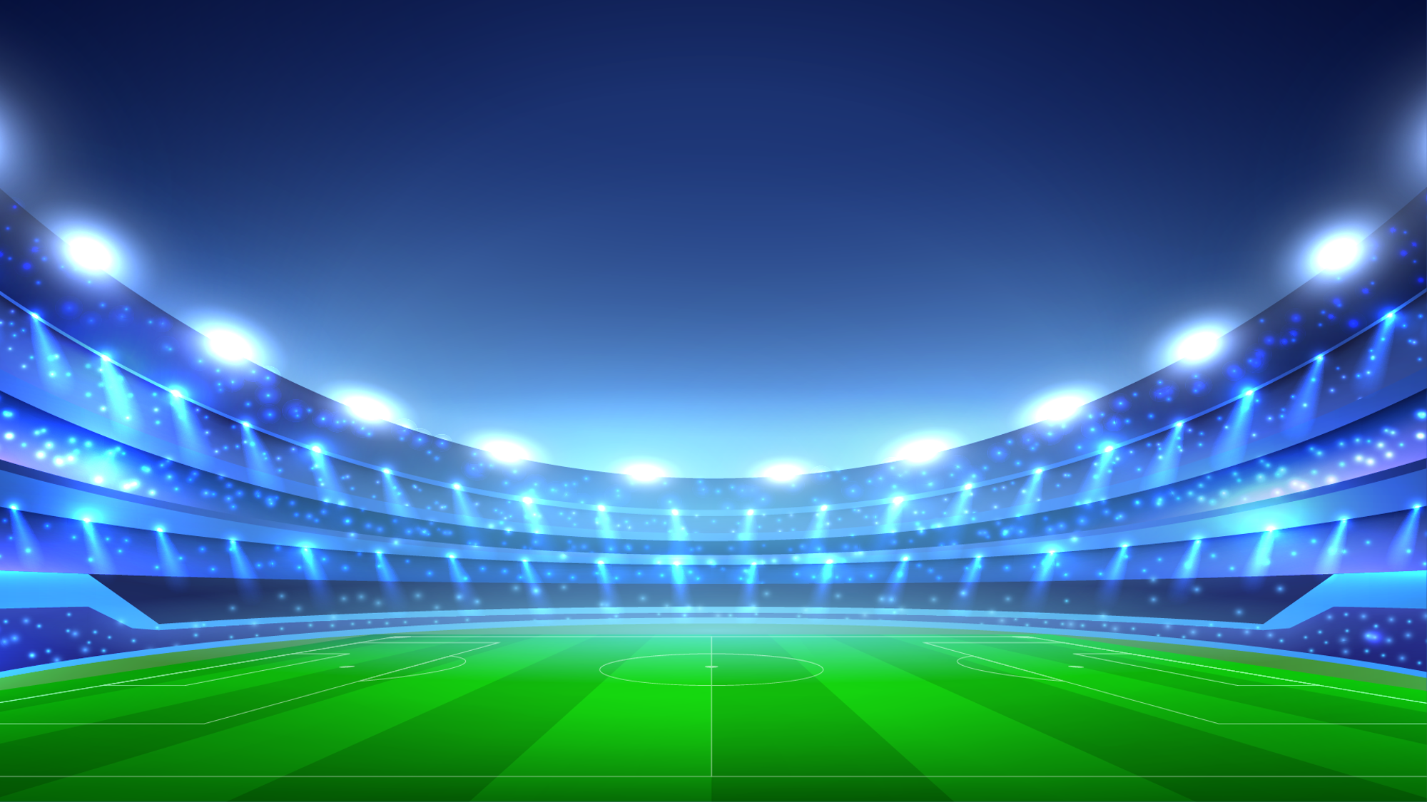
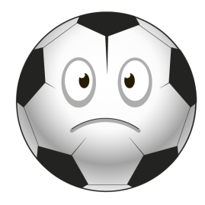
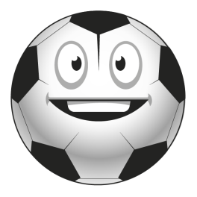
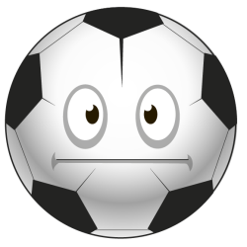
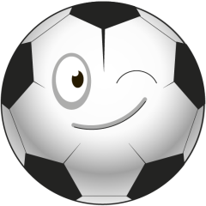
I can't drink the coffee . It's __hot .
enough
too
very
A few
أحسنت!
خطأ!

Slide 3
He can change the light bulb
without getting on a chair .
He is tall _________
too
enough
very
A few
أحسنت!
خطأ!

Slide 4
I can't hear you . You aren't speaking loudly ________
too
very
A few
enough
أحسنت!
خطأ!

Slide 5
Is there _______ paper in
the printer?
enough
too
very
two
أحسنت!
خطأ!

Slide 6
If you see the Town Hall ,
______right .
go
Turn
keep
get
أحسنت!
خطأ!

Slide 7
Let me carry that for you.
This sentence is_______.
request
promise
offer
warning
أحسنت!
خطأ!

Slide 8
Will you ________me home .
drive
drove
drives
driving
أحسنت!
خطأ!

Slide 9
As soon as it________
Raining , we’ll leave.
stopped
stopping
stop
stops
أحسنت!
خطأ!

Slide 10
Which is the correct order ??
Persian ,wonderful ,old
old ,wonderful ,Persian
wonderful , Persian ,old
wonderful ,old ,Persian
أحسنت!
خطأ!

Slide 11
The kitchen in home is not big _______.
very
too
enough
some
أحسنت!
خطأ!

Slide 12
I can’t wear that coat . It is ________hot .
very
too
A few
enough
أحسنت!
خطأ!

Slide 13
I can buy the Ferrari. I have got _____money.
enough
very
too
many
أحسنت!
خطأ!

Slide 14
That couch isn't big____ .
Enough
very
too
much
أحسنت!
خطأ!

Slide 15
I ____ you as soon as I get
home.
call
will call
calling
calls
أحسنت!
خطأ!

Slide 16
The people showed ____ for the king by putting his face on the coins .
maintain
downsize
cool
loyalty
أحسنت!
خطأ!

Slide 17
They had no money to ______their house .
hold on
comfort
furnish
crippled
أحسنت!
خطأ!

Slide 18
The museum has a quiet and peaceful ________.
environment
poverty
cliff
budget
أحسنت!
خطأ!

Slide 19
The word “ cool” means ________.
atmosphere
bad
adobe
great
أحسنت!
خطأ!

Slide 20
The word “ hold on ” means ________.
give off
Go from bigger to smaller
take care of
Stop for a moment
أحسنت!
خطأ!

Slide 21
The word “ downsize” means ___________.
attractive
Take care of
go from bigger to smaller
shelter
أحسنت!
خطأ!

Slide 22
The opposite of the word
“exterior” is _________
unforgettable
interior
rural
unsafe
أحسنت!
خطأ!

Slide 23
The opposite of the word
“ urban” is _______
rural
unforgettable
unsafe
smart
أحسنت!
خطأ!

Slide 24
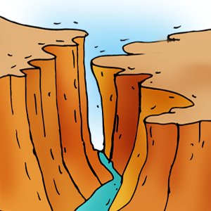
This picture shows _____
Adobe house
cliff
canyon
poverty
أحسنت!
خطأ!

Slide 25
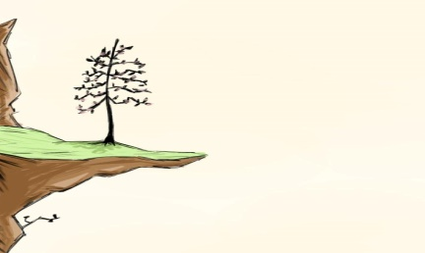
This picture shows _____
cliff
mountain
cave
desert
أحسنت!
خطأ!

Slide 26
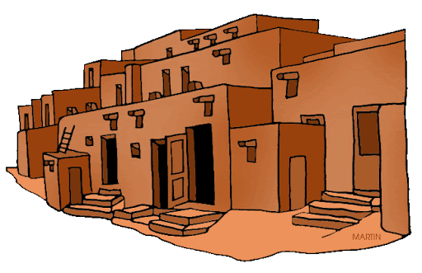
This picture shows _____
canyon
cliff
Adobe house
poverty
أحسنت!
خطأ!

Slide 27
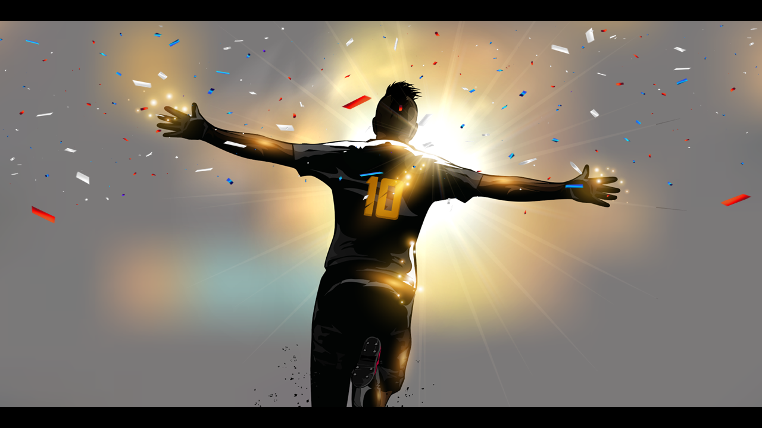

Well done . You did it .
خروج

