Slide 1
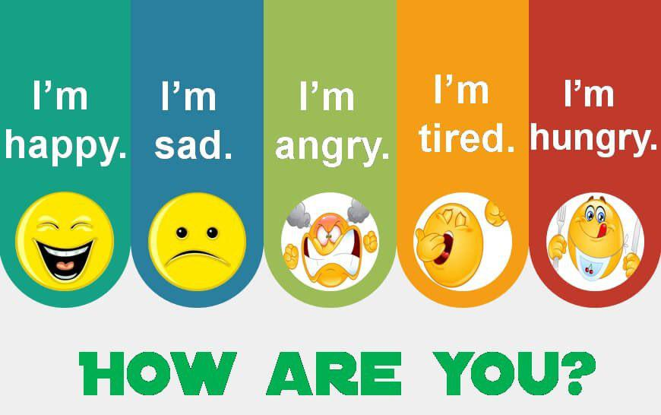


Slide 2
Revision
Write a sentence with “if”

Slide 3

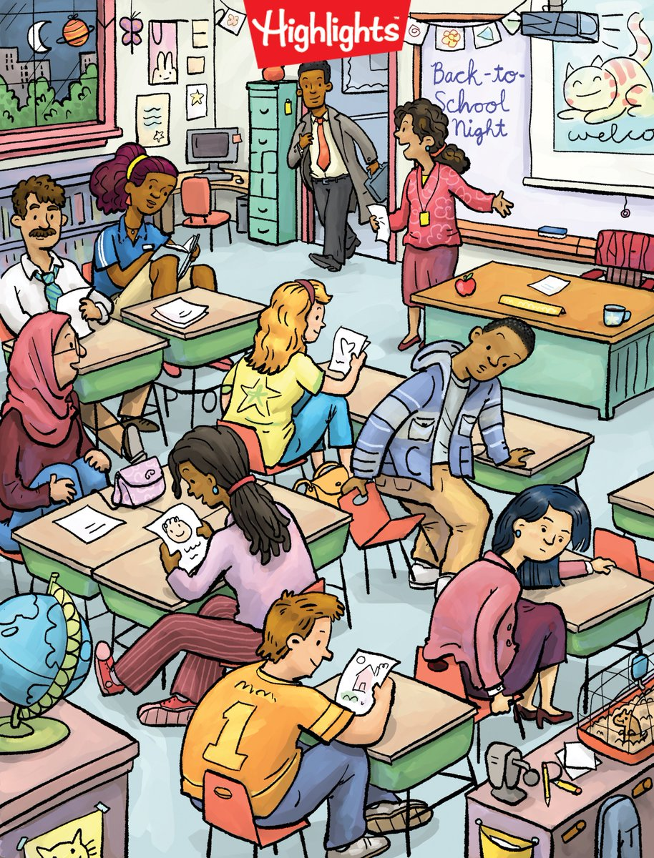
Warm up
Memory game

Slide 4
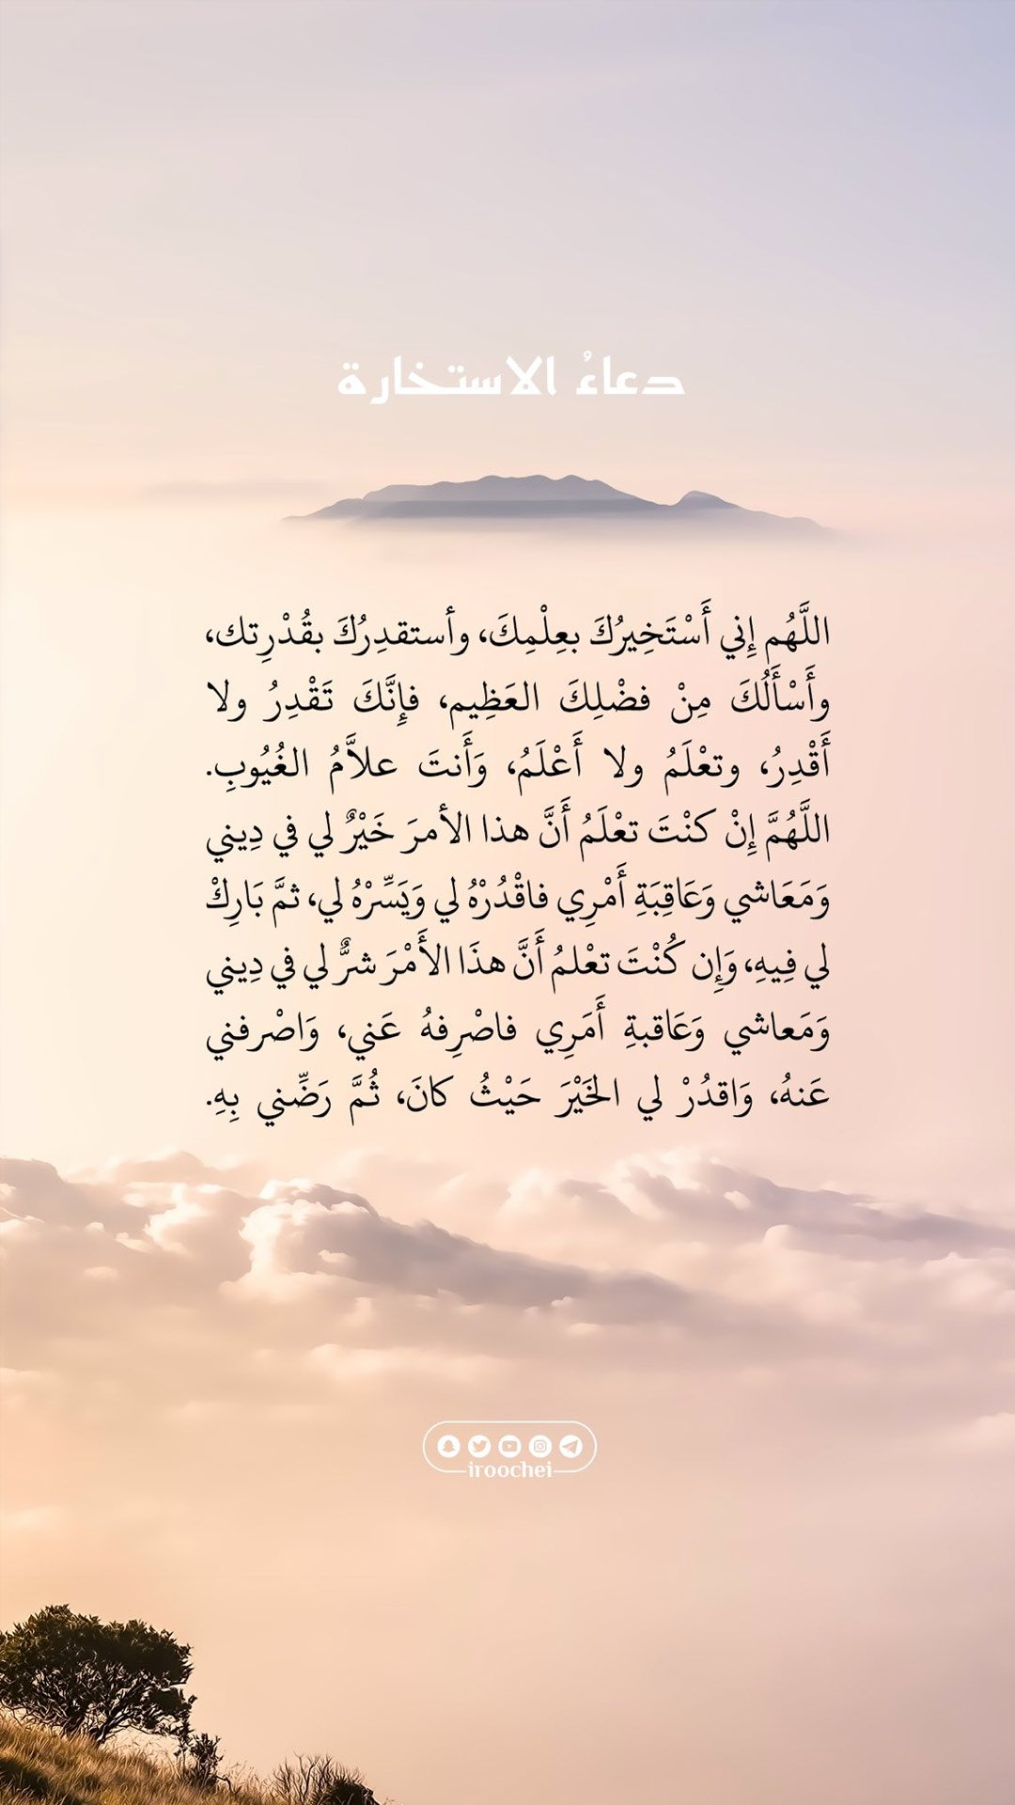

U:5
Making Choices
54

Slide 5




Learning objectives
Read the text.
answer questions about the reading
Summarize a local issue.

Slide 6


school
Living in a place

Slide 7
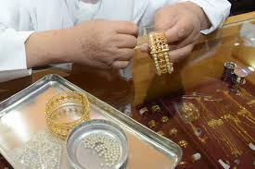
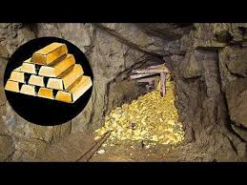
Vocabulary
goldsmith
mines

Slide 8
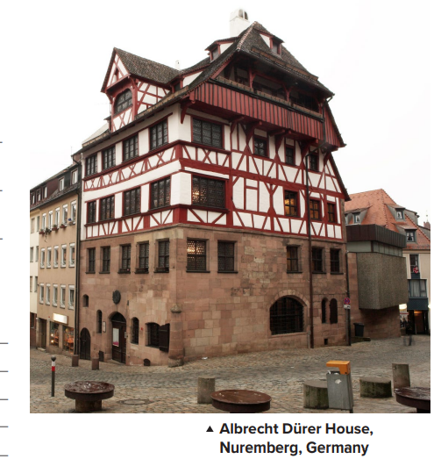
Whose house is in the picture?
Where did he live?
Why is he famous?
What painting is he famous for?

Slide 9
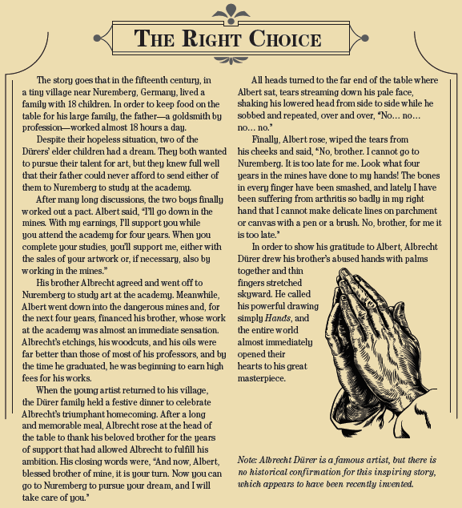


Slide 10
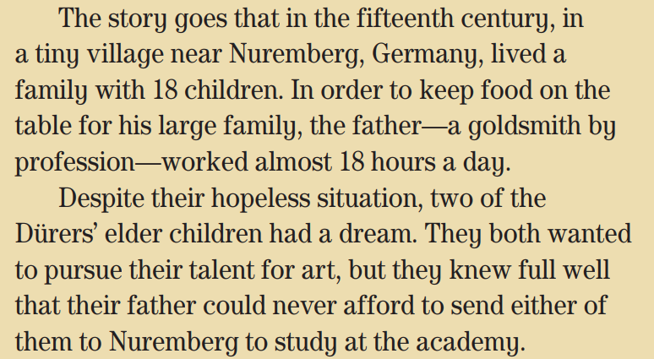
Did Albrecht Dürer live in the 1400s or the 1500s?
the 1400s)
How many brothers and sisters did Albrecht Dürer have?
(17)
What did Albrecht Dürer’s father do for a living?
(He was a goldsmith.)
What talent did Albrecht and his brother Albert have?
They were both good artists.

Slide 11
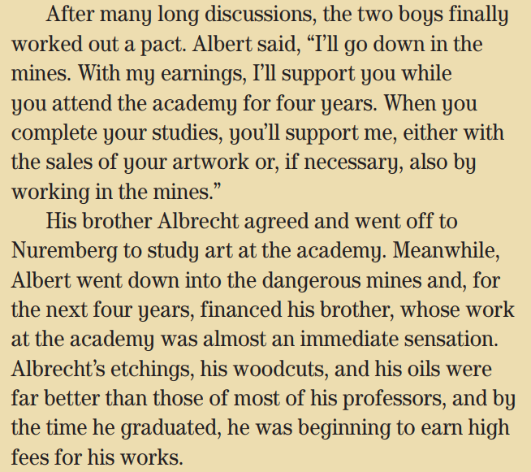
What did the brothers discuss?
who was going to study art and who was going to work in the mines
What did the brothers decide?
Albert was going to work in the mines to support Albrecht’s art studies.)
How long did Albrecht Dürer study art?
(4 years)
How do you know he was successful in Nuremberg?
He earned high fees for his works.)

Slide 12
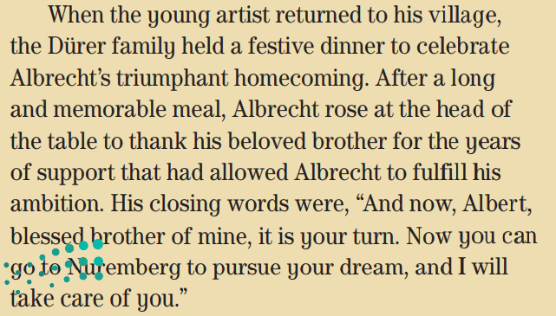
Why did the family have a festive dinner?
(to celebrate Albrecht’s return home)
Is a festive dinner a special meal or an everyday meal?
(a special meal)
What did Albrecht do after the meal?
(He thanked his brother and said he would support Albert’s studies in Nuremberg.)

Slide 13
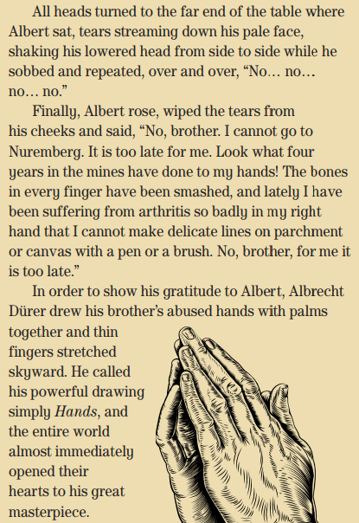
What was Albert’s reaction?
He started to cry
Why couldn’t Albert draw anymore?
His hands were ruined from working in the mines.
When Albrecht Dürer drew the hands, what was he thinking of?
(his brother’s generous support)
Why were his brother’s hands so important to him?
(Without his brother’s hard work in the mines, it would have been impossible for Albrecht to study art and become a successful artist.)

Slide 14
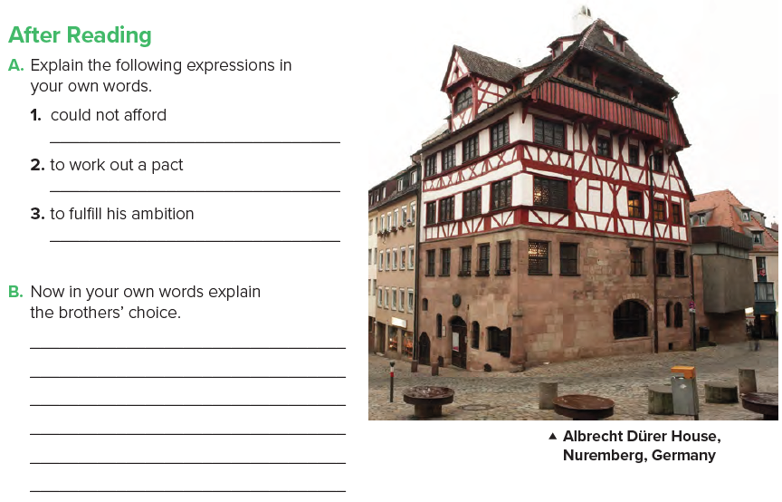
didn’t have enough money
to reach an agreement
to do what he wants to do with his life
The family could not afford to send either son to art school. The two brothers worked out a pact. Albrecht would go to fulfill his ambition at art school and Albert would work in the mines to support him.

Slide 15
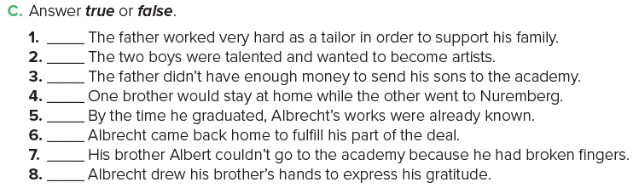
F
T
T
T
T
T
F
T

Slide 16

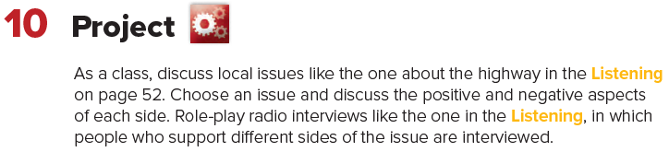

Slide 17

Homework
Workbook Page 121

