Slide 1
Mega 1.3
Comprehensive
Revision
مراجعة شاملة للمنهج

Slide 2



When the sun rises,
a new day ______.
begins
begin
began
begun

Slide 3

I don’t _____ write the report myself.
My secretary can do that for me.
need to
needed to
needs to
needing to

Slide 4
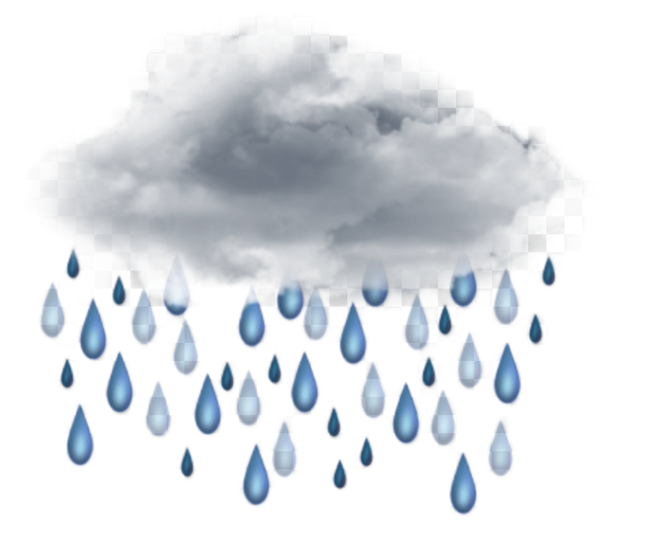
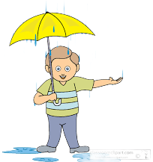
If it had rained, we wouldn’t have ___ shopping.
going
go
went
gone

Slide 5
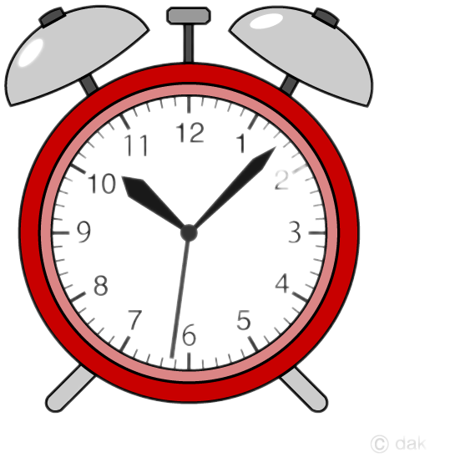
She has been here ___ seven o’clock.
since
for
before
after

Slide 6

Sara has been studying all afternoon.
She ___be tired by now.
Couldn’t have
Must had
must
Might have

Slide 7
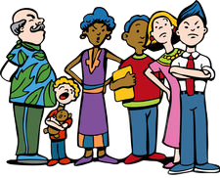
Omar can’t stand ___ in line.
wait
waiting
waited
waiting

Slide 8

I am going to have the roof____.
cleaning
cleans
cleaned
clean

Slide 9
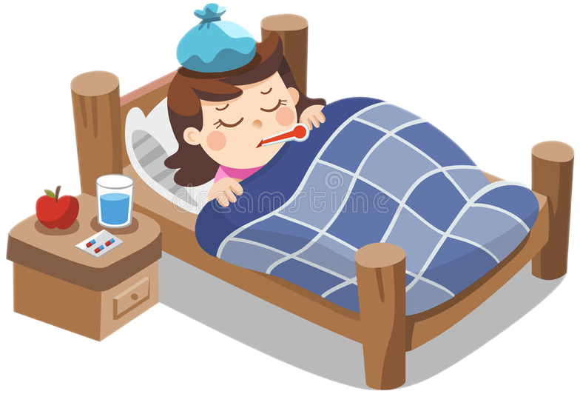
She was sick ,___she couldn’t
attend the meeting.
yet
until
because
so

Slide 10

We moved to Dubai five years___
yesterday
ago
since
for

Slide 11
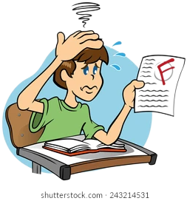
He failed the test.
He should __studied harder.
had
has
have
having

Slide 12

Listen to me when
I am talking to __.
he
you
we
I

Slide 13

We moved to Muscat two years ___.
just
ago
since
yet

Slide 14

Dubai is the place __
I want to go on
vacation.
who
where
when
whose

Slide 15

I had my house ___.
painting
paint
paints
painted

Slide 16
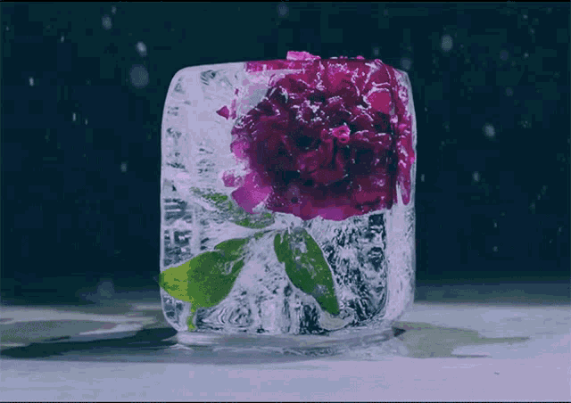
If you heat ice, it __.
melts
melted
melt
melting

Slide 17
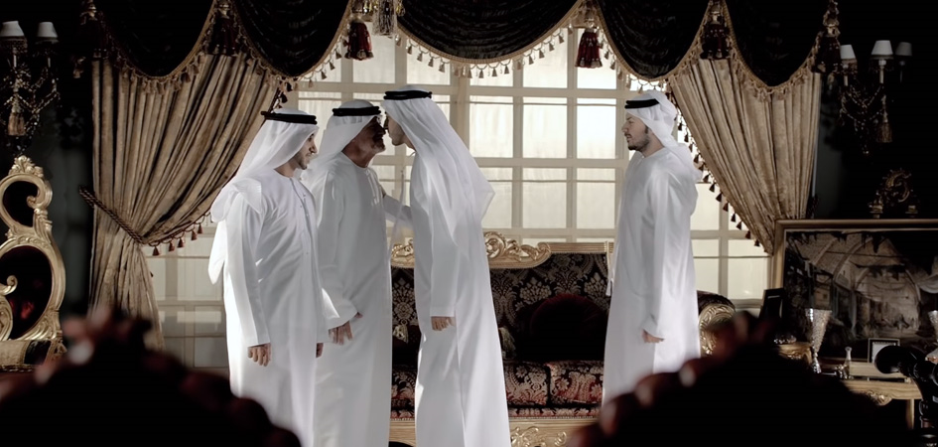
I opened the door__
greeted the guests.
or
but
so
and

Slide 18
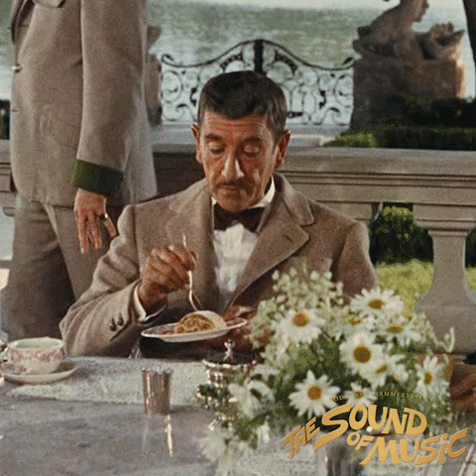
___you eaten lunch yet?
Haven’t
Isn’t
Hasn’t
Aren’t

Slide 19
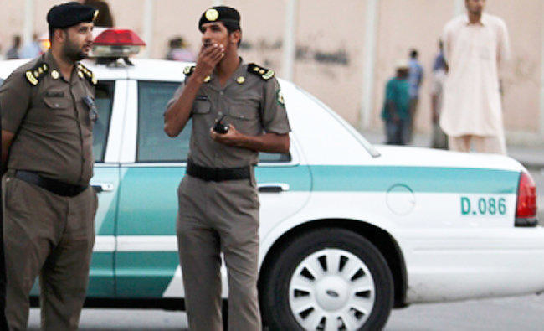
He asked how old I ___.
is
are
was
has

Slide 20
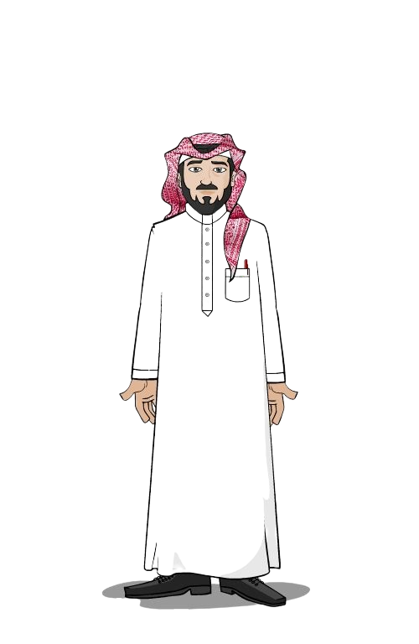
He has lived in Dammam __1999.
since
already
for
ago

Slide 21

Have you ever __ an alien?
see
seen
sees
saw

Slide 22

I don’t enjoy ___ under
the Sun.
sitting
sit
sits
sat

Slide 23

I haven’t done my homework __.
just
for
yet
already

Slide 24
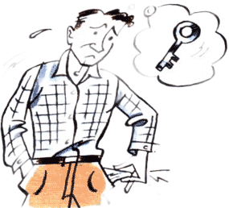
Jack ”I am looking for my keys.”
Change into reported speech. He said that………
he is looking for his keys
he was looking for his keys
he has looked for his keys
he looked for his keys

Slide 25
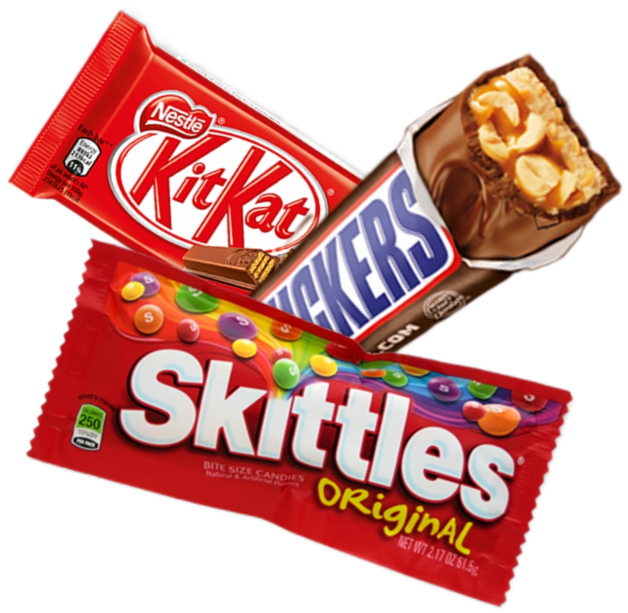
Jack ”My friend gave me a chocolate.”
Change into reported speech. He said that……..
his friend gave her a chocolate.
his friend had given him a chocolate.
his friend has given them a chocolate
his friend giving us a chocolate

Slide 26


Always active, changing, developing
dynamic
allowance
debris
devastaed

Slide 27
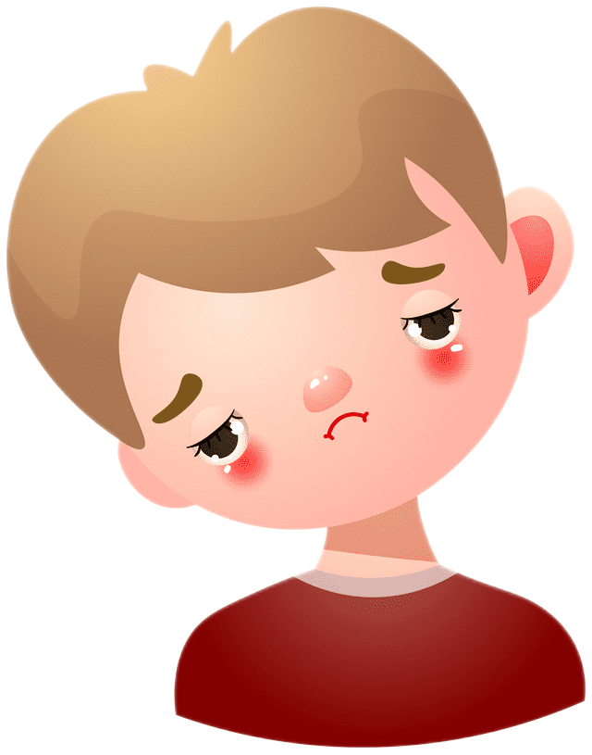
Feeling very shocked and upset
devastated
Fall out
debris
thrilling

Slide 28
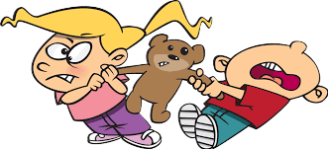
Quarrel or disagreement.
wand
Fall out
stunt
dessert

Slide 29
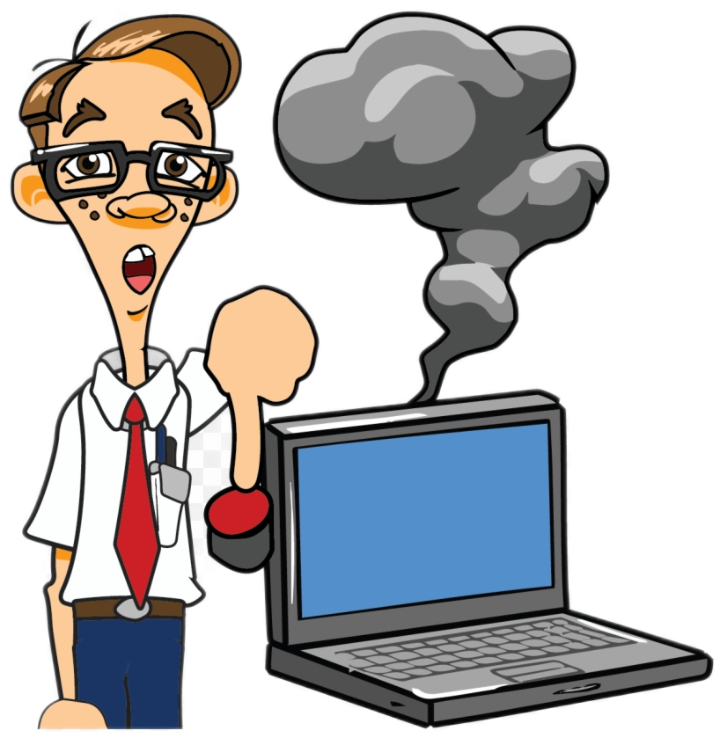
Not working correctly.
pediatric
triangular
hunter
malfunctioning

Slide 30
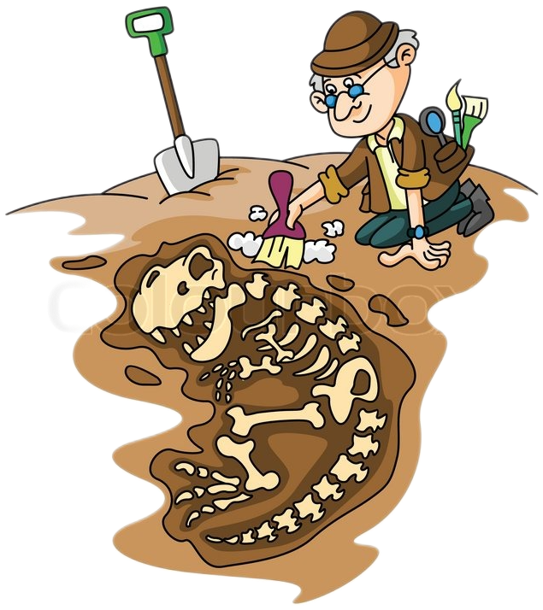
A person who studies
ancient societies
interior
order
archaeologist
devastated

Slide 31

Lasting, not destroying natural resources
discover
sustainable
delicious
disappear

Slide 32
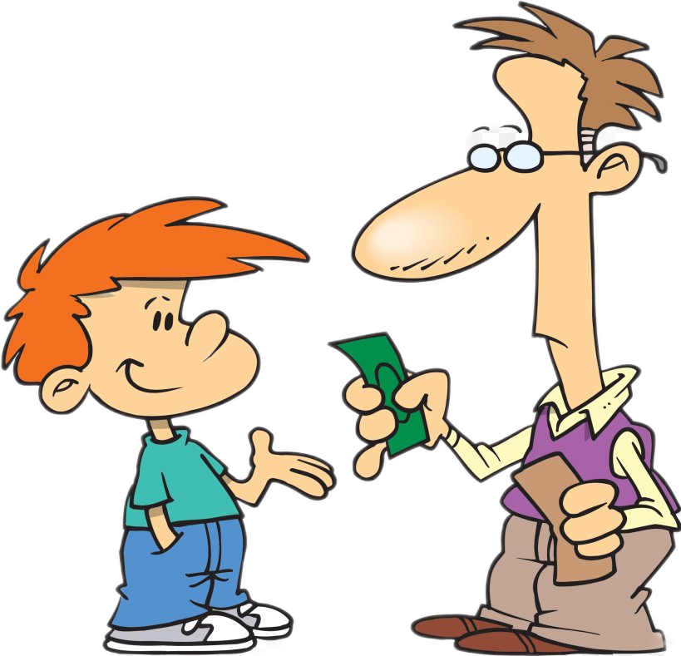
Money that a parent regularly gives to the child.
allowance
better
letter
litter

Slide 33


Pieces fallen from the meteorite.
tsunami
demand
torn
debris

Slide 34

Most people still don’t believe that______ is
a problem.
hurricane
quote
natural
Global warming

Slide 35
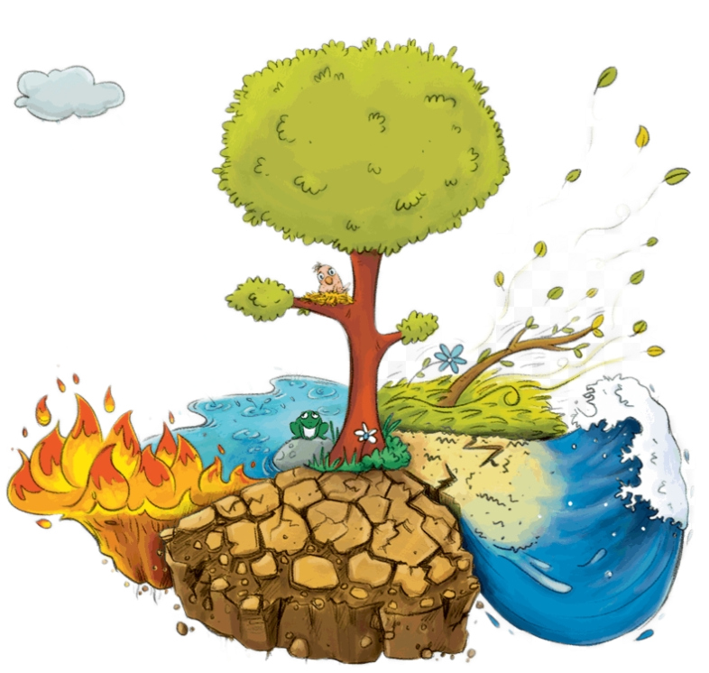
Earthquake, flood and tsunami are examples of ___disaster.
natural
Human made
normal
cultural

Slide 36
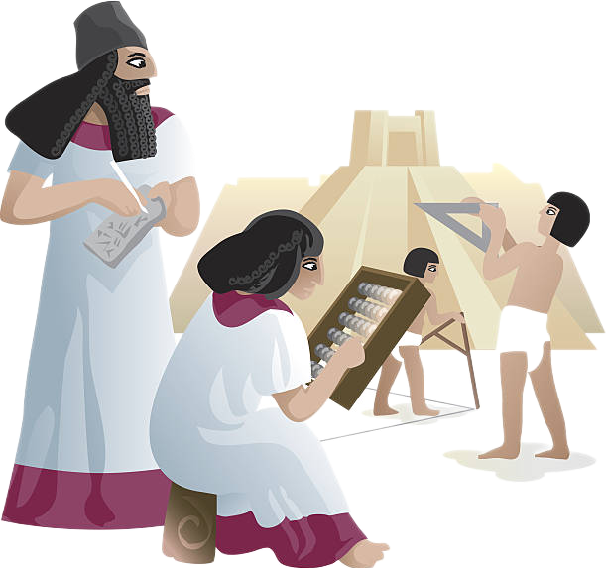
The Sumerians ___ the wheel centuries ago.
developed
invented
discovered
designed

Slide 37
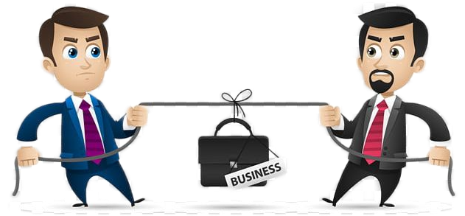
A___ is a person who is competing to get a job or elected position.
decliner
non-competitor
collector
candidate

Slide 38

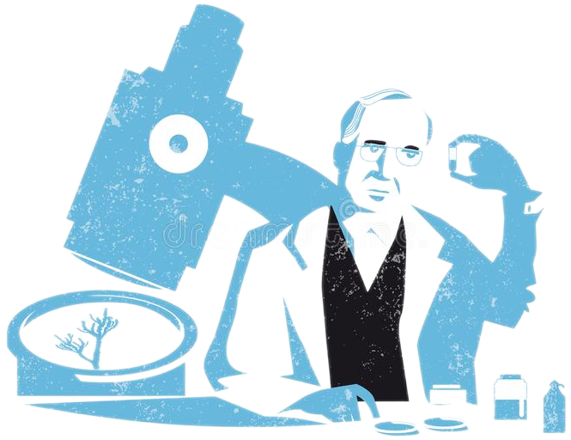
Dr. Alexander Fleming __penicillin in 1928 .
discovered
invented
developed
designed

Slide 39

The__ is words of wisdom that someone important said.
vote
quote
gee
goodbye

Slide 40

To get one’s payment back means __.
repair
warranty
refund
replace

Slide 41

Get an image with a computer.
save
scanned
copy
delete

Slide 42
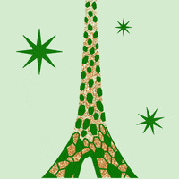

Kingdom of Saudi Arabia is blessed with many natural __.
alien
locomotives
dome
resources

Slide 43
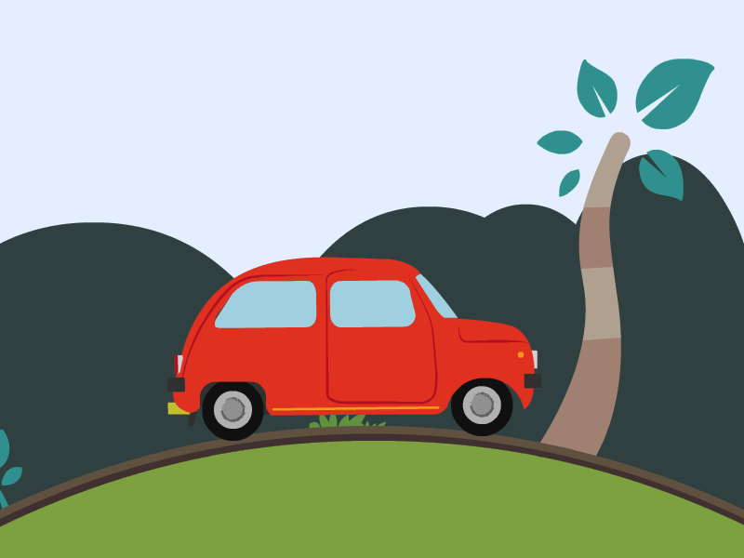
The car got its ___from gas and electricity.
faucet
bother
power
dome

Slide 44
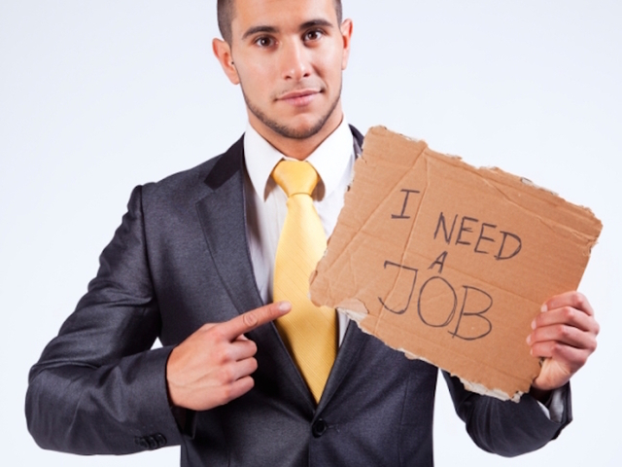
Sami has lost his job.
He had been __ for months
employed
urgent
unemployed
source

Slide 45
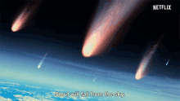
The meteorite left a lot of __.
dynamic
assets
debris
dome

Slide 46
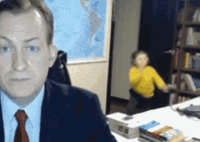
Sorry to __you but this is urgent.
quote
hoax
interrupt
global

Slide 47
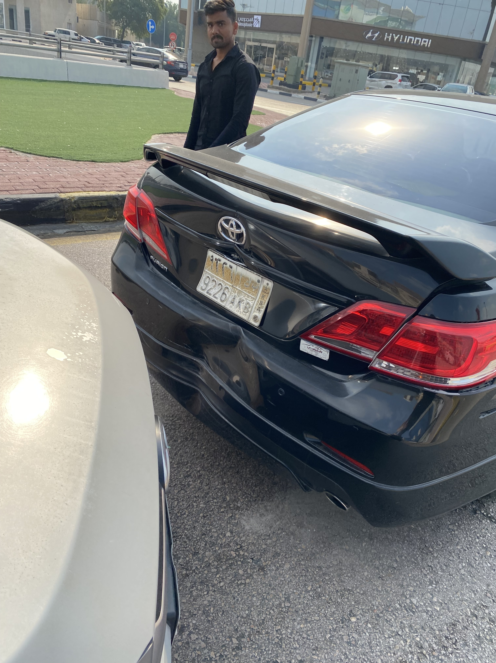
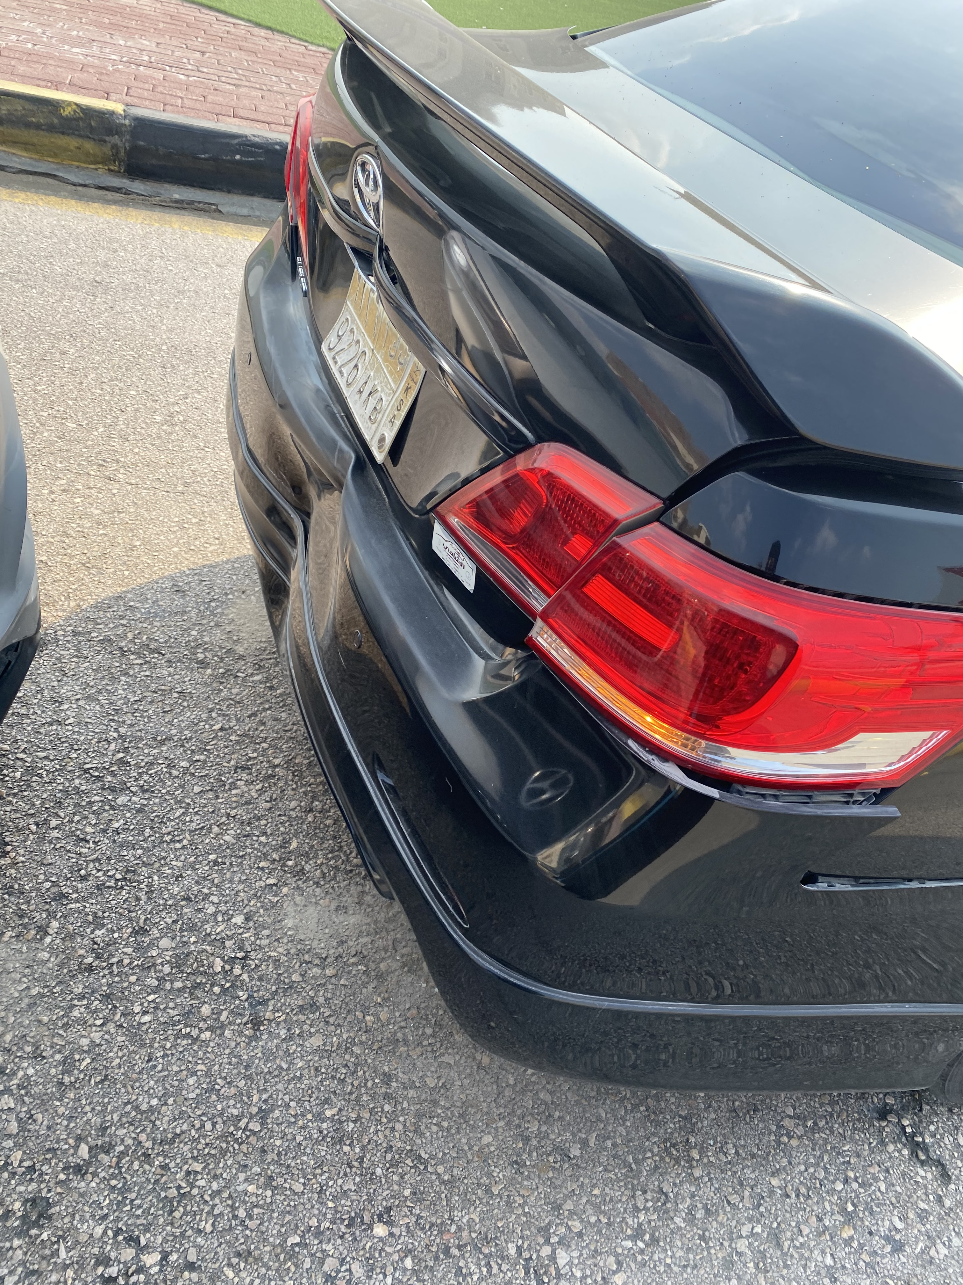
The car has a ___.
toothache
fever
dent
sleeve

Slide 48
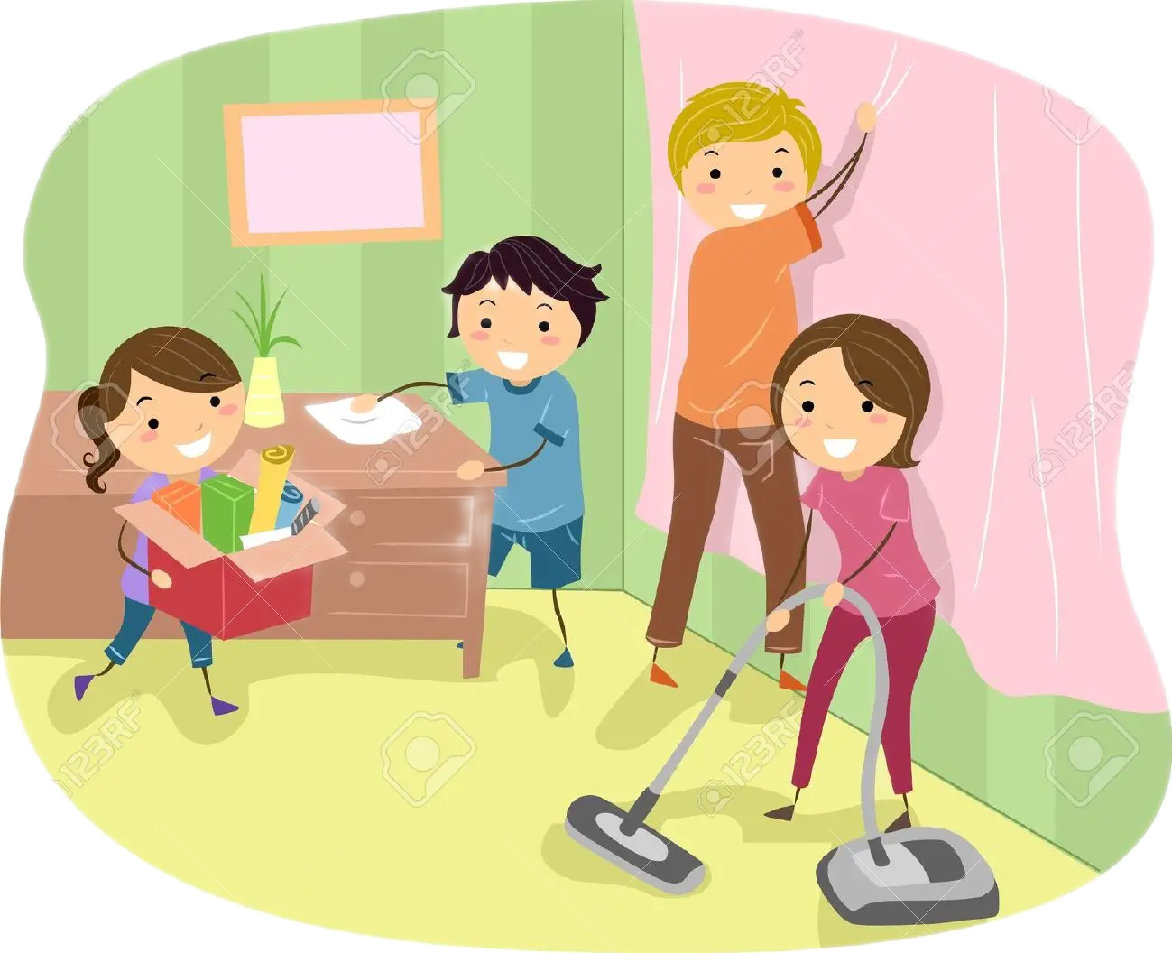
Have you __ up the mess?
cleaning
cleans
clean
cleaned

Slide 49
If it rains, the grass ___wet.
got
getting
gets
will get

Slide 50

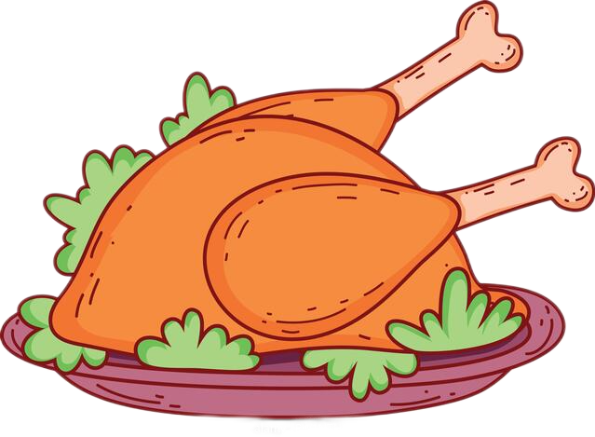
Would you like meat___ chicken?
and
or
but
else

Slide 51
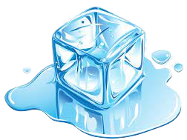
If you heat ice, it _____.
melts
melting
melted
melt

Slide 52
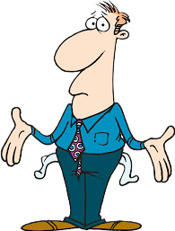
I want to buy a car, ___ I don’t have enough money.
or
but
and
so

Slide 53
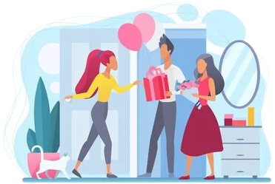
Saleh opened the door __greeted the guests.
so
but
or
and

Slide 54

Do you enjoy ___ in the sea?
swim
swam
swims
swimming

Slide 55

Have you ever ___ to China?
be
been
have
has

Slide 56

Please, turn ___your mobile.
on
at
in
off

Slide 57
I’m going to be at home tonight. Please call___.
him
them
us
me

Slide 58

I haven’t done my homework___.
yet
already
just
ever

Slide 59

Thin, not strong.
dirty
crispy
flimsy
fuzzy

Slide 60
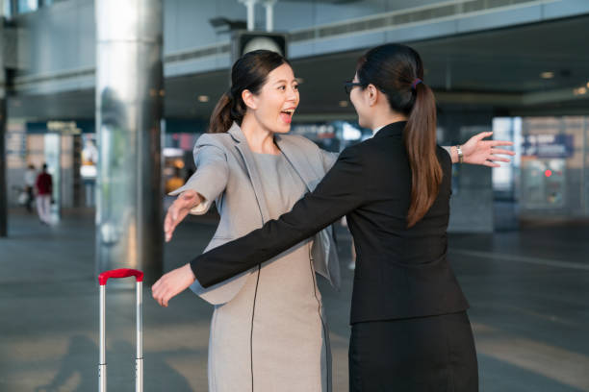
What a ___I wasn’t expecting to see you here.
refund
complaint
dent
coincidence

Slide 61
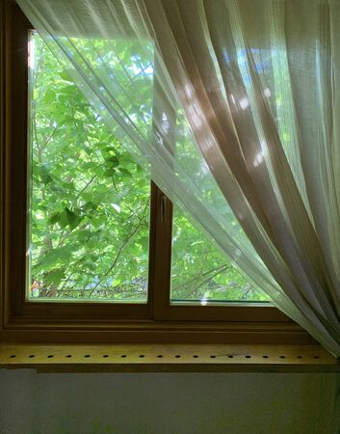
The sunlight __the thick curtains
cultural
penetrated
disaster
potential

Slide 62
Useful or valuable quality.
faucet
cassette
asset
meteorite

Slide 63
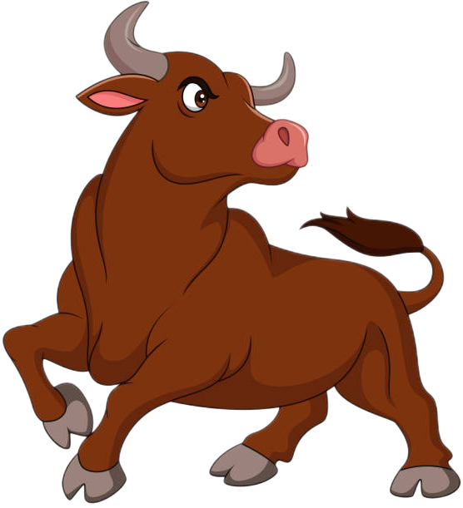
What is this?
elephant
bull
fox
mule

Slide 64
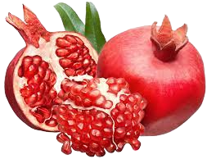
What is this?
mango
pumpkin
dates
pomegranate

Slide 65
The opposite of rural is__.
volcano
dome
dynamic
urban

Slide 66
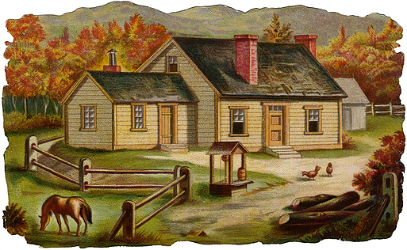
Related to the country.
flimsy
disaster
urban
rural

Slide 67

What is this?
dome
tornado
bomb
camp

Slide 68

Salem took his laptop to the ___ to fix it.
definition
technician
suspicion
complaint

Slide 69
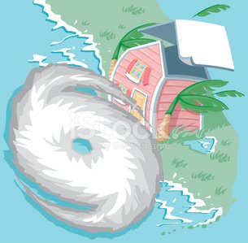
What is this?
erosion
volcano
earthquake
hurricane

Slide 70

a. clear |  | common | 1.
b. decrease |  | Advatage | 2.
c. uncommon |  | invention | 3.
d. disadvantage |  | successful | 4.
e. discovery |  | careful | 5.
f. urban |  | rural | 6.
g. careless |  | increase | 7.
h. failure |  | fuzzy | 8.
C
D
E
H
G
F
B
A

Slide 71
a. to fit a new situation |  | proof | 1.
b. Opinion |  | nuisance | 2.
c. uproot |  | deteriorate | 3.
d. getting worse |  | knock down | 4.
e. annoyance |  | reschedule | 5.
f. evidence |  | pushy | 6.
g. change the time of |  | adapt | 7.
h. insistance |  | perception | 8.
F
E
D
C
G
H
A
B

Slide 72


