Slide 1
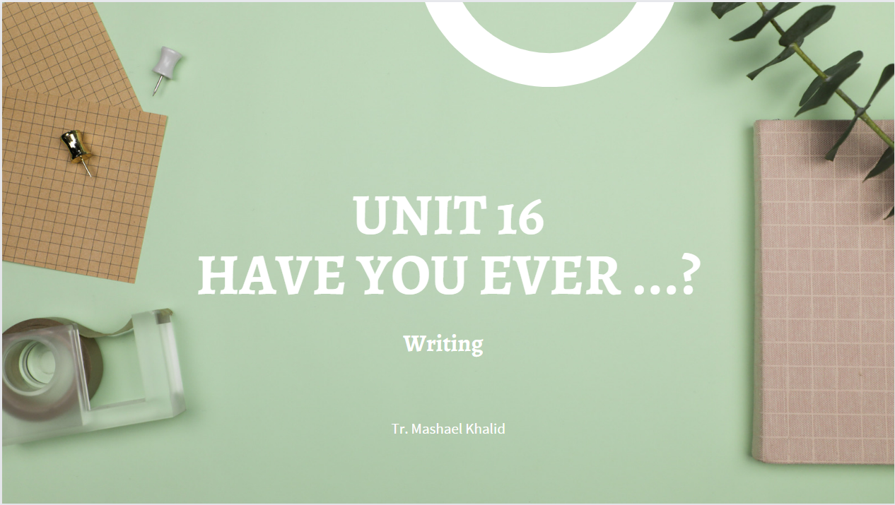

Slide 2

Sunday 24-10-1444H
Use linking words and phrases in writing.
Present information about extreme activity.
Search specific information in a written text.
Pg.144

Slide 3

Pg.144

Slide 4

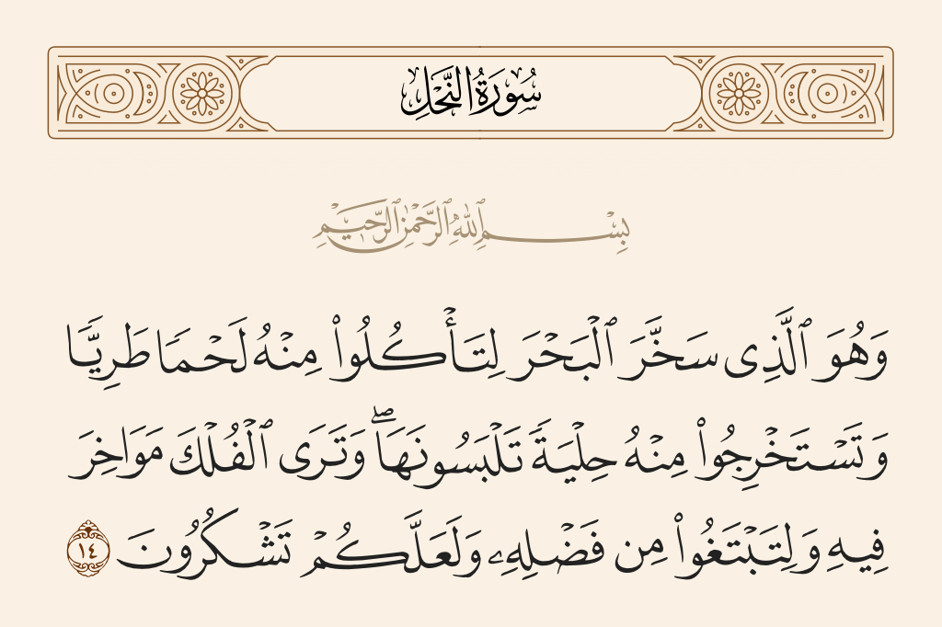
Sunday 24-10-1444H
Pg.144

Slide 5

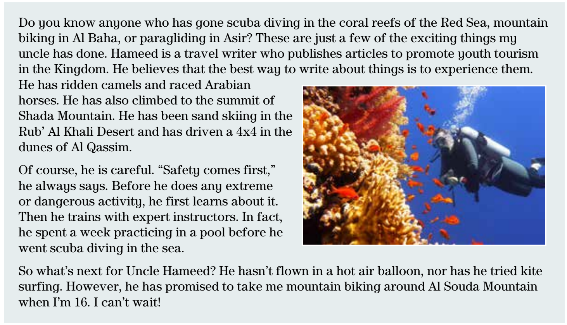
Sunday 24-10-1444H
Pg.144

Slide 6
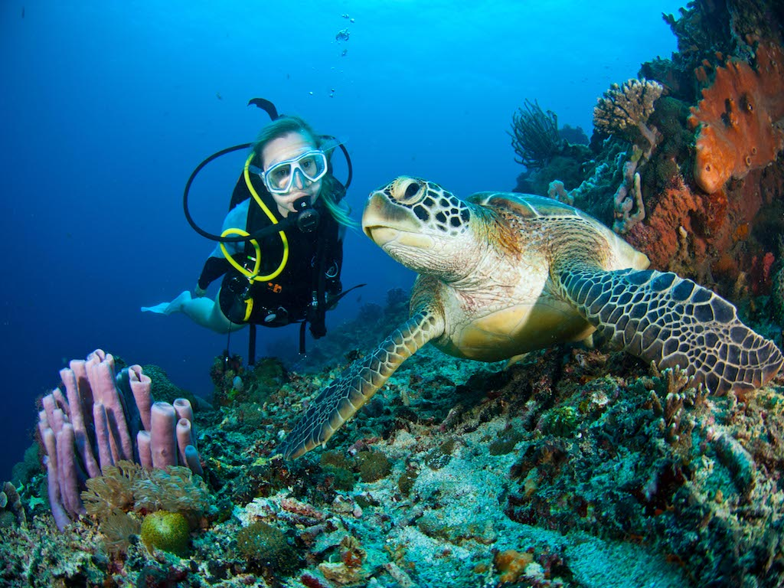
Sunday 24-10-1444H
Scuba diving
Pg.144

Slide 7
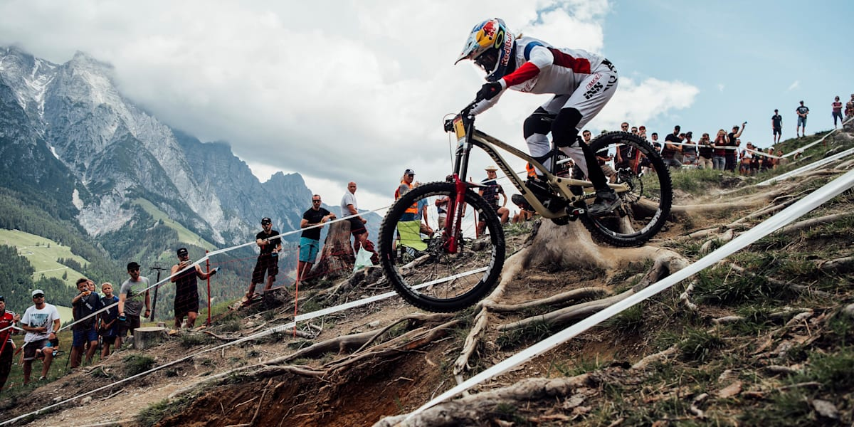
Sunday 24-10-1444H
Mountain
biking
Pg.144

Slide 8
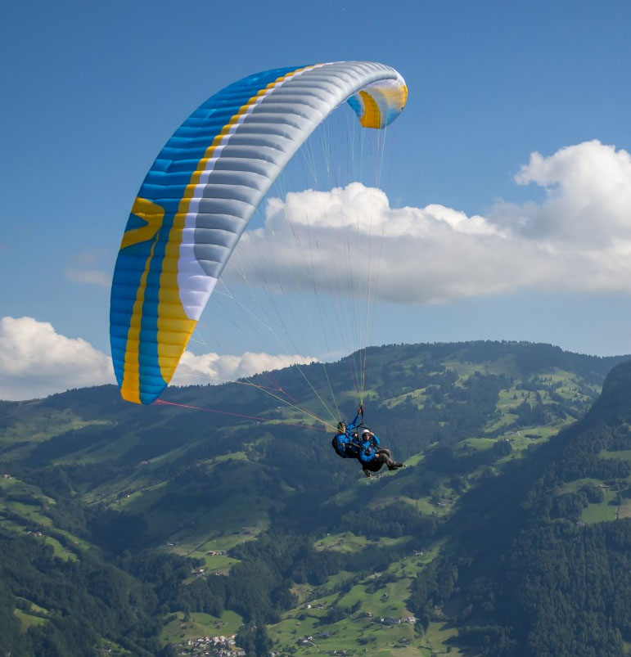
Sunday 24-10-1444H
Paragliding
Pg.144

Slide 9

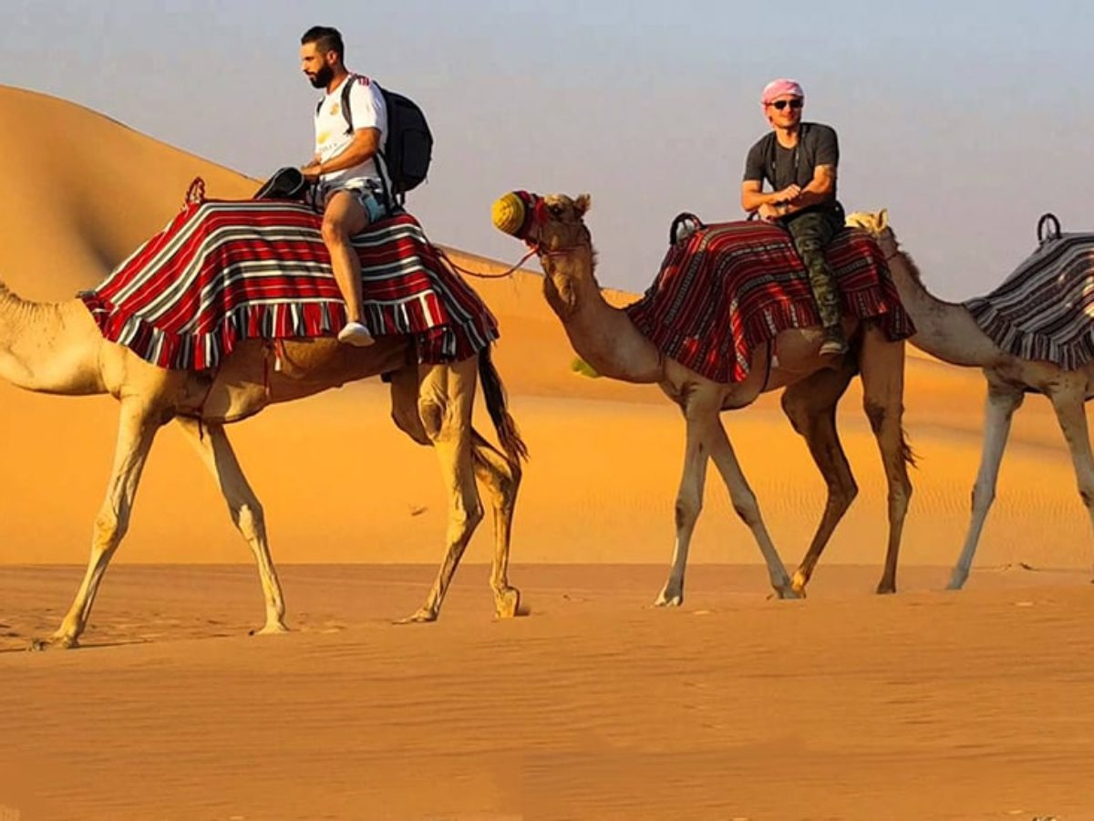
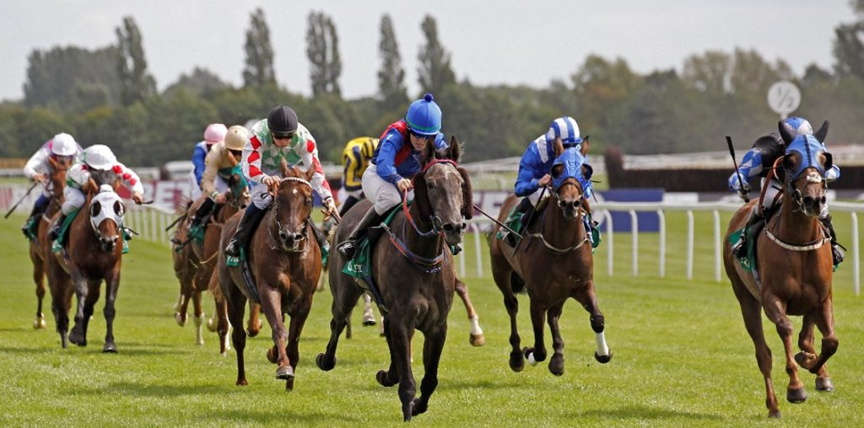
Sunday 24-10-1444H
Race Horses
Riding camels
Pg.144

Slide 10
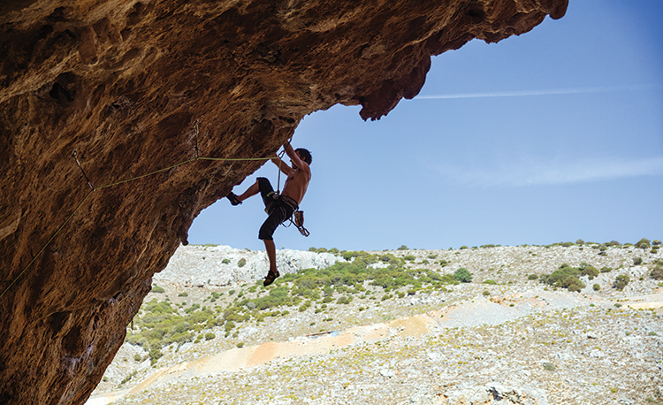
Sunday 24-10-1444H
Mountain climbing
Pg.144

Slide 11
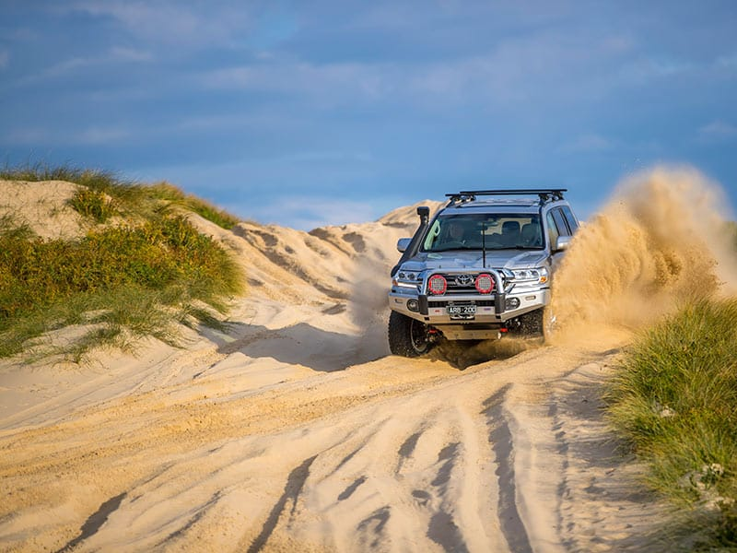
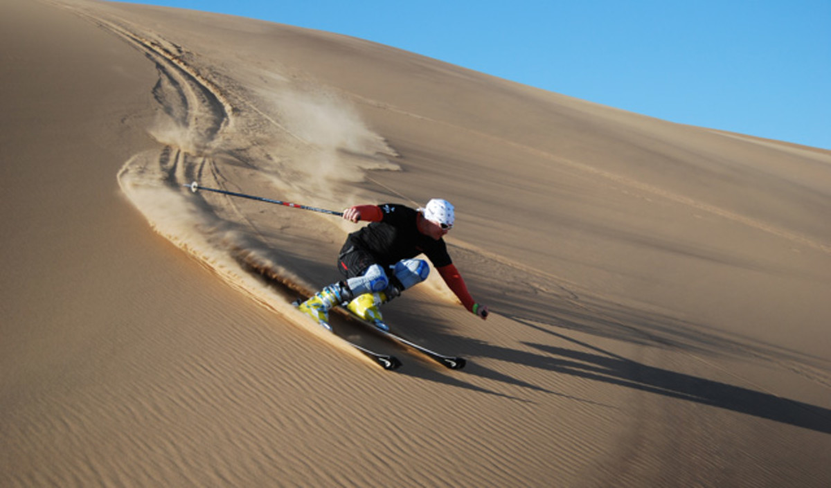
Sunday 24-10-1444H
Sand skiing
Drive 4x4
Pg.144

Slide 12
Sunday 24-10-1444H
Sand skiing
Drive 4x4
Pg.144

Slide 13
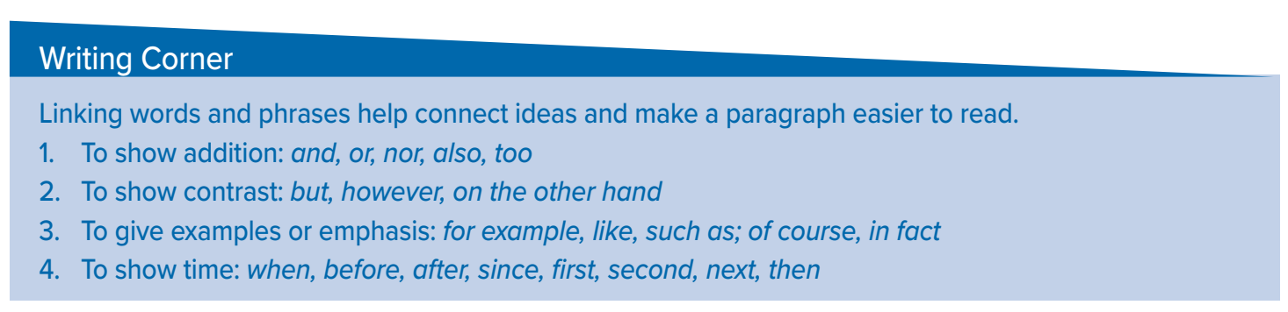

Sunday 24-10-1444H
Pg.144

Slide 14
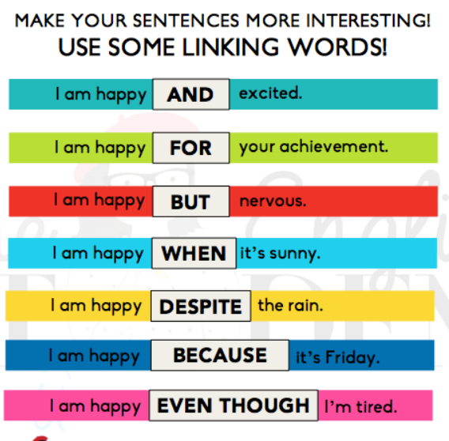

Sunday 24-10-1444H
Pg.144

Slide 15




Sunday 24-10-1444H
Contrast
Addition
But
How ever
On the other hand
And
Also
Too
Example
Show time
For example
Like
Such as
When
Before
After
since
Pg.144

Slide 16
Sunday 24-10-1444H
Pg.144

Slide 17
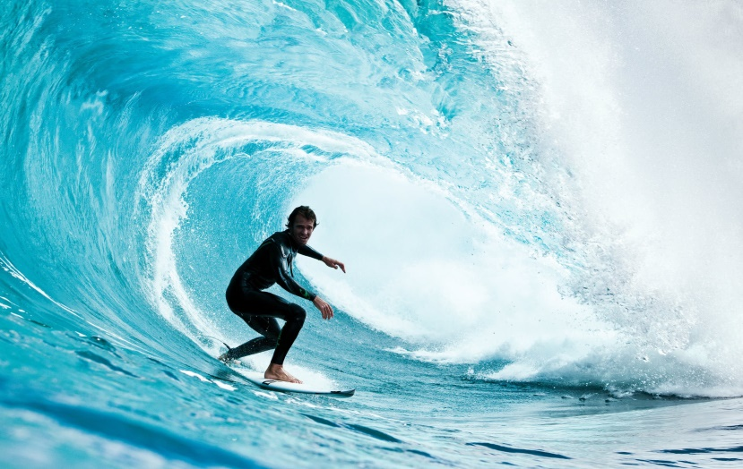
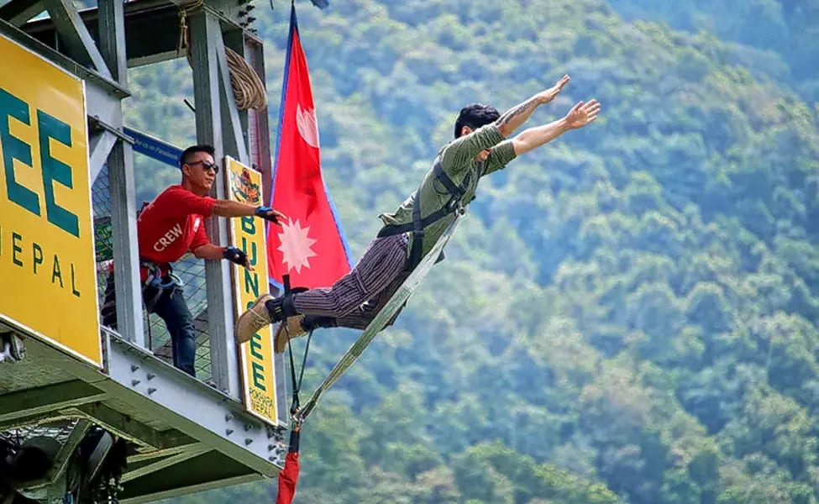
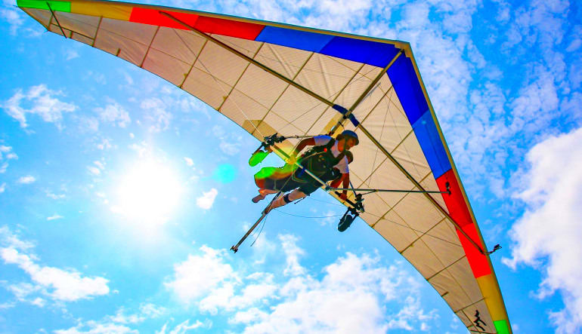
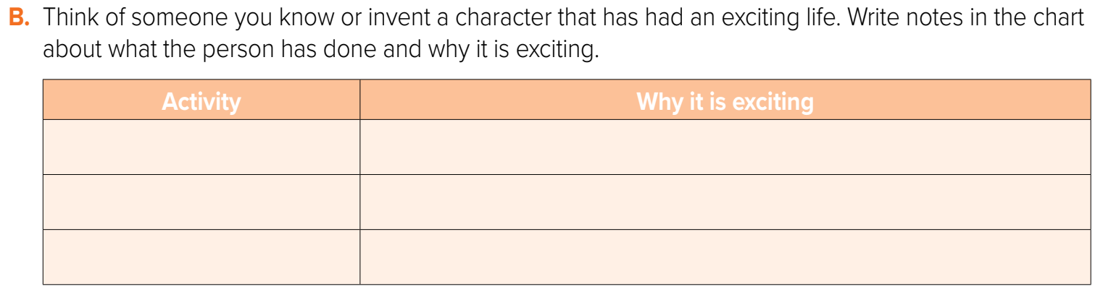
Sunday 24-10-1444H
Surfing
It is great exercise and fun. It makes me feel happy.
Bungee jumping
It is fun. It makes me feel free.
Hang gliding
It is great exercise . It makes me feel happy.
Pg.144

Slide 18

Pg. 256 (H)

Slide 19
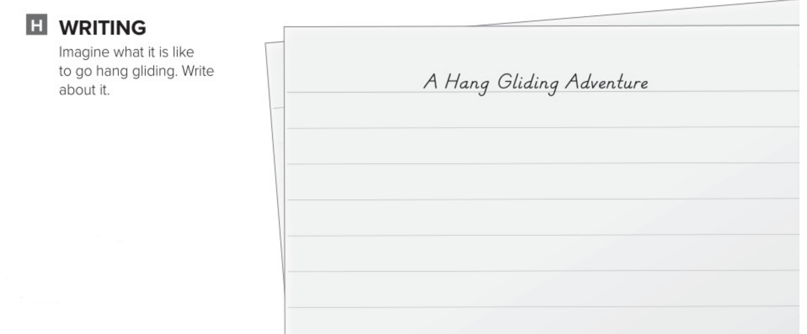
I can imagine that I have a hang glider, and the wind is blowing. I run down the hill and the hang glider lifts me up from the ground. Suddenly, I’m flying. I can see my whole town. I fly over my house. Then I get closer to the ground and gently land.
Pg. 256

Slide 20


