Slide 1


Slide 2

Sunday 24-10-1444H
Practice reading.
Answer questions about a text.
Pg.138

Slide 3
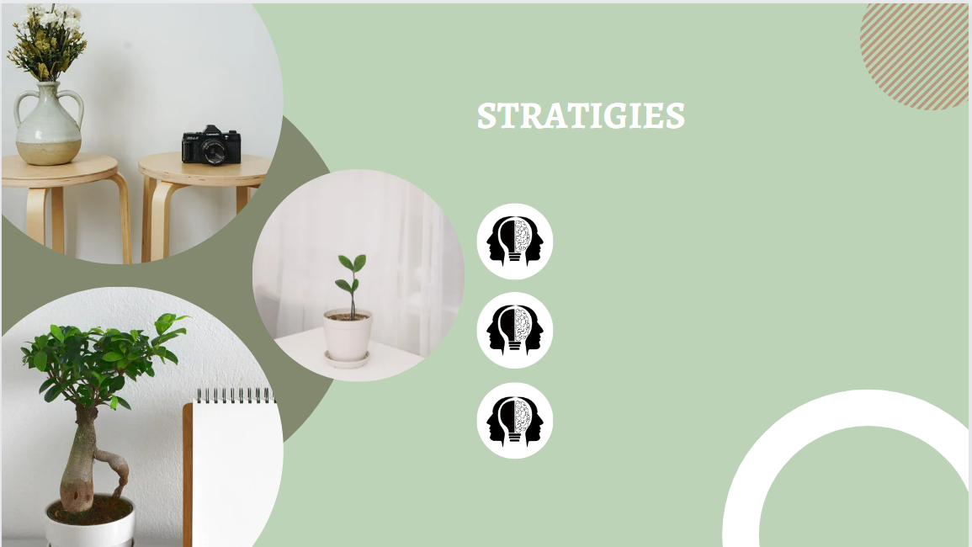
Active discussion

Slide 4

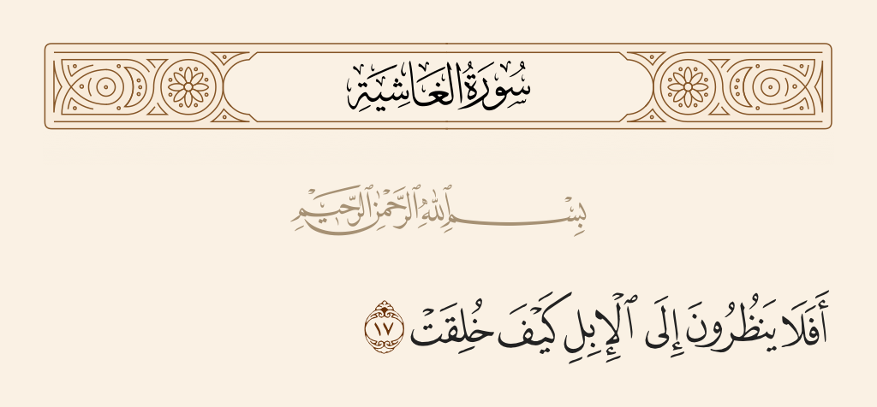
Sunday 24-10-1444H

Slide 5

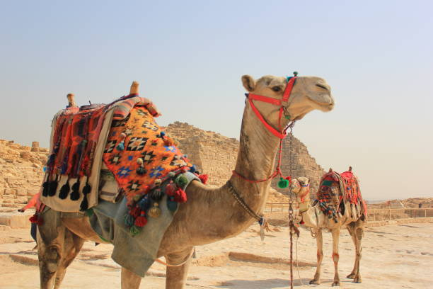
Sunday 24-10-1444H
Before Reading
What do you know about camels? Have you ever ridden one?
Pg.139

Slide 6

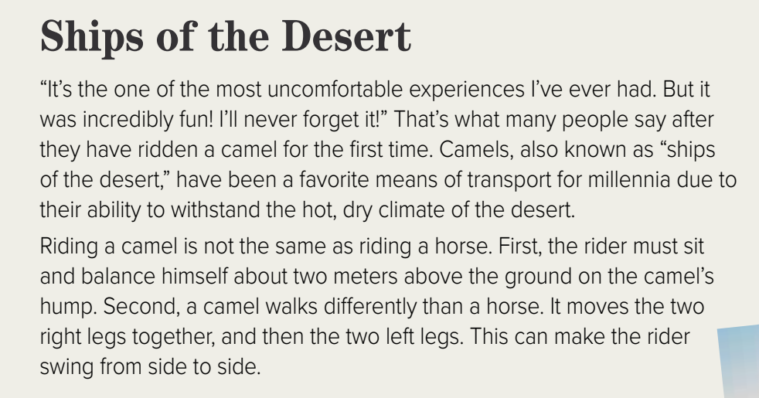
Sunday 24-10-1444H
Pg.139

Slide 7
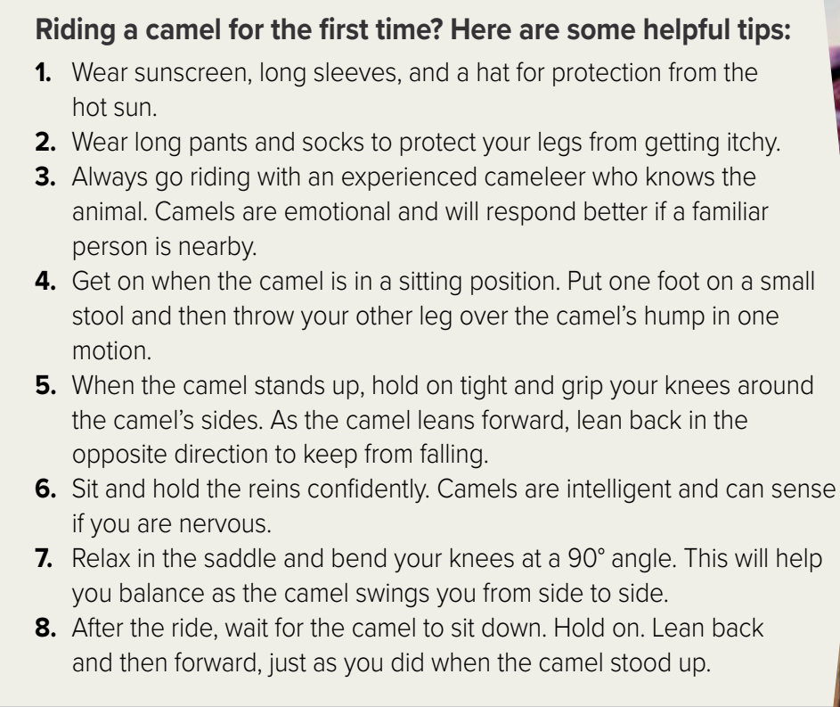
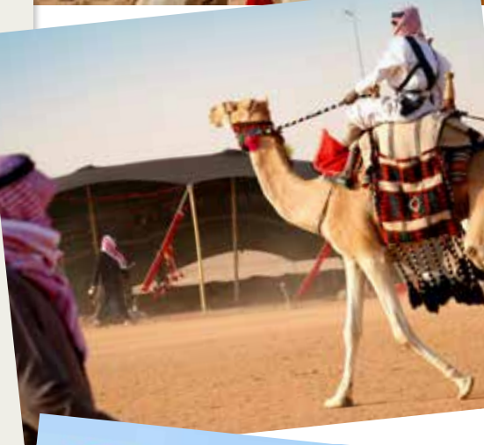
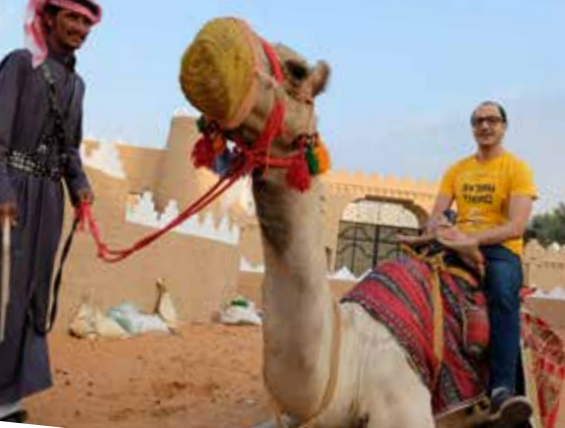
Sunday 24-10-1444H
Pg.139

Slide 8

Sunday 24-10-1444H
After Reading
Why are camels called "ships of the desert"?
2. How is riding a camel different from riding a horse?
Because they have been used as a means of transport in the desert due to their ability to withstand the hot, dry climate.
The rider must sit two meters above the ground on the camel’s hump, and the movement of the camel swings the rider from side to side.
Pg.139

Slide 9
Sunday 24-10-1444H
After Reading
3. What are two characteristics of camels?
4. Which tip do you think is the most important and why?
Camels are emotional and intelligent.
Pg.139

Slide 10
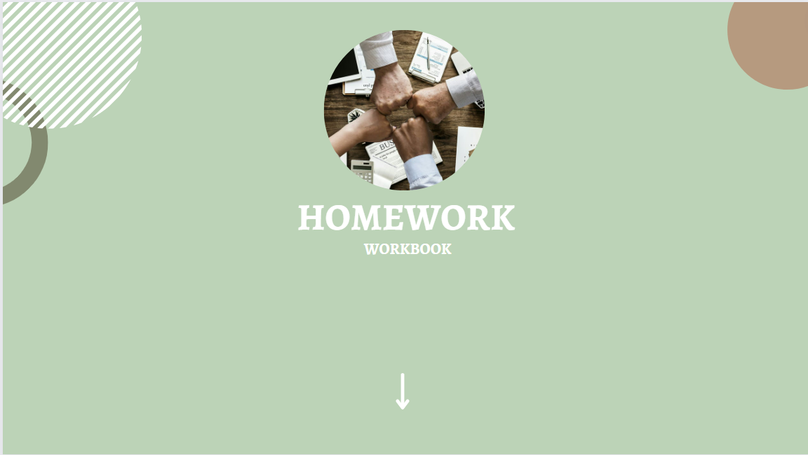
Pg. 256

Slide 11
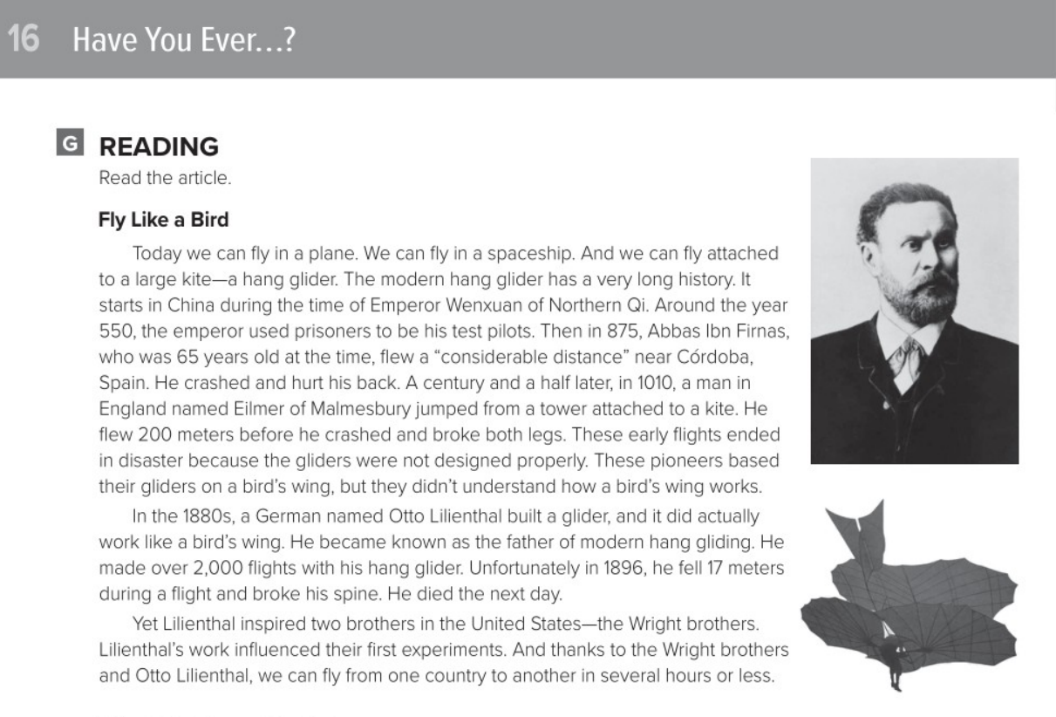
Pg. 256

Slide 12
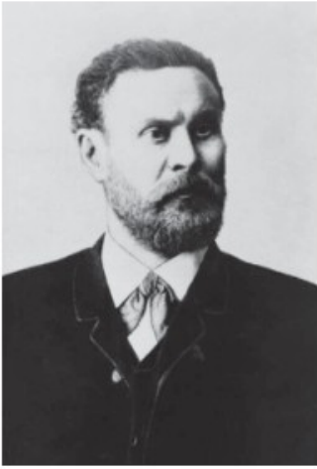
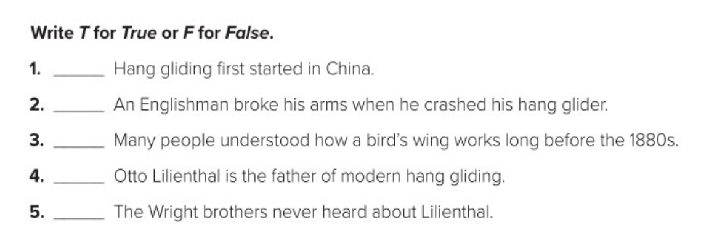
True
false
false
True
false
Pg. 256

Slide 13


